Slide 1
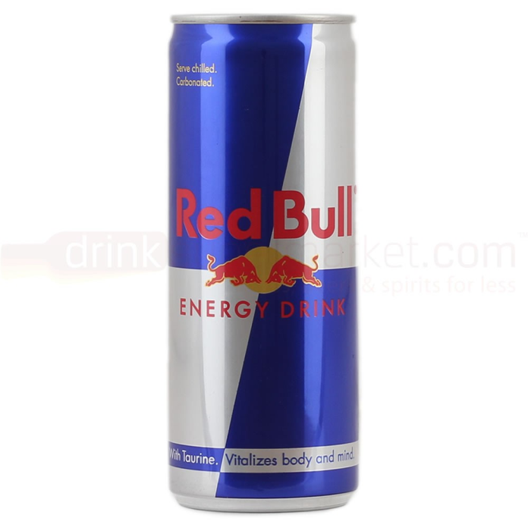
Do Now
Red Bull is a solution. Name
the solvent and two solutes.
What is the difference between the following:
a chemical equation
a complete ionic equation
a net ionic equation
Aqueous double replacement reactions must produce one of three products to go forward. What are these three products?

Slide 2
Aqueous Solutions
SWBAT describe aqueous double replacement reactions in terms of chemical equations, complete ionic equations and net ionic equations.
DO NOT WRITE IN YOUR NOTES
Continued from last class

Slide 3
Last Class

Slide 4
Today's Class
Review examples of the three types of products produced in an aqueous double replacement reaction.
Review a 2-step reaction
Practice writing chemical, complete ionic, and net ionic equations
Checks for understanding
Worksheet
Review questions on homework on Wed

Slide 5
Today's Class
Review examples of the three types of products produced in an aqueous double replacement reaction.
Review a 2-step reaction
Practice writing chemical, complete ionic, and net ionic equations
Checks for understanding
Worksheet
Review questions on homework on Wed

Slide 6
Double Replacement Reactions
in Aqueous Solutions
Three products can form:
precipitates
water
gases
This provides the driving force for the reaction to occur - without a driving force, NO REACTION

Slide 7
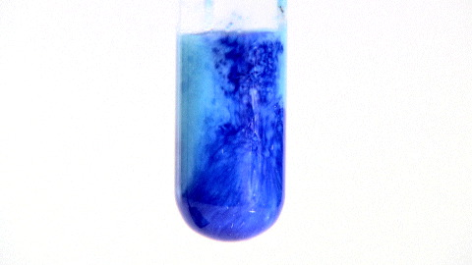
Precipitates Produced
Some reactions produce precipitates
The appearance of the precipitate is evidence that the reaction has occurred.
2NaOH(aq) + CuCl₂(aq) → 2NaCl(aq) + Cu(OH)₂(s)

Slide 8
Water Produced
Some reactions produce more water molecules.
No evidence of a chemical reaction is observable.
HBr(aq) + NaOH(aq) → H₂O(l) + NaBr(aq)
Without spectator ions
H⁺(aq) + OH–(aq) → H₂O(l)
This is also neutralization reaction because an acid (H⁺) and a base (OH–) combine to form water, a neutral molecule.
Write this in your notes

Slide 9
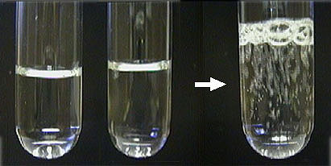
Gas Produced
Some reactions produce gasses
The release of gas bubbles is evidence that the reaction has occurred.
Gases that are commonly produced are carbon dioxide, hydrogen cyanide, and hydrogen sulfide.
2HI(aq) + Li₂S(aq) → H₂S(g) + 2LiI(aq)

Slide 10
Today's Class
Review examples of the three types of products produced in an aqueous double replacement reaction.
Review a 2-step reaction
Practice writing chemical, complete ionic, and net ionic equations
Checks for understanding
Worksheet
Review questions on homework on Wed

Slide 11
Double Replacement Reactions
in Aqueous Solutions
Three products can form:
precipitates
water
gases
This provides the driving force for the reaction to occur - without a driving force, NO REACTION
HCl(aq) + NaHCO₃(aq) → H₂CO₃(aq) + NaCl(aq)
NO REACTION???

Slide 12
Two Step Process
Aqueous double replacement reactions are driven by the production of a precipitate, water or a gas.
Sometimes these products are created through a two-step process.

Slide 13
Representation
Double Replacement Reaction
HCl(aq) + NaHCO₃(aq) → H₂CO₃(aq) + NaCl(aq)
Decomposition Reaction
H₂CO₃(aq) → H₂O(l) + CO₂(g)
Combined equation
HCl(aq) + NaHCO₃(aq) + H₂CO₃(aq) →
H₂CO₃(aq) + NaCl(aq) + H₂O(l) + CO₂(g)
Overall equation
HCl(aq) + NaHCO₃(aq) → NaCl(aq) + H₂O(l) + CO₂(g)

Slide 14
Today's Class
Review examples of the three types of products produced in an aqueous double replacement reaction.
Review a 2-step reaction
Practice writing chemical, complete ionic, and net ionic equations
Checks for understanding
Worksheet
Review questions on homework on Wed

Slide 15
Check for Understanding
Write chemical, complete ionic, and net ionic equations for each of the following reactions. Use NR to indicate that no reaction occurs.
Aqueous solutions of potassium iodide and silver nitrate are mixed forming the precipitate silver iodide.

Slide 16
Check for Understanding
Write chemical, complete ionic, and net ionic equations for each of the following reactions. Use NR to indicate that no reaction occurs.
Aqueous solutions of potassium iodide and silver nitrate are mixed forming the precipitate silver iodide.
KI + AgNO₃ à KNO₃ + AgI(s)
K⁺ + I– + Ag⁺ + NO₃– à K⁺ + NO₃– + AgI(s)
I– + Ag⁺ à AgI(s)
pg 302, #35

Slide 17
Check for Understanding
Write chemical, complete ionic, and net ionic equations for each of the following reactions. Use NR to indicate that no reaction occurs.
Aqueous solutions of lithium sulfate and calcium nitrate are mixed forming the precipitate calcium sulfate

Slide 18
Check for Understanding
Write chemical, complete ionic, and net ionic equations for each of the following reactions. Use NR to indicate that no reaction occurs.
Aqueous solutions of lithium sulfate and calcium nitrate are mixed forming the precipitate calcium sulfate
Li₂SO₄ + Ca(NO₃)₂ à LiNO₃ + CaSO₄(s)
Li₂SO₄ + Ca(NO₃)₂ à 2LiNO₃ + CaSO₄(s)
2Li⁺ + SO₄^{–2} + Ca⁺² + 2NO₃– à
2Li⁺ + 2NO₃– + CaSO₄(s)
SO₄^{–2} + Ca⁺² à CaSO₄(s)
pg 302, #36

Slide 19
Check for Understanding
Write chemical, complete ionic, and net ionic equations for each of the following reactions. Use NR to indicate that no reaction occurs.
Aqueous solutions of sodium carbonate and manganese (V) chloride react to produce a precipitate that contains manganese

Slide 20
Do Now
Write chemical, complete ionic, and net ionic equations for each of the following reactions. Use NR to indicate that no reaction occurs.
Aqueous solutions of sodium carbonate and manganese (V) chloride react to produce a precipitate that contains manganese

Slide 21
Check for Understanding
Write chemical, complete ionic, and net ionic equations for each of the following reactions. Use NR to indicate that no reaction occurs.
Aqueous solutions of sodium carbonate and manganese (V) chloride react to produce a precipitate that contains manganese
Na₂CO₃ + MnCl₅ à NaCl + Mn₂(CO₃)₅(s)
5Na₂CO₃ + 2MnCl₅ à 10NaCl + Mn₂(CO₃)₅(s)
10Na⁺ + 5CO₃^{–2} + 2Mn⁺⁵ + 10Cl– à
10Na⁺ + 10Cl– + Mn₂(CO₃)₅(s)
5CO₃^{–2} + 2Mn⁺⁵ à Mn₂(CO₃)₅(s)
pg 302, #39

Slide 22
Check for Understanding
Write chemical, complete ionic, and net ionic equations for each of the following reactions. Use NR to indicate that no reaction occurs.
Aqueous solutions of ammonium phosphate and sodium sulfate are mixed. No precipitate or gas is formed

Slide 23
Do Now
Put your homework in the red basket
Write chemical, complete ionic, and net ionic equations for the following double replacement reaction. Use NR to indicate that no reaction occurs.
Aqueous solutions of ammonium phosphate and sodium sulfate are mixed. No precipitate or gas is formed

Slide 24
Check for Understanding
Write chemical, complete ionic, and net ionic equations for each of the following reactions. Use NR to indicate that no reaction occurs.
Aqueous solutions of ammonium phosphate and sodium sulfate are mixed. No precipitate or gas is formed
(NH₄)₃PO₄ + Na₂SO₄ à (NH₄)₂SO₄ + Na₃PO₄
2(NH₄)₃PO₄ + 3Na₂SO₄ à 3(NH₄)₂SO₄ + 2Na₃PO₄
6NH₄⁺ + 2PO₄^{–3} + 6Na⁺ + 3SO₄^{–2} à
6NH₄⁺ + 2PO₄^{–3} + 6Na⁺ + 3SO₄^{–2}
NR
pg 302, #38

Slide 25
Today's Class
Review examples of the three types of products produced in an aqueous double replacement reaction.
Review a 2-step reaction
Practice writing chemical, complete ionic, and net ionic equations
Checks for understanding
Worksheet
Review questions on homework on Wed

Slide 26
Multiple Choice Questions

Slide 27
What is the solvent in an aqueous solution?
A. hydrogen
B. sodium ions
C. water
D. alcohol

Slide 28
An equation that includes only the particles that participate in a reaction is called:
A. net ionic equation
B. spectator ions
C. complete ionic equation
D. reduced ionic equation

Slide 29
CHAPTER9
Chemical Reactions
Chapter Assessment
Ions that are present in a solution and do not participate in a chemical reaction when another substance is added are called ____.
A. spectator ions
B. reactants
C. products
D. net ions

Slide 30
CHAPTER9
Chemical Reactions
Standardized Test Practice
A precipitate forms in a double replacement reaction only if:
A. the reactivities of the compounds differ
B. the new compound is denser than water
C. the new compound is soluble in water
D. the new compound is not soluble in water

Slide 31
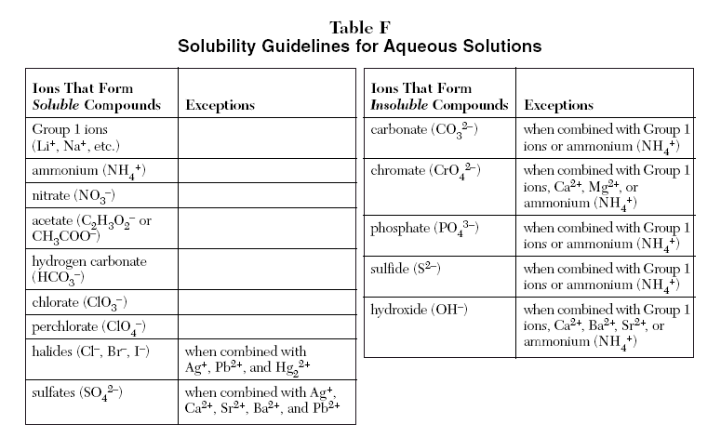

Slide 32
Backups

Slide 33
Three Different Representations
Chemical Equation
2NaOH(aq) + CuCl₂(aq) → 2NaCl(aq) + Cu(OH)₂(s)
Complete Ionic Equation
2Na⁺(aq) + 2OH–(aq) + Cu²⁺ (aq)+ 2Cl–(aq) →
2Na⁺(aq) + 2Cl–(aq) + Cu(OH)₂(s)
Net Ionic Equation
2OH–(aq) + Cu²⁺(aq) → Cu(OH)₂(s)

Slide 34
Two Step Process
Two reactions can be combined and represented by a single chemical reaction.

Slide 35
Two Step Process
Acid and baking soda react to produce carbon dioxide gas.
Step 1: Double replacement reaction
HCl(aq) + NaHCO₃(aq) → H₂CO₃(aq) + NaCl(aq)
Step 2: Decomposition reaction
H₂CO₃(aq) decomposes immediately.
H₂CO₃(aq) → H₂O(l) + CO₂(g)

