Slide 1
Do Now
Homework
Check
NO₂ ---> O₂ + N₂
Balance the equation above.
2NO₂ ---> 2O₂ + N₂

Slide 2
Test #9: Chemical Reactions
Test Format
Honors Chem: 25 open response
Chem: 5 multiple choice, 15 open response
Test will be shortened if we don't finish this unit
Dates
See schedule

Slide 5
Classify Chemical Reactions
Write this in your notes
SWBAT classify chemical reactions and use the activity series to determine if a chemical reaction will occur.

Slide 6
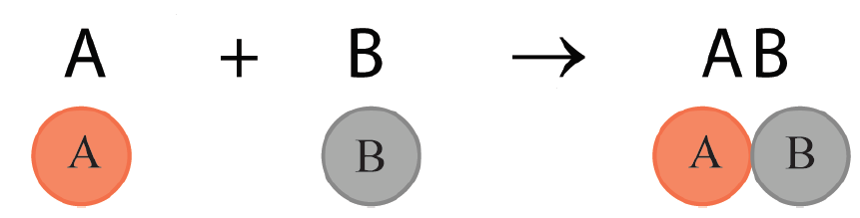

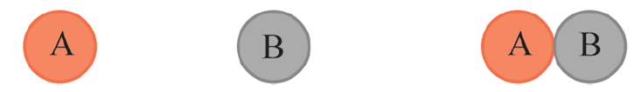
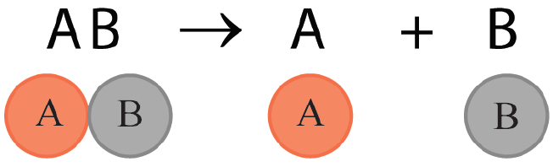
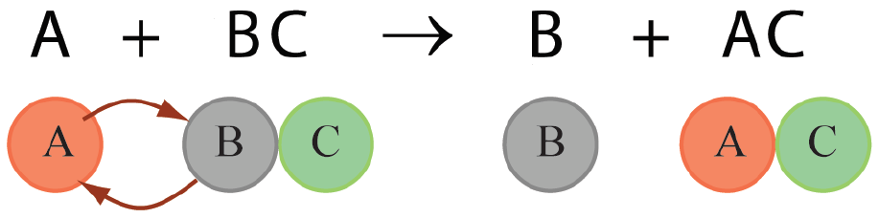
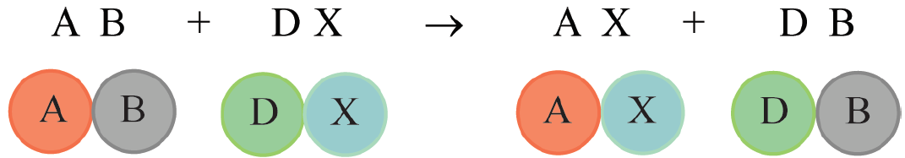
Classes of Chemical Reactions
Synthesis
Combustion
Decomposition
Single Replacement
Double Replacement
A + O₂ A_{m}O_{n} [+]
O
O

Slide 7

Chemical equations tell stories…
Reactants Products
… and stories can be put into different categories
Nonfiction
Science fiction
Adventure
Romance
History
others . . .

Slide 8
Chemical equations tell stories…
Reactants Products
… and stories can be put into different categories
Chemical equations can also be put into different categories
Synthesis
Combustion
Decomposition
Single Replacement
Double Replacement
more to come . . .
Nonfiction
Science fiction
Adventure
Romance
History
others . . .

Slide 9
Classes of Chemical Reactions
Synthesis
Combustion
Decomposition
Single Replacement
Double Replacement
A + O₂ A_{m}O_{n} [+]
O
O

Slide 10
Synthesis Reactions
Write this in your notes
A synthesis reaction is a reaction in which two or more substances react to produce a single product.
magnesium oxide
water
magnesium hydroxide

Slide 11
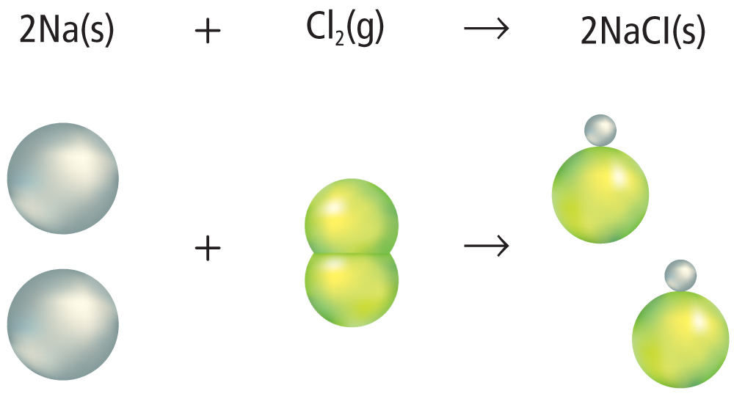
Synthesis Reactions
When two elements react, the reaction is always a synthesis reaction.

Slide 12
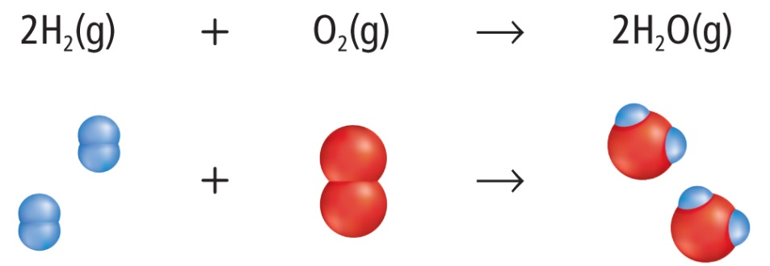
Combustion Reactions
Write this in your notes
In a combustion reaction, oxygen combines with a substance and releases energy in the
form of heat and light.

Slide 13
Combustion and/or Synthesis
Sometimes combustions reactions are also synthesis reactions.
2 H₂ + O₂ → 2 H₂O
Sometimes combustions reactions are not synthesis reactions.
C₆H₁₂ + 9 O₂ → 6 CO₂ + 6 H₂O
So long as oxygen combines with a substance and releases energy in the form of heat and light, it is a combustion reaction.

Slide 14


Decomposition Reactions
Write this in your notes
A decomposition reaction is one in which a single compound breaks down into two or more elements or new compounds.
Example:
Decomposition of water
Example:
Decomposition of ozone

Slide 15
Single Replacement Reactions
A reaction in which the atoms of one element replace the atoms of another element in a compound is called a single replacement reaction.
Write this in your notes
Example:

Slide 16
Three Types of
Single Replacement Reactions
Type | A | B

Slide 17
Three Types of
Single Replacement Reactions
Type | A | B
Hydrogen Replacement | metal | hydrogen

Slide 18
Three Types of
Single Replacement Reactions
Type | A | B
Hydrogen Replacement | metal | hydrogen
Metal Replacement | metal | different metal

Slide 19
Three Types of
Single Replacement Reactions
Write this in your notes
Type | A | B
Hydrogen Replacement | metal | hydrogen
Metal Replacement | metal | different metal
Halogen Replacement | halogen | different halogen
For halogen replacement, the halogen is the anion and is listed second

Slide 20
Examples of the Three Types of
Single Replacement Reactions
Hydrogen Replacement:
Ca + 2H₂O H₂ + Ca(OH)₂
Metal Replacement:
2Mg + TiCl₄ Ti + 2MgCl₂
Halogen Replacement:
Cl₂ + 2KBr Br₂ + 2KCl
For halogen replacement, the halogen is the anion and is listed second

Slide 21
Will a reaction occur?
Zn + CuSO₄ Cu + ZnSO₄
Ag + CuSO₄ No Reaction
Why?
Different metals have different reactivities
The relative reactivities of metals are summarized in a table called activity series
Write this in your notes

Slide 22
Will a reaction occur?
Write this in your notes
A single replacement reaction will occur so long as
A is more active than B
(i.e. A is higher in series than B)

Slide 23
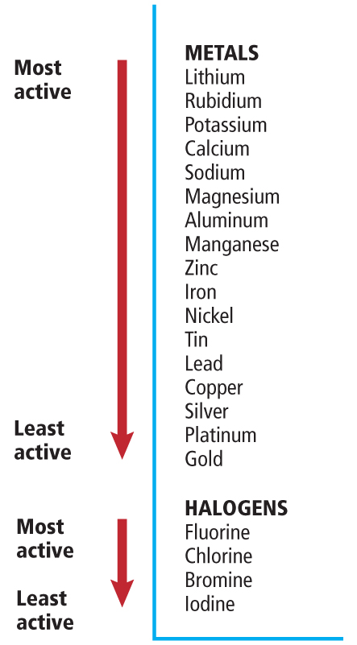
Activity Series
A single replacement reaction will occur so long as
A is more active than B
(i.e. A is higher in series than B)

Slide 24
Activity Series
A single replacement reaction will occur so long as
A is more active than B
(i.e. A is higher in series than B)
Write this in your notes
For homework assignments
The activity series is in your book (Figure 13 on page 293)
For tests
You will be given the activity series on the test

Slide 25
Example 1
Will this reaction occur and, if so, what will be the products?
Zn + CuSO₄
1) Find zinc
2) Find copper
3) Zinc higher than copper, reaction
Zinc lower than copper, no reaction

Slide 26
Example 1
Will this reaction occur and, if so, what will be the products?
Zn + CuSO₄
Zn + CuSO₄ Cu + ZnSO₄

Slide 27
Example 2
Will this reaction occur and, if so, what will be the products?
Ag + CuSO₄
1) Find silver
2) Find copper
3) Silver higher than copper, reaction
Silver lower than copper, no reaction

Slide 28
Example 2
Will this reaction occur and, if so, what will be the products?
Ag + CuSO₄
Ag + CuSO₄ No Reaction

Slide 29
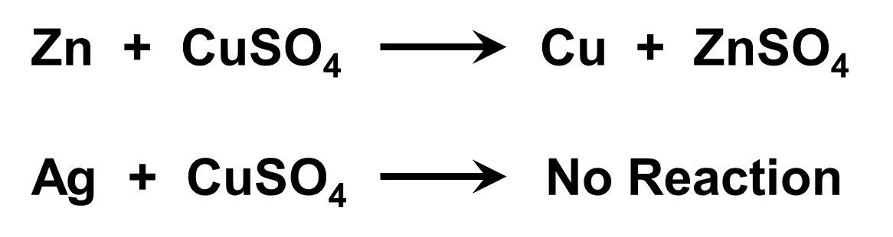
Examples 1 & 2

Slide 30
Check for Understanding
Will these reactions occur and, if so, what will be the products?
Cu + MgCl₂
Cu + PtCl₂
I₂ + 2KBr

Slide 31
Check for Understanding
Will these reactions occur and, if so, what will be the products?
Cu + MgCl₂ NR
Cu + PtCl₂
I₂ + 2KBr

Slide 32
Check for Understanding
Will these reactions occur and, if so, what will be the products?
Cu + MgCl₂ NR
Cu + PtCl₂ Pt + CuCl₂
I₂ + 2KBr

Slide 33
Check for Understanding
Will these reactions occur and, if so, what will be the products?
Cu + MgCl₂ NR
Cu + PtCl₂ Pt + CuCl₂
I₂ + 2KBr NR

Slide 34
Do Now
Identify the reaction type(s)
C₆H₁₂ + 9 O₂ → 6 CO₂ + 6 H₂O
Cl₂ + 2KBr → Br₂ + 2KCl
NaOH + KNO₃ → NaNO₃ + KOH
2H₂ + O₂ → 2H₂O
Will this reaction go forward? Why or why not? If so, balance the equation.
Mg + FeCl₃ →
combustion
single
replacement
double
replacement
synthesis & combustion

Slide 35
Do Now
Will this reaction go forward? Why or why not? If so, balance the equation.
Mg + FeCl₃ →

Slide 36
Do Now
Will this reaction go forward? Why or why not? If so, balance the equation.
3Mg + 2FeCl₃ → 2Fe + 3MgCl₂
Now balance the equation!

Slide 37
Do Now
Will this reaction go forward? Why or why not? If so, balance the equation.
3Mg + 2FeCl₃ → 2Fe + 3MgCl₂

Slide 38
Test #9: Chemical Reactions
Test Format
Honors Chem: 25 open response
Chem: 5 multiple choice, 15 open response
Test will be shortened if we don't finish this unit
Dates
See schedule

Slide 41
Classes of Chemical Reactions
Synthesis
Combustion
Decomposition
Single Replacement
Double Replacement
A + O₂ A_{m}O_{n} [+]
O
O

Slide 42

Double Replacement Reactions
Double replacement reactions occur when ions exchange between two compounds.
Write this in your notes
Example:
Pb(NO₃)₂(aq) + 2KI(aq) PbI₂(s) + 2KNO₃(aq)
Pb(NO₃)₂(aq) + 2KI(aq) PbI₂(s) + 2KNO₃(aq)

Slide 43
Double Replacement Reactions
Pb(NO₃)₂(aq) + 2KI(aq) PbI₂(s) + 2KNO₃(aq)
The solid product produced during a chemical reaction in a solution is called a precipitate.
Write this in your notes
All double replacement reactions produce either water, a precipitate, or a gas.

Slide 44
Example
Write the balanced chemical equation for the following double replacement reaction:
Aqueous solutions of lithium sulfate and calcium nitrate are mixed forming the precipitate calcium sulfate and another aqueous substance.
Skeleton Equation
Li₂SO₄(aq) + Ca(NO₃)₂(aq) à CaSO₄(s) + LiNO₃(aq)
Chemical Equation (Balanced)
Li₂SO₄(aq) + Ca(NO₃)₂(aq) à CaSO₄(s) + 2LiNO₃(aq)

Slide 45
Homework
Classwork
pg 291 14, 16
pg 292 18, 20
pg 295 21 thru 24
pg 297 26, 28 (Explain why these reactions occurred)

Slide 47
Classes of Chemical Reactions
Synthesis
Combustion
Decomposition
Single Replacement
Double Replacement
A + O₂ A_{m}O_{n} [+]
O
O

Slide 48
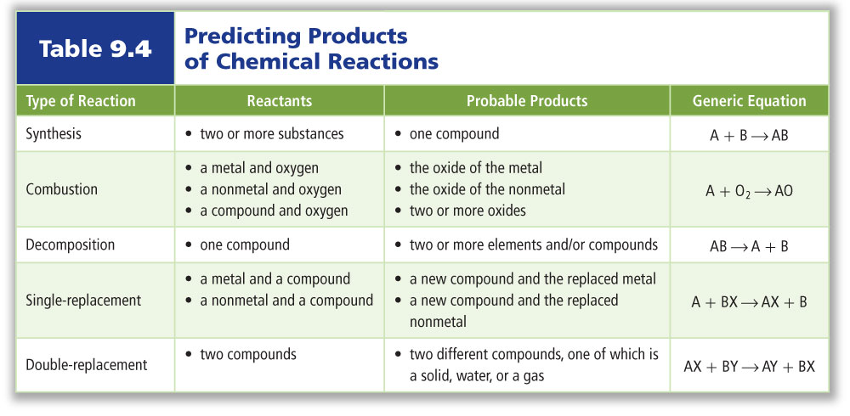
Replacement Reactions
Table 9.4 summarizes different ways to predict the products of a chemical reaction.

Slide 49
Check for Understanding
Identify the reaction type:
Na₂CO₃ ----> Na₂O + CO₂
Pb + O₂ ----> PbO₂

Slide 50
Check for Understanding
Identify the reaction type:
NaOH + KNO₃ ----> NaNO₃ + KOH
2 Fe + 6 NaBr ----> 2 FeBr₃ + 6 Na

Slide 51
Homework
pg 291 14, 16
pg 292 18, 20
pg 295 21 thru 24
pg 297 26, 28 (Explain why these reactions occurred)

Slide 52
Do Now
Identify the reaction type:
BaSO₄ + Mg(OH)₂ ---> Ba(OH)₂ + MgSO₄
3NH₃ + H₃PO₄ ---> (NH₄)₃PO₄
3Sn + 2H₃PO₄ ---> 3H₂ + Sn₃(PO₄)₂
P₄ + 3 O₂ ---> 2P₂O₃
2NO₂ ---> 2O₂ + N₂
Double Replacement
Synthesis
Single Replacement
(H Replacement)
Synthesis & Combustion
Decomposition

Slide 53
Which of the following is NOT one of the four types of reactions?
A. deconstructive
B. synthesis
C. single replacement
D. double replacement

Slide 54
CHAPTER9
Chemical Reactions
Standardized Test Practice
Which reactions are essentially the opposite of synthesis reactions?
A. single-replacement
B. decomposition
C. combustion
D. double-replacement

Slide 55
CHAPTER9
Chemical Reactions
Standardized Test Practice
A precipitate forms in a double replacement reaction only if:
A. the reactivities of the compounds differ
B. the new compound is denser than water
C. the new compound is soluble in water
D. the new compound is not soluble in water

Slide 56
CHAPTER9
Chemical Reactions
Standardized Test Practice
Predict the type of reaction.
LiBr₂ (aq) + 2NaOH (aq) → ____
A. synthesis reaction
B. combustion reaction
C. single replacement reaction
D. double replacement reaction

Slide 57
CHAPTER9
Chemical Reactions
Chapter Assessment
A double replacement reaction produces all of the following except ____.
A. gases
B. solids
C. light
D. water

Slide 58
CHAPTER9
Chemical Reactions
Chapter Assessment
A reaction that gives off heat is what type of reaction?
A. single replacement reaction
B. double replacement reaction
C. synthesis reaction
D. combustion reaction

Slide 59
CHAPTER9
Chemical Reactions
Chapter Assessment
What type of reaction is the following?
2H₂O(l) + energy → H₂(g) + O₂(g)
A. synthesis reaction
B. decomposition reaction
C. combustion reaction
D. replacement reaction

Slide 60

CHAPTER9
Chemical Reactions
Standardized Test Practice
What type of reaction is the following?
2H₂(g) + O₂(g) → 2H₂O(l)
A. replacement reaction
B. synthesis
C. decomposition reaction
D. double replacement reaction

Slide 61
The following equation is what type of reaction?
KCN(aq) + HBr(aq) → KBr(aq) + HCN(g)
A. deconstructive
B. synthesis
C. single replacement
D. double replacement

Slide 62
Multiple Choice Questions

Slide 63
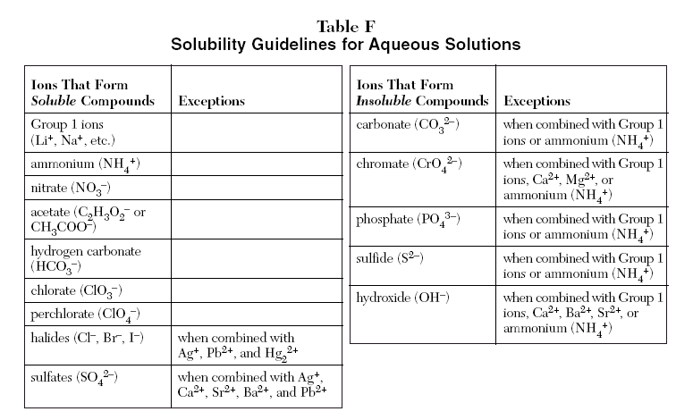

Slide 64
Check for Understanding
2H₂ + O₂ 2H₂O
Identify the following:
  reactants
  products
  symbol that separates reactants
  symbol that indicates direction of the reaction
  subscripts
  coefficients

Slide 65
What is the solvent in an aqueous solution?
A. hydrogen
B. sodium ions
C. water
D. alcohol

Slide 66
CHAPTER9
Chemical Reactions
Chapter Assessment
Ions that are present in a solution and do not participate in a chemical reaction when another substance is added are called ____.
A. spectator ions
B. reactants
C. products
D. net ions

Slide 67
An equation that includes only the particles that participate in a reaction is called:
A. net ionic equation
B. spectator ions
C. complete ionic equation
D. reduced ionic equation

Slide 68
CHAPTER9
Chemical Reactions
Chapter Assessment
The law of conservation of mass requires what in a chemical reaction equation?
A. both sides of the equation to contain the same substances
B. the reactants to have the same amount of molecules as the products
C. both sides to have the same amount of atoms of each element
D. the products to have fewer molecules than the reactants

Slide 69
CHAPTER9
Chemical Reactions
Standardized Test Practice
A ____ is a statement that uses chemical formulas to show the identities and relative amounts of the substances involved in a chemical reaction.
A. word equation
B. skeleton equation
C. chemical equation
D. balanced equation

Slide 70
SECTION9.1
Reactions and Equations
Study Guide
Key Concepts
Some physical changes are evidence that indicate a chemical reaction has occurred.
Word equations and skeleton equations provide important information about a chemical reaction.
A chemical equation gives the identities and relative amounts of the reactants and products that are involved in a chemical reaction.
Balancing an equation involves adjusting the coefficients until the number of atoms of each element is equal on both sides of the equation.

Slide 71
SECTION9.2
Classifying Chemical Reactions
Study Guide
Key Concepts
Classifying chemical reactions makes them easier to understand, remember, and recognize.
Activity series of metals and halogens can be used to predict if single-replacement reactions will occur.

Slide 72
SECTION9.3
Reactions in Aqueous Solutions
Study Guide
Key Concepts
In aqueous solutions, the solvent is always water. There are many possible solutes.
Many molecular compounds form ions when they dissolve in water. When some ionic compounds dissolve in water, their ions separate.
When two aqueous solutions that contain ions as solutes are combined, the ions might react with one another. The solvent molecules do not usually react.
Reactions that occur in aqueous solutions are double-replacement reactions.

Slide 73
A + O₂ A_{m}O_{n} [+]
O
O
A + O₂ A_{m}O_{n} [+ other products]
O
O

Slide 74
Classes of Chemical Reactions
Synthesis
Combustion
Decomposition
Single Replacement
Double Replacement
A + O₂ A_{m}O_{n} [+]
O
O

Slide 75
Activity Series

