Slide 1
Units
Scientific Method
Atomic Theory
Nuclear Chemistry
The Mole
Electrons
Periodic Properties
Covalent Bonding
Nomenclature
Chemical Reactions
Stoichiometry
Mixtures and Solutions
Chemical Equilibrium
Acid-Base Chemistry
Redox & Electrochemistry
Gas Laws
Thermodynamics

Slide 2
Units
Scientific Method
Atomic Theory
Nuclear Chemistry
The Mole
Electrons
Periodic Properties
Covalent Bonding
Nomenclature
Chemical Reactions
Stoichiometry
Mixtures and Solutions
Chemical Equilibrium
Acid-Base Chemistry
Redox & Electrochemistry
Gas Laws
Thermodynamics
Chapters 9 in our book

Slide 3
Test #9: Chemical Reactions
Test Format
Honors Chem: 25 open response
Chem: 5 multiple choice, 15 open response
Test will be shortened if we don't finish this unit
Date
Periods 3, 4, 7: Friday, June 3, 2016
Period 6: Monday, June 6, 2016

Slide 4
Chemical Reaction
Write this in your notes
SWBAT explain what a chemical reaction is and how they are represented by chemical equations.

Slide 5
Chemical Reactions
Write this in your notes
What is a chemical reaction?
The process by which one or more substances are rearranged to form different substances
Involves changes in the connectivity of atoms and/or arrangement of electrons

Slide 6
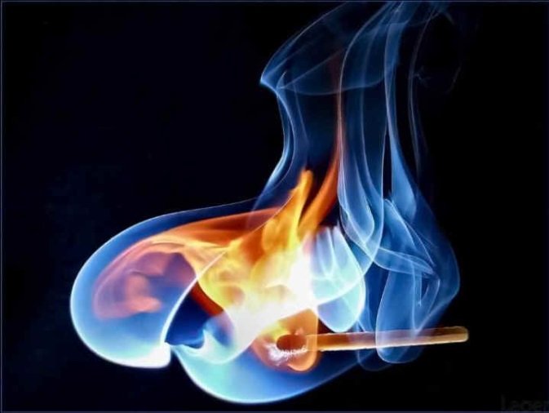
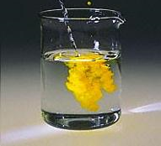
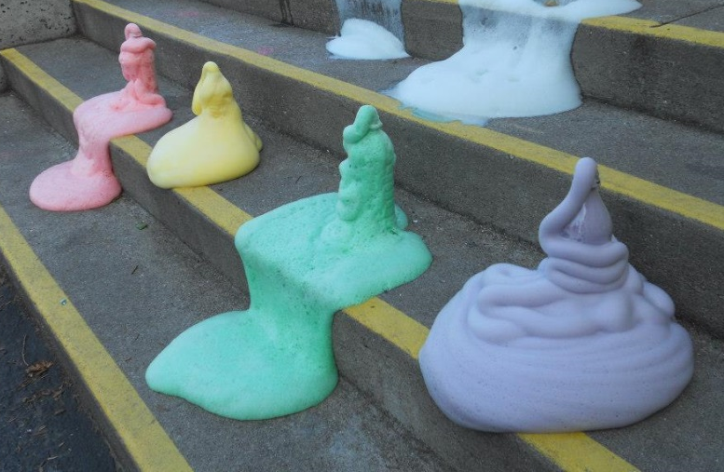
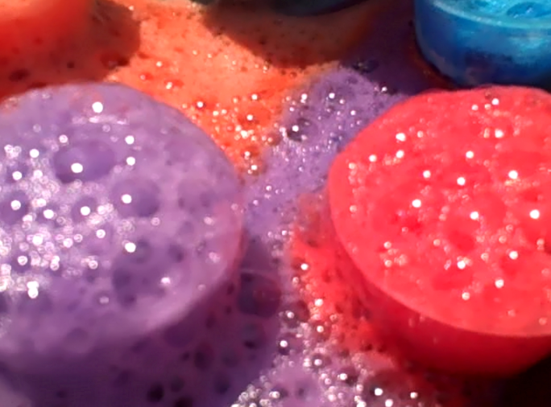
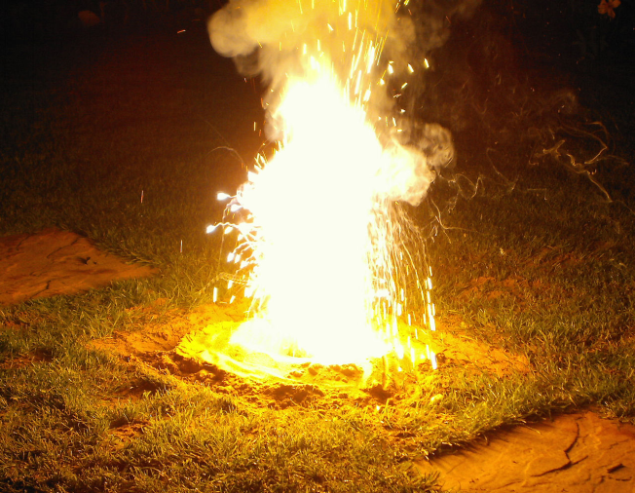
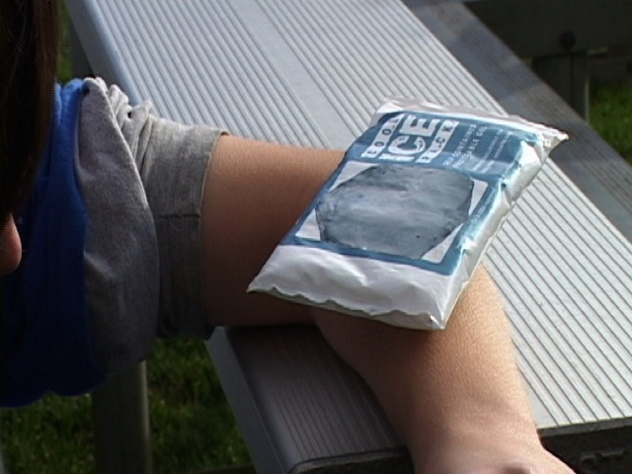
Signs of a Chemical Reaction
release of heat
release of light

Slide 7
How do we represent chemical reactions?
release of heat
release of light

Slide 8
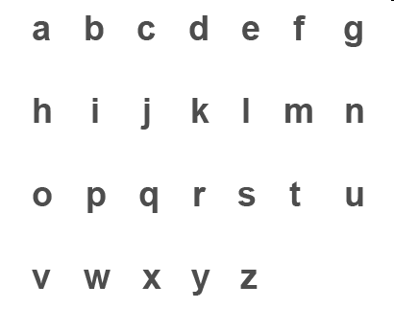
The alphabet of chemistry
More than 200,000 words in the English language

Slide 9
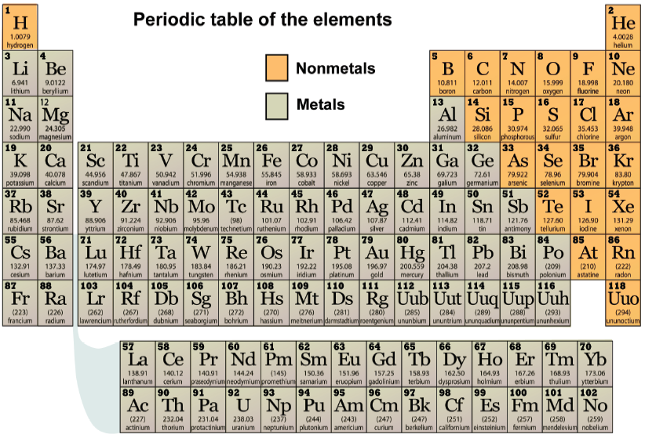
The alphabet of chemistry
More than 200,000 words in the English language
Trillions of substances
that make up the universe

Slide 10
The language of chemistry
Element symbols
H, O, Na, Fe
Alphabet
of chemistry

Slide 11
The language of chemistry
Element symbols
H, O, Na, Fe
Compound formulas
H₂O, CO₂, NaCl
Alphabet
of chemistry
Words
of chemistry

Slide 12
The language of chemistry
Element symbols
H, O, Na, Fe
Compound formulas
H₂O, CO₂, NaCl
Chemical reactions
2H₂ + O₂ 2H₂O
Alphabet
of chemistry
Words
of chemistry
Sentences
of chemistry

Slide 13
Representing Chemical Reactions
Chemists use statements called equations to represent chemical reactions.
Write this in your notes
reactants
products
reactants are the starting substances.
products are the substances formed in the reaction.

Slide 14
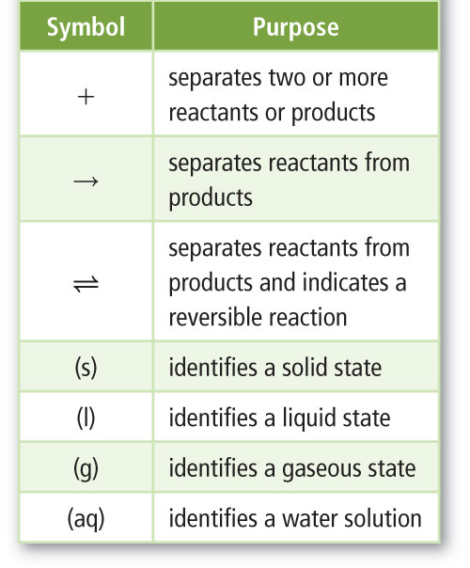
Symbols Used in Equations
Write this in your notes

Slide 15
Diatomic Elements
Most elements are found as single atoms
Seven elements are found as two atoms bonded together
These are called the diatomic elements
H₂, N₂, O₂, F₂, Cl₂, Br₂, I₂
Write this in your notes

Slide 16
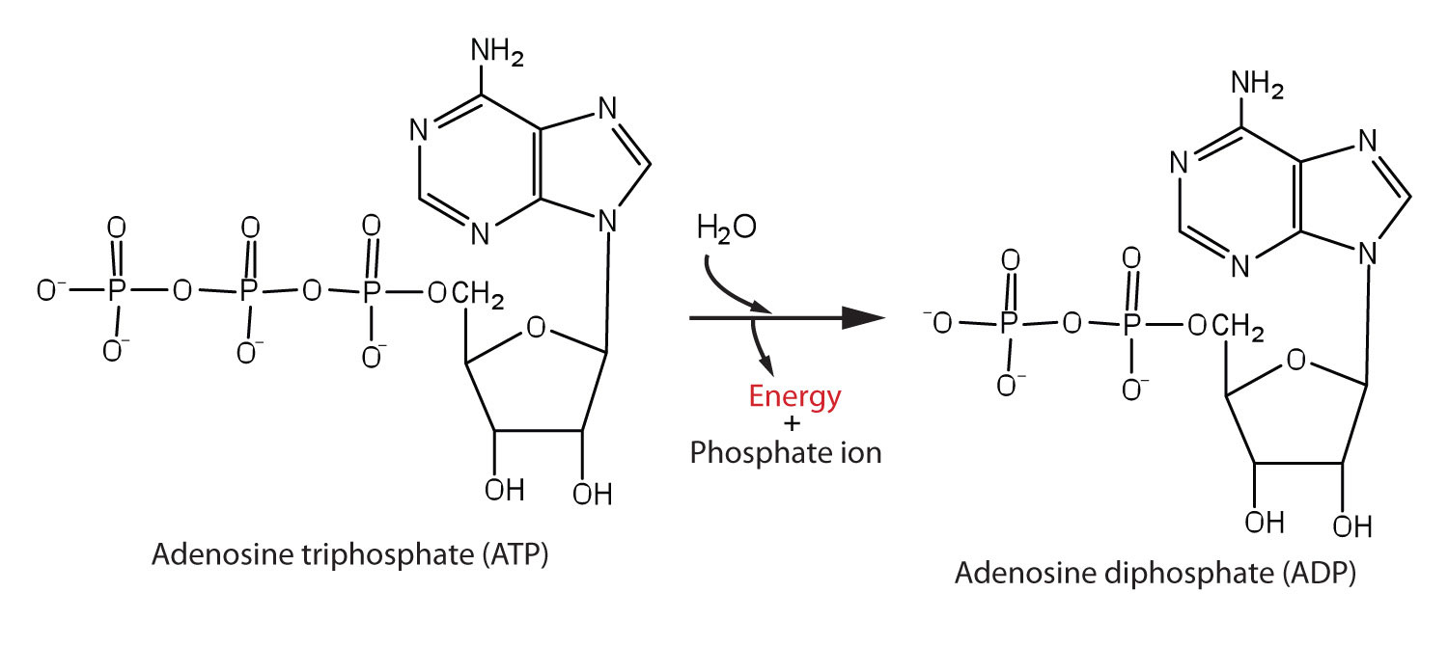
Examples
H₂ + O₂ H₂O
Pb(NO₃)₂(aq) + 2KI(aq) PbI₂(s) + 2KNO₃(aq)

Slide 17
Check for Understanding
C + O₂ CO₂
Identify the following:
reactants
products
symbol that separates reactants
symbol that separates the reactants from the products

Slide 18
Representing Chemical Reactions
Write this in your notes
Word equations
Describes reactions in words
aluminum(s) + bromine(l) → aluminum bromide(s)
reads as “aluminum and bromine react to produce aluminum bromide”.
Skeleton equations
Use symbols and formulas to represent the reactants and products.
Al(s) + Br₂(l) → AlBr₃(s)
Note that both tell what chemicals are involved, but give no information about how many

Slide 19
Check for Understanding 1
Hydrogen and bromine gases react to yield hydrogen monobromide gas.

Slide 20
Check for Understanding 1
Hydrogen and bromine gases react to yield hydrogen monobromide gas.
Word Equation
hydrogen (g) + bromine (g) hydrogen monobromide (g)
Skeleton Equation
H₂ (g) + Br₂ (g) HBr (g)

Slide 21
Check for Understanding 2
Carbon monoxide and oxygen gasses react to give carbon dioxide gas.

Slide 22
Check for Understanding 2
Carbon monoxide and oxygen gasses react to give carbon dioxide gas.
Word Equation
carbon monoxide (g) + oxygen (g) carbon dioxide (g)
Skeleton Equation
CO (g) + O₂ (g) CO₂ (g)

Slide 23
Check for Understanding 3
Solid potassium chlorate reacts to yield solid potassium chloride and oxygen gas.

Slide 24
Check for Understanding 3
Solid potassium chlorate reacts to yield solid potassium chloride and oxygen gas.
Word Equation
potassium chlorate (s)
potassium chloride (s) + oxygen (g)
Skeleton Equation
KClO₃ (s) KCl (s) + O₂ (g)

Slide 25
Representing Chemical Reactions
Chemical equation
A statement that uses chemical formulas to show the identities and relative amounts of the substances involved in a chemical reaction.
Write this in your notes

Slide 26
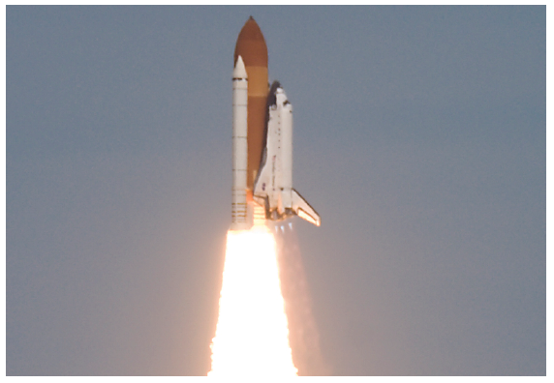

Slide 27
What is this white smoke?

Slide 28
Reaction that fuels the space shuttle:
Hydrogen burns with oxygen to produce water
The “white smoke” is actually water vapor

Slide 29
Reaction that fuels the space shuttle:
Hydrogen burns with oxygen to produce water

Slide 30
Reaction that fuels the space shuttle:
Hydrogen burns with oxygen to produce water
hydrogen
+
oxygen
water
Word Equation

Slide 31
Reaction that fuels the space shuttle:
Hydrogen burns with oxygen to produce water
hydrogen
H₂
+
+
oxygen
O₂
water
H₂O
Skeleton Equation

Slide 32
Reaction that fuels the space shuttle:
Hydrogen burns with oxygen to produce water
hydrogen
H₂
+
+
+
oxygen
O₂
water
H₂O

Slide 33
Reaction that fuels the space shuttle:
Hydrogen burns with oxygen to produce water
hydrogen
H₂
+
+
+
oxygen
O₂
water
H₂O
2 hydrogen atoms
2 oxygen atoms
2 hydrogen atoms
1 oxygen atom

Slide 34
Reaction that fuels the space shuttle:
Hydrogen burns with oxygen to produce water
hydrogen
H₂
+
+
+
oxygen
O₂
water
H₂O
2 hydrogen atoms
2 oxygen atoms
2 hydrogen atoms
1 oxygen atom

Slide 35
This chemical equation is not balanced:
it violates the law of conservation of mass
Hydrogen
H₂
+
+
+
Oxygen
O₂
Water
H₂O
2 hydrogen atoms
2 oxygen atoms
2 hydrogen atoms
1 oxygen atom

Slide 36
Write this in your notes
1 mole
x
12 g/mole
=
12 g
1 mole
x
32 g/mole
=
32 g
1 mole
x
44 g/mole
=
44 g
C + O₂ CO₂
Total mass of reactants
= 44 g
Total mass of products
= 44 g
When the mass of the products equals the mass of the reactants,
the reaction is said to be "balanced"

Slide 37
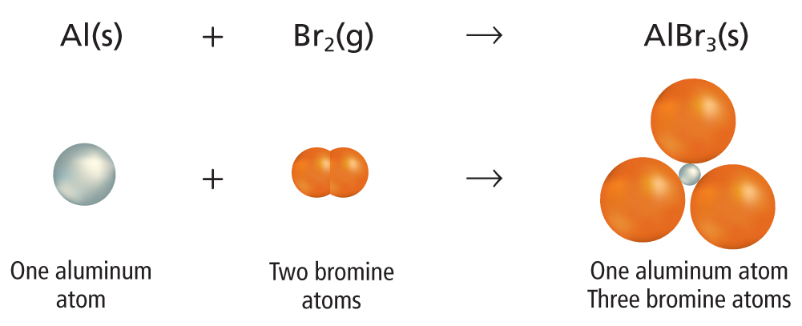
Same number of aluminum atoms in reactants and products.
Different number of bromine atoms in reactants and products
This is an unbalanced chemical equation

Slide 38
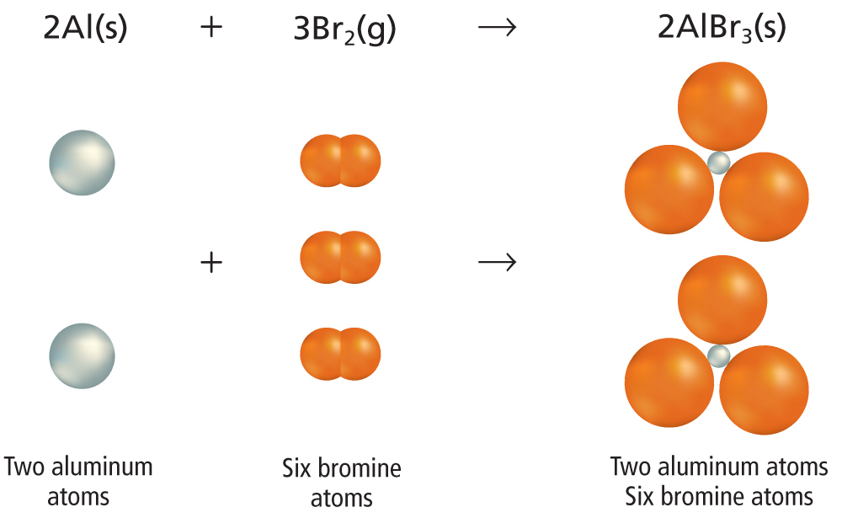
Now the number of atoms in the reactants is equal to the number of atoms in the products
This is now a balanced chemical equation

Slide 39
Check for Understanding
Determine if each equation is balanced. If not, determine which elements are out of balance
NH₃+ H₂SO₄ → (NH₄)₂SO₄
MgCl₂ + Li₂CO₃ → MgCO₃ + LiCl
Ca + Cl₂ → CaCl₂
N and H are out of balance
Li and Cl are out of balance
The equation is balanced

Slide 40
Stop Here

Slide 41
Could shorten this by skipping the word and skeleton equations. Could even remove much of the discussion of being unbalanced. Go right to the chemical equation.

