Slide 1
Do Now
Homework
Check
What is the name for P₄S₆?
What is the formula for carbon tetrachloride?
What is the name for BrF?
What is the formula for pentaboron nonahydride
tetraphosphorus hexasulfide
CCl₄
bromine monofluoride
B₅H₉

Slide 2
Chemistry
Worksheet - Covalent Nomenclature
1) SeF₆ selenium hexafluoride
2) TeO₃ tellurium trioxide
3) H₂O dihydrogen monoxide (water)
4) SCl₄ sulfur tetrachloride
5) Br₃O₈ tribromine octoxide
6) NCl₃ nitrogen trichloride
7) BrCl bromine monochloride
8) N₂O₅ dinitrogen pentoxide
9) P₂S₅ diphosphorus pentasulfide
10) IF₇ iodine heptafluoride

Slide 3
Chemistry
Worksheet - Covalent Nomenclature
11) sulfur monoxide SO
12) tellurium tetrachloride TeCl₄
13) dinitrogen trioxide N₂O₃
14) tetrasulfur dinitride S₄N₂
15) carbon tetraiodide CI₄
16) dicarbon tetrabromide C₂Br₄
17) hydrogen monochloride HCl
18) carbon diselenide CSe₂
19) silicon tetrabromide SiBr₄
20) tellurium dichloride TeCl₂

Slide 4
Cancer Research Opportunity
Dr. Katz was at the career fair
He is offering opportunities to be exposed to cancer research as a volunteer
If you are interested, send your resume to his assistant
Nancy Agyapon <nancy.agyapon@chartercare.org>

Slide 5
Test 8 - Nomenclature
Write this in your notes
Periods 3, 4, & 7: Friday, May 20, 2016
Period 6: Monday, May 23, 2016
Honors Chemistry: 66 questions
All open response
Chemistry: 50 questions
All open response

Slide 6
Nomenclature
Oxidation States and Writing Formulas
Ionic Nomenclature
Covalent Nomenclature
Acid Nomenclature

Slide 7
Acid Nomenclature
Write this in your notes
SWBAT convert back and forth between formulas and names of acids

Slide 8
Binary Acids
Write this in your notes
Binary acids consist of only two elements, one of which is hydrogen
HX H₂X H₃X
Separation of the ions releases hydrogen cation which makes it an acid

Slide 9
Binary Acid Nomenclature
hydro-
hydro-element
hydro-element-ic
hydro-element-ic acid
1) Start with the prefix "hydro-".
Write this in your notes
2) Add the element stem.
3) Add the suffix "-ic"
4) Add a space and the word "acid"
Note: Binary acid nomenclature also applies to acids made from polyatomic anions that do not contain oxygen (like CN⁻¹)

Slide 10
Example 1 - HCl
1) Start with the prefix "hydro-".
hydro
2) Add the element stem.
hydrochlor
3) Add the suffix "-ic"
hydrochloric
4) Add a space and the word "acid"
hydrochloric acid

Slide 11
Example 2 - HCN
1) Start with the prefix "hydro-".
hydro
2) Add the element stem.
hydrocyan
3) Add the suffix "-ic"
hydrocyanic
4) Add a space and the word "acid"
hydrocyanic acid

Slide 12
Oxyanion Acids
Oxyanions with the appropriate number of hydrogens attached.
Write this in your notes

Slide 13
Oxyanion Acid Nomenclature
prefix-root-suffix
prefix-root-suffix
prefix-root-suffix acid
1) Start with oxyanion name
Write this in your notes
2) Change suffix as follows:
"-ate" changes "-ic"
"-ite" changes "-ous"
3) Add a space and the word "acid"

Slide 14
Example 1: HClO
1) Start with oxyanion name
hypochlorite
2) Change suffix as follows:
"-ate" changes "-ic"
"-ite" changes "-ous"
hypochlorous
3) Add a space and the word "acid"
hypochlorous acid

Slide 15
Example 2: HNO₃
1) Start with oxyanion name
nitrate
2) Change suffix as follows:
"-ate" changes "-ic"
"-ite" changes "-ous"
nitric
3) Add a space and the word "acid"
nitric acid

Slide 16
Root Changes
Write this in your notes
Some roots are slightly changed when used for naming acids
sulfate ----> sulfuric acid
phosphate ----> phosphoric acid

Slide 17
Check for Understanding 1
Write the correct names for the formula:
H₂S
H₂SO₄
HClO₄
hydrosulfuric acid
sulfuric acid
perchloric acid

Slide 18
Check for Understanding 2
Write the correct formulas for the names
acetic acid
phosphoric acid
hydrofluoric acid
HC₂H₃O₂
H₃PO₄
HF

Slide 19
Latin Names
Write this in your notes
Some compounds were given Latin names before systematic nomenclature was created
These are still in use even today
On cations with two primary oxidation states, a suffix indicates the oxidation state
suffix "–ic" means higher oxidation state
suffix "–ous" means lower oxidation state
Most often used on elements with Latin names

Slide 20
Example of Latin Name
In Latin, iron is called ferrum
This is why its atomic symbol is Fe
Iron has two primary oxidation states, +3 and +2
Fe⁺³ is called ferric
Fe⁺² is called ferrous

Slide 21
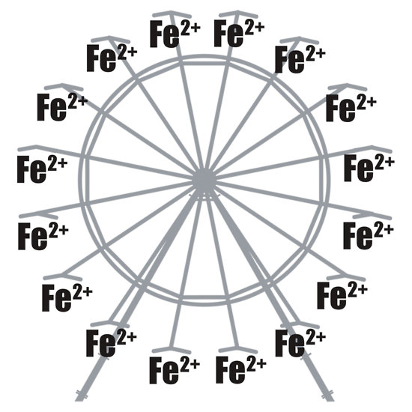
What is this called?
A ferrous wheel!!!

Slide 22
Example of Latin Name
In each oxidation state, Fe can be combined with O
Fe₂O₃ is ferric oxide
FeO is ferrous oxide

Slide 23
Latin Names
Latin names are most frequently used with iron, copper, tin and lead, but can be used with any element
Systematic Name | Latin Name
iron (III) oxide | ferric oxide
iron (II) oxide | ferrous oxide
copper (II) oxide | cupric oxide
copper (I) oxide | cuprous oxide
tin (IV) oxide | stannic oxide
tin (II) oxide | stannous oxide
lead (IV) oxide | plumbic oxide
lead (II) oxide | plumbous oxide

Slide 24
Homework
Worksheet - Acid Nomenclature

Slide 25
Nomenclature Summary
Ionic Nomenclature
cation (oxidation state) anion-ide
Covalent Nomenclature
prefix-first prefix-second-ide
Acid Nomenclature
hydro-element-ic acid
prefix-root-suffix acid

Slide 26
Formula begin with H?
Acid
Just 2 elements?
Not an Acid
Contains a metal?
Binary
Acid
Oxyanion
Acid
Ionic
Covalent
(III)
(IV)
(V)
tri-
tetra-
penta-
hydro-
-ic acid
-ate ---> -ic
-ite ---> -ous

Slide 27
Backup Slides

Slide 28
Check for Understanding 1
Write the correct names for the formula:
H₂S
H₂SO₄
HClO₄
hydrosulfuric acid
Why not hydrosulfic acid?
Sulfur goes to sulfide, why doesn't it go to hydrosulfic acid?
Does the stem change from the previous slide apply?
sulfuric acid
perchloric acid

