Slide 1
Do Now
Homework
Check
What is the name for Be(HCO₃)₂?
What is the formula for uranium (IV) oxide?
What is the name for CrN₂?
What is the formula for aluminum sulfide?
beryllium hydrogen carbonate
UO₂
chromium (VI) nitride
Al₂S₃

Slide 2
Chemistry
Worksheet - Ionic Nomenclature
1) NH₄Cl ammonium chloride
2) Fe(NO₃)₃ iron (III) nitrate
3) TiBr₃ titanium (III) bromide
4) Cu₃P copper (I) phosphide
5) SnSe₂ tin (IV) selenide
6) GaAs gallium (III) arsenide
7) Pb(SO₄)₂ lead (IV) sulfate
8) Be(HCO₃)₂ beryllium hydrogen carbonate
9) Mn₂(SO₃)₃ manganese (III) sulfite
10) Al(CN)₃ aluminum cyanide

Slide 3
Chemistry
Worksheet - Ionic Nomenclature
11) chromium (VI) phosphate Cr(PO₄)₂
12) vanadium (IV) carbonate V(CO₃)₂
13) tin (II) nitrite Sn(NO₂)₂
14) cobalt (III) oxide Co₂O₃
15) titanium (II) acetate Ti(C₂H₃O₂)₂
16) vanadium (V) sulfide V₂S₅
17) chromium (III) hydroxide Cr(OH)₃
18) lithium iodide LiI
19) lead (II) nitride Pb₃N₂
20) silver bromide AgBr

Slide 4
Cancer Research Opportunity
Dr. Katz was at the career fair
He is offering opportunities to be exposed to cancer research as a volunteer
If you are interested, send your resume to his assistant
Nancy Agyapon <nancy.agyapon@chartercare.org>

Slide 5
Test 8 - Nomenclature
Write this in your notes
Periods 3, 4, & 7: Friday, May 20, 2016
Period 6: Monday, May 23, 2016
Honors Chemistry: 66 questions
All open response
Chemistry: 50 questions
All open response

Slide 6
Nomenclature
Oxidation States and Writing Formulas
Ionic Nomenclature
Covalent Nomenclature
Acid Nomenclature

Slide 7
Covalent Nomenclature
Write this in your notes
SWBAT convert back and forth between formulas and names of covalent compounds

Slide 8
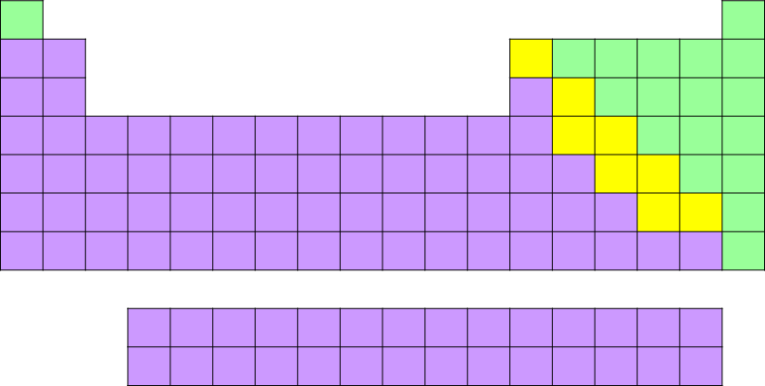
Ionic vs Covalent Nomenclature
The nomenclature used depends on the family
Ionic nomenclature is used for bonds between:
metal and non-metal or metalloid
Covalent nomenclature is used for bonds between
two non-metals
two metalloids
a non-metal & a metalloid

Slide 9
Covalent Molecule Nomenclature
first second
1) List elements names in order of electronegativity
● less electronegative first
● more electronegative second
2) Add suffix "-ide" to second element

Slide 10
Covalent Molecule Nomenclature
first second-ide
1) List elements names in order of electronegativity
● less electronegative first
● more electronegative second
2) Add suffix "-ide" to second element
3) Indicate the number of each element by a prefix before each except when only one of first element

Slide 11
Covalent Molecule Nomenclature
prefix-first prefix-second-ide
1) List elements names in order of electronegativity
● less electronegative first
● more electronegative second
Write this in your notes
2) Add suffix "-ide" to second element
3) Indicate the number of each element by a prefix before each except when only one of first element
The use of prefixes is the major difference between covalent and ionic nomenclature. If you see prefixes, you know you are dealing with a covalent compound

Slide 12
Write this in your notes
You have to memorize these prefixes

Slide 13
Double Vowels
Write this in your notes
For prefixes that end with an "a" or "o", drop this vowel when combined with oxygen (No "a-o" or "o-o" combos)
All other double vowels are okay
 |  | first letter in element
 |  | arsenic | iodine | oxygen
last letter in prefix | tetra- | tetraarsenic tetrasulfide | diphosphorus tetraiodide | dinitrogen tetraoxide dinitrogen tetroxide
 | tri- | diarsenic trioxide | diiodide triiodide | carbon dioxide
 | mono- | no examples | astatine monoiodide | carbon monooxide carbon monoxide

Slide 14
Example 1 - CO
1) List elements names in order of electronegativity
● less electronegative first
● more electronegative second
carbon oxygen
2) Add suffix "-ide" to second element
carbon oxide
3) Indicate the number of each element by a prefix before each except when only one of first element
Wrong
carbon monooxide
monocarbon monoxide
carbon monoxide

Slide 15
Example 2 - N₂O₅
1) List elements names in order of electronegativity
● less electronegative first
● more electronegative second
nitrogen oxygen
2) Add suffix "-ide" to second element
nitrogen oxide
3) Indicate the number of each element by a prefix before each except when only one of first element
Wrong
pentaoxide
dinitrogen pentoxide

Slide 16
Check for Understanding 1
Write the correct names for the formula:
BF₃
I₄O₉
S₇Cl₂
boron trifluoride
tetraiodine nonoxide
heptasulfur dichloride

Slide 17
Check for Understanding 2
Write the correct formulas for the names
tetraphosphorus decoxide
trinitrogen hexabromide
octachlorine difluoride
P₄O₁₀
N₃Br₆
Cl₈F₂

Slide 18
Organic Molecules
Organic molecules are molecules containing carbon, typically the chemicals of life
A separate system exists for unambiguously naming any organic molecule
(6E,13E)-18-bromo-12-butyl-11-chloro-4,8-diethyl-5-hydroxy-15-methoxytricosa-6,13-dien-19-yne-3,9-dione
We are not going to learn this system, but it is important that you know a separate system exists

Slide 19
Homework
Worksheet - Covalent Compounds

Slide 20
Backup Slides

Slide 21
Nomenclature Summary
Ionic Nomenclature
cation (oxidation state) anion-ide
Covalent Nomenclature
prefix-first prefix-second-ide
Acid Nomenclature
hydro-element-ic acid
prefix-root-suffix acid

Slide 22
Ratio of Elements
REVIEW
X_{x}Y_{y}
For neutral compounds, the sum of the oxidation numbers equals zero
(
)
(
)
(
)
(
)
oxidation
number
for X
x
+
oxidation
number
for Y
y
=
O

Slide 23
Double Vowels
 |  | first letter in element
 |  | a | i | o
last letter in prefix | a | a‒a | a‒i | a‒o
 | i | i‒a | i‒i | i‒o
 | o | o‒a | o‒i | o‒o

Slide 24
Double Vowels
 |  | first letter in element
 |  | arsenic | iodine | oxygen
last letter in prefix | tetra- | tetraarsenic tetrasulfide | diphosphorus tetraiodide | dinitrogen tetraoxide dinitrogen tetroxide
 | tri- | diarsenic trioxide | diiodide triiodide | carbon dioxide
 | mono- | no examples | astatine monoiodide | carbon monooxide carbon monoxide

Slide 25
Avoiding Double Vowels
If a prefix has two vowels, the second one is dropped when the element's name begins with a vowel
prefix | stem | right | wrong
mono | oxide | monoxide | monooxide
di | oxide | dioxide | doxide
tri | oxide | trioxide | troxide
tetra | oxide | tetroxide | tetraoxide
penta | oxide | pentoxide | pentaoxide
hexa | oxide | hexoxide | hexaoxide
hepta | oxide | heptoxide | heptaoxide
octa | oxide | octoxide | octaoxide
nona | oxide | nonoxide | nonaoxide
deca | oxide | decoxide | decaoxide

