Slide 1
Do Now

Slide 2
Units
Scientific Method
Atomic Theory
Nuclear Chemistry
The Mole
Electrons
Periodic Properties
Covalent Bonding
Nomenclature
Chemical Reactions
Stoichiometry
Mixtures and Solutions
Chemical Equilibrium
Acid-Base Chemistry
Redox & Electrochemistry
Gas Laws
Thermodynamics
Chapters 7.3 and 8.2 in our book

Slide 3
Nomenclature
Oxidation States and Writing Formulas
Ionic Nomenclature
Covalent Nomenclature
Acid Nomenclature

Slide 4
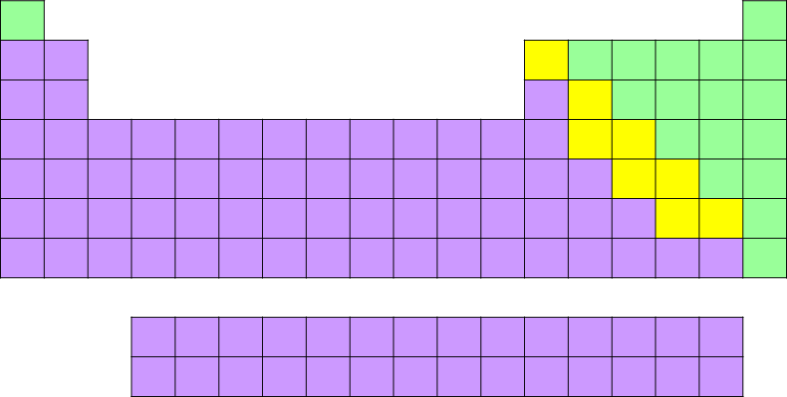
Ionic vs Covalent Nomenclature
Write this in your notes
The nomenclature used depends on the family
Ionic nomenclature is used for bonds between:
metal and non-metal or metalloid
Covalent nomenclature is used for bonds between
two non-metals
two metalloids
a non-metal & a metalloid

Slide 5
Check for Understanding
Based on families of the elements, predict the type of nomenclature that will be used:
Cl & O
Mg & F
Si & Ca
As & At
Zn & Br
Mn & S
B & F
Ge & Sn
covalent nomenclature
ionic nomenclature
ionic nomenclature
covalent nomenclature
ionic nomenclature
ionic nomenclature
covalent nomenclature
ionic nomenclature

Slide 6
Oxidation Numbers & Writing Formulas
Write this in your notes
SWBAT explain the concept of oxidation numbers and use them to predict chemical formulas

Slide 7
Nomenclature
Oxidation States and Writing Formulas
Ionic Nomenclature
Covalent Nomenclature
Acid Nomenclature

Slide 8
Predicting Formulas
When two elements combine, we can often predict the formula of the resulting compound

Slide 9
Example
Predict the formula of a compound formed from potassium and oxygen
Potassium wants to lose 1e– and get a +1 charge
K⁺¹
Oxygen wants to gain 2e– and get a –2 charge
O⁻²
K⁺¹
To make a neutral compound, they need to combine in a 2:1 ratio
O⁻²
K⁺¹
Thus we can predict a formula of K₂O

Slide 10
Predicting Formulas
When two elements combine, we can often predict the formula of the resulting compound
To help in predicting formulas, scientists created a number that describes how an atom usually bonds.
Does it usually gain or lose electron density?
How much electron density does it usually gain or lose?
In what ratio will it usually combine?
This number is called the oxidation number

Slide 11
Oxidation Number (also called Oxidation State)
Write this in your notes
A number assigned to an atom to track how many electrons it lost or gained or appears to have lost or gained when it bonded into a compound.
Conceptually, the number is equal to the charge on an atom if the more electronegative atom in each bond took all of the bonding electrons.
Compounds form such that the sum of all the oxidation numbers is zero
( or, if the compound is charged, the sum of the oxidation numbers is equal to the charge)
Write this in your notes

Slide 12
Nature of Oxidation Numbers
A positive oxidation number means an atom usually gives up electrons or releases electron density when bonding
Write this in your notes
Potassium has an oxidation number of +1
K⁺¹
A negative oxidation number means an atom usually gains electrons or gains electron density when bonding
Write this in your notes
O⁻²
Oxygen has an oxidation number of –2
As before, this allows us to predict a formula of K₂O

Slide 13
Works with Covalent Compounds
Boron and fluorine form a polar covalent bond because of their difference in electronegativity
Even though there is no electron transfer, we can use the oxidation numbers to predict the formula
Boron has an oxidation number of +3
B
Fluorine has an oxidation number of –1
F
For a neutral molecule, we predict a formula of BF₃

Slide 14
Oxidation Numbers Are Actually More Complicated
For now, we will use oxidation numbers in this simplified manner to predict formulas
There is much more to oxidation numbers
Many atoms can have multiple oxidation numbers
An atoms oxidation number can change during a reaction
Tracking oxidation numbers is vital to understanding electrochemistry and redox reactions
For us, however, we will just use them to predict formulas

Slide 15
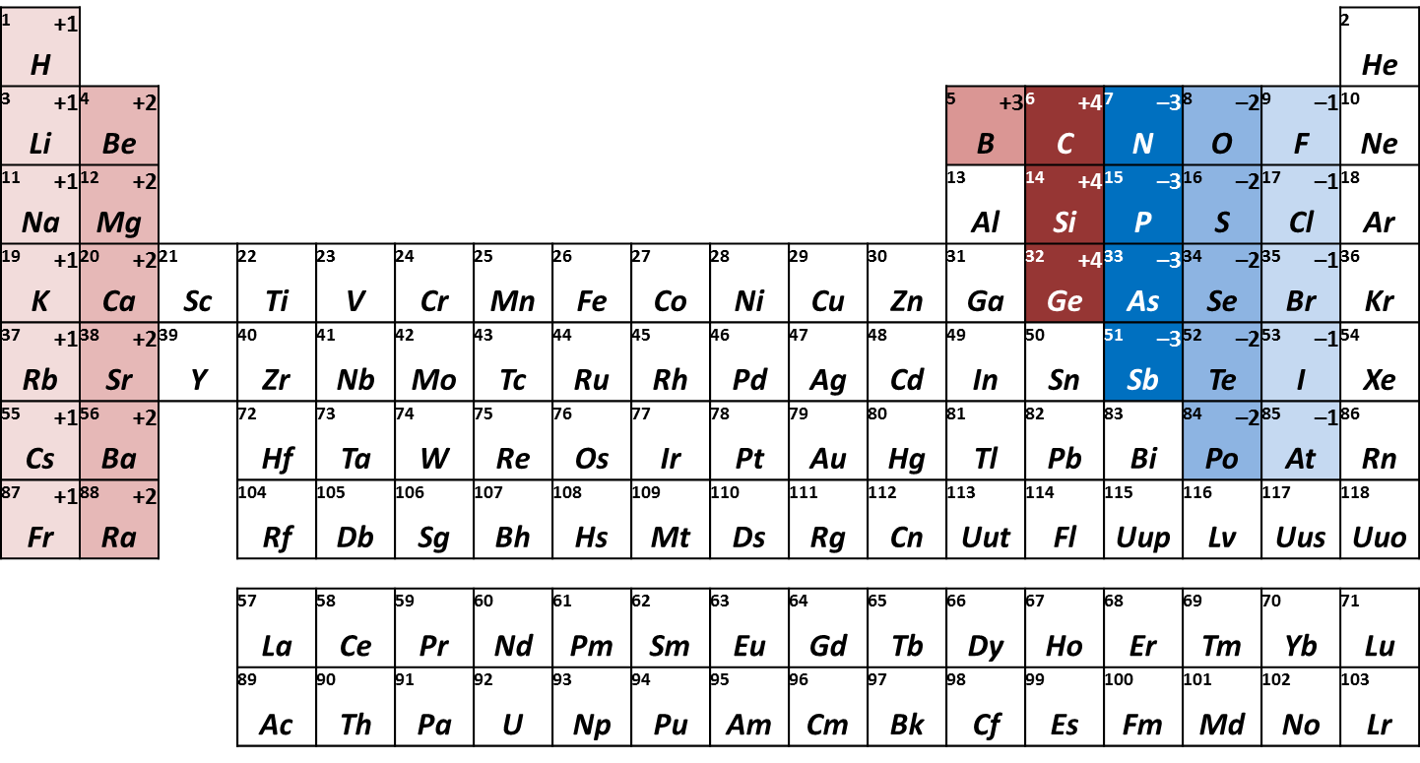
Oxidation Numbers (That Usually Don't Change)
Group 1 & Group 2 Metals
Non-Metals & Metalloids

Slide 16
You Need to Know These
Write this in your notes
There are exceptions, but you are not required to know them

Slide 17
Oxidation Numbers of Metals
These are on your sheet
Note - These are the most common oxidations numbers. All of these elements have other oxidations numbers which are less common.

Slide 18
Chemical Formula
Write this in your notes
Formula Format:
X_{x}Y_{y}
where:
X = atomic symbol for element with a positive oxidation number
Y = atomic symbol for element with a negative oxidation number
x = number of X atoms in compound
y = number of Y atoms in compound

Slide 19
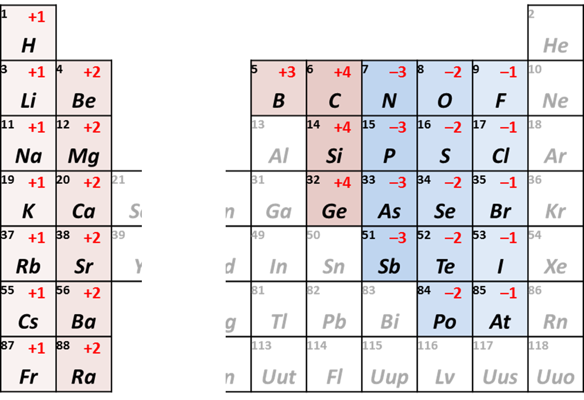
Example 1
What is the correct formula of the compound formed between calcium and nitrogen

Slide 20
Example 1
Formula:
Ca_{x}N_{y}
where:
Ca = atomic symbol for calcium, the element with a positive oxidation number
N = atomic symbol for nitrogen, the element with a negative oxidation number
x = number of Ca atoms in compound
y = number of N atoms in compound
What are x and y?

Slide 21
Calcium and Nitrogen
Ca⁺²
N^{‒3}
+2
+
‒3
=
‒1

Slide 22
Calcium and Nitrogen
Ca⁺²
N^{‒3}
Ca⁺²
+4
+
‒3
=
+1

Slide 23
Calcium and Nitrogen
Ca⁺²
N^{‒3}
Ca⁺²
N^{‒3}
+4
+
‒6
=
‒2

Slide 24
Calcium and Nitrogen
Ca⁺²
N^{‒3}
Ca⁺²
N^{‒3}
Ca⁺²
+6
+
‒6
=
0
Ca₃N₂

Slide 25
Answer to Example 1
Formula:
Ca₃N₂
where:
Ca = atomic symbol for calcium, the element with a positive oxidation number
N = atomic symbol for nitrogen, the element with a negative oxidation number
3 = number of Ca atoms in compound
2 = number of N atoms in compound

Slide 26
Calcium and Chlorine
Ca⁺²
Cl^{‒1}
Cl^{‒1}
CaCl₂

Slide 27
Aluminum and Oxygen
Al⁺³
O^{‒2}
Al⁺³
O^{‒2}
O^{‒2}
Al₂O₃

Slide 28
Check for Understanding 1
Write the correct formula for compounds formed between atoms listed
oxygen and sodium
beryllium and bromine
phosphorus and calcium
Na₂O
BeBr₂
Ca₃P₂

Slide 29
Example 4
What is the correct formula of the compound formed between iron and oxygen?
Two formulas are possible

Slide 30
Iron and Oxygen
Fe⁺²
O^{‒2}
Fe⁺³
O^{‒2}
Fe⁺³
O^{‒2}
O^{‒2}
FeO
Fe₂O₃

Slide 31
Check for Understanding 2
Write the correct formula(s) for the compounds formed between atoms listed
bromine and platinum
manganese and sulfur
tin and nitrogen
PtBr₂ & PtBr₄
MnS & Mn₂S₃
Sn₃N₂ & Sn₃N₄

Slide 32
Limitations of this Method
Our method doesn't work for compounds made from atoms with oxidation numbers of the same sign
Example: phosphorus and chlorine
Our method cannot predict the formula because both atoms have negative oxidation numbers

Slide 33
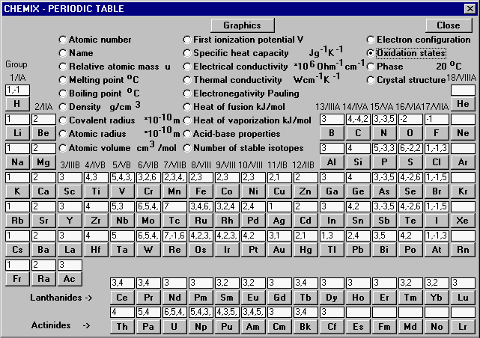
Many atoms can have multiple oxidation numbers
An atoms oxidation number can change during a reaction
Phosphorus changes its oxidation state from –3 to +3 or +5 and forms PCl₃ or PCl₅
Be aware of this limitation to our method

Slide 34
Homework
Worksheet - Oxidation States & Chemical Formulas

Slide 35
Backup Slides

Slide 36
Nomenclature Summary
Ionic Nomenclature
cation (oxidation state) anion-ide
Covalent Nomenclature
prefix-first prefix-second-ide
Acid Nomenclature
hydro-element-ic acid
prefix-root-suffix acid

Slide 41
Ionic Compounds
An ionic bond forms when one or more electron is transferred from one atom to another
The atoms then become ions with an actual physical charge on them
The ions combine in ratios such that overall compound has zero charge

Slide 42
Covalent Molecules
A covalent bond forms when electrons are shared between two atoms
Even if the electron sharing is unequal, the atoms do not acquire an actual full charge
To keep track of unequal sharing in covalent molecules, scientist created the concept of "formal charges"
To keep track of this unequal sharing all compounds (ionic or covalent), scientist created a concept called "oxidation number"

Slide 43
Also works with covalent compounds
K₂O is an ionic compound
Potassium really loses electrons to oxygen
Potassium really gain a positive charge and oxygen really gains two negative charges
In covalent compounds, however, electrons are shared, not transferred
Still,

Slide 44
Oxidation Number (also called Oxidation State)
A number of electrons assigned to an atom to track how many electrons it lost or gained when it bonded into a compound.
Conceptually, the number is equal to the charge on an atom if electronegative atom in each bond took all of the bonding electrons.
Conceptually, the number of electrons that need to be gained or lost to reach a closed shell (or, for transition metals, the nearest stable electron configuration)

Slide 45
Oxidation Numbers for Carbon
Bonds to less electronegative atoms: | 4 x | +1 = | +4
H
Bonds to less electronegative atoms: | 4 x | +1 = | +4
Bonds to more electronegative atoms: | 0 x | -1 = | 0
H
C
H
H
OH
H
C
H
H
O
H
C
H
H
O
H
C
OH
H
O
C
O

Slide 46
Oxidation Numbers for Carbon
H
Bonds to less electronegative atoms: | 4 x | +1 = | +4
Bonds to more electronegative atoms: | 0 x | -1 = | 0
 |  |  | +4
H
C
H
H
OH
Bonds to less electronegative atoms: | 3 x | +1 = | +3
Bonds to more electronegative atoms: | 1 x | -1 = | -1
 |  |  | +2
H
C
H
H
O
Bonds to less electronegative atoms: | 2 x | +1 = | +2
Bonds to more electronegative atoms: | 2 x | -1 = | -2
 |  |  | 0
H
C
H
H
O
Bonds to less electronegative atoms: | 1 x | +1 = | +1
Bonds to more electronegative atoms: | 3 x | -1 = | -3
 |  |  | -2
H
C
OH
H
O
Bonds to less electronegative atoms: | 0 x | +1 = | 0
Bonds to more electronegative atoms: | 4 x | -1 = | -4
 |  |  | -4
C
O

Slide 47
Oxidation Number (also called Oxidation State)
A number of electrons assigned to an atom to track how many electrons it lost or gained when it bonded into a compound.
Conceptually, the number is equal to the charge on an atom if electronegative atom in each bond took all of the bonding electrons.

Slide 48
Oxidation Number (also called Oxidation State)
A number of electrons assigned to an atom to track how many electrons it lost or gained when it bonded into a compound.
Conceptually, the number is equal to the charge on an atom if electronegative atom in each bond took all of the bonding electrons.
Some elements always or almost always have the same oxidation number in any compound, while others vary their oxidation number depending upon the other atom in the compound.

Slide 49
Non-Systematic Names
Formula | Systematic Name | Non-Systematic Name
H2O | dihydrogen monoxide | water
NH3 | trihydrogen mononitride | ammonia
O3 | trioxygen | ozone

Slide 50
Do Now
Identify a person without using their name
Chose someone on the other side of class
Think of 3 things you can say to describe them without using their name
You will read your items to the class and see if they can tell who you are describing

Slide 51
Oxidation Numbers of Metals
Next year, give a table with all the possible
oxidation states and just highlight the most
common ones
Also, show kids how to name any oxyanion
and hold them responsible for figuring out
several names even if they are not on a
cheat sheet
Redesign WS so there is more learning (sequences
and more problems
Also, add the flow chart and show the kids
how to deal with any formula from any type
of nomenclature. Give a homework assignment
of mixed review. Review the rules
Metal with metal?
When to use acid nomenclature (vs covalent)?
Is it wrong to use the Roman numerals if there
is only one oxidation state (e.g. sodium (I))?
When is it sufuric or sulfide (acids, covalent)?
Hydrogen bromide or hydrogen monobromide?
These are on your sheet
Note - These are the most common oxidations numbers. All of these elements have other oxidations numbers which are less common.

Slide 52
Calcium and Nitrogen
Ca⁺²
N^{‒3}
Ca⁺²
N^{‒3}
Ca⁺²
Ca₃N₂

Slide 53
Calcium and Nitrogen
Ca⁺²
N^{‒3}
Ca⁺²
N^{‒3}
Ca⁺²
Ca₃N₂

Slide 54
Ratio of Elements
Write this in your notes
X_{x}Y_{y}
For neutral compounds, the sum of the oxidation numbers equals zero
(
)
(
)
(
)
(
)
oxidation
number
for X
x
+
oxidation
number
for Y
y
=
O

Slide 55
Example 1
What is the correct formula for the compound formed between calcium and nitrogen
Oxidation number for calcium is +2
Oxidation number for nitrogen is –3
A 3:2 ratio will give a neutral compound
(+2)(3) + (–3)(2) = 0

Slide 56
Example 2
What is the correct formula for the ionic compound formed between calcium and chlorine?
Oxidation number for calcium is +2
Oxidation number for chlorine is –1
A 1:2 ratio will give a neutral compound
(+2)(1) + (–1)(2) = 0
CaCl₂

Slide 57
Example 3
What is the correct formula for the ionic compound formed between oxygen and aluminum?
Oxidation number for aluminum is +3
Oxidation number for oxygen is –2
A 2:3 ratio will give a neutral compound
(+3)(2) + (–2)(3) = 0
Al₂O₃

Slide 58
Example 4
Iron oxidation state is +2:
FeO
(+2)(1) + (–2)(1) = 0
Iron oxidation state is +3:
Fe₂O₃
(+3)(2) + (–2)(3) = 0
We will learn that these have different names

Slide 59
Calcium and Nitrogen
Ca⁺²
N^{‒3}
The positive
oxidation
numbers
add up to +6
Ca⁺²
N^{‒3}
The negative
oxidation
numbers
add up to ‒6
Ca⁺²
Ca₃N₂

Slide 60
Calcium and Nitrogen
Ca⁺²
N^{‒3}
The positive
oxidation
numbers
add up to +6
Ca⁺²
N^{‒3}
The negative
oxidation
numbers
add up to ‒6
Ca⁺²
Ca₃N₂

