Slide 1
Do Now
shorthand | meaning
LOL
:-)
ETA
:-(
TTYL
;-)
RSVP
^5
JK
:-P
YOLO
0:-)
MYOB
*\0/*
We use shorthands every day
They allow us to get our message across quickly
What are the meanings of these shorthands?

Slide 2
Do Now
shorthand | meaning
LOL | laugh out loud
:-)
ETA
:-(
TTYL
;-)
RSVP
^5
JK
:-P
YOLO
0:-)
MYOB
*\0/*
We use shorthands every day
They allow us to get our message across quickly
What are the meanings of these shorthands?

Slide 3
Do Now
shorthand | meaning
LOL | laugh out loud
:-) | happy face
ETA
:-(
TTYL
;-)
RSVP
^5
JK
:-P
YOLO
0:-)
MYOB
*\0/*
We use shorthands every day
They allow us to get our message across quickly
What are the meanings of these shorthands?

Slide 4
Do Now
shorthand | meaning
LOL | laugh out loud
:-) | happy face
ETA | estimated time of arrival
:-(
TTYL
;-)
RSVP
^5
JK
:-P
YOLO
0:-)
MYOB
*\0/*
We use shorthands every day
They allow us to get our message across quickly
What are the meanings of these shorthands?

Slide 5
Do Now
shorthand | meaning
LOL | laugh out loud
:-) | happy face
ETA | estimated time of arrival
:-( | sad face
TTYL
;-)
RSVP
^5
JK
:-P
YOLO
0:-)
MYOB
*\0/*
We use shorthands every day
They allow us to get our message across quickly
What are the meanings of these shorthands?

Slide 6
Do Now
shorthand | meaning
LOL | laugh out loud
:-) | happy face
ETA | estimated time of arrival
:-( | sad face
TTYL | talk to you later
;-)
RSVP
^5
JK
:-P
YOLO
0:-)
MYOB
*\0/*
We use shorthands every day
They allow us to get our message across quickly
What are the meanings of these shorthands?

Slide 7
Do Now
shorthand | meaning
LOL | laugh out loud
:-) | happy face
ETA | estimated time of arrival
:-( | sad face
TTYL | talk to you later
;-) | wink
RSVP
^5
JK
:-P
YOLO
0:-)
MYOB
*\0/*
We use shorthands every day
They allow us to get our message across quickly
What are the meanings of these shorthands?

Slide 8
Do Now
shorthand | meaning
LOL | laugh out loud
:-) | happy face
ETA | estimated time of arrival
:-( | sad face
TTYL | talk to you later
;-) | wink
RSVP | Repondez s'il vous plait
^5
JK
:-P
YOLO
0:-)
MYOB
*\0/*
We use shorthands every day
They allow us to get our message across quickly
What are the meanings of these shorthands?

Slide 9
Do Now
shorthand | meaning
LOL | laugh out loud
:-) | happy face
ETA | estimated time of arrival
:-( | sad face
TTYL | talk to you later
;-) | wink
RSVP | Repondez s'il vous plait
^5 | high five
JK
:-P
YOLO
0:-)
MYOB
*\0/*
We use shorthands every day
They allow us to get our message across quickly
What are the meanings of these shorthands?

Slide 10
Do Now
shorthand | meaning
LOL | laugh out loud
:-) | happy face
ETA | estimated time of arrival
:-( | sad face
TTYL | talk to you later
;-) | wink
RSVP | Repondez s'il vous plait
^5 | high five
JK | just kidding
:-P
YOLO
0:-)
MYOB
*\0/*
We use shorthands every day
They allow us to get our message across quickly
What are the meanings of these shorthands?

Slide 11
Do Now
shorthand | meaning
LOL | laugh out loud
:-) | happy face
ETA | estimated time of arrival
:-( | sad face
TTYL | talk to you later
;-) | wink
RSVP | Repondez s'il vous plait
^5 | high five
JK | just kidding
:-P | cheeky
YOLO
0:-)
MYOB
*\0/*
We use shorthands every day
They allow us to get our message across quickly
What are the meanings of these shorthands?

Slide 12
Do Now
shorthand | meaning
LOL | laugh out loud
:-) | happy face
ETA | estimated time of arrival
:-( | sad face
TTYL | talk to you later
;-) | wink
RSVP | Repondez s'il vous plait
^5 | high five
JK | just kidding
:-P | cheeky
YOLO | you only live once
0:-)
MYOB
*\0/*
We use shorthands every day
They allow us to get our message across quickly
What are the meanings of these shorthands?

Slide 13
Do Now
shorthand | meaning
LOL | laugh out loud
:-) | happy face
ETA | estimated time of arrival
:-( | sad face
TTYL | talk to you later
;-) | wink
RSVP | Repondez s'il vous plait
^5 | high five
JK | just kidding
:-P | cheeky
YOLO | you only live once
0:-) | angel
MYOB
*\0/*
We use shorthands every day
They allow us to get our message across quickly
What are the meanings of these shorthands?

Slide 14
Do Now
shorthand | meaning
LOL | laugh out loud
:-) | happy face
ETA | estimated time of arrival
:-( | sad face
TTYL | talk to you later
;-) | wink
RSVP | Repondez s'il vous plait
^5 | high five
JK | just kidding
:-P | cheeky
YOLO | you only live once
0:-) | angel
MYOB | mind your own business
*\0/*
We use shorthands every day
They allow us to get our message across quickly
What are the meanings of these shorthands?

Slide 15
Do Now
shorthand | meaning
LOL | laugh out loud
:-) | happy face
ETA | estimated time of arrival
:-( | sad face
TTYL | talk to you later
;-) | wink
RSVP | Repondez s'il vous plait
^5 | high five
JK | just kidding
:-P | cheeky
YOLO | you only live once
0:-) | angel
MYOB | mind your own business
*\0/* | cheerleader
We use shorthands every day
They allow us to get our message across quickly
What are the meanings of these shorthands?
Today we will learn a shorthand used in chemistry to keep track of electrons in an atom

Slide 16
Lewis Dot Structures
SWBAT represent an atom’s valence electrons using Lewis dot structures
Write this in your notes

Slide 17
Today’s Lesson
Today we are going to learn a chemistry shorthand called Lewis Dot Structures
These provide a simplified way to predict bonding behavior
We will start with a brief discussion on the orbital theory behind bonding and the shorthand
We will then learn to draw Lewis Dot Structures and predict the preferred number of bonds for each element

Slide 18
Covalent Bonds
REVIEW
A covalent bond is a chemical bond that results from sharing of valence electrons

Slide 20
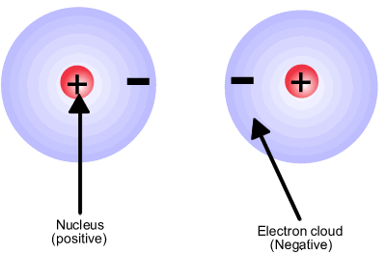
During the course of natural random motion, atoms will collide
with enough force to overcome electron cloud repulsion

Slide 21
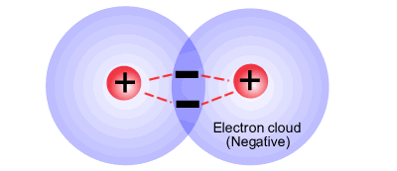
If the two atoms get close enough, the electrons will be in position
to experience a force of attraction from both nuclei
This positive-negative-positive attraction holds the atoms together
This electrostatic attraction constitutes a covalent bond
Note that a covalent bond consists of two electrons

Slide 22
This is how two hydrogen atoms came together in our last lab

Slide 23
This is how two hydrogen atoms came together in our last lab
2p_{x}
2p_{y}
2p_{z}
2p_{x}
2p_{y}
2p_{z}
2s
2s
Now we have a bond
1s
1s
1s
Both have closed shells
Neither has a charge
This is the simplest type of covalent bond

Slide 24
In most cases, the situation is more complicated
For example, carbon by itself has the following electron configuration
1s², 2s², 2p²
The electron configuration diagram looks as follows:
2p_{x}
2p_{y}
2p_{z}
2s
1s

Slide 25
In most cases, the situation is more complicated
For example, carbon by itself has the following electron configuration
1s², 2s², 2p²
The electron configuration diagram looks as follows:
The electrons fill the orbitals as shown
2p_{x}
2p_{y}
2p_{z}
2s
This is optimal for carbon as a solo element,
but not optimal for bonding
1s

Slide 26
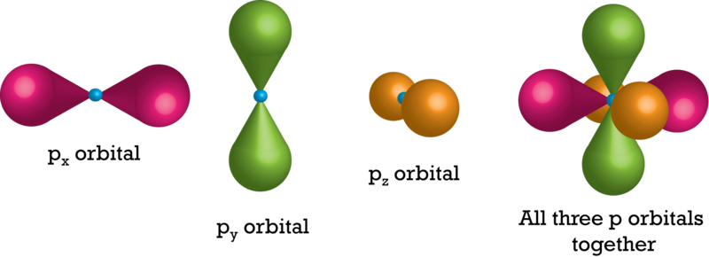
Orbital Theory Background
There are 3 p-orbitals,
one for each dimension,
all at the same energy level
When combined together,
they look as shown
Important to know for what follows

Slide 27
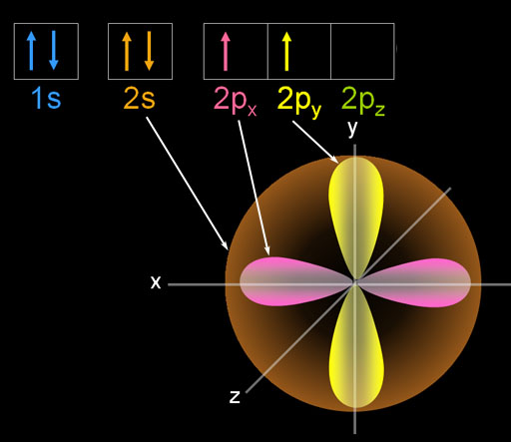
A solo carbon atom has the following electron
configuration and orbitals
This is not good for bonding
It can share electrons in
the 2p_{x} and 2p_{y} orbitals
But it doesn’t have any
electrons to share in
the 2p_{z} orbital
Carbon needs to find
a way to share electrons
so it can get a closed shell

Slide 28
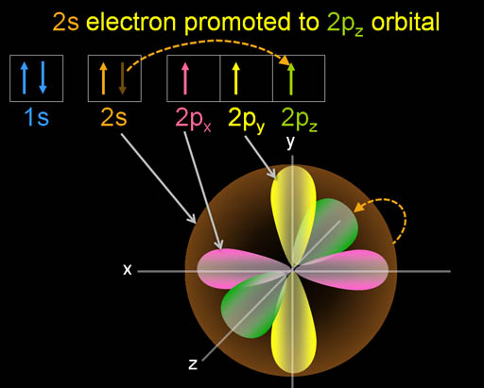
Carbon achieves this through a two step process
1) Carbon promotes a 2s electron to the 2p_{z} orbitals

Slide 29
Carbon achieves this through a two step process
1) Carbon promotes a 2s electron to the 2p_{z} orbitals
2) Carbon blends
the one 2s and three 2p orbitals into new, hybrid sp³ orbitals

Slide 30
In this way, carbon can form bonds with four other atoms
When four hydrogen atoms come along, they can bond to carbon
This gives carbon and all the hydrogens closed shells
without any charge

Slide 32
Figuring out Bonding
As scientists tried to figure out how atoms bonded, they realized they needed an easier way to keep track of the valence electrons of an atom.
Many shorthand methods were created
Today, we are going to learn one of the most useful - Lewis dot structures

Slide 33
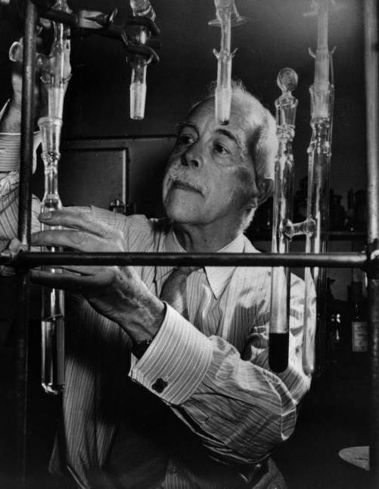
Lewis Dot Structures
Lewis dot structures are used to represent atoms and their valence electrons
When atoms form a bonds, Lewis dot structures can be used to determine the optimum bonding arrangement
Gilbert Lewis, University of California at Berkeley

Slide 34
Counting In The Electrons
Write this in your notes
Lewis dot structures put electrons in 4 imaginary boxes around the atomic symbol
top, bottom, left & right
visualize the boxes, don't draw them
6
2
Each box can hold two electrons
can start filling anywhere
each box gets one electron before any get two electrons
E
1
7
5
3
4
8
No pairing is done until the 5th electron
The unpaired electrons are available for bonding.
The paired electrons are not available for bonding.

Slide 35
Rationale for this Method
The four boxes of a Lewis dot structure represent the four sp³ hybridized orbitals that need to be filled for a closed shell.
The orbitals all get a single electron first in accordance with Hund’s Rule.
E
four sp³ orbitals
The four boxes give us a simple way to count the 8 valence electrons that are needed to get a closed shell
In this way, Lewis dot structures captures some of the key aspects of electron theory.

Slide 36
Drawing Lewis Dot Structures 1
Draw the Lewis Dot Structure for boron

Slide 37
Get Valence Electrons (Ve) from Group Numbers (GN)
Groups 1 – 2
Ve = GN
Groups 13 – 18
Ve = GN – 10

Slide 38
Groups 13 – 18
Ve = GN – 10
How many valence
electrons for B?
3

Slide 39
Drawing Lewis Dot Structures 1
Draw the Lewis Dot Structure for boron
2
B
1
3
B

Slide 40
Drawing Lewis Dot Structures 2
Draw the Lewis Dot Structure for carbon

Slide 41
Groups 13 – 18
Ve = GN – 10
How many valence
electrons for C?
4

Slide 42
Drawing Lewis Dot Structures 2
Draw the Lewis Dot Structure for carbon
2
C
1
3
4
C

Slide 43
Drawing Lewis Dot Structures 3
Draw the Lewis Dot Structure for nitrogen
2
N
1
5
3
4
N

Slide 44
Drawing Lewis Dot Structures 4
Draw the Lewis Dot Structure for fluorine
6
2
F
1
7
5
3
4
F

Slide 45
Check for Understanding 1
Draw the Lewis Dot Structures for
barium (Ba)
germanium (Ge)
arsenic (As)
Ba
Ge
As

Slide 46
Check for Understanding 2
Draw the Lewis Dot Structures for
oxygen (O)
potassium (K)
radon (Rn)
O
K
Rn

Slide 47
Special Case
Write this in your notes
Draw the Lewis Dot Structures for helium (He)
He
He
incorrect
correct
The unpaired electrons are available for bonding.
The paired electrons are not available for bonding.

Slide 48
Valence Electrons & Lewis Dot Structures

Slide 49
Individual Practice
silicon (Si)
argon (Ar)
sodium (Na)
aluminum (Al)
sulfur (S)
bismuth (Bi)
calcium (Ca)
fluorine (F)
hydrogen (H)
helium (He)
Si
Bi
Ar
Ca
Na
F
Al
Careful!!!
H
S
He

Slide 50
Counting In The Electrons
Lewis dot structures put electrons in 4 boxes around the atomic symbol
top, bottom, left right
visualize the boxes, don't draw them
6
2
Each box can hold two electrons
can start filling anywhere
each box gets one electron before any get two electrons
E
1
7
5
3
4
8
No pairing is done until the 5th electron
We can use the Lewis Dot
structure of an element
to help understand its
common bonding
The unpaired electrons are available for bonding.
The paired electrons are not available for bonding.

Slide 51
What is available for bonding?
2
B
1
3
Boron has 3 valence electrons available for bonding

Slide 52
What is available for bonding?
F
1
Fluorine has 1 valence electrons available for bonding

Slide 53
How Many Bonds Can Form?
1
2
3
4
3
2
1
0
The fact that carbon can form 4 bonds is believed to be a major reason why all life is based on the chemistry of carbon

Slide 54
Backup Slides

Slide 55
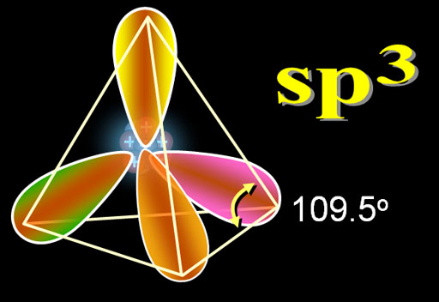
http://www.chemistryland.com/CHM151W/09-CovalentBonds/
http://www.chemistryland.com/StatusPages/Student_Status_151.html

Slide 56
2p_{x}
2p_{y}
2p_{z}
2p_{x}
2p_{y}
2p_{z}
2s
2s
1s
1s
2p_{x}
2p_{y}
2p_{z}
2s
2p_{x}
2p_{x}
2p_{z}
2p_{y}
2p_{z}
2p_{y}
2s
2s
1s
1s
1s

Slide 57
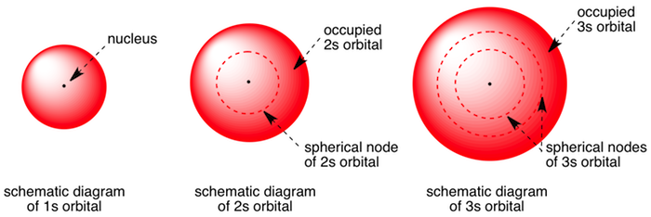

Slide 58
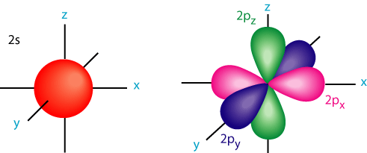

Slide 59
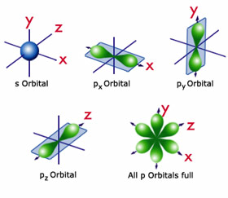

Slide 60
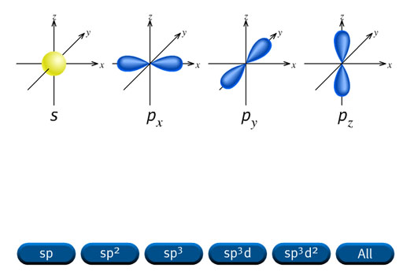

Slide 62
p_{x}
p_{y}
p_{z}
s
four sp³ orbitals

Slide 63
New Curriculum
Unit 7: Bonding Overview
Bonds, bond types & their characteristics
One lesson with a 50 point quiz
Unit 8: Covalent Bonding
Method for predicting covalent bonding in covalent molecules
Longer section with quizzes and a 100 point test
Unit 9: Advanced covalent molecules
Molecular geometry, isomers, skeletal structures and non-bonding interactions
Medium length section with a 100 point test

Slide 64
Simplified
With No Animations

Slide 65
It’s Hard for an Atom to be Happy
H

Slide 66
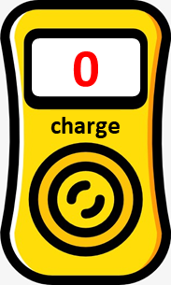
Charges
Hydrogen has 1 proton
It also has 1 electron moving swiftly in the cloud around the proton
The negative charge of the electron spends all of its time around the proton and neutralizing its positive charge
From the outside, the atom appears to have no charge
p⁺
e–

Slide 67
It’s Hard for an Atom to be Happy
0
H
Will stealing an electron to get a closed shell make it happy?
zero
charge
no closed
shell

Slide 68
It’s Hard for an Atom to be Happy
0
H
H
zero
charge
closed
shell
no closed
shell

Slide 69
Charges
e–
p⁺
p⁺
e–
e–
– 1
charge

Slide 70
It’s Hard for an Atom to be Happy
0
-1
H
H
zero
charge
closed
shell
no closed
shell
–1
charge
Neither is Perfect

Slide 71
Bonding Offers Another Solution
H
H
charge
closed
shell

Slide 72
Bonding Offers Another Solution
H
H
If two hydrogen atoms can get close enough, they can share their electrons
Even though the electrons are being shared, the valence orbitals of both atoms are full
This creates something approaching a closed shell for each atom

Slide 73
Bonding Offers Another Solution
H
H
charge
what about charges?
closed
shell

Slide 74
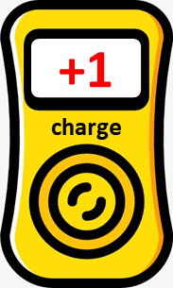
e–
p⁺
p⁺
e–
When one electron is in the green cloud, it neutralizes the left proton
When that electron moves to the violet cloud, the left proton is not neutralized
As the electron moves back and forth, the left proton is neutralized half the time

Slide 75
p⁺
p⁺
Keep in mind, however, there are two electrons being shared
The second electron also neutralizes the left proton, and together with the first electron, completely covers the proton’s charge.
In this way, both hydrogens have no charge

Slide 76
Bonding Offers Another Solution
H
H
charge
closed
shell
Still Not Perfect, but Good

Slide 77
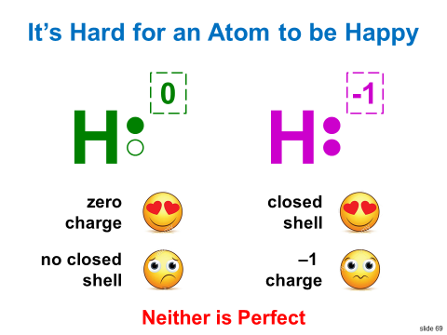
Bonding is Sometimes Best
Sharing electrons through covalent bonds sometimes provides the best solution
Atoms get something approaching a closed shell
Atoms get to minimize the charge they need to carry
Using the covalent bonding method, we will be able to find electron arrangements for the best structures

Slide 79
-
-
+
+
-
-

Slide 80
-
+
+
-

Slide 81
With Animations

Slide 82
H
H
-
-
+

Slide 83
-
+
-
-
+
-

Slide 85
It’s Hard for an Atom to be Happy
0
-1
H
H
zero
charge
closed
shell
0
no closed
shell
–1
charge
charge

