Slide 1
Do Now
Write this in your notes
List Mg, Al and Ca in order of increasing ionization energy
Ca < Mg < Al
Which metal will react most readily in a reaction that involves ionization?
Ca
Lowest ionization energy means most readily lose its electron

Slide 2
Do Now
Write this in your notes
List Mg, Al and Ca in order of increasing ionization energy
Ca < Mg < Al
Which metal will react most readily in a reaction that involves ionization?
Ca
Lowest ionization energy means most readily lose its electron

Slide 3
Do Now
Write this in your notes
List Mg, Al and Ca in order of increasing ionization energy
Ca < Mg < Al
Which metal will react most readily in a reaction that involves ionization?
Ca
Lowest ionization energy means most readily lose its electron

Slide 4
Periodic Trends Lab
Write this in your notes
SWBAT explain how periodic trends are discovered by determining the trends in ionization energy of three different metals

Slide 5
Today's Class
During today's class, we will review the theory behind our next laboratory experiment
You will conduct an experiment to determine the trends in ionization energy among Ca, Mg and Al
You will need to write a lab report on this experiment
Take notes so you are prepared to conduct this lab and write your lab report

Slide 6
Lab Report
Full lab report due on March 31st
The grade will be part of the 4th Quarter
The lab report must be submitted online through Turnitin
NO EXCEPTIONS DUE TO TECHNICAL DIFFICULTIES
If you have difficulties with online submission, plan to come to Department Night on Mar 30
LATE PENALTIES WILL BE APPLIED

Slide 7
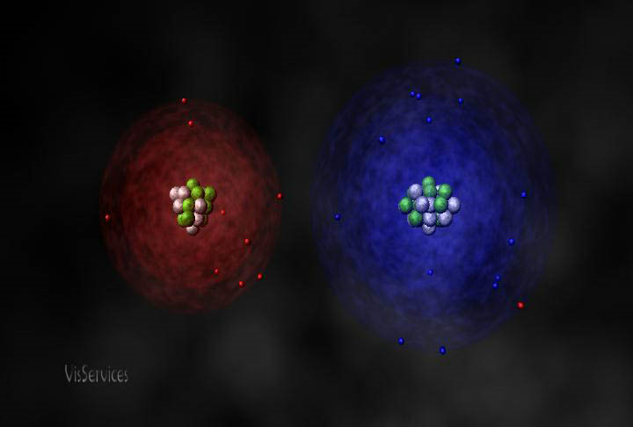
Ionization Energy
+
How much energy does it take to steal an electron away?

Slide 8
Ionization Energy - Definition
The energy required to remove an electron from an atom's electron configuration
first electron - first ionization energy
second electron - second ionization energy
etc.
How do scientists find out about periodic trends for ionization energy?

Slide 9
Do Now
Write your answer to each question
What is the purpose of this lab?
How are you going to accomplish this purpose?
What are you going to use as an "electron thief"?

Slide 10
Determining Ionization Energy
Find a reaction for which the rate is dependent upon removal of electrons
Run this reaction with a variety of different elements
The element that reacts the fastest has the lowest ionization energy
The element that reacts the slowest has the highest ionization energy
Write this in your notes

Slide 11
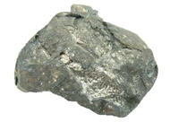

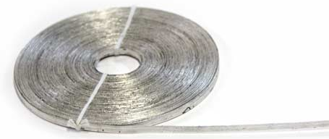
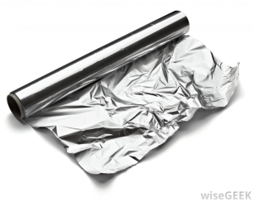
Our Experiment
calcium metal
electron thief
Whichever one reacts the most vigorously has the lowest ionization energy
magnesium ribbon
electron thief
Which one has the lowest ionization energy?
video (go to 1:10)
aluminum foil
electron thief

Slide 12
Electron Thief
Write this in your notes
Mg + H⁺ Mg⁺ + H
H⁺ can steal electrons from metals
How fast depends on two things
One is the concentration of H⁺
The other is how much energy it takes to remove the electron from the metal
This is ionization energy

Slide 13
Electron Thieving In Progress
3p
3p
3s
3s
2p
2p
2s
2s
1s
1s
1s
1s
Mg + H⁺ Mg⁺ + H
3p
3p
3s
3s
2p
2p
2s
2s
1s
1s
1s
1s
Mg⁺ + H⁺ Mg⁺² + H

Slide 14
Where do we get H⁺?
We can get H⁺ from neutral water
If we want greater concentrations, we can use acid

Slide 15
Acid-Base Theory
Write this in your notes
[X] = concentration of X
Acid
Increases [H⁺] in water
Base
Decreases [H⁺] in water
Often by increasing [OH‒] which reacts with H⁺ to make more water

Slide 16
Acid-Base in Water
Write this in your notes
H₂O H⁺ + OH‒
H₂O
Water will spontaneously break up into ions
Only a little bit of this "dissociation" occurs
The ions prefer to join back together into H₂O
Normally, [H⁺] is 1.0 x 10⁻⁷ M in H₂O

Slide 17
pH Scale
Write this in your notes
H₂O H⁺ + OH‒
A pH scale is used to indicate [H⁺]
pH means " ‒ log [H⁺] "

Slide 18
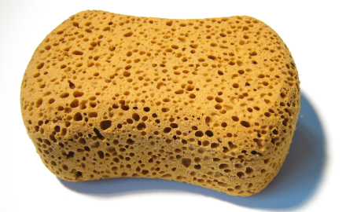
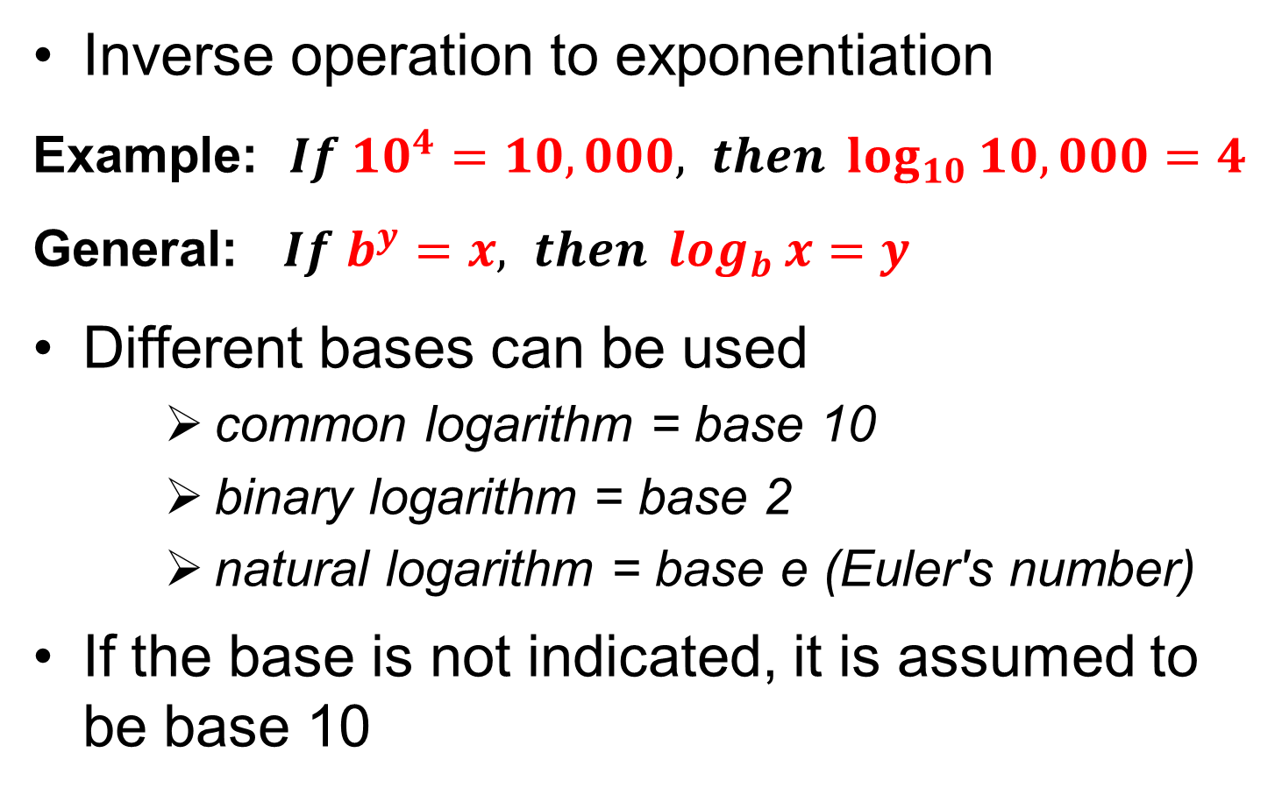
Logarithm
Inverse operation to exponentiation
Example: $If {10}^{4}=10,000, then \log_{10}{10,000=4}$
General: $If b^{y}=x, then \log_{b}{x=y}$
Different bases can be used
common logarithm = base 10
binary logarithm = base 2
natural logarithm = base e (Euler's number)
If the base is not indicated, it is assumed to be base 10

Slide 19
Common Logarithms
To what number does 10 need to be raised to get X?
X | = 10? | log X

Slide 20
Common Logarithms
To what number does 10 need to be raised to get X?
X | = 10? | log X
1 | = 10⁰ | 0

Slide 21
Common Logarithms
To what number does 10 need to be raised to get X?
X | = 10? | log X
1000 | = 10³ | 3
100 | = 10² | 2
10 | = 10¹ | 1
1 | = 10⁰ | 0

Slide 22
Common Logarithms
To what number does 10 need to be raised to get X?
X | = 10? | log X
1000 | = 10³ | 3
100 | = 10² | 2
10 | = 10¹ | 1
1 | = 10⁰ | 0
0.1 | = 10^{‒1} | ‒1
0.01 | = 10^{‒2} | ‒2
0.001 | = 10^{‒3} | ‒3

Slide 23
pH means " ‒ log [H⁺] "
In neutral water, [H⁺] is 1.0 x 10⁻⁷ M
log (1.0 x 10⁻⁷) = ‒7
‒ log (1.0 x 10⁻⁷) = 7
Neutral water has a pH of 7
The bigger the pH, the lower [H⁺]
If pH = 1, [H⁺] = 0.1 mol/L
If pH = 9, [H⁺] = 0.0000000001 mol/L
Write this in your notes

Slide 24
pH Scale
Write this in your notes
H₂O H⁺ + OH‒
A pH scale is used to indicate [H⁺]
pH means " ‒ log [H⁺] "
The pH of neutral water is 7

Slide 25
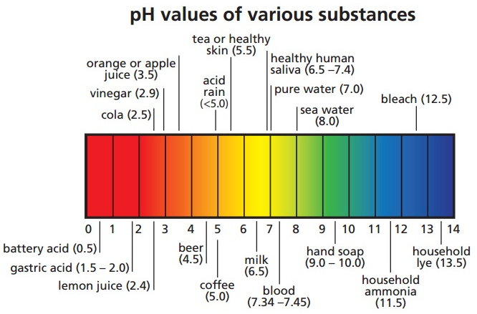

Slide 26
pH of an Acid
Write this in your notes
HCl H⁺ + Cl‒
Hydrochloric acid breaks into ions a lot more
In this lab, we will use HCl with [H⁺] = 0.5 M
‒ log (0.5) = 0.3
Thus, HCl has a pH of 0.3
This is 5 million times more H⁺ than water

Slide 27
Mechanism of Reaction
Write this in your notes
2H₂O 2H⁺ + 2OH‒
Mg + H⁺ Mg⁺ + H
Mg⁺ + H⁺ Mg⁺² + H
H + H H₂
overall reaction
Mg + 2H₂O Mg⁺² + H₂ + 2OH‒
With HCl, Cl‒ will take the place of OH‒

Slide 28
How to Detect a Reaction
Write this in your notes
Mg + 2H₂O Mg⁺² + H₂ + 2OH‒
Bubbling (H₂ is a gas)
Flame test (H₂ is explosive)
Litmus test (OH‒ is basic)
Heat (reaction is exothermic)
You will look for these during lab

Slide 29
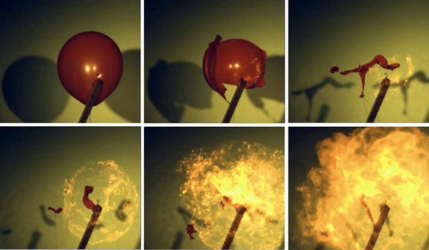
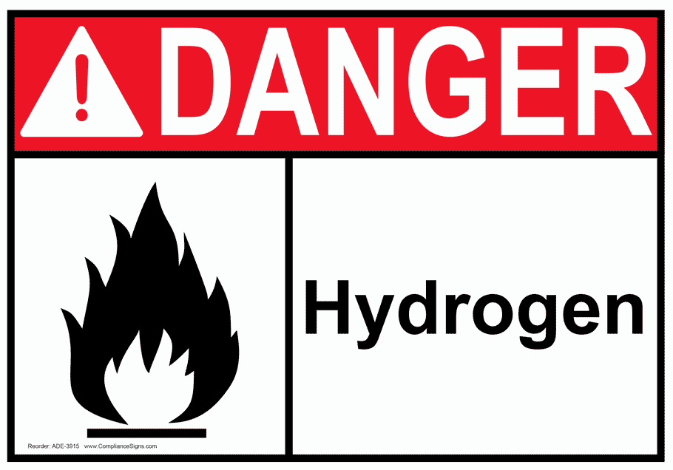
Flame Test
When H₂ gas comes in contact with a flame, it explodes with a popping noise
We will use a lit match to test for the production of H₂ gas
This test is optional
Video 0:26

Slide 30
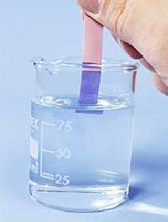
Litmus Paper
Test for pH of water
Red litmus paper will turn blue if the water is basic (pH > 8.3)
Allows us to test for production of OH‒

Slide 31


Slide 32
Safety Alerts
Write this in your notes
Wear glasses & gloves at all times
Be prepared for vigorous reactions
Use the correct amount of metal
HCl is corrosive
H₂ gas is explosive
Dispose of all metal in metal waste
No horseplay. Take this lab seriously or you will be out.

Slide 33
Proper Dress
No contact lenses (wear glasses)
No skirts or shorts
Shoes must cover the foot
Hair must be tied back or put up
Dangling jewelry must be removed
No loose or baggy clothing
Push up or roll up sleeves

Slide 34
Make Lab Teams
2-3 students per team

Slide 35
Procedure
General Guidelines

Slide 36
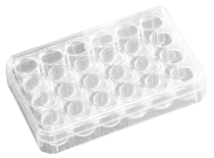
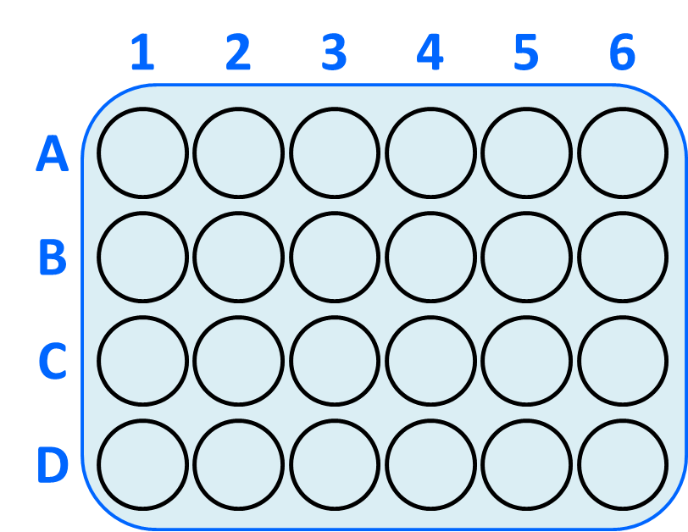
Get a 24 well plate
Clean and dry it
Add 20 drops of water into each cell A1 - A3
Test pH of each cell with litmus paper

Slide 37
calcium metal
magnesium ribbon
aluminum foil
Weigh out approximately 0.05 g of each metal
Add first metal to cell A1 and watch for any reaction
Retest pH of cell with litmus paper
Repeat for the other two metals

Slide 38
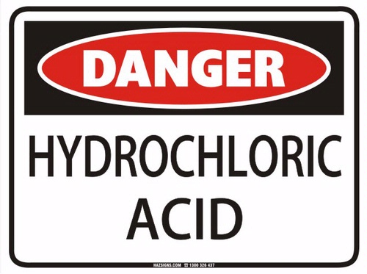
Add 20 drops of 0.5 M HCl each into cells C1-C3
Weigh out another 0.05 g of each metal
Add first metal to cell C1 and observe

Slide 39
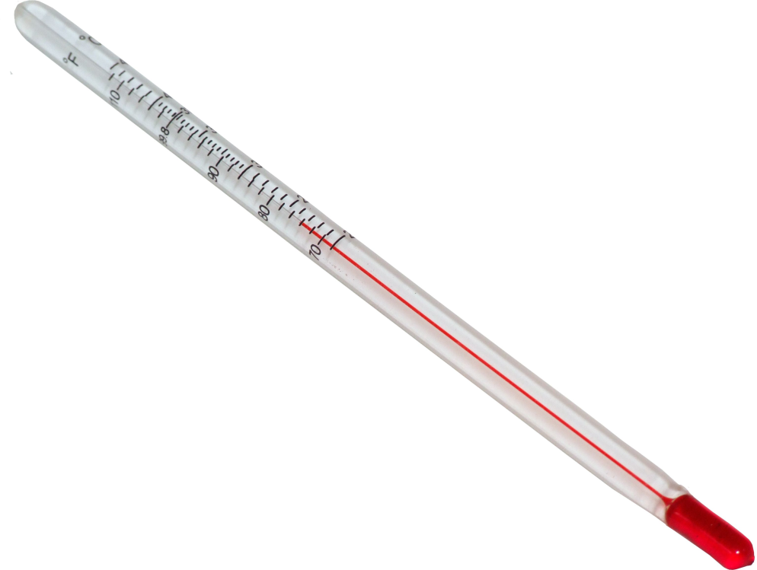
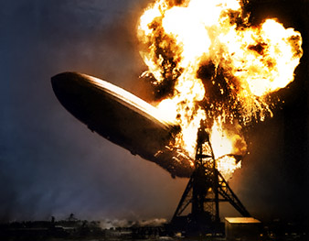
Check for rise in temperature
Hold a lit match over cell & observe
Repeat for the other two metals

Slide 40
Clean-up
Put all metal & surrounding fluids in metal waste
Wash out plate and put it out to dry
Put all matches into designated beaker
Throw out all trash
Wash off bench
Throw out gloves and wash hands with soap
Put away glasses

Slide 41
Questions???

Slide 42
Backup Slides

Slide 43
Periodic Trends
Atomic Radius
Ionic Radius
Ionization Energy
Electronegativity

Slide 44
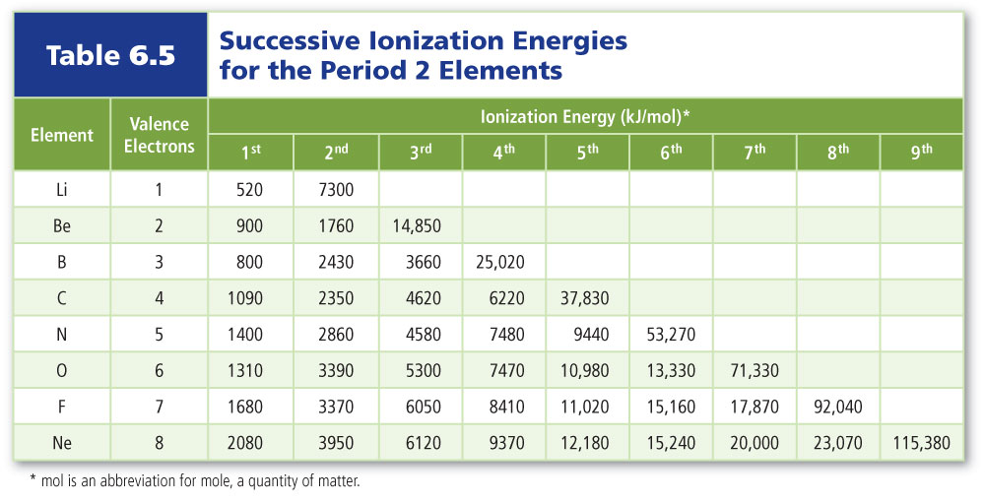
Ionization Energy

Slide 45
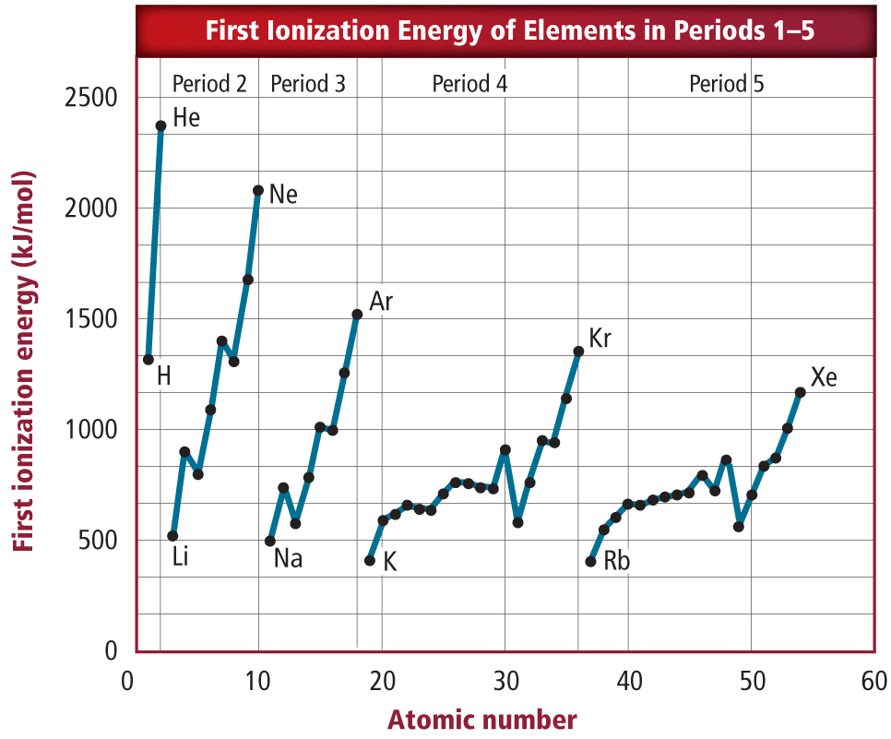
Ionization Energy

Slide 46
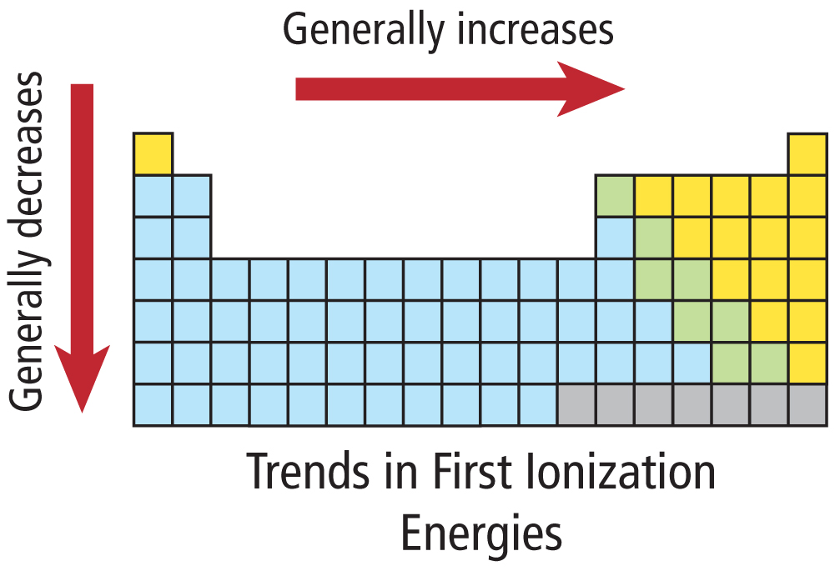
Ionization Energy - Periodic Trends

Slide 47
Ionization Energy
Rationale for Periodic Trends
Write this in your notes
Increase going left to right
Atoms on the left want to lose electrons because it gets them closer to a noble gas
Atoms on the right hate to lose electrons because it gets them farther from a noble gas
Decrease going top to bottom
Electrons are farther from nucleus, so they are held more loosely and are more easily removed

Slide 48

Summary of Periodic Trends
NE Greatest
Ionization Energy
Electronegativity
F
Ra
SW Greatest
Atomic Radius
Ionic Radius
SW Greatest
Atomic Radius
Ionic Radius

Slide 49
3p
3s
2p
2s
Electron Configuration Notation
1s², 2s², 2p⁶, 3s²
1s

Slide 50
3p
3s
2p
2s
1s

Slide 51
Mechanism of Reaction
Write this in your notes
Mg + 2H₂O Mg⁺² + H₂ + 2OH‒
2H₂O 2H⁺ + 2OH‒
Mg + H⁺ Mg⁺ + H
Mg⁺ + H⁺ Mg⁺² + H
H + H H₂

Slide 53
1
2
3
4
5
6
A
B
C
D

