Slide 1
Do Now
In our school, the bell rings between classes.
At what times does the bell ring?
Why does the bell ring at those times?

Slide 2
Do Now
In our school, the bell rings between classes.
At what times does the bell ring?
Morning: 9:50, 9:54, 9:55
Afternoon: 1:15, 1:19, 1:20
Why does the bell ring at those times?
End of class
1 minute until class begins
Class begins
This is a periodic trend
There is a reason this happens

Slide 3
Test 7 - Periodic Trends
Dates:
Honors Chemistry Test
  10 multiple choice questions
  20 open response questions
Chemistry Test
  10 multiple choice questions
  15 open response questions

Slide 4
Periodic Trends
SWBAT explain the major periodic trends and the rationale for each of them.
Write this in your notes

Slide 5
Outline
We will learn 4 periodic trends
  Atomic radius
  Ionic radius
  Ionization energy
  Electronegativity
For each trend, we will
  learn the definition
  learn the periodic trends
  review rationale for trend
  practice problems

Slide 6
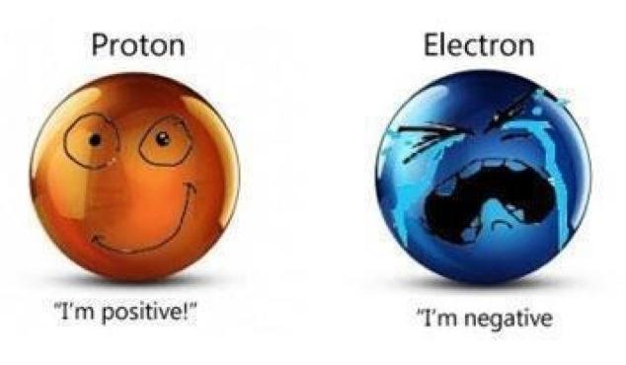
Protons and Electrons
"

Slide 7
Factors Driving Periodic Trends
Periodic trends are driven by 4 factors (in order of impact)
stability of the closed shell
distance from nucleus to an electron
charges in nucleus attracting an electron
repulsion of electron by other electrons (also called shielding)
Write this in your notes

Slide 8
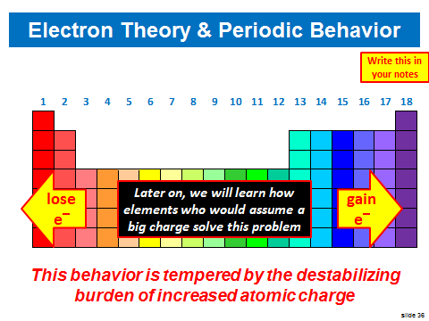
Closed Shell

Slide 9
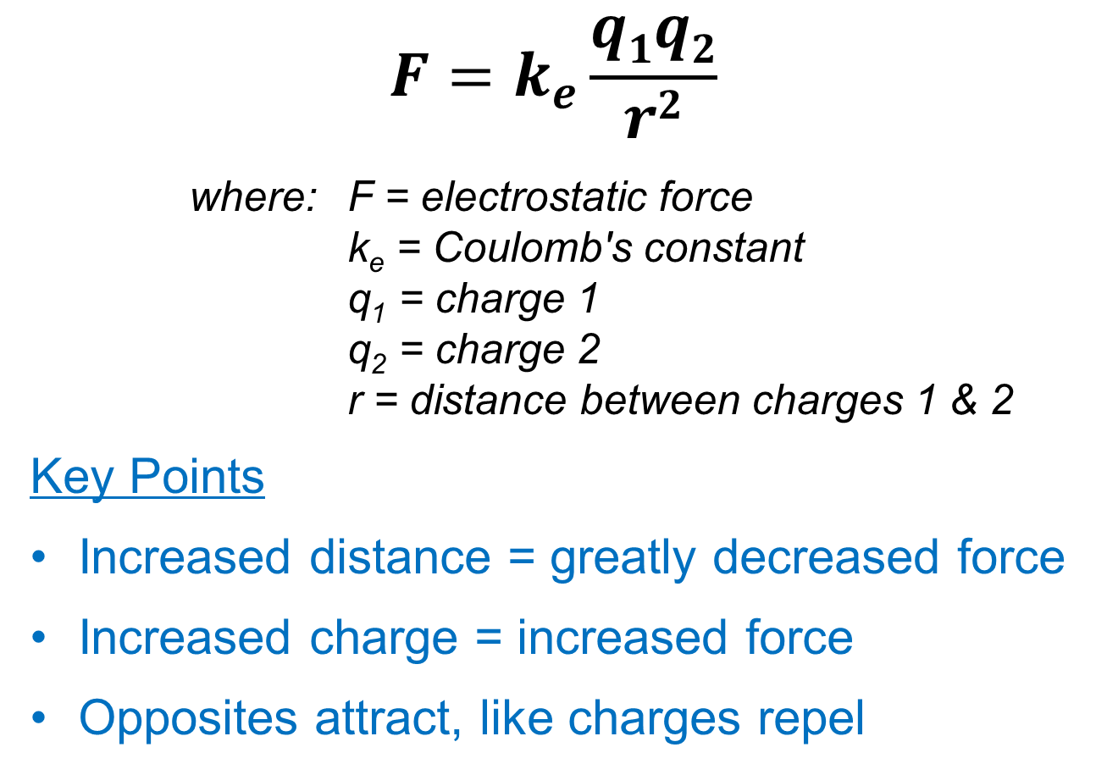
Coulomb's Law
$$F=k_{e}\frac{q1q2}{r2}$$
where: F = electrostatic force
k_{e} = Coulomb's constant
q₁ = charge 1
q₂ = charge 2
r = distance between charges 1 & 2
Key Points
Increased distance = greatly decreased force
Increased charge = increased force
Opposites attract, like charges repel

Slide 10

Increased Distance = Decreased Force
Write this in your notes
In the 1s orbital, the distance is small so the force is large
e¯
H 1s
+
In the 2s orbital, the distance is 2x larger so the force is 4x smaller
H 2s
e¯
+
H 3s
In the 3s orbital, the distance is 3x larger so the force is 9x smaller
e¯
+
Actual ratios size ratios for H : Li : Na are 1.0 : 5.8 : 7.2 (measured atomic radius)

Slide 11
Increased Charge = Increased Force
Write this in your notes
Na⁺¹
Na⁺¹ has 11 protons which attracts the electron in its cloud
+
+
+
e¯
+
+
+
+
+
Mg⁺² has an increase in charge, so an increase in attraction force
Mg⁺²
+
+
+
e¯
+
+
+
+
+
+
Al⁺³ has an increase in charge, so an increase in attraction force
+
+
+
e¯
Al⁺³
+
+
+
+
+
+
+
Actual ionic radii are 102 pm, 72 pm and 54 pm, respectively

Slide 12
Opposites Attract, Like Charges Repel
Write this in your notes
The proton and electron attract each other & make a certain sized orbital
e¯
+

Slide 13
Opposites Attract, Like Charges Repel
Write this in your notes
The proton and electron attract each other & make a certain sized orbital
e¯
If a 2nd electron enters the cloud, it repels the first electron
e¯
+

Slide 14
Opposites Attract, Like Charges Repel
Write this in your notes
The proton and electron attract each other & make a certain sized orbital
e¯
If a 2nd electron enters the cloud, it repels the first electron
e¯
+
As a result, the orbital grows slightly larger than before

Slide 15
Check for Understanding 1
We are trying to steal electrons away from potassium. Which is easier to steal, an electron in the 1s orbital, or an electron in the 4s orbital? Explain your answer.
The electron in the 4s orbital
As the primary quantum number increases, so does the radius of the orbital. Thus the 4s electrons are farther away than 1s electrons
As distance increases, the electrostatic forces decrease.

Slide 16
Check for Understanding 2
Which atom is smaller, Rb⁺¹ or Sr⁺²?
Sr⁺²
Both have 4p as their outermost orbital, so the distance from the nucleus is the same
Both have the same number of electrons (36)
Sr has 38 protons, while Rb has 37. Since Sr has a greater charge in its nucleus, it attracts its electrons more and thus is smaller

Slide 17
Check for Understanding 3
Which atom holds its outermost electron the strongest, Ne or Na?
Ne
Ne has a closed shell. To remove an electron would make it much less stable.
Na has one electron more than a closed shell. To remove an electron would make it much more stable.

Slide 18
Factors Driving Periodic Trends
Periodic trends are driven by 4 factors (in order of impact)
stability of the closed shell
distance from nucleus to an electron
charges in nucleus attracting an electron
repulsion of electron by other electrons (also called shielding)
Try to use these to understand why the periodic trends occur

Slide 19
Periodic Trends
Atomic Radius
Ionic Radius
Ionization Energy
Electronegativity

Slide 20
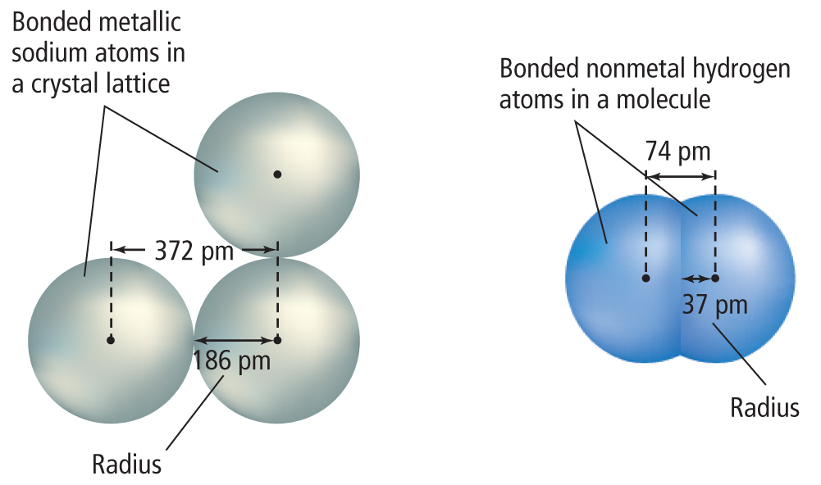
Atomic Radius - Definition
Write this in your notes
The size of an atom
Estimated as half the distance between the nuclei of two identical atoms bonded to each other

Slide 21
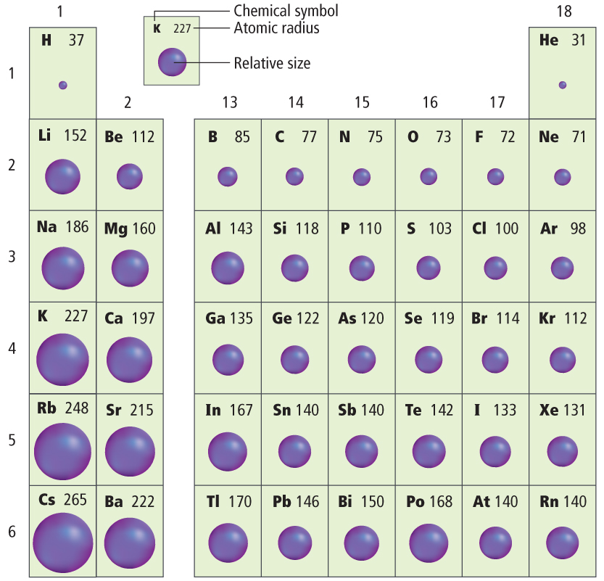
Atomic Radius

Slide 22
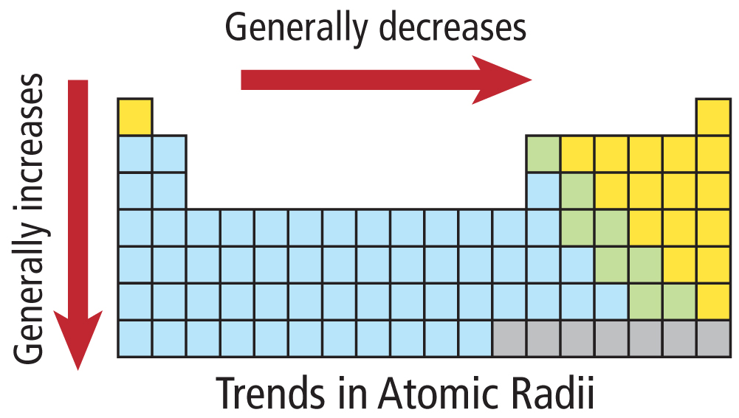
Atomic Radius - Periodic Trends

Slide 23
Atomic Radius
Rationale for Periodic Trends
Write this in your notes
Decrease going left to right
Distance is constant, but charges in the nucleus increase.
Increase going top to bottom
Distance grows with increase in the principle quantum number

Slide 24
Check for Understanding
Between Cs and Li, which has a greater atomic radius?

Slide 25
Atomic Radius
Rationale for Periodic Trends
Decrease going left to right
Distance is constant, but charges in the nucleus increase.
Increase going top to bottom
Distance grows with increase in the principle quantum number

Slide 26
Check for Understanding
Between Cs and Li, which has a greater atomic radius?
Cs and Li are in the same group
atomic radius increases from top to bottom
Cs > Li

Slide 27
Periodic Trends
Atomic Radius
Ionic Radius
Ionization Energy
Electronegativity

Slide 28
Ionic Radius - Definition
Write this in your notes
The size of an atom when it has the charge necessary to achieve a full set of valence electrons (a closed shell)

Slide 29
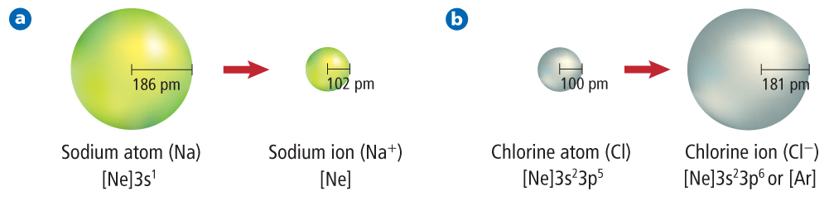
Atomic vs Ionic Radius
Atoms that become cations get smaller
  Larger ratio of protons to electrons
  Fewer electrons to repel each other

Slide 30
Atomic vs Ionic Radius
Atoms that become cations get smaller
  Larger ratio of protons to electrons
  Fewer electrons to repel each other
Atoms that become anions get bigger
  Smaller ratio of protons to electrons
  More electrons to repel each other
Atoms that become cations get smaller
  Larger ratio of protons to electrons
  Fewer electrons to repel each other

Slide 31
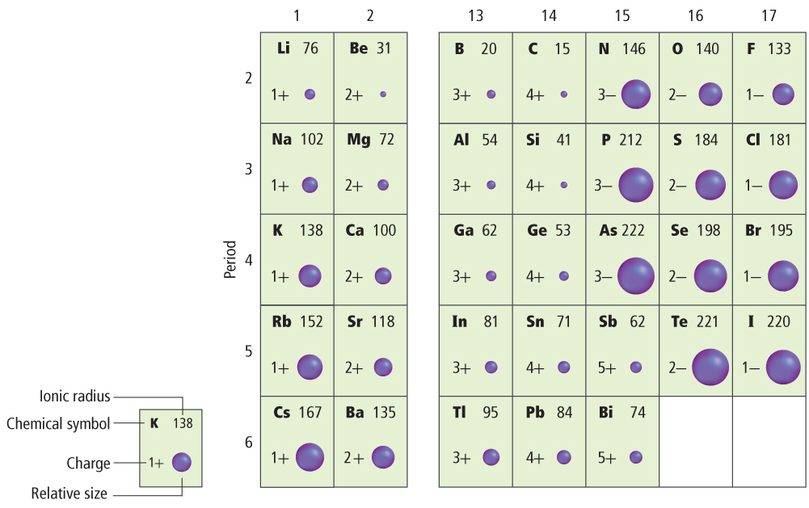
Ionic Radius
(for closed shells)

Slide 32
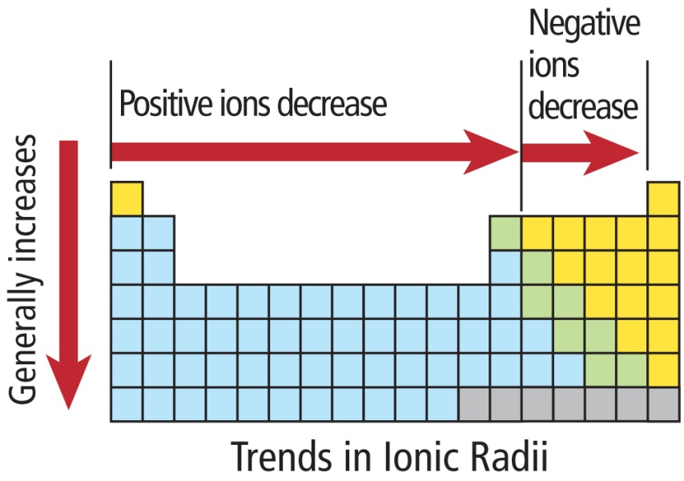
Ionic Radius - Periodic Trends

Slide 33
Ionic Radius
Rationale for Periodic Trends
Write this in your notes
Decrease going left to right
Ratio of protons to electrons rises for both cations and anions
Increase going top to bottom
Distance grows with increase in the principle quantum number

Slide 34
Do Now
Try to answer these without your notes
What are the four drivers for periodic properties?
What are the periodic trends for atomic radius?
What is the definition of ionic radius?

Slide 35
Periodic Trends
Atomic Radius
Ionic Radius
Ionization Energy
Electronegativity

Slide 36
Ionization Energy - Definition
The energy required to remove an electron from an atom's electron configuration
first electron - first ionization energy
second electron - second ionization energy
etc.
Write this in your notes

Slide 37
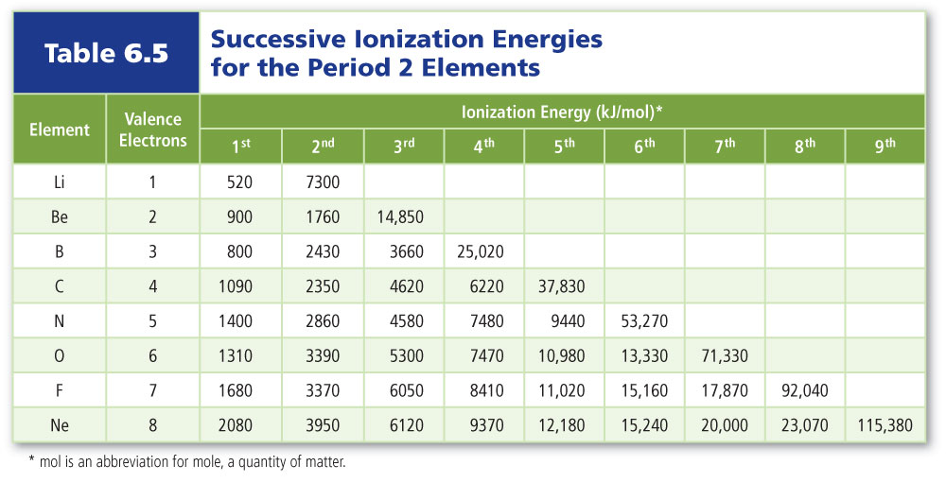
Ionization Energy

Slide 38
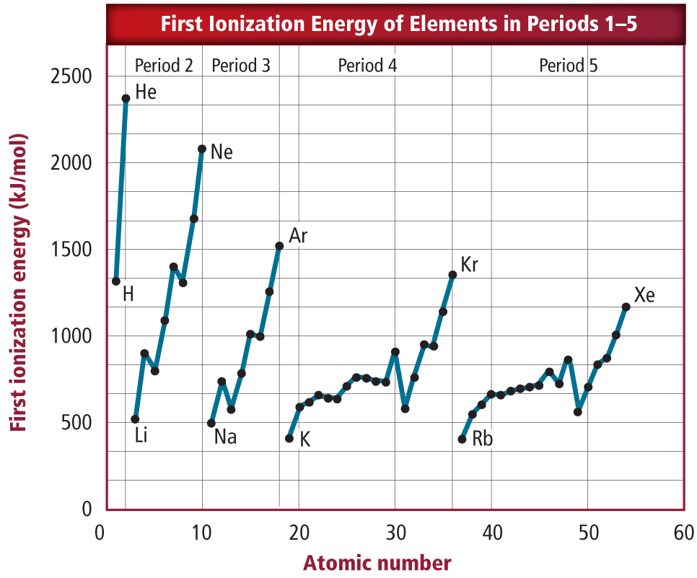
Ionization Energy

Slide 39
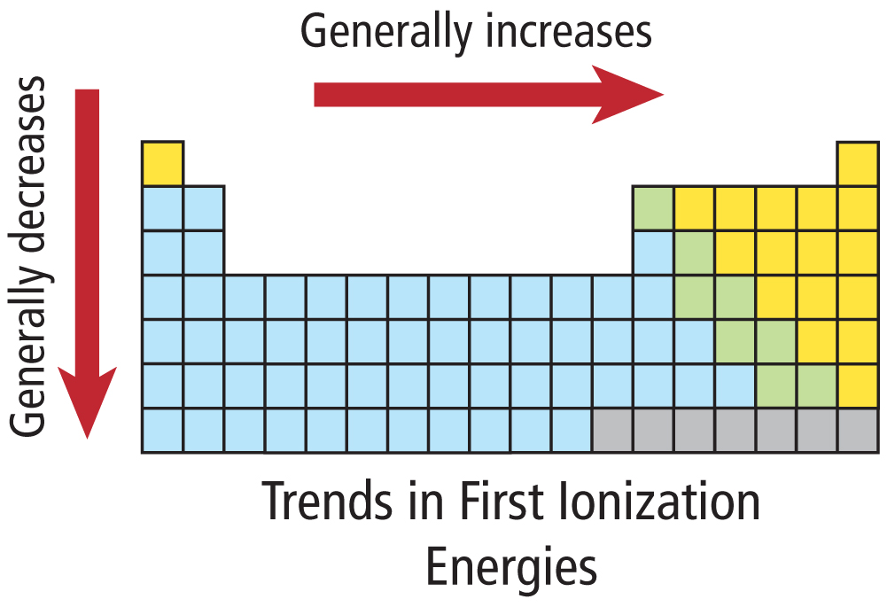
Ionization Energy - Periodic Trends

Slide 40
Ionization Energy
Rationale for Periodic Trends
Write this in your notes
Increase going left to right
Atoms on the left want to lose electrons because it gets them closer to a noble gas
Atoms on the right hate to lose electrons because it gets them farther from a noble gas
Decrease going top to bottom
Electrons are farther from nucleus, so they are held more loosely and are more easily removed

Slide 41
Periodic Trends
Atomic Radius
Ionic Radius
Ionization Energy
Electronegativity

Slide 42
Electronegativity - Definition
The ability to attract an extra electron while participating in a chemical bond
Write this in your notes

Slide 43
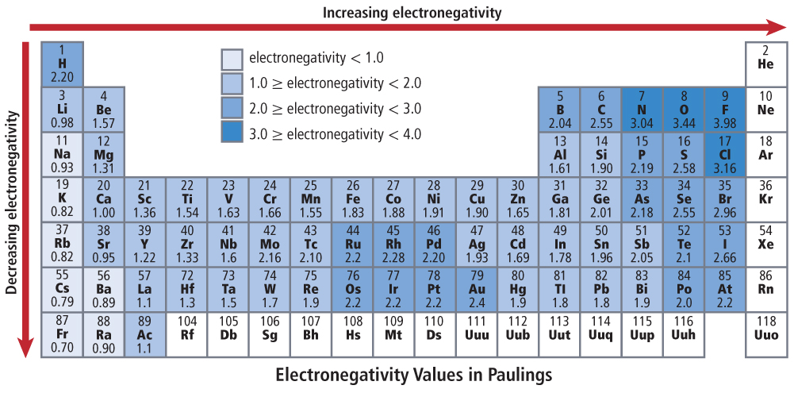
Electronegativity - Periodic Trends

Slide 44
Electronegativity
Rationale for Periodic Trends
Write this in your notes
Increase going left to right
Atoms on the left hate to gain electrons because it gets them farther from a noble gas
Atoms on the right want to gain electrons because it gets them closer to a noble gas
Decrease going top to bottom
Gained electrons are farther from nucleus, so the electrostatic attraction is decreased

Slide 45
Summary of Periodic Trends
Write this in your notes
Electronegativity & Ionization Energy
Atomic Radius & Ionic Radius
Electronegativity & Ionization Energy
Atomic Radius & Ionic Radius

Slide 46
Check for Understanding
Between F and Li, which has a greater atomic radius?

Slide 47
Check for Understanding
Between F and Li, which has a greater atomic radius?
Li and F are in the same period
atomic radius decreases from left to right
Li > F

Slide 48
Atomic Radius

Slide 49
Check for Understanding
Between B and Li, which has a greater ionic radius?

Slide 50
Ionic Radius - Periodic Trends

Slide 51
Check for Understanding
Between B and Li, which has a greater ionic radius?
Li and B are in the same period
ionic radius decreases from left to right
Li > B

Slide 52
Ionic Radius

Slide 53
Check for Understanding
Between Be and Ba, which has a greater electronegativity?
Be and Ba are in the same group
electronegativity decreases from top to bottom
Be > Ba

Slide 55
Check for Understanding
Between C and Sn, which has a greater ionic radius?
C and Sn are in the same group
ionic radius increases from top to bottom
Sn > C

Slide 56
Ionic Radius

Slide 57
Check for Understanding
List the elements K, Cs, & Br in increasing order of atomic radius
K and Br are in the same period
Atomic radius decreases from left to right
Br < K
K and Cs are in the same group
Atomic radius increases from top to bottom
K < Cs
Br < K < Cs

Slide 58
Atomic Radius

Slide 59
Check for Understanding
List the elements Ra, Se, & Ca in increasing order of electronegativity
Ca and Se are in the same period
Electronegativity increases from left to right
Ca < Se
Ca and Ra are in the same group
Electronegativity decreases from top to bottom
Ra < Ca
Ra < Ca < Se

Slide 60
Electronegativity - Periodic Trends

Slide 62
Online Homework
drmccarthyscience.weebly.com
Chemistry ---> Periodic Properties
0611 - WS Periodic Trends
Reminder about online homework
Everyone gets a different set of questions
Must be completed prior to test
Completion and grade automatically recorded
Answers will be shared online prior to test

Slide 63
Summary of Periodic Trends
Electronegativity & Ionization Energy
Atomic Radius & Ionic Radius
Electronegativity & Ionization Energy
Atomic Radius & Ionic Radius

Slide 64
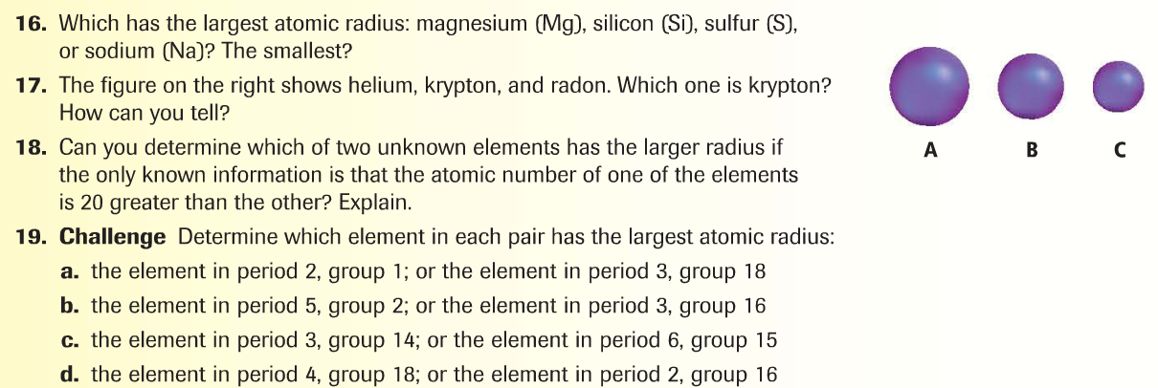

Slide 65
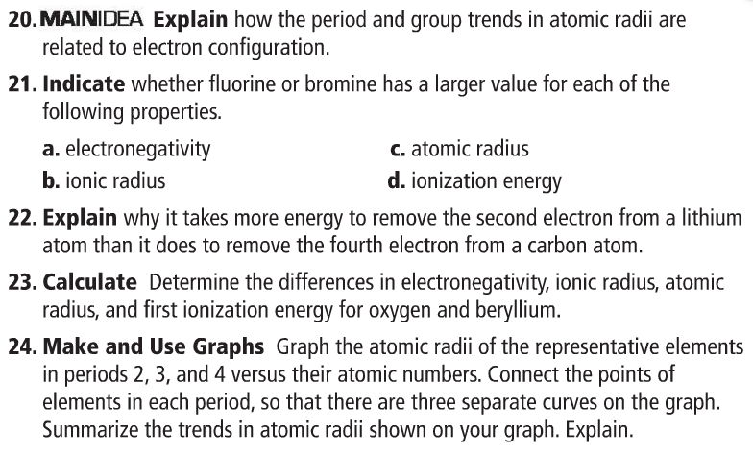

Slide 66
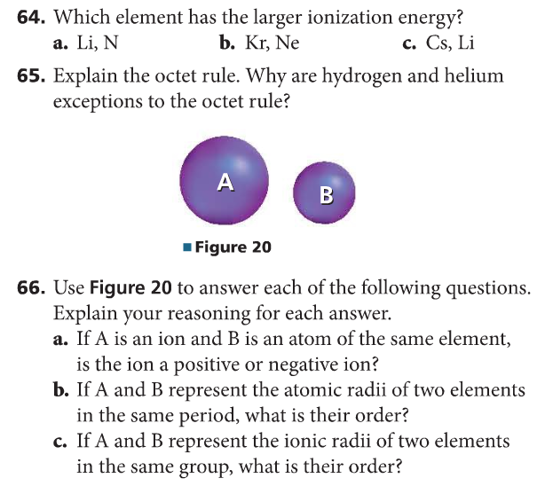

Slide 67
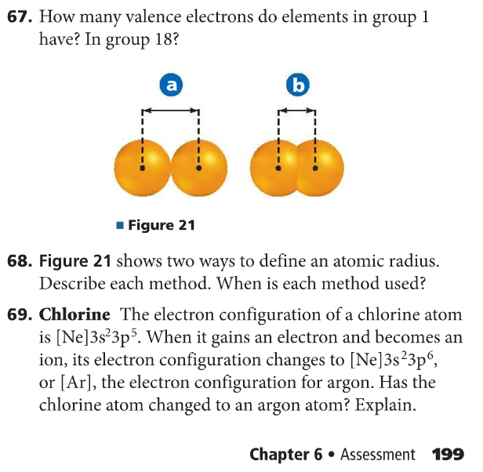

Slide 68
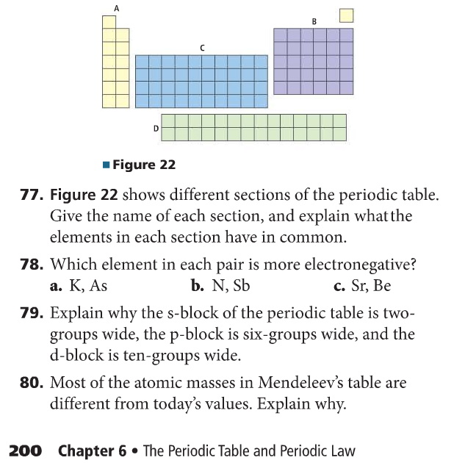

Slide 69
Backup Slides

Slide 70
Periodic Trends
Property | Left to Right | Top to Bottom
atomic radius | decrease | increase
ionic radius | decrease | increase
ionization energy | increase | decrease
electronegativity | increase | decrease

Slide 71
Atomic Radius - Definition
Write this in your notes
The size of an atom
Estimated as half the distance between the nuclei of two identical atoms bonded to each other

Slide 72
name | explanation
Charge | Increased charge results in increased attractive force
Distance | Increased distance between charges decreases attractive force
Shielding | Electrons in cloud repel each other and counter the attractive force of the nucleus

Slide 73
+
‒

Slide 74
+
‒
+
+
‒
+
‒
+
‒
‒
+
‒

Slide 75
+
‒
+
+
‒
+
‒
+
‒
‒
+
‒

Slide 77
−
+
e¯
e¯

Slide 78
Book Homework
pg 189, problems 16 & 17
pg 194, problem 21
pg 199, problems 64, 66 & 69
pg 200, problem 78

