Slide 1
Do Now
Put homework in the red basket
Name three things that are reactive
example: gasoline
Name three things that are unreactive
example: salt
Why are some things reactive while others are not?

Slide 2
Do Now Review
A material that has high reactivity has low stability
Relationship between energy and stability
Low energy is high stability
High energy is low stability
Therefore:
High reactivity is high energy

Slide 3
Electron Theory & Periodic Behavior
SWBAT explain periodic behavior in terms of electron theory
Write this in your notes

Slide 4
Why Periodic Behavior?
Winter is a periodic property
because it is related to how long it takes for the earth to travel around the sun
Telephone poles are a periodic property
because it is related to how far wire can be stretched without support
Chemical and physical behaviors of elements are periodic properties
because they are related to the electron configurations of the elements
write this in your notes

Slide 5
Valence Electrons
Write this in your notes
Valence electrons - the electrons in the outermost principal quantum level of an atom
These are the electrons that participate in bond formation
As a result, valence electrons determine the chemical properties of an element

Slide 6
Example 1
Steps of process
Write the electron configuration
Identify the highest principle quantum number
Add up all of the superscripts
How many valence electrons does Ne have?
1s², 2s², 2p⁶
1s², 2s², 2p⁶
Neon has 8 valence electrons

Slide 7
Example 2
Steps of process
Write the electron configuration
Identify the highest principle quantum number
Add up all of the superscripts
How many valence electrons does O have?
1s², 2s², 2p⁴
1s², 2s², 2p⁴
Oxygen has 6 valence electrons

Slide 8
Example 3
Notice the e‒
in the 3d-orbital are not included
Steps of process
Write the electron configuration
Identify the highest principle quantum number
Add up all of the superscripts
How many valence electrons does Br have?
1s², 2s², 2p⁶, 3s², 3p⁶, 4s², 3d¹⁰, 4p⁵
1s², 2s², 2p⁶, 3s², 3p⁶, 4s², 3d¹⁰, 4p⁵
Bromine has 7 valence electrons

Slide 9
Example 4
Notice the e‒ in
the 4f- and 5d-orbitals
are not included
Steps of process
Write the electron configuration
Identify the highest principle quantum number
Add up all of the superscripts
How many valence electrons does Pb have?
[Xe] 6s², 4f¹⁴, 5d¹⁰, 6p²
[Xe] 6s², 4f¹⁴, 5d¹⁰, 6p²
Lead has 4 valence electrons

Slide 10
Common Error
Students sometimes say that valence electrons are the electrons in the highest s- and p-orbitals.
1s², 2s², 2p⁶, 3s², 3p⁶, 4s²
1s², 2s², 2p⁶, 3s², 3p⁶, 4s²
1s², 2s², 2p⁶, 3s², 3p⁶, 4s²
1s², 2s², 2p⁶, 3s², 3p⁶, 4s²
Calcium has 8 valence electrons
Calcium has 2 valence electrons
WRONG
RIGHT

Slide 11
Individual Practice
How many valence electrons for each element?
nitrogen
aluminum
tin
bismuth
rubidium

Slide 12
Individual Practice
How many valence electrons for each element?
nitrogen 5
aluminum
tin
bismuth
rubidium

Slide 13
Individual Practice
How many valence electrons for each element?
nitrogen 5
aluminum 3
tin
bismuth
rubidium

Slide 14
Individual Practice
How many valence electrons for each element?
nitrogen 5
aluminum 3
tin 4
bismuth
rubidium

Slide 15
Individual Practice
How many valence electrons for each element?
nitrogen 5
aluminum 3
tin 4
bismuth 5
rubidium

Slide 16
Individual Practice
How many valence electrons for each element?
nitrogen 5
aluminum 3
tin 4
bismuth 5
rubidium 1

Slide 17
Reading the Periodic Table
Write this in your notes
For main group elements, the number of valence electrons is number in front of the "A"
How many valence
electrons for Be?
How many valence
electrons for C?
How many valence
electrons for Br?
2
4
7

Slide 18
Key Exception
Write this in your notes
Helium has 2 valence electrons

Slide 19
Valence Electrons are the same within each Group Write this in your notes

Slide 20
Transition & Inner-Transition Metals
You will not need to know the number of valence electrons for these families
With these elements, the d-orbital electrons sometimes participate in bond formation and are thus considered valence electrons
These elements have multiple ways of configuring their electron configurations to improve stability
As a result, many of these elements are capable of have different number of valence electrons depending upon the situation

Slide 21
Valences of Transition Metals
Group | Actual Valences | Close Shell + (n-1)d^{x} | Closed Shell + ns² | Closed Shell | Closed Shell + (n-1)d⁵ | Closed Shell + (n-1)d¹⁰
3 | 3 | 2 | 1 | 3 | --- | ---
4 | 3,4 | 2 | 2 | 4 | --- | ---
5 | 2,3,4,5 | 2 | 3 | 5 | --- | ---
6 | 2,3,4,5,6 | 2 | 4 | 6 | --- | ---
7 | 2,3,4,6,7 | 2 | 5 | 7 | 1 | ---
8 | 2,3,4,6,8 | 2 | 6 | 8 | 2 | ---
9 | 2,3,4,6 | 2 | 7 | 9 | 3 | ---
10 | 2,3,4 | 2 | 8 | 10 | 4 | ---
11 | 1,2,3 | 2 | 9 | 11 | 5 | 1
12 | 1,2 | 2 | 10 | 12 | 6 | 2
black = seen in one element, bold = seen in two elements, red = seen in three elements

Slide 22
Check for Understanding
Complete this table in less than 1 minute!
Element | Number of Valence Electrons |  | Element | Number of Valence Electrons
Ga |  |  | H
Na |  |  | He
C |  |  | Ba
I |  |  | As
Kr |  |  | S

Slide 23
Check for Understanding
Complete this table in less than 1 minute!
Element | Number of Valence Electrons |  | Element | Number of Valence Electrons
Ga | 3 |  | H | 1
Na | 1 |  | He | 2
C | 4 |  | Ba | 2
I | 7 |  | As | 5
Kr | 8 |  | S | 6

Slide 24
Back to Periodic Behavior

Slide 25
What do atoms want?
What kind of electron configurations do atoms want?
The most stable electron configurations
How do we know which electron configurations are most stable?
Elements with the most stable electron configurations are unreactive because they are happy as they are and won't want to change
So which the elements are unreactive???

Slide 26
The noble gasses are the most unreactive elements
This means they have the most stable electron configurations

Slide 27
What is special about the electron configuration of noble gasses?
He: 1s²
Ne: [He] 2s², 2p⁶
Ar: [Ne] 3s², 3p⁶
Kr: [Ar] 4s², 3d¹⁰, 4p⁶
Xe: [Kr] 5s², 4d¹⁰, 5p⁶
Rn: [Xe] 6s², 4f¹⁴, 5d¹⁰, 6p⁶
Uuo: [Rn] 7s², 5f¹⁴, 6d¹⁰, 7p⁶

Slide 28
What is special about the electron configuration of noble gasses?
He: 1s²
Ne: [He] 2s², 2p⁶
Ar: [Ne] 3s², 3p⁶
Kr: [Ar] 4s², 3d¹⁰, 4p⁶
Xe: [Kr] 5s², 4d¹⁰, 5p⁶
Rn: [Xe] 6s², 4f¹⁴, 5d¹⁰, 6p⁶
Uuo: [Rn] 7s², 5f¹⁴, 6d¹⁰, 7p⁶
The orbitals of the outermost principal quantum number are completely full

Slide 29
What Atoms Want
Write this in your notes
All atoms want to be highly stable
Noble gasses are the most stable atoms
Noble gasses have an electron configuration with a full set of valence electrons (closed shell)
Therefore:
full set of
valence electrons
=
highly stable
element
=
what atoms
want

Slide 30
What do you do if you're not a noble gas?
Ne
[He] 2s², 2p⁶
Write this in your notes
F
[He] 2s², 2p⁵
gain
1e–
F^{–1}
[He] 2s², 2p⁶
O
[He] 2s², 2p⁴
gain
2e–
O^{–2}
[He] 2s², 2p⁶
Too many e–?
lose some!!!
Too few e–?
Get more!!!
Na⁺¹
[He] 2s², 2p⁶
lose
1e–
Na
[He] 2s², 2p⁶, 3s¹
Mg⁺²
[He] 2s², 2p⁶
lose
2e–
Mg
[He] 2s², 2p⁶, 3s²

Slide 31
All halogens behave the same way because their routes to stability are identical
F
[He] 2s², 2p⁵
gain
1e–
F^{–1}
[He] 2s², 2p⁶
Cl
[Ne] 3s², 3p⁵
gain
1e–
Cl^{–1}
[Ne] 3s², 3p⁶
Br
[Ar] 4s², 3d¹⁰, 4p⁵
gain
1e–
Br^{–1}
[Ar] 4s², 3d¹⁰, 4p⁶
I
[Kr] 5s², 4d¹⁰, 5p⁵
gain
1e–
I^{–1}
[Kr] 5s², 4d¹⁰, 5p⁶
The same is true in every group,
and this drives periodic behavior

Slide 32
Question
Why do all alkali metals have the same chemical behavior?
Their pathway to stability is identical
Thus, their behavior is the same, e.g. they all want to lose an electron to get a closed shell
In this way, we can predict periodic behavior using electron theory

Slide 33
Check for Understanding
What behavior would you expect for elements in group 2? Explain your answer.
Group 3 elements would be expected to want to lose 3 electrons because doing so would give them a full valence she

Slide 34
Check for Understanding
What behavior would you expect for elements in group 2? Explain your answer.
Group 2 elements would be expected to want to lose 2 electrons because doing so would give them a full valence shell

Slide 35
Check for Understanding
What behavior would you expect for oxygen? Explain your answer.

Slide 36
Check for Understanding
What behavior would you expect for oxygen? Explain your answer.
Oxygen is a group 16 element. Group 16 elements would be expected to want to gain 2 electrons because doing so would give them a full valence shell

Slide 37
Electron Theory & Periodic Behavior
Write this in your notes
lose e–
gain e–
Later on, we will learn how elements who would assume a big charge solve this problem
This behavior is tempered by the destabilizing burden of increased atomic charge

Slide 38
Online Homework
drmccarthyscience.weebly.com
Chemistry ---> Periodic Properties
0606 - WS Electron Theory & Periodic Behavior
Reminder about online homework
Everyone gets a different set of questions
Must be completed prior to test
Completion and grade automatically recorded
Answers will be shared online prior to test

Slide 39
Backup Slides

Slide 40
Valences of Transition Metals
Group | Actual Valences | Close Shell + (n-1)d^{x} | Closed Shell + ns² | Closed Shell | Closed Shell + (n-1)d⁵ | Closed Shell + (n-1)d¹⁰
3 | 3 | 2 | 1 | 3 | --- | ---
4 | 3,4 | 2 | 2 | 4 | --- | ---
5 | 2,3,4,5 | 2 | 3 | 5 | --- | ---
6 | 2,3,4,5,6 | 2 | 4 | 6 | --- | ---
7 | 2,3,4,6,7 | 2 | 5 | 7 | 1 | ---
8 | 2,3,4,6,8 | 2 | 6 | 8 | 2 | ---
9 | 2,3,4,6 | 2 | 7 | 9 | 3 | ---
10 | 2,3,4 | 2 | 8 | 10 | 4 | ---
11 | 1,2,3 | 2 | 9 | 11 | 5 | 1
12 | 1,2 | 2 | 10 | 12 | 6 | 2
black = seen in one element, bold = seen in two elements, red = seen in three elements

Slide 41
Valence Electrons
s-block: valence = group #
p-block: valence = group # - 10
d-block: valence = group #
For the d-block (transition metals), a valence electron can also be an inner shell d-electron

Slide 42
Periodic Trends
For d- and f-block elements, similarities by period can sometimes be stronger than similarities by group

Slide 43
Oxidation Numbers
Hypothetical charge of an element if its bonds were completely ionic
Equals the number of electrons transferred from an atom to form an ion
Oxidation means loss of electrons
Derived from reactions with oxygen in which most elements lose electrons to oxygen

Slide 44
Problems for Worksheet
H: 1s¹
O: [He] 2s², 2p⁴
Al: [Ne] 3s², 3p¹
As: [Ar] 4s², 3d¹⁰, 4p³
Sn: [Kr] 5s², 4d¹⁰, 5p²
Po: [Xe] 6s², 4f¹⁴, 5d¹⁰, 6p⁴
Ra [Rn] 7s²

Slide 45
1s¹
[He] 2s², 2p⁴
[Ne] 3s², 3p¹
[Ar] 4s², 3d¹⁰, 4p³
[Kr] 5s², 4d¹⁰, 5p²
[Xe] 6s², 4f¹⁴, 5d¹⁰, 6p⁴
[Rn] 7s²

Slide 46
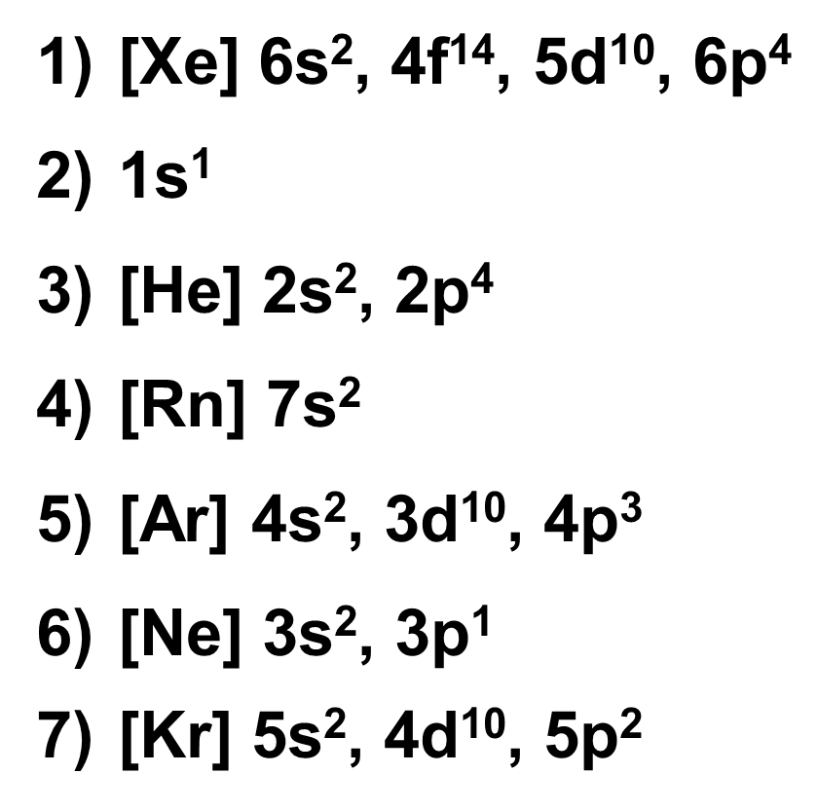
Problems for Worksheet
[Xe] 6s², 4f¹⁴, 5d¹⁰, 6p⁴
1s¹
[He] 2s², 2p⁴
[Rn] 7s²
[Ar] 4s², 3d¹⁰, 4p³
[Ne] 3s², 3p¹
[Kr] 5s², 4d¹⁰, 5p²

Slide 47
Homework
None

