Slide 1
Do Now
Write the long electron configuration for each atom:
1) neon 1s², 2s², 2p⁶
2) fluorine anion 1s², 2s², 2p⁶
  3) sodium cation 1s², 2s², 2p⁶
  4) oxygen dianion 1s², 2s², 2p⁶
  5) magnesium dication 1s², 2s², 2p⁶

Slide 2
Do Now
Write the long electron configuration for each atom:
1) neon 1s², 2s², 2p⁶
2) fluorine anion 1s², 2s², 2p⁶
  3) sodium cation 1s², 2s², 2p⁶
  4) oxygen dianion 1s², 2s², 2p⁶
  5) magnesium dication 1s², 2s², 2p⁶

Slide 3
Do Now
Write the long electron configuration for each atom:
1) neon 1s², 2s², 2p⁶
2) fluorine anion 1s², 2s², 2p⁶
  3) sodium cation 1s², 2s², 2p⁶
  4) oxygen dianion 1s², 2s², 2p⁶
  5) magnesium dication 1s², 2s², 2p⁶

Slide 4
Do Now
Write the long electron configuration for each atom:
1) neon 1s², 2s², 2p⁶
2) fluorine anion 1s², 2s², 2p⁶
  3) sodium cation 1s², 2s², 2p⁶
  4) oxygen dianion 1s², 2s², 2p⁶
  5) magnesium dication 1s², 2s², 2p⁶

Slide 5
Do Now
Write the long electron configuration for each atom:
1) neon 1s², 2s², 2p⁶
2) fluorine anion 1s², 2s², 2p⁶
  3) sodium cation 1s², 2s², 2p⁶
  4) oxygen dianion 1s², 2s², 2p⁶
  5) magnesium dication 1s², 2s², 2p⁶

Slide 6
Do Now
Write the long electron configuration for each atom:
1) neon 1s², 2s², 2p⁶
2) fluorine anion 1s², 2s², 2p⁶
  3) sodium cation 1s², 2s², 2p⁶
  4) oxygen dianion 1s², 2s², 2p⁶
  5) magnesium dication 1s², 2s², 2p⁶

Slide 7
Do Now
Neon has a very stable electron configuration.
By taking on a charge, the rest can become very stable
Write the long electron configuration for each atom:
1) neon 1s², 2s², 2p⁶
2) fluorine anion 1s², 2s², 2p⁶
  3) sodium cation 1s², 2s², 2p⁶
  4) oxygen dianion 1s², 2s², 2p⁶
  5) magnesium dication 1s², 2s², 2p⁶
This drives much of periodic properties of elements
Today we start a new unit on periodic properties

Slide 8
Units
Scientific Method
Atomic Theory
Nuclear Chemistry
The Mole
Electrons
Periodic Properties
Bonding
Nomenclature
Chemical Reactions
Stoichiometry
Mixtures and Solutions
Chemical Equilibrium
Acid-Base Chemistry
Redox & Electrochemistry
Gas Laws
Thermodynamics
Chapter 6 in our book
Short unit: only 3 lessons

Slide 9
Periodic Properties - Families
SWBAT explain the periodic table and the families found on the periodic table
Write this in your notes
If something is written in red,
please write this in you notes

Slide 10
Your Notes
Periodic Table Vocabulary
Periodic Law - there is a periodic repetition of chemical and physical properties of the elements when they are arranged by increasing atomic number
Periodic Table - element boxes arranged in order of increasing atomic number
Groups - columns on the periodic table
Periods - rows on the periodic table
Main Group Elements - elements in Groups 1, 2, 13-18 (also called "Representative Elements")
Transition Elements - elements in Groups 3-12
. . .
If it is red,
write it down

Slide 11
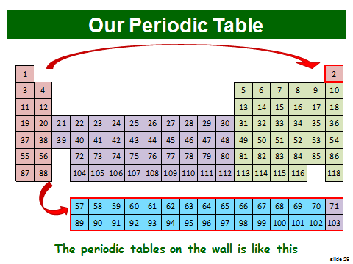
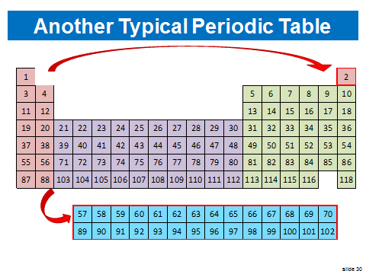
Important Note
Our periodic table has the format shown right
The periodic tables in this unit use a different format shown right

Slide 12
Lu (Z=71) & Lr (Z=103) are moved from the f-block
and shown in the d-block

Slide 13
What is a Periodic Property?
Periodic - occurring at regular intervals
A periodic property is a property that occurs at regular intervals
Winter is a periodic property of the climate in Rhode Island
  Winter begins every 12 months (regular interval)
Telephone poles are a periodic property of most roads in Scituate
  Poles are found every ~100 yards (regular interval)

Slide 14
Periodic Properties of Elements
Elements have properties that repeat themselves
If the elements are listed in order of atomic number, these repetitions occur at regular intervals
Periodic Law - there is a periodic repetition of chemical and physical properties of the elements when they are arranged by increasing atomic number
write this in your notes

Slide 15
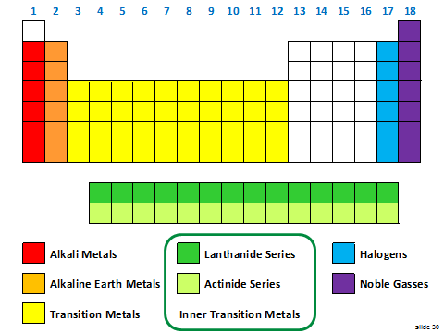
Today's Lesson
We are going to learn the names and definitions of the major families in the periodic table

Slide 16
Periodic Table
The periodic table arranges element boxes
in order of increasing atomic number

Slide 17
Groups
Groups are the columns on the periodic table
Add these numbers to your periodic table

Slide 18
Periods
Periods are the rows on the periodic table
Add these numbers to your periodic table
Note the designation of the f-orbitals

Slide 19

Metals
An element that is solid at room temperature, a good conductor of heat and electricity, and generally shiny; most metals are ductile and malleable

Slide 20
Vocabulary
ductile - ability to drawn into wire
malleable - ability to be formed into thin sheets

Slide 21
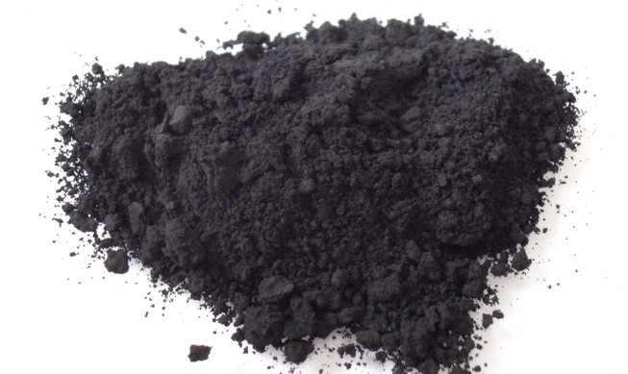
Nonmetals
Elements that are generally gasses or dull, brittle solids that are poor conductors of heat and electricity

Slide 22
Metalloids
An element that has physical and chemical properties of both metals and nonmetals
The "B-At" Line

Slide 23
Metals, Non-Metals & Metalloids

Slide 24
Main Group Elements
Elements in Groups 1, 2, 13-18
(also called "Representative Elements")

Slide 25
Alkali Metals
Group 1 elements except for hydrogen
Very reactive, low density for metals

Slide 26
Alkaline Earth Metals
Group 2 elements
Also very reactive, low density for metals

Slide 27
Halogens
Group 17 elements
Very reactive, often found as diatomic elements

Slide 28
Noble Gasses
Group 18 elements (includes helium)
Unreactive elements, gasses at room temperature

Slide 29
Transition Metals
Group 3-12 elements
Less reactive, very hard, good conductors

Slide 30
Inner Transition Metals
f-block elements
Includes both lanthanide and actinide series

Slide 31
Lanthanide Series
Elements with Z from 57 - 70 (4f orbital block)
Pale, soft metals, reactive on heating

Slide 32

Actinide Series
Elements with Z from 89 to 102 (5f orbital block)
Radioactive and very dense metals

Slide 34
Check for Understanding
Which families are very reactive?
Alkali metals, alkaline earth metals & halogens
Which family is unreactive
Noble gasses
Which family is radioactive?
Actinides
What are the rows of the periodic table called?
Periods
What does "ductile" mean?
Capable of being drawn into wire

Slide 35
Check for Understanding
Which families are very reactive?
Alkali metals, alkaline earth metals & halogens
Which family is unreactive
Noble gasses
Which family is radioactive?
Actinides
What are the rows of the periodic table called?
Periods
What does "ductile" mean?
Capable of being drawn into wire

Slide 36
Check for Understanding
Which families are very reactive?
Alkali metals, alkaline earth metals & halogens
Which family is unreactive
Noble gasses
Which family is radioactive?
Actinides
What are the rows of the periodic table called?
Periods
What does "ductile" mean?
Capable of being drawn into wire

Slide 37
Check for Understanding
Which families are very reactive?
Alkali metals, alkaline earth metals & halogens
Which family is unreactive
Noble gasses
Which family is radioactive?
Actinides
What are the rows of the periodic table called?
Periods
What does "ductile" mean?
Capable of being drawn into wire

Slide 38
Check for Understanding
Which families are very reactive?
Alkali metals, alkaline earth metals & halogens
Which family is unreactive
Noble gasses
Which family is radioactive?
Actinides
What are the rows of the periodic table called?
Periods
What does "ductile" mean?
Capable of being drawn into wire

Slide 39
Check for Understanding
Which families are very reactive?
Alkali metals, alkaline earth metals & halogens
Which family is unreactive
Noble gasses
Which family is radioactive?
Actinides
What are the rows of the periodic table called?
Periods
What does "ductile" mean?
Capable of being drawn into wire

Slide 40
Online Homework
drmccarthyscience.weebly.com
Chemistry ---> Periodic Properties
0601 - WS Periodic Properties - Families
Reminder about online homework
Everyone gets a different set of questions
Must be completed prior to test
Completion and grade automatically recorded
Answers will be shared online prior to test

Slide 41
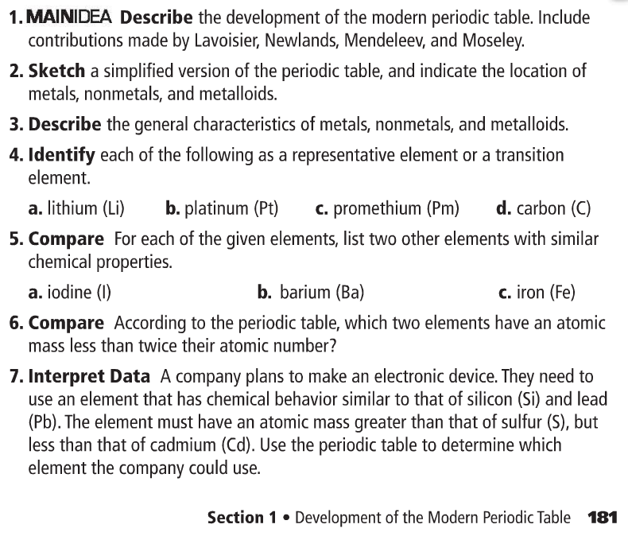

Slide 42
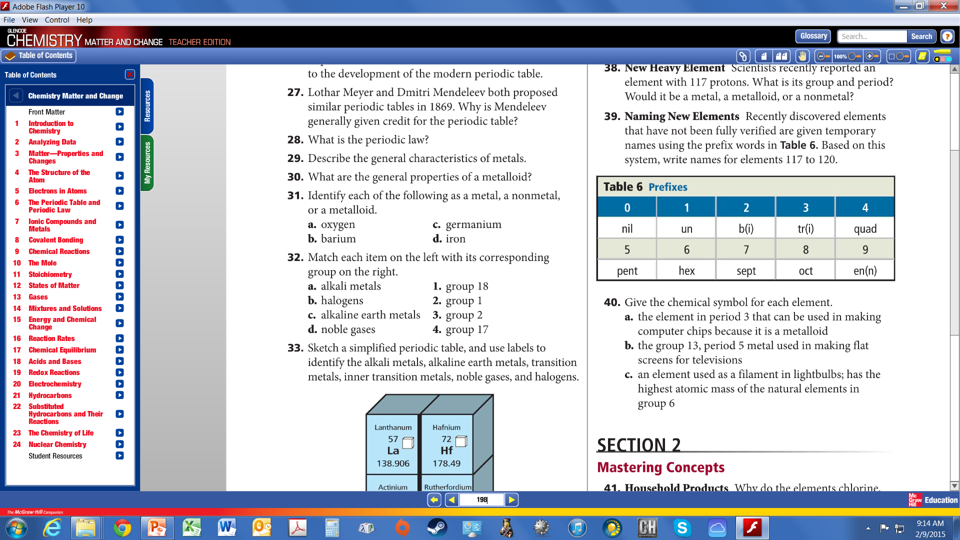

Slide 43
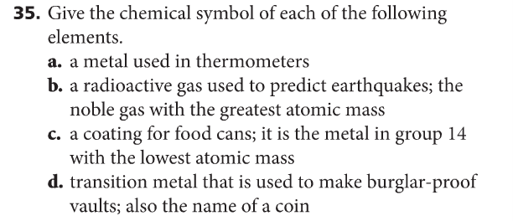

Slide 44
Backup Slides

Slide 45
Non-Metals

Slide 46
Non-Metals

Slide 47

Metalloids

Slide 48
Noble Gasses
Group 18 elements (includes helium)
Unreactive elements, gasses at room temperature

Slide 49
Book Homework
pg 181, problems 2, 5
pg 198, problems 31, 32, 35, 40

