Slide 1
Cold Call
Get the following:
A white board
A marker
A piece of paper towel
Your notes on electrons
Write the abbreviated electron configuration for bismuth (atomic number = 83)

Slide 2
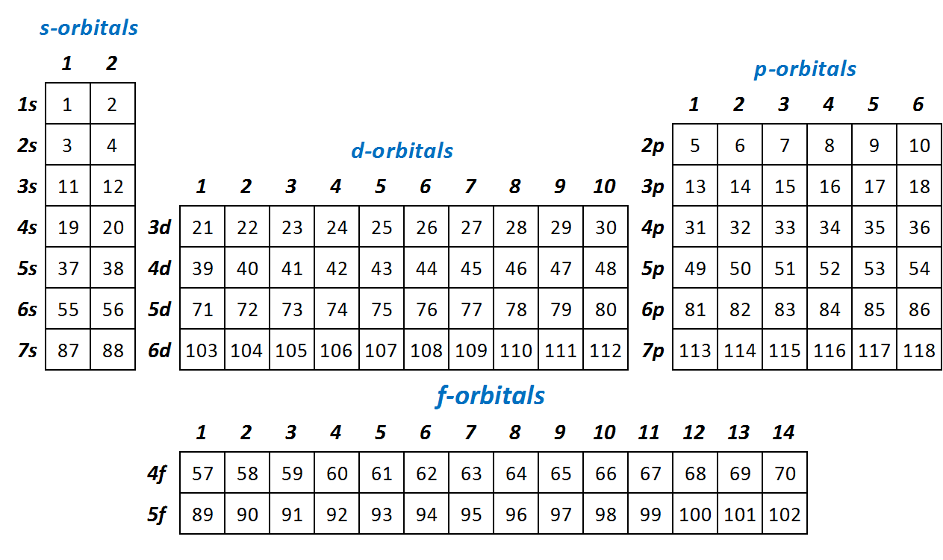
Bi: [Xe] 6s², 4f¹⁴, 5d¹⁰, 6p³

Slide 3
Bi: [Xe] 6s², 4f¹⁴, 5d¹⁰, 6p³

Slide 4
Test 5 - Electrons
Dates
Period 3 - Wed, Feb 24
Periods 4, 6, 7 - Thu, Feb 25
Honors Chemistry Test - 35 question
20 multiple choice, 2 pts each, 40 pts total
15 open response, 4 pts each, 60 pts total
Chemistry Test - 29 question
16 multiple choice, 3 pts each, 48 pts total
13 open response, 4 pts each, 52 pts total
All tests moved to Fri, Feb 26
NO ANNOTATED PERIODIC TABLES!!!

Slide 5
Lab Reports Due Friday
Submit via Turnitin.com
Suggest you use a .pdf file, but others okay
See Student Quick Start Guide https://guides.turnitin.com/01_Manuals_and_Guides/Student/Student_QuickStart_Guide
Class | Class ID Number | Password
Period 3 | 12215335 | chem309
Period 4 | 12215340 | chem416
Period 6 | 12215352 | chem636
Period 7 | 12215359 | chem749

Slide 6
Names, definition and importance of:
Quantum
Bohr Atom
Wave-Particle Duality
Heisenberg Uncertainty Principle
Schrodinger Equation
Names, symbols, allowed values & meaning of the 4 electron quantum numbers
Letter designation & # of electrons of 4 types of orbitals
Three rules for filling electron orbitals.

Slide 7
Names, definition and importance of:
Quantum
Bohr Atom
Wave-Particle Duality
Heisenberg Uncertainty Principle
Schrodinger Equation
Names, symbols, allowed values & meaning of the 4 electron quantum numbers
Letter designation & # of electrons of 4 types of orbitals
Three rules for filling electron orbitals.

Slide 8
Concept | Explanation
Quantum Energy | Electrons cannot absorb or release any amount of energy, but rather specific amounts (quanta) which allow them to transition from one allowed energy level to another.
Bohr Atom | An early model which proposed electrons orbiting the nucleus similar to how planets orbit the sun. Explains hydrogen's energy levels, but not other elements.
Wave-Particle Duality | Electrons behave like particles that have mass and waves which transfer energy.
Heisenberg Uncertainty Principle | Both position and momentum of an electron cannot both be known exactly, so electrons are described as "clouds", a volume of space of probable location
Schrödinger Equation | Describes electrons in terms of the wavelike properties. Provides our most complete description of electron orbitals

Slide 9
Names, definition and importance of:
Quantum
Bohr Atom
Wave-Particle Duality
Heisenberg Uncertainty Principle
Schrodinger Equation
Names, symbols, allowed values & meaning of the 4 electron quantum numbers
Letter designation & # of electrons of 4 types of orbitals
Three rules for filling electron orbitals.

Slide 10
Electron Quantum Numbers
name | symbol | values | what it describes
principal | n | positive integers | orbital size and energy
angular momentum | l | positive integers from 0 to (n-1) | orbital shape
magnetic | m_{l} | integers from ‒l to +l | orbital orientation
spin | m_{s} | ‒½ or +½ | electron spin

Slide 11
Names, definition and importance of:
Quantum
Bohr Atom
Wave-Particle Duality
Heisenberg Uncertainty Principle
Schrodinger Equation
Names, symbols, allowed values & meaning of the 4 electron quantum numbers
Letter designation & # of electrons of 4 types of orbitals
Three rules for filling electron orbitals.

Slide 12
Angular Momentum Quantum Number
l | letter designation
0 | s
1 | p
2 | d
3 | f

Slide 13
Names, definition and importance of:
Quantum
Bohr Atom
Wave-Particle Duality
Heisenberg Uncertainty Principle
Schrodinger Equation
Names, symbols, allowed values & meaning of the 4 electron quantum numbers
Letter designation & # of electrons of 4 types of orbitals
Three rules for filling electron orbitals.

Slide 14
Rules for Electron Configurations
Write this in your notes
Aufbau Rule
Electrons occupy the lowest possible energy level
Pauli Exclusion Principle
Only two electrons of opposite spin can occupy an orbital
Hund's Rule
Put a single electron into all equivalent orbitals before doubling up

Slide 15
Cold Call
Process
Teacher asks a question
Each student silently formulates their own answer
Do not raise hands or call out answer
Teacher calls on a student to answer the question
Every student needs to be ready for every question
Every student will get at least one question
90% correct on first try earns candy for entire class
30 question minimum
Notes can be used for the first 11 questions
White boards will be used for answering questions as requested
The class has two passes to "call a friend" in case a student is stuck

Slide 16
1) What happens to the electrons in an atom when light is absorbed?
The electrons move from the ground state to an excited state.
2) Explain how Hund's Rule impacts the configuration of electrons in the 3p orbital of sulfur
The first three electrons have identical spins and occupy different suborbitals. The fourth electron is forced to pair up in one of the suborbitals.
3) What single cation has the configuration of 1s², 2s², 2p⁶, 3s², 3p⁶, 4s², 3d¹⁰?
Ga⁺¹
4) "All matter exhibits the properties of not only particles, which have mass, but also waves, which transfer energy." is a statement of what theory?
De Broglie's wave- particle duality postulate

Slide 17
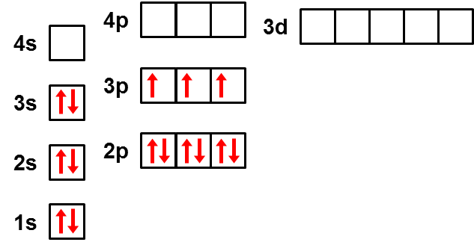
5) Draw the electron diagram for phosphorus.

Slide 18
6) What is the principal quantum number for a 5f orbital?
5
7) What is the angular momentum quantum number for a 5f orbital?
3
8) What are the allowable magnetic quantum numbers for a 5f orbital?
-3, -2, -1, 0, 1, 2, 3
9) What are the spin quantum numbers for a 5f orbital?
±½
10) How many electrons can the 5f orbital hold?
14
11) What are the values for the four quantum numbers (n, l, m_{l}, m_{s}) for the 2s orbital?
2, 0, 0, ±½

Slide 19
PUT NOTES AWAY

Slide 20
12) What is the name of the theory which asserts a fundamental limit to the precision with which certain pairs of physical properties can be known simultaneously?
The Heisenberg uncertainty principle
13) In light waves, what is the relationship between frequency and energy?
As frequency increases, energy increases.
Frequency and energy are directly related.
14) What is the long electron configuration for Y⁺³?
1s², 2s², 2p⁶, 3s², 3p⁶, 4s², 3d¹⁰, 4p⁶
15) What is the name for l and what does it describe?
The angular momentum quantum number which describes the orbital shape

Slide 21
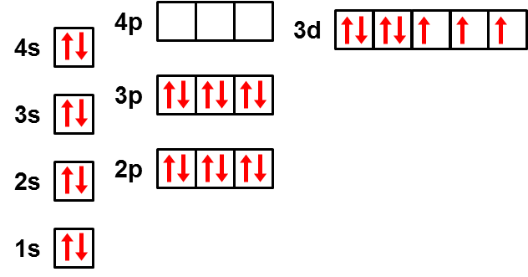
16) What element has the electron configuration shown in this electron diagram?
Cobalt

Slide 22
17) What is the abbreviated electron configuration for Pb?
[Xe] 6s², 4f¹⁴, 5d¹⁰, 6p²
18) What is the Aufbau Rule?
Electrons occupy the lowest possible energy level.
19) The quantum-mechanical description of matter in terms of the wave-like properties of particles is provided by:
The Schrödinger equation
20) What is the long electron configuration for Se?
1s², 2s², 2p⁶, 3s², 3p⁶, 4s², 3d¹⁰, 4p⁴
21) In the Bohr model of the atom, what happened when an electron transitioned from an excited state to ground state?
The atom released a specific quantum of energy which can be observed as light

Slide 23
22) Only specific wavelengths are absorbed by the electrons in a given atom. Why?
The electrons can only move to specific excited states, and thus can only absorb the energy to reach them
23) What is the name for this minimum amount of energy that can be gained by an atom?
A quantum
24) What is the abbreviated electron configuration for Ru?
[Kr] 5s², 4d⁶
25) In light waves, what is the relationship between wavelength and frequency?
Wavelength and frequency are inversely related
26) What is the name of the quantum number which describes the orientation of electron orbitals?
The magnetic quantum number

Slide 24
27) Why is there no 2d orbital?
For d-orbitals, l = 2. With n = 2, l can only be positive integers from 0 to (n-1), and n-1 = 1, thus no d-orbital.
28) What does the Pauli Exclusion Principle state?
Only two electrons of opposite spin can occupy the same orbital
29) What is the abbreviated electron configuration for Bk?
[Rn] 7s², 5f⁹
30) What are the allowed values for m_{l} in a 5d orbital?
-2, -1, 0, 1, 2

Slide 25
Blank Slides

Slide 26
XX) XXXXX YYYYY ZZZZZ XXXXX YYYYY ZZZZZ XXXXX YYYYY ZZZZZ XXXXX YYYYY ZZZZZ
XXXXX YYYYY ZZZZZ XXXXX YYYYY ZZZZZ XXXXX YYYYY ZZZZZ XXXXX YYYYY ZZZZZ
XX) XXXXX YYYYY ZZZZZ XXXXX YYYYY ZZZZZ XXXXX YYYYY ZZZZZ XXXXX YYYYY ZZZZZ
XXXXX YYYYY ZZZZZ XXXXX YYYYY ZZZZZ XXXXX YYYYY ZZZZZ XXXXX YYYYY ZZZZZ
XX) XXXXX YYYYY ZZZZZ XXXXX YYYYY ZZZZZ XXXXX YYYYY ZZZZZ XXXXX YYYYY ZZZZZ
XXXXX YYYYY ZZZZZ XXXXX YYYYY ZZZZZ XXXXX YYYYY ZZZZZ XXXXX YYYYY ZZZZZ
XX) XXXXX YYYYY ZZZZZ XXXXX YYYYY ZZZZZ XXXXX YYYYY ZZZZZ XXXXX YYYYY ZZZZZ
XXXXX YYYYY ZZZZZ XXXXX YYYYY ZZZZZ XXXXX YYYYY ZZZZZ XXXXX YYYYY ZZZZZ

Slide 27
Electron Quantum Numbers
name | symbol | values | what it describes

Slide 28
Electron Quantum Numbers
name | symbol | values | what it describes
principal | n | positive integers | orbital size and energy
angular momentum | l | positive integers from 0 to (n-1) | orbital shape
magnetic | m_{l} | integers from ‒l to +l | orbital orientation
spin | m_{s} | ‒½ or +½ | electron spin

Slide 29
Angular Momentum Quantum Number
l | letter designation

Slide 30
Angular Momentum Quantum Number
l | letter designation
0 | s
1 | p
2 | d
3 | f

Slide 31
Test 5 - Electrons
Dates
Period 3 - Wed, Feb 24
Periods 4, 6, 7 - Thu, Feb 25
Honors Chemistry Test - 35 question
20 multiple choice, 2 pts each, 40 pts total
15 open response, 4 pts each, 60 pts total
Chemistry Test - 29 question
16 multiple choice, 3 pts each, 48 pts total
13 open response, 4 pts each, 52 pts total
NO ANNOTATED PERIODIC TABLES!!!

Slide 32
Write the Following
Names, definition and importance of:
Quantum
Bohr Atom
Wave-Particle Duality
Heisenberg Uncertainty Principle
Schrodinger Equation
Names, symbols, allowed values & meaning of the 4 electron quantum numbers
Letter designation & # of electrons of 4 types of orbitals
Three rules for filling electron orbitals.

