Slide 1
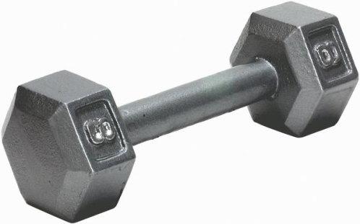
Do Now
Put homework in the red basket
There is a hand weight on the floor in front of the table.
Pick up the weight and put it on the table. Note how much energy you expended.
Put the weight back on the floor.
Calculate the energy expended:
PE = mgh
m = mass of weight (5.4 kg)
g = acceleration due to gravity (9.8 m/s²)
h = height raised (0.74 m)

Slide 2
Do Now
PE = mgh
m = mass of weight (5.4 kg)
g = acceleration due to gravity (9.8 m/s²)
h = height raised (0.74 m)
PE = (5.4 kg)(9.8 m/s²)(0.74 m)
PE = 39 kg▪m²/s²
PE = 39 J
Today we will be measuring the energy of electron transitions. Keep this energy measurement in mind as a benchmark

Slide 3
Test 6 - Electrons
Dates
tbd
Honors Chemistry Test - 35 question
20 multiple choice, 2 pts each, 40 pts total
15 open response, 4 pts each, 60 pts total
Chemistry Test - 29 question
16 multiple choice, 3 pts each, 48 pts total
13 open response, 4 pts each, 52 pts total
NO ANNOTATED PERIODIC TABLES!!!

Slide 4
Energy of Electron Transitions
SWBAT conduct an atomic emission mini-lab and use the observed light to calculate the energy of the electron transitions
Write this in your notes

Slide 5
Mini-Lab
Today we will do a short lab
No lab report needs to be written, but . . .
. . . you need to complete a worksheet
. . . and write an introduction

Slide 6
Pay Attention!
We are going to review the mini-lab and the theory behind it
REVIEW
Write this in your notes
Only a few new points will be introduced
You will need this information to complete the worksheet and write your introduction
After we have reviewed this, I will be busy running the lab and will not be able to help you with background information
Make sure you take good notes

Slide 7
Synopsis
Hand out worksheet

Slide 8
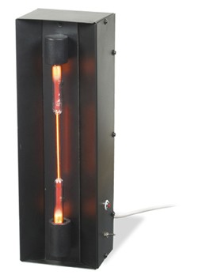
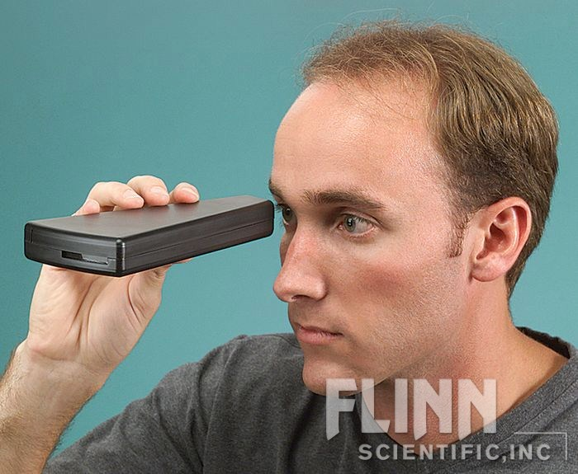
Observe the Atomic Emission
A particular element and colored emission will be assigned to you

Slide 9
Assign Element and Color

Slide 10
Measure the Wavelength
Read the wavelength here
Line up the gas tube here

Slide 11
Analyze and Explain
Use your data to calculate the frequency and then the energy of the atomic emission
Type a 1-2 page introduction on this mini-lab

Slide 12
Review of Background

Slide 13
Contents
Write this in your notes
Light as a Tool
Nature of Light
Atomic Emission
Quantum Energy
Electron Transitions

Slide 14
Light as a Tool
REVIEW
Electrons are very small and very fast moving
As electrons move from one energy state to another, they either absorb or release (emit) very small amounts of energy.
To measure the energy of these electron transitions, scientists used light

Slide 15
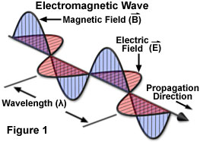
The Nature of Light
REVIEW
Light is a wave
As light waves move, they produce crests and troughs in electric and magnetic fields.

Slide 16
Describing Light
REVIEW
Like any wave, light can be described in terms of its wavelength and frequency
Wavelength and frequency have an inverse relationship

Slide 17
Wavelength-Frequency Equation
c = λν
where:
c = speed of light = 3.00 x 10⁸ m/s
λ (lambda) = wavelength (measured in m)
ν (nu) = frequency (measured in 1/s)
Write this in your notes

Slide 18
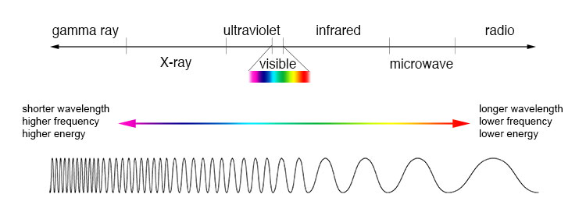
Energy of Light
REVIEW
The energy of light waves is directly proportional to their frequency

Slide 19
Energy-Frequency Equation
E = hν
where
E = energy (measured in J)
h = Planck's constant = 6.63 x 10⁻³⁴ J▪s
ν (nu) = frequency (measured in 1/s)
Write this in your notes

Slide 20
Atomic Emission
Atoms are drawn into the flame and absorb energy.
They lose this energy through the release of light.
This process is called atomic emission.
The resulting spectrum shows the energy released.

Slide 21
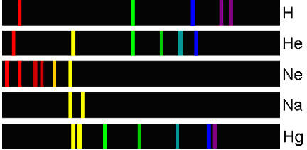
Atomic Emission Spectra
REVIEW
Atomic emission spectra provide an atom's fingerprint

Slide 22
The Concept of Quantum Energy
REVIEW
Sunlight is made up of a continuous spectrum of light
Elements only emit light of specific frequencies and energy levels
Why the difference?
Matter can gain or lose energy in small, specific amounts called quanta
A quantum is the minimum amount of energy that can be gained or lost by an atom

Slide 23
What do the Quanta do to the Atom?
REVIEW
Atoms can exist in a low-energy state called the ground state or in a number of higher-energy states call excited states
excited
states
ground state

Slide 24
What do the Quanta do to the Atom?
REVIEW
Atoms can exist in a low-energy state called the ground state or in a number of higher-energy states call excited states
When absorbing light, a specific quantum raises the atom from its ground state to a specific excited state
excited
states
ground state

Slide 25
What do the Quanta do to the Atom?
REVIEW
Atoms can exist in a low-energy state called the ground state or in a number of higher-energy states call excited states
When absorbing light, a specific quantum raises the atom from its ground state to a specific excited state
In an emission spectrum, a specific quantum of energy is released as the atom falls from a specific excited state back to the ground state
excited
states
ground state

Slide 26
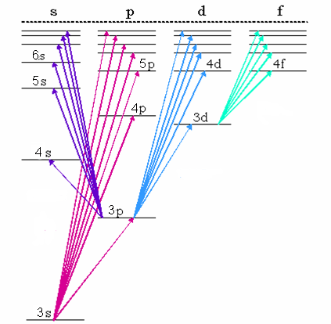
REVIEW
Electron Transitions of a Sodium Atom

Slide 27
Any Questions?
Begin the mini-lab

Slide 28
Backup Slides

Slide 29
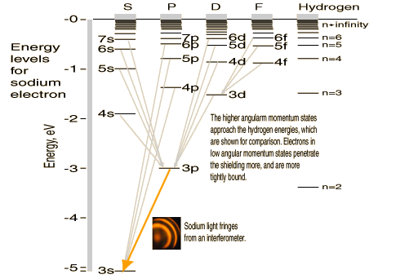

Slide 30
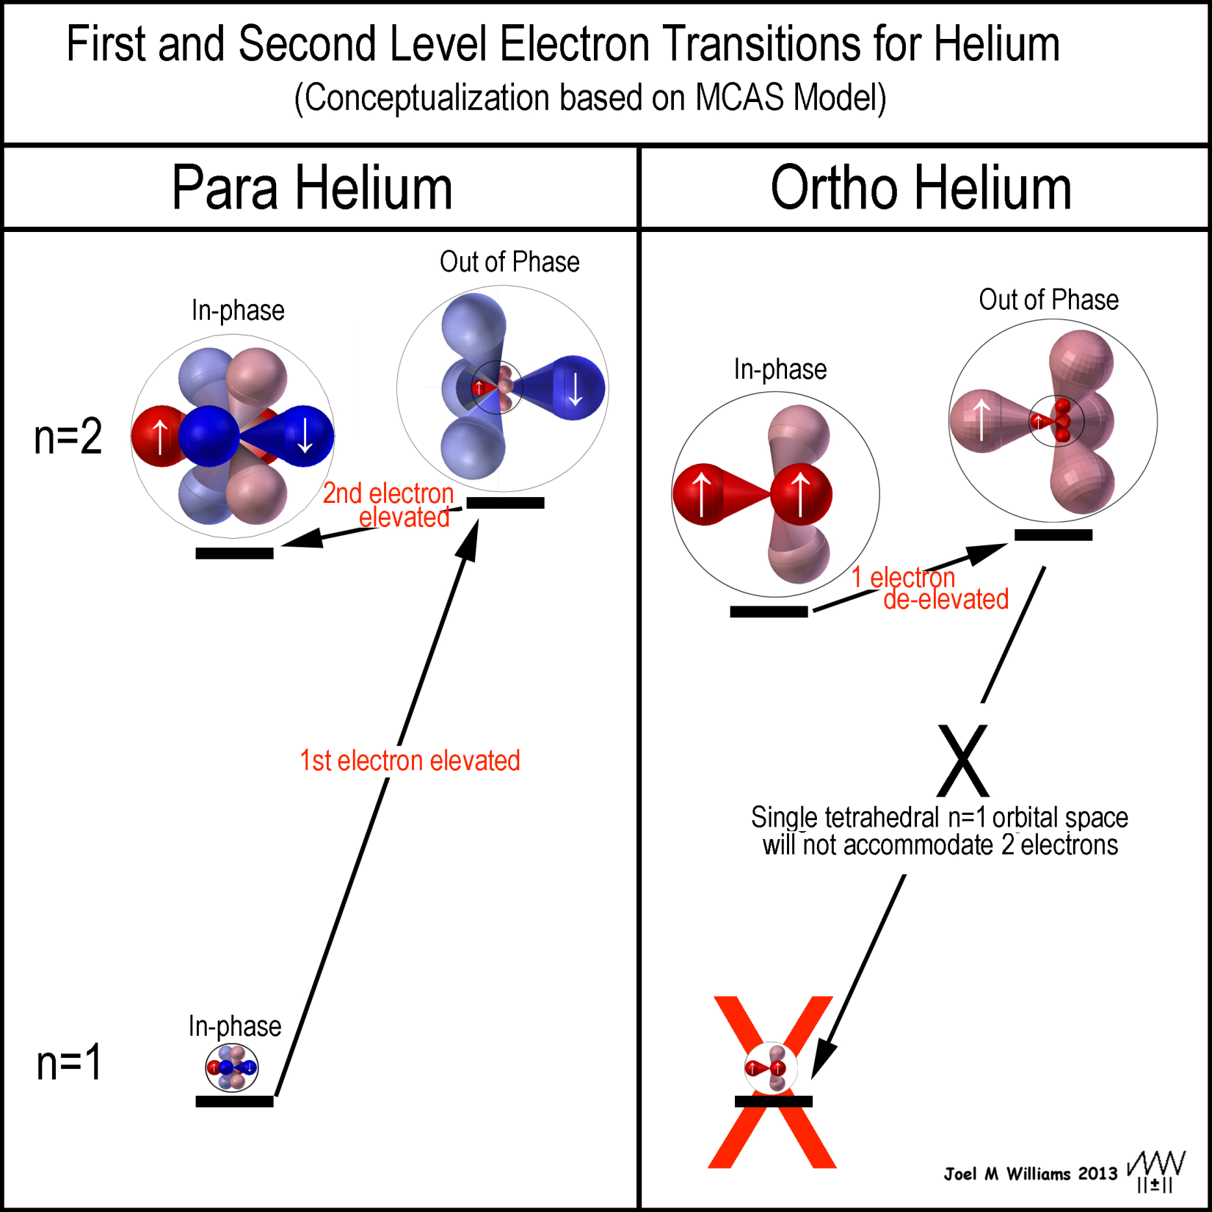

Slide 31
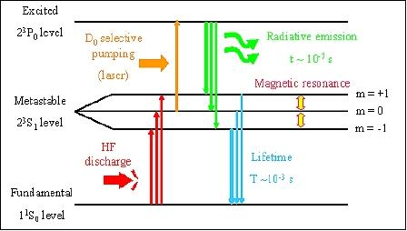

Slide 32
Transition from various excited states to the ground state releases specific quanta of energy which can be observed
write this in your notes

Slide 33
Wave Characteristics of Light
c = λν
c = speed of light (3.00 x 10⁸ m/s)
λ = wavelength (Greek letter lamda)
ν = frequency (Greek letter nu)

