Slide 1
The Mole - Homework
pg 323, problems 1-4
pg 324, problems 5-6
Note: treat "formula units" and "representative particles" the same as "molecules"

Slide 2
pg 323
1) How many atoms in 2.50 mol of Zn?
2) How many molecules in 11.5 mol of water?
3) How many molecules in 3.25 mol of AgNO₃?
4) How many oxygen atoms in 5.00 mol of O₂
1.51 x 10²⁴ Zn atoms
6.92 x 10²⁴ water molecules
1.96 x 10²⁴ AgNO₃ molecules
6.02 x 10²⁴ atoms of oxygen

Slide 3
pg 324
5a) How many moles in 5.75 x 10²⁴ atoms of Al?
5b) How many moles in 2.50 x 10²⁰ atoms of Fe
6a) How many moles in 3.75 x 10²⁴ molecules of CO₂?
6b) How many moles in 3.58 x 10²³ molecules of ZnCl₂?
9.55 mol of Al
4.15 x 10⁻⁴ mol of Fe
6.23 mol of CO₂
0.595 mol of ZnCl₂

Slide 4
Mass & the Mole - Homework
pg 328, problem 16
pg 329, problem 18
pg 331, problem 20 a & b, 21
Note: treat "formula units" and "representative particles" the same as "molecules"

Slide 5
pgs 328 & 329
16a) What is the mass of 3.45 x 10² mol of Co?
16b) What is the mass of 2.45 x 10⁻² mol of Zn?
18a) How many moles in 1.25 x 10³ g of Zn?
18b) How many moles in 1.00 kg of Fe?
2.03 x 10⁴ g Co
1.60 g Zn
1.91 x 10¹ mol Zn
1.79 x 10¹ mol Fe

Slide 6
pg 331
20a) What is the mass of 6.02 x 10²⁴ atoms of Bi?
20b) What is the mass of 1.00 x 10²⁴ atoms of Mn?
21a) How many atoms in 4.56 x 10³ g of Si?
21b) How many atoms in 0.120 kg of Ti?
2.09 x 10³ g Bi
91.3 g Mn
9.77 x 10²⁵ atoms of Si
1.51 x 10²⁴ atoms Ti

Slide 7
Moles of Compounds - Homework
pg 335, problem 35
pg 336, problems 37 & 38
pg 337, problem 40

Slide 8
Do Now
What is the molar mass of (NH₄)₃PO₄?
How many grams are there in 16.4 moles of (NH₄)₃PO₄?
How many moles are there in 0.378 grams of (NH₄)₃PO₄?
149.087 g/mol
2450 g
0.00254 mol

Slide 9
pg 335
35a) What is the molar mass of C₂H₅OH?
35b) What is the molar mass of HCN?
35c) What is the molar mass of CCl₄?
46.069 g/mol
27.026 g/mol
153.823 g/mol
not 531.638 g/mol

Slide 10
pg 336
37) What is the mass of 3.25 mol of H₂SO₄?
38) What is the mass of 4.35 x 10⁻² mol of ZnCl₂?
98.077 g/mol 319 g
136.286 g/mol 5.93 g

Slide 11
pg 337
40a) How many moles in 22.6 g AgNO₃?
40b) How many moles in 6.50 g ZnSO₄?
40c) How many mole in 35.0 g of HCl?
169.872 g/mol 0.133 mol
161.441 g/mol 0.0403 mol
36.461 g/mol 0.960 mol

Slide 12
Do Now
What is the percent composition of Mg(ClO₄)₂?
symbol | number | atomic mass | mass | percent comp

Slide 13
Do Now
What is the percent composition of Mg(ClO₄)₂?
symbol | number | atomic mass | mass | percent comp
Mg | 1 | 24.305 | 24.305
Cl | 2 | 35.453 | 70.906
O | 8 | 15.999 | 127.992
 |  |  | 223.203

Slide 14
Do Now
What is the percent composition of Mg(ClO₄)₂?
symbol | number | atomic mass | mass | percent comp
Mg | 1 | 24.305 | 24.305 | 10.889%
Cl | 2 | 35.453 | 70.906 | 31.767%
O | 8 | 15.999 | 127.992 | 57.3433%
 |  |  | 223.203 | 99.999%

Slide 15
Identifying Unknowns 1 - Homework
pg 344, # 54, 56 (% composition from molar mass)
pg 360, # 156, 159 (molecular vs empirical formulas)
pg 361, # 167 (molecular vs empirical formulas)

Slide 16
pg 344, #54
What is the percent composition of phosphoric acid, H₃PO₄?
symbol | number | atomic mass | mass | percent comp
H | 3 | 1.008 | 3.024 | 3.086%
P | 1 | 30.974 | 30.974 | 31.61%
O | 4 | 15.999 | 63.996 | 65.31%
 |  |  | 97.994

Slide 17
pg 344, #56
Find the percent composition of CaCl₂?
symbol | number | atomic mass | mass | percent comp
Ca | 1 | 40.078 | 40.078 | 36.111
Cl | 2 | 35.453 | 70.906 | 63.888
 |  |  | 110.984

Slide 18
pg 360, #156
156) What is the difference between an empirical formula and a molecular formula? Provide an example.
The empirical formula for a compound is the smallest whole-number mole ratio of the elements.
The molecular formula specifies the actual number of atoms of each element in one molecule or formula unit of the substance.
molecular
formula
empirical
formula
For caffeine
C₈H₁₀N₄O₂
C₄H₅N₂O

Slide 19
pg 360, #159
159) Which of the following formulas - NO, N₂O, NO₂, N₂O₄ and N₂O₅ - represent the empirical and molecular formulas of the same compound?
Molecular | Empirical | Same?
NO | NO | yes
N₂O | N₂O | yes
NO₂ | NO₂ | yes
N₂O₄ | NO₂ | no
N₂O₅ | N₂O₅ | yes

Slide 20
pg 361, #167
167) Determine the empirical formula for each compound
a) ethylene (C₂H₄)
b) ascorbic acid (C₆H₈O₆)
c) naphthalene (C₁₀H₈)
CH₂
C₃H₄O₃
C₅H₄

Slide 21
Do Now
Do the following problems on your calculator without building a table. Do each problem in 1 minute!
What is the molar mass of NaOH?
What is the molar mass of CaCl₂?
What is the molar mass of KC₂H₃O₂?
39.997 g/mol
110.984 g/mol
98.142 g/mol

Slide 22
Identifying Unknowns 2 - Homework
pg 346, # 58, 59 (empirical formula from % composition)
pg 350, # 64, 65 (molecular formula from % composition)
pg 353, # 74, 75 (calculate hydrate formula)
Determine formula only for 74 & 75
For 75, cobalt (II) chloride is CoCl₂

Slide 23
pg 346, #58
The circle graph at the right gives the percent composition for a blue solid. What is the empirical formula for this solid?
Empirical Formula is N₂O₃

Slide 24
pg 346, #59
Determine the empirical formula for a compound that contains 35.98% aluminum and 64.02% sulfur.
Empirical Formula is Al₂S₃

Slide 25
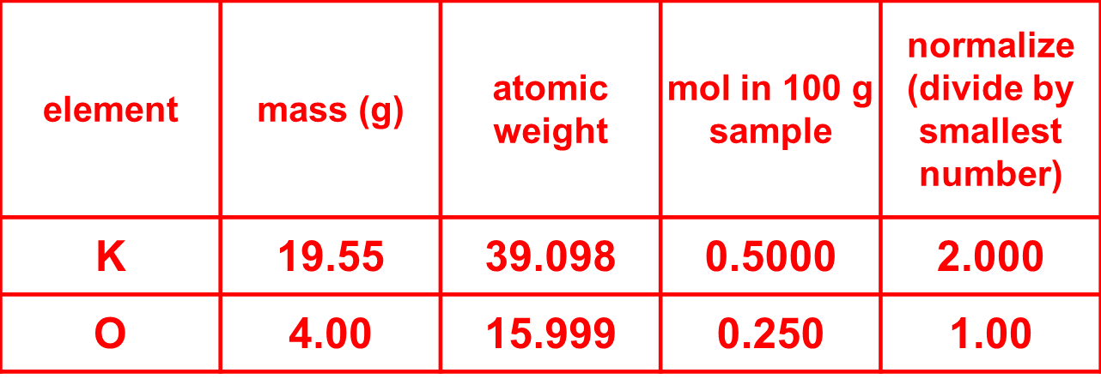
pg 350, #64
When an oxide of potassium is decomposed, 19.55 g of K and 4.00 g of O are obtained. What is the empirical formula of the compound?
Empirical Formula is K₂O

Slide 26
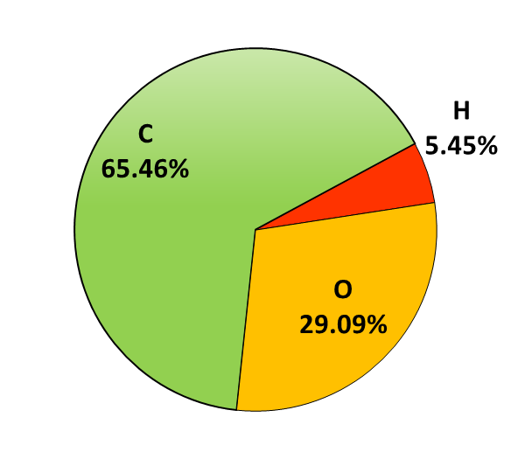
pg 350, #65
Analysis of a chemical used in photographic developing fluid yielded the percent composition data in the circle graph to the right. If the chemical's molar mass is 110.0 g/mol, what is the molecular formula?

Slide 27
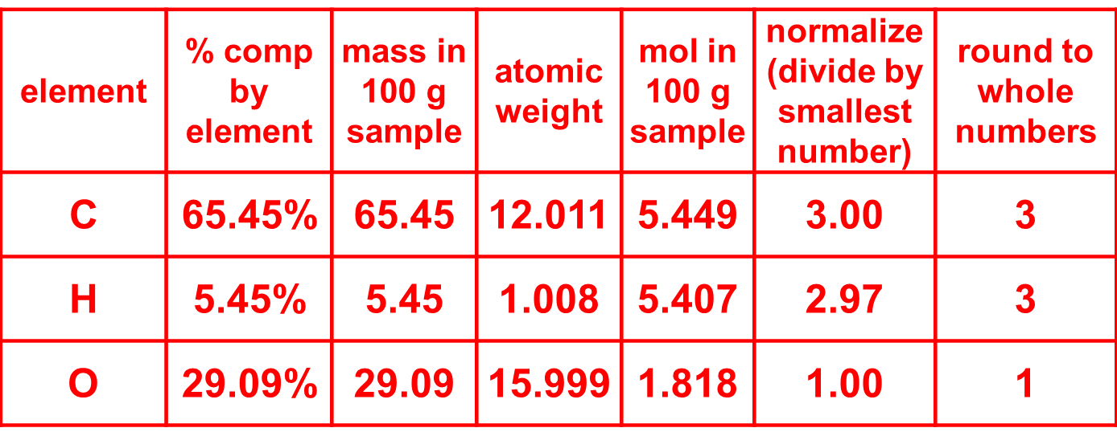
Empirical Formula is C₃H₃O

Slide 28
 | Empirical Formula |  | Molecular Formula
Formula | C₃H₃O | ? ª | ???
Molar Mass | ??? | ? ª | 110.0

Slide 29
element | number of each element | atomic weight | mass of each element
C | 3 | 12.011 | 36.033
H | 3 | 1.008 | 3.024
O | 1 | 15.999 | 15.999
 |  |  | 55.056

Slide 30
 | Empirical Formula |  | Molecular Formula
Formula | C₃H₃O | ? ª | ???
Molar Mass | 55.056 | ? ª | 110.0
$\frac{110}{55.056} ≅2$

Slide 31
 | Empirical Formula |  | Molecular Formula
Formula | C₃H₃O | 2 ª | ???
Molar Mass | 55.056 | 2 ª | 110.0

Slide 32
 | Empirical Formula |  | Molecular Formula
Formula | C₃H₃O | 2 ª | C₆H₆O₂
Molar Mass | 55.056 | 2 ª | 110.0
The molecular formula is C₆H₆O₂

Slide 33
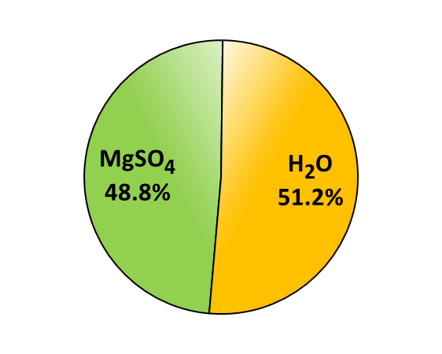
pg 353, #74
The composition of a hydrate is given in the circle graph shown below. What is the formula of this hydrate?
MgSO₄ ● ?H₂O

Slide 34
compound | % comp by cpd | mass in 100 g sample | molar mass | mol in 100 g sample | normalize (divide by smallest number) | round to whole numbers
MgSO₄ | 48.8% | 48.8
H₂O | 51.2% | 51.2

Slide 35
element | number of each element | atomic weight | mass of each element
Mg | 1 | 24.305 | 24.305
S | 1 | 32.065 | 32.065
O | 4 | 15.999 | 63.996
 |  |  | 120.366
element | number of each element | atomic weight | mass of each element
H | 2 | 1.008 | 2.016
O | 1 | 15.999 | 15.999
 |  |  | 18.015

Slide 36
compound | % comp by cpd | mass in 100 g sample | molar mass | mol in 100 g sample | normalize (divide by smallest number) | round to whole numbers
MgSO₄ | 48.8% | 48.8 | 120.366 | 0.405 | 1.00 | 1
H₂O | 51.2% | 51.2 | 18.015 | 2.84 | 7.01 | 7
The hydrate formula is MgSO₄ ● 7H₂O

Slide 37
pg 353, #75
An 11.75 g sample of a common hydrate of cobalt (II) chloride is heated. After heating, 0.0712 mol of anhydrous cobalt (II) chloride remains. What is the formula of this hydrate?

Slide 38
pg 353, #75
An 11.75 g sample of a common hydrate of cobalt (II) chloride is heated. After heating, 0.0712 mol of anhydrous cobalt (II) chloride remains. What is the formula of this hydrate?
cpd | mass of cpd (g) | molar mass of cpd (g/mol) | amount of cpd (mol) | normalize (divide by smallest number) | round to whole numbers
CoCl₂ ● nH₂O | 11.75
CoCl₂ | ??? | ??? | 0.0712 | ??? | ???
H₂O | ??? | ??? | ??? | ??? | ???

Slide 39
element | number of each element | atomic weight | mass of each element
Co | 1 | 58.933 | 58.933
Cl | 2 | 35.453 | 70.906
 |  |  | 129.839
cpd | mass of cpd (g) | molar mass of cpd (g/mol) | amount of cpd (mol) | normalize (divide by smallest number) | round to whole numbers
CoCl₂ ● nH₂O | 11.75
CoCl₂ | 9.24 | 129.839 | 0.0712 | 1.000 | 1
H₂O | 2.51 | 18.015 | 0.139 | 1.953 | 2

Slide 40
element | number of each element | atomic weight | mass of each element
H | 2 | 1.008 | 2.016
O | 1 | 15.999 | 15.999
 |  |  | 18.015
cpd | mass of cpd (g) | molar mass of cpd (g/mol) | amount of cpd (mol) | normalize (divide by smallest number) | round to whole numbers
CoCl₂ ● nH₂O | 11.75
CoCl₂ | 9.24 | 129.839 | 0.0712 | 1.000 | 1
H₂O | 2.51 | 18.015 | 0.139 | 1.953 | 2

Slide 41
The hydrate formula is CoCl₂ ● 2H₂O
cpd | mass of cpd (g) | molar mass of cpd (g/mol) | amount of cpd (mol) | normalize (divide by smallest number) | round to whole numbers
CoCl₂ ● nH₂O | 11.75
CoCl₂ | 9.24 | 129.839 | 0.0712 | 1.000 | 1
H₂O | 2.51 | 18.015 | 0.139 | 1.953 | 2

Slide 42
Backup Slides

Slide 43
pg 335
34a) What is the molar mass of NaOH?
34b) What is the molar mass of CaCl₂?
34c) What is the molar mass of KC₂H₃O₂?
40.00 g/mol
110.98 g/mol
98.14 g/mol

