Slide 1
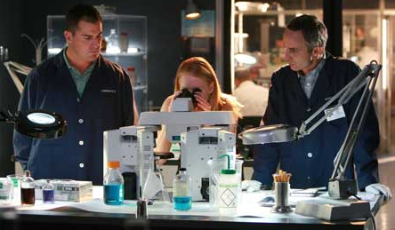
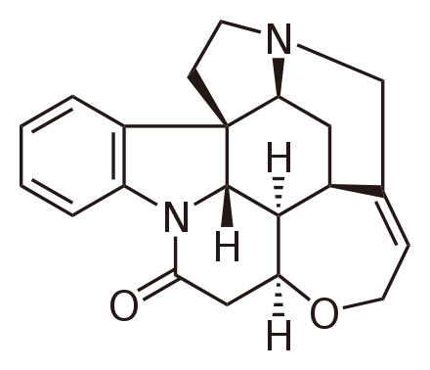
Do Now
Crime scene investigators recovered a sample of poison from a corpse. They suspected it was strychnine (C₂₁H₂₂N₂O₂) and got the following elemental analysis results. Is the poison strychnine?
symbol | unknown
C | 69.12%
H | 7.86%
N | 5.20%
O | 17.82%

Slide 2
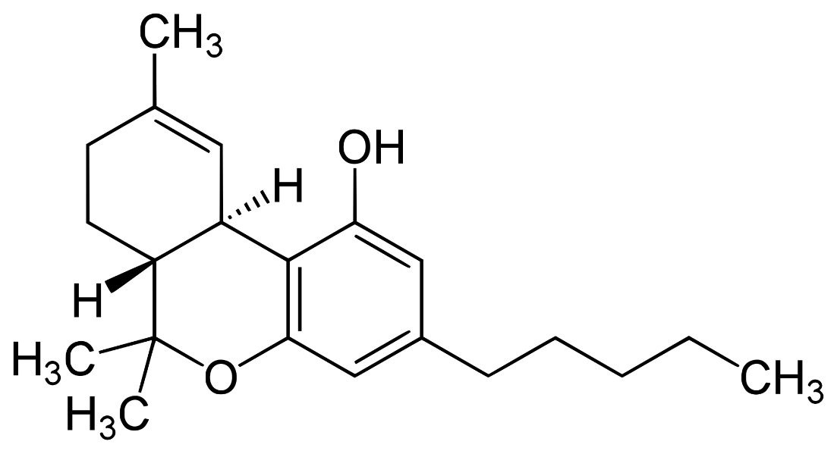
Identification Method
 | mass
C | 0.298
H | 0.036
O | 0.038
 | percent composition
C | XX.XX
H | XX.XX
O | XX.XX
elemental
analysis
calculation
If these values match, then we have strong evidence of structural identity
 | percent composition
C | XX.XX
H | XX.XX
O | XX.XX
structural
analysis
calculation
C₂₁H₃₀O₂

Slide 3
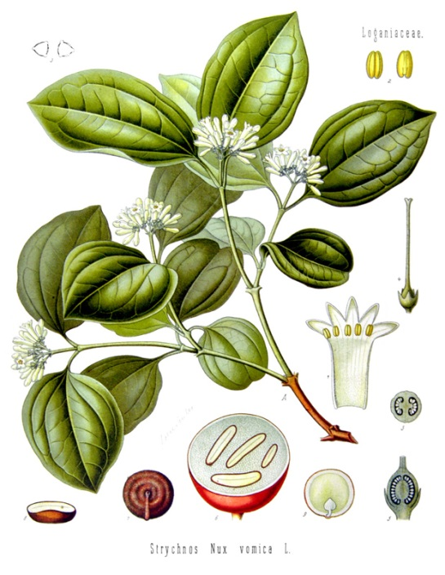
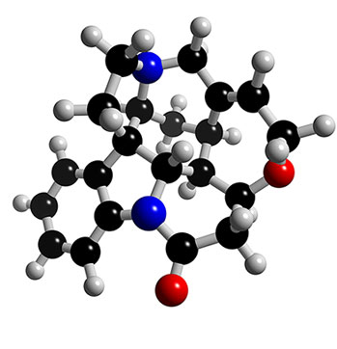
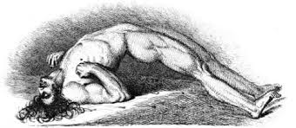

Slide 4
Do Now
What is the percent composition of C₂₁H₂₂N₂O₂?
symbol | number | molar mass | mass | percent comp
C | 21 | 12.011
H | 22 | 1.008
N | 2 | 14.007
O | 2 | 15.999

Slide 5
Do Now
What is the percent composition of C₂₁H₂₂N₂O₂?
symbol | number | molar mass | mass | percent comp
C | 21 | 12.011 | 252.231
H | 22 | 1.008 | 22.176
N | 2 | 14.007 | 28.014
O | 2 | 15.999 | 31.998
 |  |  | 334.419

Slide 6
Do Now
What is the percent composition of C₂₁H₂₂N₂O₂?
symbol | number | molar mass | mass | percent comp
C | 21 | 12.011 | 252.231 | 75.424%
H | 22 | 1.008 | 22.176 | 6.631%
N | 2 | 14.007 | 28.014 | 8.377%
O | 2 | 15.999 | 31.998 | 9.568%
 |  |  | 334.419 | 100%

Slide 7
Do Now
Do they match?
symbol | strychnine | unknown
C | 75.424% | 69.12%
H | 6.631% | 7.86%
N | 8.377% | 5.20%
O | 9.568% | 17.82%
No!
The poison found in the corpse is not strychnine

Slide 8
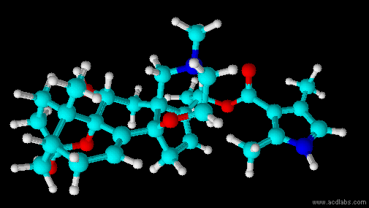
What is the unknown?
symbol | unknown
C | 69.12%
H | 7.86%
N | 5.20%
O | 17.82%
Another possible poison is batrachotoxin, better known as poison dart venom taken from colorful frogs in Colombia
The formula is C₃₁H₄₂N₂O₆
Calculate the % composition and decide if it is the unknown

Slide 9
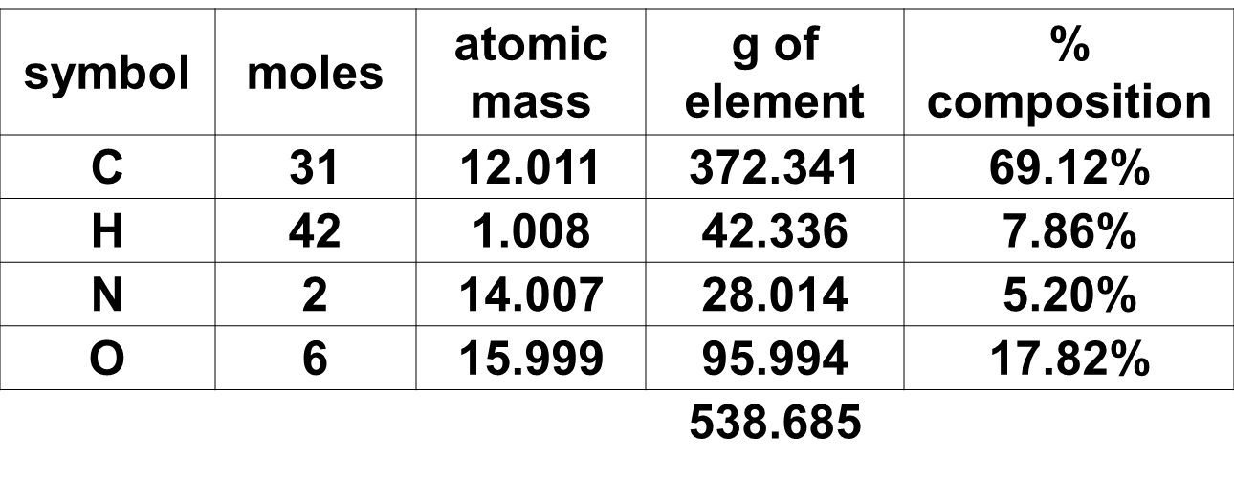
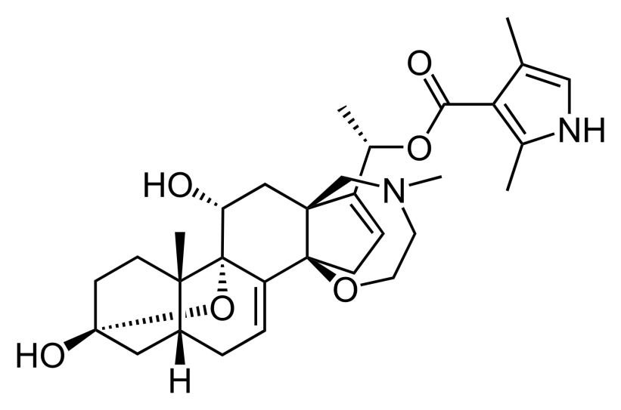
What is the unknown?
symbol | unknown
C | 69.12%
H | 7.86%
N | 5.20%
O | 17.82%
Batrachotoxin is the likely poison

Slide 10
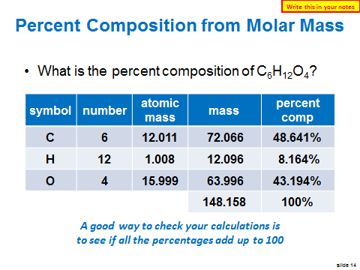
Last Class

Slide 11
Identifying Unknowns 2
SWBAT use percent composition to find an empirical formula, a molecular formula and a hydrate formula.
Write this in your notes

Slide 12
Determining Empirical Formulas from Percent Composition

Slide 13
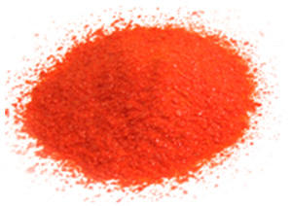
Problem
An orange powder is composed of 17.380% sodium, 40.252% chromium and 42.031% oxygen. What is the empirical formula?
The empirical formula will be
Na‘Cr‘O‘
with the boxes containing:
simplest
whole number
mole ratio of elements

Slide 14
Format for Notes
element
Na
Cr
O
7 wide, 4 high
Step 1: ………………………………………………………………………… …………………………….…………………………………………..
Step 2: ………………………………………………………………………… …………………………….…………………………………………..
Step 3: ………………………………………………………………………… …………………………….…………………………………………..
Step 4: ………………………………………………………………………… …………………………….…………………………………………..

Slide 15
Calculation Method
An orange powder is composed of 17.380% sodium, 40.252% chromium and 42.031% oxygen. What is the empirical formula?
element | mass in 100g
Na | 17.380
Cr | 40.252
O | 42.031
If we have a 100 grams of the orange powder, how many grams of sodium do we have?
17.380 grams
Step 1: Using the percentages, get the number of grams of each element in 100 g into a table

Slide 16
Calculation Method
Na_{17.380 g}Cr_{40.252 g}O_{42.031 g}
this needs to be a mole ratio
element | mass in 100g
Na | 17.380
Cr | 40.252
O | 42.031
element | mass in 100g | molar mass | mol in 100 g
Na | 17.380 | 22.990 | 0.7560
Cr | 40.252 | 51.996 | 0.7741
O | 42.031 | 15.999 | 2.627
element | mass in 100g | molar mass
Na | 17.380 | 22.990
Cr | 40.252 | 51.996
O | 42.031 | 15.999
17.380 g | 1 mol | = | 0.7560 mol
 | 22.990 g
Step 2: Using the molar masses, get the number of moles in 100 g

Slide 17
Calculation Method
Na_{0.7560}Cr_{0.7741}O_{2.627}
this needs to be whole number ratio
element | mass in 100g | molar mass | mol in 100 g
Na | 17.380 | 22.990 | 0.7560
Cr | 40.252 | 51.996 | 0.7741
O | 42.031 | 15.999 | 2.627
element | mass in 100g | molar mass | mol in 100 g | divide by smallest
Na | 17.380 | 22.990 | 0.7560 | 1
Cr | 40.252 | 51.996 | 0.7741 | 1.024
O | 42.031 | 15.999 | 2.627 | 3.475
Step 3: Divide all the mole values by the smallest to get the smallest equal to 1 (normalization)

Slide 18
Calculation Method
Na₁Cr_{1.024}O_{3.475}
Na is a whole number, but Cr and O are not
element | mass in 100g | molar mass | mol in 100 g | divide by smallest
Na | 17.380 | 22.990 | 0.7560 | 1
Cr | 40.252 | 51.996 | 0.7741 | 1.024
O | 42.031 | 15.999 | 2.627 | 3.475
Round if within 5% of a whole number
Step 4: If necessary, multiply and/or round to change the mole values into whole numbers

Slide 19
Calculation Method
Na₂Cr₂O₇
Is there a GCF >1 for this ratio?
Na₁Cr_{1.024}O_{3.475}
Na is a whole number, but Cr and O are not
element | mass in 100g | molar mass | mol in 100 g | divide by smallest
Na | 17.380 | 22.990 | 0.7560 | 1
Cr | 40.252 | 51.996 | 0.7741 | 1.024
O | 42.031 | 15.999 | 2.627 | 3.475
element | mass in 100g | molar mass | mol in 100 g | divide by smallest | multiply if necessary | round
Na | 17.380 | 22.990 | 0.7560 | 1 | 2.000 | 2
Cr | 40.252 | 51.996 | 0.7741 | 1.024 | 2.048 | 2
O | 42.031 | 15.999 | 2.627 | 3.475 | 6.950 | 7
element | mass in 100g | molar mass | mol in 100 g | divide by smallest | multiply if necessary
Na | 17.380 | 22.990 | 0.7560 | 1.000 | 2
Cr | 40.252 | 51.996 | 0.7741 | 1.024 | 2.048
O | 42.031 | 15.999 | 2.627 | 3.475 | 6.950
element | mass in 100g | molar mass | mol in 100 g | divide by smallest
Na | 17.380 | 22.990 | 0.7560 | 1
Cr | 40.252 | 51.996 | 0.7741 | 1.024
O | 42.031 | 15.999 | 2.627 | 3.475
Step 4: If necessary, multiply and/or round to change the mole values into whole numbers

Slide 20
Calculation Method
Write this in your notes
Na₂Cr₂O₇
simplest, whole number mole ratio
element | mass in 100g | molar mass | mol in 100 g | divide by smallest
Na | 17.380 | 22.990 | 0.7560 | 1
Cr | 40.252 | 51.996 | 0.7741 | 1.024
O | 42.031 | 15.999 | 2.627 | 3.475
element | mass in 100g | molar mass | mol in 100 g | divide by smallest | multiply if necessary | round
Na | 17.380 | 22.990 | 0.7560 | 1 | 2.000 | 2
Cr | 40.252 | 51.996 | 0.7741 | 1.024 | 2.048 | 2
O | 42.031 | 15.999 | 2.627 | 3.475 | 6.950 | 7
element | mass in 100g | molar mass | mol in 100 g | divide by smallest | multiply if necessary
Na | 17.380 | 22.990 | 0.7560 | 1.000 | 2
Cr | 40.252 | 51.996 | 0.7741 | 1.024 | 2.048
O | 42.031 | 15.999 | 2.627 | 3.475 | 6.950
element | mass in 100g | molar mass | mol in 100 g | divide by smallest
Na | 17.380 | 22.990 | 0.7560 | 1
Cr | 40.252 | 51.996 | 0.7741 | 1.024
O | 42.031 | 15.999 | 2.627 | 3.475

Slide 21
Check for Understanding 1
A compound consists of 65.192% bromine and 34.808% oxygen. What is its empirical formula?
element | mass in 100g
Br | 65.192
O | 34.808
element | mass in 100g | molar mass | mol in 100 g
Br | 65.192 | 79.904 | 0.816
O | 34.808 | 15.999 | 2.176
element | mass in 100g | molar mass | mol in 100 g | divide by smallest
Br | 65.192 | 79.904 | 0.816 | 1.000
O | 34.808 | 15.999 | 2.176 | 2.667
element | mass in 100g | molar mass | mol in 100 g | divide by smallest | multiply (if necessary)
Br | 65.192 | 79.904 | 0.816 | 1.000 | 3.000
O | 34.808 | 15.999 | 2.176 | 2.667 | 8.000
element | mass in 100g | molar mass | mol in 100 g | divide by smallest | multiply (if necessary) | round
Br | 65.192 | 79.904 | 0.816 | 1.000 | 3.000 | 3
O | 34.808 | 15.999 | 2.176 | 2.667 | 8.000 | 8
The empirical formula is Br₃O₈

Slide 22
Check for Understanding 2
A compound consists of 43.640% phosphorus and 56.360% oxygen. What is its empirical formula?
element | mass in 100g | molar mass | mol in 100 g | divide by smallest | multiply (if needed) | round
P | 43.640 | 30.974 | 1.409 | 1 | 2 | 2
O | 56.360 | 15.999 | 3.523 | 2.500 | 5.001 | 5
The empirical formula is P₂O₅

Slide 23
Do Now
A compound consists of 63.499% of silver, 8.245% of nitrogen and 28.255% oxygen. What is its empirical formula?
element | mass in 100g | molar mass | mol in 100 g | divide by smallest | multiply (if needed) | round
Ag | 63.499 | 107.868 | 0.589 | 1 |  | 1
N | 8.245 | 14.007 | 0.589 | 1 |  | 1
O | 28.255 | 15.999 | 1.766 | 2.998 |  | 3
The empirical formula is AgNO₃

Slide 24
Determining Molecular Formulas from Percent Composition and Molar Mass

Slide 25
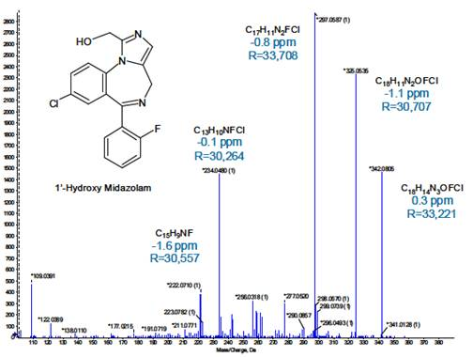
Getting the Molecular Formula
Other techniques provide the molar mass of an unknown sample
On the left is a mass spectrum that provides such information
With the molar mass and the empirical formula, the molecular formula can be determined

Slide 26
Terrorism in Berlin

Slide 27
An unknown plastic is found in a suitcase at Berlin-Tegel Airport.
Mass spectrometry shows the molar mass to be 365.255 g/mol.
Elemental analysis shows the following composition
C 32.88%
H 4.140%
N 19.17%
O 43.80%
What is the plastic?

Slide 28
Find the Empirical Formula
element | mass in 100 g | molar mass | mol in 100 g | normalize | multiply | round
C
H
N
O
element | mass in 100 g | molar mass | mol in 100 g | normalize | multiply | round
C | 32.88
H | 4.140
N | 19.17
O | 43.80
element | mass in 100 g | molar mass | mol in 100 g | normalize | multiply | round
C | 32.88 | 12.0108 | 2.738
H | 4.140 | 1.00795 | 4.107
N | 19.17 | 14.0067 | 1.369
O | 43.80 | 15.9994 | 2.738
element | mass in 100 g | molar mass | mol in 100 g | normalize | multiply | round
C | 32.88 | 12.0108 | 2.738 | 2.00
H | 4.140 | 1.00795 | 4.107 | 3.00
N | 19.17 | 14.0067 | 1.369 | 1.00
O | 43.80 | 15.9994 | 2.738 | 2.00
The empirical formula is C₂H₃NO₂

Slide 29
How do we find the Molecular Formula?
Four Box Method
This method uses the empirical formula and molecular molar mass to find the molecular formula
Empirical
Molecular
Formula
Molar
Mass

Slide 30
Four Box Method
This method uses the empirical formula and molecular molar mass to find the molecular formula
Empirical
Molecular
empirical
formula
molecular
formula
Formula
empirical
molar mass
molecular
molar mass
Molar
Mass

Slide 31
Our goal is the molecular formula
Elemental analysis gives us the empirical formula
Mass spectrometry gives us the molecular molar mass
Empirical
Molecular
elemental
analysis
data
molecular
formula
empirical
formula
GOAL
Formula
molecular
molar mass
empirical
molar mass
mass
spectrometry
data
Molar
Mass

Slide 32
The formulas are related by n, a whole number:
(empirical formula)_{n} = molecular formula
Empirical
Molecular
C₃H₄O₂
3
C₉H₁₂O₆
Formula
The molar masses are related in the same way:
72.063 x 3 = 216.189
3 x 12.011
+ 4 x 1.008
+ 2 x 15.999
72.063
3
9 x 12.011
+ 12 x 1.008
+ 6 x 15.999
216.189
Molar
Mass

Slide 33
Because of this relationship, we can start by calculating the empirical molar mass.
We will divide the molecular molar mass by the empirical molar mass to get n
We then apply n to the formulas
Empirical
Molecular
elemental
analysis
data
n
GOAL
Formula
empirical
molar mass
calculate
n
mass
spectrometry
data
Molar
Mass

Slide 34
Create four boxes with the elemental analysis & mass spectrometry data
Calculate the empirical molar mass
Divide the molecular molar mass by the empirical molar mass to get n
We then apply n to the formulas
Write this in your notes
Empirical
Molecular
C₂H₃NO₂
5
C₁₀H₁₅N₅O₁₀
Formula
73.051
5
365.255
Molar
Mass

Slide 35
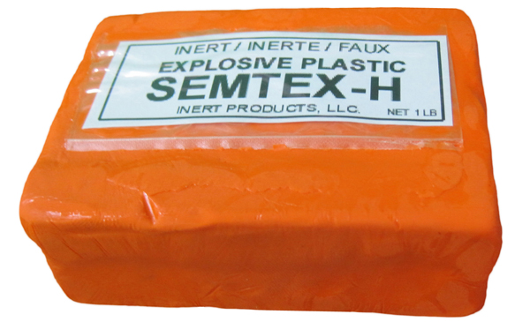
Molecular Formula of Unknown
RDX-a1
C₁₀H₁₅N₅O₁₀

Slide 36
Check for Understanding
SECTION10.4
Find the molecular formula for the following:
empirical molar molecular
formula mass formula
1) C₂H₄O 88.0 g/mole
2) C₃H₅NO₂ 348.1 g/mole
3) C₂H₈N 46.0 g/mole

Slide 37
Check for Understanding
SECTION10.4
Find the molecular formula for the following:
empirical molar molecular
formula mass formula
1) C₂H₄O 88.0 g/mole C₄H₈O₂
2) C₃H₅NO₂ 348.1 g/mole
3) C₂H₈N 46.0 g/mole

Slide 38
Check for Understanding
SECTION10.4
Find the molecular formula for the following:
empirical molar molecular
formula mass formula
1) C₂H₄O 88.0 g/mole C₄H₈O₂
2) C₃H₅NO₂ 348.1 g/mole C₁₂H₂₀N₄O₈
3) C₂H₈N 46.0 g/mole

Slide 39
Check for Understanding
SECTION10.4
Find the molecular formula for the following:
empirical molar molecular
formula mass formula
1) C₂H₄O 88.0 g/mole C₄H₈O₂
2) C₃H₅NO₂ 348.1 g/mole C₁₂H₂₀N₄O₈
3) C₂H₈N 46.0 g/mole C₂H₈N

Slide 40
Check for Understanding
Glutaminyl aspartic acid is a dipeptide composed of glutamine and aspartic acid. It is an incomplete breakdown product of protein digestion or protein catabolism. Some dipeptides are known to have physiological or cell-signaling effects although most are simply short-lived intermediates.
Mass spectrometry data shows that glutaminyl aspartic acid has a molar mass of 261.23 g/mol. Elemental analysis give the following composition:
C 41.37%
H 5.797%
N 16.08%
O 36.74%
What is the molecular formula of glutaminyl aspartic acid?

Slide 41
Find the Empirical Formula
element | mass in 100 g | molar mass | mol in 100 g | normalize | multiply | round
C
H
N
O
element | mass in 100 g | molar mass | mol in 100 g | normalize | multiply | round
C | 41.37
H | 5.797
N | 16.08
O | 36.74
element | mass in 100 g | molar mass | mol in 100 g | normalize | multiply | round
C | 41.37 | 12.0108 | 3.444
H | 5.797 | 1.00795 | 5.741
N | 16.08 | 14.0067 | 1.148
O | 36.74 | 15.9994 | 2.296
element | mass in 100 g | molar mass | mol in 100 g | normalize | multiply | round
C | 41.37 | 12.0108 | 3.444 | 3.00
H | 5.797 | 1.00795 | 5.741 | 5.00
N | 16.08 | 14.0067 | 1.148 | 1.00
O | 36.74 | 15.9994 | 2.296 | 2.00
The empirical formula is C₃H₅NO₂

Slide 42
Find the Molecular Formula
Empirical
Molecular
empirical
formula
5
molecular
formula
Formula
empirical
molar mass
5
molecular
molar mass
Molar
Mass

Slide 43
Find the Molecular Formula
Empirical
Molecular
empirical
formula
5
molecular
formula
Formula
molecular
molar mass
empirical
molar mass
5
261.23
Molar
Mass

Slide 44
Find the Molecular Formula
Empirical
Molecular
C₃H₅NO₂
5
molecular
formula
Formula
empirical
molar mass
5
261.23
Molar
Mass

Slide 45
Find the Molecular Formula
Empirical
Molecular
C₃H₅NO₂
5
molecular
formula
Formula
87.08
5
261.23
Molar
Mass

Slide 46
Find the Molecular Formula
Empirical
Molecular
C₃H₅NO₂
5
molecular
formula
Formula
87.08
3
261.23
Molar
Mass

Slide 47
Find the Molecular Formula
Empirical
Molecular
C₃H₅NO₂
3
molecular
formula
Formula
87.08
3
261.23
Molar
Mass

Slide 48
Find the Molecular Formula
Empirical
Molecular
C₃H₅NO₂
3
C₉H₁₅N₃O₆
Formula
87.08
3
261.23
Molar
Mass
The molecular formula is C₉H₁₅N₃O₆

Slide 49
Determining Hydrate Formulas

Slide 50
Hydrates
Write the red in your notes
Some molecules like to absorb water
A hydrate is a compound that has a specific number of water molecules bound to its atoms.
The number of water molecules associated with each formula unit of the compound is written following a dot.
Sodium carbonate decahydrate = Na₂CO₃ • 10H₂O

Slide 51
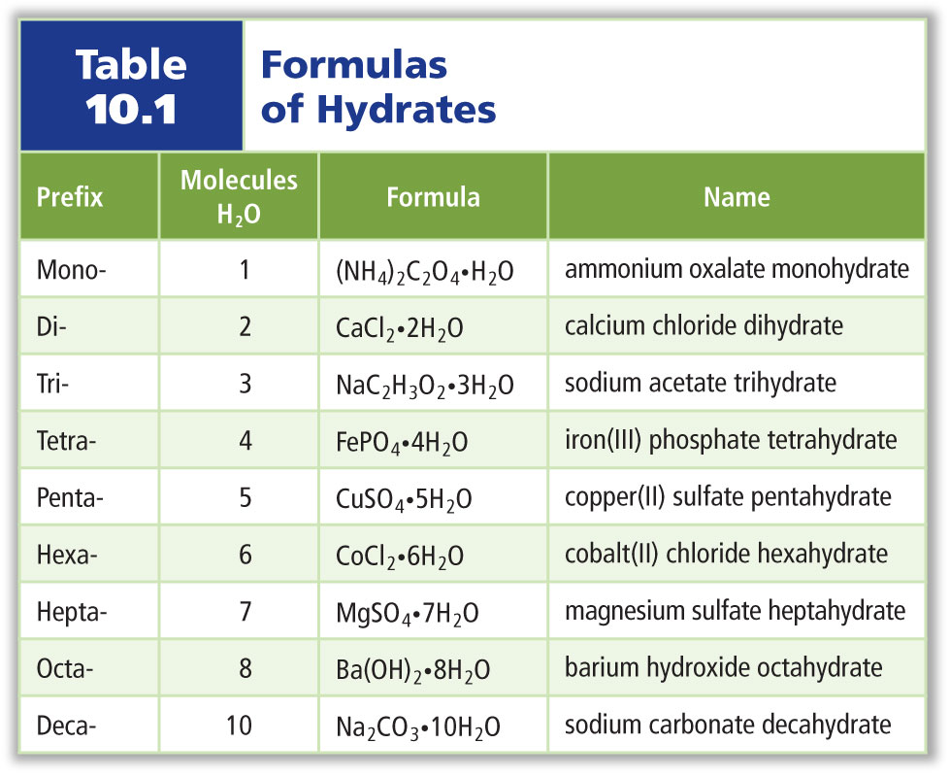
Examples of Hydrates

Slide 52
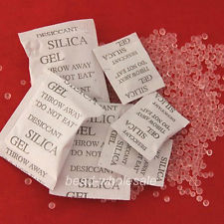
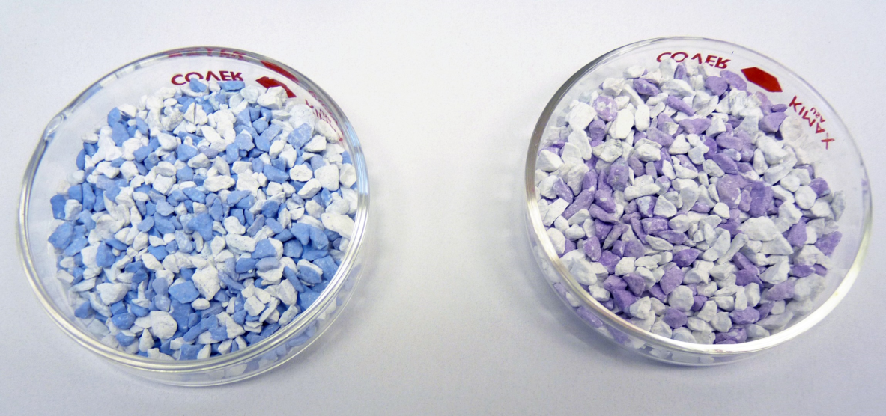
Use of Hydrates
Anhydrous forms of hydrates are often used to absorb water, particularly during shipment of electronic and optical equipment.
In chemistry labs, anhydrous forms of hydrates are used to remove moisture from the air and keep other substances dry.

Slide 53
Determining Hydrate
Maddie took an unknown hydrate of copper sulfate (CuSO₄) and dried it over a flame. Before drying, the hydrate had a mass of 34.206 g. After drying, the mass was 21.866 g.
What is the formula of the hydrate?

Slide 54
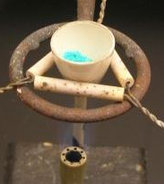
Concept for Finding Hydrate Formula
CuSO₄ ● nH₂O
CuSO₄
34.206 g
21.866 g
mol CuSO₄
n =
mol H₂O
nH₂O
mol CuSO₄
12.340 g
mol H₂O

Slide 55
Find the Moles
mol H₂O
12.340 g |  | = | mol
12.340 g | mol | = | mol
 | g
12.340 g | 1 mol | = | mol
 | 18.015 g
12.340 g | 1 mol | = | 0.685 mol
 | 18.015 g
nH₂O
2 x 1.008 + 15.999 = 18.015 g/mol
12.340 g
mol CuSO₄
21.866 g |  | = | mol
21.866 g | mol | = | mol
 | g
21.866 g | 1 mol | = | mol
 | 159.607 g
21.866 g | 1 mol | = | 0.137 mol
 | 159.607 g
CuSO₄
21.866 g
63.546 + 32.065 + 4 x 15.999 = 159.607 g/mol

Slide 56
Concept for Finding Hydrate Formula
CuSO₄ ● nH₂O
n =
mol H₂O
0.685 mol
= 5
=
mol CuSO₄
0.137 mol
CuSO₄ ● 5H₂O
You are not done until you've written the formula

Slide 57
Check for Understanding
NiCl₂ forms hydrates. A 5.00 g sample of an unknown NiCl₂ hydrate is dried to a constant mass of 2.73 g. What is the formula of the hydrate?
NiCl₂ ● 6H₂O

Slide 58
Identifying Unknowns 2 - Homework
0421 – HW
Determine formula only for 5 & 6
For 6, cobalt (II) chloride is CoCl₂

Slide 59
Backup Slides

