Slide 1
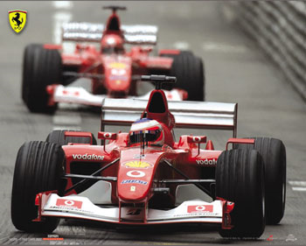
Do Now
Ferrari is one of the most successful teams in Formula 1 racing. Each race they bring several sets of spare parts for their cars. One set includes 8 tires, 3 nose cones, and 2 rear spoilers. A tire has a mass of 9 kg, a nose cones is 2 kg, and a rear spoiler is 4 kg.
Put homework into red basket
What is the total mass if Ferrari brings one set of spare parts to a race?
What is the total mass if they bring six sets of spare parts to a race?

Slide 2
item | number | mass (kg) | total mass (kg)
tires
nose cones
rear spoiler

Slide 3
item | number | mass (kg) | total mass (kg)
tires | 8
nose cones | 3
rear spoiler | 2

Slide 4
item | number | mass (kg) | total mass (kg)
tires | 8 | 9
nose cones | 3 | 2
rear spoiler | 2 | 4

Slide 5
item | number | mass (kg) | total mass (kg)
tires | 8 | 9 | 72
nose cones | 3 | 2 | 6
rear spoiler | 2 | 4 | 8
1 set = 86 kg
6 sets | 86 kg | = | 516 kg
 | 1 set

Slide 6
Last Class

Slide 7
Moles of Compounds
SWBAT compute molar masses for compounds and use this value to complete calculations.
Write this in your notes

Slide 8
Creating a Shorthand
Abbreviate each part
tires = T
nose cones = Nc
rear spoilers = Rs
Indicate how many of each with a subscript
eight tires = T₈
Indicate one set
one set = T₈Nc₃Rs₂
Indicate the number of sets with a coefficient
six sets = 6T₈Nc₃Rs₂
item
tires
nose cones
rear spoiler

Slide 9
Chemical Formulas are a Shorthand
Write this in your notes
element | symbol | number
carbon | C | 6
hydrogen | H | 12
oxygen | O | 4
C₆H₁₂O₄ means
element | symbol | number
carbon | C | 6
hydrogen | H | 12
oxygen | O | 4
6C₆H₁₂O₄ means 6 x

Slide 10
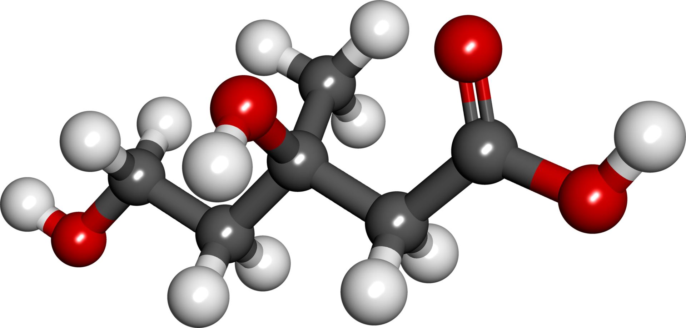
C₆H₁₂O₄ is a Compound
A pure substance that is made up of two or more different elements that are combined chemically

Slide 11
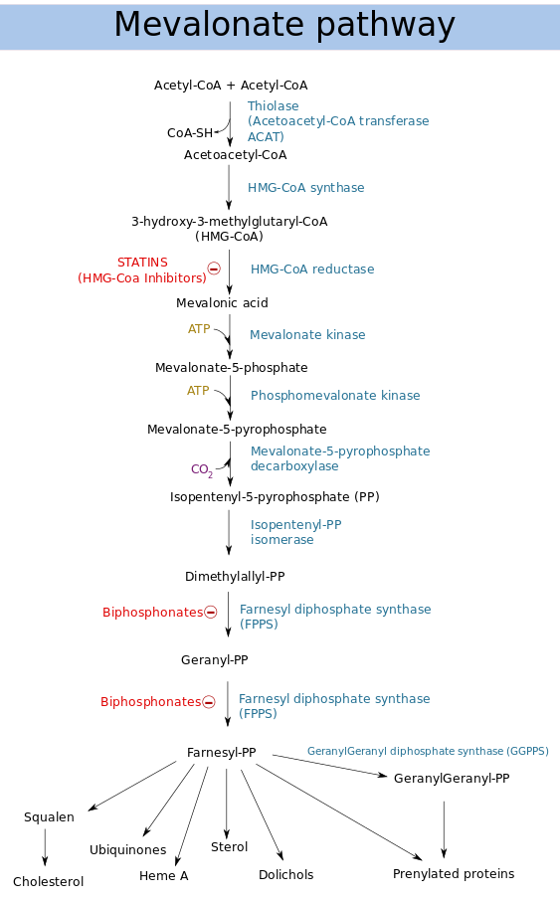
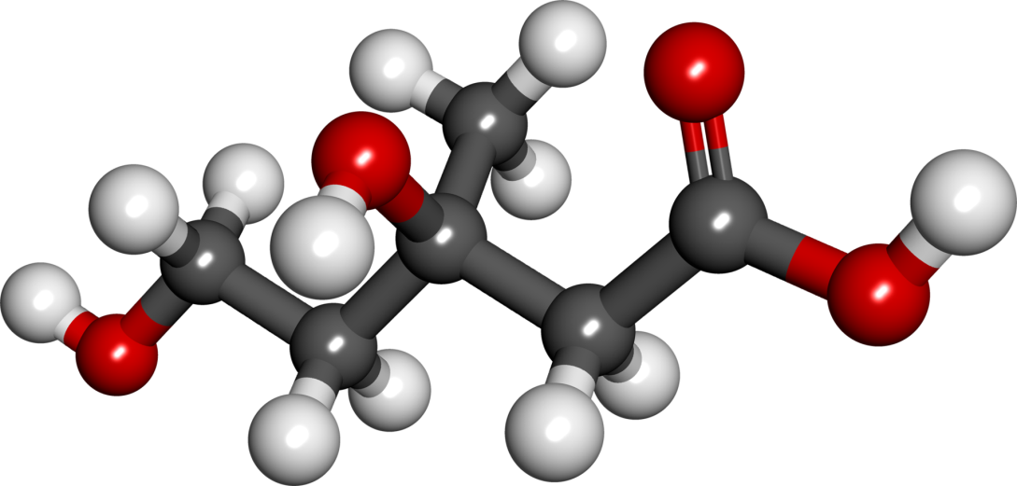
Mevalonic acid is a precursor in the biosynthetic pathway, known as the mevalonate pathway, that produces terpenes and steroids. Mevalonic acid is the primary precursor of isopentenyl pyrophosphate (IPP), that is in turn the basis for all terpenoids. Mevalonic acid is chiral and the (3R)-enantiomer is the only one that is biologically active.

Slide 12
Rules for Chemical Formulas
Write this in your notes
Subscripts
modify the element immediately to the left
NH₄Cl has 4 H's
if parentheses immediately to the left, modify everything in the parentheses
(NH₄)₃PO₄ has 3 NH₄'s
if no subscript, the value of one is assumed
H₂S has 1 S
Coefficients
modify everything in the compound immediately to the right
8H₂O has eight H₂O's

Slide 13
Check for Understanding
Identify the number of each element in these compounds
C₅H₅N
C₈H₁₆O₃
(NH₄)₂SO₄
Mg(NO₃)₂
Ca₃(PO₄)₂
NH₄OH
NH₄NO₃

Slide 14
Chemical Formulas are a Shorthand
element | symbol | number
carbon | C | 6
hydrogen | H | 12
oxygen | O | 4
C₆H₁₂O₄ means
How do we determine the molar mass of C₆H₁₂O₄?

Slide 15
Molar Mass for Compounds
Write this in your notes
Determine how many of each element is present
element | symbol | number
carbon | C | 6
hydrogen | H | 12
oxygen | O | 4

Slide 16
Molar Mass for Compounds
Write this in your notes
Determine how many of each element is present
Multiply this number by the atomic mass
element | symbol | number
carbon | C | 6
hydrogen | H | 12
oxygen | O | 4
element | symbol | number | atomic mass
carbon | C | 6 | 12.0107
hydrogen | H | 12 | 1.00794
oxygen | O | 4 | 15.9994
element | symbol | number | atomic mass | mass
carbon | C | 6 | 12.0107 | 72.0642
hydrogen | H | 12 | 1.00794 | 12.0953
oxygen | O | 4 | 15.9994 | 63.9976

Slide 17
Molar Mass for Compounds
Write this in your notes
Determine how many of each element is present
Multiply this number by the atomic mass
Add the totals together
element | symbol | number | atomic mass | mass
carbon | C | 6 | 12.0107 | 72.0642
hydrogen | H | 12 | 1.00794 | 12.0953
oxygen | O | 4 | 15.9994 | 63.9976
element | symbol | number | atomic mass | mass
carbon | C | 6 | 12.0107 | 72.0642
hydrogen | H | 12 | 1.00794 | 12.0953
oxygen | O | 4 | 15.9994 | 63.9976
 |  |  |  | 148.1571

Slide 18
Molar Mass for Compounds
Write this in your notes
The molar mass of C₆H₁₂O₄ is 148.1571 g/mol
One mole of C₆H₁₂O₄ has a mass of 148.1571 g
element | symbol | number | atomic mass | mass
carbon | C | 6 | 12.0107 | 72.0642
hydrogen | H | 12 | 1.00794 | 12.0953
oxygen | O | 4 | 15.9994 | 63.9976
 |  |  |  | 148.1571

Slide 19
Molar Mass Calculations
Write this in your notes
What is the mass of 6 moles of C₆H₁₂O₄?
The molar mass of C₆H₁₂O₄ is 148.1571 g/mol
One mole of C₆H₁₂O₄ has a mass of 148.1571 g
6 mol | 148.1571 g | = | 888.9426 g
 | 1 mol

Slide 20
item | number | mass (kg) | total mass (kg)
tires | 8 | 9 | 72
nose cones | 3 | 2 | 6
rear spoiler | 2 | 4 | 8
1 set = 86 kg
Just like the
"Do Now"
6 sets | 86 kg | = | 516 kg
 | 1 set

Slide 21
Group Practice
What is the molar mass of Na₂Cr₂O₇?
element | symbol | number | atomic mass | mass
sodium | Na | 2 | 22.989769 | 45.979538
chromium | Cr | 2 | 51.9961 | 103.992
oxygen | O | 7 | 15.9994 | 111.996
 |  |  |  | 261.968

Slide 22
Significant Figures
Sodium's atomic mass is 22.989769 g/mol
This is 8 significant figures
This is far more accuracy than most instruments can provide.
For this class, round atomic masses to the thousandths place
Sodium 22.989769 becomes 22.990
Hydrogen 1.00794 becomes 1.008
Carbon 12.0107 becomes 12.011

Slide 23
Group Practice
What is the molar mass of C₆H₁₂O₆?
element | symbol | number | atomic mass | mass
carbon | C | 6 | 12.011 | 72.066
hydrogen | H | 12 | 1.008 | 12.096
oxygen | O | 6 | 15.999 | 95.994
 |  |  |  | 180.156

Slide 24
Using Your Calculator
Once you fully understand the process for determining molar mass of compounds, you can do the whole process on your calculator
What is the molar mass of C₆H₁₂O₆?
(6 x 12.011) + (12 x 1.008) + (6 x 15.999)
In this case, you can leave out the parentheses and still get the same result, but be careful about the order of operations

Slide 25
Group Practice
What is the mass of 6.33 mol NH₄NO₃?
(2 x 14.007) + (4 x 1.008) + (3 x 15.999)
= 80.043 g/mol
6.33 mol | 80.043 g | = | 506.67219 g
 | 1 mol
 |  |  | ↓ ↓ ↓
 |  |  | 507 g

Slide 26
Group Practice
How many moles in 82.5 g of Rb₂SO₄?
(2 x 85.468) + (1 x 32.065) + (4 x 15.999)
= 266.997 g/mol
82.5 g | 1 mol | = | 0.3089922359 mol
 | 266.997 g
 |  |  | ↓ ↓ ↓
 |  |  | 0.309 mol

Slide 27
Group Practice
What is the mass of 0.0512 mol Ca₃(PO₄)₂?
(3 x 40.078) + (2 x 30.974) + (8 x 15.999)
= 310.174 g/mol
0.0512 mol | 310.174 g | = | 15.8809088 g
 | 1 mol
 |  |  | ↓ ↓ ↓
 |  |  | 15.9 g

Slide 28
Group Practice
How many moles in 3.83 x 10⁻⁴ g of Ti(OH)₄?
(1 x 47.867) + (4 x 1.008) + (4 x 15.999)
= 115.895 g/mol
3.83 x 10⁻⁴ g | 1 mol | = | 3.30 x 10⁻⁶ g
 | 115.895 g

Slide 29
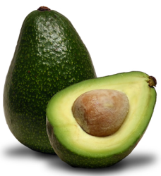
Challenge
How many oxygen atoms in 14.3 g of Fe(OH)₃?
1
molar mass
of Fe(OH)₃
14.9 g Fe(OH)₃
mol Fe(OH)₃
2
3
mol O
atoms O

Slide 30
Challenge
How many oxygen atoms in 14.3 g of Fe(OH)₃?
1
(1 x 55.845) + (3 x 1.008) + (3 x 15.999) = 106.866 g/mol
14.3 g | 1 mol Fe(OH)₃ | = | 0.133812 mol Fe(OH)₃
 | 106.866 g
0.133812 mol Fe(OH)₃ | 3 mol O | = | 0.401437 mol O
 | 1 mol Fe(OH)₃
2
0.401437 mol O | 6.02 x 10²³ atoms | = | 2.42 x 10²³ atoms
 | 1 mol
3
14.3 g | 1 mol Fe(OH)₃ | 3 mol O | 6.02 x 10²³ atoms | = | 2.42 x 10²³ atoms
 | 106.866 g | 1 mol Fe(OH)₃ | 1 mol
1
2
3

Slide 31
Moles of Compounds - Homework
pg 335, problem 35
pg 336, problems 37 & 38
pg 337, problem 40

Slide 32
Individual Practice
What is the molar mass of NaOH?
What is the molar mass of CaCl₂?
How many moles in 22.6 g AgNO₃?
What is the mass of 3.25 mol of H₂SO₄?
40.00 g/mol
110.98 g/mol
0.133 mol
319 g
pg 335, #35a & b, pg 337, #40a, pg 336 #37

Slide 33
Individual Practice
What is the molar mass of KC₂H₃O₂?
How many moles in 6.50 g ZnSO₄?
What is the mass of 4.35 x 10⁻² of ZnCl₂?
How many mole in 35.0 g of HCl?
98.14 g/mol
0.0403 mol
5.93 g
0.960 mol
pg 335, #35c, pg 337, #40b, pg 336 #38 , pg 337, #40c

Slide 34
Backup Slides

Slide 35
Not Covered

Slide 36
The periodic table gives us atomic masses and molar masses for each element

