Slide 1
Do Now
Use a picket fence to determine how many donuts are found in 8 dozen.
Use a picket fence to determine how many dozen can be made from 72 donuts
8 dozen | 12 donuts | = | 96 donuts
 | 1 dozen
72 donuts | 1 dozen | = | 6 dozen
 | 12 donuts

Slide 2
Nuclear Chem Lab Report
Lab report will be due on Monday, Jan 9th
Worth 100 points toward 2nd quarter grade
Late penalties apply
10 point penalty per day for first 4 days
If you skip all the lab reports, expect to fail this course

Slide 3
GET WET Project Groundwater Education Through Water Evaluation and Testing
You will be participating in the GET WET project this year
Provides you with education on groundwater and the opportunity to test a water sample from your home for contaminants.
This involves three sessions
Jan 6 - Introduction & Bottle Distribution
Jan 13 - Water Testing (Lab Day!)
Jan 27 - Results Day

Slide 4
Units
Scientific Method
Atomic Theory
Nuclear Chemistry
The Mole
Electrons
Periodic Properties
Bonding
Nomenclature
Chemical Reactions
Stoichiometry
Mixtures and Solutions
Chemical Equilibrium
Acid-Base Chemistry
Redox & Electrochemistry
Gas Laws
Thermodynamics
Chapter 10 in our book
This unit is heavy on computation with relatively simple concepts

Slide 5
This Unit Has a Different Format
Lesson
In-class practice
Homework
Homework review
Quiz
Repeat 5 Times
Review
Cold Call
Test 4 - The Mole

Slide 6
Quizzes
You will have 5 quizzes in this unit
Each will have 2-5 questions
Each question is worth 3 points
NO PARTIAL CREDIT!!!
To get 3 points, you must have:
the correct answer
properly use scientific notation, significant figures and units

Slide 7
Test 4 - The Mole
Course | Questions | Point Value | MC Question | OR Questions | Concept Questions | Computations
Honors | 14 | 5 & 10 | 0 | 14 | 2 | 12
Chem | 13 | 5, 10 & 15 | 2 | 11 | 2 | 11
Period | Test Day & Date
7 | Thursday, January 26 |  | Write this in your notes
2, 3, 4 | Tuesday, January 31
6 | Wednesday, February 1
Note that this test will be part of 3Q, not 2Q (ends Jan 24)
If you need to boost your grade, do well on the lab report (100 pts), the homework (50 pts) the quizzes (48 pts)
and participation (50 pts)
This represents 53% of your 2Q grade

Slide 8
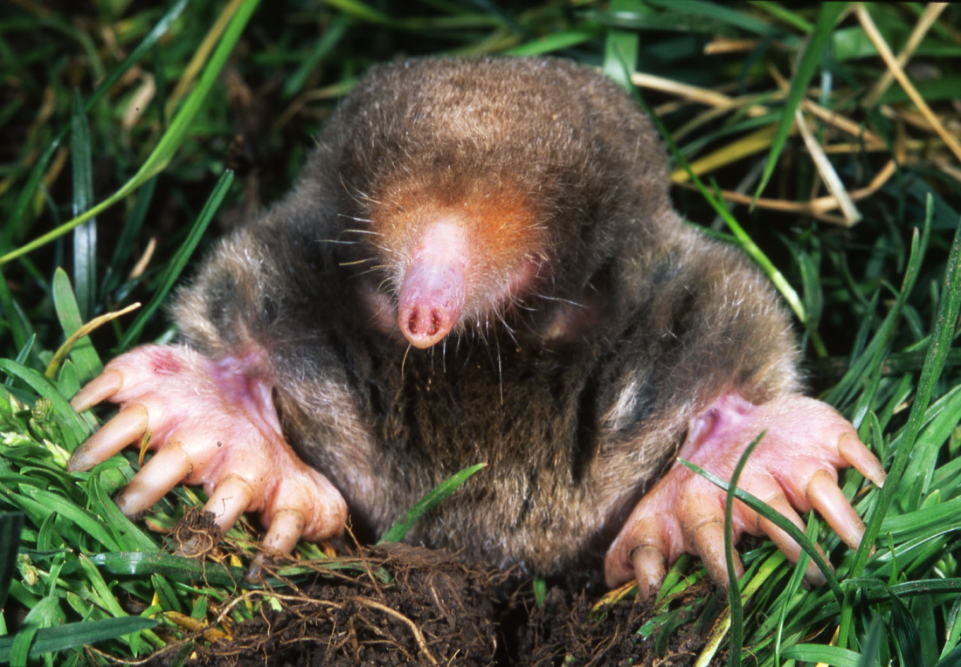
The Mole
SWBAT explain the concept of a mole and use Avogadro's number to convert back and forth between moles and atoms
Write this in your notes

Slide 9
Units of Measurement
A unit of measurement is a defined magnitude of a physical quantity
Units of measurement are chosen in a way that is appropriate and convenient for their use
Many different units for distance

Slide 10
Units for Chemistry
Chemistry deals with atoms which are very, very small.
Even a speck of dust contains a very, very large number of atoms
To measure atoms, chemists needed a unit that counted a very, very large number of atoms
The unit created is called the "mole"

Slide 11
The Mole
Write this in your notes
The mole is a unit for counting atoms
1 mol = 6.02 x 10²³ atoms
(or molecules, or formula units, or particles)
Symbol is "mol"
The mole is the SI base unit used to measure the amount of a substance
SI defines the mole as the amount of atoms in 12 g of pure carbon-12

Slide 12
You Must Memorize This Conversion Factor
6.02 x 10²³ atoms
1 mole

Slide 13
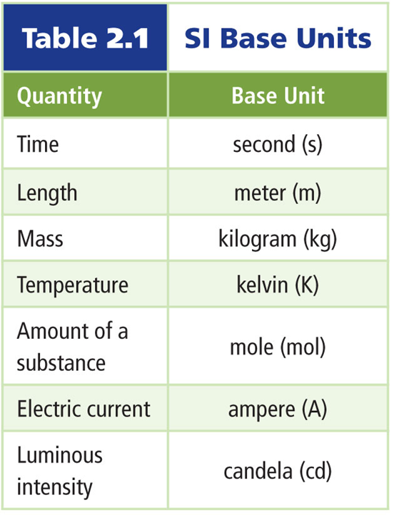
SI Base Units
Review

Slide 14
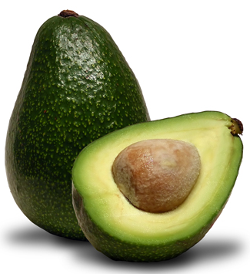
Avogadro's Number
1 mol = 6.02 x 10²³ atoms
6.02 x 10²³ is the number we will use
The real number is
602,214,129,000,000,000,000,000
6.02 x 10²³ is called Avogadro's number
Write this in your notes
For our purposes, Avogadro's number to three significant figures will be accurate enough

Slide 15
Calculations
Two types of calculations in this lesson
Conversions from moles to atoms
Conversions from atoms to moles
Instead of atoms, these calculations can involve:
molecules (NH₃)
formula units (part of a molecule)
particles (electrons)

Slide 16
Conversions from Moles to Atoms
A chunk of sodium contains 0.044 mol. How many atoms does it contain?
0.044 mol | 6.02 x 10²³ atoms | = | 2.6 x 10²² atoms
 | 1 mol

Slide 17
Conversions from Moles to Atoms
A cylinder contains 18.5 mol of ammonia gas. How many molecules does it contain?
18.5 mol | 6.02 x 10²³ molecules | = | 1.11 x 10²⁵ molecules
 | 1 mol

Slide 18
Conversions from Moles to Atoms
A computer chip is sprayed with 7.3 x 10⁻⁵ mol of germanium. How many atoms does it contain?
7.3 x 10⁻⁵ mol | 6.02 x 10²³ atoms | = | 4.4 x 10¹⁹ atoms
 | 1 mol

Slide 19
Conversions from Moles to Atoms
3.6 mol of AlBr₃ is added to water. Each AlBr₃ molecule separated into 1 Al⁺³ and 3 Br⁻¹. How many bromine ions does it contain?
3.6 mol | 6.02 x 10²³ AlBr₃ | 3 Br⁻¹ ions | = | 6.5 x 10²⁴ ions
 | 1 mol | 1 AlBr₃

Slide 20
Conversions from Atoms to Moles
An electroplating procedure attached 2.71 x 10²⁵ atoms of silver to a mirror. How many moles does this contain?
2.71 x 10²⁵ atoms | 1 mol | = | 45.0 mol
 | 6.02 x 10²³ atoms
If your answer was 4.50 x 10⁴⁷,
you didn't divide by scientific notation correctly

Slide 21
Conversions from Atoms to Moles
A piece of ice contained 4.54 x 10²² molecules of water. How many moles does this contain?
4.54 x 10²² molecules | 1 mol | = | 0.0754 mol
 | 6.02 x 10²³ molecules

Slide 22
Conversions from Atoms to Moles
When Jordan touched the plug, he got a shock that contained 5.9 x 10¹⁹ electrons. How many moles of electrons does this contain?
5.9 x 10¹⁹ electrons | 1 mol | = | 9.8 x 10⁻⁵ mol
 | 6.02 x 10²³ electrons

Slide 23
The Mole - Homework
pg 323, problems 1-4
pg 324, problems 5-6
Note: treat "formula units" and "representative particles" the same as "molecules"

Slide 24
Backup Slides

Slide 25
Individual Practice
How many atoms in 2.50 mol of Zn?
How many moles in 5.75 x 10²⁴ atoms of Al?
How many molecules in 11.5 mol of water?
How many moles in 2.50 x 10²⁰ atoms of Fe
1.51 x 10²⁴ Zn atoms
9.55 mol of Al
6.92 x 10²⁴ water molecules
4.15 x 10⁻⁴ mol of Fe
pg 323, #1, pg 324, #5a, pg 323 #2, pg 324, #5b

Slide 26
Individual Practice
How many atoms in 3.25 mol of AgNO₃?
How many moles in 3.75 x 10²⁴ molecules of CO₂?
How many moles in 3.58 x 10²³ molecules of ZnCl₂?
How many oxygen atoms in 5.00 mol of O₂
1.96 x 10²⁴ AgNO₃ atoms
6.23 mol of CO₂
0.595 mol of ZnCl₂
6.02 x 10²⁴ atoms of oxygen
pg 323, #3, pg 324, #6a & b, pg 323 #4

Slide 27
Not Covered

Slide 28
Improvements
Work the penny & sand into an activity in class
For Unknowns 2,
make unknown something we will determine (slide 1)
slide 15
Lab on hydrates

Slide 29
Do Now
What is the value of these units of measurement?
Unit of measure | Items measured | Value
dozen | donuts, eggs
gross | pens, pencils
ream | paper
mile | distance
acre | area
Hiroshima bomb | energy
Wheaton | Twitter followers

Slide 30
Do Now
What is the value of these units of measurement?
Unit of measure | Items measured | Value
dozen | donuts, eggs | 12 items
gross | pens, pencils
ream | paper
mile | distance
acre | area
Hiroshima bomb | energy
Wheaton | Twitter followers

Slide 31
Do Now
What is the value of these units of measurement?
Unit of measure | Items measured | Value
dozen | donuts, eggs | 12 items
gross | pens, pencils | 144 items
ream | paper
mile | distance
acre | area
Hiroshima bomb | energy
Wheaton | Twitter followers

Slide 32
Do Now
What is the value of these units of measurement?
Unit of measure | Items measured | Value
dozen | donuts, eggs | 12 items
gross | pens, pencils | 144 items
ream | paper | 500 sheets
mile | distance
acre | area
Hiroshima bomb | energy
Wheaton | Twitter followers

Slide 33
Do Now
What is the value of these units of measurement?
Unit of measure | Items measured | Value
dozen | donuts, eggs | 12 items
gross | pens, pencils | 144 items
ream | paper | 500 sheets
mile | distance | 5280 feet
acre | area
Hiroshima bomb | energy
Wheaton | Twitter followers

Slide 34
Do Now
What is the value of these units of measurement?
Unit of measure | Items measured | Value
dozen | donuts, eggs | 12 items
gross | pens, pencils | 144 items
ream | paper | 500 sheets
mile | distance | 5280 feet
acre | area | 43,560 square feet
Hiroshima bomb | energy
Wheaton | Twitter followers

Slide 35
Do Now
What is the value of these units of measurement?
Unit of measure | Items measured | Value
dozen | donuts, eggs | 12 items
gross | pens, pencils | 144 items
ream | paper | 500 sheets
mile | distance | 5280 feet
acre | area | 43,560 square feet
Hiroshima bomb | energy | 6 x 10¹³ joules
Wheaton | Twitter followers

Slide 36
Do Now
What is the value of these units of measurement?
Unit of measure | Items measured | Value
dozen | donuts, eggs | 12 items
gross | pens, pencils | 144 items
ream | paper | 500 sheets
mile | distance | 5280 feet
acre | area | 43,560 square feet
Hiroshima bomb | energy | 6 x 10¹³ joules
Wheaton | Twitter followers | 500,000 followers

