Slide 1
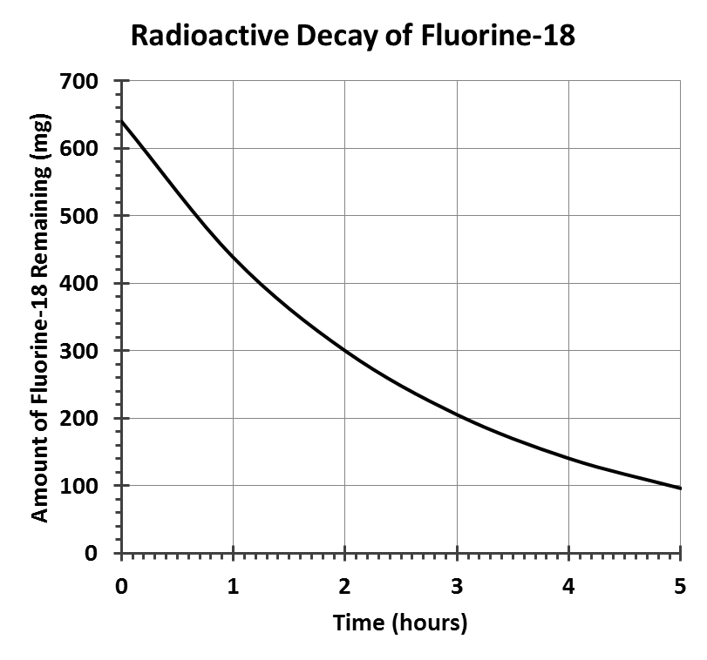
0331 – Practice - Kinetics
Name
Date
Period
SHOW YOUR WORK and put your final answer in the box for each question. Be sure to use proper units and significant figures.
1) Vanadium-48 has a half-life of 16 days. If a 800.0 gram sample is allowed to stand for 80.0 days, how much vanadium-48 will remain?
2) Fermium-253 has a half-life of 3.0 days. After sitting for 9.0 days, a sample of fermium-253 weighs 4.6 milligrams. What was the initial mass?
3) A graph showing the radioactive decay of fluorine-18 is shown below. Based on only this information and using proper significant figures, what is the half-life of fluorine-18?

Slide 2
4) 0.600 g of iodine-131 was generated. After 24 days, only 0.075 g remain. What is the half-life in days of the iodine-131
5) How much of a 3.44 g sample of cobalt-57 remains after exactly two years if it has a half-life of 272 days?
6) Carbon-11 has a half-life of 20.3 minutes. After decaying for 2.66 minutes, a sample of carbon-11 has a mass of 45.7 mg. What was the mass of the original sample?

Slide 3
7) Helium-8 has a half-life of only 119 milliseconds. When first generated, it took 1.05 seconds to determine the sample had a mass of 81.6 ug. What was the mass of the original sample?
8) Carbon-14 dating is a tool to determine the age of ancient objects. It takes advantage of the fact that animals and plants stop exchanging carbon with their environment as soon as they die. For example, Ötzi the Iceman, a mummy found in the Italian Alps, was shown to have died some 5300 years ago. If the typical human has 150 picograms of carbon-14 at the time of his or her death, and the half-life of carbon-14 is 5730 years, how much carbon-14 did scientists find in Ötzi's body?

Slide 4
9) Beryllium-14 is an unstable isotope which suffers beta decay to produce boron-14. When it was first discovered, a 112 ug sample was produced. The process to confirm identity took 14.52 milliseconds, at which time only 14.0 ug remained. Based on this information, what is the half-life of beryllium-14?
10) Positron emission tomography (PET) is a nuclear medicine technique that provides three dimensional images of the inside of the body. The most common PET technique uses glucose that has been modified to include a radioactive fluorine-18 atom. When the fluorine-18 decays in the body, the released positrons collide with electrons in the surrounding tissues. This matter-antimatter collision annihilates both particles and produces gamma ray photons that are detected. Because the body uses the fluorinated glucose, PET scanning also shows the metabolic activity of the tissues being scanned.
Fluorine-18 has a half-life of 1.83 hours, so samples must be prepared fresh at the hospital for PET scans. Beginning with a 1.440 gram sample, a chemist carries out the entire synthesis of fluorinated glucose and delivers 45.0 mg of pure materials for PET scanning. Based on this information, how long did the synthesis take to complete.

Slide 5
0331 – Practice - Kinetics
Name
Date
SHOW YOUR WORK and put your final answer in the box for each question. Be sure to use proper units and significant figures.
1) Vanadium-48 has a half-life of 16 days. If a 800.0 gram sample is allowed to stand for 80.0 days, how much vanadium-48 will remain?
5 half-lives, so 800 è 400 è 200 è 100 è 50 è 25 g
2) Fermium-253 has a half-life of 3.0 days. After sitting for 9.0 days, a sample of fermium-253 weighs 4.6 milligrams. What was the initial mass?
3 half-lives, so 4.6 è 9.2 è 18.4 è 36.8 ----> 37 mg (multiplication rules)
3) A graph showing the radioactive decay of fluorine-18 is shown below. Based on only this information and using proper significant figures, what is the half-life of fluorine-18?
1.83 hours (actual is 1.83 hours)
25 g
37 mg
1.83 h

Slide 6

4) 0.600 g of iodine-131 was generated. After 24 days, only 0.075 g remain. What is the half-life in days of the iodine-131
0.600 è 0.300 è 0.150 è 0.075 g. 3 half-lives have passed, so T = 8.0 days.
5) How much of a 3.44 g sample of cobalt-57 remains after exactly two years if it has a half-life of 272 days?
N = N₀$(\frac{1}{2})^{t/T}$ = 3.44$(\frac{1}{2})^{{730}/{272}}$ = 0.53536 ---> 535 mg
6) Carbon-11 has a half-life of 20.3 minutes. After decaying for 2.66 minutes, a sample of carbon-11 has a mass of 45.7 mg. What was the mass of the original sample?
N₀ = $\frac{N}{(\frac{1}{2})^{t/T}}\text{= }\frac{45.7}{(\frac{1}{2})^{{2.66}/{20.3}}}$= 50.04509 ---> 50.0 mg
8.0 days
535 mg
50.0 mg

Slide 7
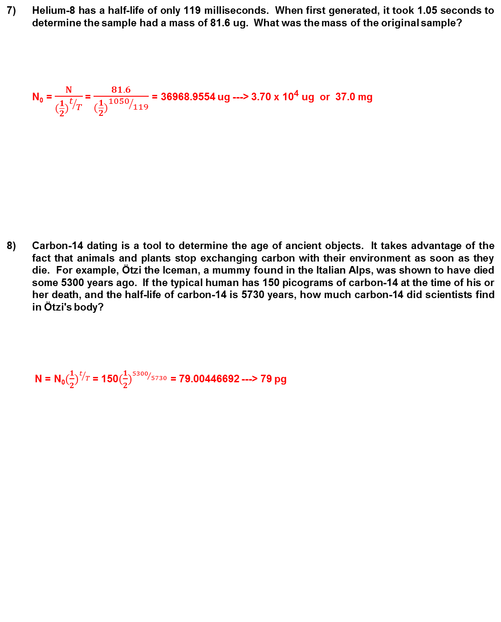
7) Helium-8 has a half-life of only 119 milliseconds. When first generated, it took 1.05 seconds to determine the sample had a mass of 81.6 ug. What was the mass of the original sample?
N₀ = $\frac{N}{(\frac{1}{2})^{t/T}}\text{= }\frac{81.6}{(\frac{1}{2})^{{1050}/{119}}}$= 36968.9554 ug ---> 3.70 x 10⁴ ug or 37.0 mg
8) Carbon-14 dating is a tool to determine the age of ancient objects. It takes advantage of the fact that animals and plants stop exchanging carbon with their environment as soon as they die. For example, Ötzi the Iceman, a mummy found in the Italian Alps, was shown to have died some 5300 years ago. If the typical human has 150 picograms of carbon-14 at the time of his or her death, and the half-life of carbon-14 is 5730 years, how much carbon-14 did scientists find in Ötzi's body?
N = N₀$(\frac{1}{2})^{t/T}$ = 150$(\frac{1}{2})^{{5300}/{5730}}$ = 79.00446692 ---> 79 pg
37,000 ug
79 pg

Slide 8
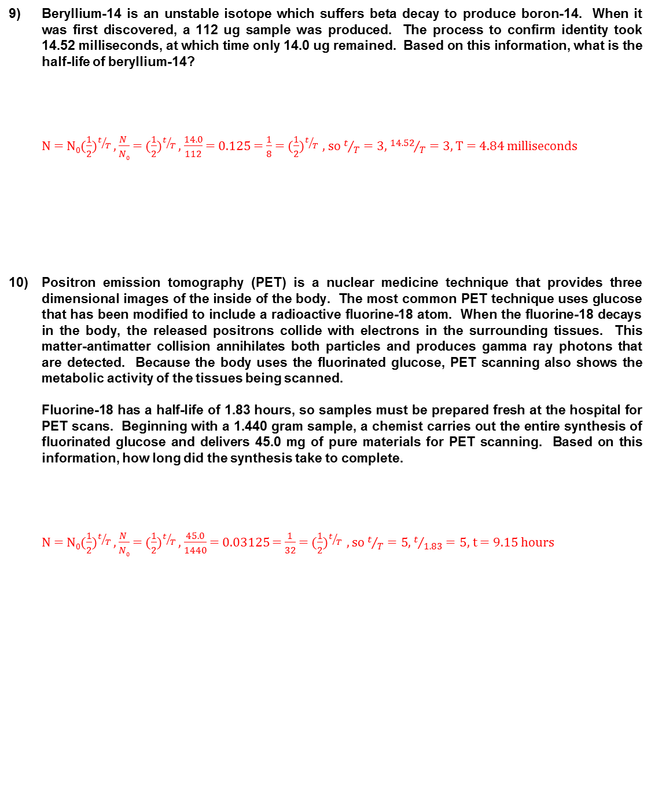
9) Beryllium-14 is an unstable isotope which suffers beta decay to produce boron-14. When it was first discovered, a 112 ug sample was produced. The process to confirm identity took 14.52 milliseconds, at which time only 14.0 ug remained. Based on this information, what is the half-life of beryllium-14?
N = N₀$(\frac{1}{2})^{t/T}$ , $\frac{N }{N0}$ = $(\frac{1}{2})^{t/T}$ , $\frac{14.0}{112}$ = 0.125 = $\frac{1}{8}$ = $(\frac{1}{2})^{t/T}$ , so $t/T=3$, ${14.52}/T=3$, T = 4.84 milliseconds
10) Positron emission tomography (PET) is a nuclear medicine technique that provides three dimensional images of the inside of the body. The most common PET technique uses glucose that has been modified to include a radioactive fluorine-18 atom. When the fluorine-18 decays in the body, the released positrons collide with electrons in the surrounding tissues. This matter-antimatter collision annihilates both particles and produces gamma ray photons that are detected. Because the body uses the fluorinated glucose, PET scanning also shows the metabolic activity of the tissues being scanned.
Fluorine-18 has a half-life of 1.83 hours, so samples must be prepared fresh at the hospital for PET scans. Beginning with a 1.440 gram sample, a chemist carries out the entire synthesis of fluorinated glucose and delivers 45.0 mg of pure materials for PET scanning. Based on this information, how long did the synthesis take to complete.
N = N₀$(\frac{1}{2})^{t/T}$ , $\frac{N }{N0}$ = $(\frac{1}{2})^{t/T}$ , $\frac{45.0}{1440}$ = 0.03125 = $\frac{1}{32}$ = $(\frac{1}{2})^{t/T}$ , so $t/T=5$, $t/{1.83}=5$, t = 9.15 hours
4.84 ms
9.15 h

