Slide 1
Do Now
Many isotopes need to go through multiple decays in order to become stable.
Astatine-215 suffers 2 alpha decays followed by a beta decay to become stable.
For astatine-215 and its decay daughter atom
determine the atomic notation
determine the stability factors
rate the stability factors
(J K L)

Slide 2
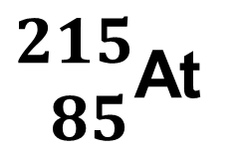
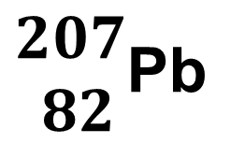
Do Now
$\begin{matrix}215 \\ 85\end{matrix}$At
α
α
β
$\begin{matrix}207 \\ 82\end{matrix}$Pb
–2
–2
+1
p:
85
82
–2
–2
–1
n:
130
125
n/p:
1.53
J
1.52
J
o/e:
o/e
K
e/o
K
Z:
>82
L
≤ 82
J

Slide 3
Homework
Do all 4 steps of analysis for the following isotopes:
fluorine-16
arsenic-76
bismuth-209
zirconium-93
gallium-66

Slide 4
Check for Understanding 1
Fluorine-16 is radioactive.
Analyze all three nuclear stability factors
Determine which factor(s) need to be altered
Predict the decay pathway & product
Reanalyze the three nuclear stability factors to determine if they are now acceptable.

Slide 5
Check for Understanding 1
$\begin{matrix}16 \\ 9\end{matrix}$F
β⁺
$\begin{matrix}16 \\ 8\end{matrix}$O
p:
9
8
n:
7
8
n/p:
0.78
L
1.00
K
odd/even:
o/o
L
e/e
J
Z:
≤ 82
J
≤ 82
J
This decay occurs in PET scanning
PET = Positron Emission Tomography

Slide 6
Check for Understanding 2
Arsenic-76 is radioactive.
Analyze all three nuclear stability factors
Determine which factor(s) need to be altered
Predict the decay pathway & product
Reanalyze the three nuclear stability factors to determine if they are now acceptable.

Slide 7
Check for Understanding 2
$\begin{matrix}76 \\ 33\end{matrix}$As
β
$\begin{matrix}76 \\ 34\end{matrix}$Se
p:
33
34
n:
43
42
n/p:
1.30
L
1.24
J
odd/even:
o/o
L
e/e
J
Z:
≤ 82
J
≤ 82
J

Slide 8
Check for Understanding 3
Bismuth-209 is radioactive.
Analyze all three nuclear stability factors
Determine which factor(s) need to be altered
Predict the decay pathway & product
Reanalyze the three nuclear stability factors to determine if they are now acceptable.

Slide 9
Check for Understanding 3
$\begin{matrix}209 \\ 83\end{matrix}$Bi
α
$\begin{matrix}205 \\ 81\end{matrix}$Tl
p:
83
81
n:
126
124
n/p:
1.52
J
1.53
J
odd/even:
o/e
K
o/e
K
Z:
> 82
L
< 82
J

Slide 10
Check for Understanding 4
Zirconium-93 is radioactive.
Analyze all three nuclear stability factors
Determine which factor(s) need to be altered
Predict the decay pathway & product
Reanalyze the three nuclear stability factors to determine if they are now acceptable.

Slide 11
Check for Understanding 4
$\begin{matrix}93 \\ 40\end{matrix}$Zr
β
$\begin{matrix}93 \\ 41\end{matrix}$Nb
p:
40
41
n:
53
52
n/p:
1.33
L
1.27
J
odd/even:
e/o
K
o/e
K
Z:
≤ 82
J
≤ 82
J

Slide 12
Check for Understanding 5
Gallium-66 is radioactive.
Analyze all three nuclear stability factors
Determine which factor(s) need to be altered
Predict the decay pathway & product
Reanalyze the three nuclear stability factors to determine if they are now acceptable.

Slide 13
Check for Understanding 5
$\begin{matrix}66 \\ 31\end{matrix}$Ga
β⁺
$\begin{matrix}66 \\ 30\end{matrix}$Zn
p:
31
30
n:
35
36
n/p:
1.13
L
1.20
J
odd/even:
o/o
L
e/e
J
Z:
≤ 82
J
≤ 82
J

Slide 14
Backups

Slide 15
Check for Understanding 1
Fluorine-16 is radioactive.
Analyze all three nuclear stability factors
Determine which factor(s) need to be altered
Predict the decay pathway & product
Reanalyze the three nuclear stability factors to determine if they are now acceptable.

Slide 16
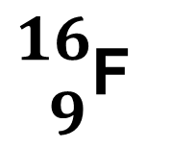
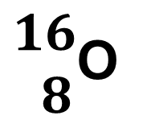
Check for Understanding 1
$\begin{matrix}16 \\ 9\end{matrix}$F
β⁺
$\begin{matrix}16 \\ 8\end{matrix}$O
p:
9
8
n:
7
8
n/p:
0.78
L
1.00
K
odd/even:
o/o
L
e/e
J
Z:
≤ 82
J
≤ 82
J
This decay occurs in PET scanning
PET = Positron Emission Tomography

Slide 17
Check for Understanding 2
Carbon-14 is radioactive.
Analyze all three nuclear stability factors
Determine which factor(s) need to be altered
Predict the decay pathway & product
Reanalyze the three nuclear stability factors to determine if they are now acceptable.

Slide 18
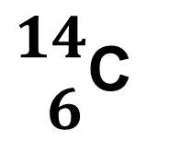
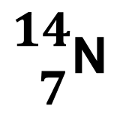
Check for Understanding 2
$\begin{matrix}14 \\ 6\end{matrix}$C
β
$\begin{matrix}14 \\ 7\end{matrix}$N
p:
6
7
n:
8
7
n/p:
1.33
L
1.00
K
odd/even:
e/e
J
o/o
L
Z:
≤ 82
J
≤ 82
J
Even though the odd/odd status is unstable, this decay occurs because the n/p ratio is so far from predicted

Slide 19
Check for Understanding 3
Radon-222 is radioactive.
Analyze all three nuclear stability factors
Determine which factor(s) need to be altered
Predict the decay pathway & product
Reanalyze the three nuclear stability factors to determine if they are now acceptable.

Slide 20
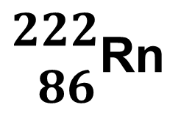
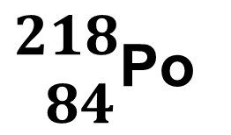
Check for Understanding 3
$\begin{matrix}222 \\ 86\end{matrix}$Rn
α
$\begin{matrix}218 \\ 84\end{matrix}$Po
p:
86
84
n:
136
134
n/p:
1.58
J
1.59
J
odd/even:
e/e
J
e/e
J
Z:
> 82
L
> 82
L
Alpha decay is predicted, but it doesn't fix the nuclei.
This will go through a cascade of decays to fix it.

Slide 21
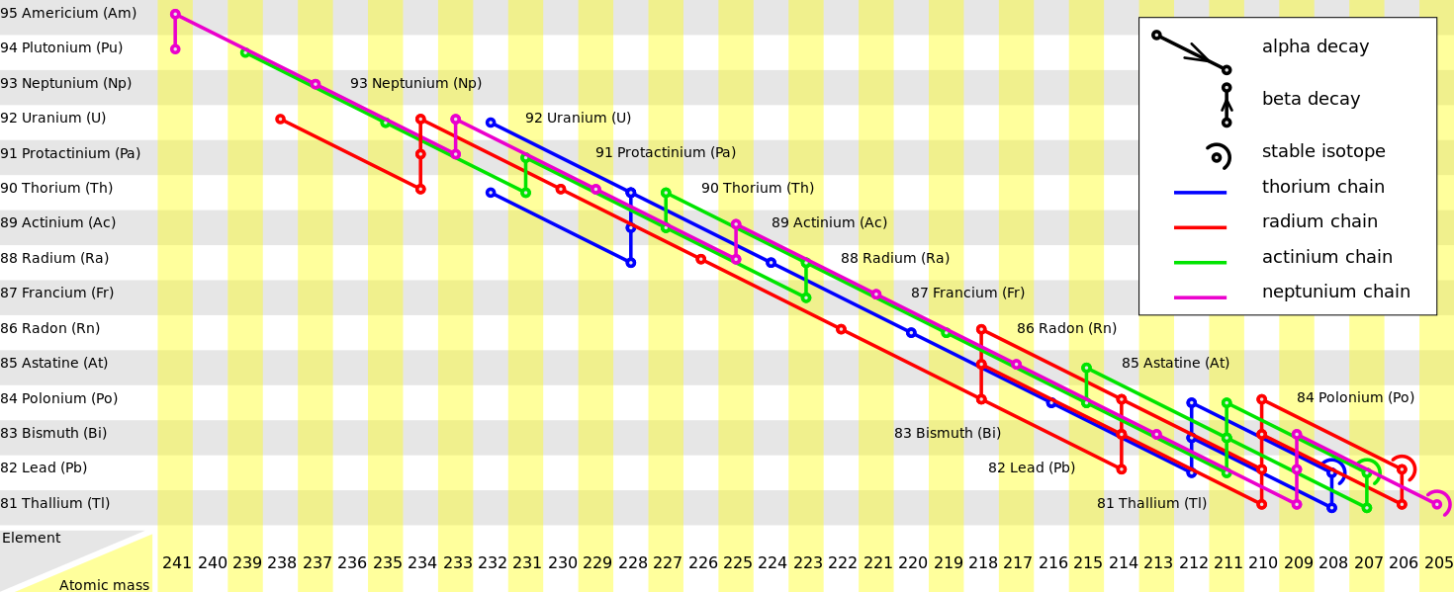

Slide 23
Check for Understanding 4
Nitrogen-13 is radioactive.
Analyze all three nuclear stability factors
Determine which factor(s) need to be altered
Predict the decay pathway & product
Reanalyze the three nuclear stability factors to determine if they are now acceptable.

Slide 24
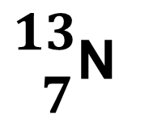
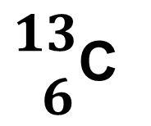
Check for Understanding 4
$\begin{matrix}13 \\ 7\end{matrix}$N
β⁺
$\begin{matrix}13 \\ 6\end{matrix}$C
p:
7
6
n:
6
7
n/p:
0.85
L
1.17
K
odd/even:
o/e
K
e/o
K
Z:
≤ 82
J
≤ 82
J
The daughter's n/p ratio is a bit high, but much better than it was in the parent

Slide 25
Check for Understanding 5
Hydrogen-3 is radioactive.
Analyze all three nuclear stability factors
Determine which factor(s) need to be altered
Predict the decay pathway & product
Reanalyze the three nuclear stability factors to determine if they are now acceptable.

Slide 26
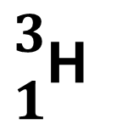
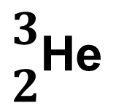
Check for Understanding 5
$\begin{matrix}3 \\ 1\end{matrix}$H
β
$\begin{matrix}3 \\ 2\end{matrix}$He
p:
1
2
n:
2
1
n/p:
2.0
L
0.5
K
odd/even:
o/e
K
e/o
K
Z:
≤ 82
J
≤ 82
J
In nuclei with only a few protons, the atom is forced to choose the lesser of two evils

Slide 27
Number of Nuclides
>3300 known nuclides
339 are naturally-occurring
>3000 are man-made
254 are stable

