Slide 1
Do Now
All of these isotopes are radioactive. Review all three nuclear stability factors. Identify the factor that is most responsible for the nuclei's instability.
isotope
n/p
odd/even
Z ≤ 82
plutonium-240
arsenic-74
iodine-133

Slide 2
Z | median acceptable n/p ratio | e/e range | e/o & o/e range
10 | 1.10 | ± 0.10 | ± 0.05
30 | 1.20
50 | 1.30
70 | 1.50
>82 | all are unstable

Slide 3
Do Now
All of these isotopes are radioactive. Review all three nuclear stability factors. Identify the factor that is most responsible for the nuclei's instability.
isotope
n/p
odd/even
Z ≤ 82
plutonium-240
$${146}/{94}=1.55$$
e/e
no
arsenic-74
$${41}/{33}=1.24$$
o/o
yes
iodine-133
$${80}/{53}=1.51$$
o/e
yes

Slide 4
Last Class

Slide 5
Nuclear Stability
REVIEW
SWBAT explain the factors that influence nuclear stability, the characteristics of the band of stability, and predict the radioactive decay path of a nuclei based on these principles

Slide 6
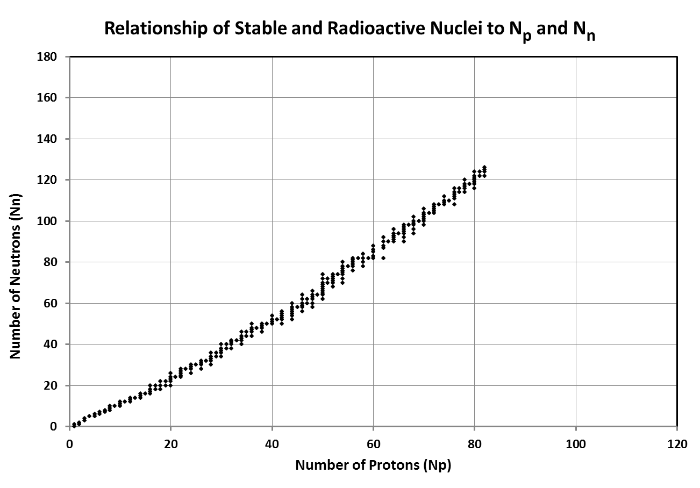
All of these nuclei are stable
These 254 nuclei are collectively called the "band of stability"

Slide 7
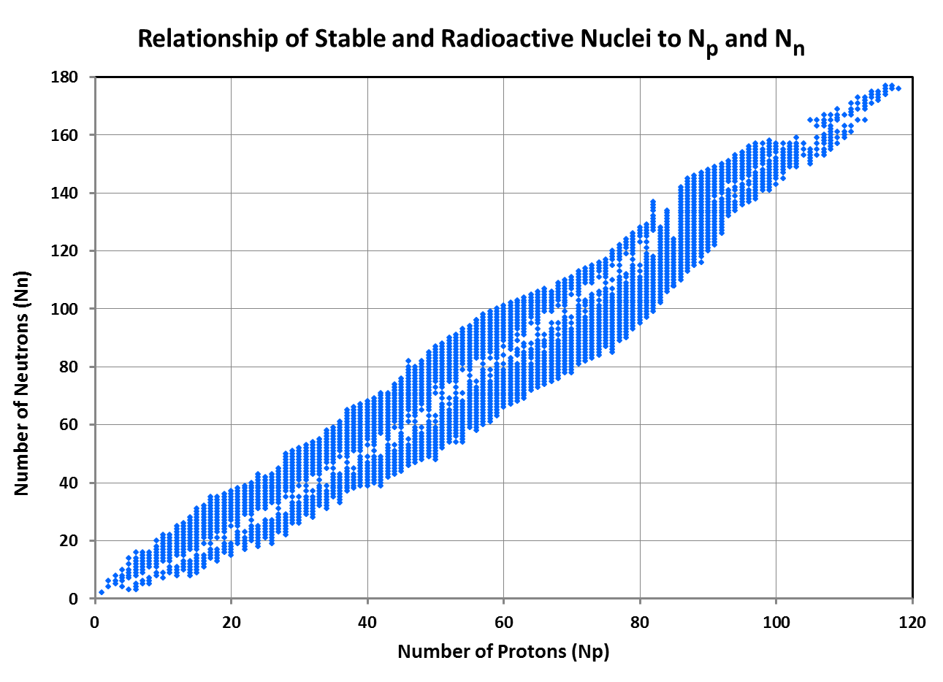
>3300 other nuclei are known
None of these other nuclei are stable
These spontaneously change their nuclei
What are they seeking by changing themselves?
Write this in your notes
The aim of radioactive decay is to make the nucleus more stable

Slide 8
There is a distinct pattern to the types of radioactive decay that unstable nuclei use to make themselves more stable

Slide 9
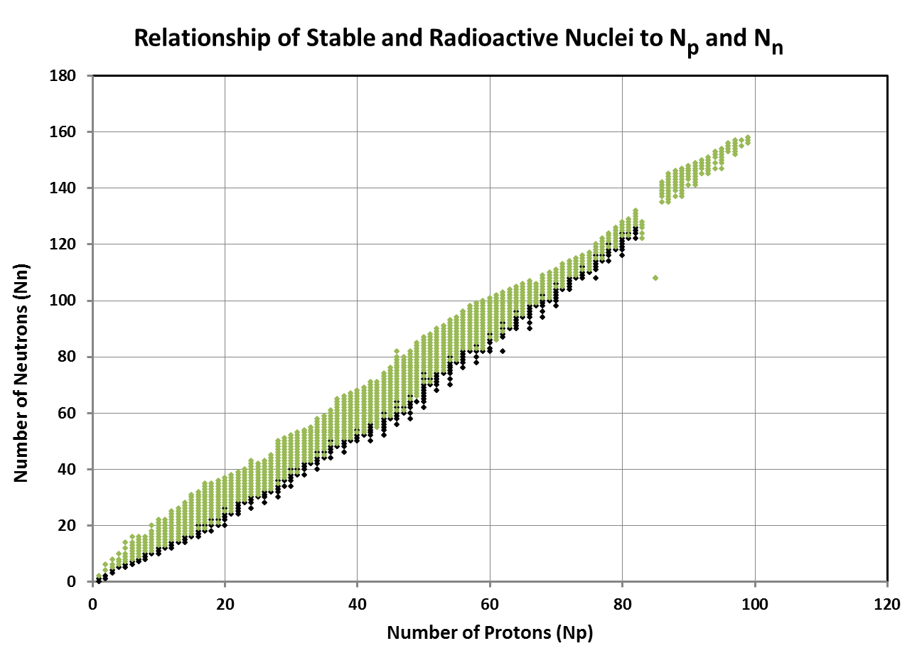
What is the pattern for beta minus decay?
stable
alpha
beta +
beta -
Nuclei that use beta minus decay are usually above the band of stability

Slide 10
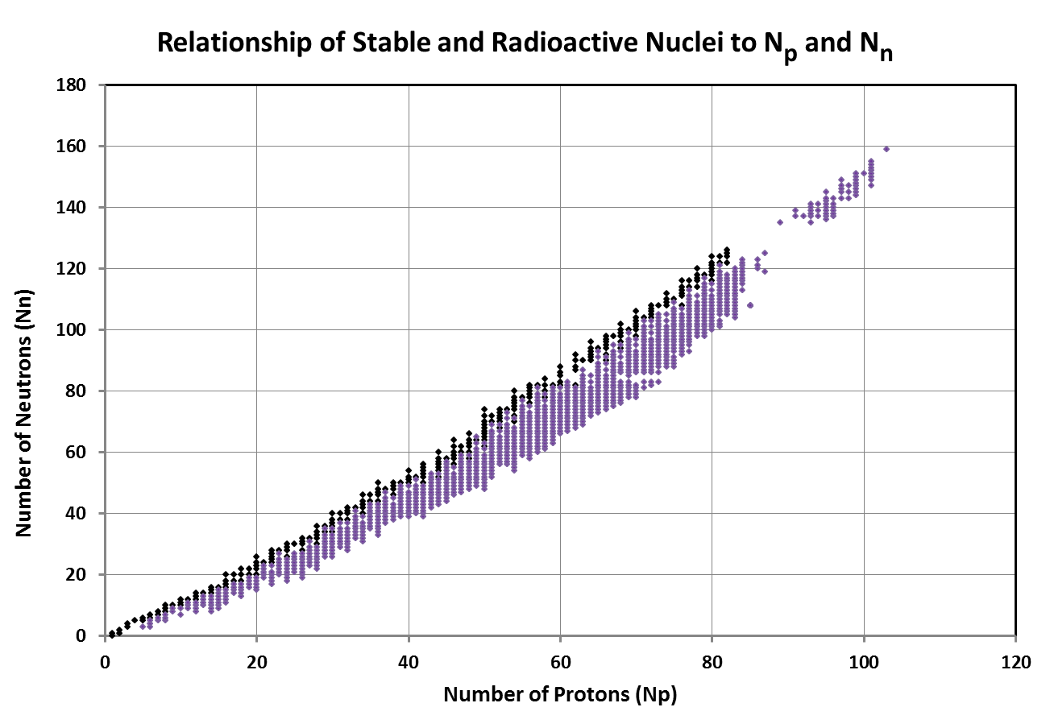
What is the pattern for beta plus decay?
stable
alpha
beta +
beta -
Nuclei that use beta plus decay are usually below the band of stability

Slide 11
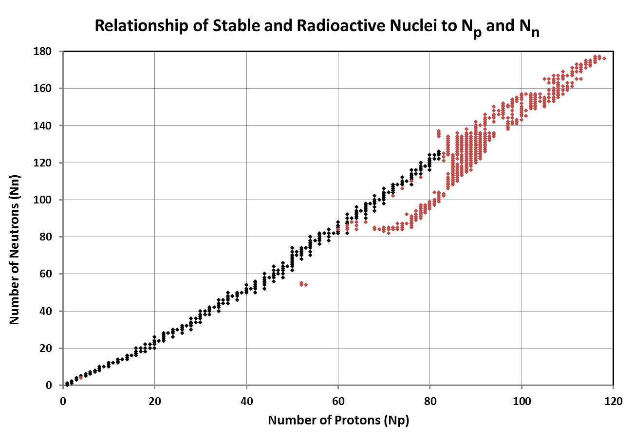
What is the pattern for alpha decay?
stable
alpha
beta +
beta -
Nuclei that use alpha decay are usually right of the band of stability

Slide 12
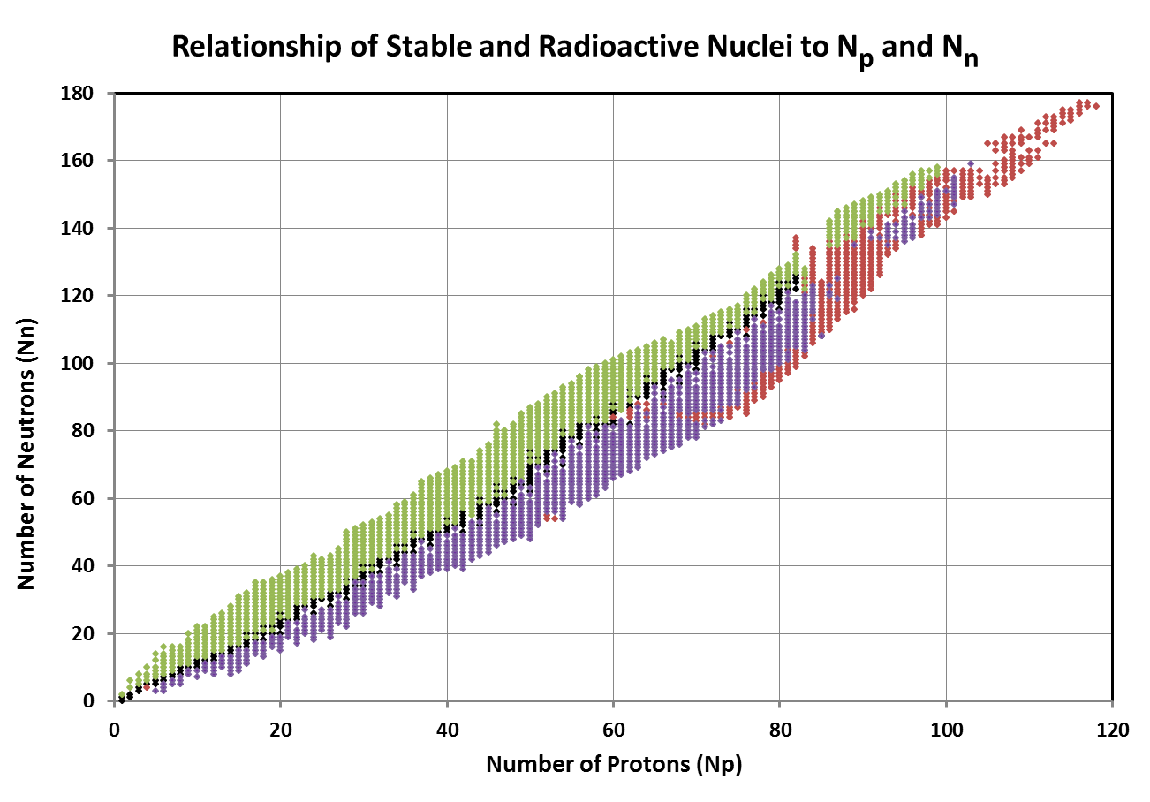
What explains this distinct pattern?
stable
alpha
beta +
beta -

Slide 13
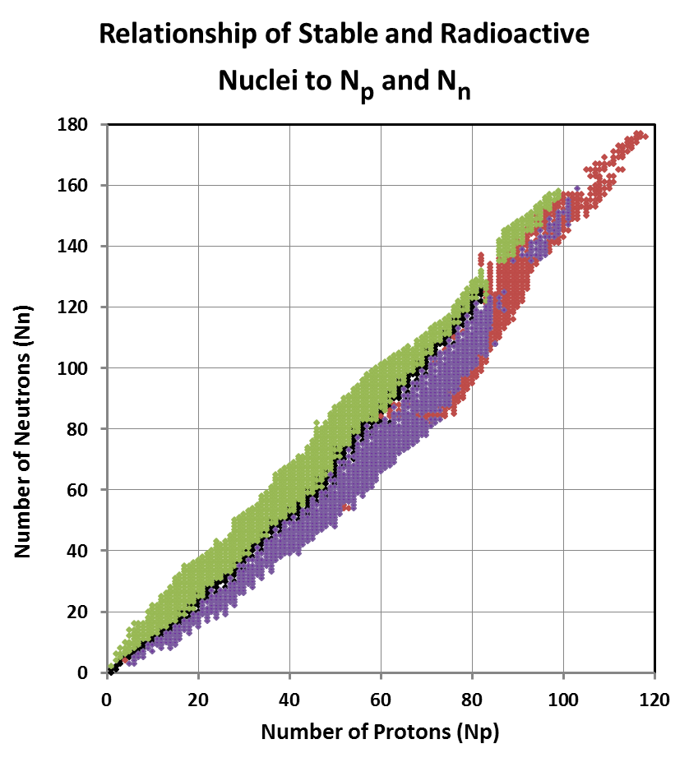
Why the Pattern?
The aim of radioactive decay is to make the nucleus more stable
This suggests nuclei in similar regions of this graph:
Are unstable for the same reason
Need to follow the same pathway to improve stability

Slide 14
Alpha Decay Example
$\begin{matrix}210 \\ 84\end{matrix}$Po
α
$\begin{matrix}206 \\ 82\end{matrix}$Pb
p:
84
82
n:
126
124
n/p:
1.50
J
1.51
J
odd/even:
e/e
J
e/e
J
Z:
> 82
L
≤ 82
J
Polonium-210 used alpha decay to address instability caused by Z > 82

Slide 15
Nuclei that use alpha decay are usually right of the band of stability
Nuclei in this region need to get rid of protons and neutrons to reach the band of stability
stable
alpha
beta +
beta -
Alpha decay gets rid of 2 protons and 2 neutrons, so it is the favored pathway to stability

Slide 16
We need to summarize in a table

Slide 17
REVIEW
Radioactive Decay Pathways
name | impact | diagram
alpha | lose 2p & 2n
beta minus | change n into p
beta plus | change p into n
gamma | lose energy

Slide 18
Radioactive Decay Pathways
name | impact | diagram
alpha | lose 2p & 2n
beta minus | change n into p
beta plus | change p into n
gamma | lose energy

Slide 19
Write this in your notes
Radioactive Decay Pathways
name | impact | when used | parent’s location
alpha | lose 2p & 2n
beta minus | change n into p
beta plus | change p into n
gamma | lose energy

Slide 20
Nuclei that use alpha decay are usually right of the band of stability
Nuclei in this region need to get rid of protons and neutrons to reach the band of stability
stable
alpha
beta +
beta -
Alpha decay gets rid of 2 protons and 2 neutrons, so it is the favored pathway to stability

Slide 21
Write this in your notes
Radioactive Decay Pathways
name | impact | when used | parent’s location
alpha | lose 2p & 2n | Z is too high
beta minus | change n into p
beta plus | change p into n
gamma | lose energy

Slide 22
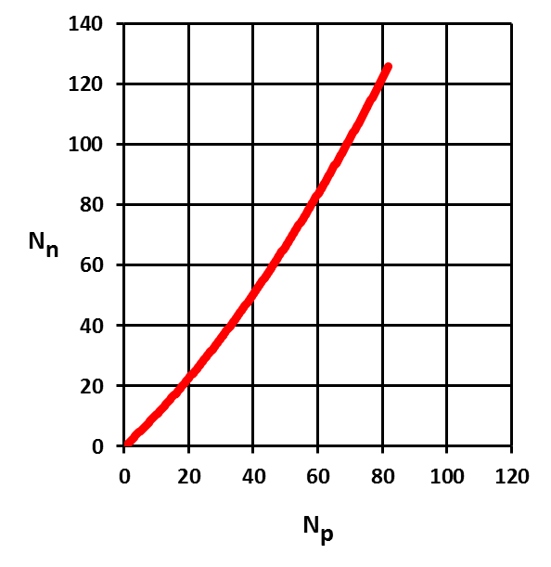
Predicted Decay Trends on Graph
α
decay

Slide 23
Write this in your notes
Radioactive Decay Pathways
name | impact | when used | parent’s location
alpha | lose 2p & 2n | Z is too high | right of band of stability
beta minus | change n into p
beta plus | change p into n
gamma | lose energy

Slide 24
Beta Minus Decay Example
$\begin{matrix}151 \\ 61\end{matrix}$Pm
β⁻
p:
61
n:
90
Is this an acceptable n/p ratio?
n/p:
1.48
odd/even:
o/e
Z:
≤ 82

Slide 25
Beta Minus Decay Example
$\begin{matrix}151 \\ 61\end{matrix}$Pm
β⁻
p:
61
Z | median acceptable n/p ratio | e/e range | e/o & o/e range
10 | 1.10 | ± 0.10 | ± 0.05
30 | 1.20
50 | 1.30
70 | 1.50
>82 | all are unstable
n:
90
n/p:
1.48
odd/even:
o/e
Z:
≤ 82

Slide 26
Beta Minus Decay Example
$\begin{matrix}151 \\ 61\end{matrix}$Pm
β⁻
p:
61
Z | median acceptable n/p ratio | e/e range | e/o & o/e range
10 | 1.10 | ± 0.10 | ± 0.05
30 | 1.20
50 | 1.30
70 | 1.50
>82 | all are unstable
n:
90
n/p:
1.48
odd/even:
o/e
61
1.40
1.35 – 1.45
Z:
≤ 82

Slide 27
Beta Minus Decay Example
$\begin{matrix}151 \\ 61\end{matrix}$Pm
β⁻
p:
61
n:
90
n/p:
1.48
L
odd/even:
o/e
Z:
≤ 82

Slide 28
Beta Minus Decay Example
$\begin{matrix}151 \\ 61\end{matrix}$Pm
β⁻
$\begin{matrix}151 \\ 62\end{matrix}$Sm
p:
61
62
n:
90
89
n/p:
1.48
L
1.44
J
odd/even:
o/e
K
e/o
K
Z:
≤ 82
J
≤ 82
J
Promethium-151 used beta minus decay to address instability caused by high n/p

Slide 29
Nuclei that use beta minus decay are usually above the band of stability
stable
alpha
beta +
beta -
Nuclei in this region need to get rid of a neutron and/or add a proton
Beta decay converts a neutron to a proton, so it is the favored pathway to stability

Slide 30
Write this in your notes
Radioactive Decay Pathways
name | impact | when used | parent’s location
alpha | lose 2p & 2n | Z is too high | right of band of stability
beta minus | change n into p | n/p is too high
beta plus | change p into n
gamma | lose energy

Slide 31
Predicted Decay Trends on Graph
β⁻
decay
α
decay

Slide 32
Write this in your notes
Radioactive Decay Pathways
name | impact | when used | parent’s location
alpha | lose 2p & 2n | Z is too high | right of band of stability
beta minus | change n into p | n/p is too high | above band of stability
beta plus | change p into n
gamma | lose energy

Slide 33
Beta Plus Decay Example
$\begin{matrix}43 \\ 21\end{matrix}$Sc
β⁺
p:
21
Z | median acceptable n/p ratio | e/e range | e/o & o/e range
10 | 1.10 | ± 0.10 | ± 0.05
30 | 1.20
50 | 1.30
70 | 1.50
>82 | all are unstable
n:
22
n/p:
1.05
odd/even:
o/e
Z:
≤ 82

Slide 34
Beta Plus Decay Example
$\begin{matrix}43 \\ 21\end{matrix}$Sc
β⁺
p:
21
Z | median acceptable n/p ratio | e/e range | e/o & o/e range
10 | 1.10 | ± 0.10 | ± 0.05
30 | 1.20
50 | 1.30
70 | 1.50
>82 | all are unstable
n:
22
n/p:
1.05
21
1.15
1.10 – 1.20
odd/even:
o/e
Z:
≤ 82

Slide 35
Beta Plus Decay Example
$\begin{matrix}43 \\ 21\end{matrix}$Sc
β⁺
$\begin{matrix}43 \\ 20\end{matrix}$Ca
p:
21
20
n:
22
23
n/p:
1.05
L
1.15
J
odd/even:
o/e
K
e/o
K
Z:
≤ 82
J
≤ 82
J
Scandium-43 used beta plus decay to address instability caused by low n/p

Slide 36
Nuclei that use beta plus decay are usually below the band of stability
stable
alpha
beta +
beta -
Nuclei in this region need to get rid of a proton and/or add a neutron
Beta plus decay converts a proton to a neutron, so it is the favored pathway to stability

Slide 37
Write this in your notes
Radioactive Decay Pathways
name | impact | when used | parent’s location
alpha | lose 2p & 2n | Z is too high | right of band of stability
beta minus | change n into p | n/p is too high | above band of stability
beta plus | change p into n | n/p is too low
gamma | lose energy

Slide 38
Predicted Decay Trends on Graph
β⁻
decay
α
decay
β⁺
decay

Slide 39
Write this in your notes
Radioactive Decay Pathways
name | impact | when used | parent’s location
alpha | lose 2p & 2n | Z is too high | right of band of stability
beta minus | change n into p | n/p is too high | above band of stability
beta plus | change p into n | n/p is too low | below band of stability
gamma | lose energy

Slide 40
Gamma Decay
Gamma decay involves the loss of energy without changes to protons & neutron number
As a result, we cannot determine the which nuclides will undergo gamma decay from the band of stability graph

Slide 41
Write this in your notes
Radioactive Decay Pathways
name | impact | when used | parent’s location
alpha | lose 2p & 2n | Z is too high | right of band of stability
beta minus | change n into p | n/p is too high | above band of stability
beta plus | change p into n | n/p is too low | below band of stability
gamma | lose energy | energy is too high | cannot be determined

Slide 42
Predicted Decay Trends on Graph
β⁻
decay
α
decay
Write this in your notes
β⁺
decay

Slide 43
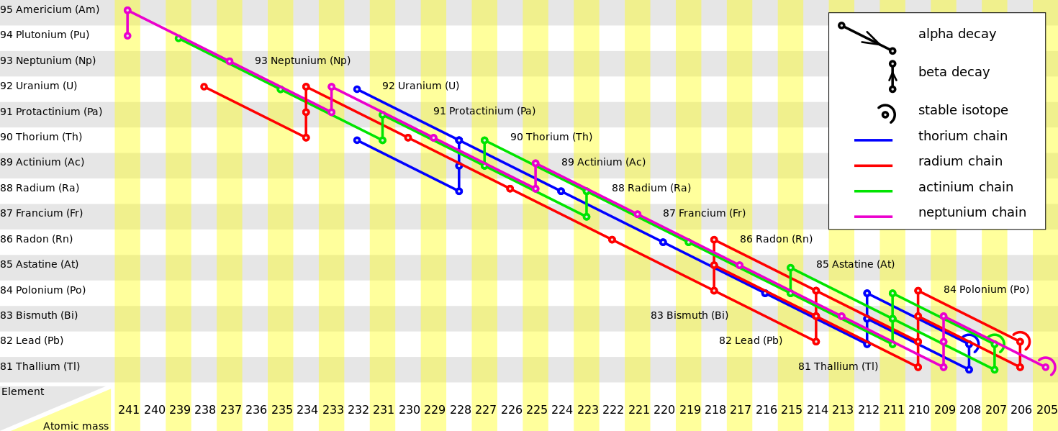
Important Note
Write this in your notes
Sometimes a nuclei needs to go through multiple decay reactions before it is stable.
Unless I say otherwise, we will just determine the first decay expected from a nuclei

Slide 44
Nuclear Stability Problem 1
Manganese-58 is radioactive.
Analyze all three nuclear stability factors
Determine which factor(s) need to be altered
Predict the decay pathway & product
Reanalyze the three nuclear stability factors to determine if they are now acceptable.

Slide 45
Nuclear Stability Problem 1
$\begin{matrix}58 \\ 25\end{matrix}$Mn
β⁻
$\begin{matrix}58 \\ 26\end{matrix}$Fe
p:
25
26
n:
33
32
n/p:
1.32
L
1.23
J
odd/even:
o/o
L
e/e
J
Z:
≤ 82
J
≤ 82
J
Note that beta minus decay improved both n/p and odd/even

Slide 46
Nuclear Stability Problem 2
Antimony-114 is radioactive.
Analyze all three nuclear stability factors
Determine which factor(s) need to be altered
Predict the decay pathway & product
Reanalyze the three nuclear stability factors to determine if they are now acceptable.

Slide 47
Nuclear Stability Problem 2
$\begin{matrix}114 \\ 51\end{matrix}$Sb
β⁺
$\begin{matrix}114 \\ 50\end{matrix}$Sn
p:
51
50
n:
63
64
n/p:
1.24
L
1.28
J
odd/even:
o/o
L
e/e
J
Z:
≤ 82
J
≤ 82
J
Note that beta plus decay improved both n/p and odd/even

Slide 48
Optional Practice Problems
Do all 4 steps of analysis for the following isotopes:
fluorine-16
arsenic-76
bismuth-209
zirconium-93
gallium-66

Slide 49
Check for Understanding 1
Fluorine-16 is radioactive.
Analyze all three nuclear stability factors
Determine which factor(s) need to be altered
Predict the decay pathway & product
Reanalyze the three nuclear stability factors to determine if they are now acceptable.

Slide 50
Check for Understanding 1
$\begin{matrix}16 \\ 9\end{matrix}$F
β⁺
$\begin{matrix}16 \\ 8\end{matrix}$O
p:
9
8
n:
7
8
n/p:
0.78
L
1.00
K
odd/even:
o/o
L
e/e
J
Z:
≤ 82
J
≤ 82
J
This decay occurs in PET scanning
PET = Positron Emission Tomography

Slide 51
Check for Understanding 2
Arsenic-76 is radioactive.
Analyze all three nuclear stability factors
Determine which factor(s) need to be altered
Predict the decay pathway & product
Reanalyze the three nuclear stability factors to determine if they are now acceptable.

Slide 52
Check for Understanding 2
$\begin{matrix}76 \\ 33\end{matrix}$As
β⁻
$\begin{matrix}76 \\ 34\end{matrix}$Se
p:
33
34
n:
43
42
n/p:
1.30
L
1.24
J
odd/even:
o/o
L
e/e
J
Z:
≤ 82
J
≤ 82
J

Slide 53
Check for Understanding 3
Bismuth-209 is radioactive.
Analyze all three nuclear stability factors
Determine which factor(s) need to be altered
Predict the decay pathway & product
Reanalyze the three nuclear stability factors to determine if they are now acceptable.

Slide 54
Check for Understanding 3
$\begin{matrix}209 \\ 83\end{matrix}$Bi
α
$\begin{matrix}205 \\ 81\end{matrix}$Tl
p:
83
81
n:
126
124
n/p:
1.52
J
1.53
J
odd/even:
o/e
K
o/e
K
Z:
> 82
L
< 81
J

Slide 55
Check for Understanding 4
Zirconium-93 is radioactive.
Analyze all three nuclear stability factors
Determine which factor(s) need to be altered
Predict the decay pathway & product
Reanalyze the three nuclear stability factors to determine if they are now acceptable.

Slide 56
Check for Understanding 4
$\begin{matrix}93 \\ 40\end{matrix}$Zr
β⁻
$\begin{matrix}93 \\ 41\end{matrix}$Nb
p:
40
41
n:
53
52
n/p:
1.33
L
1.27
J
odd/even:
e/o
K
o/e
K
Z:
≤ 82
J
≤ 82
J

Slide 57
Check for Understanding 5
Gallium-66 is radioactive.
Analyze all three nuclear stability factors
Determine which factor(s) need to be altered
Predict the decay pathway & product
Reanalyze the three nuclear stability factors to determine if they are now acceptable.

Slide 58
Check for Understanding 5
$\begin{matrix}66 \\ 31\end{matrix}$Ga
β⁺
$\begin{matrix}66 \\ 30\end{matrix}$Zn
p:
31
30
n:
35
36
n/p:
1.13
L
1.20
J
odd/even:
o/o
L
e/e
J
Z:
≤ 82
J
≤ 82
J

