Slide 1
Do Now
Some positions
are very stable
Some positions
are not stable at all
Why are some positions more stable?
What makes the position on the right harder to hold? Give specific reasons.

Slide 2
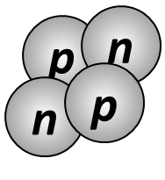
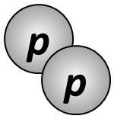
Do Now
We can give specific reasons why some positions are stable.
stable
not stable
What are the specific reasons why some nuclei are stable?

Slide 3
Nuclear Stability
Write this in your notes
SWBAT explain the factors that influence nuclear stability, the characteristics of the band of stability, and predict the radioactive decay path of a nuclei based on these principles

Slide 4
Why Are Some Nuclei Stable?
Some nuclei are stable
Some nuclei are radioactive
What factors determine this difference?

Slide 5
Factors in Nuclear Stability
Write this in your notes
n/p ratio
odd/even status
Z > 82

Slide 6
Factors in Nuclear Stability
n/p ratio
odd/even status
Z > 82

Slide 7
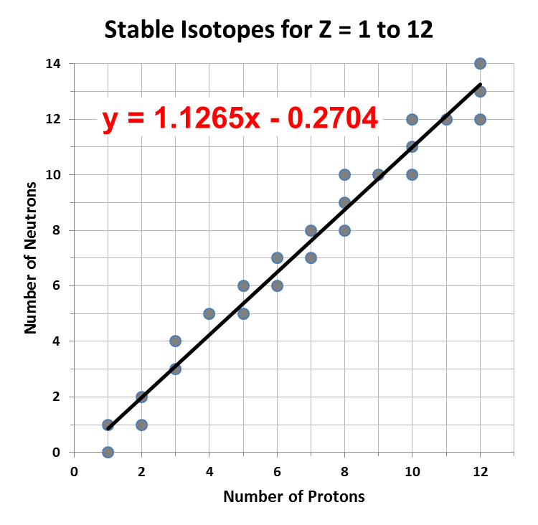
Neutron to Proton Ratio
x-axis: p
y-axis: n
points are stable
isotopes

Slide 8
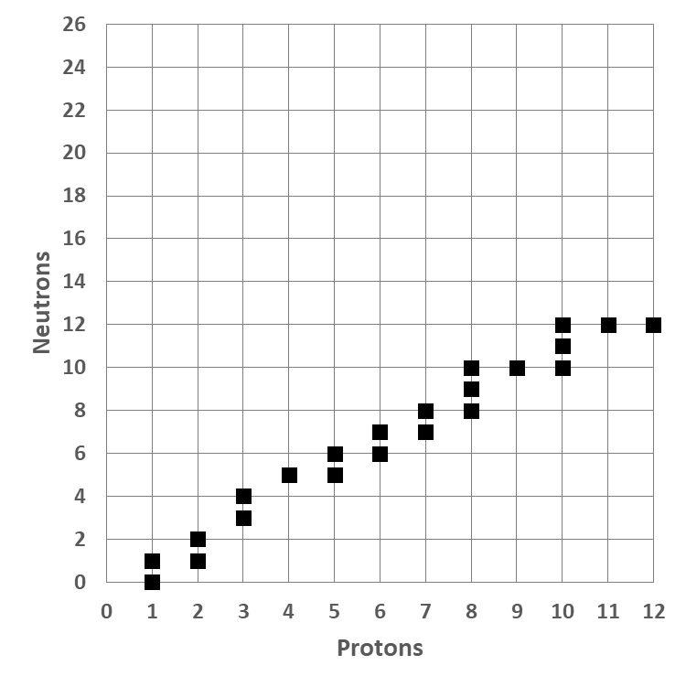
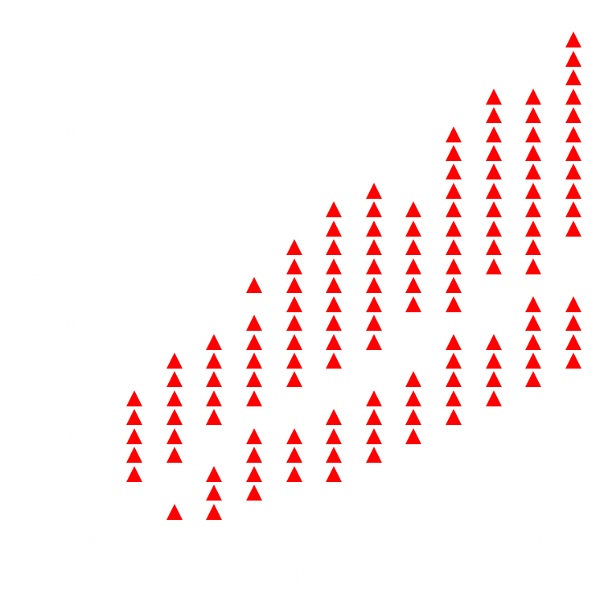
KEY
CONCEPT
These are all of the stable isotopes among the first 12 elements
But many other isotopes exist
Only the isotopes in black are stable
The isotopes in red are unstable and will slowly decay
There is something special about the isotopes in black

Slide 9
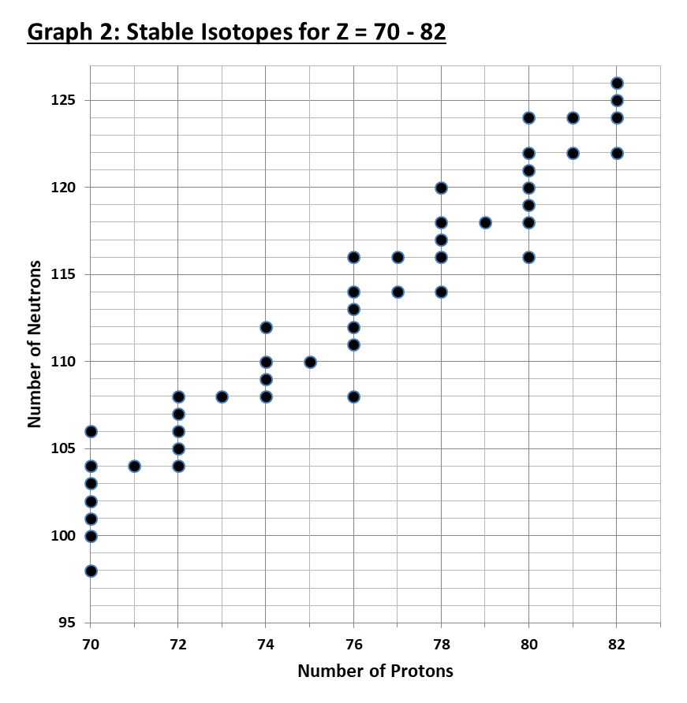
Neutron to Proton Ratio
All n/p ratios are between 1.40 and 1.55
As p rises, the acceptable n/p ratio rises with it

Slide 10
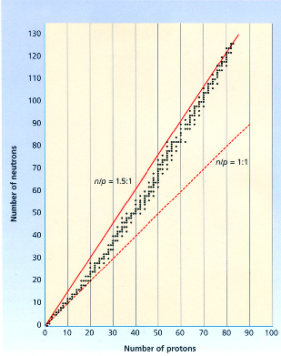
Graph p on x-axis
Graph n on y-axis
A black point represents every stable nuclei
All points lay between lines with slopes of 1.0 and 1.5
This collection of stable nuclei is known as the
BAND OF STABILITY
Write this in your notes

Slide 11
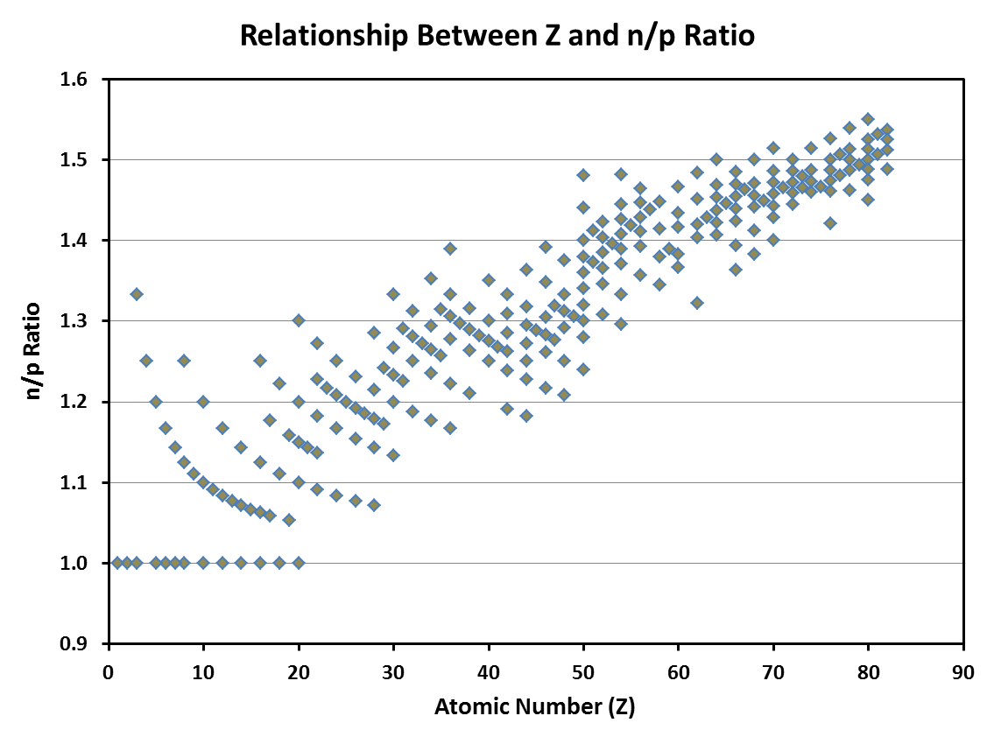
x-axis: Z
y-axis: n/p ratio
points are stable
isotopes
All stable nuclei have an n/p ratio between 1.00 & 1.55.
Exception: hydrogen-1 has n/p ratio = 0

Slide 12
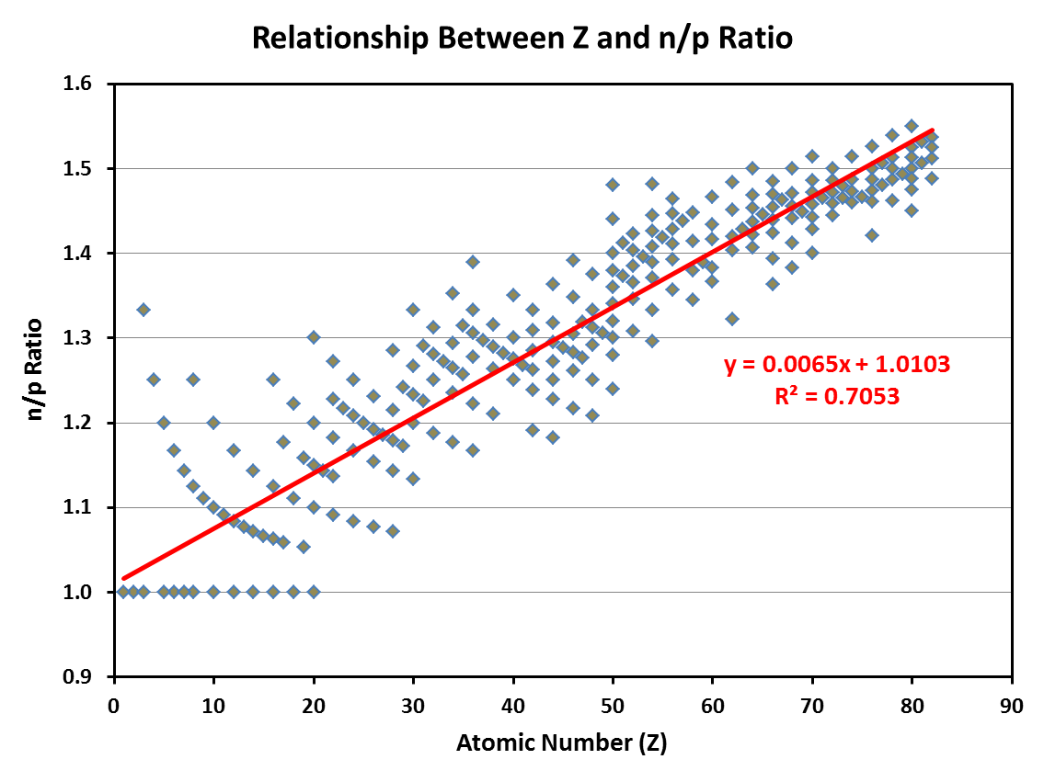
If Z increases, the stable n/p ratio increases too
A best fit line tells us the relationship between Z and n/p ratio

Slide 13
Predicting Value for n/p Ratio
Write this in your notes
Z | Predicted n/p ratio
10 | 1.10
30 | 1.20
50 | 1.30
70 | 1.50
Acceptable value can vary as much as ± 0.1
depending on odd/even status

Slide 14
Why n/p ratio?
$\begin{matrix}2 \\ 2\end{matrix}$He
$\begin{matrix}4 \\ 2\end{matrix}$He
Electromagnetic Force Repulsive Interactions |  | Strong Nuclear Force Attractive Interactions
p₁ with p₂ |  | p₁ with p₂
Electromagnetic Force Repulsive Interactions |  | Strong Nuclear Force Attractive Interactions
p₁ with p₂ |  | p₁ with p₂
 |  | n₁ with p₁
 |  | n₁ with p₂
 |  | n₂ with p₁
 |  | n₂ with p₂
 |  | n₁ with n₂
1 Repulsive Force
1 Attractive Force
Unstable
1 Repulsive Force
6 Attractive Forces
Stable

Slide 15
Why n/p ratio?
Attractive forces increase
Repulsive forces increase
Attractive forces increase
Repulsive forces do not
increase!

Slide 16
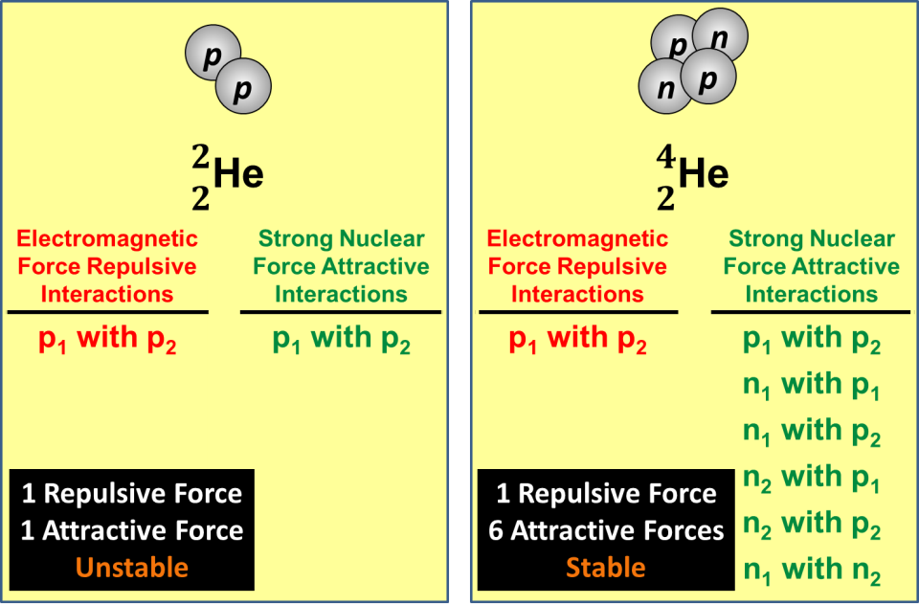
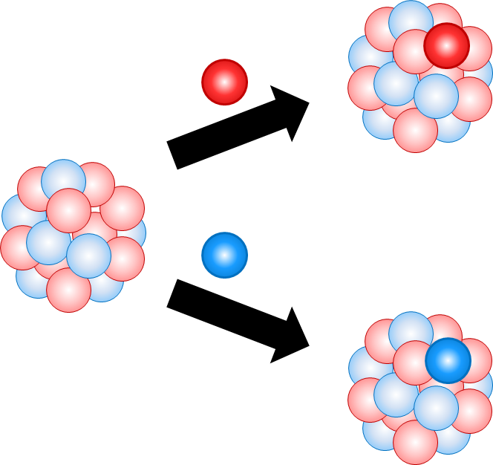
Why n/p ratio?
Write the red text in your notes
Protons introduce both repulsive EMF and attractive SNF
Neutrons introduce only attractive SNF
As Z rises, more neutrons are needed to offset the growing number of proton:proton repulsions

Slide 17
Factors in Nuclear Stability
n/p ratio
odd/even status
Z > 82

Slide 18
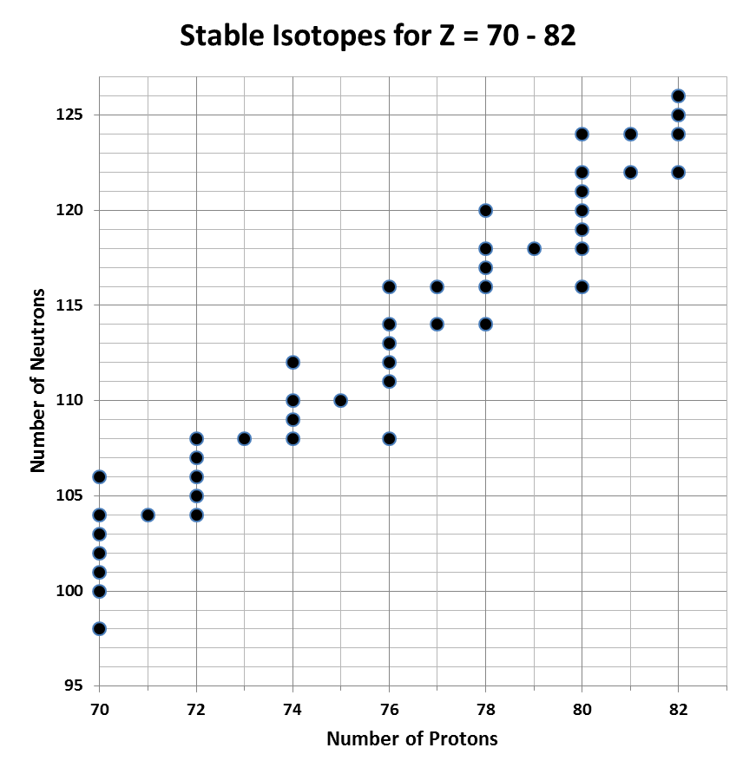
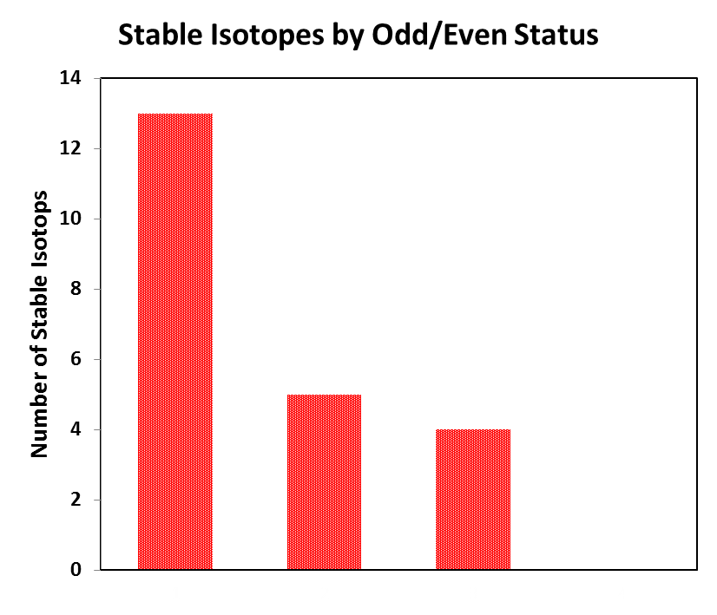
Odd and Even p and n
Graph 3
p :
n :
even
even
even
odd
odd
even
odd
odd

Slide 19
Odd and Even p and n
Write the red text in your notes
number of stable nuclei | p | n | %
148 | even | even | 58%
53 | even | odd | 21%
48 | odd | even | 19%
5 | odd | odd | 2%
Total: 254
Even/even
Very likely to be stable
Even/odd
Odd/even
Half as likely to be stable
Odd/odd
Unlikely to be stable

Slide 20
The Stability Associated with Even p and/or n Creates Zig-Zag Shape

Slide 21
Interaction Between n/p Ratio and Odd/Even Status
These two factors work together to determine nuclear stability

Slide 22
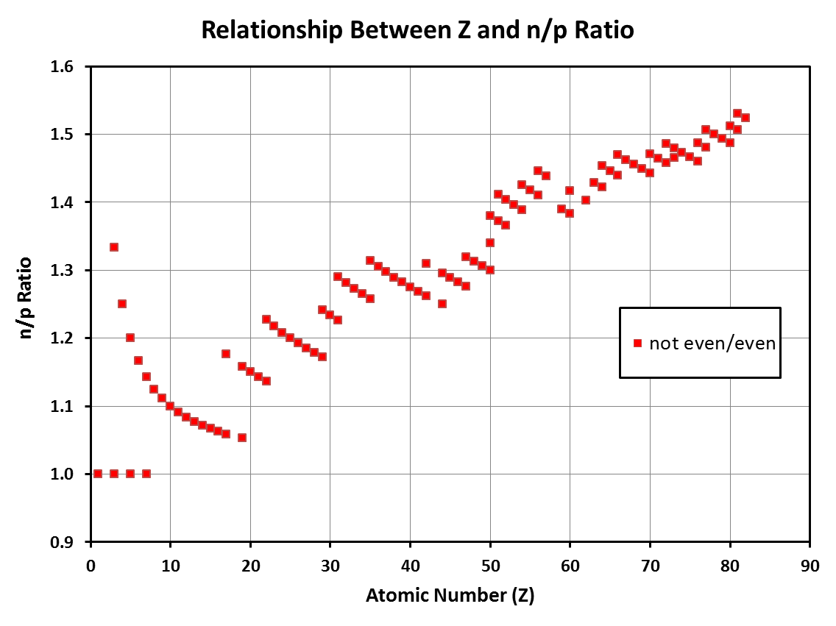

Slide 23
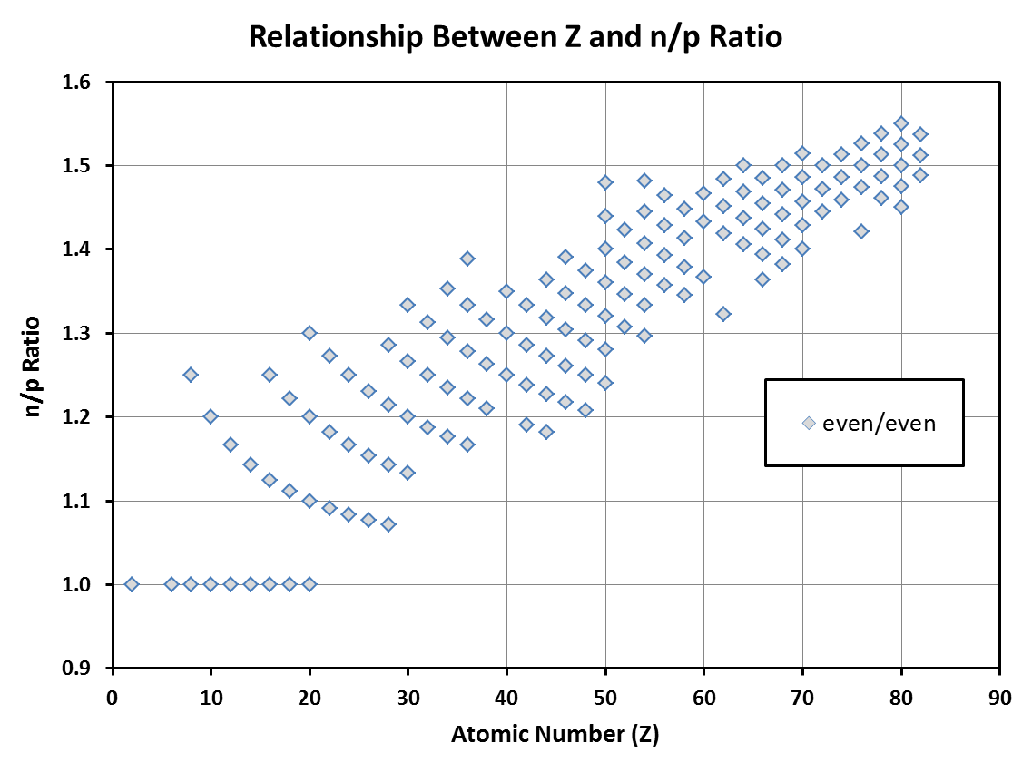

Slide 24
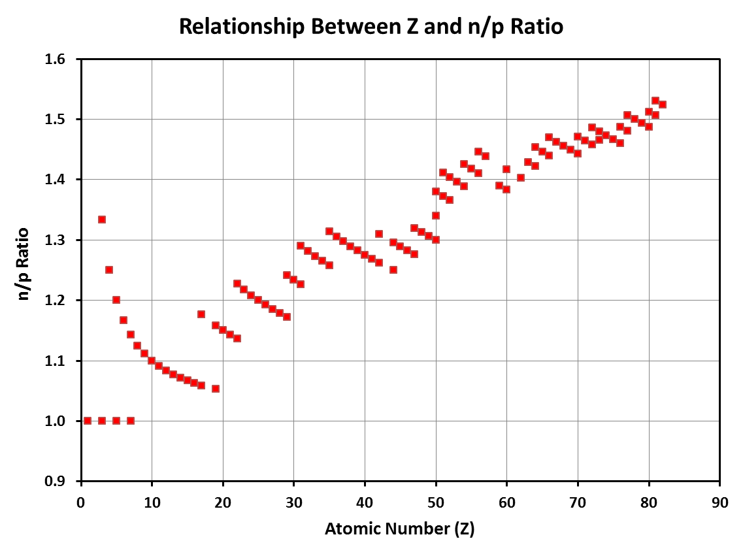
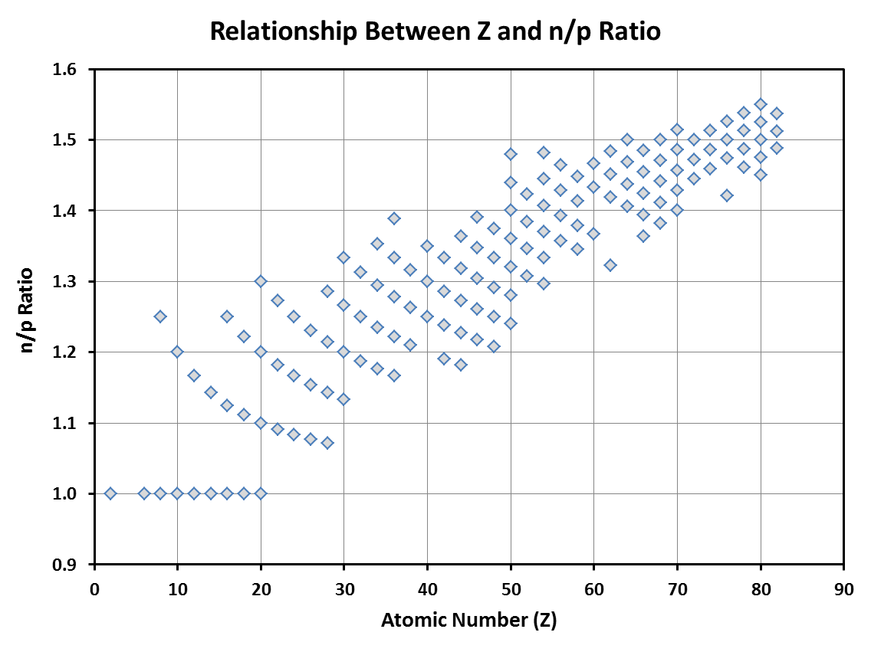
Because even/even status confers stability, even/even nuclei can have n/p ratios that are further away from the predicted value

Slide 25
Factors in Nuclear Stability
n/p ratio
odd/even status
Z > 82

Slide 26
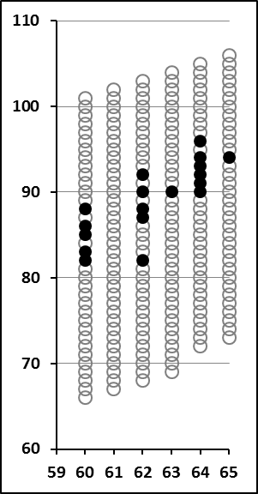
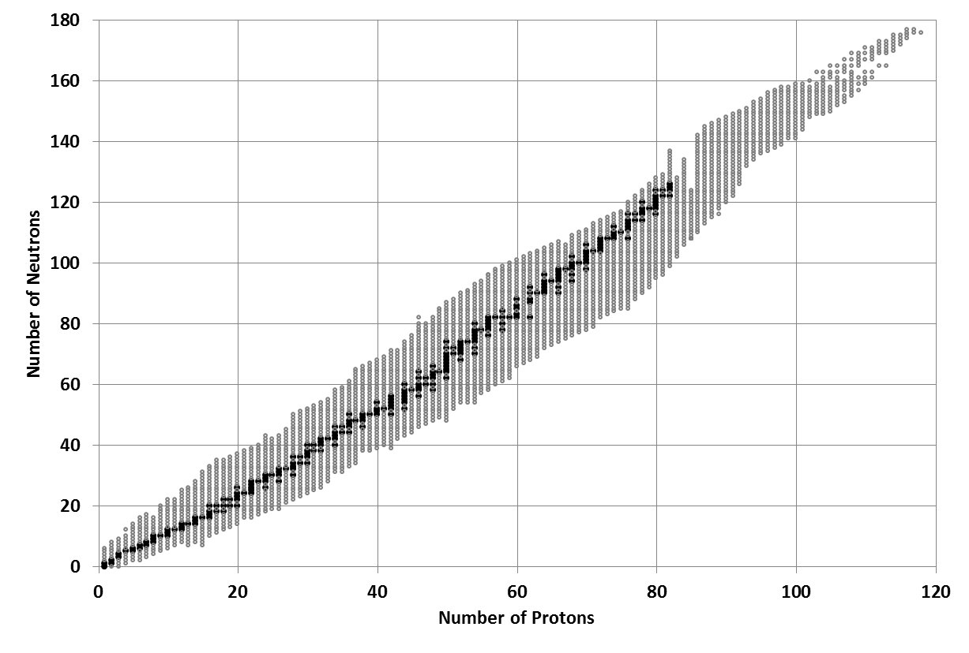
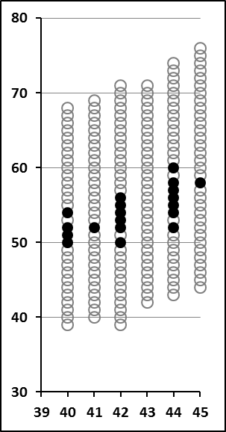
Graph 4: All Known Stable and Unstable Isotopes
Stable
Unstable
There are no stable isotopes once Z > 82

Slide 27
Graph 4: All Known Stable and Unstable Isotopes
Stable
Unstable
Every element with Z ≤ 82 has at least one stable isotope with two exceptions

Slide 28
Atomic Number
Write this in your notes
All elements with atomic numbers greater than 82 are unstable and undergo spontaneous radioactive decay

Slide 29
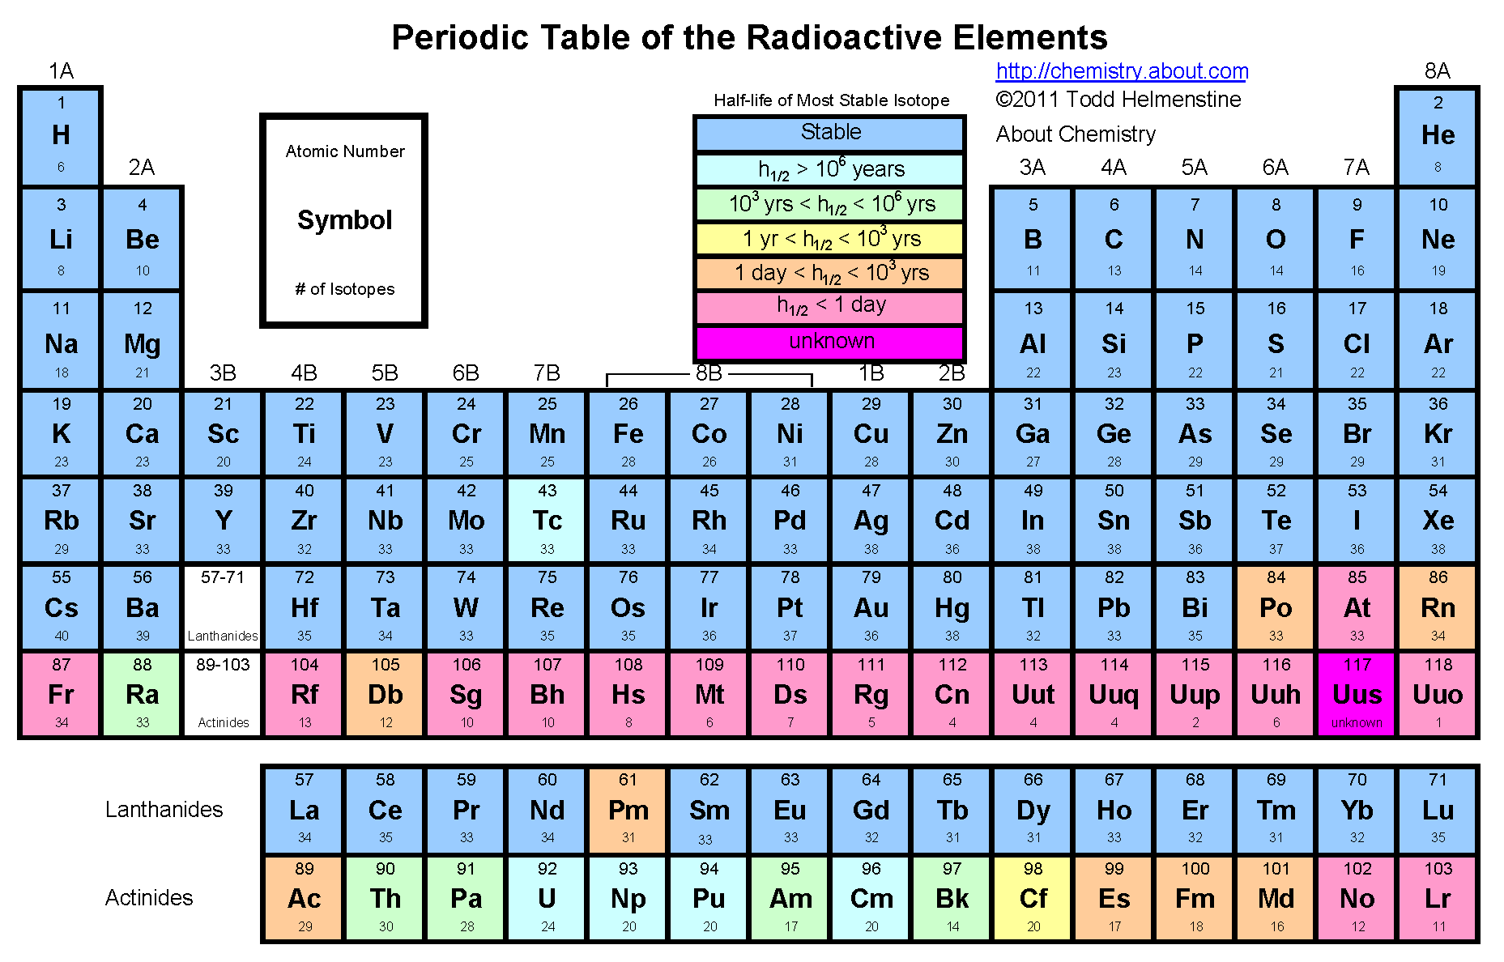
Some consider bismuth-209 to be stable because of its very long half-life of 1.9 x 10¹⁹ years

Slide 30
Factors in Nuclear Stability
n/p ratio
odd/even status
Z > 82

Slide 31
Summary of Stability Factors
Z | median acceptable n/p ratio
10 | 1.10
30 | 1.20
50 | 1.30
70 | 1.50

Slide 32
Summary of Stability Factors
Z | median acceptable n/p ratio | e/e range
10 | 1.10 | ± 0.10
30 | 1.20
50 | 1.30
70 | 1.50

Slide 33
Summary of Stability Factors
Z | median acceptable n/p ratio | e/e range
10 | 1.10 | 1.00 – 1.20
30 | 1.20 | 1.10 – 1.30
50 | 1.30 | 1.20 – 1.40
70 | 1.50 | 1.40 – 1.55

Slide 34
Summary of Stability Factors
Z | median acceptable n/p ratio | e/e range
10 | 1.10 | ± 0.10
30 | 1.20
50 | 1.30
70 | 1.50

Slide 35
Summary of Stability Factors
Z | median acceptable n/p ratio | e/e range | e/o & o/e range
10 | 1.10 | ± 0.10 | ± 0.05
30 | 1.20
50 | 1.30
70 | 1.50

Slide 36
Summary of Stability Factors
Z | median acceptable n/p ratio | e/e range | e/o & o/e range
10 | 1.10 | ± 0.10 | 1.05 – 1.15
30 | 1.20 |  | 1.15 – 1.25
50 | 1.30 |  | 1.25 – 1.35
70 | 1.50 |  | 1.45 – 1.55

Slide 37
Summary of Stability Factors
Z | median acceptable n/p ratio | e/e range | e/o & o/e range
10 | 1.10 | ± 0.10 | ± 0.05
30 | 1.20
50 | 1.30
70 | 1.50

Slide 38
Summary of Stability Factors
Write this in your notes
Z | median acceptable n/p ratio | e/e range | e/o & o/e range
10 | 1.10 | ± 0.10 | ± 0.05
30 | 1.20
50 | 1.30
70 | 1.50
>82 | all are unstable

Slide 39
Check For Understanding 1
What would you predict to be the acceptable n/p ratio values for the following elements?
neon
gallium
antimony
osmium
1.1
Z | Predicted n/p
10 | 1.10
30 | 1.20
50 | 1.30
70 | 1.50
1.2
1.3
1.5

Slide 40
Check For Understanding 2
One of the isotopes below is stable while the other two are radioactive. Determine their n/p ratios and odd/even status. Based on these data, predict which isotope is stable & explain your reasoning.
isotope
n/p ratio
odd/even
tin-113
$${63}/{50}=1.26$$
even/odd
tin-114
$${64}/{50}=1.28$$
even/even
indium-114
$${65}/{49}=1.32$$
odd/odd
I predict tin-114 is stable because it's n/p ratio is close to ideal (1.3) and it has even/even status

Slide 41
Check For Understanding 3
Only one of the following isotopes is radioactive. Calculate all three nuclear stability factors. Predict which one and explain the reason behind your answer.
isotope
n/p ratio
odd/even
Z ≤ 82
oxygen-17
$$9/8=1.13$$
e/o
yes
copper-63
$${34}/{29}=1.17$$
o/e
yes
thorium-224
$${134}/{90}=1.49$$
e/e
no
I predict thorium-224 will be radioactive. All 3 isotopes have acceptable n/p ratios and odd/even status, but thorium-224 has Z > 82.

Slide 42
Backups

Slide 43
Interaction Between n/p Ratio and Odd/Even Status
These two factors work together to determine nuclear stability
odd/even:
lower stability
not even/even
higher stability
even/even
n/p ratio:
higher stability
must be close to
predicted value
lower stability
can be farther from
predicted value

