Slide 1
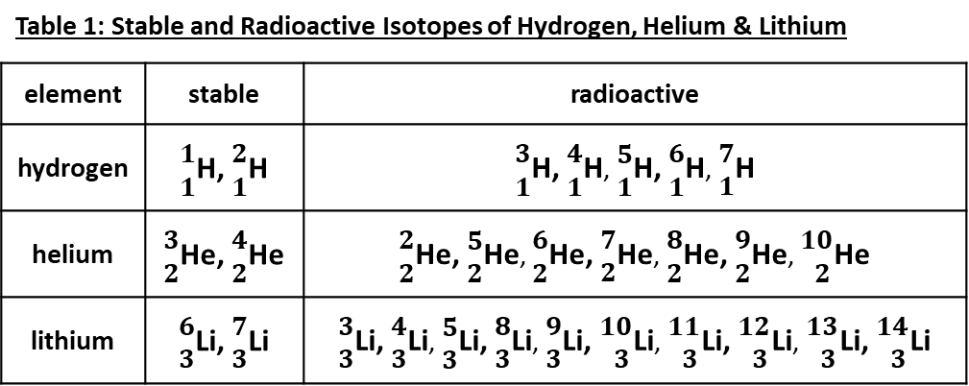
Nuclear Decay of Isotopes - Part 1
Question Sheet
Directions:
You will be reading a story and analyzing the provided data to answer a set of questions. Read each question and thoroughly explain all of your answers. You may include labeled drawings or diagrams to help answer the questions.
Ms. Gallagher's chemistry class was studying the radioactive decay of atoms. The class watched a video about different isotopes of hydrogen, helium and lithium (see Table 1). The video discussed how some isotopes were stable, while other isotopes are unstable and undergo radioactive decay. Many of the radioactive isotopes were made in a laboratory and decayed in a fraction of a second. Ms. Gallagher ask the students what they learned from this video.
"Each element has some isotopes that are stable," said Marcus, "but there are also many isotopes that are not stable."
"Yes, but it is hard to see a pattern to the this difference," Dominica added.
"What factors drive the stability of isotopes?" Marcus asked Ms. Gallagher.
"That's an interesting question," replied Ms. Gallagher, "The nucleus of an atom is just made up of protons and neutrons. Why are some combinations stable while others are not?
Ms. Gallagher asked the students to consider what they had learned so far about atoms and nuclear chemistry. Then she asked the class to write a research question together about the nuclear stability and the number of protons & neutrons in the nucleus. The class wrote the following research question:
Research Question:
How do the number of protons and neutrons affect the stability of a nucleus?
Table 1: Stable and Radioactive Isotopes of Hydrogen, Helium & Lithium
element | stable | radioactive
hydrogen | $\begin{matrix}1 \\ 1\end{matrix}$H, $\begin{matrix}2 \\ 1\end{matrix}$H | $\begin{matrix}3 \\ 1\end{matrix}$H, $\begin{matrix}4 \\ 1\end{matrix}$H, $\begin{matrix}5 \\ 1\end{matrix}$H, $\begin{matrix}6 \\ 1\end{matrix}$H, $\begin{matrix}7 \\ 1\end{matrix}$H
helium | $\begin{matrix}3 \\ 2\end{matrix}$He, $\begin{matrix}4 \\ 2\end{matrix}$He | $\begin{matrix}2 \\ 2\end{matrix}$He, $\begin{matrix}5 \\ 2\end{matrix}$He, $\begin{matrix}6 \\ 2\end{matrix}$He, $\begin{matrix}7 \\ 2\end{matrix}$He, $\begin{matrix}8 \\ 2\end{matrix}$He, $\begin{matrix}9 \\ 2\end{matrix}$He, $\begin{matrix}10 \\ 2\end{matrix}$He
lithium | $\begin{matrix}6 \\ 3\end{matrix}$Li, $\begin{matrix}7 \\ 3\end{matrix}$Li | $\begin{matrix}3 \\ 3\end{matrix}$Li, $\begin{matrix}4 \\ 3\end{matrix}$Li, $\begin{matrix}5 \\ 3\end{matrix}$Li, $\begin{matrix}8 \\ 3\end{matrix}$Li, $\begin{matrix}9 \\ 3\end{matrix}$Li, $\begin{matrix}10 \\ 3\end{matrix}$Li, $\begin{matrix}11 \\ 3\end{matrix}$Li, $\begin{matrix}12 \\ 3\end{matrix}$Li, $\begin{matrix}13 \\ 3\end{matrix}$Li, $\begin{matrix}14 \\ 3\end{matrix}$Li

Slide 2
"The video presents all the information about the isotopes of hydrogen, helium and lithium in a table," replied Ms. Gallagher, "but there might be a better way to show the data so the relationship between stability and the number of protons and neutrons can be seen. Any ideas?"
"When we want to show relationships between variables," said Amelia, "we usually create a graph."
"It also helps if you have more data," said Marcus, "Table 1 only covers three elements."
"I just found an interesting table online," Camila said, "It shows all the stable isotopes for the first 12 elements" (Table 2)
Table 2: Stable Isotopes for Z = 1-12
Stable Isotope | protons | neutrons
hydrogen-1 | 1 | 0
hydrogen-2 | 1 | 1
helium-3 | 2 | 1
helium-4 | 2 | 2
lithium-6 | 3 | 3
lithium-7 | 3 | 4
beryllium-9 | 4 | 5
boron-10 | 5 | 5
boron-11 | 5 | 6
carbon-12 | 6 | 6
carbon-13 | 6 | 7
nitrogen-14 | 7 | 7
nitrogen-15 | 7 | 8
oxygen-16 | 8 | 8
oxygen-17 | 8 | 9
oxygen-18 | 8 | 10
fluorine-19 | 9 | 10
neon-20 | 10 | 10
neon-21 | 10 | 11
neon-22 | 10 | 12
sodium-23 | 11 | 12
magnesium-24 | 12 | 12
magnesium-25 | 12 | 13
magnesium-26 | 12 | 14
Answer questions 1, 2 and 3 on pages 1 & 2 of your Student Answer Sheet
Plot the stable isotopes found from hydrogen to magnesium. Put the protons on the x-axis, the neutrons on the y-axis, and mark a point for each stable isotope. After the graph is made, draw a best fit line. Try to have it go through the middle of the points and have as many points above the line as below.
Choose two points that are on the line and determine the slope. Be sure to include the proper units for the slope.
Consider the research question. What hypothesis would you draw based upon the graph you made?
❶
❷
❸

Slide 3
"So I see nuclear stability is related to the number of protons and neutrons," remarked Dominica, "but what causes other atoms to be unstable? What is wrong with the number of protons and neutrons in those nuclei that are unstable?"
"That's a great question," replied Ms. Gallagher, "To answer that, we need to remember the two main forces that act on protons in the nucleus. Who remembers what they are and what they affect they have on nucleons?"
"I remember electromagnetic force (EMF) is one of them," said Marcus, "This is what we observed with magnets. Like charges repel and opposite charges attract. In the nucleus, EMF causes protons to repel each other."
"I remember strong nuclear force (SNF) is the second force," added Camila, "It causes all nucleons to attract one another. SNF is stronger than EMF but only over a very short distance. If two protons get too far apart, EMF wins and they are repelled."
Ms. Gallagher suggested the students consider Table 2. “This table shows the forces that occur when nucleons interact.” said Ms. Gallagher, “EMF is trying to push the nucleus apart, while SNF is trying to hold it together. What do you observe about the three types of interactions?”
Table 2 – Forces Between Nucleons
“When two protons interact in the nucleus, the experience both repulsive and attractive forces,” observed Dominica, “The interaction is both good and bad for the stability of the nucleus.”
“Yes, that is surprising,” commented Camila, “The proton-proton interaction is the only repulsive force in the nucleus. All the other forces are either attractive or have no effect.”
“Interactions with neutrons are different,” said Marcus, “All the neutron does is hold the nucleus together. It never introduces repulsive forces.”
“Correct,” said Ms. Gallagher, “The neutron has no charge so it never experiences EMF repulsion.”
Subatomic Particle 1 | Subatomic Particle 2 | Electromagnetic Force | Strong Nuclear Force
 |  | REPEL | ATTRACT
 |  | NONE | ATTRACT
 |  | NONE | ATTRACT
p
p
p
n
n
n

Slide 4
Answer questions 4 on page 2 of your Student Answer Sheet.
Consider what happens to EMF and SNF interactions when a proton or a neutron is added to the nucleus. Write a brief explanation as to why neutrons are sometimes called the "glue of the atom".
“Okay, so I see the difference in forces between nucleons," remarked Dominica, "but what makes some collections of protons and neutrons stable, while other collections are unstable?“
“To answer your question, we will have to consider some actual atoms and think about the forces at play inside their nuclei,” said Ms. Gallagher, “For example, tally up all of the repulsive and attractive interactions you can envision in helium-2.”
“Helium-2 has a nucleus with just two protons and no neutrons,” commented Amelia, “These two protons will repel each other because of EMF On the other hand, the protons will also attract each other because of SNF. Is this enough to hold a nucleus together?”
“I don’t think so,” said Marcus, “Helium-2 decomposes in less than a second. If it decomposes this fast, it can’t be very stable.”
“What if a neutron is added in?” asked Ms. Gallagher, “What would happen with helium-3?”
“In this case, we have two protons and one neutron in the nucleus,” said Amelia, “Once again, the two protons will repel each other because of EMF.”
“True,” said Dominica, “but now you have more attraction because of SNF. You have the SNF attraction between the two protons, just like in helium-2. In helium-3, however, the neutron has an SNF-driven attractive interaction with each of the two protons.”
“That makes three attractive interactions against one repulsive interaction,” said Camilla.
“I see,” said Marcus, “thanks to the neutron, the total SNF attraction overcomes EMF repulsion. That explains why helium-3 is a stable isotope.”
Answer questions 5 on page 2 of your Student Answer Sheet.
Write a tally of all the attractive and repulsive interactions that occur in helium-4. Write a hypothesis as to why helium-4 is stable and helium-2 is not.
❹
p₁
Helium-2 Nucleus
white arrows: EMF repulsion
black arrows: SNF attraction
p₂
❺

Slide 5
Nuclear Decay of Isotopes - Part 1
Student Answer Sheet
Name
Date
❶
Plot the stable isotopes found from hydrogen to magnesium. Put the protons on the x-axis, the neutrons on the y-axis, and mark a point for each stable isotope. After the graph is made, draw a best fit line. Try to have it go through the middle of the points and have as many points above the line as below.

Slide 6
❷
Choose two points that are on the line and determine the slope. Be sure to include the proper units for the slope.
Consider the research question. What hypothesis would you draw based upon the graph you made?
Consider what happens to EMF and SNF interactions when a proton or a neutron is added to the nucleus. Write a brief explanation as to why neutrons are sometimes called the "glue of the atom".
Write a tally of all the attractive and repulsive interactions that occur in helium-4. Write a hypothesis as to why helium-4 is stable and helium-2 is not.
❸
❹
❺

Slide 7
p₁
p₂
p₁
n₂
n₁
p₂

