Slide 1
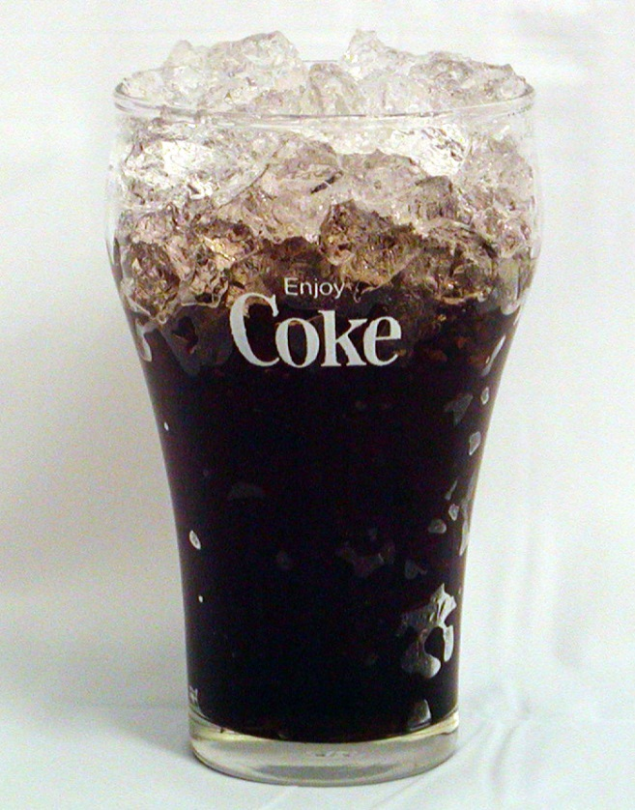
Do Now
Put homework in the red basket
Ice cubes with a temperature of –25ºC are used to cool off a glass of coke. Which absorbs more heat: warming up the ice or melting the ice into water?
Explain your answer.

Slide 2
Announcements
Class | Test #3 - Energy & Matter (earliest date) | Lab Reports Due
Period 2 | Friday, Oct 24 | Friday, Oct 31
Period 3
Period 4
Period 7 | Wednesday, Oct 22 | Friday, Oct 31

Slide 3
Any Questions on the Homework?

Slide 4
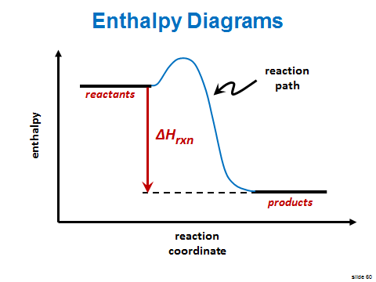
Previously

Slide 5
Enthalpy (Heat) of Phase Changes
SWBAT:
explain the relationship between intermolecular forces and phases of matter
explain the concept of enthalpy (heat) of phases changes
calculate the enthalpy required for phase changes.
Write this in your notes

Slide 6
Differences Between Phases
Review

Slide 7
Phase Changes
Review

Slide 8
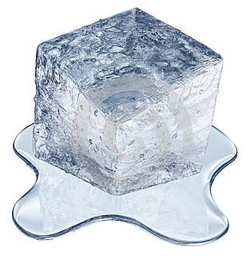
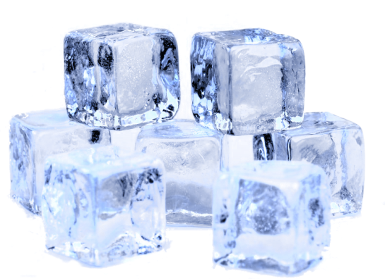
Adding Enthalpy (Heat) to Water

Slide 9
Where is the energy going?
To explain this, we need to think about the phases of matter and phase changes at the molecular level
Energy Absorbed
Lots of energy being absorbed during a phase change
But the temperature is not changing
What is happening to the energy?

Slide 10
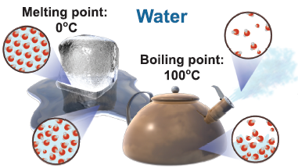
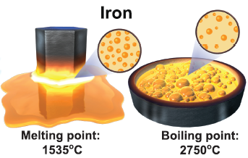
A Phase Change is a Physical Change
Frozen or boiled water molecules
are still water molecules
Melted iron is still iron.
Physical change - altering a substance without altering its composition
This is not a chemical change. There are no changes to the bonds

Slide 11
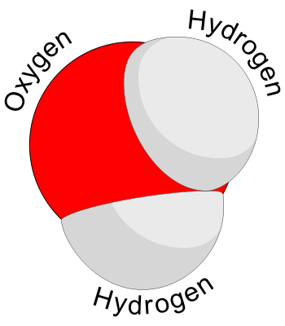
Intramolecular Forces
Write this in your notes
A molecule is a group of atoms chemically bonded together.
A chemical bond is an attractive force between atoms within a molecule.
These are called intramolecular forces

Slide 12
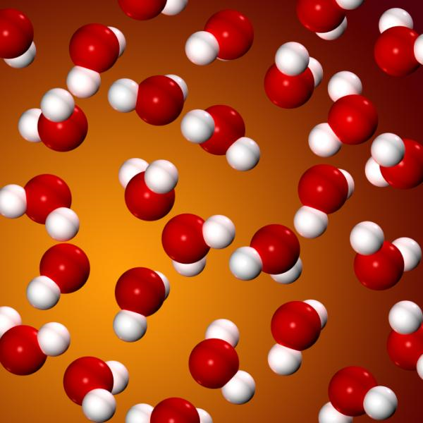
Intermolecular Forces
Write this in your notes
There are also attractive forces between different molecules.
These are called intermolecular forces.
These forces are not as strong as bonds, but still have key effects.

Slide 13
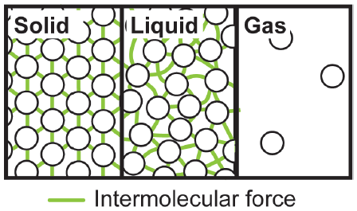
Phases at the Molecular Level
Phases of matter are different from each other because their intermolecular forces are different
solids have strongest intermolecular forces
gasses have the weakest
liquids are in between
Write this in your notes

Slide 14
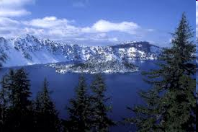
Continuum of Phase Changes, Temperature & Intermolecular Forces
Write this in your notes

Slide 15
Check for Understanding
Which phase (solid, liquid, gas) has the strongest intermolecular forces?
Solids

Slide 16
Check for Understanding
What is the difference between intramolecular and intermolecular forces?
Intramolecular forces are within a molecule
Intermolecular forces are between different molecules
6 more CFUs

Slide 17
Check for Understanding
Which phase (solid, liquid, gas) has the highest temperature?
Gas

Slide 18
Temperature Transitions Between Phases
Temperature scale
Melting point
Boiling point
Write this in your notes

Slide 19
Phase Changes
How can we move from solid to liquid, and from liquid to gas?
By overcoming the intermolecular forces.
Write this in your notes

Slide 20
Overcoming Intermolecular Forces
How much enthalpy will it take to change phases?
Heat of fusion
Heat of vaporization
Write this in your notes

Slide 21
Check for Understanding
To go in this direction, do we add or remove heat?
Remove heat to go from gas to liquid, and from liquid to solid.

Slide 22
Check for Understanding
Is the melting of ice an exothermic or endothermic phase change? Explain.
To melt, ice needs to absorb enthalpy. Because enthalpy is being absorbed, the melting of ice is an endothermic phase change

Slide 23
Check for Understanding
Which enthalpy graph describes the phase change from liquid water to steam? Explain.
reactants
products
ΔH_{rxn}
ΔH_{rxn}
products
reactants

Slide 24
Check for Understanding
To go in this direction, do we add or remove heat?
Add heat to go from solid to liquid, and from liquid to gas.

Slide 25
Overcoming Intermolecular Forces
How much enthalpy will it take to change phases?
Heat of fusion
Heat of vaporization

Slide 26
Definitions
Write this in your notes
Enthalpy (heat) of fusion: ∆H_{f} (J/g or cal/g)
The enthalpy required to change the phase of one gram of a material from solid to liquid
Enthalpy (heat) of vaporization: ∆H_{v} (J/g or cal/g)
The enthalpy required to change the phase of one gram of a material from liquid to gas
Note that the opposite phase changes require an equal but opposite amount of enthalpy

Slide 27
Heats of Fusion & Vaporization
Substance | Formula | ΔH(fusion) / kJ mol¹ | ΔH(vaporization) / kJ mol⁻¹
Neon | Ne | 0.33 | 1.80
Oxygen | O₂ | 0.44 | 6.82
Methane | CH₄ | 0.94 | 8.18
Ethane | C₂H₆ | 2.85 | 14.72
Chlorine | Cl₂ | 6.40 | 20.41
Carbon tetrachloride | CCl₄ | 2.67 | 30.00
n-Nonane | C₉H₂₀ | 19.3 | 40.5
Mercury | Hg | 2.30 | 58.6
Sodium | Na | 2.60 | 98
Aluminum | Al | 10.9 | 284
Lead | Pb | 4.77 | 178

Slide 28
Equations
Write this in your notes
Enthalpy (heat) of phase changes
H = m∆H_{f}
H = m∆H_{v}

Slide 29
Check for Understanding
What is the enthalpy (heat) of sublimation?
The enthalpy required to change the phase of one gram of a material from a solid to a gas

Slide 30
Check for Understanding
To melt two grams of ice requires 670 J of enthalpy. What is the enthalpy of fusion of water?
335 J/g

Slide 31
Check for Understanding
If the enthalpy (heat) of fusion of water is 335 J/g, how much enthalpy is required to freeze one gram of water?
–335 J

Slide 32
Check for Understanding
As a substance changes phase from a liquid to a gas, does it absorb enthalpy or release it?
Absorbs energy

Slide 33
Check for Understanding
As a substance changes phase from a liquid to a gas, how much does the substance temperature change?
The temperature does not change. All of the enthalpy goes to overcoming the intermolecular forces

Slide 34
Do Now
Ice cubes with a temperature of –25ºC are used to cool off a glass of coke. Which absorbs more heat: warming up the ice or melting the ice into water?
Explain your answer.
We will review how to answer this problem
Pay careful attention because you will need to solve similar problems on your own

Slide 35
Equations
Enthalpy (heat) of temperature changes
q = mc (T₂ – T₁)
H = mc (T₂ – T₁) at constant pressure
Enthalpy (heat) of phase changes
H = m∆H_{f} and H = m∆H_{v}

Slide 36
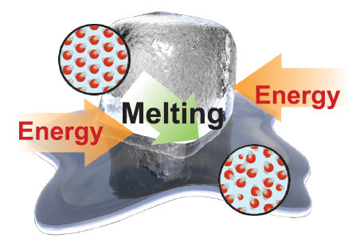
Phases at the Molecular Level
Ice cubes with a temperature of –25ºC are used to cool off a glass of coke. Which absorbs more heat: warming up the ice or melting the ice into water? Assume 1 gram of ice.
The specific heat of ice is 2.0 J/(g·ºC).
∆H_{f}(water) = 335 J/g.
H = mc (T₂ – T₁)
H = m∆H_{f}

Slide 37
Phases at the Molecular Level
Ice cubes with a temperature of –25ºC are used to cool off a glass of coke. Which absorbs more heat: warming up the ice or melting the ice into water?
The specific heat of ice is 2.0 J/(g·ºC). ∆H_{f}(water) = 335 J/g. Assume 1 gram of ice.
Asked: Which absorbs more heat, warming ice by 25ºC or melting it?
Given: The ice starts at –25ºC. The specific heat of ice is 2.0 J/(g·ºC). ∆H_{f}(water) = 335 J
Relationships: H = mc_{p}(T₂ – T₁) and H = m∆H_{f}

Slide 38
Phases at the Molecular Level
Ice cubes with a temperature of –25ºC are used to cool off a glass of coke. Which absorbs more heat: warming up the ice or melting the ice into water?
The specific heat of ice is 2.0 J/(g·ºC).
Asked: Which absorbs more heat, warming ice by 25ºC or melting it?
Given: The ice starts at –25ºC. The specific heat of ice is 2.0 J/(g·ºC). ∆H_{f}(water) = 335 J
Relationships: H = mc (T₂ – T₁) and H = m∆H_{f}
Solve: First, let’s calculate the enthalpy that it takes to warm up a gram of ice from –25ºC to 0ºC.
So it takes 50 J to warm up 1 g of ice from –25ºC to 0ºC. The same gram of ice takes 335 J to melt into liquid water.
H

Slide 39
Phases at the Molecular Level
Ice cubes with a temperature of –25ºC are used to cool off a glass of coke. Which absorbs more heat: warming up the ice or melting the ice into water?
The specific heat of ice is 2.0 J/(g·ºC).
Asked: Which absorbs more heat, warming ice by 25ºC or melting it?
Given: The ice starts at –25oC. The specific heat of ice is 2.0 J/(g·oC). ∆H_{f}(water) = 335 J
Relationships: E = mc_{p}(T₂ – T₁) and E = m∆H_{f}
Solve: First, let’s calculate the enthalpy that it takes to warm up a gram of ice from –25ºC to 0ºC.
So it takes 50 J to warm up 1 g of ice from –25ºC to 0ºC. The same gram of ice takes 335 J to melt into liquid water.
Answer: Changing phase (melting) absorbs 335 J per gram of ice but warming the ice only absorbs 50 J/g. The phase change is responsible for most of ice’s cooling effect on drinks!
H

Slide 40
Problem Set
Enthalpy (heat) of temperature changes
H = mc (T₂ – T₁) at constant pressure
Enthalpy (heat) of phase changes
H = m∆H_{f} and H = m∆H_{v}

Slide 41
Homework
Worksheet on Enthalpy of Change
We will start this in class. Anything not complete by the end of class needs to be done for homework

Slide 42
GUEST Method
Steps for solving a problem
G Givens
U Unknowns
E Equation
S Solve
T Track units

Slide 43
1) Acetone has a heat of vaporization of 539 J/g. How much enthalpy would it take to vaporize a 75 gram bottle of acetone?
2) Solid carbon dioxide, better known as "dry ice", has a heat of sublimation of 571 J/g. How much enthalpy would it take to sublime a 26 gram cube of dry ice?
3) Paraffin wax has a heat of fusion of 211 J/g. How much enthalpy would it take to melt a 92 gram candle made of paraffin wax?

Slide 44
4) Formic acid has a heat of fusion of 276 J/g. Freezing a sample requires removal of 41,400 J of enthalpy. What is the mass of the sample?
5) Methanol has a heat of vaporization of 1104 J/g. Vaporizing a sample requires 298 J of enthalpy. What is the mass of the sample?

Slide 45
6) An unknown material releases 13,125 J of enthalpy as it deposits on a sheet of glass. The mass of the deposits is 25 grams. What is the heat of sublimation for this unknown material?
7) A 18 g sample of ammonia vaporizes through the absorption of 24,678 J of enthalpy. What is the heat of vaporization for ammonia?

Slide 46
8) Ruby pours 240 g of Coke into a glass. The Coke is at room temperature (20°C) and has a specific heat of 4.2 J/g°C. Ruby adds some ice which cools the Coke. As soon as the ice has melted completely, Ruby measures the temperature of the Coke and finds it to be 6°C. How much enthalpy has the Coke lost?
9) Assuming that the ice Ruby added was at exactly 0°C, what was the mass of the ice? The heat of fusion of water is 334 J/g.

Slide 47
10) If Ruby wanted her Coke to be colder, say 2°C, how much 0°C ice must she add?
11) Ruby's uncle gave her a 30 gram nugget of dry ice to cool her next Coke. When all of the dry ice had disappeared, the Coke was at 3°C. What is the heat of sublimation of dry ice?

Slide 48
Backup Slides

Slide 49
Not Covered

Slide 50
Heat During Phase Changes
While a substance is changing phases, it is absorbing enthalpy but its temperature is not changing.
The absorbed enthalpy is being used to disrupt the intermolecular interactions of the substance and allow it to change from one phase to another
The amount of enthalpy absorbed during a phase change cannot be calculated using the equation we have

Slide 51
Enthalpy (heat) of Phase Changes
Heat required to go from the solid to liquid:
q = m ▪ ΔH_{fus}
where: q = heat
m = mass
ΔH_{fus} = molar enthalpy (heat) of fusion
Heat required to go from the liquid to gas:
q = m ▪ ΔH_{vap}
where: q = heat
m = mass
ΔH_{vap} = molar enthalpy (heat) of vaporization

Slide 52
Phase Change Heat
The heat required for a phase change can be determined by the following equation:
q =

Slide 53
Phases at the Molecular Level
Adding more heat may not increase the temperature during melting or vaporization!
Write this in your notes

Slide 54
Phases at the Molecular Level
Heat of vaporization
∆H_{v} (J/g)
Heat of fusion
∆H_{f} (J/g)
Overcome
intermolecular forces
Overcome
intermolecular forces

Slide 55
Difference between Phases
Which group has the most inter-personal connections? Which has the least?
Which group(s) occupy the same floor area as they move?
Which group(s) keep the same shape as they move?
Which group is like a solid? liquid? gas?

