Slide 1
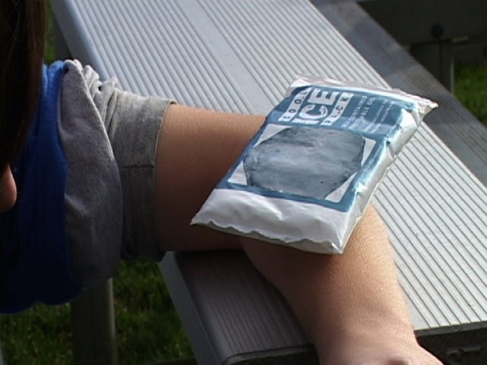
Do Now
Put homework in the red basket
Instant cold packs are used as first aid for injuries to reduce swelling and tissue damage due to inflammation
How does an instant cold pack work?

Slide 2
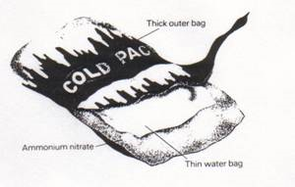
Discussion
The pack has chemicals separated by a weak inner membrane
Force on the pack ruptures the membrane allowing the chemicals to mix and react
The reaction absorbs energy, thereby taking heat from the surrounding environment

Slide 3
Early Enrollment Program
Application forms in black basket
This is a 4 credit class
Call #: 12361
Course Title: General Chemistry I
Application deadline is October 15
Return application form to Mrs. Nobrega

Slide 4
Any Questions on Worksheet?

Slide 5
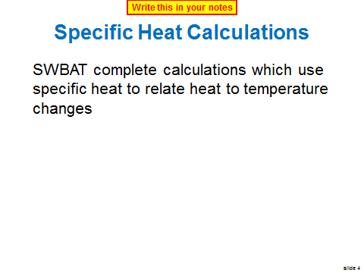
Previously

Slide 6
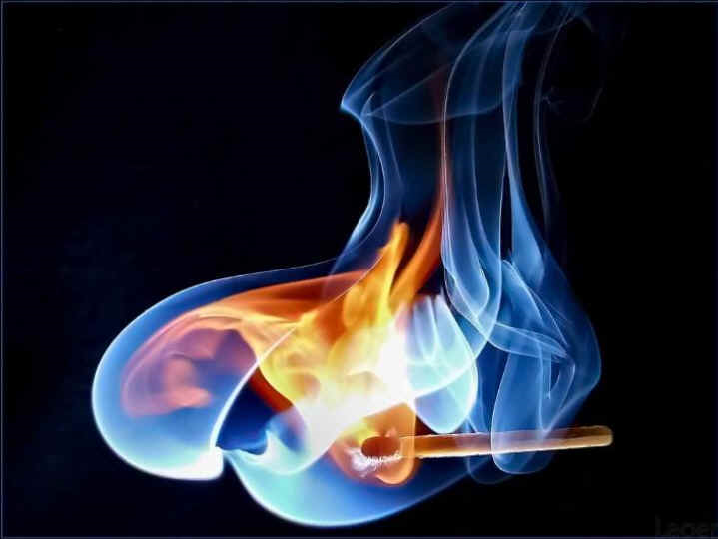
The Study of Energy & Heat
We have learned about the heat associated with temperature changes
What about the heat associated with chemical reactions?

Slide 7
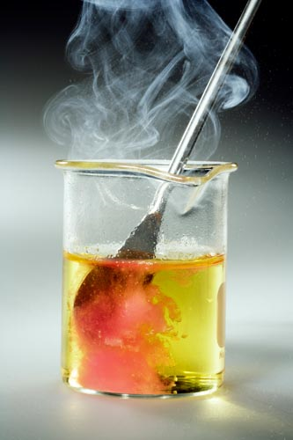
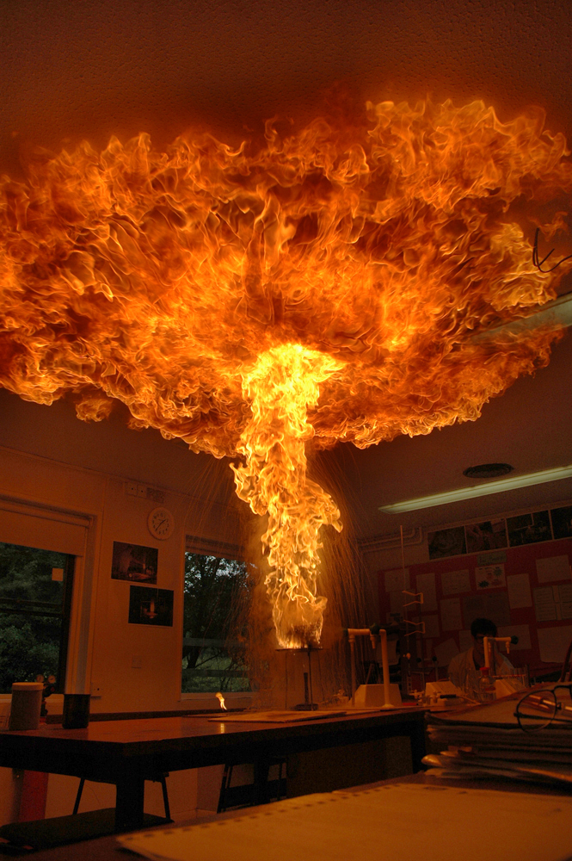
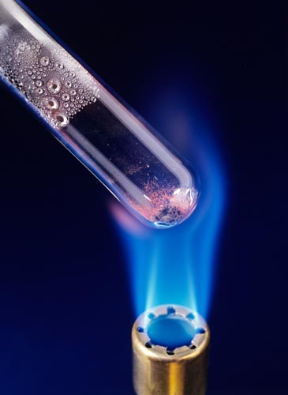
Heat Change During a Reaction
Some reactions release heat
Some reactions release lots of heat
Some reactions need heat

Slide 8
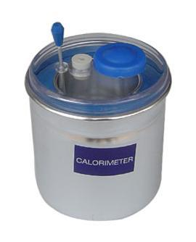
Measuring Heat During a Reaction
Scientists devised ways of measuring the heat change that occurred during a reaction
Calorimeters are devices created for this purpose
In this lesson, we will learn about heat changes that occur during reactions
We will also learn how to represent the heat changes on graphs called enthalpy diagrams

Slide 9
Enthalpy of Reactions
SWBAT explain the concept of enthalpy of reaction, as well as interpret and create enthalpy diagrams of chemical reactions
Write this in your notes

Slide 10
Enthalpy
Write red text in your notes
When measuring heat changes during a reaction, a quantity called "enthalpy" is used.
Enthalpy = heat content of a system at constant pressure
Very complicated explanation why this stipulation about pressure is necessary
Symbol is "H"
Units can be joules, joules/mol or joules/gram
Because pressure often stays constant, people often use "enthalpy", "heat", and "energy" interchangeably.
Nonetheless, you need to know the definition of enthalpy and the difference between enthalpy, heat & energy

Slide 11
Enthalpy (Heat) of a Reaction
Write this in your notes
reactants products
The enthalpy (heat) of reaction
defined as the amount of heat released or absorbed by a chemical reaction
symbol is "ΔH_{rxn}"
units can be joules, joules/mol or joules/gram
determined by the following equation
ΔH_{rxn} = H_{products} – H_{reactants}

Slide 12
Enthalpy Diagrams
Write this in your notes
ΔH_{rxn}
reactants products
Enthalpy diagrams show this change graphically
reactants
ΔH_{rxn}
products

Slide 13
Y Axis
reactants
ΔH_{rxn}
products
The y-axis represents enthalpy
items high on the y-axis have high enthalpy
items low on the y-axis have low enthalpy
Write this in your notes

Slide 14
Y Axis
reactants
5
ΔH_{rxn}
kcal/mole
products
0
The y-axis sometimes has a scale

Slide 15
Check for Understanding
reactants
ΔH_{rxn}
products
Which is higher in enthalpy?
the reactants?
the products?

Slide 16
Check for Understanding
products
ΔH_{rxn}
reactants
Which is higher in enthalpy?
the reactants?
the products?

Slide 17
Check for Understanding
reactants
5
ΔH_{rxn}
kcal/mole
products
0
What is the enthalpy difference between the reactants and products?

Slide 18
Key Concept
Write this in your notes
high energy = low stability
low energy = high stability
Everything in the universe prefers low energy, high stability states

Slide 19
Check for Understanding
products
ΔH_{rxn}
reactants
Which is more stable?
the reactants?
the products?

Slide 20
Check for Understanding
reactants
ΔH_{rxn}
products
Which is more stable?
the reactants?
the products?

Slide 21
X Axis
reactants
ΔH_{rxn}
products
The x-axis represents progress of change
often called the "reaction coordinate"
change could be a chemical reaction or a physical phase change
Write this in your notes

Slide 22
Connecting Line
reactants
ΔH_{rxn}
products
A line is often drawn connecting the reactant enthalpy state with the product enthalpy state.
This line is meant to reflect the enthalpy levels of the intermediary states in between.
This is often called the "reaction path"
Write this in your notes

Slide 23
Step by Step Process

Slide 24
Step by Step Process from Reactants to Products

Slide 25
Check for Understanding
Write down 5 steps you take in going to lunch

Slide 26
Do Now
Identify all six features of this enthalpy diagram
reactants
reaction path
1
2
3
ΔE
enthalpy
4
products
5
reaction
coordinate
6

Slide 27
Answers
Which is higher in enthalpy?
Which is more stable?
reactants
reaction path
1
2
3
ΔE
4
enthalpy
ΔH_{rxn}
products
5
reaction
coordinate
6

Slide 28
Enthalpy Consumed or Released
In some cases, enthalpy must be consumed in order for the reaction to proceed forward
endothermic reaction
In other cases, enthalpy is released when the reaction proceeds forward
exothermic reaction

Slide 29
The Sign of ΔH_{rxn}
Write this in your notes
If the reaction ... | then the reaction is ... | and ΔH_{rxn} is ...

Slide 30
The Sign of ΔH_{rxn}
Write this in your notes
If the reaction ... | then the reaction is ... | and ΔH_{rxn} is ...
loses heat

Slide 31
The Sign of ΔH_{rxn}
Write this in your notes
If the reaction ... | then the reaction is ... | and ΔH_{rxn} is ...
loses heat | exothermic

Slide 32
The Sign of ΔH_{rxn}
Write this in your notes
If the reaction ... | then the reaction is ... | and ΔH_{rxn} is ...
loses heat | exothermic | negative

Slide 33
The Sign of ΔH_{rxn}
Write this in your notes
If the reaction ... | then the reaction is ... | and ΔH_{rxn} is ...
loses heat | exothermic | negative
gains heat

Slide 34
The Sign of ΔH_{rxn}
Write this in your notes
If the reaction ... | then the reaction is ... | and ΔH_{rxn} is ...
loses heat | exothermic | negative
gains heat | endothermic

Slide 35
The Sign of ΔH_{rxn}
Write this in your notes
If the reaction ... | then the reaction is ... | and ΔH_{rxn} is ...
loses heat | exothermic | negative
gains heat | endothermic | positive
exits is exo
into is endo

Slide 36
Check for Understanding
reactants
products
ΔH_{rxn}
ΔH_{rxn}
products
reactants
Which is endothermic?
Which is exothermic?
What is the sign of ΔH_{rxn} for each?

Slide 37
Check for Understanding
Sketch an enthalpy diagram of an exothermic reaction
Label the reactants and products
Which is more stable?
What is the sign of ΔH_{rxn}?
reactants
ΔH_{rxn}
products

Slide 38
What is the bump?
Write this in your notes
reactants
ΔH_{rxn}
products
In most reactions, the reactants must get near to one another to begin breaking old bonds and forming new bonds
This arrangement of the molecules has a higher overall enthalpy than either the reactants or products by themselves
This arrangement of molecules is called the "transition state"

Slide 39
Transition State
Carbon-oxygen bond is forming
Carbon-bromine bond is breaking
This arrangement of the molecules has a higher overall enthalpy than either the reactants or products by themselves

Slide 40
Activation Energy
E_{act}
Write this in your notes
The difference between the enthalpy of the reactants and the enthalpy of the transition state is called the "activation energy" or E_{act}

Slide 41
E_{act} is Important
Write this in your notes
For a reaction to happen, the reaction must get enough energy to get over the bump.
exothermic reactions would occur spontaneously without the bump
Activation energy determines how easily the reaction can occur.
high activation energy = hard to get over bump
low activation energy = easy to get over bump
Catalyst, such as enzymes, act by stabilizing the transition states and lowering the activation energy of reactions

Slide 42
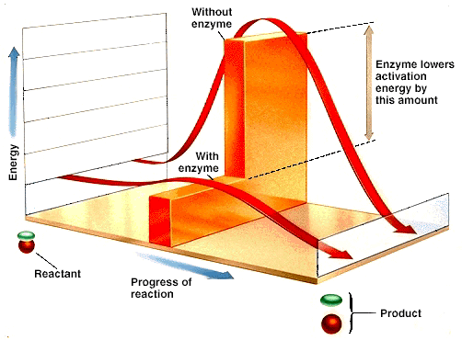

Slide 43
Check for Understanding
reactants
product
2
product
1
Which is reaction is more exothermic?
Which reaction will happen more easily?

Slide 44
Kinetic vs Thermodynamic
reactants
kinetic
product
thermodynamic product
product
2
product
1

Slide 45
More on Activation Energy
Write this in your notes
products
E_{act}
ΔH_{rxn}
reactants
In endothermic reactions, the activation energy is higher than the heat of reaction!!!

Slide 46
Don't Get Confused
Write this in your notes
reactants
products
Enthalpy of Reaction = ΔH_{rxn}
= H_{products} – H_{reactants}
Activation Energy = E_{activation}
= H_{transition state} – H_{reactants}
H_{transition state} – H_{products} not often used

Slide 47
Exit Ticket
Check for Understanding
Add the reaction enthalpy and activation energy symbols to this energy diagram
reactants
products

Slide 48
Check for Understanding
Add the reaction enthalpy and activation energy symbols to this enthalpy diagram
products
reactants

Slide 49
Check for Understanding
In your notebook, sketch the enthalpy diagram for a reaction which is exothermic and has a high activation energy.
Be sure your diagram includes
reactants and products with correct relative enthalpy
a reaction path
labeled x and y axes
indication of enthalpy (heat) of reaction
indication of the activation energy

Slide 50
Do Now
In your notebook, sketch the enthalpy diagram for a reaction which is endothermic and has a high activation energy.
Be sure your diagram includes
reactants and products with correct relative enthalpy
a reaction path
labeled x and y axes
indication of enthalpy (heat) of reaction
indication of the activation energy

Slide 51
Group Problem Do this problem on graph paper
Draw an enthalpy diagram of a reaction. The reactants enthalpy is 3 kcal/mole, the products enthalpy is 14 kcal/mole, and the transition state energy is 19 kcal per mole. Include the following items on your diagram:
labels and energy levels for reactants, products and transition state 5 pts
reaction path 1 pt
label for the x and y axes 1 pt
proper scale and units for the y-axis 1 pt
indication of the enthalpy of reaction (symbol, amount) 4 pts
indication of the activation energy (symbol, amount) 4 pts
indicate whether the reaction is exothermic or endothermic 4 pts

Slide 53
Enthalpy
ΔH_{rxn}

Slide 54
Homework
Worksheet on Enthalpy Diagrams
Get 2-4 pieces of graph paper
We will work the rest of the period on this worksheet
It will be due to me by the beginning of next class
It will be graded as a homework assignment.
If you fail to finish it during class, you will have to complete it for homework

Slide 55
Backup Slides

Slide 56
Not Covered

Slide 57
Thermochemistry
The study of heat changes that accompany chemical reactions or physical changes
For thermochemistry, the following definitions are used
universe - everything
system - the part of the universe we are studying, usually a chemical reaction or physical change
surroundings - everything in the universe except for the system

Slide 58
Enthalpy of Combustion
Enthalpy (heat) of combustion
ΔH_{comb} = enthalpy change for the complete burning of one mole of a substance
Standard enthalpy (heat) of combustion
ΔH°_{comb} = enthalpy of combustion measured at 1 atm pressure and 25°C temperature (standard conditions)
Practice calculating overall heat of combustions based on stand

Slide 59
Representing Change
Write this in your notes
before after
reactants products
A B
M_{(t = 0)} M_{(t = 1)}
These are all examples of a short hand notation used to represent change.
The change can be a chemical reaction, a phase change or any other change.

Slide 60
Delta Δ
Write this in your notes
Greek letter equivalent to our "D"
Delta is a symbol that means "change"
Δx means "change in x" or "x₂ - x₁"
Δt means "change in t" or "t₂ - t₁"
Delta is used frequently in math and science to indicate change.

Slide 61
Endothermic Reaction

Slide 62
Enthalpy Diagrams
reaction path
reactants
enthalpy
ΔH_{rxn}
products
reaction
coordinate

Slide 63
Check for Understanding

