Slide 1
Fill in the Table
type | abbrev. | location in atom | relative mass | charge | change in number produces

Slide 2
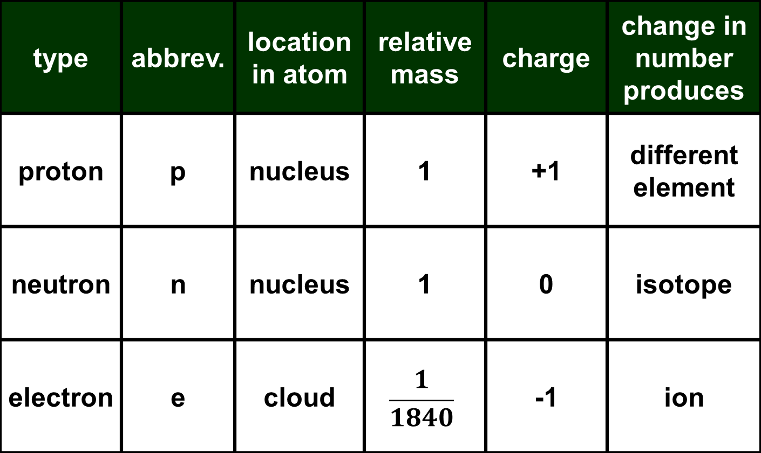
Sub-Atomic Particles
type | abbrev. | location in atom | relative mass | charge | change in number produces
proton | p | nucleus | 1 | +1 | different element
neutron | n | nucleus | 1 | 0 | isotope
electron | e | cloud | $$\frac{1}{1840}$$ | -1 | ion

Slide 3
What are the Definitions?
Element - atoms with the same number of protons
Isotopes - atoms with the same number of protons (e.g. same element), but different number of neutrons
Ions - atoms with a charge, usually through the gain or loss of electrons
Cation - atoms with a positive charge
Anion - atoms with a negative charge
Nucleons - subatomic particles in the nucleus (e.g. protons and neutrons)

Slide 4
Vocabulary
Element - atoms with the same number of protons
Isotopes - atoms with the same number of protons (e.g. same element), but different number of neutrons
Ions - atoms with a charge, usually through the gain or loss of electrons
Cation - atoms with a positive charge
Anion - atoms with a negative charge
Nucleons - subatomic particles in the nucleus (e.g. protons and neutrons)

Slide 5
Review
What is the abbreviation for:
atomic number:
mass number:
What is the equation for:
atomic number:
mass number:
charge:

Slide 6
Review
What are the five parts of Dalton's atomic theory?
Describe the three key experiments on the subatomic particles and what they discovered.

Slide 7
Dalton's Atomic Theory
Elements are made of extremely small particles called atoms.
Atoms of a given element are the same; atoms of different elements are not the same
Atoms cannot be subdivided, created, or destroyed.
Atoms of different elements combine in simple whole-number ratios to form chemical compounds.
In chemical reactions, atoms are combined, separated, or rearranged

Slide 8
Key Experiments
Thomson Experiment
Cathode rays bent in magnetic field
Leads to discovery of subatomic particles & electron
Rutherford Experiment
Alpha particles rarely bounce off of thin gold foil
Leads to discovery of nucleus and proton
Chadwick Experiment
Alpha particle bombardment create a neutral ray
Leads to discovery of the neutron

Slide 9
Questions
What is the electron cloud?
What percentage of the mass of the atom is in the nucleus?
What effect does electrostatic force have on a proton and an electron interaction?
How can some elements have no charge when they are made up of charged particles?
What is strong nuclear force?

Slide 10
Complete the Table
isotope name | atomic notation | atomic number | mass number | # of protons | # of neutrons | # of electrons
oxygen-18 dianion
 |  |  |  | 24 | 28 | 18

Slide 11
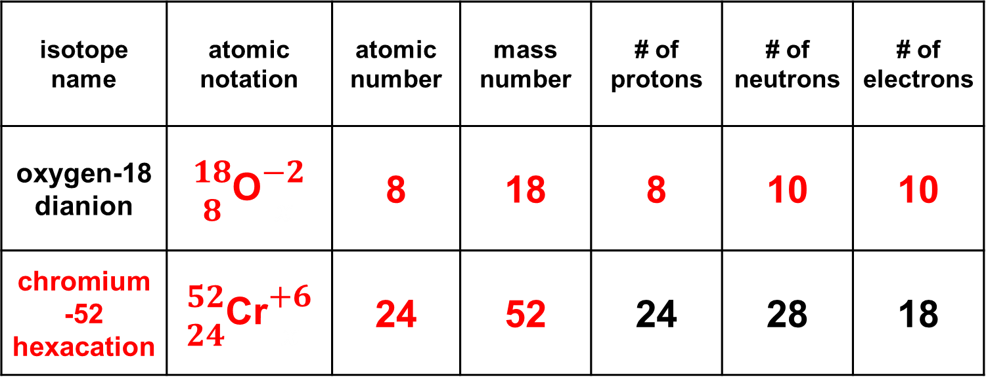
Complete the Table
isotope name | atomic notation | atomic number | mass number | # of protons | # of neutrons | # of electrons
oxygen-18 dianion | $\begin{matrix}18 \\ 8\end{matrix}$O$\begin{matrix}−2 \\ x\end{matrix}$ | 8 | 18 | 8 | 10 | 10
chromium -52 hexacation | $\begin{matrix}52 \\ 24\end{matrix}$Cr$\begin{matrix}+6 \\ x\end{matrix}$ | 24 | 52 | 24 | 28 | 18

Slide 12
Write the Definitions
Atomic Number
Mass Number
Atomic Symbol
Standard Atomic Mass

Slide 13
Write the Definitions
Atomic Number | Number of protons in nucleus
Mass Number | Number of protons and neutrons (nucleons) in nucleus
Atomic Symbol | 1-2 letter abbreviation for element name
Standard Atomic Mass | Mass of element weighted according to natural abundance

Slide 14
Do Now
Identify the seven parts of atomic notation below:
6
1
C
2
3
12.011
This is also called "carbon-12"
4
5
12
C
6
7
6

Slide 15
Check for Understanding
How does Dalton's atomic theory explain the law of conservation of mass?
Mass is conserved because atoms cannot be created, divided or destroyed.

Slide 16
Check for Understanding
Why did Thomson believe that the particles in the cathode ray were negatively-charged?
Because they were repelled by the negative pole of a magnet

Slide 17
Check for Understanding
Before Rutherford's experiment, it was theorized that the positive and negative charges of an atom were spread out thinly throughout the space of an atom. What part of Rutherford's data showed that this theory was wrong?
A few heavy, positively-charged alpha particles were deflected or even bounced backwards. This meant the positive charge of the atom was concentrated and massive

Slide 18
Check for Understanding
Why did Chadwick believe the particles released by the beryllium were neutral?
Because a magnet had no effect on their path (unlike the cathode rays in Thomson's experiment)

