Slide 1
Early Enrollment Program
Application forms in black basket
This is a 4 credit class
Call #: 12361
Application deadline is October 15
Return application form to Mrs. Nobrega

Slide 2
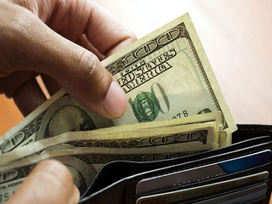
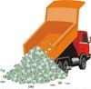
Do Now
A wallet full
of $100 bills
A dump truck
full of $20 bills
If you could take one bill from either the wallet or the dump truck, which would you take it from? Why?
If you could have all the bills from either the wallet or the dump truck, which would you take it from? Why?

Slide 3
A wallet full
of $100 bills
A dump truck
full of $20 bills
If you could take one bill from either the wallet or the dump truck, which would you take it from? Why?
The wallet has a higher average bill value.
If you could have all the bills from either the wallet or the dump truck, which would you take it from? Why?
The dump truck has a greater amount of money.

Slide 4
Topics to be Covered
Introduction to Chemistry
Science & the Scientific Method
Energy & Matter
Atomic Theory
The Mole
Electrons
Periodic Properties
Bonding
Nomenclature
Chemical Reactions
Stoichiometry
Mixtures and Solutions
Chemical Equilibrium
Acid-Base Chemistry
Redox & Electrochemistry
Thermodynamics
Nuclear Chemistry
Gas Laws

Slide 5
Homework on Matter
Lesson | Problems
Introduction to Matter | Chapter 3: 17, 39, 60, 62, 67
Physical & Chemical Changes | Chapter 3: 12, 33, 34, 41, 45
Three Laws of Matter | Chapter 3: 27, 55, 71, 73, 75
Due next class

Slide 6
Energy and Heat
Write this in your notes
SWBAT explain the concepts of energy, heat and specific heat
Should we introduce enthalpy here so it is not confused with heat later on???

Slide 7
What is Energy?
Energy is . . . energy!
Energy
the ability to do work
power which may be translated into motion, overcoming resistance, or effecting physical change
The symbol for energy is E
Write this in your notes

Slide 8
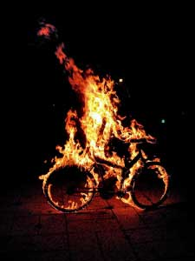
Two Basic Forms of Energy
Write this in your notes
Many subtypes, but basic forms are:
Kinetic Energy
Energy of motion
Potential Energy
Energy due to the composition or position of an object

Slide 9
Conservation of Energy
Write this in your notes
Law of Conservation of Energy
(First Law of Thermodynamics)
Energy can not be created or destroyed but only converted from one form to another

Slide 10
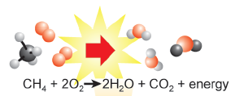
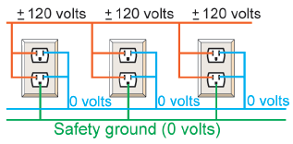
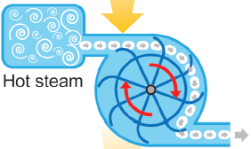
Energy Conversion
Thermal energy
Chemical energy
Electrical energy
Mechanical energy

Slide 11
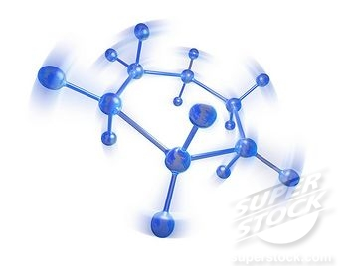
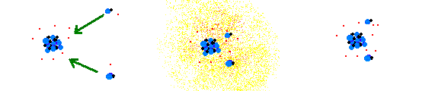
Energy in Chemical Systems
Write this in your notes
Kinetic Energy
random motion of particles
stretching or bending of bonds
Potential Energy
energy of bonds
energy of atoms
number of atoms

Slide 12
Chemical Potential Energy
Energy stored in a substance
Example
energy released when burning propane
Write this in your notes
C₃H₈ + 5O₂ 4H₂O + 3CO₂

Slide 13
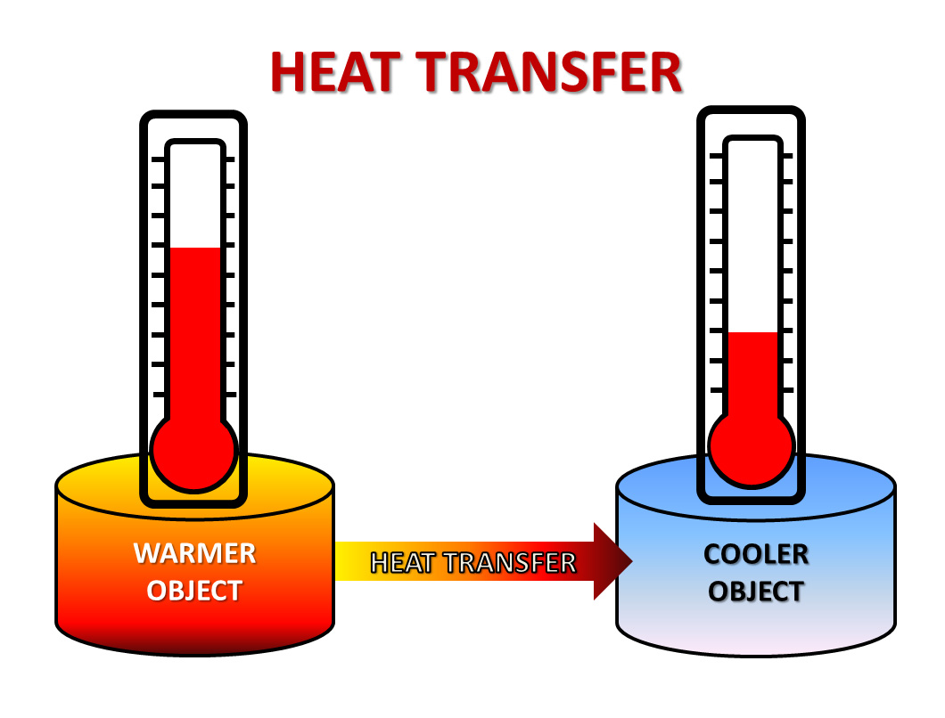
Heat
Write this in your notes
Energy that is in the process of flowing from a warmer object to a cooler object
The symbol for heat is "q"

Slide 14
warmer object loses energy & its temperature drops
cooler object gains energy & its temperature rises

Slide 15
Units of Heat
Write this in your notes
calories (cal) - energy required to raise the temperature of one gram of water by one degree Celsius
Calories (Cal) - calories with a capital "C" are nutritional calories and are equal to 1000 calories or 1 kcal
joule (J) - SI unit of heat. 1 cal = 4.184 J

Slide 16
Check for Understanding
Convert 55.3 cal into joules
Convert 9,445 joules into cal
Convert 120 Calories into calories
Convert 76 Calories into joules
55.3 cal | 4.184 J | = | 231 J
 | 1 cal
9445 J | 1 cal | = | 2257 cal
 | 4.184 J
120 Calories | 1000 cal | = | 120,000 cal
 | 1 Calorie
76 Calories | 1000 cal | 4.184 J | = | 320,000 J
 | 1 Calorie | 1 cal

Slide 17
Heat & Temperature similar but not the same
Heat is defined as energy that is in the process of flowing from a warmer object to a cooler object
Heat and temperature are measures similar phenomena - similar but not identical
Heat measures the total amount of kinetic energy of a sample
Temperature measures the average kinetic energy of a sample

Slide 18
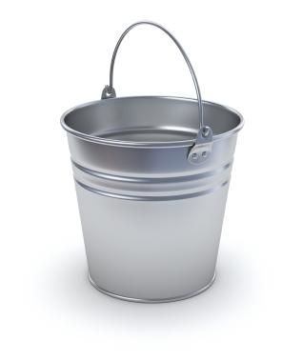
Bucket vs Cup
Bucket of water
temperature = 100°F
Cup of water
temperature = 212°F

Slide 19
Bucket vs Cup
Which one is hotter?

Slide 20
Bucket vs Cup
If your bathtub was a little too cold,
which would warm it up more?

Slide 21
Bucket vs Cup
The average kinetic energy of the water
in the teacup is greater than that in the bucket
The teacup has a higher temperature

Slide 22
Bucket vs Cup
The total amount of kinetic energy of the water
in the bucket is greater than that in the cup
The bucket has more heat

Slide 23
Do Now
A wallet full
of $100 bills
A dump truck
full of $20 bills
If you could take one bill from either the wallet or the dump truck, which would you take it from? Why?
If you could have all the bills from either the wallet or the dump truck, which would you take it from? Why?

Slide 24
Do Now
A wallet full
of $100 bills
A dump truck
full of $20 bills
If you could take one bill from either the wallet or the dump truck, which would you take it from? Why?
wallet has a higher "temperature" of money
If you could have all the bills from either the wallet or the dump truck, which would you take it from? Why?

Slide 25
Do Now
Which is an extensive property?
heat
A wallet full
of $100 bills
A dump truck
full of $20 bills
If you could take one bill from either the wallet or the dump truck, which would you take it from? Why?
wallet has a higher "temperature" of money
If you could have all the bills from either the wallet or the dump truck, which would you take it from? Why?
dump truck has a greater "heat" of money

Slide 26
Heat & Temperature similar but not the same
Write this in your notes
Heat and temperature are measures similar phenomena - similar but not identical
Heat measures the total amount of kinetic energy of a sample
Temperature measures the average kinetic energy of a sample
Write this in your notes

Slide 27
Relationship between Heat and Temperature
Write this in your notes
$$q=c ∗m ∗∆T$$
Where: q = heat
c = specific heat
m = mass
ΔT = change in temperature
= T_{final} - T_{initial} = T₂ - T₁

Slide 28
What is Specific Heat?
Write this in your notes
The amount of heat required to raise the temperature of one gram of substance by one degree Celsius
Specific heat can vary dramatically between different substances
Symbol is "c"
Units are cal/g°C or J/g°C
By definition, the specific heat of water is 1 cal/g°C or 4.184 J/g°C
$$\frac{cal}{g ℃}$$
$$\frac{J}{g ℃}$$

Slide 29
Differences in Specific Heat

Slide 30
Same
energy input

Slide 31
Same
energy input

Slide 32
Same
energy input
Different
temperature
change

Slide 33
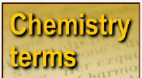
specific heat: the quantity of energy it takes per gram of a certain material to raise the temperature by one degree Celsius.
Specific heat of water:
4.184 J/(g·ºC)
Specific heat of gold:
0.129 J/(g·ºC)

Slide 34
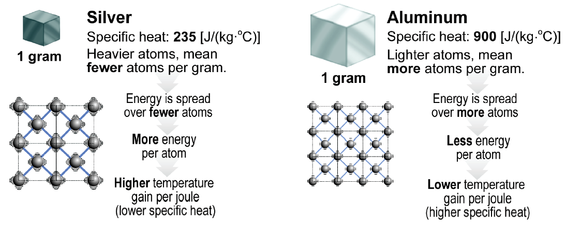
Why do different substances have different specific heats?
One reason is:

Slide 35
Review
Energy is the ability to do work
Two basic forms are kinetic and potential energy
Energy cannot be created or destroyed, but only converted from one form to another
Chemical systems also have kinetic and potential energy
Chemical potential energy is the energy stored in a substance
Heat is energy that is in the process of flowing from a warmer object to a cooler object
Heat is represented by q and is measured in calories, Calories or joules
A calorie is the energy required to raise the temperature of one gram of water by 1°C
1 calorie = 4.184 J. 1000 calories = 1 Calorie
Heat measures the total amount of kinetic energy of a sample
Temperature measures the average kinetic energy of a sample
q = c m ΔT
Specific heat is the amount of heat required to raise the temperature of substance by 1°C
Specific heat is represented c and is measured in cal/g or J/g
Specific heat varies from substance to substance

Slide 36
Announcements

