Slide 1
Do Now
What is the atomic number of copper?
29
What element has 80 protons?
mercury (Hg)
An isotope of magnesium (Mg) has a mass number of 26. How many neutrons does it have?
14

Slide 2
Test 2 – Atomic Theory
Lessons
Creation of the Atomic Theory
Subatomic Particles
Identifying Atoms
Atomic Notation
Periods 3, 5, 6: Wednesday, Nov 20
Period 4: Thursday, Nov 21
Department Night: Tuesday, Nov 19

Slide 3
Atomic Notation
Write this in your notes
SWBAT read and write atomic notation

Slide 4
Atomic Notation
Write this in your notes
Atomic notation provides a shorthand to indicate a single atom or a group of atoms with a specific number of protons, neutrons & electrons
mass number
13
C
+2
charge
atomic symbol
atomic number
6
A
E
C
Z

Slide 5
Spoken or Written Version
mass number
13
C
+2
charge
atomic symbol
atomic number
6
Write this in your notes
carbon-13 dication
not written if no charge
element
name
–
mass
number
cation
or
anion
prefix
dash, not a
minus sign
space
number
of charges
type
of charges

Slide 6
Molecular Prefixes (on your Unit Reference Sheet)
Prefix | Value
mono- (or nothing) | 1
di- | 2
tri- | 3
tetra- | 4
penta- | 5
hexa- | 6
hepta- | 7
octa- | 8
nona- | 9
deca- | 10

Slide 7
Write this in your notes
Periodic Table Notation
6
atomic number
C
atomic symbol
standard
atomic weight
12.011
Atomic Notation
mass number
12
C
charge
atomic symbol
atomic number
6

Slide 8
Write this in your notes
Periodic Table Notation
6
atomic number
The atomic number is on top!
C
standard
atomic weight
12.011
Atomic Notation
The atomic number is on the bottom!
mass number
12
C
atomic number
6

Slide 9
Write this in your notes
Periodic Table Notation
6
atomic number
C
standard
atomic weight
12.011
Standard atomic weight
is not the same as
mass number
Atomic Notation
mass number
12
C
atomic number
6

Slide 10
Atomic Notation Summary
A
E
C
Z
not written if no charge
element
name
–
mass
number
cation
or
anion
prefix
dash, not a
minus sign
space
number
of charges
type
of charges

Slide 11
Check for Understanding 1
mass number
13
C
+2
charge
atomic symbol
atomic number
6
p:
6
Z = p
6 = p
n:
7
13 = 6 + n
A = p + n
e:
4
+2 = 6 – e
C = p – e

Slide 12
Check for Understanding 2
197
Pt
+3
78
p:
78
n:
119
e:
75
name:
platinum-197 trication

Slide 13
Check for Understanding 3
241
Pu
– 5
94
p:
94
n:
147
e:
99
name:
plutonium-241 pentaanion

Slide 14
Check for Understanding 4
79
Se
– 2
34
p:
34
n:
45
e:
36
name:
selenium-79 dianion

Slide 15
Atomic Notation Summary
A
E
C
Z
not written if no charge
element
name
–
mass
number
cation
or
anion
prefix
dash, not a
minus sign
space
number
of charges
type
of charges

Slide 16
Examples from Practice Sheet
Write this in your notes
Example | isotope name | atomic notation | atomic number | mass number | # of protons | # of neutrons | # of electrons
1 | calcium-43
2 |  |  |  |  | 16 | 20 | 18

Slide 17
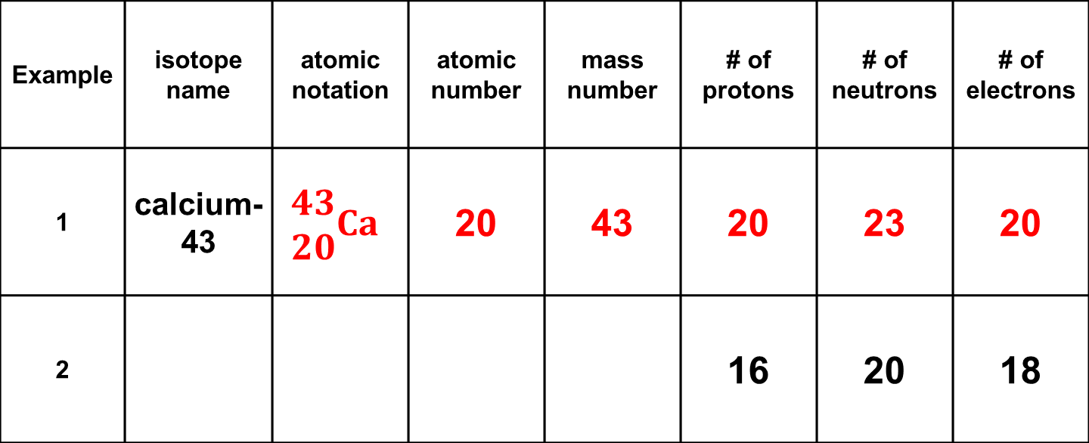
Examples from Practice Sheet
Write this in your notes
Example | isotope name | atomic notation | atomic number | mass number | # of protons | # of neutrons | # of electrons
1 | calcium-43 | $$\begin{matrix}43 \\ 20\end{matrix}Ca$$ | 20 | 43 | 20 | 23 | 20
2 |  |  |  |  | 16 | 20 | 18

Slide 18
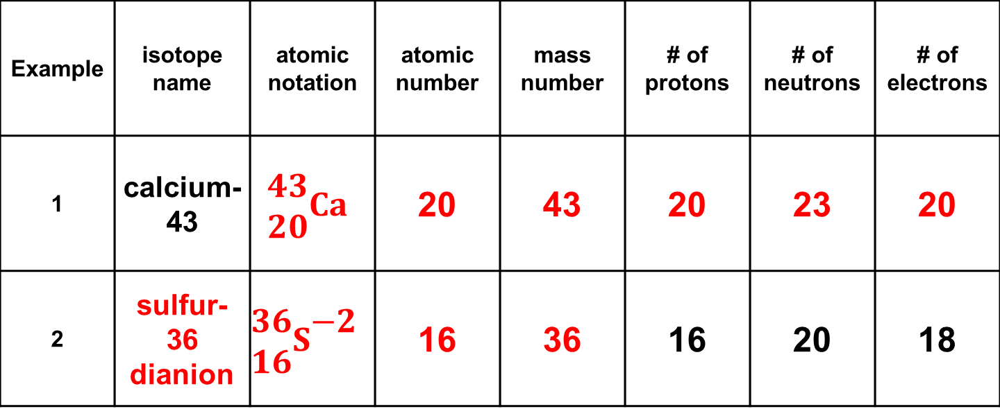
Examples from Practice Sheet
Write this in your notes
Example | isotope name | atomic notation | atomic number | mass number | # of protons | # of neutrons | # of electrons
1 | calcium-43 | $$\begin{matrix}43 \\ 20\end{matrix}Ca$$ | 20 | 43 | 20 | 23 | 20
2 | sulfur-36 dianion | $$\begin{matrix}36 \\ 16\end{matrix}S\begin{matrix}−2 \\ x\end{matrix}$$ | 16 | 36 | 16 | 20 | 18

Slide 19
Start with Text Notation
isotope name | atomic notation | atomic number | mass number | # of protons | # of neutrons | # of electrons
magnesium -26 | $\begin{matrix}1 \\ 1\end{matrix}$H | 1 | 1 | 1 | 0 | 1

Slide 20
Start with Atomic Notation
isotope name | atomic notation | atomic number | mass number | # of protons | # of neutrons | # of electrons
 | $\begin{matrix}81 \\ 35\end{matrix}$B$r\begin{matrix}− \\ x\end{matrix}$ | 1 | 1 | 1 | 0 | 1

Slide 21
Start with Subatomic Particles
isotope name | atomic notation | atomic number | mass number | # of protons | # of neutrons | # of electrons
 | $\begin{matrix}1 \\ 1\end{matrix}$H | 1 | 1 | 34 | 43 | 36

Slide 22
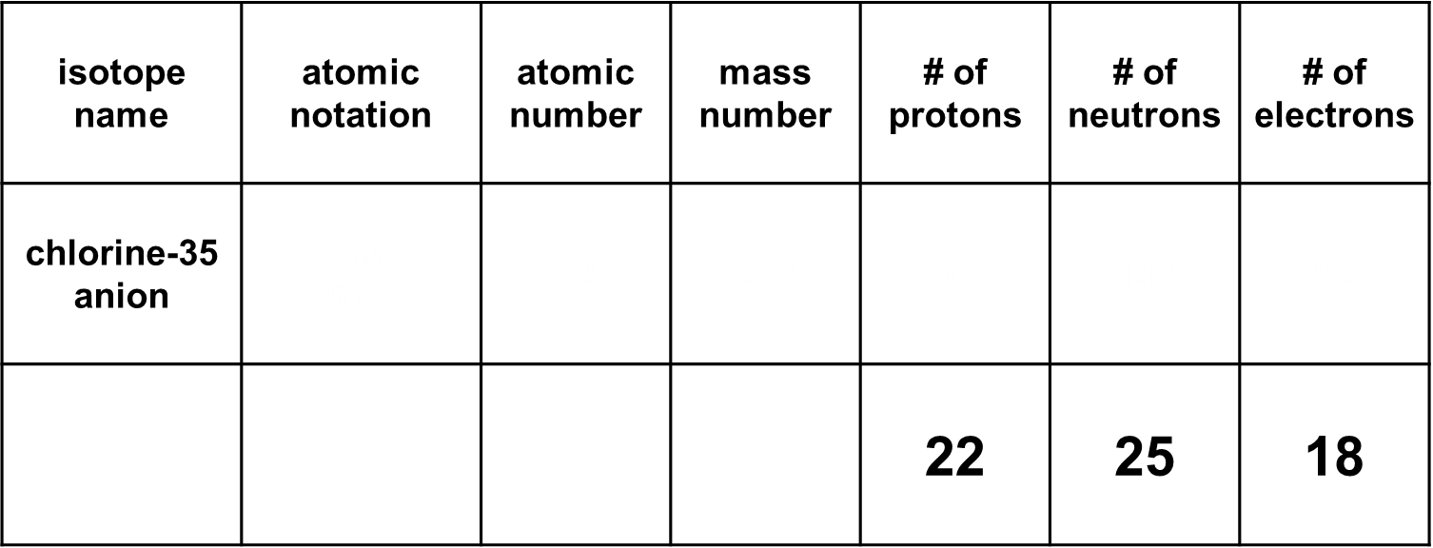
Check for Understanding
isotope name | atomic notation | atomic number | mass number | # of protons | # of neutrons | # of electrons
chlorine-35 anion | $\begin{matrix}238 \\ 92\end{matrix}$U | 92 | 238 | 92 | 146 | 92
 |  |  |  | 22 | 25 | 18

