Slide 1
Do Now
Identify the pattern and then predict the next number in the sequence
1) | -5 |  | -3 |  | -1 |  | 1 |  | ?
2) | 4 |  | 7 |  | 12 |  | 19 |  | ?
3) | 1 |  | 3 |  | 7 |  | 15 |  | ?

Slide 2
Do Now
Identify the pattern and then predict the next number in the sequence
1) | -5 |  | -3 |  | -1 |  | 1 |  | 3
 |  | +2 |  | +2 |  | +2 |  | +2
2) | 4 |  | 7 |  | 12 |  | 19 |  | ?
3) | 1 |  | 3 |  | 7 |  | 15 |  | ?

Slide 3
Do Now
Identify the pattern and then predict the next number in the sequence
1) | -5 |  | -3 |  | -1 |  | 1 |  | 3
 |  | +2 |  | +2 |  | +2 |  | +2
2) | 4 |  | 7 |  | 12 |  | 19 |  | 28
 |  | +3 |  | +5 |  | +7 |  | +9
3) | 1 |  | 3 |  | 7 |  | 15 |  | ?

Slide 4
Do Now
Identify the pattern and then predict the next number in the sequence
1) | -5 |  | -3 |  | -1 |  | 1 |  | 3
 |  | +2 |  | +2 |  | +2 |  | +2
2) | 4 |  | 7 |  | 12 |  | 19 |  | 28
 |  | +3 |  | +5 |  | +7 |  | +9
3) | 1 |  | 3 |  | 7 |  | 15 |  | 31
 |  | +2 |  | +4 |  | +8 |  | +16

Slide 5
Discussion
When scientists were first studying matter, they started by trying to recognize patterns they were seeing in the composition of matter
Today's class will trace their progress

Slide 6
Homework on Matter
Lesson | Problems
Introduction to Matter | Chapter 3: 17, 39, 60, 62, 67
Physical & Chemical Changes | Chapter 3: 12, 33, 34, 41, 45
Three Laws of Matter | Chapter 3: 27, 55, 71, 73, 75
Homework is due two classes from today

Slide 7
Announcements

Slide 8
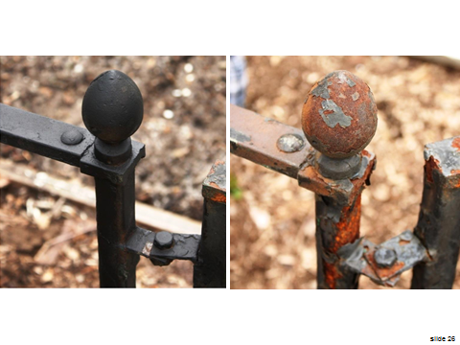
Last Class

Slide 9
Three Laws of Matter
SWBAT explain three laws of matter:
Conservation of Mass
Definite Proportions
Multiple Proportions
Write this in your notes

Slide 10
Conceptual Lesson
When this lesson is over, you should be able to:
Name the three laws
Summarize what they say
Provide examples that illustrates each of these three laws
Solve simple computations associated with these three laws

Slide 11
Changing Theories on Matter
Can matter be created or destroyed?
It is easy to see why some people believed the answer was "yes"
A burning candle will eventually disappear
Huge trees grow out of nothing

Slide 12
Different Views
As their tools improved, scientists began to gather evidence that the answer was "no"
Burning candle - the wax was converted to invisible carbon dioxide and water vapor
Growing tree - the wood of the tree was made from invisible carbon dioxide in the air and water absorbed through roots.

Slide 13
Matter During a Chemical Change
The formation of a precipitate clearly shows that a chemical change has taken place
Where did the solid come from?
Was matter created?

Slide 14
Was Matter Created?
"No!" The mass did not change at all.
It is a perfectly balance chemical reaction
CaCl₂(aq) + Na₂SO₄(aq) → CaSO₄(s) + NaCl(aq)

Slide 15
Law of Conservation of Mass
Mass is neither created nor destroyed during a chemical reaction - it is conserved
Mass_{reactants} = Mass_{products}
The mass of the reactants equals the mass of the products
Write this in your notes

Slide 16
mass_{reactants} = mass_{products}
mass_{mercury(II)oxide} = mass_{mercury} + mass_{oxygen}
15.00 g = mass_{mercury} + 1.11 g
13.89 g = mass_{mercury}

Slide 17
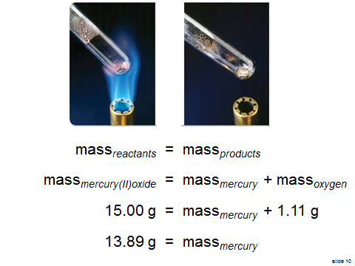
Impact of this Law
While this example seems trivial, this law has huge impact throughout science
We will use the Law of Conservation of Mass to solve many, many problems in chemistry

Slide 18
Another Aspect of Matter
We know that pure substances can be either elements or compounds
We also know that compounds are made up of two or more different elements that are combined chemically
As scientists studied compounds further, they realized that any sample of a particular compound always had its elements in the same proportions when measured by mass

Slide 19
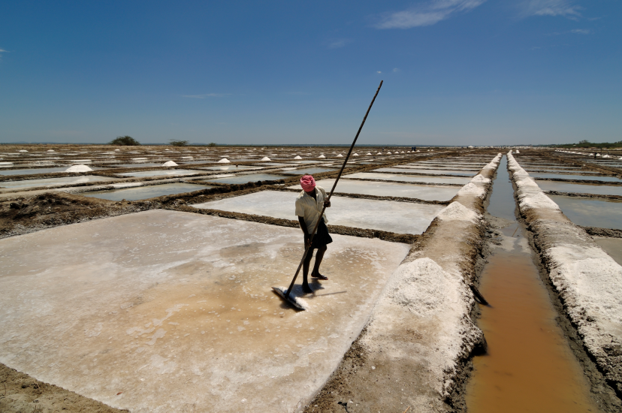
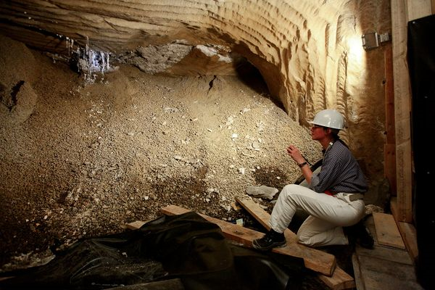
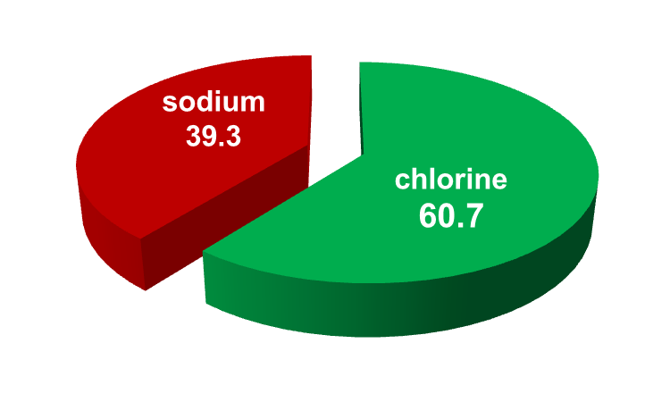
Same Proportion of Elements Regardless of Source or Size

Slide 20
Law of Definite Proportions
Write this in your notes
A compound is always composed of the same elements in the same proportion by mass
no matter the size of the sample
no matter the source of the sample

Slide 21
Percent by Mass
Write this in your notes
$$percent by mass \left(\%\right)= \frac{mass of element}{mass of compound} ×100$$

Slide 22
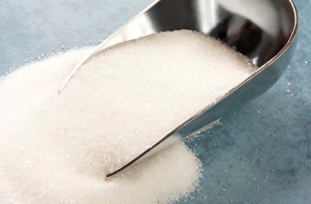
Analysis of Sugar 1
A sample of exactly 20.00 g of granulated sugar was analyzed to determine how much carbon, hydrogen and oxygen it contained
carbon: 8.44 g
hydrogen: 1.30 g
oxygen: 10.26 g

Slide 23
C, H, & O Percent by Mass
$$percent by mass \left(\%\right)= \frac{mass of element}{mass of compound} ×100$$
$$carbon: \frac{8.44 g}{20.00 g} ×100=42.2 \% C in sugar$$
$$hydrogen: \frac{1.30 g}{20.00 g} ×100=6.50 \% H in sugar$$
$$oxygen: \frac{10.26 g}{20.00 g} ×100=51.30 \% O in sugar$$

Slide 24
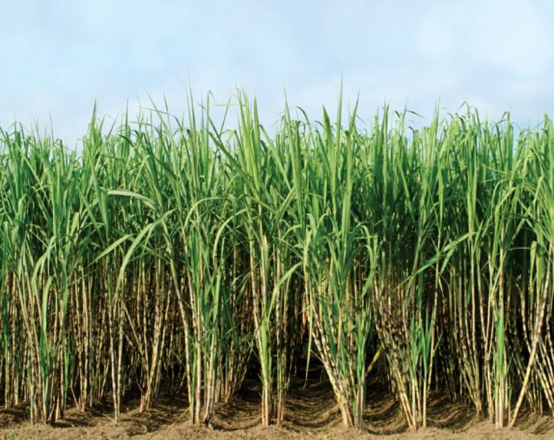
Analysis of Sugar 2
A sample of exactly 500.0 g of sugarcane sugar was analyzed to determine how much carbon, hydrogen and oxygen it contained
carbon: 211.0 g
hydrogen: 32.5 g
oxygen: 256.5 g
Calculate the percent by mass

Slide 25
C, H, & O Percent by Mass
$$percent by mass \left(\%\right)= \frac{mass of element}{mass of compound} ×100$$
$$carbon: \frac{211.0 g}{500.0 g} ×100=42.20 \% C in sugar$$
$$hydrogen: \frac{32.5 g}{500.0 g} ×100=6.50 \% H in sugar$$
$$oxygen: \frac{256.5 g}{500.0 g} ×100=51.30 \% O in sugar$$

Slide 26
Comparison of Different Samples
element
carbon
hydrogen
oxygen
total

Slide 27
Comparison of Different Samples
element | granulated sugar percent by mass
carbon | 42.2%
hydrogen | 6.50%
oxygen | 51.30%
total | 100%

Slide 28
Comparison of Different Samples
element | granulated sugar percent by mass | sugarcane sugar percent by mass
carbon | 42.2% | 42.20%
hydrogen | 6.50% | 6.50%
oxygen | 51.30% | 51.30%
total | 100% | 100%
Sugar is composed of the same elements in the same proportion by mass regardless of the sample size or source
This demonstrates the Law of Definite Proportions

Slide 29
A Third Aspect of Matter
The law of definite proportions showed that for any one compound, the elements were present in fixed ratios
Sometimes, however, more than one compound was made up of the same set of elements, but with ratios that were different for each compound
As scientist studied these ratios more, they noticed some patterns . . .

Slide 30
carbon & oxygen gas 1
For example, it was known that there were two different gasses that were made out of just carbon and oxygen
Even though they used the same elements, they were different compounds with different physical and chemical properties
carbon & oxygen gas 2
In an effort to understand their composition, scientists determined the percent by mass of the two elements present in both compounds

Slide 31
carbon & oxygen gas 1
C | 42.9%
O | 57.1%
C | 27.3%
O | 72.7%
carbon & oxygen gas 2
The percentages by weight didn't immediately show any pattern, so scientists tried many mathematical analyses of these data
An interesting pattern emerged when the numbers were normalized

Slide 32
carbon & oxygen gas 1
C | 42.9%
O | 57.1%
C | 27.3%
O | 72.7%
carbon & oxygen gas 2
Normalization is a mathematical method for converting the percentage by weight of one element to one
This is achieved by multiplying the percentage by weight by its inverse

Slide 33
carbon & oxygen gas 1
C | 42.9% | $$×\frac{1}{42.9}$$
O | 57.1%
C | 27.3%
O | 72.7%
carbon & oxygen gas 2

Slide 34
carbon & oxygen gas 1
C | 42.9% | $$×\frac{1}{42.9}$$ | 1
O | 57.1% |  | 1.33
C | 27.3%
O | 72.7%
carbon & oxygen gas 2

Slide 35
carbon & oxygen gas 1
C | 42.9% | $$×\frac{1}{42.9}$$ | 1
O | 57.1% |  | 1.33
C | 27.3% | $$×\frac{1}{27.3}$$
O | 72.7%
carbon & oxygen gas 2

Slide 36
carbon & oxygen gas 1
C | 42.9% | $$×\frac{1}{42.9}$$ | 1
O | 57.1% |  | 1.33
C | 27.3% | $$×\frac{1}{27.3}$$ | 1
O | 72.7% |  | 2.66
carbon & oxygen gas 2
When the data is normalized, a pattern emerges
C:O ratio (gas 1) = 1 : 1.33
2:66 = 2 x 1.33
C:O ratio (gas 2) = 1 : 2.66
Gas 2 has exactly twice the amount of oxygen as gas 1

Slide 37
Law of Multiple Proportions
Write this in your notes
If two elements form more than one compound between them, then the ratios of the masses of the second element which combine with a fixed mass of the first element will be ratios of small whole numbers.

Slide 38
Explaining the Law of Multiple Proportions
Applies to cases where two elements form more than one compound
If the mass of the first element is held constant between the two compounds
Then the masses of the second element will be a small whole number ratio

Slide 39
Example of the Law of Multiple Proportions
Law | Example

Slide 40
Example of the Law of Multiple Proportions
Law | Example
Two elements . . . | Two elements - carbon & oxygen

Slide 41
Example of the Law of Multiple Proportions
Law | Example
Two elements . . . | Two elements - carbon & oxygen
. . . form more than one compound | Form gas 1 & gas 2

Slide 42
Example of the Law of Multiple Proportions
Law | Example
Two elements . . . | Two elements - carbon & oxygen
. . . form more than one compound | Form gas 1 & gas 2
If the mass of the first element is held constant | Set carbon mass as 1.00

Slide 43
Example of the Law of Multiple Proportions
Law | Example
Two elements . . . | Two elements - carbon & oxygen
. . . form more than one compound | Form gas 1 & gas 2
If the mass of the first element is held constant | Set carbon mass as 1.00
Then the masses of the second element . . . | Masses of oxygen are 1.33 and 2.66

Slide 44
Example of the Law of Multiple Proportions
Law | Example
Two elements . . . | Two elements - carbon & oxygen
. . . form more than one compound | Form gas 1 & gas 2
If the mass of the first element is held constant | Set carbon mass as 1.00
Then the masses of the second element . . . | Masses of oxygen are 1.33 and 2.66
. . . will be a small whole number ratio | Ratio of oxygen masses is 1:2

Slide 45
Check for Understanding
There are two compounds that contain only chlorine and copper.
Compound 1
Ratio of chlorine to copper is 1.0 to 1.8
Compound 2
Ratio of chlorine to copper is 1.0 to x
According to the Law of Multiple Proportions, what are the possible values of x?

Slide 46
Check for Understanding
Ratio of chlorine to copper is 1.0 to 1.8
Ratio of chlorine to copper is 1.0 to x
According to the Law of Multiple Proportions, what are the possible values of x?

Slide 47
Check for Understanding
Ratio of chlorine to copper is 1.0 to 1.8
Ratio of chlorine to copper is 1.0 to x
According to the Law of Multiple Proportions, what are the possible values of x?
1.8 x 2 = 3.6

Slide 48
Check for Understanding
Ratio of chlorine to copper is 1.0 to 1.8
Ratio of chlorine to copper is 1.0 to x
According to the Law of Multiple Proportions, what are the possible values of x?
1.8 x 2 = 3.6
1.8 x 3 = 5.4

Slide 49
Check for Understanding
Ratio of chlorine to copper is 1.0 to 1.8
Ratio of chlorine to copper is 1.0 to x
According to the Law of Multiple Proportions, what are the possible values of x?
1.8 x 2 = 3.6
1.8 x 3 = 5.4
1.8 x 4 = 7.2

Slide 50
Check for Understanding
Ratio of chlorine to copper is 1.0 to 1.8
Ratio of chlorine to copper is 1.0 to x
According to the Law of Multiple Proportions, what are the possible values of x?
1.8 x 2 = 3.6 | 1.8 ÷ 2 = 0.9
1.8 x 3 = 5.4
1.8 x 4 = 7.2

Slide 51
Check for Understanding
Ratio of chlorine to copper is 1.0 to 1.8
Ratio of chlorine to copper is 1.0 to x
According to the Law of Multiple Proportions, what are the possible values of x?
1.8 x 2 = 3.6 | 1.8 ÷ 2 = 0.9
1.8 x 3 = 5.4 | 1.8 ÷ 3 = 0.6
1.8 x 4 = 7.2

Slide 52
Check for Understanding
Ratio of chlorine to copper is 1.0 to 1.8
Ratio of chlorine to copper is 1.0 to x
According to the Law of Multiple Proportions, what are the possible values of x?
1.8 x 2 = 3.6 | 1.8 ÷ 2 = 0.9
1.8 x 3 = 5.4 | 1.8 ÷ 3 = 0.6
1.8 x 4 = 7.2 | 1.8 ÷ 4 = 0.45

Slide 53
Impact of the New Law
This law was a major clue in the understanding of matter
Scientists began to realize that matter was made up of smaller building blocks combining in fixed ratios

Slide 54
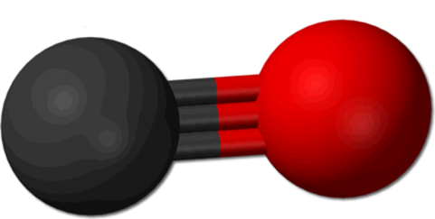
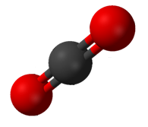
carbon & oxygen gas 1
C | 42.9% | $$×\frac{1}{42.9}$$ | 1
O | 57.1% |  | 1.33
C | 27.3% | $$×\frac{1}{27.3}$$ | 1
O | 72.7% |  | 2.66
carbon & oxygen gas 2
We now understand the reason for this result
gas1 is carbon monoxide (CO)
gas 2 is carbon dioxide (CO₂)
CO₂ really does have twice the amount of oxygen as CO

Slide 55
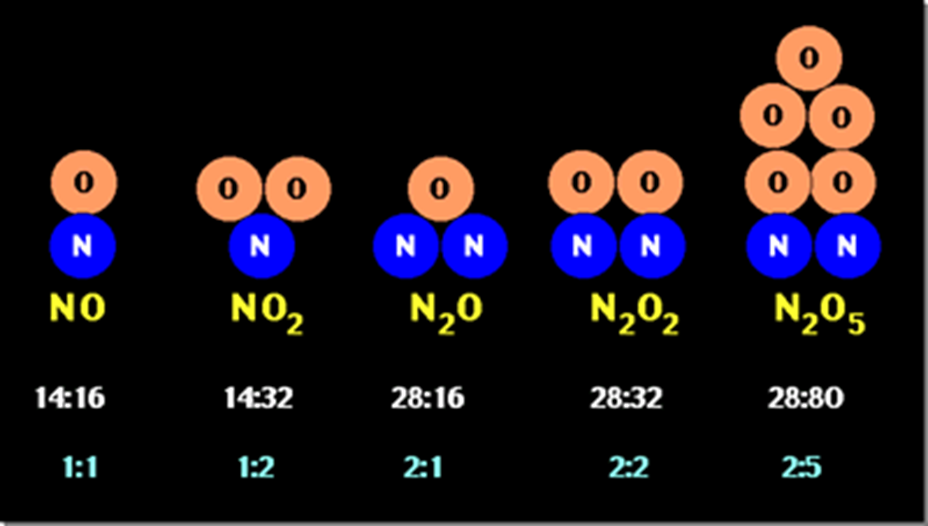
The Whole Number Ratios Can Still Be Complex

Slide 56
Importance of the Three Laws
The Modern
Atomic Theory

Slide 57
Conceptual Lesson
When this lesson is over, you should be able to:
Name the three laws
Summarize what they say
Provide examples that illustrates each of these three laws
Solve simple computations associated with these three laws

Slide 58
Homework on Matter
Lesson | Problems
Introduction to Matter | Chapter 3: 17, 39, 60, 62, 67
Physical & Chemical Changes | Chapter 3: 12, 33, 34, 41, 45
Three Laws of Matter | Chapter 3: 27, 55, 71, 73, 75
Homework is due two classes from today

Slide 59
Backup Slides

Slide 60
Not Covered

Slide 61
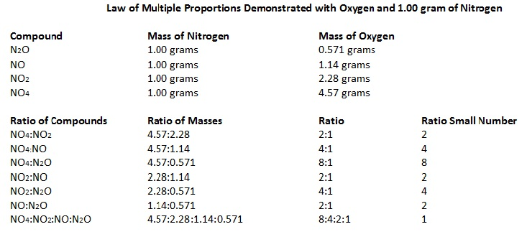

Slide 62
Law of Multiple Proportions
Compounds composed of the same elements have mass ratio of the two elements that is a small whole number
Write this in your notes

