Slide 1
Do Now
DO NOT USE YOUR NOTES!!!
What was Thompson's experiment and what did it discover?
What was Rutherford's experiment and what did it discover?
What was Chadwick's experiment and what did it discover?

Slide 2
Key Experiments
Thompson Experiment
Cathode rays bent in magnetic field
Leads to discovery of subatomic particles & electron
Rutherford Experiment
Alpha particles rarely bounce off of thin gold foil
Leads to discovery of nucleus and proton
Chadwick Experiment
Alpha particle bombardment create a neutral ray
Leads to discovery of the neutron

Slide 3
Subatomic Particles
Write this in your notes
SWBAT identify the three subatomic particles of atoms (protons, electrons, neutrons) and their location within an atom, their relative mass, and their charge.

Slide 4
Sub-Atomic Particles
Write this in your notes

Slide 5
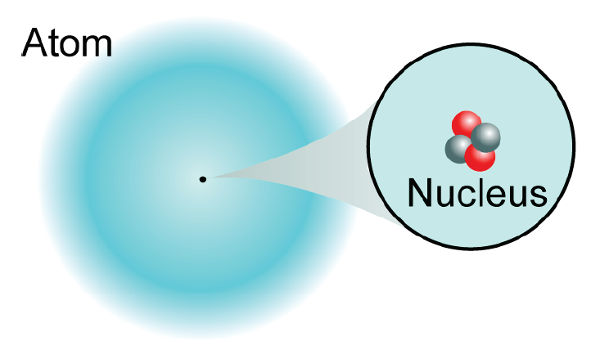
Our Picture of the Atom
Atoms are made from smaller particles!
protons
neutrons
electrons

Slide 6
Sub-Atomic Particles
Write this in your notes
type | abbrev.
proton | p
neutron | n
electron | e

Slide 7
Write this in your notes
Where are the particles located?
protons
neutrons
electrons
The protons and neutrons are located in the nucleus

Slide 8
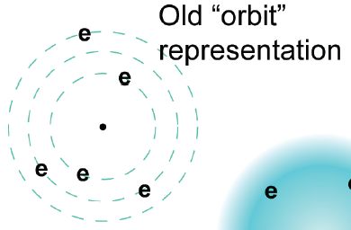
Write this in your notes
Where is the electron?
Electrons are often shown to orbit the nucleus much like planets orbit the sun
This can be a useful analogy, but it is not the most accurate description

Slide 9
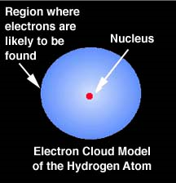
Write this in your notes
Where is the electron?
Electrons are very small and moving very fast, such that their position cannot describe precisely.
Instead an electron's location is described by the probability of an electron being in a volume of space.
This is called:
"The electron cloud"

Slide 10
Sub-Atomic Particles
Write this in your notes
type | abbrev. | location in atom
proton | p | nucleus
neutron | n | nucleus
electron | e | cloud

Slide 11
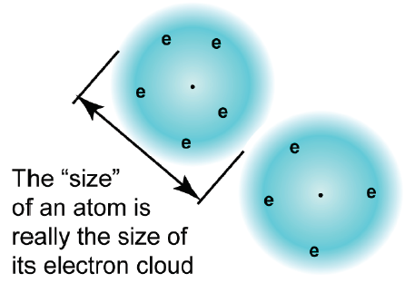
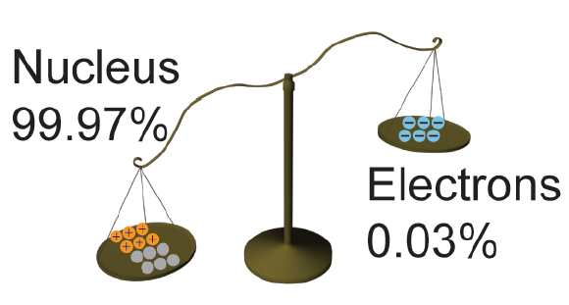
Size and mass
Write this in your notes
The size of the atom comes mostly from the space occupied by the electrons
The mass of the atom comes mostly from the nucleus

Slide 12
Sub-Atomic Particles
Write this in your notes
type | abbrev. | location in atom | relative mass
proton | p | nucleus | 1
neutron | n | nucleus | 1
electron | e | cloud | $$\frac{1}{1840}$$

Slide 13
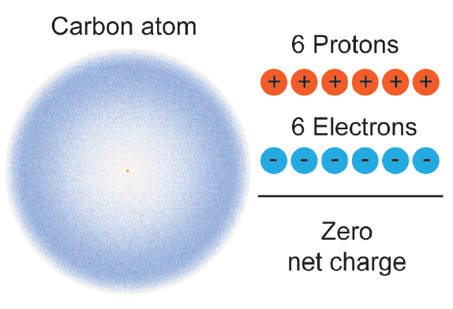
Charges in the atom
A complete atom has a charge of zero

Slide 14
Charges in the atom
Electrostatic Force: Like charges repel
Opposite charges attract

Slide 15
Sub-Atomic Particles
Write this in your notes
type | abbrev. | location in atom | relative mass | charge
proton | p | nucleus | 1 | +1
neutron | n | nucleus | 1 | 0
electron | e | cloud | $$\frac{1}{1840}$$ | -1

Slide 16
Check for Understanding
I am a positively charged particle. Where am I located?
I am the lightest of the particles. What is my charge?
I am not impacted by electrostatic forces. What is my name?
I am located in the cloud. What is my name?

Slide 17
neutrons
protons
electrons
What happens when you change the number of protons?

Slide 18
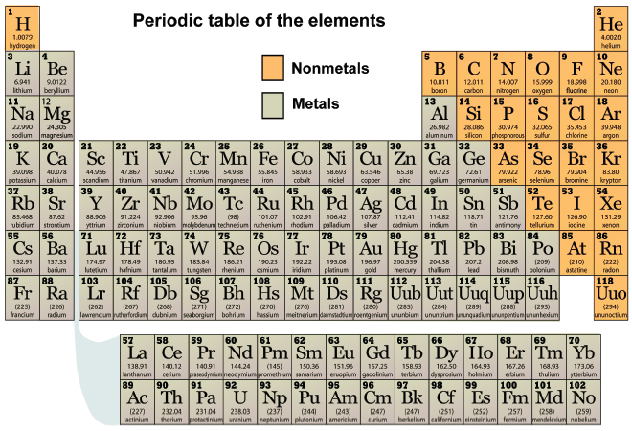
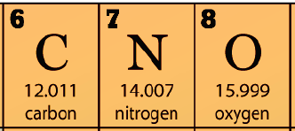
6 protons in carbon
7 protons in nitrogen
8 protons in oxygen
If you change the number of protons,
you obtain a different element!
The number of protons is also called the atomic number for that element.

Slide 19
Sub-Atomic Particles
Write this in your notes
type | abbrev. | location in atom | relative mass | charge | change in number produces
proton | p | nucleus | 1 | +1 | different element
neutron | n | nucleus | 1 | 0
electron | e | cloud | $$\frac{1}{1840}$$ | -1

Slide 20
neutrons
protons
electrons
What happens when you change the number of electrons?

Slide 21
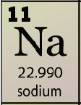
11 protons
A neutral sodium atom
Na
The protons and
electrons cancel each other out
Balanced charges
A positive sodium ion
Na¹⁺
One proton is not neutralized by an electron, making this a +1 charged atom
One electron short

Slide 22
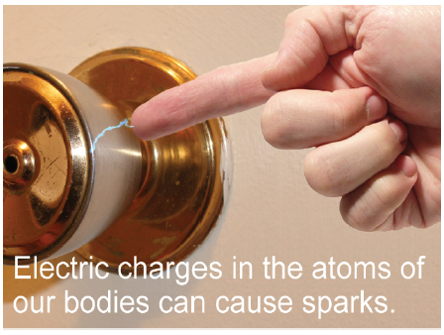
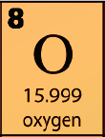
8 protons
A negative oxygen ion
O²⁻
Two electrons are not neutralized by protons, making this a –2 charged atom
Two extra electrons

Slide 23
Sub-Atomic Particles
Write this in your notes
type | abbrev. | location in atom | relative mass | charge | change in number produces
proton | p | nucleus | 1 | +1 | different element
neutron | n | nucleus | 1 | 0
electron | e | cloud | $$\frac{1}{1840}$$ | -1 | ion

Slide 24
neutrons
protons
electrons
What happens when you change the number of neutrons?

Slide 25
If you change the number of neutrons,
you obtain a different isotope

Slide 26
Isotope periodic table (first 4 rows)

Slide 27
Sub-Atomic Particles
Write this in your notes
type | abbrev. | location in atom | relative mass | charge | change in number produces
proton | p | nucleus | 1 | +1 | different element
neutron | n | nucleus | 1 | 0 | isotope
electron | e | cloud | $$\frac{1}{1840}$$ | -1 | ion

Slide 28
Vocabulary
Write this in your notes
Element - atoms with the same number of protons
Isotopes - atoms with the same number of protons (e.g. same element), but different number of neutrons
Ions - atoms with a charge, usually through the gain or loss of electrons
Cation - atoms with a positive charge
Anion - atoms with a negative charge
Nucleons - subatomic particles in the nucleus (e.g. protons and neutrons)

Slide 29
Check for Understanding
I have changed from a neutral atom to a cation. What has happened to my subatomic particles.
I have lost one of my neutral nucleons. What have I become?
I have lost one of my protons. What have I become?

Slide 30
Exit Ticket
A nuclear reaction removes 2 protons from an atom. Relative to the original atom, the new atom is
1) ______________________
The two subatomic particles in the nucleus are 2) ______________________ and
3) ______________________.
The two subatomic particles that are charged are 4) ______________________ and
5) ______________________.

Slide 31
Sub-Atomic Particles
Write this in your notes
type | abbrev. | location in atom | relative mass | charge | change in number produces
proton | p | nucleus | 1 | +1 | different element
neutron | n | nucleus | 1 | 0 | isotope
electron | e | cloud | $$\frac{1}{1840}$$ | -1 | ion

