Slide 1
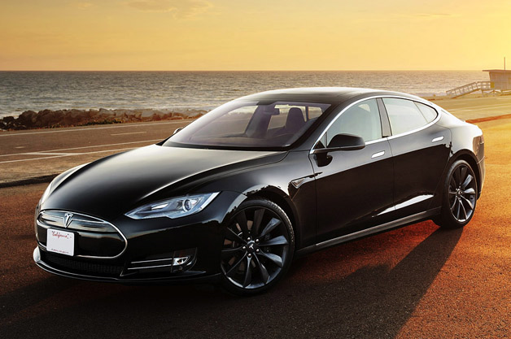
Do Now
This is a photo of Tesla Model S sedan. It is a full-sized, fully-electric, luxury liftback made by Tesla Motors.
Based on this photo and description, write down three things you would say to describe the Model S to a friend

Slide 2
Discussion of Do Now
How would you categorize our descriptions?
physical appearance
performance
environmental impact
cost
Each category of description provides different insights about the Model S
In science, we also have different ways of describing matter, and each way provides different insights about matter

Slide 3
Announcements

Slide 4
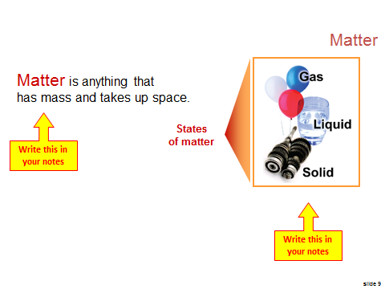
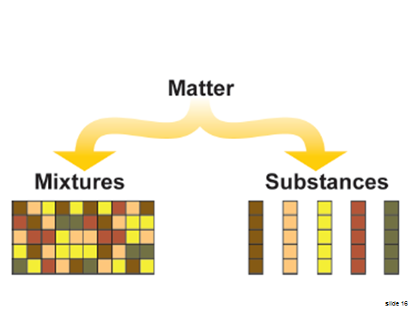
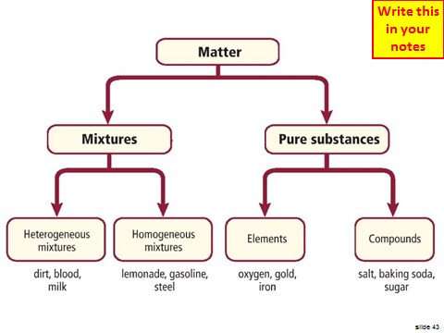
Last Class

Slide 5
Physical & Chemical Changes
SWBAT distinguish between physical and chemical properties and changes
Write this in your notes

Slide 6
Characterizing Matter
In science, we distinguish matter in various ways
"Is it a solid? a liquid? a gas?"
"What is its density?"
"Will it burn? rust?"
These are all properties of matter
We are going to learn about the differences between these different properties
. . . and how they can change

Slide 7
Physical Properties
Physical properties - characteristics of matter that can be observed and measured without changing a sample's composition.
Examples
mass
density
color
odor
hardness
melting point
boiling point
Write this in your notes

Slide 8
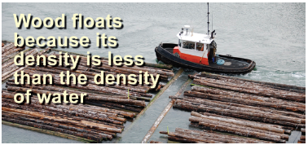
Is this a physical property?
Can it be observed or measured?
Can this be done without changing the sample's composition?

Slide 9
Extensive vs Intensive
Write this in your notes
Some physical properties are dependent on the amount of substance present
These are called extensive properties
Other physical properties are independent of the amount of substance present
These are called intensive properties

Slide 10
Check for Understanding
# | Property | Extensive or Intensive?
1 | boiling point
2 | mass
3 | volume
4 | mass/volume = density
5 | color
6 | temperature
7 | number of moles
8 | specific heat capacity

Slide 11
Check for Understanding
# | Property | Extensive or Intensive?
1 | boiling point | intensive
2 | mass
3 | volume
4 | mass/volume = density
5 | color
6 | temperature
7 | number of moles
8 | specific heat capacity

Slide 12
Check for Understanding
# | Property | Extensive or Intensive?
1 | boiling point | intensive
2 | mass | extensive
3 | volume
4 | mass/volume = density
5 | color
6 | temperature
7 | number of moles
8 | specific heat capacity

Slide 13
Check for Understanding
# | Property | Extensive or Intensive?
1 | boiling point | intensive
2 | mass | extensive
3 | volume | extensive
4 | mass/volume = density
5 | color
6 | temperature
7 | number of moles
8 | specific heat capacity

Slide 14
Check for Understanding
# | Property | Extensive or Intensive?
1 | boiling point | intensive
2 | mass | extensive
3 | volume | extensive
4 | mass/volume = density | intensive
5 | color
6 | temperature
7 | number of moles
8 | specific heat capacity

Slide 15
Check for Understanding
# | Property | Extensive or Intensive?
1 | boiling point | intensive
2 | mass | extensive
3 | volume | extensive
4 | mass/volume = density | intensive
5 | color | intensive
6 | temperature
7 | number of moles
8 | specific heat capacity

Slide 16
Check for Understanding
# | Property | Extensive or Intensive?
1 | boiling point | intensive
2 | mass | extensive
3 | volume | extensive
4 | mass/volume = density | intensive
5 | color | intensive
6 | temperature | intensive
7 | number of moles
8 | specific heat capacity

Slide 17
Check for Understanding
# | Property | Extensive or Intensive?
1 | boiling point | intensive
2 | mass | extensive
3 | volume | extensive
4 | mass/volume = density | intensive
5 | color | intensive
6 | temperature | intensive
7 | number of moles | extensive
8 | specific heat capacity

Slide 18
Check for Understanding
# | Property | Extensive or Intensive?
1 | boiling point | intensive
2 | mass | extensive
3 | volume | extensive
4 | mass/volume = density | intensive
5 | color | intensive
6 | temperature | intensive
7 | number of moles | extensive
8 | specific heat capacity | intensive

Slide 19
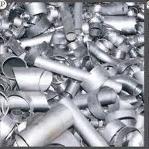
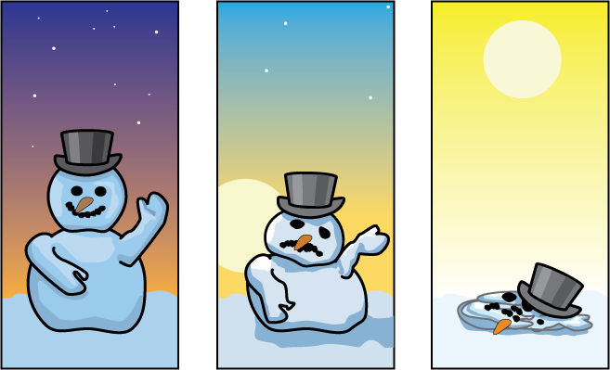
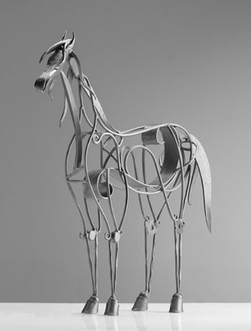
Physical changes include changes in shape, phase or temperature.

Slide 20
Physical Change
Write this in your notes
Physical change - altering a substance without altering its composition
crumbling a piece of aluminum foil
cutting a sheet of paper
breaking a crystal

Slide 21
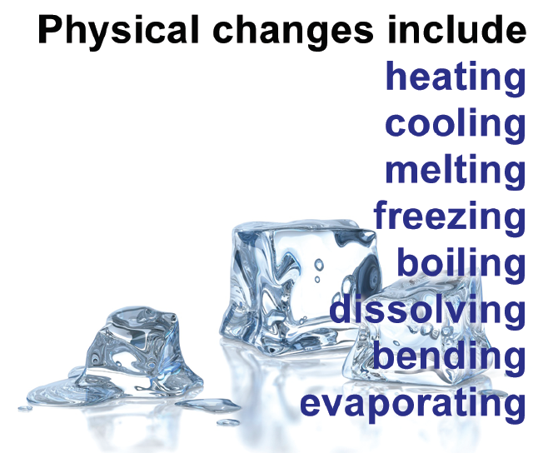

Slide 22
Chemical Properties
We know physical properties can be observed without changing a sample's composition.
There are other properties of matter which can only be observed when changing a sample's composition.
Some of these are called chemical properties
The ability or inability of a substance to combine with or change into one or more other substances
Write this in your notes

Slide 23
Is this a chemical property?
"Does a substance catch fire or not?"
This property can only be observed by changing the sample's compositions
... so it cannot be a physical property
Burning means the substance is combining with oxygen and changing into another substance
... this is the definition of a chemical property
Use this logic to distinguish between chemical and physical properties

Slide 24
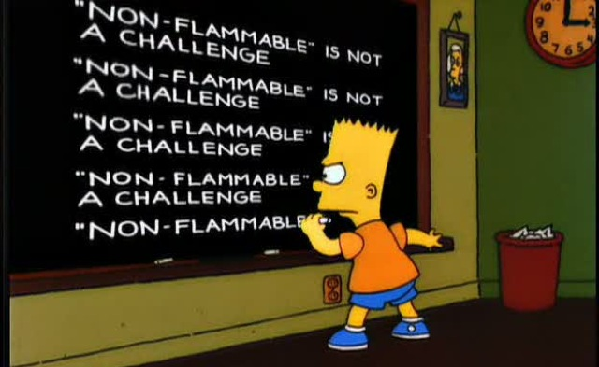
Important Point #1
"Does a substance catch fire or not?"
The inability to combine with oxygen is also considered a chemical property

Slide 25
Important Point #2
By definition, chemical properties cannot be observed without change, specifically a chemical change
Different from physical properties
Thus, to determine any chemical property, a sample of a substance must be changed in some way

Slide 27
Rusting is a Chemical Change
Over time, iron rusts
Rusting - when a substance combines with oxygen and changes into its oxide
Chemical change
Iron Rust
4 Fe (s)
+
3 O₂ (g)
2 Fe₂O₃ (s)

Slide 28
Other examples of chemical changes
burning of wood
cooking an egg
mixing baking soda with vinegar
metabolizing food in your body
neutralize an acid with a base
using a battery
electroplating a metal

Slide 29
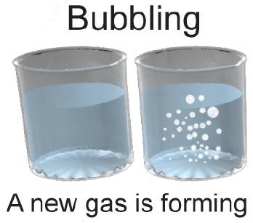
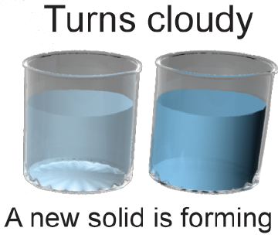
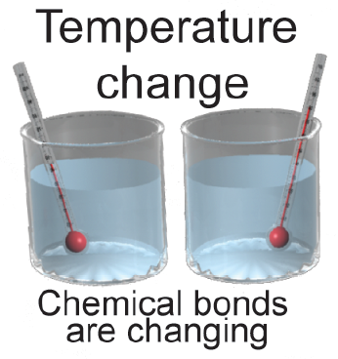
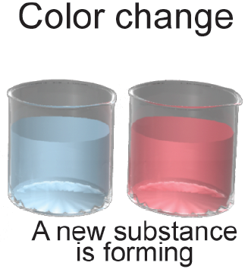
Did a chemical change occur?
Signs
that a
chemical change
has occurred

Slide 30
Observing Properties
When observing properties of matter, it is key to note the conditions under which the observation is made.
Temperature & pressure are two key conditions to note when observing properties
Example: Is water a solid, liquid or gas?
A solid below 0°C
A gas above 100°C
A liquid in between
only true at atmospheric pressure

Slide 31
Changes in the Matter Diagram

Slide 32
Physical Changes
Write this in your notes

Slide 33
Chemical Changes
Write this in your notes

Slide 34
Check for Understanding
# | Change | Type
1 | Grinding coffee beans
2 | Silver tarnishing
3 | Toasting bread
4 | Ice melting
5 | Fermenting grapes
6 | Vegetables rotting
7 | Sharpening a knife
8 | Crushing a can
9 | Burning leaves
10 | Breaking a bottle

Slide 35
Check for Understanding
# | Change | Type
1 | Grinding coffee beans | physical
2 | Silver tarnishing
3 | Toasting bread
4 | Ice melting
5 | Fermenting grapes
6 | Vegetables rotting
7 | Sharpening a knife
8 | Crushing a can
9 | Burning leaves
10 | Breaking a bottle

Slide 36
Check for Understanding
# | Change | Type
1 | Grinding coffee beans | physical
2 | Silver tarnishing | chemical
3 | Toasting bread
4 | Ice melting
5 | Fermenting grapes
6 | Vegetables rotting
7 | Sharpening a knife
8 | Crushing a can
9 | Burning leaves
10 | Breaking a bottle

Slide 37
Check for Understanding
# | Change | Type
1 | Grinding coffee beans | physical
2 | Silver tarnishing | chemical
3 | Toasting bread | chemical
4 | Ice melting
5 | Fermenting grapes
6 | Vegetables rotting
7 | Sharpening a knife
8 | Crushing a can
9 | Burning leaves
10 | Breaking a bottle

Slide 38
Check for Understanding
# | Change | Type
1 | Grinding coffee beans | physical
2 | Silver tarnishing | chemical
3 | Toasting bread | chemical
4 | Ice melting | physical
5 | Fermenting grapes
6 | Vegetables rotting
7 | Sharpening a knife
8 | Crushing a can
9 | Burning leaves
10 | Breaking a bottle

Slide 39
Check for Understanding
# | Change | Type
1 | Grinding coffee beans | physical
2 | Silver tarnishing | chemical
3 | Toasting bread | chemical
4 | Ice melting | physical
5 | Fermenting grapes | chemical
6 | Vegetables rotting
7 | Sharpening a knife
8 | Crushing a can
9 | Burning leaves
10 | Breaking a bottle

Slide 40
Check for Understanding
# | Change | Type
1 | Grinding coffee beans | physical
2 | Silver tarnishing | chemical
3 | Toasting bread | chemical
4 | Ice melting | physical
5 | Fermenting grapes | chemical
6 | Vegetables rotting | chemical
7 | Sharpening a knife
8 | Crushing a can
9 | Burning leaves
10 | Breaking a bottle

Slide 41
Check for Understanding
# | Change | Type
1 | Grinding coffee beans | physical
2 | Silver tarnishing | chemical
3 | Toasting bread | chemical
4 | Ice melting | physical
5 | Fermenting grapes | chemical
6 | Vegetables rotting | chemical
7 | Sharpening a knife | physical
8 | Crushing a can
9 | Burning leaves
10 | Breaking a bottle

Slide 42
Check for Understanding
# | Change | Type
1 | Grinding coffee beans | physical
2 | Silver tarnishing | chemical
3 | Toasting bread | chemical
4 | Ice melting | physical
5 | Fermenting grapes | chemical
6 | Vegetables rotting | chemical
7 | Sharpening a knife | physical
8 | Crushing a can | physical
9 | Burning leaves
10 | Breaking a bottle

Slide 43
Check for Understanding
# | Change | Type
1 | Grinding coffee beans | physical
2 | Silver tarnishing | chemical
3 | Toasting bread | chemical
4 | Ice melting | physical
5 | Fermenting grapes | chemical
6 | Vegetables rotting | chemical
7 | Sharpening a knife | physical
8 | Crushing a can | physical
9 | Burning leaves | chemical
10 | Breaking a bottle

Slide 44
Check for Understanding
# | Change | Type
1 | Grinding coffee beans | physical
2 | Silver tarnishing | chemical
3 | Toasting bread | chemical
4 | Ice melting | physical
5 | Fermenting grapes | chemical
6 | Vegetables rotting | chemical
7 | Sharpening a knife | physical
8 | Crushing a can | physical
9 | Burning leaves | chemical
10 | Breaking a bottle | physical

Slide 45
Homework

Slide 46
Backup Slides

Slide 47
Not Covered

