Slide 1
Investigation
Put a blank piece of paper and a probe in front of you on your desk

Slide 2
Investigation 1
I will put an object on your paper
DO NOT TOUCH THE OBJECT
Investigate the object with your eyes and with your probe.
Do not remove the object from the paper
ANY QUESTIONS?

Slide 3
Investigation 2 DO NOT TOUCH THE OBJECT
What do you see?
color?
surface?
shape?
size?
What can you probe
weight?
hardness?
reflectiveness?

Slide 4
Investigation 3
What do you think the object is?
What other experiments would you want to do?
Do we know everything about these?

Slide 5
New Experiment
Put two objects close to one another
Charges
Opposite charges attract
Like charges repel

Slide 6
Lessons
Some properties are visible
Some properties are invisible
You need to do the right experiments to observe everything
Today we are starting a new unit which deals with properties that are invisible
Although they are invisible, the could be understood with the right experiments

Slide 7
Please don't tell the others
The educational value is lost if people know they are dealing with magnets
Please return your magnet, probes and paper

Slide 8
Units
Scientific Method
Atomic Theory
Nuclear Chemistry
The Mole
Electrons
Periodic Properties
Bonding
Nomenclature
Chemical Reactions
Stoichiometry
Mixtures and Solutions
Chemical Equilibrium
Acid-Base Chemistry
Redox & Electrochemistry
Gas Laws
Thermodynamics

Slide 9
Creation of the Atomic Theory
Write this in your notes
SWBAT explain how humans created the atomic theory
Probably will take two days to cover this lesson

Slide 10
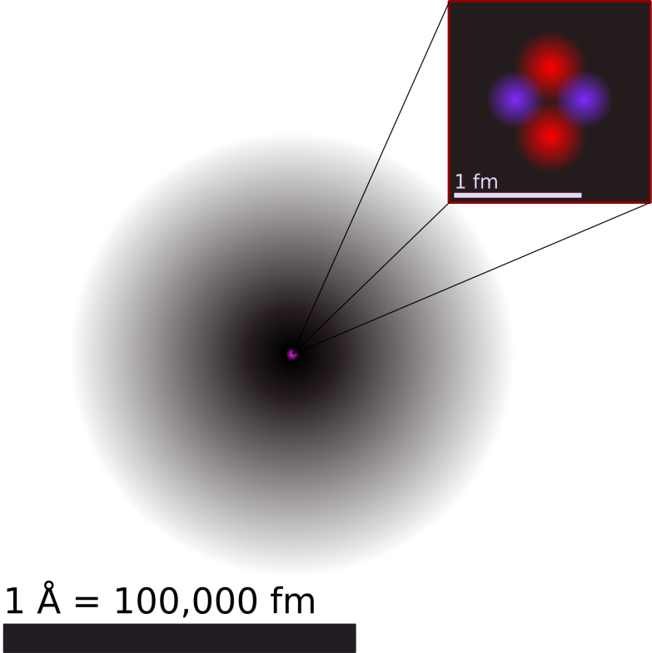
Atoms
Write this in your notes
Modern Definition
The smallest particle of an element that retains all of the properties of that element
What is an atom like?
Small, spherically-shaped
Composed of protons, neutrons & electrons
Electronically neutral

Slide 11
What is the Atomic Theory?
Write this in your notes
The atomic theory state that matter is composed of discrete units called atoms
This is a theory created and refined by humans over 2000 years
Scientists are still studying the atomic theory and making new discoveries

Slide 12
Creation of Atomic Theory
The theory is being refined constantly to get a more accurate view of reality
The theory will probably never be "perfect", but will continue to become more useful
Today's class will trace some key milestones in the creation of the atomic theory

Slide 13
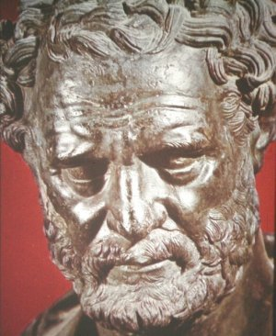
Early Philosophy
Write this in your notes
About 400 BC, a Greek philosopher named Democritus introduced the concept of atoms
He believed the world was made up of small, indestructible particles that could not be broken into smaller parts
Called them "atomos" which means indivisible
Idea was created to explain many phenomena, but there was no evidence as we know it
Aristotle rejected the concept of atoms

Slide 14
2000 Years Passes . . .
Democritus's theory of atoms was not further advanced for over 2000 years
During the Renaissance, science began to increase its reliance on observation.
Early in the Modern Era, scientists made some key observations about matter
Eventually scientists returned to the concept of atoms to come up with a theory to explain what they had observed

Slide 15
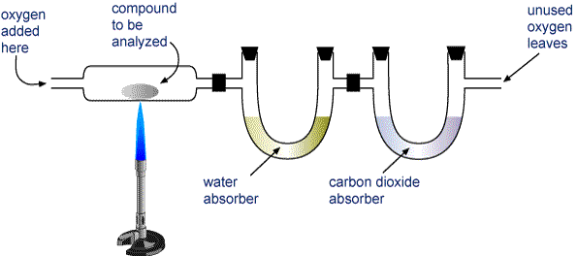
Elemental Analysis
Write this in your notes
Elemental analysis is a way of finding out how much of each element is in a substance
Empirical formula - simplest, whole-number, molar ratio of atoms present in compound
Many methods exist, but combustion analysis is one of the most common

Slide 16
Law of Conservation of Mass
Write this in your notes
The mass of starting materials is equal to the mass of the products

Slide 17
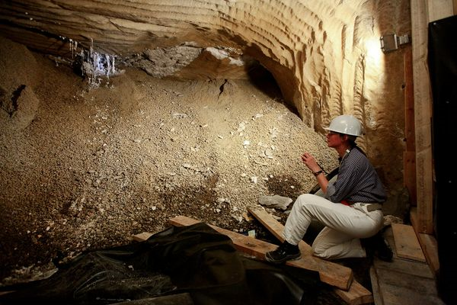
Law of Definite Proportions
Write this in your notes
39.3% sodium
60.7% chlorine
39.3% sodium
60.7% chlorine
Compounds are made up of elements in exactly the same mass proportions regardless of their sizes or sources of the samples

Slide 18
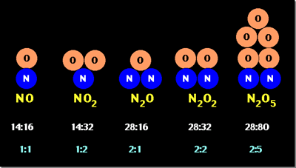
Law of Multiple Proportions
Write this in your notes
Compounds composed of the same elements have mass ratio of the two elements that is a small whole number

Slide 19
Putting it all Together
Compounds are made up of elements in exactly the same mass proportions regardless of their sizes or sources of the samples
The mass of starting materials is equal to the mass of the products
Compounds composed of the same elements have mass ratio of the two elements that is a small whole number
What single theory could explain all of these laws?

Slide 20
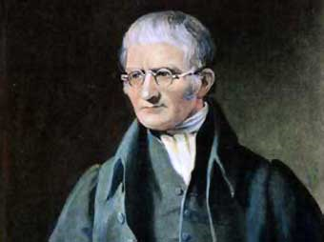
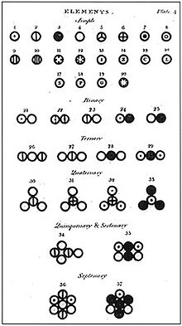
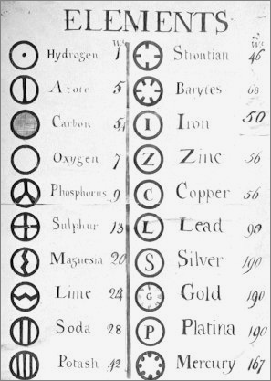
Dalton's Atomic Theory
In 1808, an English scientist named John Dalton proposed a theory that explained all of these laws
It updated Democritus's theory of atoms
Dalton Theory Video https://www.youtube.com/watch?v=L2KmCTst2o0

Slide 21
Dalton's Atomic Theory
Write this in your notes
Elements are made of extremely small particles called atoms.
Atoms of a given element are the same; atoms of different elements are not the same
Atoms cannot be subdivided, created, or destroyed.
Atoms of different elements combine in simple whole-number ratios to form chemical compounds.
In chemical reactions, atoms are combined, separated, or rearranged

Slide 22
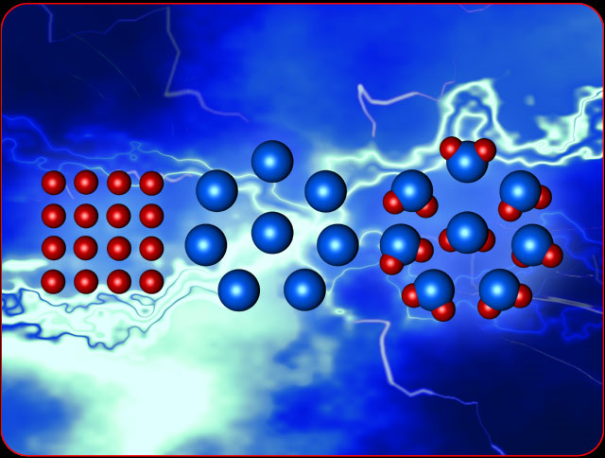
Atoms are very small

Slide 23
All the red atoms are the same
All the blue atoms are the same
The red and blue are not the same

Slide 24
These atoms can not be subdivided, created or destroyed

Slide 25
Different atoms combine in simple ratios to make compounds (2:1 ratio here)

Slide 26
Chemical reactions combine, separate or rearrange atoms

Slide 27
Dalton's Atomic Theory
Elements are made of extremely small particles called atoms.
Atoms of a given element are the same; atoms of different elements are not the same
Atoms cannot be subdivided, created, or destroyed.
Atoms of different elements combine in simple whole-number ratios to form chemical compounds.
In chemical reactions, atoms are combined, separated, or rearranged
The first modern description of the atomic theory

Slide 28
Check for Understanding
How does Dalton's atomic theory explain the law of conservation of mass?
Mass is conserved because atoms cannot be created, divided or destroyed. In a chemical reaction, atoms are only combined, separated or rearranged.

Slide 29
Dalton Wasn't Completely Right
Two of parts Dalton's theory are now known to be incorrect.
Atoms of a given element are the same
We now know elements can have different isotopes
Atoms cannot be subdivided
We now know that atoms can be broken into simpler particles
Despite this, most of Dalton's theory still stands as part of the modern atomic theory
Write this in your notes

Slide 30
The Subatomic World
In the late 1800's and early 1900's, tools became available to further aid in the understanding of the atom's composition.
Emerging from this work is our understanding of the subatomic world.
What follows is a very brief description of some key experiments that led to recognition of the electron, proton and neutron.
You need to be able to provide a brief explanation of each key experiment

Slide 31
Timeline
460 – 370 BC
1808
Today
Democritus
Atomism
Dalton
“Modern”
atomic theory

Slide 32
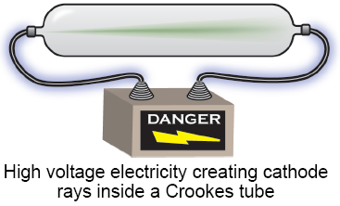
Cathode Ray Tube
460 – 370 BC
1808
1870
Today
Democritus
Atomism
Dalton
“Modern”
atomic theory
William Crookes invents a tube in which virtually all the gas has been removed.
Under high voltage, a ray was emitted from the cathode and flowed to the anode.

Slide 33
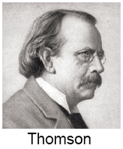
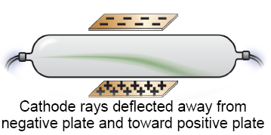
Discovery of the Electron
460 – 370 BC
1808
1870
1897
Today
Democritus
Atomism
Dalton
“Modern”
atomic theory
Crookes
Cathode rays
J.J. Thomson discovers the electron
Cathode rays must be negative.
Video 1 https://www.youtube.com/watch?v=O9Goyscbazk

Slide 34
Thomson Experiment
A stream of particles are deflected by a magnetic field
Deflected away from (‒) charge & toward (+) charge
The particles are negative (electrons)
Occurs with all electrodes and gasses, so must be part of all matter.
Later, Robert Millikan found that the electron was 2000 times lighter than the smallest atom!!!
Since these particles were smaller than an atom, they were called "subatomic particles"

Slide 35
Check for Understanding
Why did Thomson believe that the particles in the cathode ray were negatively-charged?
Because they were repelled by the negative pole of a magnet

Slide 36
Key Experiments
Write this in your notes
Thomson Experiment
Cathode rays bent in magnetic field
Leads to discovery of subatomic particles & electron

Slide 37
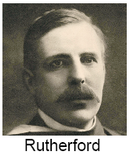
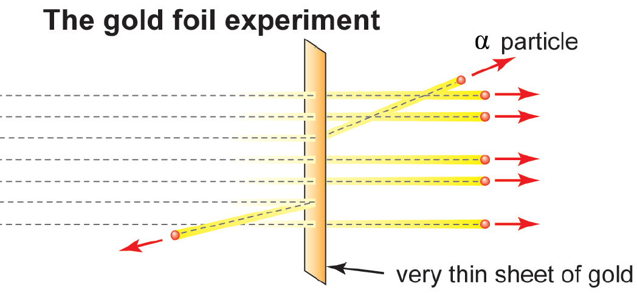
Discovery of the Nucleus & Proton
460 – 370 BC
1808
1870
1897
1910
Today
Democritus
Atomism
Dalton
“Modern”
atomic theory
Crookes
Cathode rays
Thomson
Discovery
of the electron
Ernest Rutherford discovers the nucleus & proton
Video 1 https://www.youtube.com/watch?v=5pZj0u_XMbc

Slide 38
Rutherford Experiment
Heavy, positively-charged alpha particles were fired at a thin sheet of gold foil
Most passed straight through
shows that atoms are mostly empty space
A few were deflected and fewer still bounced back
shows that something small, heavy and positively charged is in the atom
Led to discovery of the nucleus and proton

Slide 39
Check for Understanding
Before Rutherford's experiment, it was theorized that the positive and negative charges of an atom were spread out thinly throughout the space of an atom. What part of Rutherford's data showed that this theory was wrong?
A few heavy, positively-charged alpha particles were deflected or even bounced backwards. This meant the positive charge of the atom was concentrated and massive

Slide 40
Key Experiments
Write this in your notes
Thomson Experiment
Cathode rays bent in magnetic field
Leads to discovery of subatomic particles & electron
Rutherford Experiment
Alpha particles rarely bounce off of thin gold foil
Leads to discovery of nucleus and proton

Slide 41
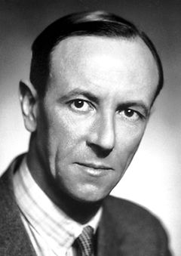
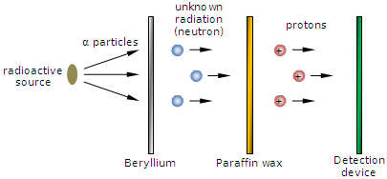
Discovery of the Neutron
460 – 370 BC
1808
1870
1897
1932
Today
Democritus
Atomism
Dalton
“Modern”
atomic theory
Crookes
Cathode rays
Thomson
Discovery
of the electron
James Chadwick discovers the neutron
Chadwick
Chadwick Experiment https://www.youtube.com/watch?v=HnmEI94URK8 (2:13)

Slide 42
Chadwick Experiment
Protons don't have enough mass to account for all the mass in an atom
Bombardment of dense beryllium with alpha particles creates a stream of unknown particles
Not affected by either a negative or positive charge
The particles could hit other substances, and the damage done showed they were heavy
These particles became known as neutrons

Slide 43
Check for Understanding
Why did Chadwick believe the particles released by the beryllium were neutral?
Because a magnet had no effect on their path (unlike the cathode rays in Thomson's experiment)

Slide 44
Key Experiments
Write this in your notes
Thomson Experiment
Cathode rays bent in magnetic field
Leads to discovery of subatomic particles & electron
Rutherford Experiment
Alpha particles rarely bounce off of thin gold foil
Leads to discovery of nucleus and proton
Chadwick Experiment
Alpha particle bombardment create a neutral ray
Leads to discovery of the neutron

Slide 45
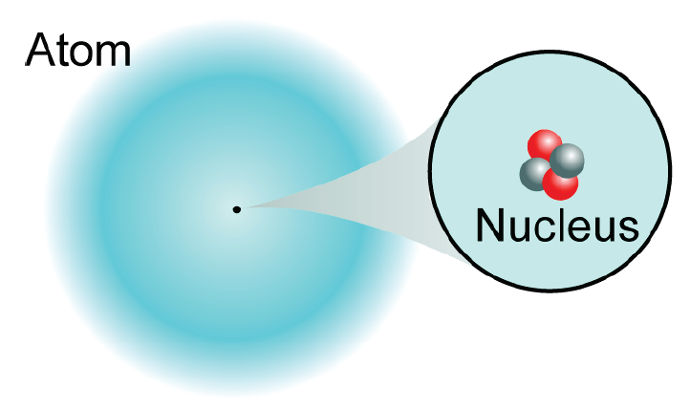
Our Picture of the Atom
Atoms are made from smaller particles!
protons
neutrons
electrons
The atomic theory continues to be revised today

Slide 46
Open Note Quiz 10 point value. No talking!!
What does the atomic theory state?
Who first introduced the concept of atoms and when did this happen?
What three laws of matter were explained with the atomic theory?
Dalton's Atomic Theory has 5 parts. Explain one part.
Three key experiments illuminated the subatomic world. Explain one experiment.

Slide 47
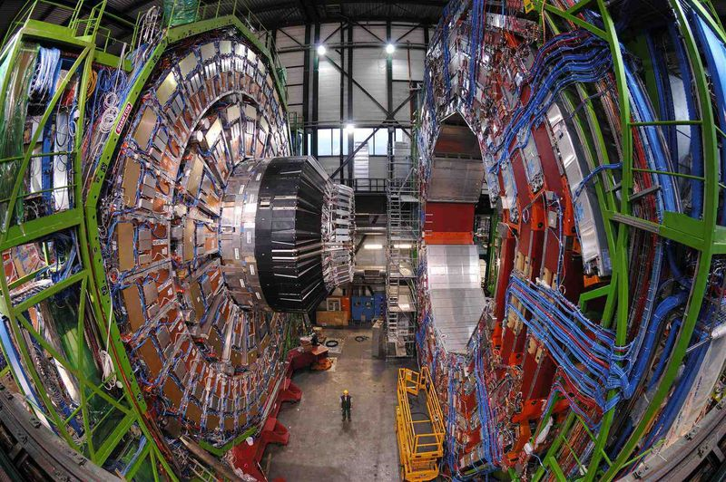
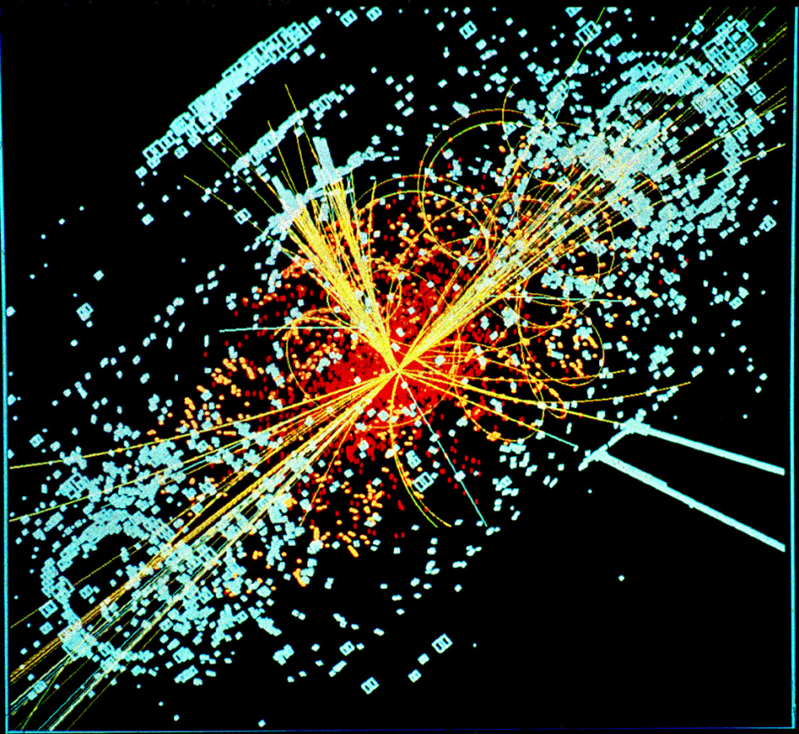
The "God Particle"
2 minute explanation of Higg's Bosun https://www.youtube.com/watch?v=HaD6ynY8LKY
3 minute explanation of Higg's Bosun https://www.youtube.com/watch?v=Na5VKVTTfV0

Slide 48
Video on All Discoveries (11:37)
https://www.youtube.com/watch?v=kBgIMRV895w

Slide 49
Summary
Objective: SWBAT explain how humans created the atomic theory
Atomic theory was created by humans to explain and manipulate nature
The concept of atoms dates back to the Greeks
Dalton articulated the first principles of the modern atomic theory in 1806. Most of these principles are still believed to be correct.
Key experiments around the turn of the 20th century led to the understanding of the subatomic world.
The atomic theory continues to be revised today, and likely will be in the future.

Slide 50
Our Picture of the Atom
Atoms are made from smaller particles!
protons
neutrons
electrons
Each of the elements is a unique type of atom.

