Slide 1
Graphing

Slide 2
Graphing Part 2
Write this in your notes
SWBAT use Google Sheets to create a graph with all of the key features

Slide 3
The Scientific Method
REVIEW
This unit will cover some basic skills you will need in chemistry this year
Measurement
Significant Digits
Units
Dimensional Analysis
Scientific Notation
Graphing
Part 2

Slide 4
Features of a Good Graph
Write this in your notes
Axis scales, labels and units
Title describing the graph
Points for all measured data
Best fit line (if possible)
With multiple data types, add a legend
Neat, easy-to-read format

Slide 5
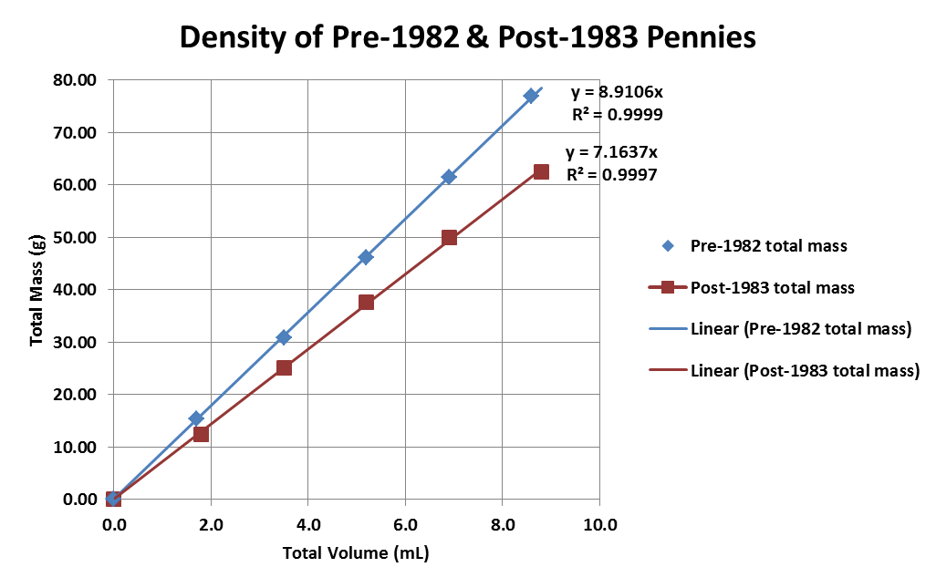
Example of a Good Graph

Slide 6
Axis scales, labels and units

Slide 7
Axis scales, labels and units

Slide 8
Axis scales, labels and units

Slide 9
Title describing the graph

Slide 10
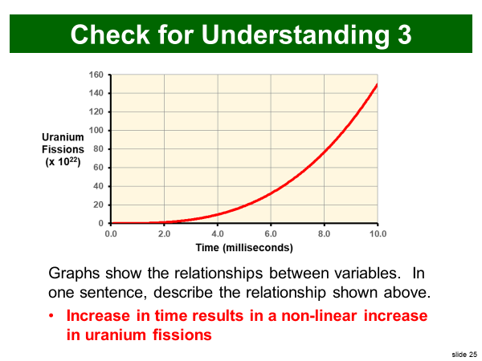
A Reliable Way to Write Titles
Write this in your notes
Increase in _________ results in
independent
variable
_________ _________ in _________
linear
or
non-linear
increase
or
decrease
dependent
variable
Increase in time results in
a non-linear increase
in uranium fissions

Slide 11
Points for all measured data

Slide 12
Best fit line (if possible)

Slide 13
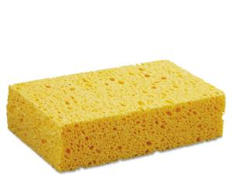
With multiple data types, add a legend

Slide 14
Neat, easy-to-read format

Slide 15
Features of a Good Graph
Axis scales, labels and units
Title describing the graph
Points for all measured data
Best fit line (if possible)
With multiple data types, add a legend
Neat, easy-to-read format
Be sure your graphs have all of these features!!!

Slide 16
0136 – Practice – Graphing Part 2

