Slide 1
Scientific Notation

Slide 2
Scientific Notation
Write this in your notes
SWBAT:
convert from standard notation to scientific notation
convert from scientific notation to standard notation
use a calculator to do math on numbers in scientific notation

Slide 3
The Scientific Method
REVIEW
This unit will cover some basic skills you will need in chemistry this year
Measurement
Significant Digits
Units
Dimensional Analysis
Scientific Notation
Graphing

Slide 4
What is Scientific Notation
Scientific notation was created as a way to deal with very large and very small numbers
It has the added benefit of simplifying significant digits
In chemistry, you will have to do computations with very large and very small numbers
You will be expected to be able to use scientific notation to successfully get the correct answer

Slide 5
The Hope Diamond

Slide 6
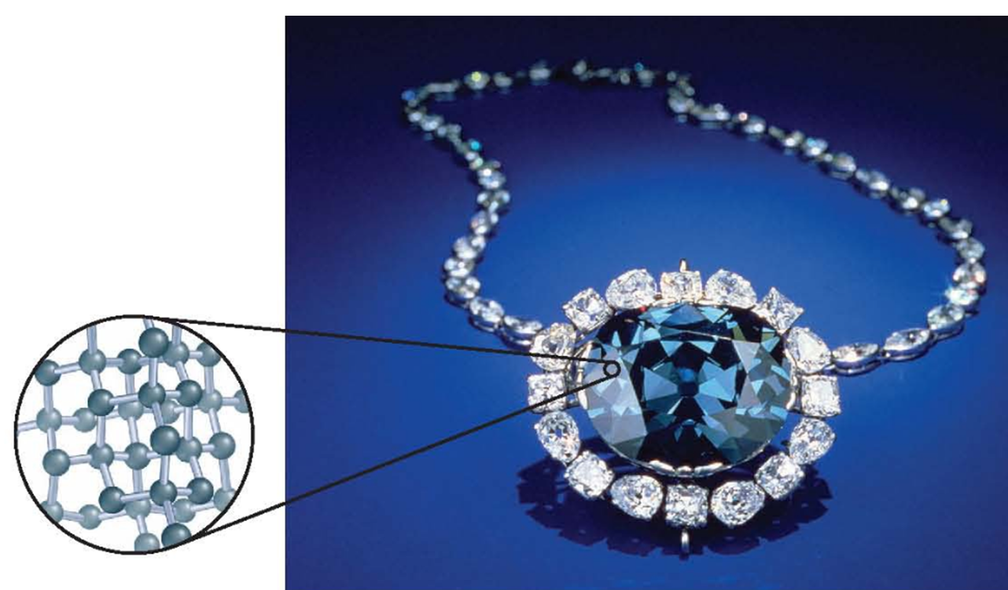
460
sextillion
Contains lots of carbon atoms
460,000,000,000,000,000,000,000 atoms
Each atom has very little mass
0.00000000000000000000002 grams
When numbers are really big or really small, it is easier to express them in terms of scientific notation

Slide 7
Scientific Notation
exponent
sign
exponent
number
coefficient
x 10
+
6
4.3
x 10
4.3
x 1,000,000
4,300,000

Slide 8
Scientific Notation
Write this in your notes
exponent
sign
exponent
number
coefficient
x 10
Breaks a number into two parts
The coefficient is a number ≥1 and <10
It shows only significant figures
The exponent is the power to which 10 is raised
10⁵ = 10 x 10 x 10 x 10 x 10 = 100,000
10⁻⁵ = $1/{10}$ x $1/{10}$ x $1/{10}$ x $1/{10}$ x $1/{10}$ = $1/{100,000}$
10⁰ = 1

Slide 9
You Must Be Able To:

Slide 10
Standard into Scientific Notation
81400
81,400
4
3
2
1
sig figs only
coefficient
Move the decimal point until number is ≥1 and <10
exponent
number
Count how many place the decimal was moved
exponent
sign
If number > 1, sign is positive
If number < 1, sign is negative
exponent
sign
exponent
number
+
4
8.14 x 10⁴
coefficient
x 10
8.14

Slide 11
Standard into Scientific Notation
000708
0.00708
1
2
3
coefficient
Move the decimal point until number is ≥1 and <10
exponent
number
Count how many place the decimal was moved
exponent
sign
If number > 1, sign is positive
If number < 1, sign is negative
exponent
sign
exponent
number
–
3
7.08 x 10^{–3}
coefficient
x 10
7.08

Slide 12
Check for Understanding 1
50.40
coefficient
Move the decimal point until number is ≥1 and <10
exponent
number
Count how many place the decimal was moved
exponent
sign
If number > 1, sign is positive
If number < 1, sign is negative
use all
sig figs
5.040 x 10¹

Slide 13
Check for Understanding 2
0.00000720
coefficient
Move the decimal point until number is ≥1 and <10
exponent
number
Count how many place the decimal was moved
exponent
sign
If number > 1, sign is positive
If number < 1, sign is negative
use all
sig figs
7.20 x 10^{–6}

Slide 14
You Must Be Able To:

Slide 15
Scientific into Standard Notation
610
0
6100
1
2
3
add non-sig zeros
exponent
number
Move decimal point as many places as the exponent
exponent
sign
If positive, number gets bigger
If negative, number gets smaller
coefficient
Write the coefficient as shown but without the decimal point
+
3
6.10
x 10

Slide 16
Scientific into Standard Notation
000
537
0.000537
4
3
2
1
add non-sig zeros
exponent
number
Move decimal point as many places as the exponent
exponent
sign
If positive, number gets bigger
If negative, number gets smaller
coefficient
Write the coefficient as shown but without the decimal point
–
4
5.37
x 10

Slide 17
Check for Understanding 3
0.0000409
add non-sig zeros
exponent
number
Move decimal point as many places as the exponent
exponent
sign
If positive, number gets bigger
If negative, number gets smaller
coefficient
Write the coefficient as shown but without the decimal point
4.09 x 10^{–5}

Slide 18
Check for Understanding 4
409,000
add non-sig zeros
exponent
number
Move decimal point as many places as the exponent
exponent
sign
If positive, number gets bigger
If negative, number gets smaller
coefficient
Write the coefficient as shown but without the decimal point
4.09 x 10⁵

Slide 19
Check for Understanding 5
Convert 8,340,000 into scientific notation
Convert 0.00556 into scientific notation
Convert 4.06 x 10⁻⁸ into normal notation
Convert 9.11 x 10¹² into normal notation

Slide 20
Check for Understanding 5
Convert 8,340,000 into scientific notation
8.34 x 10⁶
Convert 0.00556 into scientific notation
Convert 4.06 x 10⁻⁸ into normal notation
Convert 9.11 x 10¹² into normal notation

Slide 21
Check for Understanding 5
Convert 8,340,000 into scientific notation
8.34 x 10⁶
Convert 0.00556 into scientific notation
5.56 x 10⁻³
Convert 4.06 x 10⁻⁸ into normal notation
Convert 9.11 x 10¹² into normal notation

Slide 22
Check for Understanding 5
Convert 8,340,000 into scientific notation
8.34 x 10⁶
Convert 0.00556 into scientific notation
5.56 x 10⁻³
Convert 4.06 x 10⁻⁸ into normal notation
0.0000000406
Convert 9.11 x 10¹² into normal notation

Slide 23
Check for Understanding 5
Convert 8,340,000 into scientific notation
8.34 x 10⁶
Convert 0.00556 into scientific notation
5.56 x 10⁻³
Convert 4.06 x 10⁻⁸ into normal notation
0.0000000406
Convert 9.11 x 10¹² into normal notation
9,110,000,000,000

Slide 24
The Hope Diamond
Write these values in scientific notation
Contains lots of carbon atoms
460,000,000,000,000,000,000,000 atoms
Each atom has very little mass
0.00000000000000000000002 grams

Slide 25
The Hope Diamond
Write these values in scientific notation
Contains lots of carbon atoms
460,000,000,000,000,000,000,000 atoms
4.6 x 10²³ atoms
Each atom has very little mass
0.00000000000000000000002 grams

Slide 26
The Hope Diamond
Write these values in scientific notation
Contains lots of carbon atoms
460,000,000,000,000,000,000,000 atoms
4.6 x 10²³ atoms
Each atom has very little mass
0.00000000000000000000002 grams
2 x 10⁻²³ grams

Slide 27
You Must Be Able To:

Slide 28
Scientific Notation Computations
2.2 x 10^{–11} x 9.7 x 10¹⁵
= 2.134 x 10⁵
= 2.1 x 10⁵
Demo on TI calculator
Write equation on the board

Slide 29
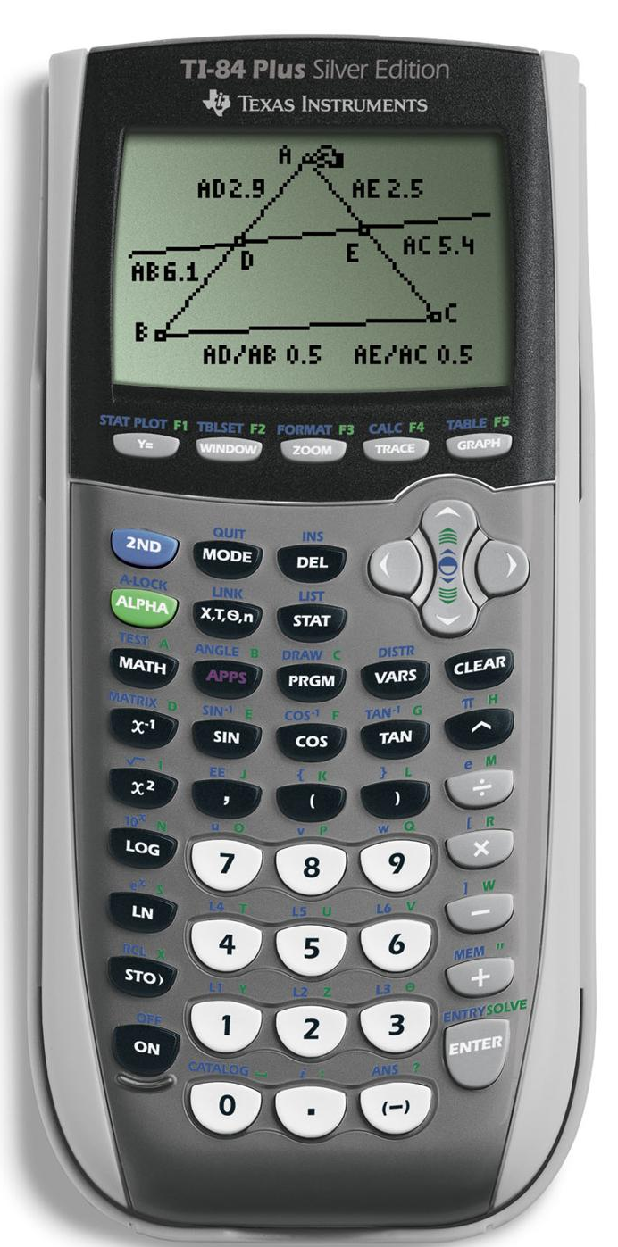
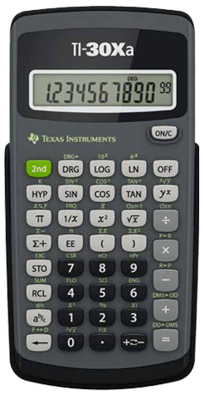
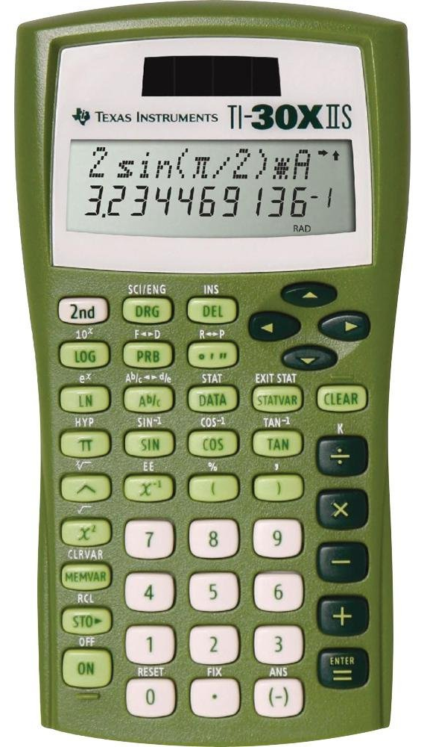
Texas Instruments -
Use EE button. It automatically links the coefficient and exponent

Slide 30
Scientific Notation Computations
2.2 x 10^{–11}
X
9.7 x 10¹⁵
=
2.134 x 10⁵
2
.
2
EE
(-)
1
1
X
9
.
7
EE
1
5
ENTER

Slide 31
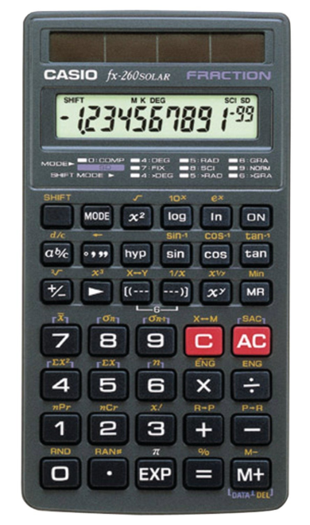
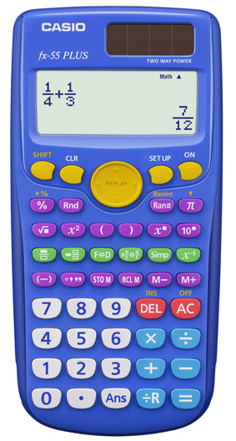
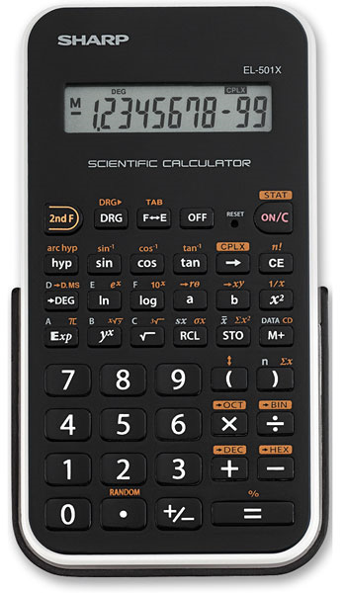
All others use 10^{x} or 10^{n} button, or if you want to use the caret (^) button on a Texas Instruments -
Put parentheses around the entire number (2 x 10⁻⁶)

Slide 32
Check for Understanding 6
1) 6.0 x 10^{–7} ∗ 3.0 x 10³
2) 6.7 x 10^{–7} ∗ 3.7 x 10³
³
3) 9.0 x 10^{–6} + 9.6 x 10^{–4}
⁴
4) 1.24 x 10⁶ – 8.3 x 10⁵
5) 8 x 10^{–3} ÷ 2 x 10^{–6}

Slide 33
Check for Understanding 6
1) 6.0 x 10^{–7} ∗ 3.0 x 10³ 1.8 x 10^{–3}
2) 6.7 x 10^{–7} ∗ 3.7 x 10³
³
3) 9.0 x 10^{–6} + 9.6 x 10^{–4}
⁴
4) 1.24 x 10⁶ – 8.3 x 10⁵
5) 8 x 10^{–3} ÷ 2 x 10^{–6}

Slide 34
Check for Understanding 6
1) 6.0 x 10^{–7} ∗ 3.0 x 10³ 1.8 x 10^{–3}
2) 6.7 x 10^{–7} ∗ 3.7 x 10³ 2.5 x 10^{–3}
not 2.479 x 10^{–3}
3) 9.0 x 10^{–6} + 9.6 x 10^{–4}
⁴
4) 1.24 x 10⁶ – 8.3 x 10⁵
5) 8 x 10^{–3} ÷ 2 x 10^{–6}

Slide 35
Check for Understanding 6
1) 6.0 x 10^{–7} ∗ 3.0 x 10³ 1.8 x 10^{–3}
2) 6.7 x 10^{–7} ∗ 3.7 x 10³ 2.5 x 10^{–3}
not 2.479 x 10^{–3}
3) 9.0 x 10^{–6} + 9.6 x 10^{–4} 9.7 x 10^{–4}
not 9.69 x 10^{–4}
4) 1.24 x 10⁶ – 8.3 x 10⁵
5) 8 x 10^{–3} ÷ 2 x 10^{–6}

Slide 36
Sig Fig Rules Apply
3) 9.0 x 10^{–6} + 9.6 x 10^{–4} 9.7 x 10^{–4}
not 9.69 x 10^{–4}
0.0000090
+ 0.00096
0.0009690
0.00097

Slide 37
Check for Understanding 6
1) 6.0 x 10^{–7} ∗ 3.0 x 10³ 1.8 x 10^{–3}
2) 6.7 x 10^{–7} ∗ 3.7 x 10³ 2.5 x 10^{–3}
not 2.479 x 10^{–3}
3) 9.0 x 10^{–6} + 9.6 x 10^{–4} 9.7 x 10^{–4}
not 9.69 x 10^{–4}
4) 1.24 x 10⁶ – 8.3 x 10⁵
5) 8 x 10^{–3} ÷ 2 x 10^{–6}

Slide 38
Check for Understanding 6
1) 6.0 x 10^{–7} ∗ 3.0 x 10³ 1.8 x 10^{–3}
2) 6.7 x 10^{–7} ∗ 3.7 x 10³ 2.5 x 10^{–3}
not 2.479 x 10^{–3}
3) 9.0 x 10^{–6} + 9.6 x 10^{–4} 9.7 x 10^{–4}
not 9.69 x 10^{–4}
4) 1.24 x 10⁶ – 8.3 x 10⁵ 4.1 x 10⁵
5) 8 x 10^{–3} ÷ 2 x 10^{–6}

Slide 39
Check for Understanding 6
1) 6.0 x 10^{–7} ∗ 3.0 x 10³ 1.8 x 10^{–3}
2) 6.7 x 10^{–7} ∗ 3.7 x 10³ 2.5 x 10^{–3}
not 2.479 x 10^{–3}
3) 9.0 x 10^{–6} + 9.6 x 10^{–4} 9.7 x 10^{–4}
not 9.69 x 10^{–4}
4) 1.24 x 10⁶ – 8.3 x 10⁵ 4.1 x 10⁵
5) 8 x 10^{–3} ÷ 2 x 10^{–6} 4 x 10³
not 4 x 10^{–9}

Slide 40
Common Calculator Error
Write this in your notes
8 x 10⁻³ ÷ 2 x 10⁻⁶ =
$$\frac{8 × {10}^{−3}}{2 × {10}^{−6}}$$
$$4 × {10}^{3}$$
Correct
$$\frac{8 × {10}^{−3}× {10}^{−6}}{2 }$$
$$4 × {10}^{−9}$$
Incorrect
Why does this happen?
When typing the equation into the calculator, the "2"
and the "10⁻⁶". Instead of dividing by 10^{-6,} we have
multiplied by 10⁻⁶.

Slide 41
Write this in your notes
How to Avoid this Error
8 x 10⁻³ ÷ 2 x 10⁻⁶ =
Enter the equation with "2" and "10⁻⁶" in parentheses so you divide by "10⁻⁶"
8 x 10⁻³ ÷ (2 x 10⁻⁶ ) =
The best way to do this depends on the type of calculator you have

Slide 42
Texas Instruments -
Use EE button. It automatically links the 2 with 10⁻⁶ for all calculations

Slide 43
All others use 10^{x} or 10^{n} button, or if you want to use the caret (^) button on a Texas Instruments -
Put parentheses around the entire number (2 x 10⁻⁶)

Slide 44
Check for Understanding 7
Equation | Correct | Incorrect
2.33 x 10⁻⁶ ÷ 9.7 x 10³ =
7.01 x 10⁵ ÷ 6.17 x 10⁹ =
6.02 x 10²³ ÷ 6.02 x 10²³ =
4.8 x 10¹¹ ÷ 1.2 x 10⁻⁶ =

Slide 45
Check for Understanding 7
Equation | Correct | Incorrect
2.33 x 10⁻⁶ ÷ 9.7 x 10³ = | 2.4 x 10⁻¹⁰ | 2.4 x 10⁻⁴
7.01 x 10⁵ ÷ 6.17 x 10⁹ =
6.02 x 10²³ ÷ 6.02 x 10²³ =
4.8 x 10¹¹ ÷ 1.2 x 10⁻⁶ =

Slide 46
Check for Understanding 7
Equation | Correct | Incorrect
2.33 x 10⁻⁶ ÷ 9.7 x 10³ = | 2.4 x 10⁻¹⁰ | 2.4 x 10⁻⁴
7.01 x 10⁵ ÷ 6.17 x 10⁹ = | 1.14 x 10⁻⁴ | 1.14 x 10¹⁴
6.02 x 10²³ ÷ 6.02 x 10²³ =
4.8 x 10¹¹ ÷ 1.2 x 10⁻⁶ =

Slide 47
Check for Understanding 7
Equation | Correct | Incorrect
2.33 x 10⁻⁶ ÷ 9.7 x 10³ = | 2.4 x 10⁻¹⁰ | 2.4 x 10⁻⁴
7.01 x 10⁵ ÷ 6.17 x 10⁹ = | 1.14 x 10⁻⁴ | 1.14 x 10¹⁴
6.02 x 10²³ ÷ 6.02 x 10²³ = | 1.00 | 1.00 x 10⁴⁶
4.8 x 10¹¹ ÷ 1.2 x 10⁻⁶ =

Slide 48
Check for Understanding 7
Equation | Correct | Incorrect
2.33 x 10⁻⁶ ÷ 9.7 x 10³ = | 2.4 x 10⁻¹⁰ | 2.4 x 10⁻⁴
7.01 x 10⁵ ÷ 6.17 x 10⁹ = | 1.14 x 10⁻⁴ | 1.14 x 10¹⁴
6.02 x 10²³ ÷ 6.02 x 10²³ = | 1.00 | 1.00 x 10⁴⁶
4.8 x 10¹¹ ÷ 1.2 x 10⁻⁶ = | 4.0 x 10¹⁷ | 4.0 x 10⁵

Slide 49
Backup Slides

Slide 50
Test #1 - The Scientific Method
30 Questions
21 multiple choice
9 open response
Test will be given after:
Scientific Notation
Review Day (Cold Call)
Write this in your notes

Slide 51
STUDY FOR UNIT TESTS!!!
Unit Tests are comprehensive & difficult
You will be tested on everything we’ve learned
Our in-class review (Cold Call) helps but is not enough by itself
It’s actually best if you study before Cold Call
Your grade will largely depend on your performance on unit tests
Remember you need a 93 to get out of the final
High scores on Unit Tests earn a place on the Wall of Fame

Slide 52
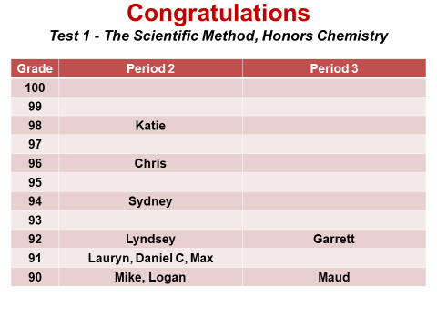
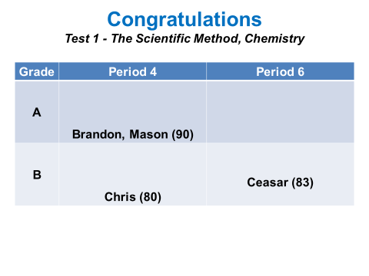
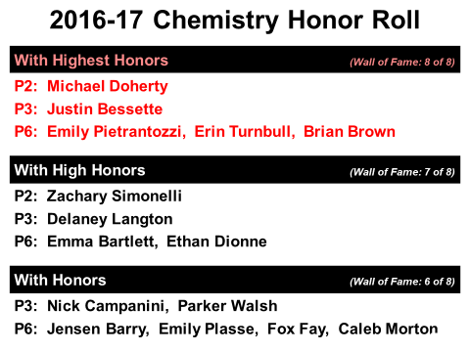
Wall of Fame

Slide 53
Website has Updated Slides

Slide 54
Website also has Class Photos

Slide 55
Penny Density Lab
Write this in your notes
When: as soon as Test #1 is complete
We will review the theory first
Lab Reports due on Friday, October 26
Will count as 2nd quarter grade
Don’t hand them in late!
Don’t waste time in lab

Slide 56
Early Enrollment Program
Incomplete Applications
Technical Issues
Nicole Belanger
Ben Fontes
Madison Medbury
Logan Butkins
Madison Carney
Cam Barry (?)
No Response
Kristen DeMatteo
Luke Gentile
Evan Pendergast
Olivia Santilli
Alysha Agrela
This is a hard deadline – don’t miss it!

