Slide 1
Do Now
On her 17th birthday, Jennifer's dad asked her how many seconds she had been alive.
Showing your calculations, determine how many seconds are in exactly 17 years

Slide 2
How many seconds in 17 years?
1 year = 365.25 days
1 day = 24 hours
1 hour = 60 min
1 min = 60 seconds
17 y | 365.25 d | 24 h | 60 m | 60 s | = | 536,479,200 s
 | 1 y | 1 d | 1 h | 1 m

Slide 3
Wait!!! I did it differently!!!
Days / Year | Seconds in 17 Years
365 | 536,112,000
365 + 4 leap days | 536,457,600
365.25 | 536,479,200
365 + 5 leap days | 536,544,000
17 y | 365.25 d | 24 h | 60 m | 60 s | = | 536,479,200 s
 | 1 y | 1 d | 1 h | 1 m
Definition of units is important!

Slide 4
This calculation converted from one time unit (years) to another (seconds)
Calculations such as this are called
Dimensional Analysis
They change units with conversion factors
This example used the picket fence method
This is a lesson on dimensional analysis
17 y | 365.25 d | 24 h | 60 m | 60 s | = | 536,479,200 s
 | 1 y | 1 d | 1 h | 1 m

Slide 5
Dimensional Analysis
Write this in your notes
SWBAT convert between different units using dimensional analysis.

Slide 6
The Scientific Method
REVIEW
This unit will cover some basic skills you will need in chemistry this year
Measurement
Significant Digits
Units
Dimensional Analysis
Scientific Notation
Graphing

Slide 7
Dimensional Analysis
17 y | 365.25 d | 24 h | 60 m | 60 s | = | 536,479,200 s
 | 1 y | 1 d | 1 h | 1 m
This is an example of dimensional analysis
Dimensional Analysis is rigorous method for converting between different units.
Most times you don’t need to be this rigorous, but when you do, dimensional analysis is the tool to use
Write this in your notes

Slide 8
Dimensional Analysis
17 y | 365.25 d | 24 h | 60 m | 60 s | = | 536,479,200 s
 | 1 y | 1 d | 1 h | 1 m
Dimensional analysis uses conversion factors
Conversion Factors are ratios that show equal values in two different units
The dimensional analysis above uses the four conversion factors highlighted in green
Write this in your notes

Slide 9
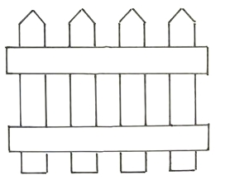
Picket Fence
This is normal way to show a calculation
When we do dimensional analysis, we will use a simplified notation called a "picket fence“
Picket fence notation separates each conversion factor with a vertical line and all of the numerators from denominators with a horizontal line
$$4.43 kg ∗ \frac{1000 g}{1 kg} = 4,430 g$$
4.43 kg | 1000 g | = | 4,430 g
 | 1 kg

Slide 10
Follow the Units
17 y | 365.25 d | 24 h | 60 m | 60 s | = | 536,479,200 s
 | 1 y | 1 d | 1 h | 1 m
Picket fence notation makes it easy to check that all the unwanted units cancel out
We started in years and wanted to convert to seconds, so all other units should cancel
The only unit remaining is seconds
Following the units is laborious, but it helps enormously to catch errors

Slide 11
One Step Dimensional Analysis
How many inches in 6.5 feet?
6.5 feet |  | =
Create a picket fence with the original number in the upper left spot

Slide 12
One Step Dimensional Analysis
How many inches in 6.5 feet?
6.5 feet |  | =
6.5 feet |  | = | inches
Put the units for the answer in the final spot on the right

Slide 13
One Step Dimensional Analysis
How many inches in 6.5 feet?
6.5 feet |  | = | inches
6.5 feet | inches | = | inches
 | foot
Add the units for the conversion factor

Slide 14
One Step Dimensional Analysis
How many inches in 6.5 feet?
6.5 feet | inches | = | inches
 | foot
Make sure the units cancel properly to give the answer's units

Slide 15
One Step Dimensional Analysis
How many inches in 6.5 feet?
6.5 feet | inches | = | inches
 | foot
6.5 feet | 12 inches | = | inches
 | 1 foot
Add the values for the conversions factors

Slide 16
One Step Dimensional Analysis
How many inches in 6.5 feet?
6.5 feet | 12 inches | = | inches
 | 1 foot
6.5 feet | 12 inches | = | 78 inches
 | 1 foot
Compute the answer

Slide 17
Check for Understanding 1
Doctors say we all should drink 64 oz of water per day. If a regular water bottle holds 8 oz, how many should we be drinking per day?
64 oz | 1 bottle | = | 8 bottles
 | 8 oz

Slide 18
1-Step Dimensional Analysis Practice
1) How many kg in 240 g?
240 g | 1 kg | = | 0.24 kg
 | 1000 g
2) How many days in 4.770 years?
4.770 y | 365.25 d | = | 1742 days
 | 1 y
3) How many dozen in 88 donuts?
88 donuts | 1 dozen | = | 7.3 dozen
 | 12 donuts

Slide 19
Two Step Dimensional Analysis
If 1 in = 2.54 cm, how many inches in 34 m?
34 m |  |  | =
Create a picket fence with the original number in the upper left spot

Slide 20
Two Step Dimensional Analysis
If 1 in = 2.54 cm, how many inches in 34 m?
34 m |  |  | = | in
Put the units for the answer in the final spot on the right

Slide 21
Two Step Dimensional Analysis
If 1 in = 2.54 cm, how many inches in 34 m?
34 m |  |  | = | in
 | m
Put the units we need to cancel on the first conversion factor

Slide 22
Two Step Dimensional Analysis
If 1 in = 2.54 cm, how many inches in 34 m?
34 m |  | in | = | in
 | m
Put the units we need to introduce on the last conversion factor

Slide 23
Two Step Dimensional Analysis
If 1 in = 2.54 cm, how many inches in 34 m?
34 m |  | in | = | in
 | m
Figure out which unit will allow you to complete the conversions

Slide 24
Two Step Dimensional Analysis
If 1 in = 2.54 cm, how many inches in 34 m?
34 m | cm | in | = | in
 | m | cm
Plug in the missing unit to complete the picket fence

Slide 25
Two Step Dimensional Analysis
If 1 in = 2.54 cm, how many inches in 34 m?
34 m | cm | in | = | in
 | m | cm
Check that all unwanted units cancel leaving just the desired unit

Slide 26
Two Step Dimensional Analysis
If 1 in = 2.54 cm, how many inches in 34 m?
34 m | cm | in | = | in
 | m | cm
34 m | 100 cm | 1 in | = | 1336 in
 | 1 m | 2.54 cm
Put in the actual conversion factors and solve the dimensional analysis

Slide 27
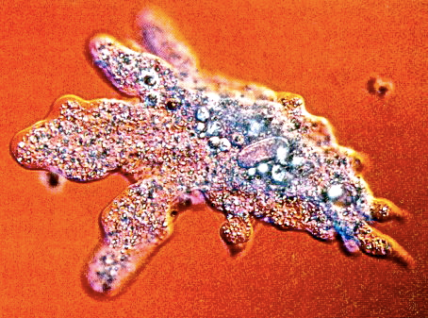
Check For Understanding 2
An amoeba is 735 μm in diameter. What is this in inches? (2.54 cm = 1 inch)
735 μM | 1 cm | 1 inch | = | 0.0289 inch
 | 10,000 μM | 2.54 cm
 |  |  |  | not
 |  |  |  | 0.187 inch

Slide 28
Check for Understanding 3
Joe and Megan were arguing about who runs farther. Joe runs the 1500 m, the so-called "metric mile", while, in her race, Megan runs 4 laps around a 440 yard track. Convert both numbers into miles and determine who runs farther.
1 m = 3.281 ft
1 yard = 3 ft
1 mile = 5280 ft
1500 m | 3.281 ft | 1 mile | = | 0.93 mile
 | 1 m | 5280 ft
4 x 440 yds | 3 ft | 1 mile | = | 1.0 mile
 | 1 yd | 5280 ft

Slide 29
2-Step Dimensional Analysis Practice
1) How many lbs in 14.8 g? (1 kg = 2.20 lbs)
14.8 g | 1 kg | 2.20 lbs | = | 0.0326 lbs
 | 1000 g | 1 kg
2) How many inches in 7.62 mm? (2.54 cm = 1 inch)
7.62 mm | 1 cm | 1 inch | = | 0.300 inch
 | 10 mm | 2.54 cm
3) How many minutes in 9,040 ms?
9,040 ms | 1 s | 1 min | = | 0.151 min
 | 1000 ms | 60 s

Slide 30
Multi-Step Dimensional Analysis
Once you’ve mastered 2-step dimensional analysis, it is easy to move on to 3 or more steps using the same principles
Recall that you completed a 4 step dimensional analysis for Jennifer’s birthday
17 y | 365.25 d | 24 h | 60 m | 60 s | = | 536,479,200 s
 | 1 y | 1 d | 1 h | 1 m

Slide 31
Multi-Step Dimensional Analysis
I do
SHS students love chemistry so much, they want to cherish every minute. How many minutes do they have to cherish?
1 school year = 180 class days
5 class days = 4 chem classes
1 chem class = 60 min
1 school year | 180 class days | 4 chem classes | 60 min
 | 1 school year | 5 class days | 1 chem class
= | 8640 min

Slide 32
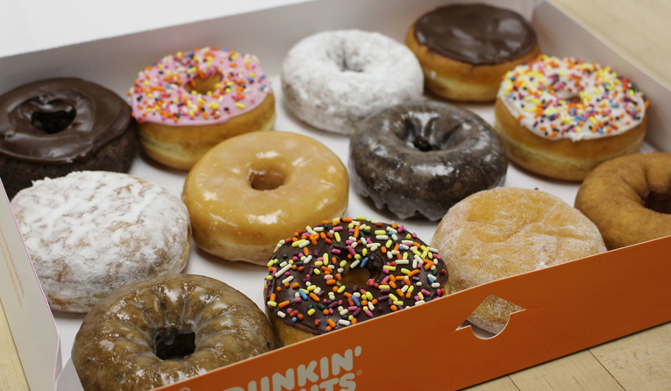
Check for Understanding 4
Dr. McCarthy wants to get donuts for all of his science classes. He has five classes. Each class has 24 students, and each student should get one donut. Dunkins only sells in dozens, so how many dozen does he need?
5 classes | 24 students | 1 donut | 1 dozen | = | 10 dozen
 | 1 class | 1 student | 12 donuts

Slide 33
Check for Understanding 5
Convert 4.22 m³ into cm³
This is completely wrong
A cubic meter (m³) is 1 meter x 1 meter x 1 meter
Each meter must be converted into centimeters
Be careful when units have exponents
4.22 m³ | 100 cm | = | 422 cm³
 | 1 m
4.22 m•m•m | 100 cm | 100 cm | 100 cm | = | 4,220,000 cm•cm•cm
 | 1 m | 1 m | 1 m

Slide 34
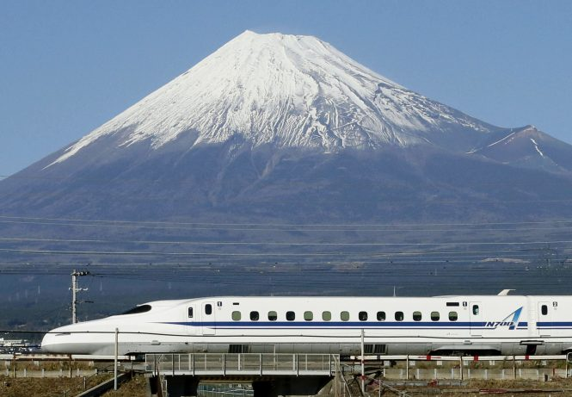
Conversion of the Denominator
I do
The Japanese "bullet train" travels at 220 mph. Create a dimensional analysis to show the train's speed in miles per second
Set up a dimensional analysis with conversion factors
Make sure the units cancel correctly
Compute the answer
220 miles | 1 hour | 1 min | = | 0.061 miles/s
1 hour | 60 min | 60 s

Slide 35
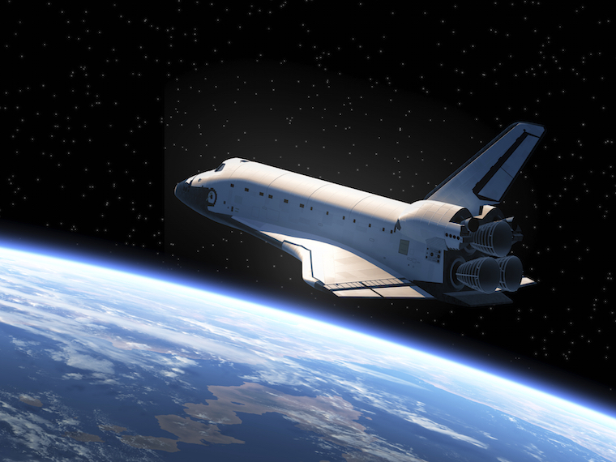
Check for Understanding 6
The space shuttle travels at 17,500 mph in orbit. How many miles will it travel in one second?
Set up a dimensional analysis with conversion factors
Make sure the units cancel correctly
Compute the answer
17,500 miles | 1 hour | 1 min | = | 4.86 miles/s
1 hour | 60 min | 60 s

Slide 36
Convert Numerator & Denominator
A 9 mm bullet leaves a pistol at 465 meters per second. How fast is this in mph?
3.281 ft = 1 m
5280 ft = 1 mile
465 m | 60 s | 60 min | 3.281 ft | 1 mile
1 s | 1 min | 1 h | 1 m | 5280 ft
= | 1040 miles/h

Slide 37
Additional CFUs

Slide 38
Check For Understanding
How many inches in 1 kilometer?
(1 in = 2.54 cm)
1 km | 100,000 cm | 1 in | = | 39,400 in
 | 1 km | 2.54 cm

Slide 39
Check For Understanding
A hectare is 1 km². What is this unit ins m²?
1 km² | 100 m | 100 m | = | 10,000 m²
 | 1 km | 1 km
 |  |  |  | not
 |  |  |  | 100 m²

Slide 40
Check for Understanding
SHS students love chemistry so much, they want to cherish every minute. How many minutes do they have to cherish?
1 school year = 180 class days
5 class days = 4 chem classes
1 chem class = 60 min
1 school year | 180 class days | 4 chem classes | 60 min
 | 1 school year | 5 class days | 1 chem class
= | 8640 min

Slide 41
Tip on Metric Prefixes
If you did not know there were 100,000 cm in km . . .
. . . you can turn this into a 3 step analysis by converting from km to meters and then meters to cm
1 km | 1000 m | 100 cm | 1 in | = | 39,400 in
 | 1 km | 1 m | 2.54 cm

