Slide 1
Unit 1: Scientific Method
Write this in your notes
This unit will cover some basic skills you will need in chemistry this year
Measurement
Significant Digits
Units
Dimensional Analysis
Scientific Notation
Graphing
When we are done, you will be held responsible for using these skills all year long
whenever it is needed

Slide 2
Measurement
Write this in your notes
Students will be able to (SWBAT) properly make measurements on both analog and digital devices

Slide 3
What is Measurement?
The assignment of a number to a characteristic of an object or event, which can be compared with other objects or events
Measurement is the cornerstone of experimentation and science
In science, a specific technique is required in order to make a measurement properly

Slide 4
Number vs Digit
Write this in your notes
This is a number
– shows all the digits associated with a particular value
2
4
.
9
0
This is a digit
– a number between 0 and 9 with particular place value
Tens Digit =
2
Ones Digit =
4
Tenths Digit =
9
Hundredths Digit =
0

Slide 5
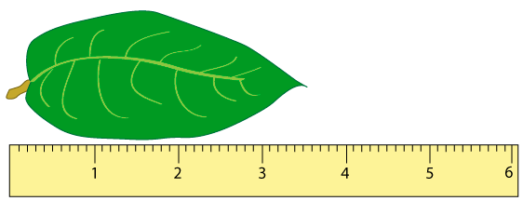
So How Do We Measure?

Slide 6
Proper Reporting of Measured Data
Write this in your notes
Report all known digits
All digit you can actually read off of the measurement device
Report the first estimated digit
One digit beyond what you can actually read off of the measurement device

Slide 7
Applying the Rules
Digits you can read off of this ruler
The 1 cm digit
The 0.1 cm digit
Digits you can estimate with this ruler
The 0.01 cm digit
These are the known digits
This is the
first estimated digit

Slide 8
Reporting by the Rules
1) All known digits
2) One estimated digit
3 cm is a known digit
Length with this ruler
3.57 cm
0.5 cm is a known digit
0.07 cm is an estimated digit

Slide 9
Proper Reporting of Measured Data
REVIEW
Report all known digits
All digit you can actually read off of the measurement device
Report the first estimated digit
One digit beyond what you can actually read off of the measurement device

Slide 10
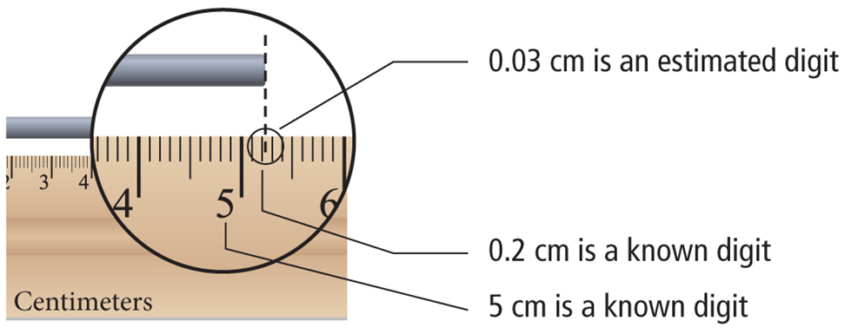
Check for Understanding 1
Given this ruler as the measuring device, what is the proper way to report the length of this metal rod?
5.23 cm

Slide 11
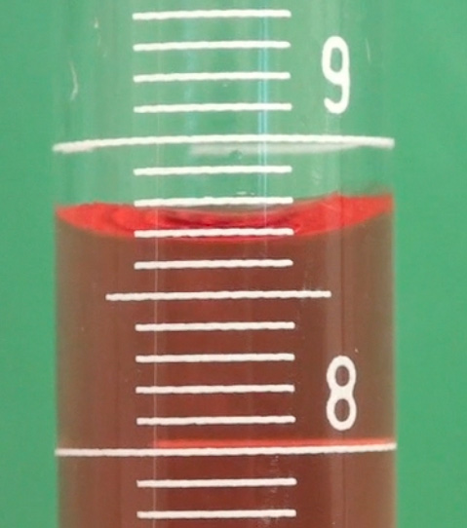
Check for Understanding 2
The volume of fluid in a graduated cylinder is read from the bottom of the meniscus (dotted white line)
What is the proper volume to report?
Units are milliliters (mL)
8.62 mL

Slide 12
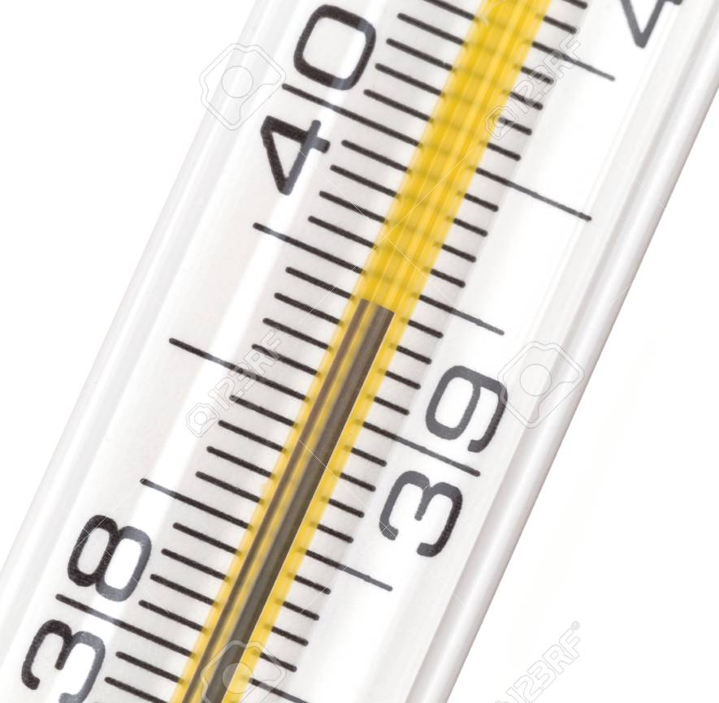
Check for Understanding 3
What is the proper way to report the temperature recorded on this Celsius thermometer
39.40 °C

Slide 13
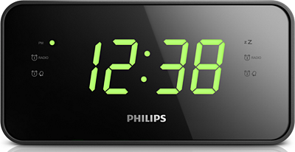
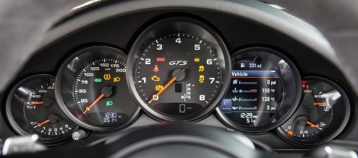
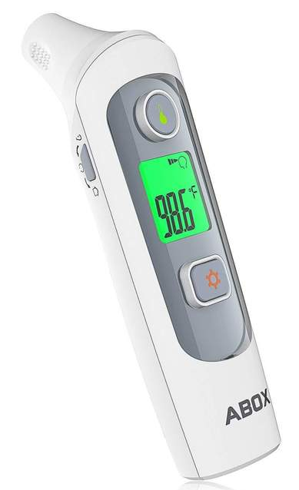
Impact of Instrument Type
Analog
Digital
Have a physical scale
Magnitude is measured either directly or indirectly
Have an electronic number display
Magnitude is converted into an electronic signal

Slide 14
Which is analog & which is digital?

Slide 15
For Analog Instruments

Slide 16
For Digital Instruments
If the displayed numbers are unchanging, then
all are known digits
there is no first estimated digit

Slide 17
For Digital Instruments
If the displayed numbers are unchanging, then
all are known digits
there is no first estimated digit
If some displayed numbers are fluctuating, then
the unchanging displayed numbers are known digits
the first fluctuating digit is the first estimated digit

Slide 18
Key Points
Write this in your notes
7
.
4
0
3
1
2
3
4
Everyone should have the same number of digits
Everyone should have the same known digits
Everyone should have first estimated digits that are similar if not identical
In this way, the Rules of Measurement give us confidence that each digit of a measured number is correct and reproducible

Slide 19
Measurement Lab
In your lab groups, you are going to make actual measurements in lab
Each group should get one lab sheet and then move through all stations to record their answers
When done, we will review
Show your sheet to me for a completion grade

Slide 20
Lab Partners
You now need to pick your lab partners for this lab
Be sure to pick your lab partner(s) wisely
All lab work and report writing will be done together
Everyone in your group will get the same grade
You will have to conduct lab work and report writing even if your lab partner(s) is absent
Do your fair share, or next time, you may be alone!

Slide 21
Measurement Lab
ANY QUESTIONS?
Get in your lab groups and get on some goggles

Slide 22
Station 1
Using a ruler, measure the length of the straight vertical pipe on the lab faucet on the front bench.

Slide 23
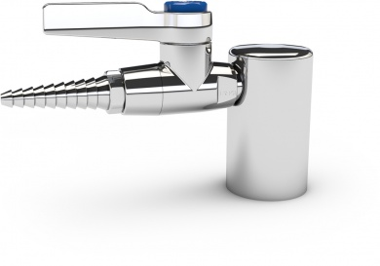
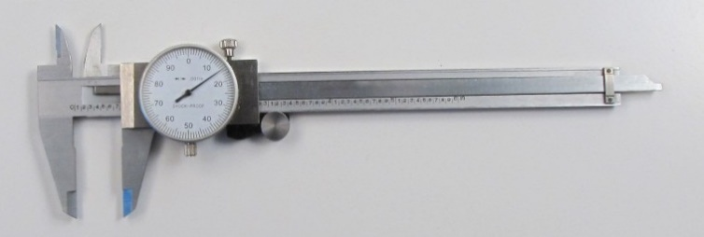
Station 2
Using dial calipers, measure the diameter of the gas turret base on the front bench.
If you do not know how to use this device, please review the
Dial Caliper Instructions

Slide 24
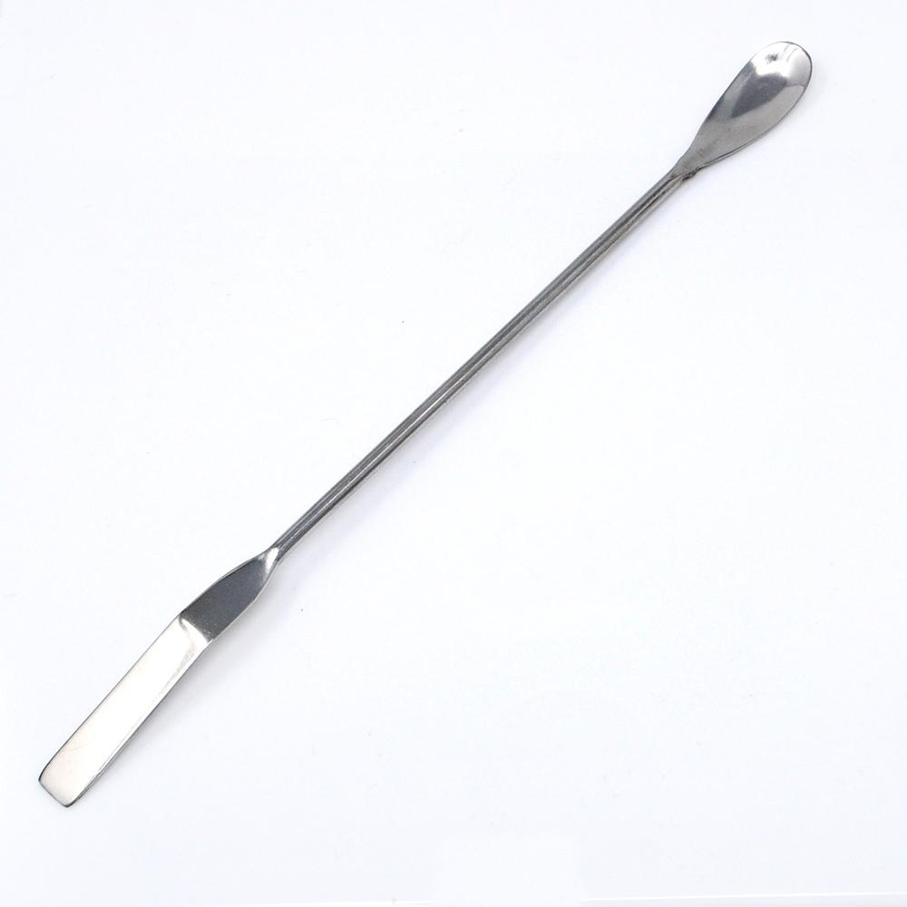
Station 3
Using the electronic balance, measure the mass of a lab spatula

Slide 25
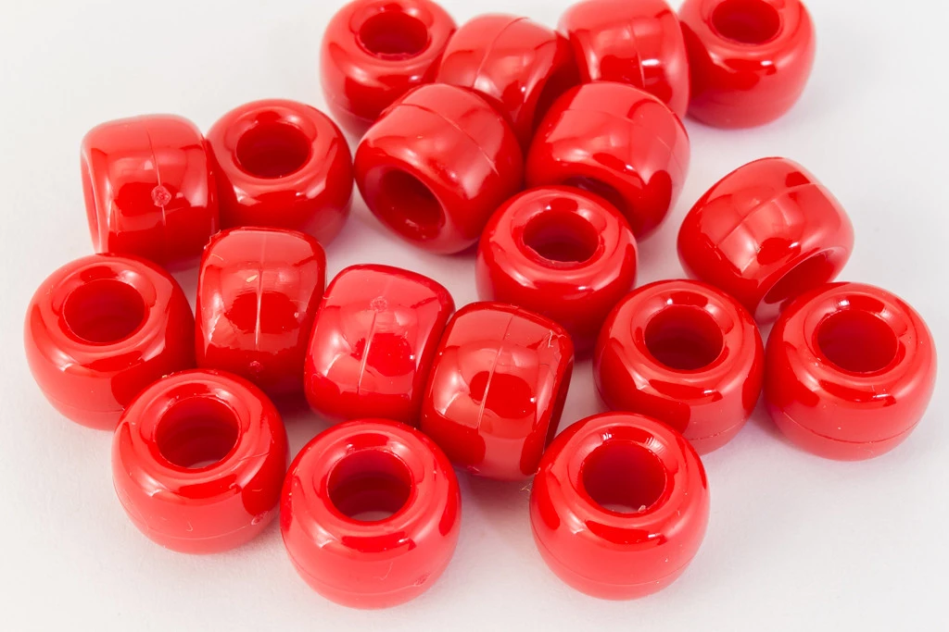
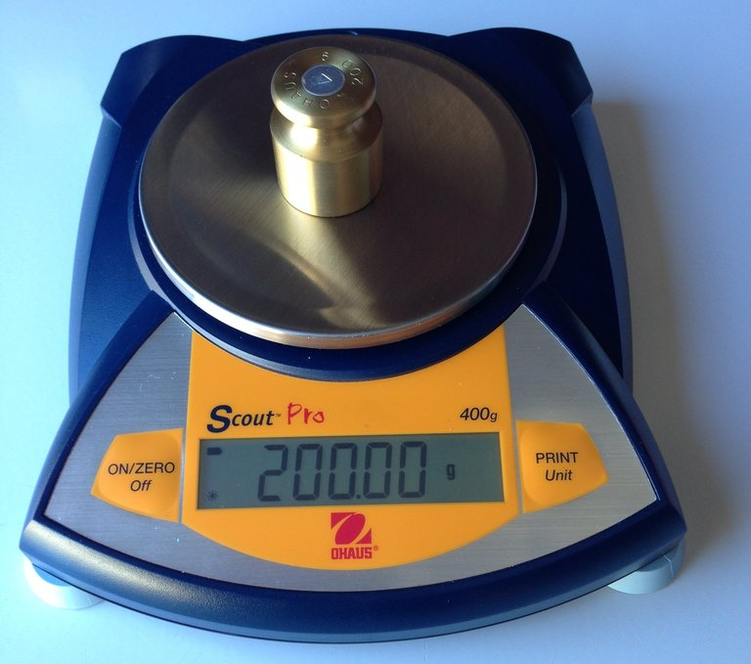
Station 4
Using the Ohaus electronic balance, determine the mass of a single red pony bead.
Because one bead’s mass is so small, measure the mass of 17 and divide to get weight of one bead.

Slide 26
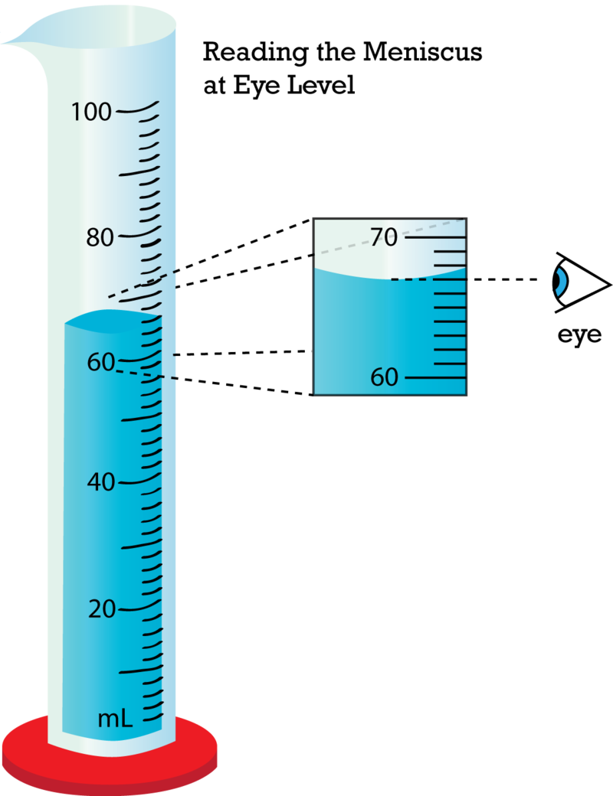
Station 5
Read the volume of colored water in the graduated cylinder

Slide 27
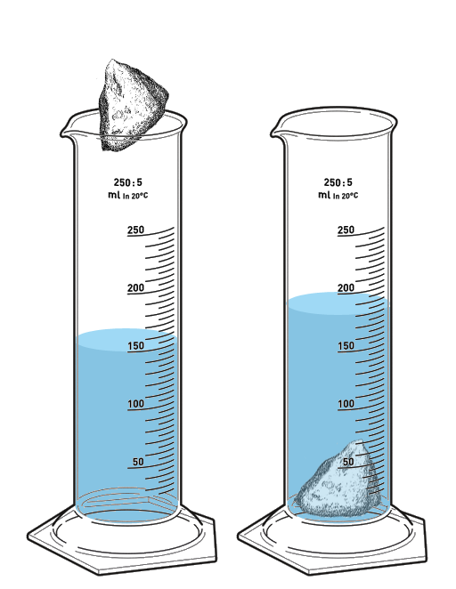
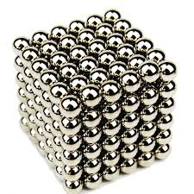
Station 6
Determine the mass of a single ball magnet
Measure 17 ball magnets in a graduated cylinder by water displacement

Slide 28
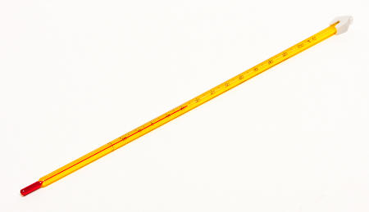
Station 7
Using the thermometer on top of the oven, measure the internal temperature of the oven

Slide 29
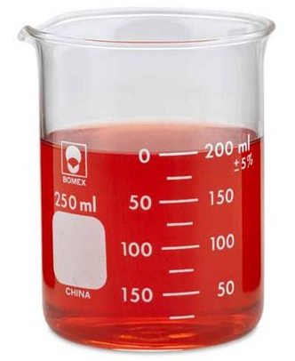
Station 8
Measure the volume copper foil using water displacement in a 200 mL flask

Slide 30
Station 9
Measure the amount of colored water in the large Erlenmeyer flask

Slide 31
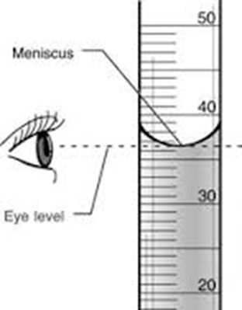
Station 10
Measure the amount of colored water in the burette
PLEASE BE CAREFUL, ESPECIALLY WITH THE BURETTE TIP

Slide 32
Chemistry
Measurement Lab
Partner 1
Partner 2
Partner 3
Date
Period
Station 1 |  | Station 6
 | Final Answer |  | Final Answer
Station 2 |  | Station 7
 | Final Answer |  | Final Answer
Station 3 |  | Station 8
 | Final Answer |  | Final Answer
Station 4 |  | Station 9
 | Final Answer |  | Final Answer
Station 5 |  | Station 10
 | Final Answer |  | Final Answer

Slide 33
Chemistry
Measurement Lab
Partner 1
Partner 2
Partner 3
Date
Period
ANSWERS
Station 1 |  | Station 6
 | Final Answer |  | Final Answer
Station 2 |  | Station 7
 | Final Answer |  | Final Answer
Station 3 |  | Station 8
 | Final Answer |  | Final Answer
Station 4 |  | Station 9
 | Final Answer |  | Final Answer
Station 5 |  | Station 10
 | Final Answer |  | Final Answer

