Slide 1
Please Sit in Your Assigned Seat

Slide 2
Today's Class
School Safety
Lab Safety

Slide 3
School Safety

Slide 4
School Evacuation
Exit front door
Take right
Down stairs
Leave building by exit behind Middle School office, or, if blocked exit next to stairs and walk around the Middle School
Go through double gate
Assemble on track

Slide 5
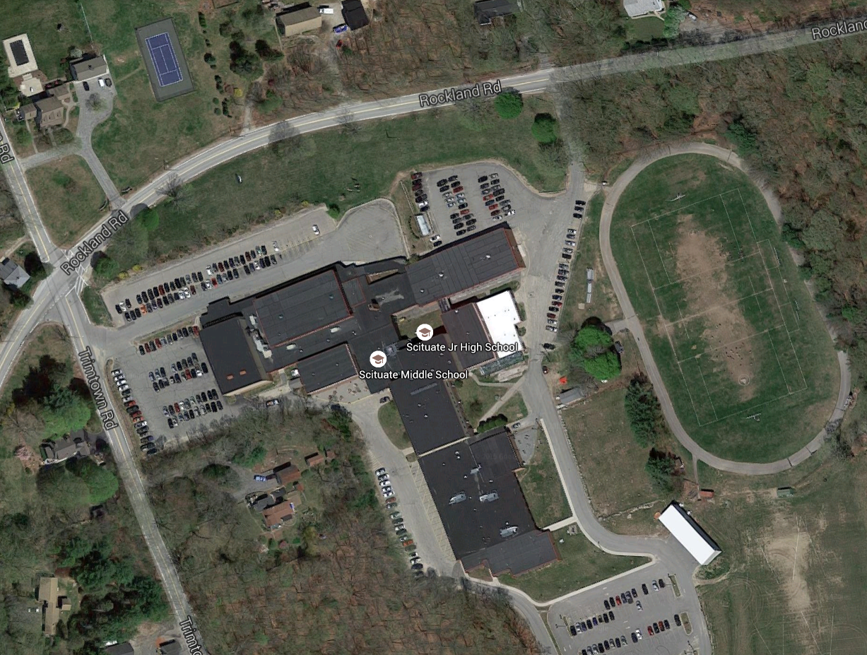
x

Slide 6
New School Security Procedures
Normal Operations
Shelter in Place
Restricted Movement
Lockdown

Slide 7
Procedure for Each Security Level
Doors
Windows
& Blinds
Building Entrance
Classroom Exit
Classroom Activity
Normal Operations
Locked
Normal
Use
Yes
Yes
Teaching
Shelter in Place
Locked
Locked/
Closed
No
Yes
Teaching
Restricted Movement
Locked
Locked/
Closed
No
No
Teaching
Lockdown
Locked
Locked/
Closed
No
No
Shelter in Classroom

Slide 8
Lockdown
Sit on the floor in front of the cabinets
Make sure you are not visible to the door windows
Doc will turn off lights in classroom & prep room
Lock all doors (usually kept locked)
STAY SILENT
DO NOT USE YOUR PHONE
We must stay in lockdown until someone enters the room to release us
Metal poles

Slide 9
Lab Safety

Slide 10
Safety in the Lab
Follow directions
Be certain you understand the hazards of any procedure before starting
Do not play around in the lab

Slide 11
Review of Safety Equipment
Tour the lab and see the safety equipment
fire extinguishers
emergency power shut-off
safety shower
eye washer
first aid kit
safety blanket
cabinet for safety glasses
fume hood
aprons
prep room

Slide 12
Goggles
Write this in your notes
KEEP YOUR GOGGLES ON AT ALL TIMES
Goggles are required whenever we use:
chemicals
heat
glassware

Slide 13
Food or Drink in the Lab
Write this in your notes
NO EATING OR DRINKING IN THE LAB

Slide 14
Proper Dress
No contact lenses (wear glasses)
All skin covered from waist down
No skirts or shorts
Shoes must cover the foot
Nothing that can catch on equipment or dip into liquids/flames
Hair must be tied back or put up
Dangling jewelry/clothing must be removed
Push up or roll up sleeves

Slide 15
If something happens . . .
Write this in your notes
Tell me
Don't hesitate
Sometimes seconds count

Slide 16
Check for Understanding 1
Goggles are required whenever we are using any one of three things. What are the three?
Any time we are using:
chemicals
heat
glassware

Slide 17
Check for Understanding 2
You were late to class on the day of the lab, and you didn't understand your lab partner's instructions for handling a chemical. What should you do?
Ask before starting.
Keep asking until you are sure you understand.

Slide 18
Check for Understanding 3
If the edge of your goggles feel like they are cutting into your cheek, what should you do?
DO NOT REMOVE YOUR GOGGLE IN THE LAB
Move to the very front of the classroom, remove your goggles and adjust them.

Slide 19
Check for Understanding 4
Name three safety equipment items in the lab

Slide 20
Check for Understanding 4
Name three safety equipment items in the lab
fire extinguishers
emergency power shut-off
safety shower
eye washer
first aid kit
safety blanket
cabinet for safety glasses
fume hood
aprons
prep room

Slide 21
Check for Understanding 5
You and your partner are doing a lab together when you notice your solution begin to bubble. You don't remember reading about bubbling in the procedure, and you are worried that you may have done something wrong. What should you do?
Call Dr. McCarthy immediately

