Slide 1
Please Sit in Your Assigned Seat

Slide 2
Do Now
Make your name card
Fold a piece of card stock in half along the long axis
Write you first name in clearly on both sides
Put this on your desk
When done, complete a student survey
On front table
Beyoncé

Slide 3
Welcome to Chemistry!!!

Slide 4
Today's Class
Assignments & Announcements
Introductions
Who am I?
Who are you?
What is chemistry?

Slide 5
Assignments & Announcements

Slide 6
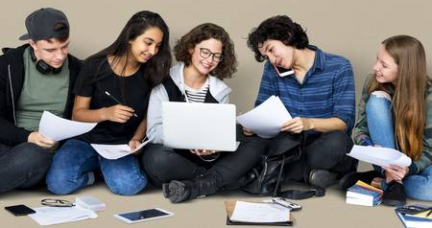
Read Key Documents
Write this in your notes
Read the following documents:
Syllabus
SHS Science Student Handbook
Safety Contract

Slide 7
Where Are the Documents?
Write this in your notes
Go to the class website
http://drmccarthyscience.weebly.com/
Hover on the "Chemistry" tab

Slide 8
Where Are the Documents?
Write this in your notes
Go to the class website
http://drmccarthyscience.weebly.com/
Hover on the "Chemistry" tab
Go to the class website
http://drmccarthyscience.weebly.com/
Hover on the "Chemistry" tab
Click on the "Introduction" menu option

Slide 9
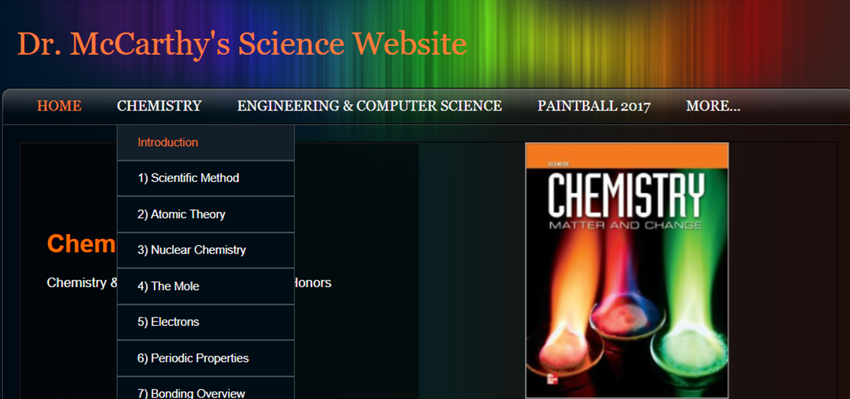
Where Are the Documents?
Write this in your notes
Go to the class website
http://drmccarthyscience.weebly.com/
Hover on the "Chemistry" tab
Click on the "Introduction" menu option

Slide 10
Where Are the Documents?
Write this in your notes
Go to the class website
http://drmccarthyscience.weebly.com/
Hover on the "Chemistry" tab
Click on the "Introduction" menu option
Click on each document
1
2
3

Slide 11
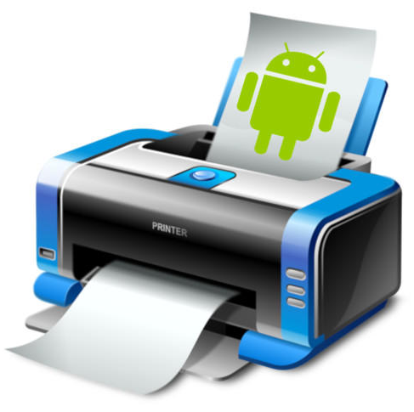
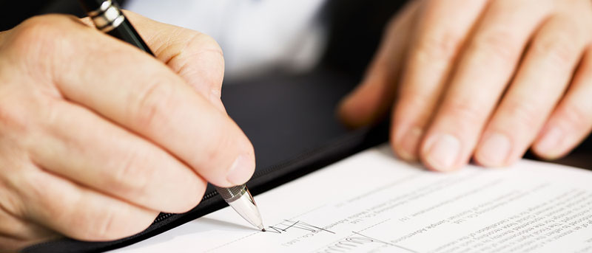
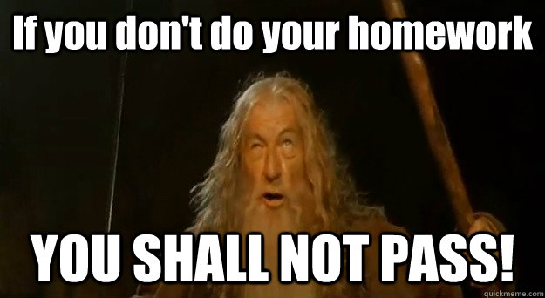
Signature Forms
Write this in your notes
Print the last page of each document
Have each signed by you and your parent or guardian
Turn in each document to me by this Friday, Aug 31st for 10 assignment points

Slide 12
Quizzes
Write this in your notes
We will have quizzes every Friday
This Friday’s quiz covers:
Safety
Typical Lesson and Unit
Grading Policies
Student Responsibilities
Class Rules & Procedures
You will read about them online
We will also learn about these in class

Slide 13
Introductions
Who am I?
Who are you?
What is chemistry?

Slide 14
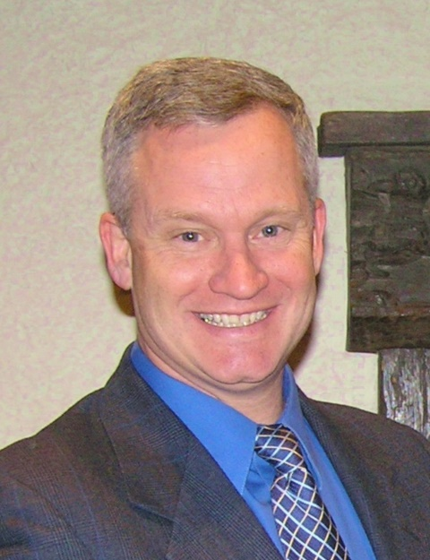
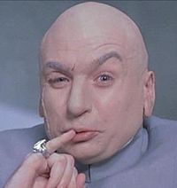
Who Am I?
Peter McCarthy
Most people call me “Doc”
Some students call me “Dr. Evil”

Slide 15
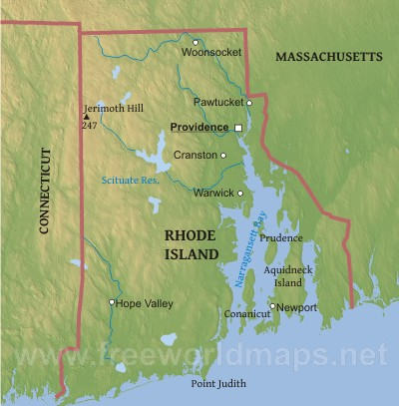
Scituate, RI
Boston, MA
Stonington, CT
West Greenwich, RI
I live in West Greenwich, RI
I raised my sons in Stonington, CT
I grew up mostly in the Boston area

Slide 16
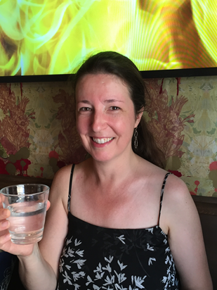
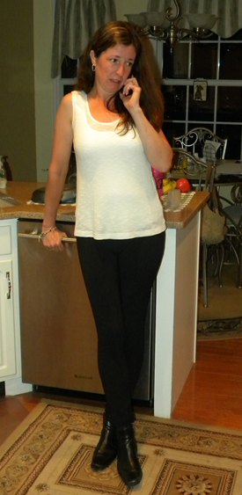
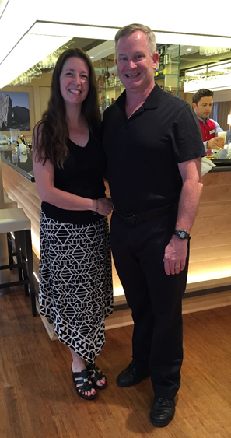
My lovely wife’s name is Maureen
She is a scientist (Biochemistry, URI)
She works at a drug company hunting down people making fake drugs

Slide 17
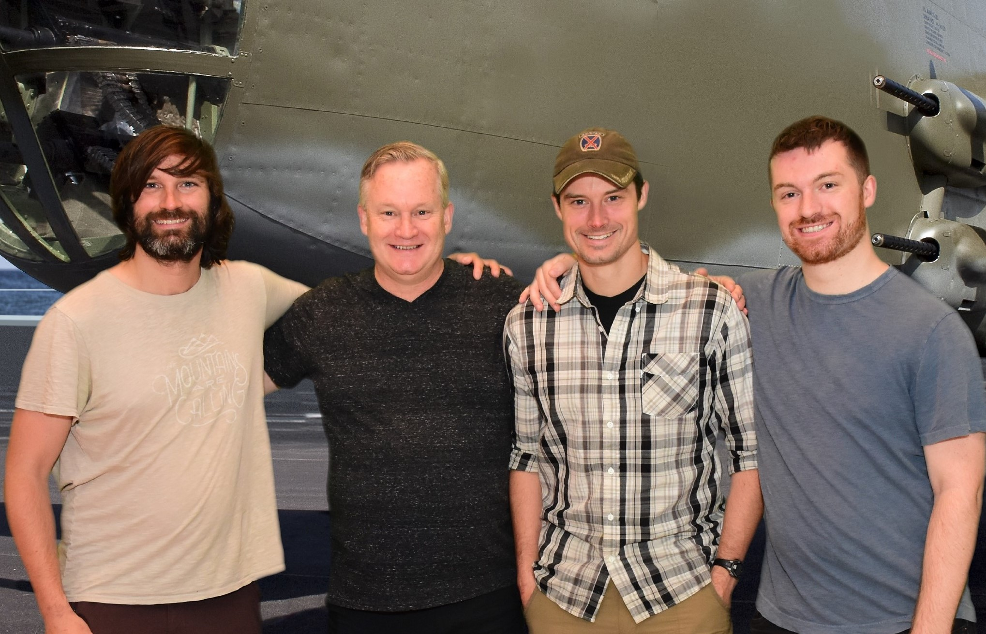
I have three sons:
Chris
Andrew
Marcus

Slide 18
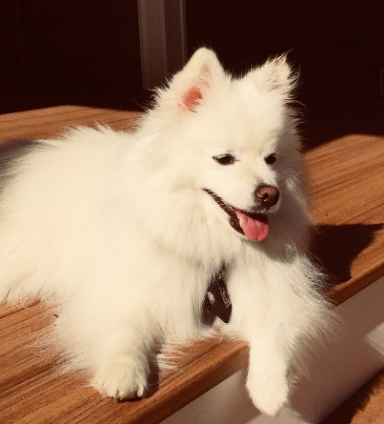
With my sons on their own, Maureen & I live with two dogs:
Marlena
Holly

Slide 19
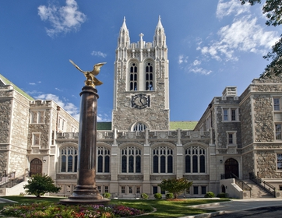
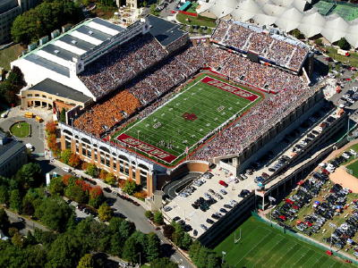
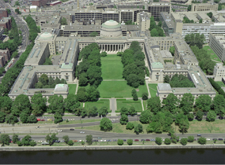
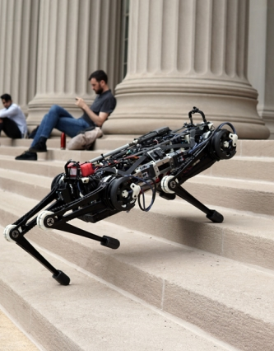
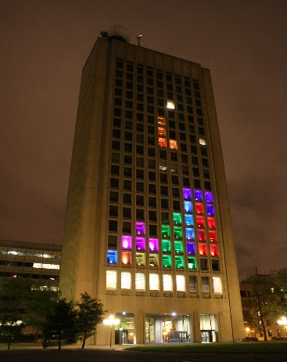
Educational Background
B.S. Chemistry, Boston College
Ph.D. Organic Chemistry, MIT

Slide 20
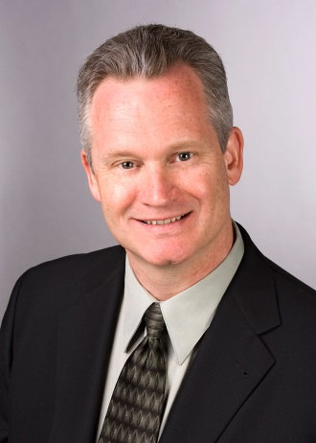
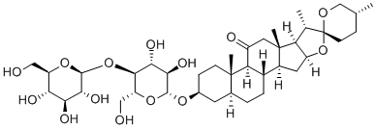
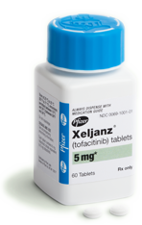
Professional Background
28 years of drug research

Slide 21
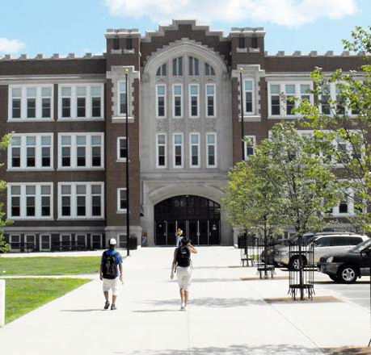
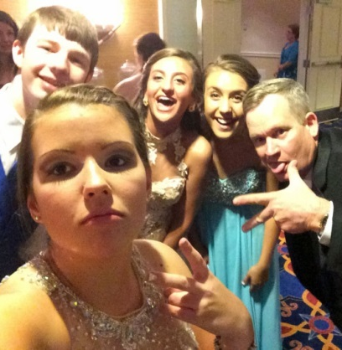
Professional Background
7 years of teaching

Slide 22
I hope we have a good year together
I would like to have a fun atmosphere in class
BUT . . .
I will push you hard, maybe harder than you’ve ever been pushed before
There will be times when you don’t like me very much
Still, I will never give up on you doing better
I see us as a team working together to get you ready for whatever you choose to do in your life
I will try to do my job as best as I can every day, and all I ask is that you do the same

Slide 23
Introductions
Who am I?
Who are you?
What is chemistry?

Slide 24
Who are you?
Paired Introduction
One minute to introduce your partner
Name
Where in Scituate they live
What they want to do in their life
One fun thing their did this summer
One interesting fact about them

Slide 25
Introductions
Who am I?
Who are you?
What is chemistry?

Slide 26
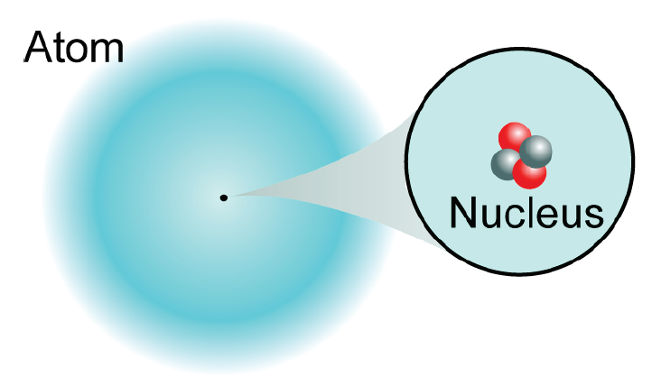
What is Chemistry?
Chemistry is the story of three particles
protons
neutrons
electrons
Everything in the universe is made of these three particles

Slide 27
We are going to learn the atomic theory
The properties of each particle
How they interact with each other
What kind of atoms exist
How we describe and name them
How humans learned this

Slide 28
Next we will learn about nuclear chemistry
What nuclei are stable?
What nuclei are unstable?
How do the unstable nuclei become stable?
How can we characterize and predict this behavior?
We will also learn to use the mole to count atoms by measuring their mass

Slide 29
From that point on, everything we learn will be about electrons
electrons
The vast majority of chemistry is concerned with electrons & their behavior

Slide 30
Electron theory will explain how we came to understand electrons
Periodic properties will show the repetitive attributes of atoms
Bonding will show how atoms share or transfer electrons to form multi-atom entities known as molecules
Nomenclature will explain how we name molecules
Chemical reactions will show how we change from one molecule to another
And much, much more if we have time

Slide 31
End

