Slide 1
Do Now
The cafeteria is asked to make a snack for parent conferences. The decide to make ham sandwiches and cut them into quarters to offer as a snack. Each sandwich will need two slices of bread and three slices of ham. If 160 snacks are needed, how many slices of bread and ham are needed?

Slide 2
Do Now
2 bread + 3 ham ----> 4 snacks
2 bread |  | 3 ham
4 snacks |  | 4 snacks
160 snacks | 2 bread | = | 80 slices of bread
 | 4 snacks
160 snacks | 3 ham | = | 120 slices of ham
 | 4 snacks

Slide 3
Announcements
Today is the start of . . .
the 3rd quarter
the 2nd semester
Participation grade
100 points per quarter (equivalent to 1 test)
Everyone gets the full 100 points at the beginning
Points deducted if
Not taking notes
Not doing in-class problems
Not going to board
Any off-task behaviors
Easy 100 points each quarter so long as you participate

Slide 4
Course Sequence
Introduction
Matter and Change
Measurement
Nomenclature
The Mole
Chemical Reactions
Atomic Theory
Electrons
Periodic Table
Bonding
Gas Laws
Gas Law Stoichiometry

Slide 5
Unit Outline
Introduction to Stoichiometry
Stoichiometric Calculations
Limiting Reactants
Percent Yield

Slide 6
Objective
Write this in your notes
SWBAT explain the concept of stoichiometry, and, using chemical equations, properly interpret stoichiometric relationships and determine mole ratios.

Slide 7
What is Stoichiometry?
reactants
products
number of atoms
in the reactants
=
number of atoms
in the products
mass of
the reactants
=
mass of
the products
Stoichiometry - the study of the quantitative relationship between the amounts of reactants used and the amounts of products formed by a chemical reaction
Write this in your notes

Slide 8
Interpreting Chemical Equations
4 Fe (s)
+
3 O₂ (g)
2 Fe₂O₃ (s)
Write this in your notes
Individual atoms and molecules
4 atoms
of Fe
+
3 molecules
of O₂
2 molecules
of Fe₂O₃
Moles
4 moles
of Fe
+
3 moles
of O₂
2 moles
of Fe₂O₃
Mass
??? g
of Fe
+
??? g
of O₂
??? g
of Fe₂O₃

Slide 9
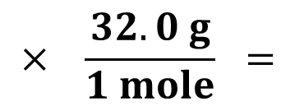
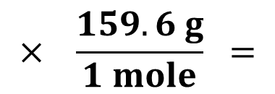
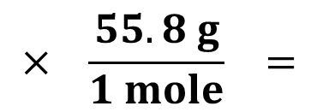
Converting Moles to Mass
4 moles of Fe
$$× \frac{55.8 g}{1 mole} =$$
223.2 g of Fe
3 moles of O₂
$$× \frac{32.0 g}{1 mole} =$$
96.0 g of O₂
2 moles of Fe₂O₃
$$× \frac{159.6 g}{1 mole} =$$
319.2 g of Fe₂O₃

Slide 10
Interpreting Chemical Equations
4 Fe (s)
+
3 O₂ (g)
2 Fe₂O₃ (s)
Write this in your notes
Individual atoms and molecules
4 atoms
of Fe
+
3 molecules
of O₂
2 molecules
of Fe₂O₃
Moles
4 moles
of Fe
+
3 moles
of O₂
2 moles
of Fe₂O₃
Mass
223.2 g
of Fe
+
96.0 g
of O₂
319.2 g
of Fe₂O₃

Slide 11
Check for Understanding
C₃H₈ + 5O₂ 4H₂O + 3CO₂
Interpret this chemical equation in terms of:
1) individual atoms or molecules
2) moles
3) mass

Slide 12
Check for Understanding
C₃H₈ + 5O₂ 4H₂O + 3CO₂
1 molecule
of C₃H₈
5 molecules
of O₂
4 molecules
of H₂O
3 molecules
of CO₂

Slide 13
Check for Understanding
C₃H₈ + 5O₂ 4H₂O + 3CO₂
1 molecule
of C₃H₈
5 molecules
of O₂
4 molecules
of H₂O
3 molecules
of CO₂
1 mole
of C₃H₈
5 moles
of O₂
4 moles
of H₂O
3 moles
of CO₂

Slide 14
Check for Understanding
C₃H₈ + 5O₂ 4H₂O + 3CO₂
1 molecule
of C₃H₈
5 molecules
of O₂
4 molecules
of H₂O
3 molecules
of CO₂
1 mole
of C₃H₈
5 moles
of O₂
4 moles
of H₂O
3 moles
of CO₂
44.09 g
of C₃H₈
160.0 g
of O₂
72.08
of H₂O
132.0 g
of CO₂

Slide 15
Check for Understanding
C₃H₈ + 5O₂ 4H₂O + 3CO₂
1 molecule
of C₃H₈
5 molecules
of O₂
4 molecules
of H₂O
3 molecules
of CO₂
1 mole
of C₃H₈
5 moles
of O₂
4 moles
of H₂O
3 moles
of CO₂
44.09 g
of C₃H₈
160.0 g
of O₂
72.08
of H₂O
132.0 g
of CO₂
204.1 g of reactants
204.1 g of products

Slide 16
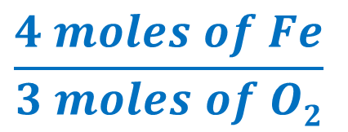
Molar Ratios
Write this in your notes
4 Fe (s)
+
3 O₂ (g)
2 Fe₂O₃ (s)
$$\frac{4 moles of Fe}{3 moles of O2}$$
$$\frac{3 moles of O2}{2 moles of Fe2O3}$$
$$\frac{4 moles of Fe}{2 moles of Fe2O3}$$

Slide 17
Check for Understanding
Write the molar ratios for all molecules in each chemical equation
4 Al (s)
+
3 O₂ (g)
2 Al₂O₃ (s)
2 HgO (s)
2 Hg (l)
+
O₂ (g)
3 Fe (s)
+
4 H₂O (l)
Fe₃O₄ (s)
+
4 H₂ (g)

Slide 18
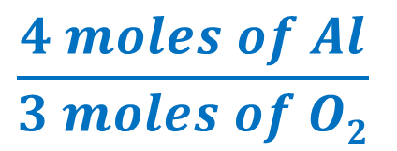
Molar Ratios
4 Al (s)
+
3 O₂ (g)
2 Al₂O₃ (s)
$$\frac{4 moles of Al}{3 moles of O2}$$
$$\frac{3 moles of O2}{2 moles of Al2O3}$$
$$\frac{4 moles of Al}{2 moles of Al2O3}$$

Slide 19
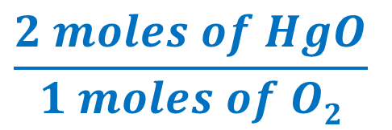
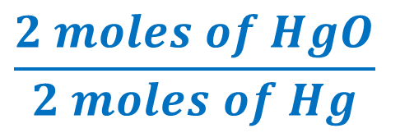
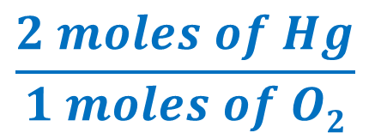
Molar Ratios
2 HgO (s)
2 Hg (l)
+
O₂ (g)
$$\frac{2 moles of HgO}{2 moles of Hg}$$
$$\frac{2 moles of HgO}{1 moles of O2}$$
$$\frac{2 moles of Hg}{1 moles of O2}$$

Slide 20
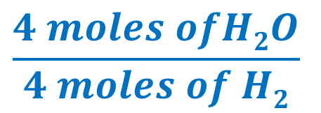
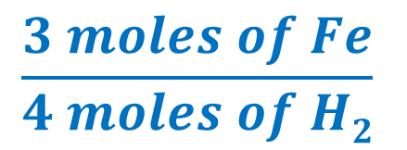
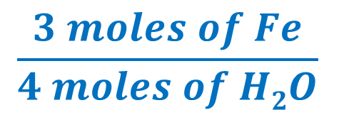
Molar Ratios
3 Fe (s)
+
4 H₂O (l)
Fe₃O₄ (s)
+
4 H₂ (g)
$$\frac{3 moles of Fe}{4 moles of H2O}$$
$$\frac{4 moles ofH2O}{1 moles of Fe3O4}$$
$$\frac{3 moles of Fe}{1 moles of Fe3O4}$$
$$\frac{4 moles ofH2O}{4 moles of H2}$$
$$\frac{3 moles of Fe}{4 moles of H2}$$
$$\frac{1 moles of Fe3O4}{4 moles of H2}$$

Slide 21
Objective
SWBAT explain the concept of stoichiometry, and, using chemical equations, properly interpret stoichiometric relationships and determine mole ratios.

