Slide 1
Do Now
Put homework in the red basket
Identify the reaction type(s)
C₆H₁₂ + 9 O₂ → 6 CO₂ + 6 H₂O
Cl₂ + 2KBr → Br₂ + 2KCl
NaOH + KNO₃ → NaNO₃ + KOH
2H₂ + O₂ → 2H₂O
Will this reaction go forward? Why or why not? If so, balance the equation.
Mg + FeCl₃ →
combustion
single
replacement
double
replacement
synthesis & combustion

Slide 2
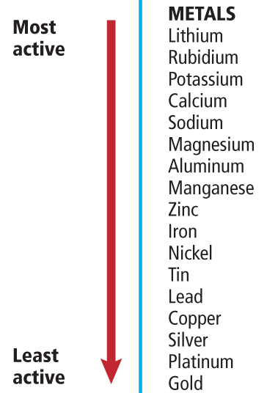
Do Now
Will this reaction go forward? Why or why not? If so, balance the equation.
Mg + FeCl₃ →

Slide 3
Do Now
Will this reaction go forward? Why or why not? If so, balance the equation.
3Mg + 2FeCl₃ → 2Fe + 3MgCl₂

Slide 4
Do Now
Will this reaction go forward? Why or why not? If so, balance the equation.
3Mg + 2FeCl₃ → 2Fe + 3MgCl₂

Slide 5
Test #9: Chemical Reactions
Test Format
Honors Chem: 25 open response
Chem: 5 multiple choice, 15 open response
Test will be shortened if we don't finish this unit
Date
Periods 3, 4, 7: Friday, June 3, 2016
Period 6: Monday, June 6, 2016

Slide 6
Aqueous Solutions
Write this in your notes
SWBAT describe aqueous double replacement reactions in terms of chemical equations, complete ionic equations and net ionic equations.

Slide 7
Last Class

Slide 8
Vocabulary of Solutions
Write this in your notes
solution
a uniform mixture that can contain solids, liquids or gasses.
solute
one or more substances dissolved in a solution
solvent
the substance that dissolves the solute to form the solution
Example: Salt water is a solution
Salt is the solute
Water is the solvent

Slide 9
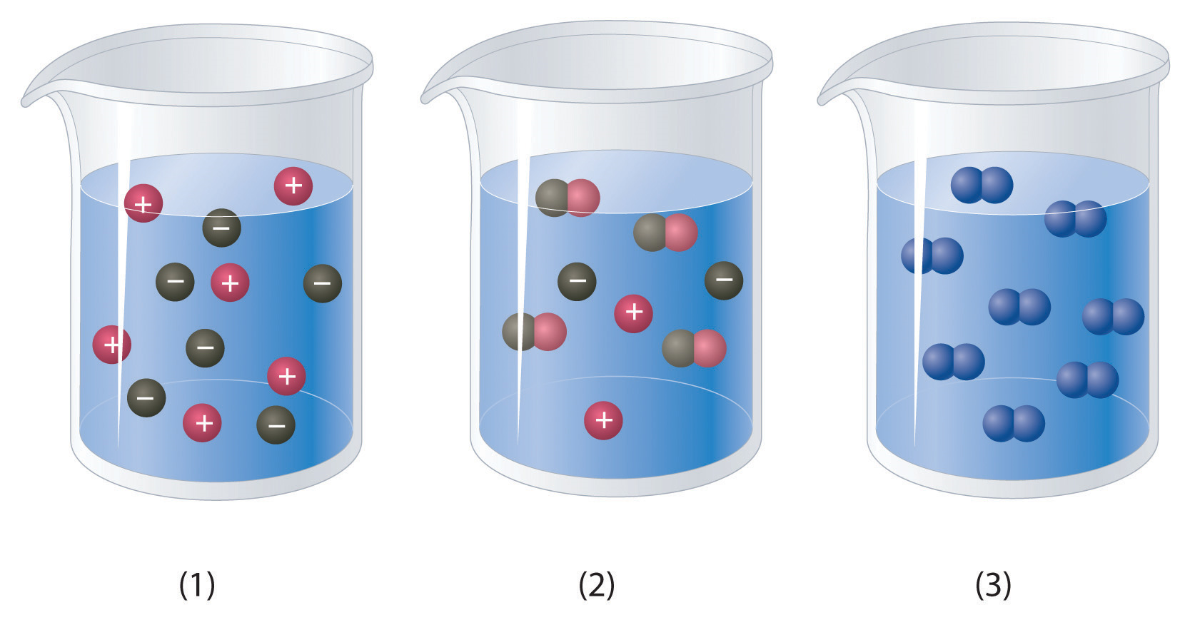
Aqueous Solutions
Write this in your notes
An aqueous solution contains one or more dissolved substances (called solutes) in water.
Water is the solvent.

Slide 10
Solutes in Aqueous Solutions
Solutes can behave differently in aqueous solutions
Molecular (covalent) compounds will remain as a unit in aqueous solutions
sucrose
ethanol
Ionic compounds will separate (dissociate) into ions in aqueous solutions
sodium chloride
hydrochloric acid
Write this in your notes
Write this in your notes

Slide 11
Which is Ionic? Which is Covalent?
Ionic
Covalent
(molecular)

Slide 12
Acids and Bases
Ionic compounds that dissociate H⁺ ions are called acids
Ionic compounds that dissociate OH– ions are called bases
Write this in your notes

Slide 13
Representing Ionic Reactions
Reactions in aqueous solutions are represented three ways
Chemical Equations
Complete Ionic Equations
Net Ionic Equations
Write this in your notes

Slide 14
Chemical Equation
Aqueous solutions of sodium hydroxide and copper(II) chloride react to form the precipitate copper(II) hydroxide.
Unbalanced Chemical Equation
NaOH(aq) + CuCl₂(aq) → NaCl(aq) + Cu(OH)₂(s)
Balanced Chemical Equation
2NaOH(aq) + CuCl₂(aq) → 2NaCl(aq) + Cu(OH)₂(s)

Slide 15
Complete Ionic Equations
2NaOH(aq) + CuCl₂(aq) → 2NaCl(aq) + Cu(OH)₂(s)
To help understand reactions, it can be useful to show the ions separated from each other.
Ionic equations that show all of the particles in a solution as they actually exist are called complete ionic equations.
Write this in your notes
2Na⁺(aq) + 2OH–(aq) + Cu²⁺ (aq)+ 2Cl–(aq) →
2Na⁺(aq) + 2Cl–(aq) + Cu(OH)₂(s)

Slide 16
Spectator Ions
2Na⁺(aq) + 2OH–(aq) + Cu²⁺ (aq)+ 2Cl–(aq) →
2Na⁺(aq) + 2Cl–(aq) + Cu(OH)₂(s)
Note that Na⁺ and Cl– are present in unchanged in both the reactants and products.
Write this in your notes
Ions that do not participate in a reaction are called spectator ions

Slide 17
Net Ionic Equations
2Na⁺(aq) + 2OH–(aq) + Cu²⁺ (aq)+ 2Cl–(aq) →
2Na⁺(aq) + 2Cl–(aq) + Cu(OH)₂(s)
To simplify ionic equations, spectator ions are sometimes not written
Write this in your notes
Equations that include only the particles that participate in reactions are called net ionic equations.
2OH–(aq) + Cu²⁺(aq) → Cu(OH)₂(s)

Slide 18
Three Different Representations
Write this in your notes
Chemical Equation
2NaOH(aq) + CuCl₂(aq) → 2NaCl(aq) + Cu(OH)₂(s)
Complete Ionic Equation
2Na⁺(aq) + 2OH–(aq) + Cu²⁺ (aq)+ 2Cl–(aq) →
2Na⁺(aq) + 2Cl–(aq) + Cu(OH)₂(s)
Net Ionic Equation
2OH–(aq) + Cu²⁺(aq) → Cu(OH)₂(s)

Slide 19
Reactions in Aqueous Solutions
When two solutions that contain ions as solutes are combined, the ions might react.
If they react, it is always a double replacement reaction.
Three products can form:
precipitates
water
gases
This provides the driving force for the reaction to occur - without a driving force, NO REACTION
Write this in your notes

Slide 20
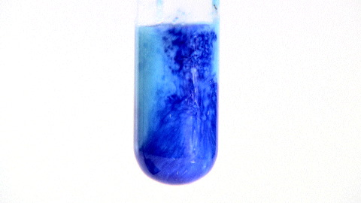
Precipitates Produced
Some reactions produce precipitates
The appearance of the precipitate is evidence that the reaction has occurred.
2NaOH(aq) + CuCl₂(aq) → 2NaCl(aq) + Cu(OH)₂(s)

Slide 21
Water Produced
Some reactions produce more water molecules.
No evidence of a chemical reaction is observable.
HBr(aq) + NaOH(aq) → H₂O(l) + NaBr(aq)
Without spectator ions
H⁺(aq) + OH–(aq) → H₂O(l)
This is also neutralization reaction because an acid (H⁺) and a base (OH–) combine to form water, a neutral molecule.
Write this in your notes

Slide 22
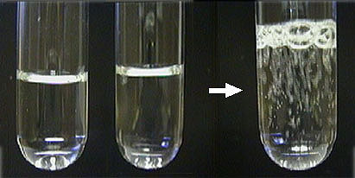
Gas Produced
Some reactions produce gasses
The release of gas bubbles is evidence that the reaction has occurred.
Gases that are commonly produced are carbon dioxide, hydrogen cyanide, and hydrogen sulfide.
2HI(aq) + Li₂S(aq) → H₂S(g) + 2LiI(aq)

Slide 23
Example
Write chemical, complete ionic, and net ionic equations for each of the following reactions. Use NR to indicate that no reaction occurs.
Aqueous solutions of barium nitrate and sodium carbonate are mixed forming the precipitate barium carbonate

Slide 24
Example
Write chemical, complete ionic, and net ionic equations for each of the following reactions. Use NR to indicate that no reaction occurs.
Aqueous solutions of barium nitrate and sodium carbonate are mixed forming the precipitate barium carbonate
Ba(NO₃)₂(aq) + Na₂CO₃(aq) à NaNO₃(aq) + BaCO₃(s)

Slide 25
Example
Write chemical, complete ionic, and net ionic equations for each of the following reactions. Use NR to indicate that no reaction occurs.
Aqueous solutions of barium nitrate and sodium carbonate are mixed forming the precipitate barium carbonate
Ba(NO₃)₂(aq) + Na₂CO₃(aq) à NaNO₃(aq) + BaCO₃(s)
Ba(NO₃)₂(aq) + Na₂CO₃(aq) à 2NaNO₃(aq) + BaCO₃(s)

Slide 26
Example
Write chemical, complete ionic, and net ionic equations for each of the following reactions. Use NR to indicate that no reaction occurs.
Aqueous solutions of barium nitrate and sodium carbonate are mixed forming the precipitate barium carbonate
Ba(NO₃)₂(aq) + Na₂CO₃(aq) à NaNO₃(aq) + BaCO₃(s)
Ba(NO₃)₂(aq) + Na₂CO₃(aq) à 2NaNO₃(aq) + BaCO₃(s)
Ba⁺²(aq) + 2NO₃–(aq) + 2Na⁺(aq) + CO₃^{–2}(aq) à
2Na⁺(aq) + 2NO₃–(aq) + BaCO₃(s)

Slide 27
Example
Write chemical, complete ionic, and net ionic equations for each of the following reactions. Use NR to indicate that no reaction occurs.
Aqueous solutions of barium nitrate and sodium carbonate are mixed forming the precipitate barium carbonate
Ba(NO₃)₂(aq) + Na₂CO₃(aq) à NaNO₃(aq) + BaCO₃(s)
Ba(NO₃)₂(aq) + Na₂CO₃(aq) à 2NaNO₃(aq) + BaCO₃(s)
Ba⁺²(aq) + 2NO₃–(aq) + 2Na⁺(aq) + CO₃^{–2}(aq) à
2Na⁺(aq) + 2NO₃–(aq) + BaCO₃(s)
Ba⁺²(aq) + CO₃^{–2}(aq) à BaCO₃(s)

Slide 28
Homework
pg 302, problems 35, 36, 38 & 39

Slide 29
Reactions in Aqueous Solutions
When two solutions that contain ions as solutes are combined, the ions might react.
If they react, it is always a double replacement reaction.
Three products can form:
precipitates
water
gases
This provides the driving force for the reaction to occur - without a driving force, NO REACTION
Write this in your notes

Slide 30
Two Step Process
Aqueous double displacement reactions are driven by the production of a precipitate, water or a gas.
Sometimes these products are created through a two-step process.
An example is mixing acid and baking soda, which produces carbon dioxide gas.
Step 1: Double displacement reaction
Step 2: Decomposition reaction

Slide 31
Two Step Process
Acid and baking soda react to produce carbon dioxide gas.
Step 1: Double displacement reaction
HCl(aq) + NaHCO₃(aq) → H₂CO₃(aq) + NaCl(aq)
Step 2: Decomposition reaction
H₂CO₃(aq) decomposes immediately.
H₂CO₃(aq) → H₂O(l) + CO₂(g)

Slide 32
Two Step Process
Two reactions can be combined and represented by a single chemical reaction.

Slide 33
Representation
Reaction 1
HCl(aq) + NaHCO₃(aq) → H₂CO₃(aq) + NaCl(aq)
Reaction 2
H₂CO₃(aq) → H₂O(l) + CO₂(g)
Combined equation
HCl(aq) + NaHCO₃(aq) + H₂CO₃(aq) →
H₂CO₃(aq) + NaCl(aq) + H₂O(l) + CO₂(g)
Overall equation
HCl(aq) + NaHCO₃(aq) → NaCl(aq) + H₂O(l) + CO₂(g)

Slide 34
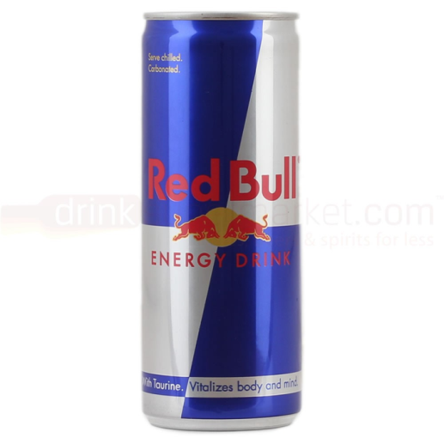
Homework Review Do Now
Put homework in the red basket
Red Bull is a solution. Name
the solvent and two solutes.
What is the difference between the following:
a chemical equation
a complete ionic equation
a net ionic equation
Aqueous double replacement reactions must produce one of three products to go forward. What are these three products?

Slide 35
Homework Answers

Slide 36
Check for Understanding
Write chemical, complete ionic, and net ionic equations for each of the following reactions. Use NR to indicate that no reaction occurs.
Aqueous solutions of potassium iodide and silver nitrate are mixed forming the precipitate silver iodide.
pg 302, #35

Slide 37
Check for Understanding
Write chemical, complete ionic, and net ionic equations for each of the following reactions. Use NR to indicate that no reaction occurs.
Aqueous solutions of potassium iodide and silver nitrate are mixed forming the precipitate silver iodide.
KI(aq) + AgNO₃(aq) à KNO₃(aq) + AgI(s)
pg 302, #35

Slide 38
Check for Understanding
Write chemical, complete ionic, and net ionic equations for each of the following reactions. Use NR to indicate that no reaction occurs.
Aqueous solutions of potassium iodide and silver nitrate are mixed forming the precipitate silver iodide.
KI(aq) + AgNO₃(aq) à KNO₃(aq) + AgI(s)
K⁺(aq) + I–(aq) + Ag⁺(aq) + NO₃–(aq)
à K⁺(aq) + NO₃–(aq) + AgI(s)
pg 302, #35

Slide 39
Check for Understanding
Write chemical, complete ionic, and net ionic equations for each of the following reactions. Use NR to indicate that no reaction occurs.
Aqueous solutions of potassium iodide and silver nitrate are mixed forming the precipitate silver iodide.
KI(aq) + AgNO₃(aq) à KNO₃(aq) + AgI(s)
K⁺(aq) + I–(aq) + Ag⁺(aq) + NO₃–(aq)
à K⁺(aq) + NO₃–(aq) + AgI(s)
I–(aq) + Ag⁺(aq) à AgI(s)
pg 302, #35

Slide 40
Check for Understanding
Write chemical, complete ionic, and net ionic equations for each of the following reactions. Use NR to indicate that no reaction occurs.
Aqueous solutions of ammonium phosphate and sodium sulfate are mixed. No precipitate or gas is formed
pg 302, #36

Slide 41
Check for Understanding
Write chemical, complete ionic, and net ionic equations for each of the following reactions. Use NR to indicate that no reaction occurs.
Aqueous solutions of ammonium phosphate and sodium sulfate are mixed. No precipitate or gas is formed
(NH₄)₃PO₄(aq) + Na₂SO₄(aq) à (NH₄)₂SO₄(aq) + Na₃PO₄(aq)
pg 302, #36

Slide 42
Check for Understanding
Write chemical, complete ionic, and net ionic equations for each of the following reactions. Use NR to indicate that no reaction occurs.
Aqueous solutions of ammonium phosphate and sodium sulfate are mixed. No precipitate or gas is formed
(NH₄)₃PO₄(aq) + Na₂SO₄(aq) à (NH₄)₂SO₄(aq) + Na₃PO₄(aq)
2(NH₄)₃PO₄(aq) + 3Na₂SO₄(aq)
à 3(NH₄)₂SO₄(aq) + 2Na₃PO₄(aq)
pg 302, #36

Slide 43
Check for Understanding
Write chemical, complete ionic, and net ionic equations for each of the following reactions. Use NR to indicate that no reaction occurs.
Aqueous solutions of ammonium phosphate and sodium sulfate are mixed. No precipitate or gas is formed
(NH₄)₃PO₄(aq) + Na₂SO₄(aq) à (NH₄)₂SO₄(aq) + Na₃PO₄(aq)
2(NH₄)₃PO₄(aq) + 3Na₂SO₄(aq)
à 3(NH₄)₂SO₄(aq) + 2Na₃PO₄(aq)
6NH₄⁺(aq) + 2PO₄^{–3}(aq) + 6Na⁺(aq) + 3SO₄^{–2}(aq)
à 6NH₄⁺(aq) + 2PO₄^{–3}(aq) + 6Na⁺(aq) + 3SO₄^{–2}(aq)
pg 302, #36

Slide 44
Check for Understanding
Write chemical, complete ionic, and net ionic equations for each of the following reactions. Use NR to indicate that no reaction occurs.
Aqueous solutions of ammonium phosphate and sodium sulfate are mixed. No precipitate or gas is formed
(NH₄)₃PO₄(aq) + Na₂SO₄(aq) à (NH₄)₂SO₄(aq) + Na₃PO₄(aq)
2(NH₄)₃PO₄(aq) + 3Na₂SO₄(aq)
à 3(NH₄)₂SO₄(aq) + 2Na₃PO₄(aq)
6NH₄⁺(aq) + 2PO₄^{–3}(aq) + 6Na⁺(aq) + 3SO₄^{–2}(aq)
à 6NH₄⁺(aq) + 2PO₄^{–3}(aq) + 6Na⁺(aq) + 3SO₄^{–2}(aq)
NR
pg 302, #36

Slide 45
Check for Understanding
Write chemical, complete ionic, and net ionic equations for each of the following reactions. Use NR to indicate that no reaction occurs.
Aqueous solutions of lithium sulfate and calcium nitrate are mixed forming the precipitate calcium sulfate
pg 302, #38

Slide 46
Check for Understanding
Write chemical, complete ionic, and net ionic equations for each of the following reactions. Use NR to indicate that no reaction occurs.
Aqueous solutions of lithium sulfate and calcium nitrate are mixed forming the precipitate calcium sulfate
Li₂SO₄(aq) + Ca(NO₃)₂(aq) à LiNO₃(aq) + CaSO₄(s)
pg 302, #38

Slide 47
Check for Understanding
Write chemical, complete ionic, and net ionic equations for each of the following reactions. Use NR to indicate that no reaction occurs.
Aqueous solutions of lithium sulfate and calcium nitrate are mixed forming the precipitate calcium sulfate
Li₂SO₄(aq) + Ca(NO₃)₂(aq) à LiNO₃(aq) + CaSO₄(s)
Li₂SO₄(aq) + Ca(NO₃)₂(aq) à 2LiNO₃(aq) + CaSO₄(s)
pg 302, #38

Slide 48
Check for Understanding
Write chemical, complete ionic, and net ionic equations for each of the following reactions. Use NR to indicate that no reaction occurs.
Aqueous solutions of lithium sulfate and calcium nitrate are mixed forming the precipitate calcium sulfate
Li₂SO₄(aq) + Ca(NO₃)₂(aq) à LiNO₃(aq) + CaSO₄(s)
Li₂SO₄(aq) + Ca(NO₃)₂(aq) à 2LiNO₃(aq) + CaSO₄(s)
2Li⁺(aq) + SO₄^{–2}(aq) + Ca⁺²(aq) + 2NO₃– (aq) à
2Li⁺(aq) + 2NO₃–(aq) + CaSO₄(s)
pg 302, #38

Slide 49
Check for Understanding
Write chemical, complete ionic, and net ionic equations for each of the following reactions. Use NR to indicate that no reaction occurs.
Aqueous solutions of lithium sulfate and calcium nitrate are mixed forming the precipitate calcium sulfate
Li₂SO₄(aq) + Ca(NO₃)₂(aq) à LiNO₃(aq) + CaSO₄(s)
Li₂SO₄(aq) + Ca(NO₃)₂(aq) à 2LiNO₃(aq) + CaSO₄(s)
2Li⁺(aq) + SO₄^{–2}(aq) + Ca⁺²(aq) + 2NO₃– (aq) à
2Li⁺(aq) + 2NO₃–(aq) + CaSO₄(s)
SO₄^{–2}(aq) + Ca⁺²(aq) à CaSO₄(s)
pg 302, #38

Slide 50
Check for Understanding
Write chemical, complete ionic, and net ionic equations for each of the following reactions. Use NR to indicate that no reaction occurs.
Aqueous solutions of sodium carbonate and manganese (V) chloride react to produce a precipitate that contains manganese
pg 302, #39

Slide 51
Check for Understanding
Write chemical, complete ionic, and net ionic equations for each of the following reactions. Use NR to indicate that no reaction occurs.
Aqueous solutions of sodium carbonate and manganese (V) chloride react to produce a precipitate that contains manganese
Na₂CO₃(aq) + MnCl₅(aq) à NaCl(aq) + Mn₂(CO₃)₅(s)
pg 302, #39

Slide 52
Check for Understanding
Write chemical, complete ionic, and net ionic equations for each of the following reactions. Use NR to indicate that no reaction occurs.
Aqueous solutions of sodium carbonate and manganese (V) chloride react to produce a precipitate that contains manganese
Na₂CO₃(aq) + MnCl₅(aq) à NaCl(aq) + Mn₂(CO₃)₅(s)
5Na₂CO₃(aq) + 2MnCl₅(aq) à 10NaCl(aq) + Mn₂(CO₃)₅(s)
pg 302, #39

Slide 53
Check for Understanding
Write chemical, complete ionic, and net ionic equations for each of the following reactions. Use NR to indicate that no reaction occurs.
Aqueous solutions of sodium carbonate and manganese (V) chloride react to produce a precipitate that contains manganese
Na₂CO₃(aq) + MnCl₅(aq) à NaCl(aq) + Mn₂(CO₃)₅(s)
5Na₂CO₃(aq) + 2MnCl₅(aq) à 10NaCl(aq) + Mn₂(CO₃)₅(s)
10Na⁺(aq) + 5CO₃^{–2}(aq) + 2Mn⁺⁵(aq) + 10Cl–(aq)
à10Na⁺(aq) + 10Cl–(aq) + Mn₂(CO₃)₅(s)
pg 302, #39

Slide 54
Check for Understanding
Write chemical, complete ionic, and net ionic equations for each of the following reactions. Use NR to indicate that no reaction occurs.
Aqueous solutions of sodium carbonate and manganese (V) chloride react to produce a precipitate that contains manganese
Na₂CO₃(aq) + MnCl₅(aq) à NaCl(aq) + Mn₂(CO₃)₅(s)
5Na₂CO₃(aq) + 2MnCl₅(aq) à 10NaCl(aq) + Mn₂(CO₃)₅(s)
10Na⁺(aq) + 5CO₃^{–2}(aq) + 2Mn⁺⁵(aq) + 10Cl–(aq)
à10Na⁺(aq) + 10Cl–(aq) + Mn₂(CO₃)₅(s)
5CO₃^{–2}(aq) + 2Mn⁺⁵(aq) à Mn₂(CO₃)₅(s)
pg 302, #39

Slide 55
Multiple Choice Questions

Slide 56
What is the solvent in an aqueous solution?
A. hydrogen
B. sodium ions
C. water
D. alcohol

Slide 57
An equation that includes only the particles that participate in a reaction is called:
A. net ionic equation
B. spectator ions
C. complete ionic equation
D. reduced ionic equation

Slide 58
CHAPTER9
Chemical Reactions
Chapter Assessment
Ions that are present in a solution and do not participate in a chemical reaction when another substance is added are called ____.
A. spectator ions
B. reactants
C. products
D. net ions

Slide 59
CHAPTER9
Chemical Reactions
Standardized Test Practice
A precipitate forms in a double replacement reaction only if:
A. the reactivities of the compounds differ
B. the new compound is denser than water
C. the new compound is soluble in water
D. the new compound is not soluble in water

Slide 60
Backups

Slide 61
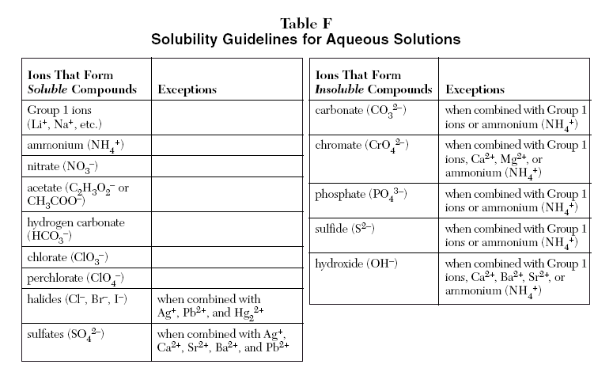

Slide 62
Three Different Representations
Chemical Equation
2NaOH(aq) + CuCl₂(aq) → 2NaCl(aq) + Cu(OH)₂(s)
Complete Ionic Equation
2Na⁺(aq) + 2OH–(aq) + Cu²⁺ (aq)+ 2Cl–(aq) →
2Na⁺(aq) + 2Cl–(aq) + Cu(OH)₂(s)
Net Ionic Equation
2OH–(aq) + Cu²⁺(aq) → Cu(OH)₂(s)

Slide 63
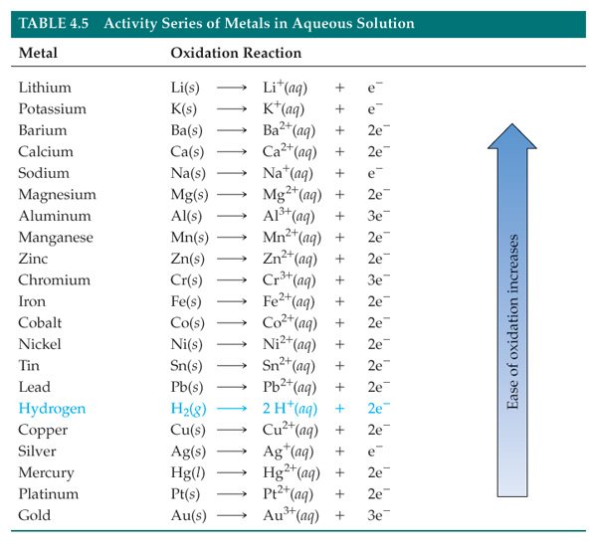

Slide 64
