Slide 1
Do Now
The Student Council wants bouquets for the buffet tables at the Winter Ball. Dr. Sollitto agrees to pay for them so long as everything purchased is used.
The council decides on an elegant bouquet with a single red rose and four stalks of baby's breath. Red roses can only be bought by the dozen, and the baby's breath can only be bought in bunches of 16 stalks. You are put in charge of this purchase & must make sure everything purchased is used.
How many dozen red roses should you buy?
How many bunches of baby's breath should you buy?
How many bouquets will you be able to make without wasting anything?

Slide 2
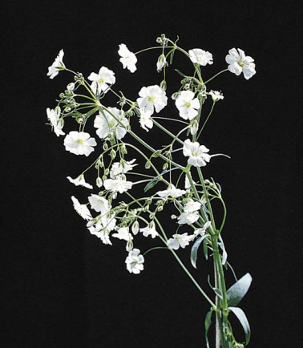
+
Roses
purchased by the dozen
Baby's breath
purchased in bunches of 16
Bouquet
requires 1 rose & 4 stalks of baby's breath

Slide 3
+
Roses
purchased by the dozen
Baby's breath
purchased in bunches of 16
Bouquet
requires 1 rose & 4 stalks of baby's breath
Ro₁₂

Slide 4
+
Roses
purchased by the dozen
Baby's breath
purchased in bunches of 16
Bouquet
requires 1 rose & 4 stalks of baby's breath
Ro₁₂
Use Ro as a symbol to represent roses

Slide 5
+
Roses
purchased by the dozen
Baby's breath
purchased in bunches of 16
Bouquet
requires 1 rose & 4 stalks of baby's breath
Ro₁₂
Use subscript 12 to indicate that the roses only come in groups of 12

Slide 6
+
Roses
purchased by the dozen
Baby's breath
purchased in bunches of 16
Bouquet
requires 1 rose & 4 stalks of baby's breath
Ro₁₂ + 3Bb₁₆ 12RoBb₄

Slide 7
+
Roses
purchased by the dozen
Baby's breath
purchased in bunches of 16
Bouquet
requires 1 rose & 4 stalks of baby's breath
Ro₁₂ + 3Bb₁₆ 12RoBb₄

Slide 8
+
Roses
purchased by the dozen
Baby's breath
purchased in bunches of 16
Bouquet
requires 1 rose & 4 stalks of baby's breath
Ro₁₂ + 3Bb₁₆ 12RoBb₄

Slide 9
Do Now
Ro₁₂ + 3Bb₁₆ 12RoBb₄

Slide 10
Do Now
Ro₁₂ + 3Bb₁₆ 12RoBb₄
flower | purchased | used
Ro
Bb

Slide 11
Do Now
Ro₁₂ + 3Bb₁₆ 12RoBb₄
flower | purchased | used
Ro | 12
Bb | 16
Buy the minimum number of roses and baby's breath.

Slide 12
Do Now
Ro₁₂ + 3Bb₁₆ 12RoBb₄
flower | purchased | used
Ro | 12 | 1
Bb | 16 | 4
Make one bouquet.

Slide 13
Do Now
Ro₁₂ + 3Bb₁₆ 12RoBb₄
flower | purchased | used
Ro | 12 | 1
Bb | 16 | 4
11 roses and 12 baby's breath are wasted!!!
Dr. Sollitto will not approve.

Slide 14
Do Now
Ro₁₂ + 3Bb₁₆ 12RoBb₄
flower | purchased | used
Ro | 12 | 12
Bb
Use all 12 roses and make 12 bouquets.

Slide 15
Do Now
Ro₁₂ + 3Bb₁₆ 12RoBb₄
flower | purchased | used
Ro | 12 | 12
Bb |  | ???
How many bunches of baby's breath are needed to make 12 bouquets???

Slide 16
Do Now
Ro₁₂ + 3Bb₁₆ 12RoBb₄
flower | purchased | used
Ro | 12 | 12
Bb |  | 48
You need 48 stalks to make 12 bouquets (each bouquet needs 4 stalks)

Slide 17
Do Now
Ro₁₂ + 3Bb₁₆ 12RoBb₄
flower | purchased | used
Ro | 12 | 12
Bb | 48 | 48
If you buy 3 bunches of baby's breath, you will have 48. This is enough to make all 12 bouquets and nothing will be wasted

Slide 18
Do Now
Ro₁₂ + 3Bb₁₆ 12RoBb₄
flower | purchased | used
Ro | 12 | 12
Bb | 48 | 48
How many dozen red roses should you buy?
1 dozen red roses
How many bunches of baby's breath should you buy?
3 bunches of baby's breath
How many bouquets will you be able to make without wasting anything?
12 bouquets can be made

Slide 19
Do Now
Ro₁₂ + 3Bb₁₆ 12RoBb₄
flower | purchased | used
Ro | 12 | 12
Bb | 48 | 48
This is the same process used for balancing chemical equations.

Slide 20
Test #9: Chemical Reactions
Test Format
Honors Chem: 25 open response
Chem: 5 multiple choice, 15 open response
Test will be shortened if we don't finish this unit
Date
Periods 3, 4, 7: Friday, June 3, 2016
Period 6: Monday, June 6, 2016

Slide 21
Balancing Chemical Equations
Write this in your notes
SWBAT balance chemical equations.

Slide 22
Last Class

Slide 23
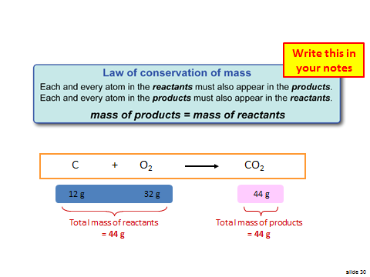
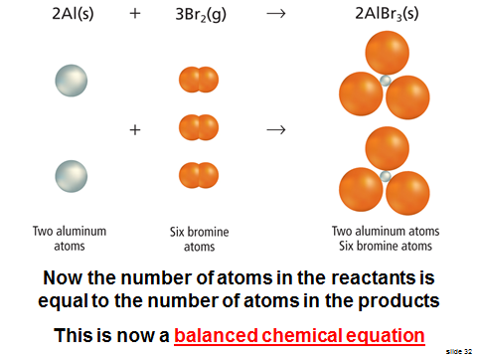
Balanced Chemical Equations

Slide 24
How do we balance chemical equations?
Write this in your notes
By adjusting the coefficients in front of each reactant and product until:
number of atoms
in the reactants
=
number of atoms
in the products

Slide 25
Key Point
When balancing a chemical equation, only coefficients can be changed
Subscripts must remain the same

Slide 26
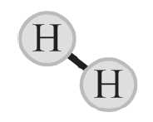
Write this in your notes
2H₂
Subscript tells how many atoms in 1 molecule
Hydrogen gas

Slide 27
Write this in your notes
Coefficient tells how many molecules are involved
2H₂
Hydrogen gas

Slide 28
Write this in your notes
Coefficient tells how many molecules are involved
2H₂
Subscript tells how many atoms in 1 molecule
Hydrogen gas
When balancing a chemical equation, only coefficients can be changed
Subscripts must remain the same

Slide 29
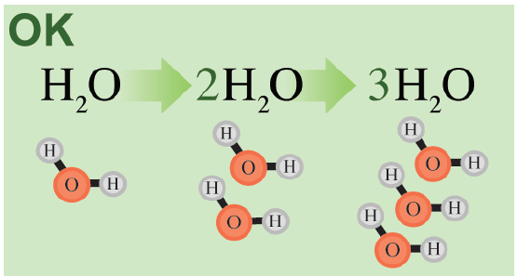
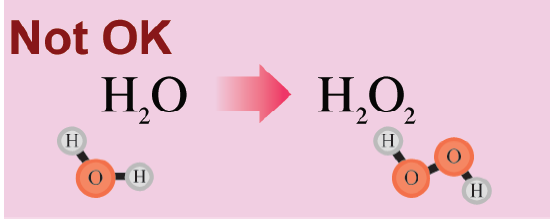

Slide 30
Steps to Balance a Chemical Equation
Write this in your notes
Write the skeleton equation
Write an element inventory
Working with one element at a time, change coefficients until element is balanced
Repeat until all elements are balanced
Very Important
Update the element inventory after each coefficient change!!!

Slide 31
Example
Write this in your notes
Propane and oxygen
react to produce
water and carbon dioxide

Slide 32
Example
Write this in your notes
Propane and oxygen
react to produce
water and carbon dioxide
1) Write the skeleton equation

Slide 33
Example
Write this in your notes
Propane and oxygen
react to produce
water and carbon dioxide
C₃H₈ + 5O₂ 4H₂O + 3CO₂
1) Write the skeleton equation

Slide 34
Example
Write this in your notes
C₃H₈ + 5O₂ 4H₂O + 3CO₂
2) Write an element inventory

Slide 35
Example
Write this in your notes
C₃H₈ + 5O₂ 4H₂O + 3CO₂
element | reactants | products
C
H
O
2) Write an element inventory

Slide 36
Example
Write this in your notes
C₃H₈ + 5O₂ 4H₂O + 3CO₂
element | reactants | products
C | 3
H | 8
O | 2
2) Write an element inventory

Slide 37
Example
Write this in your notes
C₃H₈ + 5O₂ 4H₂O + 3CO₂
element | reactants | products
C | 3 | 1
H | 8 | 2
O | 2 | 3
2) Write an element inventory

Slide 38
Example
Write this in your notes
C₃H₈ + 5O₂ 4H₂O + 3CO₂
element | reactants | products
C | 3 | 1
H | 8 | 2
O | 2 | 3
3) Working with one element at a time, change coefficients until element is balanced

Slide 39
Example
Write this in your notes
C₃H₈ + 5O₂ 4H₂O + 3CO₂
element | reactants | products
C | 3 | 1
H | 8 | 2
O | 2 | 3
3) Working with one element at a time, change coefficients until element is balanced

Slide 40
Example
Write this in your notes
C₃H₈ + 5O₂ 4H₂O + 3CO₂
element | reactants | products
C | 3 | 1
H | 8 | 2
O | 2 | 3
3) Working with one element at a time, change coefficients until element is balanced

Slide 41
Example
Write this in your notes
C₃H₈ + 5O₂ 4H₂O + 3CO₂
element | reactants | products
C | 3 | 1 3
H | 8 | 2
O | 2 | 3
3) Working with one element at a time, change coefficients until element is balanced

Slide 42
Example
Write this in your notes
C₃H₈ + 5O₂ 4H₂O + 3CO₂
element | reactants | products
C | 3 | 1 3
H | 8 | 2
O | 2 | 3
Very Important
Update the element inventory after each coefficient change!!!

Slide 43
Example
Write this in your notes
C₃H₈ + 5O₂ 4H₂O + 3CO₂
element | reactants | products
C | 3 | 1 3
H | 8 | 2
O | 2 | 3 7
Very Important
Update the element inventory after each coefficient change!!!

Slide 44
Example
Write this in your notes
C₃H₈ + 5O₂ 4H₂O + 3CO₂
element | reactants | products
C | 3 | 1 3
H | 8 | 2
O | 2 | 3 7
4) Repeat until all elements are balanced

Slide 45
Example
Write this in your notes
C₃H₈ + 5O₂ 4H₂O + 3CO₂
element | reactants | products
C | 3 | 1 3
H | 8 | 2
O | 2 | 3 7
Repeat step 3 with a different element

Slide 46
Example
Write this in your notes
C₃H₈ + 5O₂ 4H₂O + 3CO₂
element | reactants | products
C | 3 | 1 3
H | 8 | 2
O | 2 | 3 7
Repeat step 3 with a different element

Slide 47
Example
Write this in your notes
C₃H₈ + 5O₂ 4H₂O + 3CO₂
element | reactants | products
C | 3 | 1 3
H | 8 | 2
O | 2 | 3 7
Repeat step 3 with a different element

Slide 48
Example
Write this in your notes
C₃H₈ + 5O₂ 4H₂O + 3CO₂
element | reactants | products
C | 3 | 1 3
H | 8 | 2 8
O | 2 | 3 7
Repeat step 3 with a different element

Slide 49
Example
Write this in your notes
C₃H₈ + 5O₂ 4H₂O + 3CO₂
element | reactants | products
C | 3 | 1 3
H | 8 | 2 8
O | 2 | 3 7
Very Important
Update the element inventory after each coefficient change!!!

Slide 50
Example
Write this in your notes
C₃H₈ + 5O₂ 4H₂O + 3CO₂
element | reactants | products
C | 3 | 1 3
H | 8 | 2 8
O | 2 | 3 7 10
Very Important
Update the element inventory after each coefficient change!!!

Slide 51
Example
Write this in your notes
C₃H₈ + 5O₂ 4H₂O + 3CO₂
element | reactants | products
C | 3 | 1 3
H | 8 | 2 8
O | 2 | 3 7 10
4) Repeat until all elements are balanced

Slide 52
Example
Write this in your notes
C₃H₈ + 5O₂ 4H₂O + 3CO₂
element | reactants | products
C | 3 | 1 3
H | 8 | 2 8
O | 2 | 3 7 10
Repeat step 3 with a different element

Slide 53
Example
Write this in your notes
C₃H₈ + 5O₂ 4H₂O + 3CO₂
element | reactants | products
C | 3 | 1 3
H | 8 | 2 8
O | 2 | 3 7 10
Repeat step 3 with a different element

Slide 54
Example
Write this in your notes
C₃H₈ + 5O₂ 4H₂O + 3CO₂
element | reactants | products
C | 3 | 1 3
H | 8 | 2 8
O | 2 | 3 7 10
Repeat step 3 with a different element

Slide 55
Example
Write this in your notes
C₃H₈ + 5O₂ 4H₂O + 3CO₂
element | reactants | products
C | 3 | 1 3
H | 8 | 2 8
O | 2 10 | 3 7 10
Very Important
Update the element inventory after each coefficient change!!!

Slide 56
Example
Write this in your notes
C₃H₈ + 5O₂ 4H₂O + 3CO₂
element | reactants | products
C | 3 | 1 3
H | 8 | 2 8
O | 2 10 | 3 7 10
Once all of the elements balance,
the chemical equation is balanced

Slide 57
Tips for Balancing Equations
Write this in your notes
Balance oxygen and hydrogen last
Start with elements that appear in only one molecule in the reactants and products
Polyatomic ions - if unchanged - can be balanced as a single species

Slide 58
Check for Understanding
SeCl₆ + O₂ SeO₂ + 3Cl₂
element | reactants | products
Se
Cl
O
SeCl₆ + O₂ SeO₂ + 3Cl₂

Slide 59
Check for Understanding
2H₂ + O₂ 2H₂O
element | reactants | products
H
O
2H₂ + O₂ 2H₂O
sometimes you must add to the reactants

Slide 60
Check for Understanding
C₅H₁₂ + 8O₂ 6H₂O + 5CO₂
element | reactants | products
C
H
O
C₅H₁₂ + 8O₂ 6H₂O + 5CO₂

Slide 61
Check for Understanding
2P + 3Cl₂ 2PCl₃
element | reactants | products
P
Cl
2P + 3Cl₂ 2PCl₃
sometimes you must adjust the reactants
and products at the same time

Slide 62
Homework
Worksheet - Balancing Chemical Reactions

Slide 63
BACKUP SLIDES

