Slide 1
Lesson 4 – Methanol
Write this in your notes
SWBAT use the covalent bonding method to make methanol

Slide 2
Today’s Lesson
Today, we will make methanol using the covalent bonding method
This will further illustrate the need treat hydrogen differently during several steps of the covalent bonding method

Slide 3
What to write in your notes
Not everything will be flagged
For each problem, write the electron accounting
Draw the structure as it is built
Write down key steps for the covalent bonding method
Write down any key points on how the method varies
CSe: | 8 + 8 = 16
Ve: | 7 + 7 = 14
Be: | 16 – 14 = 2, ²/₂ = 1 bond
LPe: | 14 – 2 = 12, ¹²/₂ = 6 lone pairs
Write this in your notes
Shortcut Method
Draw a circle around all LPe and half of the Be
Normal
Ve
–
Electrons
in Circle
=
Formal
Charge
Hydrogen only needs 2 electrons to have a closed shell
Hydrogen can only form one bond
Hydrogen can never be a center atom so it should be added last in structures

Slide 4
Ways Hydrogen is Different
REVIEW
Hydrogen only needs 2 electrons to have a closed shell
Hydrogen can only form one bond
Hydrogen can never be a center atom so it should be added last in structures

Slide 5
Step 1: Electron Accounting
 | CH₄O example
CSe:
Ve:
Be:
LPe:

Slide 6
Step 1: Electron Accounting
 | CH₄O example
 | C |  | H |  | H |  | H |  | H |  | O
CSe:
Ve:
Be:
LPe:

Slide 7
Step 1: Electron Accounting
 | CH₄O example
 | C |  | H |  | H |  | H |  | H |  | O
CSe:
Ve:
Be:
LPe:

Slide 8
Step 1: Electron Accounting
 | CH₄O example
 | C |  | H |  | H |  | H |  | H |  | O
CSe: | 8 | + | 2 | + | 2 | + | 2 | + | 2 | + | 8 | = | 24
Ve:
Be:
LPe:

Slide 9
Step 1: Electron Accounting
 | CH₄O example
 | C |  | H |  | H |  | H |  | H |  | O
CSe: | 8 | + | 2 | + | 2 | + | 2 | + | 2 | + | 8 | = | 24
Ve: | 4 | + | 1 | + | 1 | + | 1 | + | 1 | + | 6 | = | 14
Be:
LPe:

Slide 10
Step 1: Electron Accounting
 | CH₄O example
 | C |  | H |  | H |  | H |  | H |  | O
CSe: | 8 | + | 2 | + | 2 | + | 2 | + | 2 | + | 8 | = | 24
Ve: | 4 | + | 1 | + | 1 | + | 1 | + | 1 | + | 6 | = | 14
Be: | 24 – 14 = 10 |  |  |  |  |  | ¹⁰/₂ = 5 bonds
LPe:

Slide 11
Step 1: Electron Accounting
 | CH₄O example
 | C |  | H |  | H |  | H |  | H |  | O
CSe: | 8 | + | 2 | + | 2 | + | 2 | + | 2 | + | 8 | = | 24
Ve: | 4 | + | 1 | + | 1 | + | 1 | + | 1 | + | 6 | = | 14
Be: | 24 – 14 = 10 |  |  |  |  |  | ¹⁰/₂ = 5 bonds
LPe: | 14 – 10 = 4 |  |  |  |  |  | ⁴/₂ = 2 lone pairs

Slide 12
Step 1: Electron Accounting
 | CH₄O example
 | C |  | H |  | H |  | H |  | H |  | O
CSe: | 8 | + | 2 | + | 2 | + | 2 | + | 2 | + | 8 | = | 24
Ve: | 4 | + | 1 | + | 1 | + | 1 | + | 1 | + | 6 | = | 14
Be: | 24 – 14 = 10 |  |  |  |  |  | ¹⁰/₂ = 5 bonds
LPe: | 14 – 10 = 4 |  |  |  |  |  | ⁴/₂ = 2 lone pairs
If we want all atoms to get a closed shell, we need a structure with 5 bonds and 2 lone pairs

Slide 13
Step 2: Connect the Atoms
C
H
H
H
H
O
In this step, H must be treated differently
Even though it has the lowest electronegativity, H only forms one bond, so it cannot be a central atom

Slide 14
Step 2: Connect the Atoms
C
H
H
H
H
O
In this step, H must be treated differently
Even though it has the lowest electronegativity, H only forms one bond, so it cannot be a central atom
In these cases, set aside:
all H’s
1 bond for each H
all lone pairs
Build the core structure with what remains
Write this in your notes

Slide 15
Step 2: Connect the Atoms
Both C & O have room for 3 more bonds
We have 4 H’s to attach, so there are 3 possibilities:
3 on C, 1 on O
2 on C, 2 on O
1 on C, 3 on O
H
H
H
H
H
H
H
C
O
C
O
C
O
H
H
H
H
H

Slide 16
Step 3: Close the Shells
Some of the atoms do not yet have a closed shell
The lone pairs are added to close the shells
H
H
H
H
H
H
H
C
O
C
O
C
O
H
H
H
H
H

Slide 17
Step 3: Close the Shells
Some of the atoms do not yet have a closed shell
The lone pairs are added to close the shells
H
H
H
H
H
H
H
C
O
C
O
C
O
H
H
H
H
H

Slide 18
Step 4: Determine Formal Charges
4 – 4 = 0
4 – 5 = –1
4 – 6 = –2
H
H
H
H
H
H
H
C
O
C
O
C
O
H
H
H
H
H
6 – 6 = 0
6 – 5 = +1
6 – 4 = +2
As long as H has only one bond, its FC = 0

Slide 19
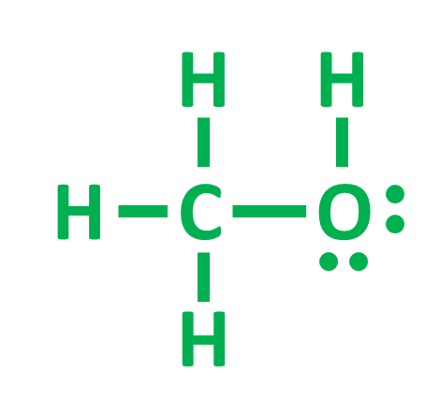
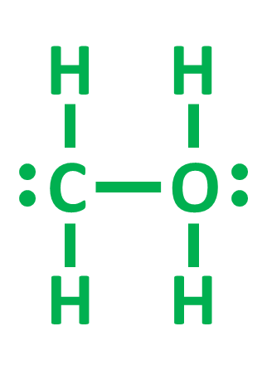
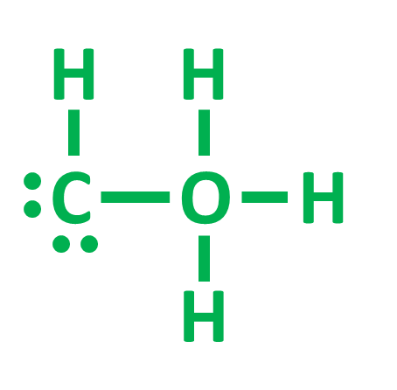
Step 5: Evaluate Structures
All connected | yes | yes | yes
All closed shell | yes | yes | yes
Zero formal charge | yes | no | no

Slide 20
We could have identified the structure with zero formal charges by remembering FC = 0 when the number of bonds equals the number of unpaired electrons in the Lewis Dot structure

Slide 21
Classwork / Homework
0726 – Hydrofluoric Acid and Water

Slide 22
We could have identified the structure with zero formal charges by remembering FC = 0 when the number of bonds equals the number of unpaired electrons in the Lewis Dot structure
C
O
Zero formal charge
with 4 bonds
Zero formal charge
with 2 bonds
C
O
4 unpaired electrons
in Lewis Dot structure
2 unpaired electrons
in Lewis Dot structure

