Slide 1
Do Now
1) In the covalent bonding method, what are closed shell electrons?
The number of electrons needed in the valence orbitals for each atom to have a closed shell.
2) How many closed shell electrons are needed for Br₂?
16, 8 for each bromine atom
3) How many electrons are in a bond?
Two
4) How many electrons are in a lone pair?
Two

Slide 2
Making Molecules
Write this in your notes
SWBAT use the covalent bonding method to make molecules

Slide 3
Types of Electrons
REVIEW
CSe | Closed Shell Electrons | The number of valence electrons needed for each atom to have a closed shell.
Ve | Valence Electrons | The usual number of electrons in the outermost principal quantum level of atom which are available for bonding.
Be | Bonding Electrons | The electrons being shared by two atoms. Each bond has two electrons.
LPe | Lone Pair Electrons | The electrons not shared by atoms. Each lone pair has two electrons

Slide 4
Covalent Bonding Method Objectives
REVIEW
We want to find a Lewis dot structure that:
Connects all the atoms together
Gives closed shells to all atoms
Leaves all atoms with no charge
MUST HAVE
BEST POSSIBLE
BEST POSSIBLE

Slide 5
Covalent Bonding Method
REVIEW
1) Determine number of bonds and lone pairs
2) Connect the atoms using bonds
3) Get closed shells by adding remaining bonds and lone pairs
4) Determine formal charges
5) Evaluate structure

Slide 6
Today’s Lesson
Today, we will start making molecules using the covalent bonding method
We will learn the five steps of the covalent bonding method on simple molecules
In coming lessons, we will advance to more complicated situations
Most of our unit test will evaluate your ability to use this method to identify the best structure for giving atoms what they want.

Slide 7
Using the Method
Br
Br
In our last lesson, we did an exhaustive analysis to show the theory behind the covalent bonding method and determine the best structure for Br₂.
Now that we understand the theory, we will learn how to use the method to find the best structure

Slide 8
Step 1: Electron Accounting
Write the RED in your notes
type | accounting | Br₂ example
CSe:
Ve:
Be:
LPe:

Slide 9
Step 1: Electron Accounting
type | accounting | Br₂ example
CSe:
Ve:
Be:
LPe:
CSe | Closed Shell Electrons | The number of valence electrons needed for each atom to have a closed shell.

Slide 10
Step 1: Electron Accounting
type | accounting | Br₂ example
CSe:
Ve:
Be:
LPe:
Except for hydrogen, all atoms need 8 electrons in their valence orbitals to have a closed shell.
Hydrogen needs only two electrons to have closed shell

Slide 11
Step 1: Electron Accounting
Write this
in your TABLE
type | accounting | Br₂ example
CSe: | 2 for H, 8 for others
Ve:
Be:
LPe:
Except for hydrogen, all atoms need 8 electrons in their valence orbitals to have a closed shell.
Hydrogen needs only two electrons to have closed shell
Each bromine needs 8 electrons for a total of 16

Slide 12
Step 1: Electron Accounting
Write this
in your TABLE
type | accounting | Br₂ example
CSe: | 2 for H, 8 for others | 8 + 8 = 16
Ve:
Be:
LPe:
Except for hydrogen, all atoms need 8 electrons in their valence orbitals to have a closed shell.
Hydrogen needs only two electrons to have closed shell
Each bromine needs 8 electrons for a total of 16

Slide 13
Step 1: Electron Accounting
type | accounting | Br₂ example
CSe: | 2 for H, 8 for others | 8 + 8 = 16
Ve:
Be:
LPe:
Ve | Valence Electrons | The usual number of electrons in the outermost principal quantum level of atom which are available for bonding.

Slide 14
Step 1: Electron Accounting
type | accounting | Br₂ example
CSe: | 2 for H, 8 for others | 8 + 8 = 16
Ve:
Be:
LPe:
For Ve, simply add up all of the valence electrons normally occurring for each atom

Slide 15
Step 1: Electron Accounting
Write this
in your TABLE
type | accounting | Br₂ example
CSe: | 2 for H, 8 for others | 8 + 8 = 16
Ve: | Add Ve for all atoms
Be:
LPe:
For Ve, simply add up all of the valence electrons normally occurring for each atom
Bromine normally has 7 valence electrons, so Br₂ will have 14 total

Slide 16
Step 1: Electron Accounting
Write this
in your TABLE
type | accounting | Br₂ example
CSe: | 2 for H, 8 for others | 8 + 8 = 16
Ve: | Add Ve for all atoms | 7 + 7 = 14
Be:
LPe:
For Ve, simply add up all of the valence electrons normally occurring for each atom
Bromine normally has 7 valence electrons, so Br₂ will have 14 total

Slide 17
Step 1: Electron Accounting
type | accounting | Br₂ example
CSe: | 2 for H, 8 for others | 8 + 8 = 16
Ve: | Add Ve for all atoms | 7 + 7 = 14
Be:
LPe:
Be | Bonding Electrons | The electrons being shared by two atoms. Each bond has two electrons.

Slide 18
Step 1: Electron Accounting
type | accounting | Br₂ example
CSe: | 2 for H, 8 for others | 8 + 8 = 16
Ve: | Add Ve for all atoms | 7 + 7 = 14
Be:
LPe:
When more electrons are needed than available, some have to be shared in a bond so they can cover multiple atoms
Needed minus available equals the number to be shared (Be)

Slide 19
Step 1: Electron Accounting
Write this
in your TABLE
type | accounting | Br₂ example
CSe: | 2 for H, 8 for others | 8 + 8 = 16
Ve: | Add Ve for all atoms | 7 + 7 = 14
Be: | CSe – Ve, ^{Be}/₂ = bonds | 16 – 14 = 2, ²/₂ = 1 bond
LPe:
When more electrons are needed than available, some have to be shared in a bond so they can cover multiple atoms
Needed minus available equals the number to be shared (Be)

Slide 20
Step 1: Electron Accounting
Write this
in your TABLE
type | accounting | Br₂ example
CSe: | 2 for H, 8 for others | 8 + 8 = 16
Ve: | Add Ve for all atoms | 7 + 7 = 14
Be: | CSe – Ve, ^{Be}/₂ = bonds | 16 – 14 = 2, ²/₂ = 1 bond
LPe:
When more electrons are needed than available, some have to be shared in a bond so they can cover multiple atoms
Needed minus available equals the number to be shared (Be)

Slide 21
Step 1: Electron Accounting
Write this
in your TABLE
type | accounting | Br₂ example
CSe: | 2 for H, 8 for others | 8 + 8 = 16
Ve: | Add Ve for all atoms | 7 + 7 = 14
Be: | CSe – Ve, ^{Be}/₂ = bonds | 16 – 14 = 2, ²/₂ = 1 bond
LPe:
When more electrons are needed than available, some have to be shared in a bond so they can cover multiple atoms
Needed minus available equals the number to be shared (Be)
Bonds contain 2 electrons, so ^{Be}/₂ gives the number of bonds

Slide 22
Step 1: Electron Accounting
Write this
in your TABLE
type | accounting | Br₂ example
CSe: | 2 for H, 8 for others | 8 + 8 = 16
Ve: | Add Ve for all atoms | 7 + 7 = 14
Be: | CSe – Ve, ^{Be}/₂ = bonds | 16 – 14 = 2, ²/₂ = 1 bond
LPe:
When more electrons are needed than available, some have to be shared in a bond so they can cover multiple atoms
Needed minus available equals the number to be shared (Be)
Bonds contain 2 electrons, so ^{Be}/₂ gives the number of bonds

Slide 23
Step 1: Electron Accounting
Write this
in your TABLE
type | accounting | Br₂ example
CSe: | 2 for H, 8 for others | 8 + 8 = 16
Ve: | Add Ve for all atoms | 7 + 7 = 14
Be: | CSe – Ve, ^{Be}/₂ = bonds | 16 – 14 = 2, ²/₂ = 1 bond
LPe:
When more electrons are needed than available, some have to be shared in a bond so they can cover multiple atoms
Needed minus available equals the number to be shared (Be)
Bonds contain 2 electrons, so ^{Be}/₂ gives the number of bonds

Slide 24
Step 1: Electron Accounting
type | accounting | Br₂ example
CSe: | 2 for H, 8 for others | 8 + 8 = 16
Ve: | Add Ve for all atoms | 7 + 7 = 14
Be: | CSe – Ve, ^{Be}/₂ = bonds | 16 – 14 = 2, ²/₂ = 1 bond
LPe:
LPe | Lone Pair Electrons | The electrons not shared by atoms. Each lone pair has two electrons

Slide 25
Step 1: Electron Accounting
type | accounting | Br₂ example
CSe: | 2 for H, 8 for others | 8 + 8 = 16
Ve: | Add Ve for all atoms | 7 + 7 = 14
Be: | CSe – Ve, ^{Be}/₂ = bonds | 16 – 14 = 2, ²/₂ = 1 bond
LPe:
The electrons that are not shared can be kept by one atom
Subtracting the Be from the Ve gives the unshared electrons

Slide 26
Step 1: Electron Accounting
Write this
in your TABLE
type | accounting | Br₂ example
CSe: | 2 for H, 8 for others | 8 + 8 = 16
Ve: | Add Ve for all atoms | 7 + 7 = 14
Be: | CSe – Ve, ^{Be}/₂ = bonds | 16 – 14 = 2, ²/₂ = 1 bond
LPe: | Ve – Be, ^{LPe}/₂ = lone pairs | 14 – 2 = 12, ¹²/₂ = 6 lone pairs
The electrons that are not shared can be kept by one atom
Subtracting the Be from the Ve gives the unshared electrons

Slide 27
Step 1: Electron Accounting
Write this
in your TABLE
type | accounting | Br₂ example
CSe: | 2 for H, 8 for others | 8 + 8 = 16
Ve: | Add Ve for all atoms | 7 + 7 = 14
Be: | CSe – Ve, ^{Be}/₂ = bonds | 16 – 14 = 2, ²/₂ = 1 bond
LPe: | Ve – Be, ^{LPe}/₂ = lone pairs | 14 – 2 = 12, ¹²/₂ = 6 lone pairs
The electrons that are not shared can be kept by one atom
Subtracting the Be from the Ve gives the unshared electrons

Slide 28
Step 1: Electron Accounting
Write this
in your TABLE
type | accounting | Br₂ example
CSe: | 2 for H, 8 for others | 8 + 8 = 16
Ve: | Add Ve for all atoms | 7 + 7 = 14
Be: | CSe – Ve, ^{Be}/₂ = bonds | 16 – 14 = 2, ²/₂ = 1 bond
LPe: | Ve – Be, ^{LPe}/₂ = lone pairs | 14 – 2 = 12, ¹²/₂ = 6 lone pairs
The electrons that are not shared can be kept by one atom
Subtracting the Be from the Ve gives the unshared electrons
Unshared electrons are kept in lone pairs of 2 electrons

Slide 29
Step 1: Electron Accounting
Write this
in your TABLE
type | accounting | Br₂ example
CSe: | 2 for H, 8 for others | 8 + 8 = 16
Ve: | Add Ve for all atoms | 7 + 7 = 14
Be: | CSe – Ve, ^{Be}/₂ = bonds | 16 – 14 = 2, ²/₂ = 1 bond
LPe: | Ve – Be, ^{LPe}/₂ = lone pairs | 14 – 2 = 12, ¹²/₂ = 6 lone pairs
The electrons that are not shared can be kept by one atom
Subtracting the Be from the Ve gives the unshared electrons
Unshared electrons are kept in lone pairs of 2 electrons

Slide 30
Step 1: Electron Accounting
Write this
in your TABLE
type | accounting | Br₂ example
CSe: | 2 for H, 8 for others | 8 + 8 = 16
Ve: | Add Ve for all atoms | 7 + 7 = 14
Be: | CSe – Ve, ^{Be}/₂ = bonds | 16 – 14 = 2, ²/₂ = 1 bond
LPe: | Ve – Be, ^{LPe}/₂ = lone pairs | 14 – 2 = 12, ¹²/₂ = 6 lone pairs
The electrons that are not shared can be kept by one atom
Subtracting the Be from the Ve gives the unshared electrons
Unshared electrons are kept in lone pairs of 2 electrons

Slide 31
Step 1: Electron Accounting
type | accounting | Br₂ example
CSe: | 2 for H, 8 for others | 8 + 8 = 16
Ve: | Add Ve for all atoms | 7 + 7 = 14
Be: | CSe – Ve, ^{Be}/₂ = bonds | 16 – 14 = 2, ²/₂ = 1 bond
LPe: | Ve – Be, ^{LPe}/₂ = lone pairs | 14 – 2 = 12, ¹²/₂ = 6 lone pairs
If we want all atoms to get a closed shell, we need a structure with 1 bond and 6 lone pairs
Other configurations will not satisfy the closed shells objective
. . . and this is sometimes preferred
Write this
in your notes

Slide 32
Step 2: Connect the Atoms
Write the RED in your notes
Br
Br
Place the least electronegative atom in the center
Attach all other atoms to the center atom with a single bond
The best structure is usually, but not always, generated by
following these two steps. Later we will learn about
alternative steps that are sometime followed

Slide 33
Step 3: Close the Shells
Write the RED in your notes
Br
Br
Add any remaining bonds between atoms that can take them
Add lone pairs to get all atoms to a closed shell
If multiple options, continue to FC analysis with
multiple options until best structure is clear

Slide 34
Step 4: Determine Formal Charges
Write the RED in your notes
Br
Br
Use shortcut method to determine formal charge

Slide 35
Formal Charge Shortcut
REVIEW
Br
Br
7 – 7 = 0
7 – 7 = 0
1) Draw a circle around:
a) All of Br’s lone pair electrons
b) Half of Br’s bonding electrons
2) Count all the electrons in the circle
3) This number subtracted from the valence number is the formal charge

Slide 36
Step 4: Determine Formal Charges
Write the RED in your notes
Br
Br
7
–
7
=
0
7
–
7
=
0
Use shortcut method to determine formal charge
Shortcut Method
Draw a circle around all LPe and half of the Be
Normal
Ve
–
Electrons
in Circle
=
Formal
Charge

Slide 37
Zero Formal Charges
Each group has a set number of bonds it can form and maintain FC = 0
This number of bonds is the same as the number of unpaired electrons in the Lewis Dot structure
Use this knowledge to quickly make molecules with the lowest possible formal charge

Slide 38
Step 4: Determine Formal Charges
Write the RED in your notes
Br
Br
7
–
7
=
0
7
–
7
=
0
Use shortcut method to determine formal charge
If any atom has a formal charge, revisit step 3 to see if the problem can be fixed
If multiple options, continue to FC analysis with
multiple options until best structure is clear

Slide 39
Step 5: Evaluate Structure
Write the RED in your notes
Br
Br
If all atoms have a closed shell and a zero formal charge, then the structure is valid
If not, further analysis needs to be done to see if the structure can be improved
There are many complexities that can occur here

Slide 40
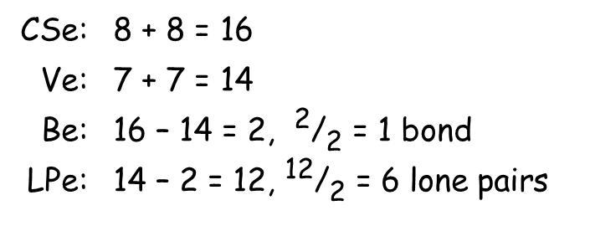
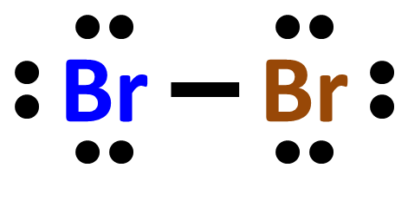
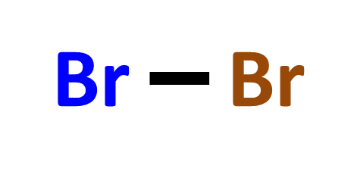
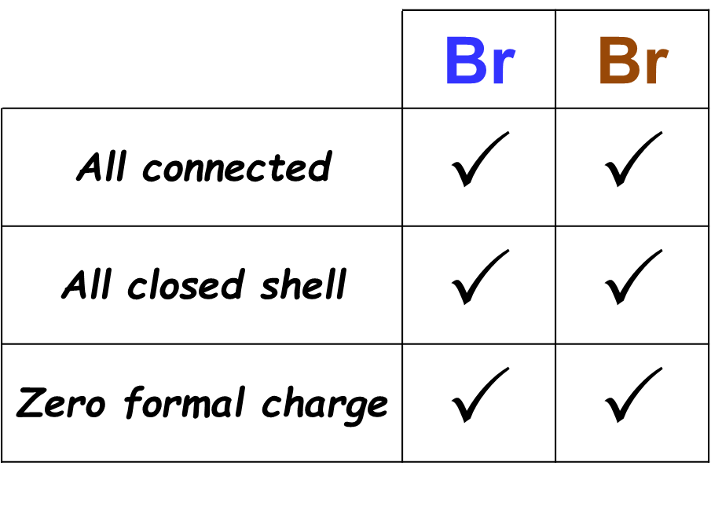
How this looks on your paper
STEP 1: ELECTRON ACCOUNTING
STEP 2: CONNECT THE ATOMS
STEP 3: CLOSE THE SHELLS
STEP 4: DETERMINE FORMAL CHARGES
STEP 5: EVALUATE STRUCTURE

Slide 41
Classwork / Homework
0716 – Chlorine Fluoride

Slide 42
Backup Slides

Slide 43
Priorities Among Objectives
 | Br | Br
All connected | P | P
All closed shell | P | P
Zero formal charge | P | P

Slide 44
Step 5: Evaluate Structure
Check the three objectives
All atoms connected
All atoms have a closed shell
All atoms have the lowest possible formal charge

Slide 45
Lowest Possible Formal Charge
The sum of the absolute values of the formal charges for the molecule (Σ|FC|) should be as low as possible
If a FC cannot be avoided, it should be located on the atoms that can best handle it
Negative charges on the most electronegative
Positive charges on the least electronegative

Slide 46
Priorities Among Objectives
 | C, H, N, O, F | Groups 2 & 13 Elements | Periods 3 – 7 Elements
All atoms connected | 1 | 1 | 1
All atoms have closed shell | 2 (odd electrons) | 3 | 3
Molecule has the lowest possible formal charge | 3 | 2 (suboctets) | 2 (expanded octets)

Slide 47
CSe: | 8 + 8 = 16
Ve: | 7 + 7 = 14
Be: | 16 – 14 = 2, ²/₂ = 1 bond
LPe: | 14 – 2 = 12, ¹²/₂ = 6 lone pairs

