Slide 1
Do Now
For each element, draw the Lewis dot structures and the number of valence electrons that are available for bonding
hydrogen (H)
oxygen (O)
helium (He)
bromine (Br)
H
1 Ve available
O
2 Ve available
He
0 Ve available
Br
1 Ve available
Ve = valence electrons

Slide 2
Covalent Bonding Method
Write this in your notes
SWBAT understand the covalent bonding method to determine the best Lewis dot structures and formal charges of covalent molecules

Slide 3
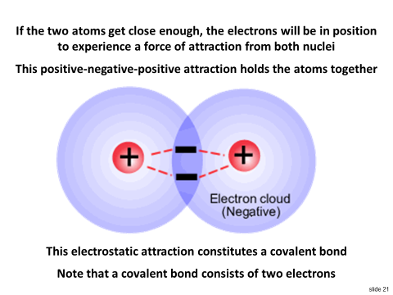
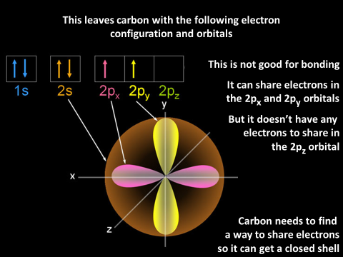
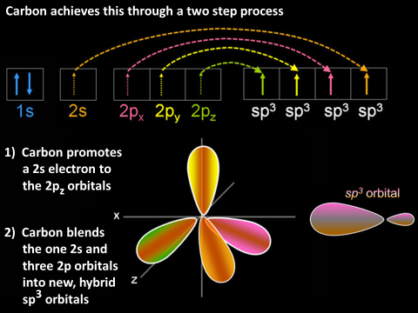
Last Class
In this lesson, we will learn method to figure how atoms covalently bond in molecules

Slide 4
Types of Electrons
Write this in your notes
CSe | Closed Shell Electrons | The number of electrons needed in the valence orbitals for each atom to have a closed shell.
Ve | Valence Electrons | The usual number of electrons in the outermost principal quantum level of atom which are available for bonding.
Be | Bonding Electrons | The electrons being shared by two atoms. Each bond has two electrons.
LPe | Lone Pair Electrons | The electrons not shared by atoms. Each lone pair has two electrons

Slide 5
Covalent Bonding Method Objectives
Write this in your notes
We want to find a Lewis dot structure that:
Connects all the atoms together
Gives closed shells to all atoms
Leaves all atoms with no charge
MUST HAVE
BEST POSSIBLE
BEST POSSIBLE

Slide 6
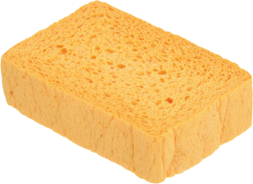
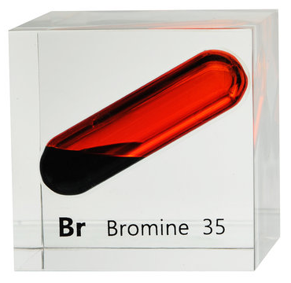
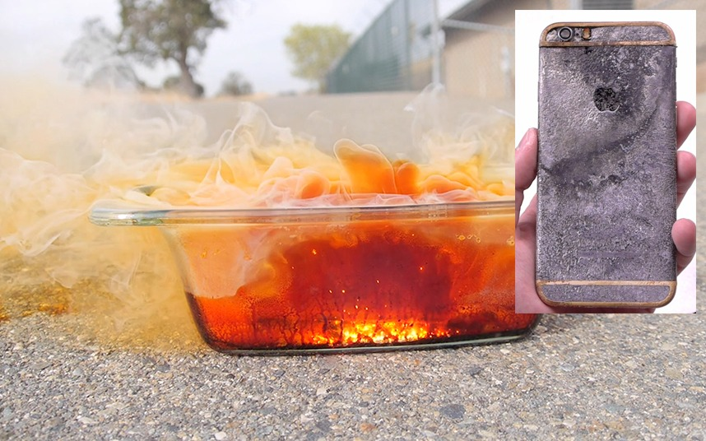
Example
Bromine is a diatomic element, meaning that the element is naturally found with two bromine atoms bonded to each other as Br₂.
Draw a Lewis dot structure of Br₂ and determine the formal charge on each atom

Slide 7
Br₂: what’s the story on electrons?
Br
Br
How many Ve needed for closed shell?
Br needs 8 and Br needs 8
16 Ve needed
How many Ve are available?
Br has 7 and Br has 7
14 Ve available
How many Ve need to be shared?
2 Ve shared
16 – 14 = 2
How many Ve are not shared?
12 Ve not shared
14 – 2 = 12

Slide 8
Br₂: what’s the story on electrons?
Br
Br
Two valence electrons will be shared
This will make one covalent bond
Twelve valence electrons will not be shared
This will make six lone pairs
A single covalent bond consists of two shared electrons
A lone pair consists of two unshared electrons

Slide 9
Lewis Dot Structures of Molecules
Write this in your notes
E’s lone pairs
E
E
E’s lone pairs
1) Place bonding atoms next to each other.
2) In the space directly between the two atoms, place all shared electrons (bonding electrons).
More commonly, a pair of bonding electrons is shown as a straight line bond.
3) On the periphery of each atom, place all of their unshared electrons (lone pairs).

Slide 10
Lewis Dot Structures of Br₂
This Lewis dot structure connects all atoms & gives both atoms closed shells
Br
Br
Where should we put the lone pairs?
The 2 bonding electrons give Br 2 electrons in its valence shell
Br needs 6 unshared electrons to get the 8 needed for a closed shell
Same is true of Br

Slide 11
What about the Charge?
Br
Br
Where should we put the lone pairs?
The 2 bonding electrons give Br 2 electrons in its valence shell
Br needs 6 unshared electrons to get the 8 needed for a closed shell
Same is true of Br

Slide 12
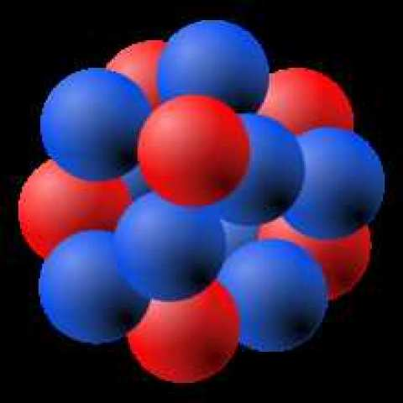
Atomic Charge while Alone
The charge of a lone atom is simply p⁺ ‒ e‒
For bromine:
p⁺ = 35
‒
e‒ = 35
charge = 0

Slide 13
Atomic Charge while Alone
If we add an electron, the charge changes
For bromine anion:
p⁺ = 35
‒ e‒ = 36
charge = ‒ 1

Slide 14
Simpler Way to Figure Charge
As long as the atom has the correct number of valence electrons, then
it has no charge
Br
We can simplify the analysis by just looking at the valence electrons
We can simplify even further by just using the Lewis dot structure

Slide 15
Method to Determine Charge FOR ATOMS
Use the periodic table to find the normal number of valence electrons

Slide 16
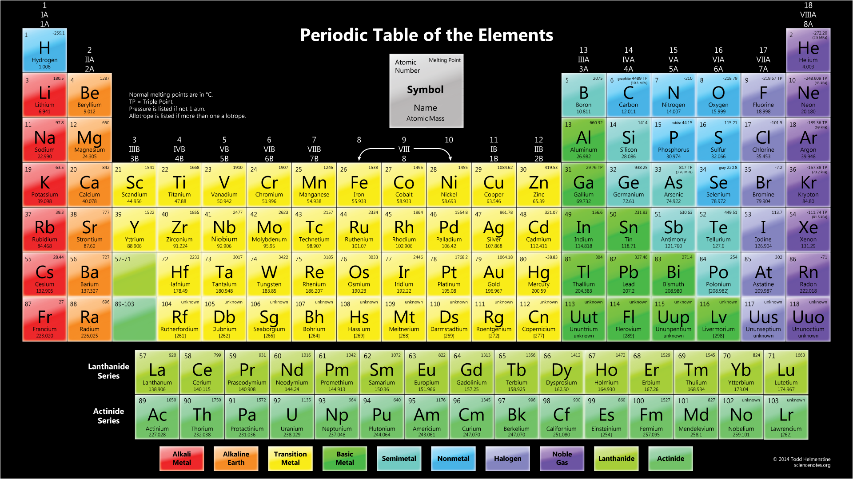
Bromine is in Group 17 . . .
. . . so it normally has 7 valence electrons

Slide 17
Method to Determine Charge FOR ATOMS
Use the periodic table to find the normal number of valence electrons
V = 7
A = 7
‒
charge = 0
Use the Lewis dot structure to count the actual number of valence electrons
Br
Valence minus Actual is the charge on the atom

Slide 18
Method to Determine Charge FOR ATOMS
Use the periodic table to find the normal number of valence electrons
V = 7
A = 8
‒
charge = ‒ 1
Use the Lewis dot structure to count the actual number of valence electrons
Valence minus Actual is the charge on the atom
‒ 1
If the actual number of valence electrons changes, the charge is easily determined
Br

Slide 19
Method to Determine Charge FOR ATOMS
Write this in your notes
Normal number of valence electrons
Actual number of valence electrons
=
‒
Charge
C
=
Ve
‒
Ae
But what about molecules?

Slide 20
Method to Determine Charge FOR MOLECULES
The concept is the same as with atoms
Normal number of valence electrons
Actual number of valence electrons
=
‒
Charge
The challenge is figuring the actual number of valence electrons
Br
Br
Which of these electrons are available to neutralize the positively charged nuclei in Br and Br?

Slide 21
Actual Number of Valence Electrons
Br
Br
The lone pair electrons for Br only orbit Br, so they are fully available to neutralize the positively charged nuclei
The bonding electrons are in orbit around Br but also around Br
Since they split their time evenly, each can only neutralize Br’s positive charged nucleus half of the time
Actual number of valence electrons
Bonding electrons
2
=
Lone pair
electrons
+

Slide 22
Formal Charge
Write this in your notes
This changes the equation as follows:
Normal number of valence electrons
Actual number of valence electrons
=
‒
Charge
Normal number of valence electrons
Lone
pair
electrons
Bonding
electrons
2
Formal charge
=
‒
+
Be
2
FC
=
Ve
‒
LPe
+

Slide 23
Formal Charge
Write this in your notes
Formal Charge – the charge assigned to an atom in a molecule assuming that all bonding electrons are shared equally regardless of electronegativity

Slide 24
Formal Charges on Br₂
Be
2
2
2
FC (for Br)
=
Ve
‒
+
=
0
7
LPe
6
Br
Br
Br
Br
Br
Br
Ve
=
7
LPe
=
6
Be
=
2
Same analysis shows Br has a formal charge of zero

Slide 25
Formal Charge Shortcut
Write this in your notes
Br
Br
7 – 7 = 0
7 – 7 = 0
1) Draw a circle around:
a) All of Br’s lone pair electrons
b) Half of Br’s bonding electrons
2) Count all the electrons in the circle
3) This number subtracted from the valence number is the formal charge

Slide 26
Zero Formal Charges
N
Each group has a set number of bonds it can form and maintain FC = 0
This number of bonds is the same as the number of unpaired electrons in the Lewis Dot structure
Zero formal charge
with 3 bonds
N
3 unpaired electrons
in Lewis Dot structure

Slide 27
Zero Formal Charges
O
Each group has a set number of bonds it can form and maintain FC = 0
This number of bonds is the same as the number of unpaired electrons in the Lewis Dot structure
Zero formal charge
with 2 bonds
O
2 unpaired electrons
in Lewis Dot structure

Slide 28
Zero Formal Charges
B
Each group has a set number of bonds it can form and maintain FC = 0
This number of bonds is the same as the number of unpaired electrons in the Lewis Dot structure
Zero formal charge
with 3 bonds
B
3 unpaired electrons
in Lewis Dot structure

Slide 29
Zero Formal Charges
Write the yellow in your notes
C
Each group has a set number of bonds it can form and maintain FC = 0
This number of bonds is the same as the number of unpaired electrons in the Lewis Dot structure
Use this knowledge to quickly make molecules with the lowest possible formal charge
Zero formal charge
with 4 bonds
C
4 unpaired electrons
in Lewis Dot structure

Slide 30
Evaluate the Structure
Br
Br
All atoms are connected, but how do we count electrons???

Slide 31
Counting Electrons
Write this in your notes
For closed shell, bonding electrons count fully for each atom
For formal charge, bonding electrons count half for each atom
For Br
6 LPe
+ 2 Be
8 CSe
(closed shell)
For Br
6 LPe
+ 1 Be
7 e
(enough to neutralize protons in nucleus)
Br
Br

Slide 32
Evaluate the Structure
Br
Br
All of our objectives have been met!!!
When all objectives are met, the proposed structure is probably a good estimate of reality
The greater challenge comes when it is not possible to meet all objectives at the same time.

Slide 33
Covalent Bonding Method
Write the RED in your notes
1) Determine number of bonds and lone pairs
2) Connect the atoms using bonds
3) Get closed shells by adding remaining bonds and lone pairs
4) Determine formal charges
5) Evaluate structure

Slide 34
Backup Slides

Slide 35
Lewis Dot Structures of Br₂
Br
Br

Slide 36
Lewis Dot Structures of Br₂
Br
Br

Slide 37
Br
H
Br
H
Br
H
Br
H

Slide 38
Simpler Way to Figure Charge
The charge of a lone atom is simply p⁺ ‒ e‒
For bromine:
p⁺ = 35
‒ e‒ = 35
charge = 0

Slide 39
Be
2
2
2
FC (for Br)
=
Ve
‒
+
7
LPe
6

Slide 40
Covalent Bonding Method Objectives
Write this in your notes
We want a Lewis dot structure where:
All atoms are connected
All atoms have a closed shell
All atoms have no formal charge
MUST HAVE
BEST POSSIBLE
BEST POSSIBLE

Slide 41
Covalent Bonding Method
Write this in your notes
1) Determine number of bonds and lone pairs
2) Connect the atoms using bonds
3) Get closed shells by adding remaining bonds and lone pairs
4) Determine formal charges
5) Evaluate structure

