Slide 1
Units
Scientific Method
Atomic Theory
Nuclear Chemistry
The Mole
Electrons
Periodic Properties
Covalent Bonding
Nomenclature
Chemical Reactions
Stoichiometry
Mixtures and Solutions
Chemical Equilibrium
Acid-Base Chemistry
Redox & Electrochemistry
Gas Laws
Thermodynamics

Slide 2
Chemical Bonds
SWBAT describe ionic, metallic, and covalent bonds, and explain reasons why pairs of elements choose each type
Write this in your notes

Slide 3
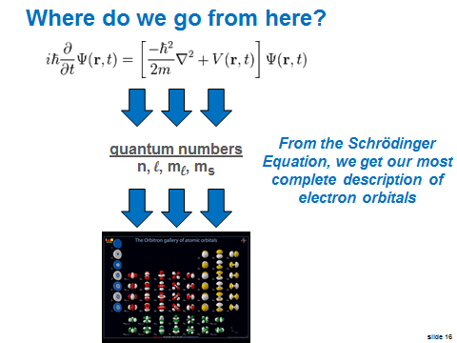
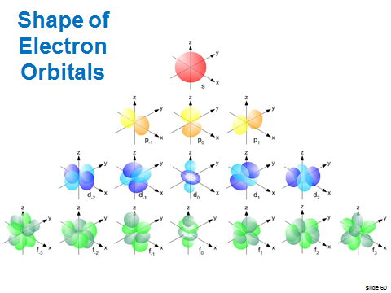
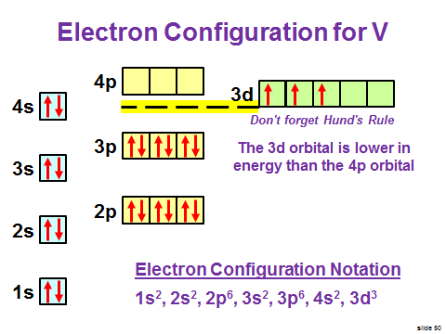
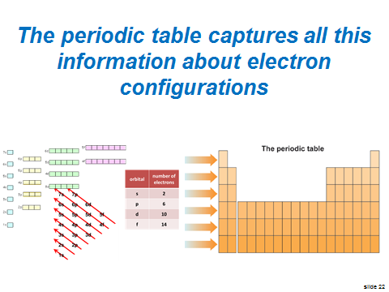
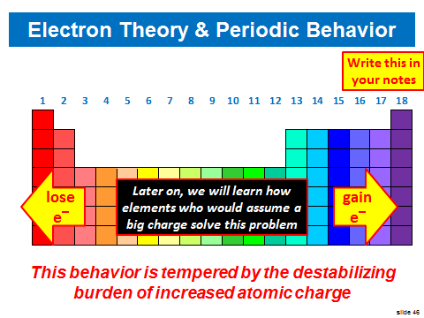
What We've
Learned About
Electrons
What's Next?

Slide 4
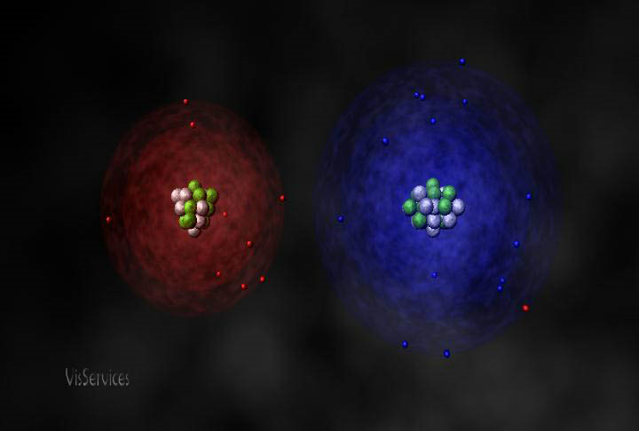
Chemical Bonding
Today, we will learn about chemical bonding
We will learn that atoms can sometimes get close enough that their outermost electrons can interact
Under the right circumstances, this interaction can produce an attraction we call a chemical bond

Slide 5
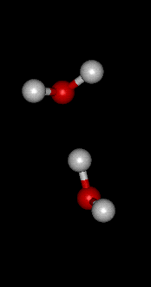
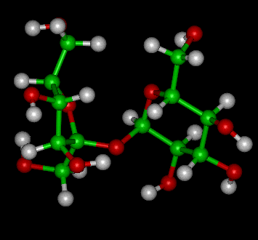
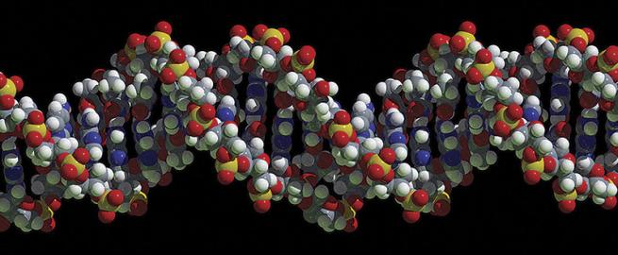
Bonding Makes Molecules

Slide 6
Review of
What Atoms Want

Slide 7
What Atoms Want
REVIEW
All atoms want to be highly stable
Noble gases are the most stable atoms
Noble gases have an electron configuration with a full set of valence electrons (closed shell)
Therefore:
full set of
valence electrons
=
highly stable
element
=
what atoms
want

Slide 8
Why Do Atoms Form Bonds?
Write this in your notes
Except for the noble gases, all elements need to gain or lose electrons to get a closed shell and become more stable.
Gaining or losing electrons means acquiring a charge which is destabilizing.
For some atoms, the magnitude of the charge is more than they can handle.
Bonding allows elements to gain or lose electron density, yet stabilize any charge.
In this way, atoms can get what they want.

Slide 9
Reminder on Periodic Behavior
The green elements are non-metals which generally have high electronegativities
The violet elements are metals which generally have low electronegativities

Slide 10
Definitions
Write this in your notes
Chemical Bond - The force that holds two atoms together
Ionic Bond - A chemical bond that results from the electrostatic attraction between two oppositely charged ions. The ions are usually the result of electron transfer between atoms.
Metal Bond - A chemical bond that results from electrostatic attraction between metal cations and a their delocalized "sea" of electrons.
Covalent Bond - A chemical bond that results from the sharing of valence electrons

Slide 11
Types of Bonds
Write this in your notes
1st Atom | 2nd Atom | Bond Type

Slide 12
Definitions
Write this in your notes
Chemical Bond - A force that holds two atoms together
Ionic Bond - A chemical bond that results from the electrostatic attraction between two oppositely charged ions. The ions are usually the result of electron transfer between atoms.
Metal Bond - A chemical bond that results from electrostatic attraction between metal cations and a their delocalized "sea" of electrons.
Covalent Bond - A chemical bond that results from the sharing of valence electrons

Slide 13
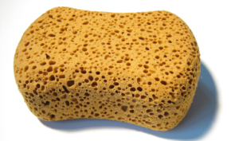
Ways to Get a Closed Shell
In some situations, the answer is simple.
Na
Sodium needs to lose one electron to get a closed shell
Cl
Chlorine needs to gain one electron to get a closed shell

Slide 14
Ways to Get a Closed Shell
In some situations, the answer is simple.
Na
When they get together, both can fill their needs by transferring one electron from sodium to chlorine
one
electron
This converts both elements into ions
Cl

Slide 15
Ways to Get a Closed Shell
In some situations, the answer is simple.
Na⁺
Both elements now have a charge which is bad for their stability
To help stabilize the charge, the two ions move next to one another which allows the opposite charges to be partially stabilized
Cl‒

Slide 16
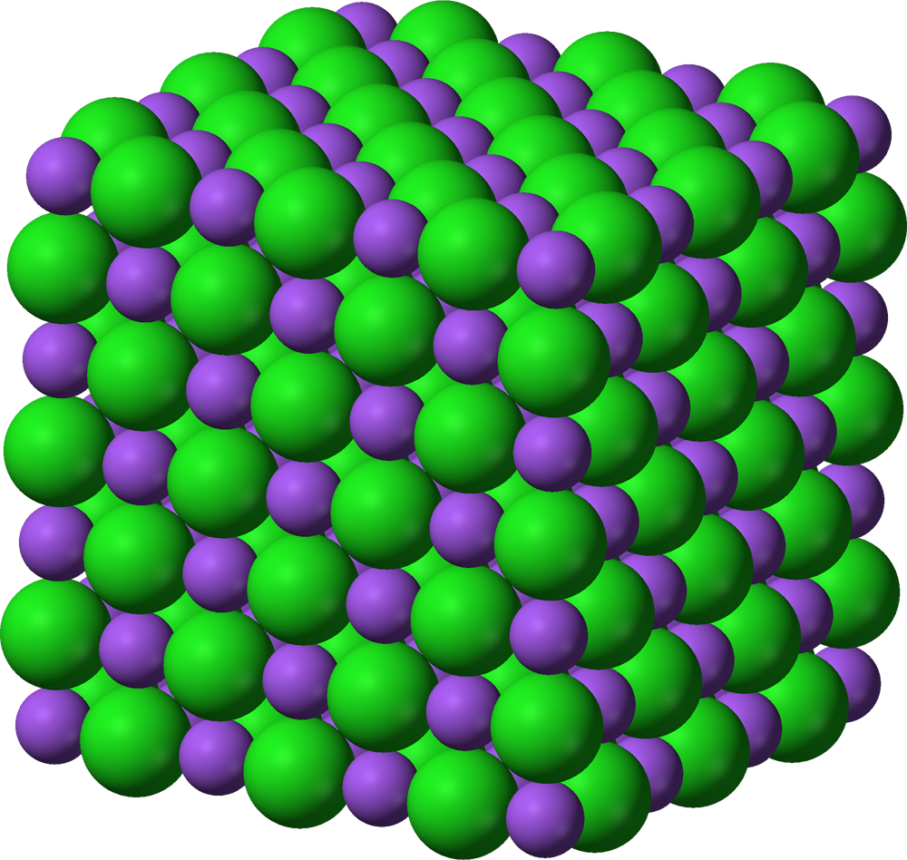

Slide 17
Ways to Get a Closed Shell
In some situations, the answer is simple.
Na⁺
The two ions are held together by electrostatic attraction.
This arrangement is best when one atom wants to lose electron(s) and the other atom wants to gain them.
Cl‒
This arrangement is called an ionic bond

Slide 18
Definitions
Write this in your notes
Chemical Bond - A force that holds two atoms together
Ionic Bond - A chemical bond that results from the electrostatic attraction between two oppositely charged ions. The ions are usually the result of electron transfer between atoms.
Metal Bond - A chemical bond that results from electrostatic attraction between metal cations and a their delocalized "sea" of electrons.
Covalent Bond - A chemical bond that results from the sharing of valence electrons

Slide 19
What Types of Elements
Form Ionic Bonds?
One element wants to gain electrons
  typically a non-metal (high electronegativity)
One element is willing to lose electrons
  typically a metal (low electronegativity)

Slide 20
Types of Bonds
Write this in your notes
1st Atom | 2nd Atom | Bond Type
Metal low electronegativity | Non-metal high electronegativity | Ionic

Slide 21
Other Ways to Get a Closed Shell
In some situations, the answer is not simple.
If two sodium atoms come together, an ionic bond is not the answer
Na
Both atoms want to lose just one electron to get a closed shell
"sea of electrons"
The best solution is to release them into a surrounding "sea of electrons"
Na

Slide 22
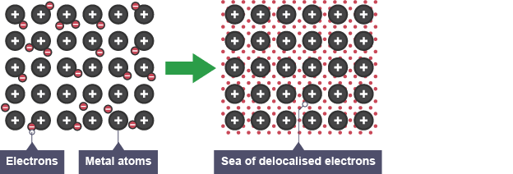
"Sea of Electrons"

Slide 23
Other Ways to Get a Closed Shell
In some situations, the answer is not simple.
If two sodium atoms come together, an ionic bond is not the answer
Na+
Both atoms want to lose just one electron to get a closed shell
"sea of electrons"
The best solution is to release them into a surrounding "sea of electrons"
Na+
This arrangement is called a metal bond

Slide 24
Definitions
Write this in your notes
Chemical Bond - A force that holds two atoms together
Ionic Bond - A chemical bond that results from the electrostatic attraction between two oppositely charged ions. The ions are usually the result of electron transfer between atoms.
Metal Bond - A chemical bond that results from electrostatic attraction between metal cations and their delocalized "sea" of electrons.
Covalent Bond - A chemical bond that results from the sharing of valence electrons

Slide 25
What Types of Elements
Form Metallic Bonds?
One element is willing to lose electrons
  typically a metal (low electronegativity)
Another that is willing to lose electrons
  typically a metal (low electronegativity)

Slide 26
Types of Bonds
Write this in your notes
1st Atom | 2nd Atom | Bond Type
Metal low electronegativity | Non-metal high electronegativity | Ionic
Metal low electronegativity | Metal low electronegativity | Metallic

Slide 27
Still Other Ways
In some situations, the answer is not simple.
If two chlorine atoms come together, an ionic bond is not the answer
Cl
Both atoms want to gain just one electron to get a closed shell
shared electrons
The best solution is to share two electrons to get a closed shell
Cl

Slide 28
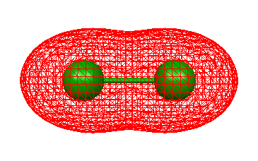
Sharing Electrons

Slide 29
Still Other Ways
In some situations, the answer is not simple.
If two chlorine atoms come together, an ionic bond is not the answer
Cl
Both atoms want to gain just one electron to get a closed shell
shared electrons
The best solution is to share two electrons to get a closed shell
Cl
This sharing of electrons is called a covalent bond

Slide 30
Other Reasons for Covalent Bonds
In some situations, the answer is not simple.
For carbon to get a closed shell, it needs to either gain or lose 4 electrons
C⁺⁴
This gives carbon a huge positive or negative charge to stabilize
It is better off sharing 8 electrons to get something like a closed shell
C^{‒4}

Slide 31
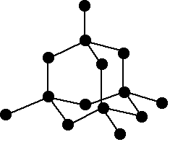
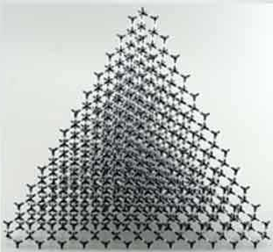


Slide 32
Other Reasons for Covalent Bonds
In some situations, the answer is not simple.
For carbon to get a closed shell, it needs to either gain or lose 4 electrons
C⁺⁴
This gives carbon a huge positive or negative charge to stabilize
It is better off sharing 8 electrons to get something like a closed shell
C^{‒4}
This sharing of electrons is also called a covalent bond

Slide 33
Definitions
Write this in your notes
Chemical Bond - A force that holds two atoms together
Ionic Bond - A chemical bond that results from the electrostatic attraction between two oppositely charged ions. The ions are usually the result of electron transfer between atoms.
Metal Bond - A chemical bond that results from electrostatic attraction between metal cations and a their delocalized "sea" of electrons.
Covalent Bond - A chemical bond that results from the sharing of valence electrons

Slide 34
What Types of Elements
Form Covalent Bonds?
One element that wants to gain electrons
  high electronegativity (typically a non-metal)
A second element that wants to gain electrons
  high electronegativity (typically a non-metal)

Slide 35
Types of Bonds
Write this in your notes
1st Atom | 2nd Atom | Bond Type
Metal low electronegativity | Non-metal high electronegativity | Ionic
Metal low electronegativity | Metal low electronegativity | Metallic
Non-metal high electronegativity | Non-metal high electronegativity | Non-Polar Covalent
 |  | Polar Covalent

Slide 36
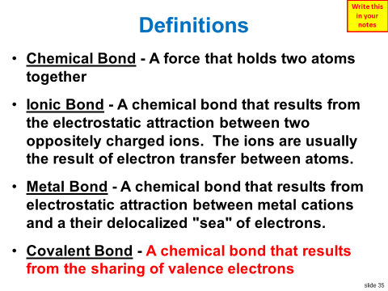
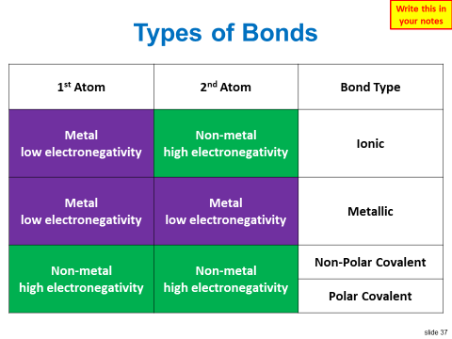
Do We Finish
These Slides?
What's Next?

Slide 37
Na⁺

