Slide 1
Do Now
Write the electron configuration notation for the following atoms:
  N
  P
  Li⁺
  S⁻²

Slide 2
Do Now
Write the electron configuration notation for the following atoms:
  N 1s², 2s², 2p³
  P
  Li⁺
  S⁻²

Slide 3
Do Now
Write the electron configuration notation for the following atoms:
  N 1s², 2s², 2p³
  P 1s², 2s², 2p⁶, 3s², 3p³
  Li⁺
  S⁻²

Slide 4
Do Now
Write the electron configuration notation for the following atoms:
  N 1s², 2s², 2p³
  P 1s², 2s², 2p⁶, 3s², 3p³
  Li⁺ 1s²
  S⁻²

Slide 5
Do Now
Write the electron configuration notation for the following atoms:
  N 1s², 2s², 2p³
  P 1s², 2s², 2p⁶, 3s², 3p³
  Li⁺ 1s²
  S⁻² 1s², 2s², 2p⁶, 3s², 3p⁶

Slide 6
Individual Practice 4
Determine which element has the electron configuration notation shown:
  1s², 2s¹
  1s², 2s², 2p²
  1s², 2s², 2p⁶, 3s²
  1s², 2s², 2p⁶, 3s², 3p⁶

Slide 7
Individual Practice 4
Determine which element has the electron configuration notation shown:
  1s², 2s¹ Li
  1s², 2s², 2p²
  1s², 2s², 2p⁶, 3s²
  1s², 2s², 2p⁶, 3s², 3p⁶

Slide 8
Individual Practice 4
Determine which element has the electron configuration notation shown:
  1s², 2s¹ Li
  1s², 2s², 2p² C
  1s², 2s², 2p⁶, 3s²
  1s², 2s², 2p⁶, 3s², 3p⁶

Slide 9
Individual Practice 4
Determine which element has the electron configuration notation shown:
  1s², 2s¹ Li
  1s², 2s², 2p² C
  1s², 2s², 2p⁶, 3s² Mg
  1s², 2s², 2p⁶, 3s², 3p⁶

Slide 10
Individual Practice 4
Determine which element has the electron configuration notation shown:
  1s², 2s¹ Li
  1s², 2s², 2p² C
  1s², 2s², 2p⁶, 3s² Mg
  1s², 2s², 2p⁶, 3s², 3p⁶ Ar

Slide 11
Periodic Table and
Electron Configurations
SWBAT determine electron configurations using the periodic table and represent these configurations using an abbreviated notation
Write this in your notes

Slide 12
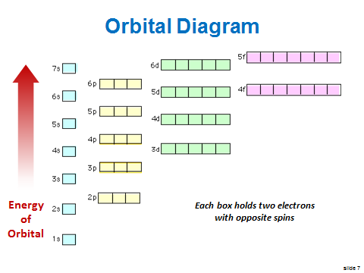
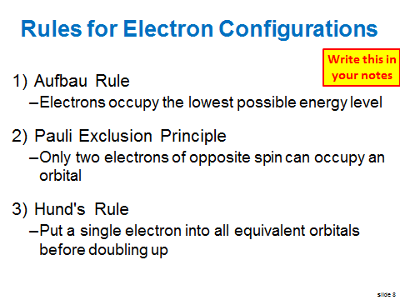
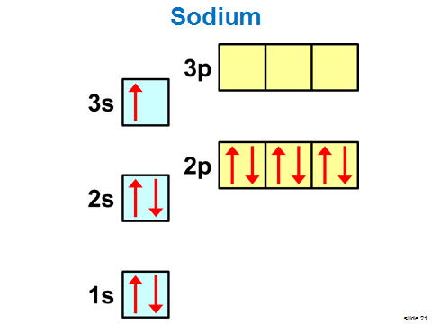
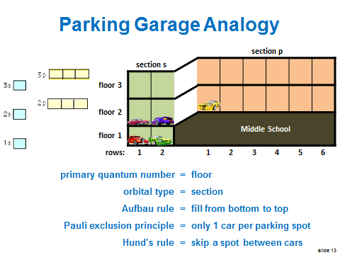
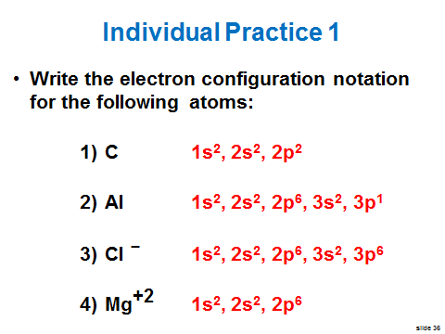
Last Class

Slide 13
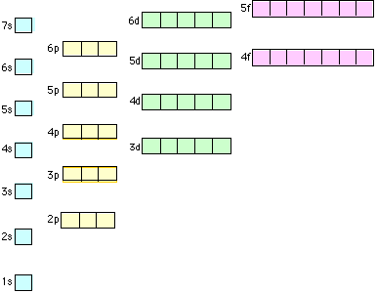
Orbital Diagram
Energy
of
Orbital
Each box holds two electrons with opposite spins

Slide 14
Orbital Diagram
Energy
of
Orbital
Last class we focused on the lower energy levels

Slide 15
Orbital Diagram
Energy
of
Orbital
Today, we will focus on the higher energy levels.
Strange things happen at the higher energy levels.

Slide 16
4s is lower than 3d
Energy
of
Orbital

Slide 17
6s is lower than 4f
Energy
of
Orbital
This is not what we expected

Slide 18
The way we think it should be
Energy Levels of Orbitals
7s | 7p
6s | 6p | 6d
5s | 5p | 5d | 5f
4s | 4p | 4d | 4f
3s | 3p | 3d
2s | 2p
1s

Slide 19
Energy Levels of Orbitals
7s | 7p
6s | 6p | 6d
5s | 5p | 5d | 5f
4s | 4p | 4d | 4f
3s | 3p | 3d
2s | 2p
1s
The way it is

Slide 20

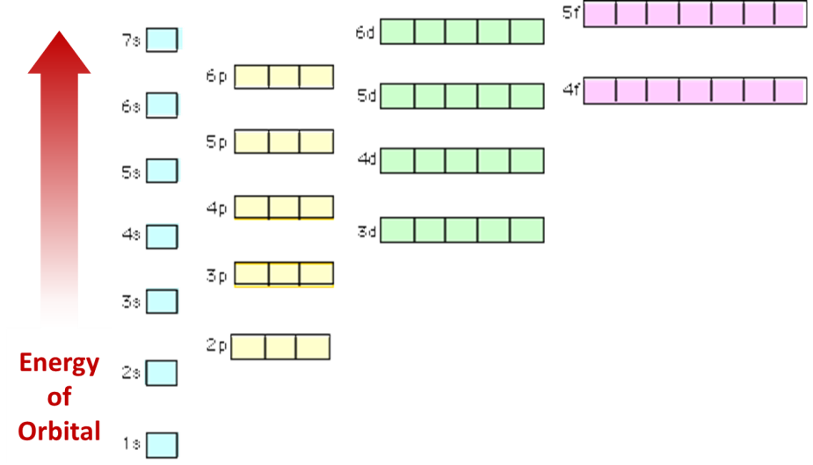
Energy of the Orbitals
quantum numbers
n, l, m_{l}, m_{s}
The Schrödinger Equation also provides us with the relative energy levels of the different orbitals

Slide 21
Electron Configuration for K
4p
3d
4s
3p
The 4s orbital is lower in energy than the 3d orbital
3s
2p
Write this in your notes
2s
Electron Configuration Notation
1s², 2s², 2p⁶, 3s², 3p⁶, 4s¹
1s

Slide 22
Electron Configuration for V
4p
3d
4s
Don't forget Hund's Rule
3p
The 3d orbital is lower in energy than the 4p orbital
3s
2p
Write this in your notes
2s
Electron Configuration Notation
1s², 2s², 2p⁶, 3s², 3p⁶, 4s², 3d³
1s

Slide 23
Electron Configuration for Ge
4p
3d
4s
3p
Once 3d is full, electrons start filling 4p
3s
2p
Write this in your notes
2s
Electron Configuration Notation
1s², 2s², 2p⁶, 3s², 3p⁶, 4s², 3d¹⁰, 4p²
1s

Slide 24
Individual Practice
Write the electron configuration notation for the following atoms:
  Co
  As
  Ca

Slide 25
Individual Practice
Write the electron configuration notation for the following atoms:
  Co 1s², 2s², 2p⁶, 3s², 3p⁶, 4s², 3d⁷
  As
  Ca

Slide 26
Individual Practice
Write the electron configuration notation for the following atoms:
  Co 1s², 2s², 2p⁶, 3s², 3p⁶, 4s², 3d⁷
  As 1s², 2s², 2p⁶, 3s², 3p⁶, 4s², 3d¹⁰, 4p³
  Ca

Slide 27
Individual Practice
Write the electron configuration notation for the following atoms:
  Co 1s², 2s², 2p⁶, 3s², 3p⁶, 4s², 3d⁷
  As 1s², 2s², 2p⁶, 3s², 3p⁶, 4s², 3d¹⁰, 4p³
  Ca 1s², 2s², 2p⁶, 3s², 3p⁶, 4s²

Slide 28
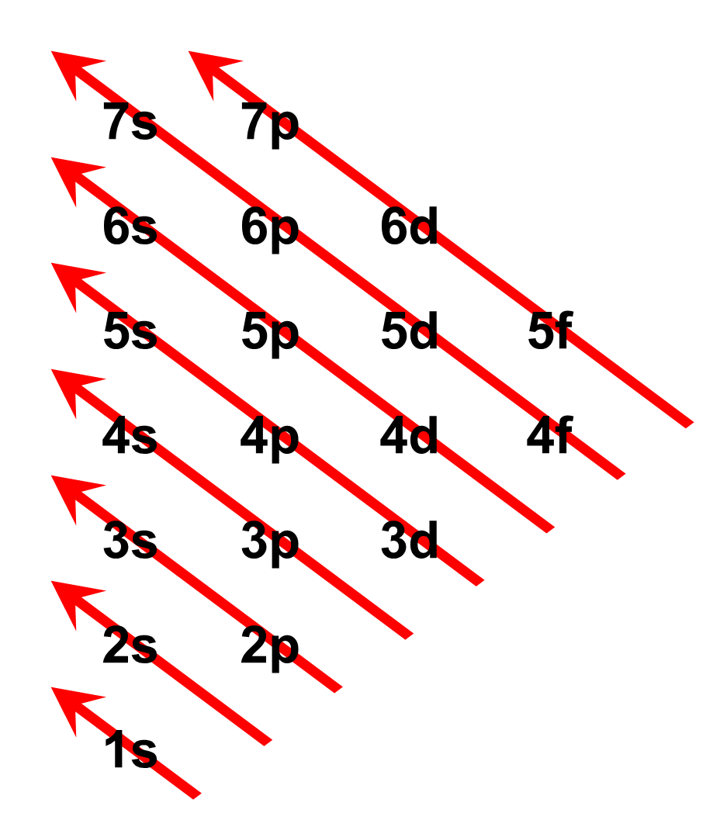
How can I remember all of this???
orbital | number of electrons
s | 2
p | 6
d | 10
f | 14
You don't have to remember it.
You just have to know how
to read the periodic table.

Slide 29
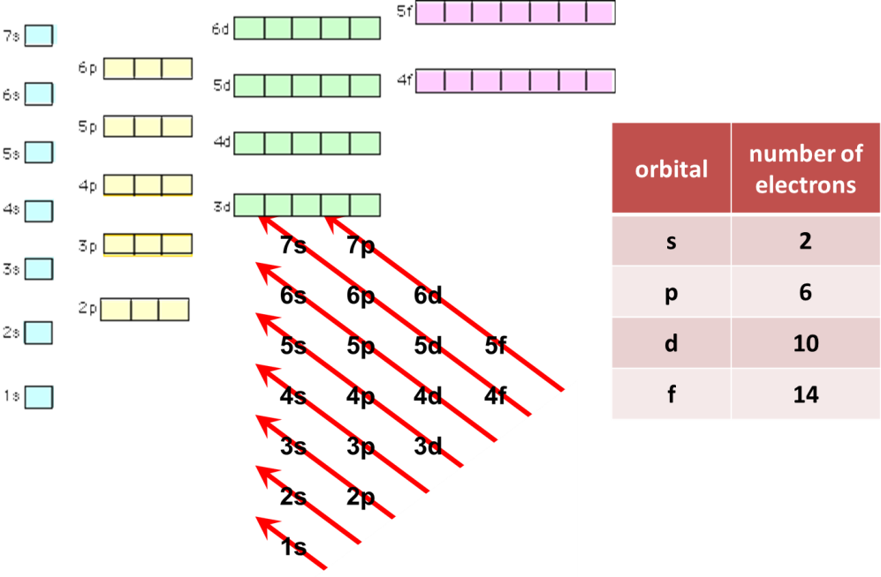
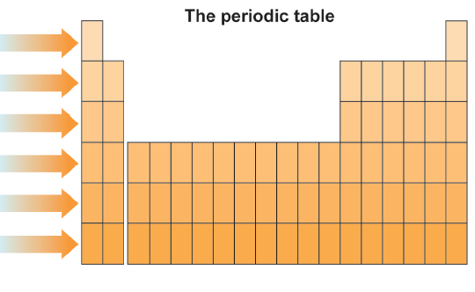
The periodic table captures all this information about electron configurations

Slide 30
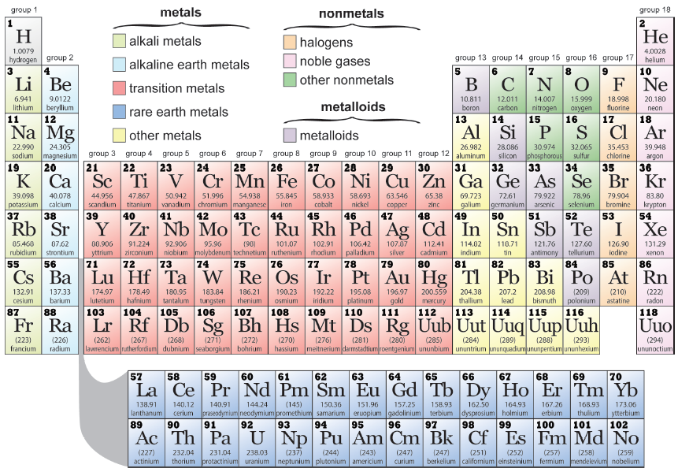
The Periodic Table

Slide 31





Parking Garage Analogy
 | section s |  |  | section p
floor 3
floor 2
 |  |  |  | Middle School
floor 1
rows: | 1 | 2 |  | 1 | 2 | 3 | 4 | 5 | 6
primary quantum number = floor
Aufbau rule = fill from bottom to top
Pauli exclusion principle = only 1 car per parking spot
Hund's rule = skip a spot between cars
Electron configuration notation = ticket for parking locations

Slide 32
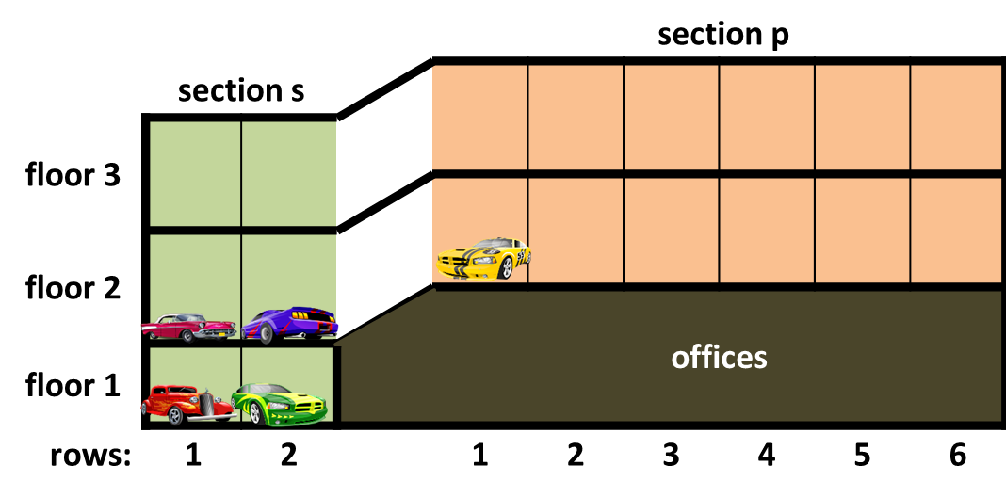
floor 1
offices
floor 2
floor 3
section s
section p

Slide 33
floor 1
offices
floor 2
floor 3
section s
section p

Slide 34
Inverted Energy Diagram
Write this in your notes
low energy
high
energy

Slide 35
The Periodic Table

Slide 36
The Periodic Table
Notice this
part here

Slide 37
This is the way the periodic table should really look
Normally the rare earth metals are pulled out an placed below the rest to save space

Slide 38
The periodic table is actually organized by orbitals
Write this in your notes
s
p
d
f
Why?
Electron configurations determine
the properties of atoms and molecules

Slide 39
Our Periodic Table
The periodic table on the wall is like this

Slide 40
Another Typical Periodic Table

Slide 41
Orbital "Blocks"

Slide 42
Orbital Designations

Slide 43
Write this in your notes
s block starts at n = 1
p block starts at n = 2
d block starts at n = 3
f block starts at n = 4

Slide 44
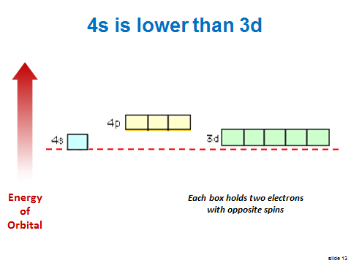
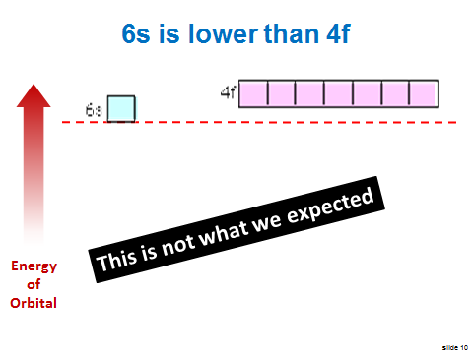
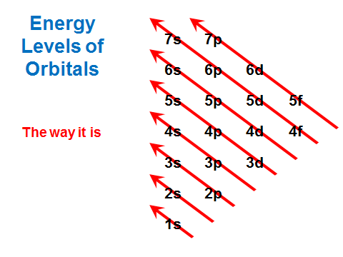
In this way, the periodic table accounts for energy difference in orbitals

Slide 45
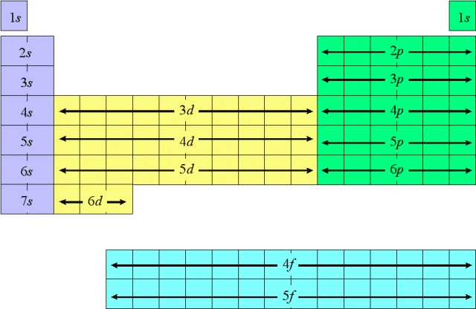
Electronic Configurations on the Periodic Table

Slide 46
4s goes to 3d
Write this in your notes
3d goes to 4p
6s goes to 4f
4f goes to 5d

Slide 47
Rules for Electron Configurations
Aufbau Rule
  Electrons occupy the lowest possible energy level
Pauli Exclusion Principle
  Only two electrons of opposite spin can occupy an orbital
Hund's Rule
  Put a single electron into all equivalent orbitals before doubling up
These cover most elements, but not all

Slide 48
Exceptions
Increased stability from half-filled or completely filled orbitals
Reason for exception not known
Anions and cations are often exceptions

Slide 49
Homework
WS Orbitals on the Periodic Table

Slide 50
DAY 2
Practice Writing
Electron Configurations using Periodic Table

Slide 51
Do Now
Put homework in the red basket
Write the electron configuration notation for the following atoms:
  Ga
  Ti
  Rb

Slide 52
Do Now
Write the electron configuration notation for the following atoms:
  Ga 1s², 2s², 2p⁶, 3s², 3p⁶, 4s², 3d¹⁰, 4p¹
  Ti
  Rb

Slide 53
Do Now
Write the electron configuration notation for the following atoms:
  Ga 1s², 2s², 2p⁶, 3s², 3p⁶, 4s², 3d¹⁰, 4p¹
  Ti 1s², 2s², 2p⁶, 3s², 3p⁶, 4s², 3d²
  Rb

Slide 54
Do Now
Write the electron configuration notation for the following atoms:
  Ga 1s², 2s², 2p⁶, 3s², 3p⁶, 4s², 3d¹⁰, 4p¹
  Ti 1s², 2s², 2p⁶, 3s², 3p⁶, 4s², 3d²
  Rb 1s², 2s², 2p⁶, 3s², 3p⁶, 4s², 3d¹⁰, 4p⁶, 5s¹

Slide 55

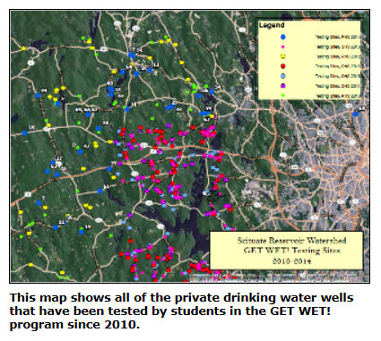
Molly Allard
Environmental Education and Outreach Coordinator
Northern Rhode Island Conservation District
2283 Hartford Avenue
Johnston, RI 02919

Slide 56
Periodic Table and
Electron Configurations
SWBAT determine electron configurations using the periodic table and represent these configurations using an abbreviated notation
REVIEW

Slide 57
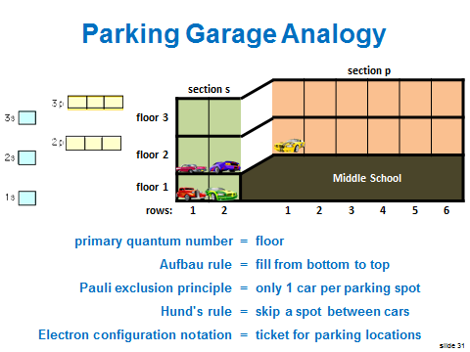
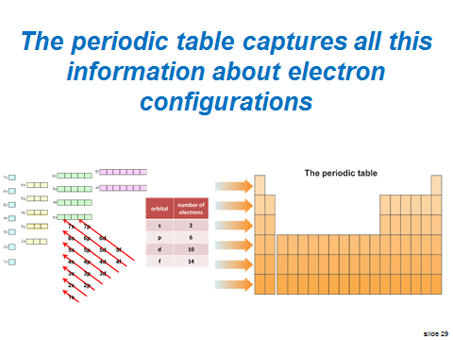
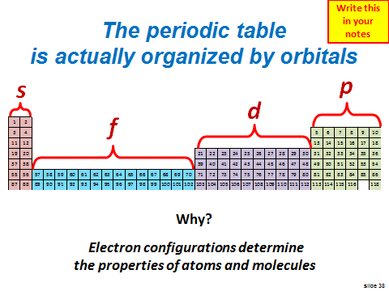
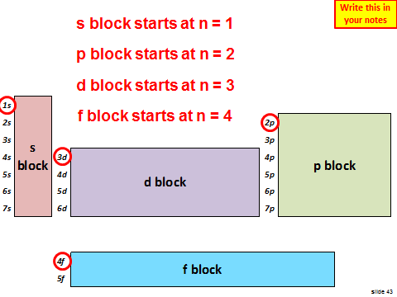
Previously

Slide 58
Using the
Periodic Table to Write
Electron Configurations

Slide 59
Determining
Electron Configurations
Electron configurations are easily determined if you can read the periodic table
Steps
  Find the element on the periodic table
  View where all of the electrons are "parked"
  Write down the configuration one orbital at a time

Slide 60
Write the Electron Configurations
Fe: 1s², 2s², 2p⁶, 3s², 3p⁶, 4s², 3d⁶
Fe: [Ar] 4s², 3d⁶

Slide 62
Write the Electron Configurations
Fe: 1s², 2s², 2p⁶, 3s², 3p⁶, 4s², 3d⁶
Fe: [Ar] 4s², 3d⁶

Slide 63
Write the Electron Configurations
Fe: 1s², 2s², 2p⁶, 3s², 3p⁶, 4s², 3d⁶
Fe: [Ar] 4s², 3d⁶

Slide 64
Write the Electron Configurations
Fe: 1s², 2s², 2p⁶, 3s², 3p⁶, 4s², 3d⁶
Fe: [Ar] 4s², 3d⁶

Slide 65
Write the Electron Configurations
Fe: 1s², 2s², 2p⁶, 3s², 3p⁶, 4s², 3d⁶
Fe: [Ar] 4s², 3d⁶

Slide 66
Write the Electron Configurations
Fe: 1s², 2s², 2p⁶, 3s², 3p⁶, 4s², 3d⁶
Fe: [Ar] 4s², 3d⁶

Slide 67
Write the Electron Configurations
Fe: 1s², 2s², 2p⁶, 3s², 3p⁶, 4s², 3d⁶
Fe: [Ar] 4s², 3d⁶

Slide 68
Write the Electron Configurations
Fe: 1s², 2s², 2p⁶, 3s², 3p⁶, 4s², 3d⁶
Fe: [Ar] 4s², 3d⁶

Slide 69
Write the Electron Configurations
Fe: 1s², 2s², 2p⁶, 3s², 3p⁶, 4s², 3d⁶
Fe: [Ar] 4s², 3d⁶

Slide 70
Write the Electron Configurations
Fe: 1s², 2s², 2p⁶, 3s², 3p⁶, 4s², 3d⁶
Fe: [Ar] 4s², 3d⁶
Questions???

Slide 71
Group Practice 1
Sb: 1s², 2s², 2p⁶, 3s², 3p⁶, 4s², 3d¹⁰, 4p⁶,
5s², 4d¹⁰, 5p³

Slide 73
Write the Electron Configurations
Sb: 1s², 2s², 2p⁶, 3s², 3p⁶, 4s², 3d¹⁰, 4p⁶,
5s², 4d¹⁰, 5p³

Slide 74
Write the Electron Configurations
Sb: 1s², 2s², 2p⁶, 3s², 3p⁶, 4s², 3d¹⁰, 4p⁶,
5s², 4d¹⁰, 5p³

Slide 75
Group Practice 2
Pm: 1s², 2s², 2p⁶, 3s², 3p⁶, 4s², 3d¹⁰, 4p⁶,
5s², 4d¹⁰, 5p⁶, 6s², 4f⁵

Slide 77
Write the Electron Configurations
Pm: 1s², 2s², 2p⁶, 3s², 3p⁶, 4s², 3d¹⁰, 4p⁶,
5s², 4d¹⁰, 5p⁶, 6s², 4f⁵

Slide 78
Write the Electron Configurations
Pm: 1s², 2s², 2p⁶, 3s², 3p⁶, 4s², 3d¹⁰, 4p⁶,
5s², 4d¹⁰, 5p⁶, 6s², 4f⁵

Slide 79
Write the Electron Configurations
Pm: 1s², 2s², 2p⁶, 3s², 3p⁶, 4s², 3d¹⁰, 4p⁶,
5s², 4d¹⁰, 5p⁶, 6s², 4f⁵

Slide 80
Group Practice 3
Ir: 1s², 2s², 2p⁶, 3s², 3p⁶, 4s², 3d¹⁰, 4p⁶,
5s², 4d¹⁰, 5p⁶, 6s², 4f¹⁴, 3d⁷

Slide 82
Write the Electron Configurations
Ir: 1s², 2s², 2p⁶, 3s², 3p⁶, 4s², 3d¹⁰, 4p⁶,
5s², 4d¹⁰, 5p⁶, 6s², 4f¹⁴, 3d⁷

Slide 83
Write the Electron Configurations
Ir: 1s², 2s², 2p⁶, 3s², 3p⁶, 4s², 3d¹⁰, 4p⁶,
5s², 4d¹⁰, 5p⁶, 6s², 4f¹⁴, 3d⁷

Slide 84
Write the Electron Configurations
Ir: 1s², 2s², 2p⁶, 3s², 3p⁶, 4s², 3d¹⁰, 4p⁶,
5s², 4d¹⁰, 5p⁶, 6s², 4f¹⁴, 5d⁷

Slide 85
Notation to Element
What element has the electron configuration below?
1s², 2s², 2p⁶, 3s², 3p⁶, 4s², 3d¹⁰, 4p⁶,
5s², 4d¹⁰, 5p³

Slide 87
Notation to Element
What element has the electron configuration below?
1s², 2s², 2p⁶, 3s², 3p⁶, 4s², 3d¹⁰, 4p⁶,
5s², 4d¹⁰, 5p³
Sb (antimony)

Slide 88
Group Practice 4
What element has the electron configuration below?
1s², 2s², 2p⁶, 3s², 3p⁶, 4s², 3d¹⁰, 4p⁶,
5s², 4d¹⁰, 5p⁶, 6s², 4f⁹

Slide 90
Group Practice 5
What element has the electron configuration below?
1s², 2s², 2p⁶, 3s², 3p⁶, 4s², 3d¹⁰, 4p⁶,
5s², 4d¹⁰, 5p⁶, 6s², 4f¹⁴, 5d⁴

Slide 92
Homework\
WS Electron Configurations (Long)

Slide 93
DAY 3
Abbreviated Electron Configurations

Slide 94
Do Now
Put homework in red basket
Write the electron configuration for dubnium (Db or Unp, Z = 105)
1s², 2s², 2p⁶, 3s², 3p⁶, 4s², 3d¹⁰, 4p⁶, 5s², 4d¹⁰, 5p⁶, 6s², 4f¹⁴, 5d¹⁰, 6p⁶, 7s², 5f¹⁴, 6d³

Slide 95
Objective
Write this in your notes
SWBAT use the periodic table to determine the long and abbreviated electron configuration for any atom
abbreviated notation = noble gas notation

Slide 96
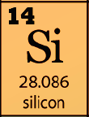
Abbreviated
Electron Configuration Notation
Write the electron configuration for Si

Slide 97
Abbreviated
Electron Configuration Notation
Write the electron configuration for Si
1s², 2s², 2p⁶, 3s², 3p²
This electron configuration
is the same as neon

Slide 98
Abbreviated Electron Configuration
1s², 2s², 2p⁶, 3s², 3p²
[Ne] 3s², 3p²

Slide 99
Abbreviated
Electron Configuration Notation
Write the electron configuration for Si
1s², 2s², 2p⁶, 3s², 3p²
[Ne] 3s², 3p²
Write this in your notes
abbreviated electron configuration
uses the noble gasses
(far right column of periodic table)

Slide 100
Rules for Abbreviated
Electron Configuration Notation
Write this in your notes
Only noble gasses can be put in the square brackets
Right: Ti = [Ar] 4s², 3d²
Wrong: Ti = [Ca] 3d²
Something must be written after the square brackets (e.g. need to show valence electrons)
Wrong: Ar = [Ar]
Right: Ar = [Ne] 3s², 3p⁶

Slide 101
Write the Abbreviated
Electron Configurations
Fe: 1s², 2s², 2p⁶, 3s², 3p⁶, 4s², 3d⁶
Fe: [Ar] 4s², 3d⁶
Sr: 1s², 2s², 2p⁶, 3s², 3p⁶, 4s², 3d¹⁰, 4p⁶, 5s²
Sr: [Kr] 5s²
  Br ̶ : 1s², 2s², 2p⁶, 3s², 3p⁶, 4s², 3d¹⁰, 4p⁶
  Br : [Ar] 4s², 3d¹⁰, 4p⁶ not [Kr]

Slide 102
Write the Abbreviated
Electron Configurations
Fe: 1s², 2s², 2p⁶, 3s², 3p⁶, 4s², 3d⁶
Fe: [Ar] 4s², 3d⁶
Sr: 1s², 2s², 2p⁶, 3s², 3p⁶, 4s², 3d¹⁰, 4p⁶, 5s²
Sr: [Kr] 5s²
  Br ̶ : 1s², 2s², 2p⁶, 3s², 3p⁶, 4s², 3d¹⁰, 4p⁶
  Br : [Ar] 4s², 3d¹⁰, 4p⁶ not [Kr]

Slide 103
Write the Abbreviated
Electron Configurations
Fe: 1s², 2s², 2p⁶, 3s², 3p⁶, 4s², 3d⁶
Fe: [Ar] 4s², 3d⁶
Sr: 1s², 2s², 2p⁶, 3s², 3p⁶, 4s², 3d¹⁰, 4p⁶, 5s²
Sr: [Kr] 5s²
  Br ̶ : 1s², 2s², 2p⁶, 3s², 3p⁶, 4s², 3d¹⁰, 4p⁶
  Br : [Ar] 4s², 3d¹⁰, 4p⁶ not [Kr]

Slide 104
Write the Abbreviated
Electron Configurations
Fe: 1s², 2s², 2p⁶, 3s², 3p⁶, 4s², 3d⁶
Fe: [Ar] 4s², 3d⁶
Sr: 1s², 2s², 2p⁶, 3s², 3p⁶, 4s², 3d¹⁰, 4p⁶, 5s²
Sr: [Kr] 5s²
  Br ̶ : 1s², 2s², 2p⁶, 3s², 3p⁶, 4s², 3d¹⁰, 4p⁶
  Br : [Ar] 4s², 3d¹⁰, 4p⁶ not [Kr]

Slide 105
Write the Long and Abbreviated
Electron Configurations
V
  1s², 2s², 2p⁶, 3s², 3p⁶, 4s², 3d³
  [Ar] 4s², 3d³
Sn
  1s², 2s², 2p⁶, 3s², 3p⁶, 4s², 3d¹⁰, 4p⁶, 5s², 4d¹⁰, 5p²
  [Kr] 5s², 4d¹⁰, 5p²
Eu
  1s², 2s², 2p⁶, 3s², 3p⁶, 4s², 3d¹⁰, 4p⁶, 5s², 4d¹⁰, 5p⁶, 6s², 4f⁷
  [Xe] 6s², 4f⁷
I ̶
  1s², 2s², 2p⁶, 3s², 3p⁶, 4s², 3d¹⁰, 4p⁶, 5s², 4d¹⁰, 5p⁶
  [Kr] 5s², 4d¹⁰, 5p⁶ not [Xe]

Slide 106
Write the Long and Abbreviated
Electron Configurations
V
  1s², 2s², 2p⁶, 3s², 3p⁶, 4s², 3d³
  [Ar] 4s², 3d³
Sn
  1s², 2s², 2p⁶, 3s², 3p⁶, 4s², 3d¹⁰, 4p⁶, 5s², 4d¹⁰, 5p²
  [Kr] 5s², 4d¹⁰, 5p²
Eu
  1s², 2s², 2p⁶, 3s², 3p⁶, 4s², 3d¹⁰, 4p⁶, 5s², 4d¹⁰, 5p⁶, 6s², 4f⁷
  [Xe] 6s², 4f⁷
I ̶
  1s², 2s², 2p⁶, 3s², 3p⁶, 4s², 3d¹⁰, 4p⁶, 5s², 4d¹⁰, 5p⁶
  [Kr] 5s², 4d¹⁰, 5p⁶ not [Xe]

Slide 107
Write the Long and Abbreviated
Electron Configurations
V
  1s², 2s², 2p⁶, 3s², 3p⁶, 4s², 3d³
  [Ar] 4s², 3d³
Sn
  1s², 2s², 2p⁶, 3s², 3p⁶, 4s², 3d¹⁰, 4p⁶, 5s², 4d¹⁰, 5p²
  [Kr] 5s², 4d¹⁰, 5p²
Eu
  1s², 2s², 2p⁶, 3s², 3p⁶, 4s², 3d¹⁰, 4p⁶, 5s², 4d¹⁰, 5p⁶, 6s², 4f⁷
  [Xe] 6s², 4f⁷
I ̶
  1s², 2s², 2p⁶, 3s², 3p⁶, 4s², 3d¹⁰, 4p⁶, 5s², 4d¹⁰, 5p⁶
  [Kr] 5s², 4d¹⁰, 5p⁶ not [Xe]

Slide 108
Write the Long and Abbreviated
Electron Configurations
V
  1s², 2s², 2p⁶, 3s², 3p⁶, 4s², 3d³
  [Ar] 4s², 3d³
Sn
  1s², 2s², 2p⁶, 3s², 3p⁶, 4s², 3d¹⁰, 4p⁶, 5s², 4d¹⁰, 5p²
  [Kr] 5s², 4d¹⁰, 5p²
Eu
  1s², 2s², 2p⁶, 3s², 3p⁶, 4s², 3d¹⁰, 4p⁶, 5s², 4d¹⁰, 5p⁶, 6s², 4f⁷
  [Xe] 6s², 4f⁷
I ̶
  1s², 2s², 2p⁶, 3s², 3p⁶, 4s², 3d¹⁰, 4p⁶, 5s², 4d¹⁰, 5p⁶
  [Kr] 5s², 4d¹⁰, 5p⁶ not [Xe]

Slide 109
Write the Long and Abbreviated
Electron Configurations
V
  1s², 2s², 2p⁶, 3s², 3p⁶, 4s², 3d³
  [Ar] 4s², 3d³
Sn
  1s², 2s², 2p⁶, 3s², 3p⁶, 4s², 3d¹⁰, 4p⁶, 5s², 4d¹⁰, 5p²
  [Kr] 5s², 4d¹⁰, 5p²
Eu
  1s², 2s², 2p⁶, 3s², 3p⁶, 4s², 3d¹⁰, 4p⁶, 5s², 4d¹⁰, 5p⁶, 6s², 4f⁷
  [Xe] 6s², 4f⁷
I ̶
  1s², 2s², 2p⁶, 3s², 3p⁶, 4s², 3d¹⁰, 4p⁶, 5s², 4d¹⁰, 5p⁶
  [Kr] 5s², 4d¹⁰, 5p⁶ not [Xe]

Slide 110
What is the element?
Electron Configuration | Element
1s², 2s², 2p⁶, 3s², 3p⁶, 4s², 3d¹⁰, 4p⁶, 5s², 4d¹⁰, 5p⁶, 6s², 4f¹⁴, 5d⁹
1s², 2s², 2p⁶, 3s², 3p⁶, 4s², 3d¹⁰, 4p⁶, 5s², 4d¹⁰, 5p⁶
1s², 2s², 2p⁶, 3s², 3p⁶, 4s², 3d¹⁰, 4p⁶, 5s², 4d¹⁰, 5p⁶, 6s², 4f¹¹
[Ar] 4s², 3d⁷
1s², 2s², 2p⁶, 3s², 3p⁶, 4s², 3d¹⁰, 4p⁶, 5s², 4d¹⁰, 5p⁶, 6s², 4f¹⁴, 5d¹⁰, 6p⁶, 7s², 5f⁶
[Xe] 6s², 4f¹⁴, 5d¹⁰, 6p²

Slide 111
What is the element?
Electron Configuration | Element
1s², 2s², 2p⁶, 3s², 3p⁶, 4s², 3d¹⁰, 4p⁶, 5s², 4d¹⁰, 5p⁶, 6s², 4f¹⁴, 5d⁹ | Au
1s², 2s², 2p⁶, 3s², 3p⁶, 4s², 3d¹⁰, 4p⁶, 5s², 4d¹⁰, 5p⁶
1s², 2s², 2p⁶, 3s², 3p⁶, 4s², 3d¹⁰, 4p⁶, 5s², 4d¹⁰, 5p⁶, 6s², 4f¹¹
[Ar] 4s², 3d⁷
1s², 2s², 2p⁶, 3s², 3p⁶, 4s², 3d¹⁰, 4p⁶, 5s², 4d¹⁰, 5p⁶, 6s², 4f¹⁴, 5d¹⁰, 6p⁶, 7s², 5f⁶
[Xe] 6s², 4f¹⁴, 5d¹⁰, 6p²

Slide 112
What is the element?
Electron Configuration | Element
1s², 2s², 2p⁶, 3s², 3p⁶, 4s², 3d¹⁰, 4p⁶, 5s², 4d¹⁰, 5p⁶, 6s², 4f¹⁴, 5d⁹ | Au
1s², 2s², 2p⁶, 3s², 3p⁶, 4s², 3d¹⁰, 4p⁶, 5s², 4d¹⁰, 5p⁶ | Xe
1s², 2s², 2p⁶, 3s², 3p⁶, 4s², 3d¹⁰, 4p⁶, 5s², 4d¹⁰, 5p⁶, 6s², 4f¹¹
[Ar] 4s², 3d⁷
1s², 2s², 2p⁶, 3s², 3p⁶, 4s², 3d¹⁰, 4p⁶, 5s², 4d¹⁰, 5p⁶, 6s², 4f¹⁴, 5d¹⁰, 6p⁶, 7s², 5f⁶
[Xe] 6s², 4f¹⁴, 5d¹⁰, 6p²

Slide 113
What is the element?
Electron Configuration | Element
1s², 2s², 2p⁶, 3s², 3p⁶, 4s², 3d¹⁰, 4p⁶, 5s², 4d¹⁰, 5p⁶, 6s², 4f¹⁴, 5d⁹ | Au
1s², 2s², 2p⁶, 3s², 3p⁶, 4s², 3d¹⁰, 4p⁶, 5s², 4d¹⁰, 5p⁶ | Xe
1s², 2s², 2p⁶, 3s², 3p⁶, 4s², 3d¹⁰, 4p⁶, 5s², 4d¹⁰, 5p⁶, 6s², 4f¹¹ | Ho
[Ar] 4s², 3d⁷
1s², 2s², 2p⁶, 3s², 3p⁶, 4s², 3d¹⁰, 4p⁶, 5s², 4d¹⁰, 5p⁶, 6s², 4f¹⁴, 5d¹⁰, 6p⁶, 7s², 5f⁶
[Xe] 6s², 4f¹⁴, 5d¹⁰, 6p²

Slide 114
What is the element?
Electron Configuration | Element
1s², 2s², 2p⁶, 3s², 3p⁶, 4s², 3d¹⁰, 4p⁶, 5s², 4d¹⁰, 5p⁶, 6s², 4f¹⁴, 5d⁹ | Au
1s², 2s², 2p⁶, 3s², 3p⁶, 4s², 3d¹⁰, 4p⁶, 5s², 4d¹⁰, 5p⁶ | Xe
1s², 2s², 2p⁶, 3s², 3p⁶, 4s², 3d¹⁰, 4p⁶, 5s², 4d¹⁰, 5p⁶, 6s², 4f¹¹ | Ho
[Ar] 4s², 3d⁷ | Co
1s², 2s², 2p⁶, 3s², 3p⁶, 4s², 3d¹⁰, 4p⁶, 5s², 4d¹⁰, 5p⁶, 6s², 4f¹⁴, 5d¹⁰, 6p⁶, 7s², 5f⁶
[Xe] 6s², 4f¹⁴, 5d¹⁰, 6p²

Slide 115
What is the element?
Electron Configuration | Element
1s², 2s², 2p⁶, 3s², 3p⁶, 4s², 3d¹⁰, 4p⁶, 5s², 4d¹⁰, 5p⁶, 6s², 4f¹⁴, 5d⁹ | Au
1s², 2s², 2p⁶, 3s², 3p⁶, 4s², 3d¹⁰, 4p⁶, 5s², 4d¹⁰, 5p⁶ | Xe
1s², 2s², 2p⁶, 3s², 3p⁶, 4s², 3d¹⁰, 4p⁶, 5s², 4d¹⁰, 5p⁶, 6s², 4f¹¹ | Ho
[Ar] 4s², 3d⁷ | Co
1s², 2s², 2p⁶, 3s², 3p⁶, 4s², 3d¹⁰, 4p⁶, 5s², 4d¹⁰, 5p⁶, 6s², 4f¹⁴, 5d¹⁰, 6p⁶, 7s², 5f⁶ | Pu
[Xe] 6s², 4f¹⁴, 5d¹⁰, 6p²

Slide 116
What is the element?
Electron Configuration | Element
1s², 2s², 2p⁶, 3s², 3p⁶, 4s², 3d¹⁰, 4p⁶, 5s², 4d¹⁰, 5p⁶, 6s², 4f¹⁴, 5d⁹ | Au
1s², 2s², 2p⁶, 3s², 3p⁶, 4s², 3d¹⁰, 4p⁶, 5s², 4d¹⁰, 5p⁶ | Xe
1s², 2s², 2p⁶, 3s², 3p⁶, 4s², 3d¹⁰, 4p⁶, 5s², 4d¹⁰, 5p⁶, 6s², 4f¹¹ | Ho
[Ar] 4s², 3d⁷ | Co
1s², 2s², 2p⁶, 3s², 3p⁶, 4s², 3d¹⁰, 4p⁶, 5s², 4d¹⁰, 5p⁶, 6s², 4f¹⁴, 5d¹⁰, 6p⁶, 7s², 5f⁶ | Pu
[Xe] 6s², 4f¹⁴, 5d¹⁰, 6p² | Pb

Slide 117
Homework
WS Electron Configurations (Abbreviated)

Slide 119
Electronic Configurations on the Periodic Table

Slide 120
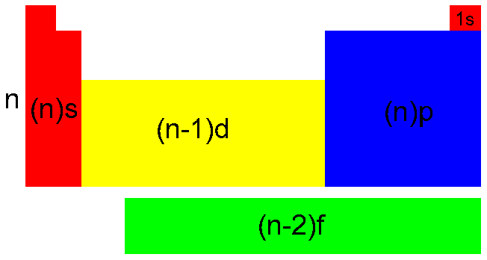
Note the Difference in the Quantum Number

Slide 121
Do Now
Write the electron configuration for each atom:
beryllium (Be)
nitrogen (N)
  potassium (K)

Slide 122
Do Now
Write the electron configuration for each atom:
beryllium (Be)
1s², 2s²
nitrogen (N)
  1s², 2s², 2p³
  potassium (K)
  1s², 2s², 2p⁶, 3s², 3p⁶, 4s¹

Slide 123
Do Now
Write the abbreviated electron configuration for each atom:
1) beryllium (Be)
[He] 2s²
2) phosphorus (P)
  [Ne] 3s², 4p³
  3) cesium (Cs)
  [Xe] 6s¹

Slide 125
