Slide 1





Do Now
 | section s |  |  | section p
floor 3
floor 2
 |  |  |  | Middle School
floor 1
rows: | 1 | 2 |  | 1 | 2 | 3 | 4 | 5 | 6
The parking garage fills its spots from lowest to highest
Each spot is designated by floor section ^{row #}
  yellow car is at spot 2 p ¹
In which spot is the green car parked?
In which spot is the purple car parked?
If 9 more cars came, in which would the 9th car be parked?

Slide 2
Electron Configurations
SWBAT explain and use the rules governing electron configurations and represent these configurations using diagrams & notation.
Write this in your notes

Slide 3
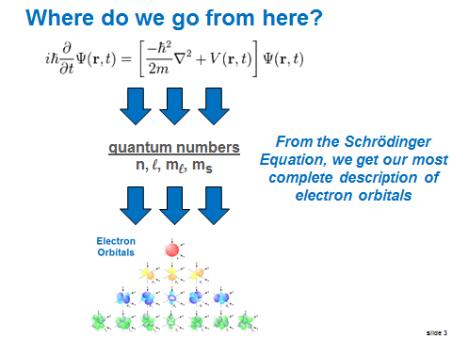
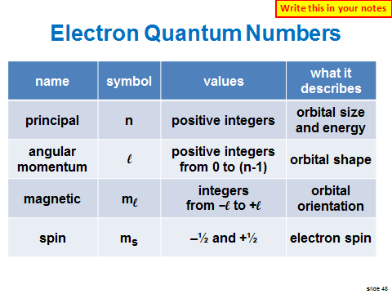
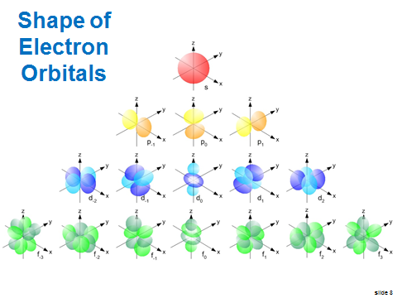
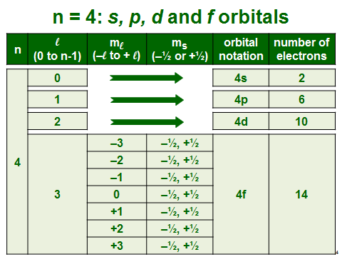
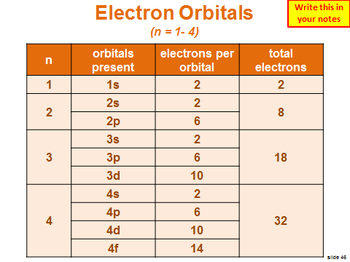
Last Class

Slide 4

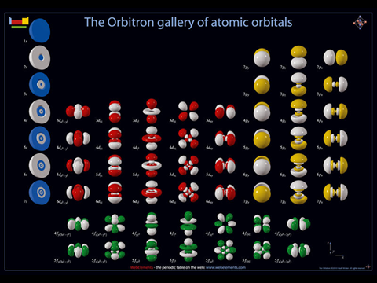
Description of the Orbitals
quantum numbers
n, l, m_{l}, m_{s}
From the Schrödinger Equation, we get our most complete description of electron orbitals

Slide 5
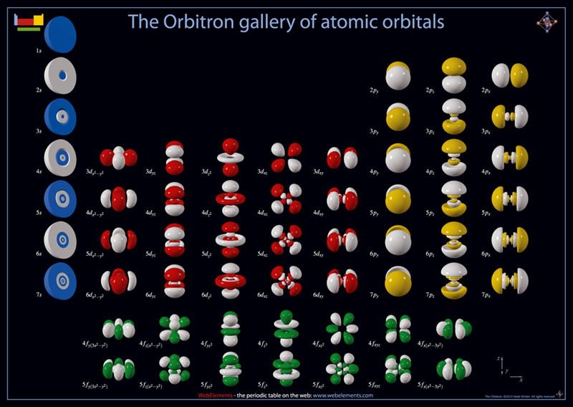

Slide 6
Energy of the Orbitals
quantum numbers
n, l, m_{l}, m_{s}
The Schrödinger Equation also provides us with the relative energy levels of the different orbitals
Write this in your notes

Slide 7
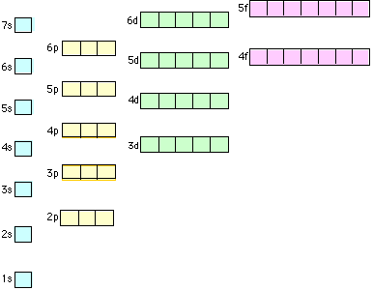
Relative Energy Levels of Orbitals
Energy
of
Orbital
How are the electrons arranged in these orbitals?

Slide 8
Electron Configuration
Write this in your notes
The electron configuration is the arrangement of electrons in an atom

Slide 9
Rules for Electron Configurations
Write this in your notes
Aufbau Rule
  Electrons occupy the lowest possible energy level
Pauli Exclusion Principle
  Only two electrons of opposite spin can occupy an orbital
Hund's Rule
  Put a single electron into all equivalent orbitals before doubling up

Slide 10
Relative Energy Levels of Orbitals
Energy
of
Orbital
We will start by making
electron configuration diagrams of the five lowest energy orbitals
draw these on the board & go to next slide

Slide 11
Rules for Electron Configurations
Aufbau Rule
  Electrons occupy the lowest possible energy level
Pauli Exclusion Principle
  Only two electrons of opposite spin can occupy an orbital
Hund's Rule
  Put a single electron into all equivalent orbitals before doubling up

Slide 12
1) Aufbau Rule
Hydrogen has an atomic number of 1
That means it has 1 proton
It is neutral, so it has the same number of electrons (e.g. 1)
Aufbau rule says the electron occupies the lowest energy level
It is represented by an up arrow to indicate its spin
3p
3s
2p
2s
1s

Slide 13
2) Pauli Exclusion Principle
Helium has an atomic number of 2
That means it has 2 protons
It is neutral, so it has the same number of electrons (e.g. 2)
Aufbau rule says the electrons occupy the lowest energy levels
Pauli exclusion principle says the electrons must have opposite spins
3p
3s
2p
2s
1s

Slide 14
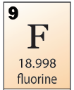
3) Hund's Rule
3p
3s
2p
2s
Hund's rule says the next electron must go into an equivalent orbital rather than pair up
1s
Only when all equivalent orbitals are full do the electron pair up

Slide 15
Rules for Electron Configurations
Aufbau Rule
  Electrons occupy the lowest possible energy level
Pauli Exclusion Principle
  Only two electrons of opposite spin can occupy an orbital
Hund's Rule
  Put a single electron into all equivalent orbitals before doubling up

Slide 16
Group Practice
Write this in your notes
Draw an orbital diagram for Be:
3p
3s
2p
2s
1s

Slide 17
Group Practice
Write this in your notes
Draw an orbital diagram for Be:
3p
3s
2p
2s
Aufbau Rule requires 1s to be filled before 2s.
Pauli Exclusion Principle requires the two electrons to have opposite spins
1s

Slide 18
Group Practice
Write this in your notes
Draw an orbital diagram for O:
3p
3s
2p
2s
1s

Slide 19
Group Practice
Write this in your notes
Draw an orbital diagram for O:
3p
3s
2p
2s
Hund's Rule requires the first 3 electrons in the 2p orbital to have the same spin.
The 4th electron has an opposite spin
1s

Slide 20
Group Practice
Write this in your notes
Draw an orbital diagram for P:
3p
3s
2p
2s
1s

Slide 21
Group Practice
Write this in your notes
Draw an orbital diagram for P:
3p
3s
2p
2s
Hund's Rule requires the first 3 electrons in the 3p orbital to have the same spin.
1s

Slide 22
Individual Practice
Draw an orbital diagram for the following atoms:
  Li
  Ne
  Na
  Na⁺
3p
3s
2p
2s
1s

Slide 23
Lithium
3p
3s
2p
2s
1s

Slide 24
Neon
3p
3s
2p
2s
1s

Slide 25
Sodium
3p
3s
2p
2s
1s

Slide 26
Sodium Cation
3p
3s
2p
2s
1s

Slide 27
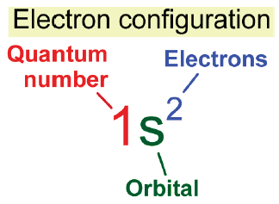
Electron Configuration Notation
Drawing these diagrams takes a long time and a lot of space.
For this reason, chemists came up with a short notation (shown here for helium)
3p
3s
2p
2s
1s
Write this in your notes

Slide 28
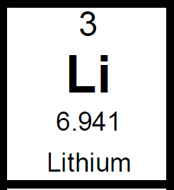
Electron Configuration Notation 2
3p
3s
2p
2s
1s², 2s¹
1s

Slide 29
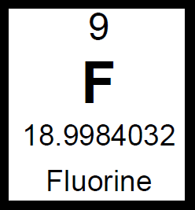
Electron Configuration Notation 3
3p
3s
2p
2s
1s², 2s², 2p⁵
1s

Slide 30
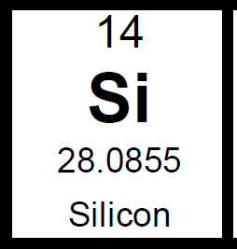
Electron Configuration Notation 4
3p
3s
2p
2s
1s², 2s², 2p⁶, 3s², 3p²
1s

Slide 31
Individual Practice
Write the electron configuration notation for the following atoms:
  Li
  Ne
  Na
  Na⁺

Slide 32
Lithium
3p
3s
2p
1s², 2s¹, 2p⁵
2s
1s

Slide 33
Neon
3p
3s
2p
1s², 2s², 2p⁶
2s
1s

Slide 34
Sodium
3p
3s
2p
1s², 2s², 2p⁶, 3s¹
2s
1s

Slide 35
Sodium Cation
3p
3s
2p
1s², 2s², 2p⁶
2s
1s

Slide 36
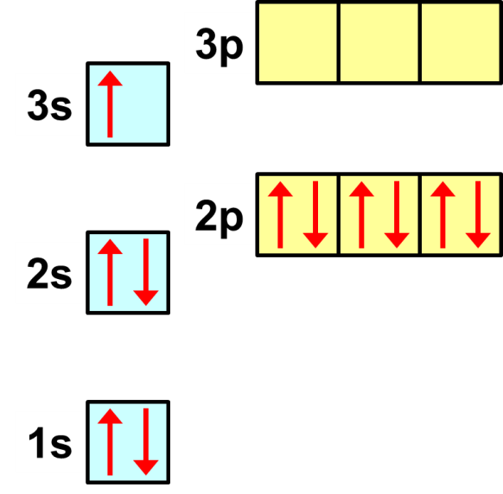

Note the Difference Between Sodium and Sodium Cation
1s², 2s², 2p⁶, 3s¹
1s², 2s², 2p⁶, 3s¹

Slide 37
Note that Ne and Na⁺ have the Same Electron Configuration
1s², 2s², 2p⁶
1s², 2s², 2p⁶, 3s¹

Slide 38
From Notation to Atom
What neutral atom has the electron configuration of 1s², 2s², 2p⁶, 3s², 3p¹?
Count the number of electrons
13 electrons
If atom is neutral, find the atom with the same number of protons (e.g. atomic number equal to the number of electrons)
Al

Slide 39
From Notation to Cation or Anion
What cation and anion have the electron configuration of 1s², 2s², 2p⁶, 3s², 3p¹?
Count the number of electrons
13 electrons
For a cation, choose atom with 1 more proton
Si⁺
For an anion, choose atom with 1 less proton
Mg‒

Slide 40





Parking Garage Analogy
 | section s |  |  | section p
floor 3
floor 2
 |  |  |  | Middle School
floor 1
rows: | 1 | 2 |  | 1 | 2 | 3 | 4 | 5 | 6
primary quantum number = floor
Aufbau rule = fill from bottom to top
Pauli exclusion principle = only 1 car per parking spot
Hund's rule = skip a spot between cars
Electron configuration notation = ticket for parking locations

Slide 41
Do Now
Draw the electron configuration orbital diagram for chlorine.
Write the electron configuration notation for chlorine.

Slide 42
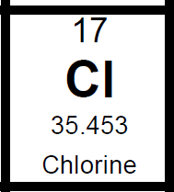
Do Now
3p
3s
2p
2s
1s², 2s², 2p⁶, 3s², 3p⁵
1s

Slide 43
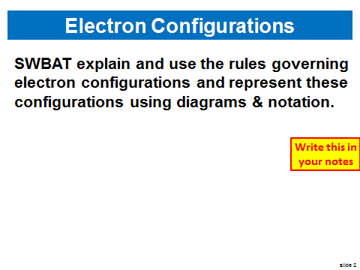
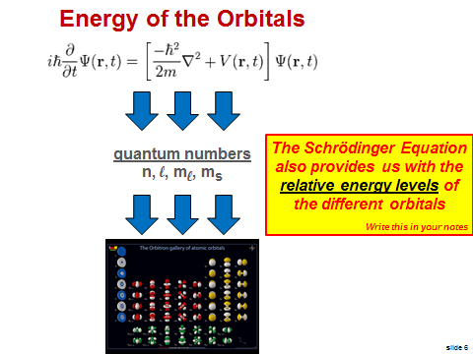
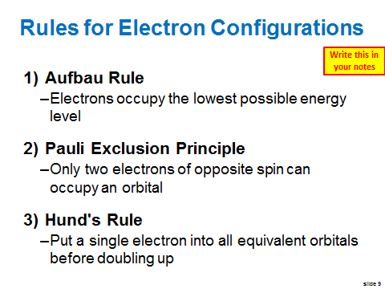
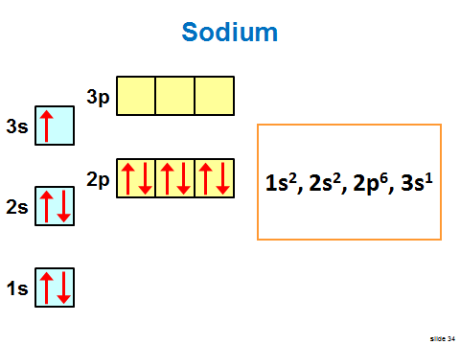
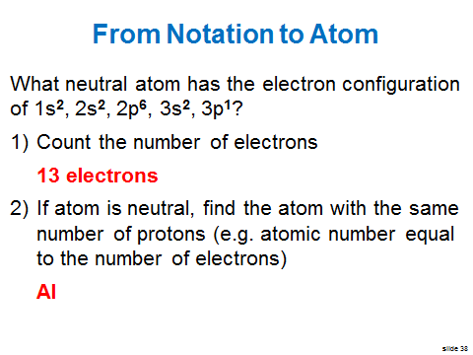
Last Class

Slide 44
Individual Practice 1
Write the electron configuration notation for the following atoms:
  C
  Al
  Cl ̶
  Mg⁺²

Slide 45
Individual Practice 1
Write the electron configuration notation for the following atoms:
  C 1s², 2s², 2p²
  Al
  Cl ̶
  Mg⁺²

Slide 46
Individual Practice 1
Write the electron configuration notation for the following atoms:
  C 1s², 2s², 2p²
  Al 1s², 2s², 2p⁶, 3s², 3p¹
  Cl ̶
  Mg⁺²

Slide 47
Individual Practice 1
Write the electron configuration notation for the following atoms:
  C 1s², 2s², 2p²
  Al 1s², 2s², 2p⁶, 3s², 3p¹
  Cl ̶ 1s², 2s², 2p⁶, 3s², 3p⁶
  Mg⁺²

Slide 48
Individual Practice 1
Write the electron configuration notation for the following atoms:
  C 1s², 2s², 2p²
  Al 1s², 2s², 2p⁶, 3s², 3p¹
  Cl ̶ 1s², 2s², 2p⁶, 3s², 3p⁶
  Mg⁺² 1s², 2s², 2p⁶

Slide 49
Individual Practice 2
Determine which element has the electron configuration notation shown:
  1s², 2s²
  1s², 2s², 2p³
  1s², 2s², 2p⁶, 3s¹
  1s², 2s², 2p⁶, 3s², 3p⁴

Slide 50
Individual Practice 2
Determine which element has the electron configuration notation shown:
  1s², 2s² Be
  1s², 2s², 2p³
  1s², 2s², 2p⁶, 3s¹
  1s², 2s², 2p⁶, 3s², 3p⁴

Slide 51
Individual Practice 2
Determine which element has the electron configuration notation shown:
  1s², 2s² Be
  1s², 2s², 2p³ N
  1s², 2s², 2p⁶, 3s¹
  1s², 2s², 2p⁶, 3s², 3p⁴

Slide 52
Individual Practice 2
Determine which element has the electron configuration notation shown:
  1s², 2s² Be
  1s², 2s², 2p³ N
  1s², 2s², 2p⁶, 3s¹ Na
  1s², 2s², 2p⁶, 3s², 3p⁴

Slide 53
Individual Practice 2
Determine which element has the electron configuration notation shown:
  1s², 2s² Be
  1s², 2s², 2p³ N
  1s², 2s², 2p⁶, 3s¹ Na
  1s², 2s², 2p⁶, 3s², 3p⁴ S

Slide 54
Individual Practice 3
Write the electron configuration notation for the following atoms:
  N
  P
  Li⁺
  S⁻²

Slide 55
Individual Practice 3
Write the electron configuration notation for the following atoms:
  N 1s², 2s², 2p³
  P
  Li⁺
  S⁻²

Slide 56
Individual Practice 3
Write the electron configuration notation for the following atoms:
  N 1s², 2s², 2p³
  P 1s², 2s², 2p⁶, 3s², 3p³
  Li⁺
  S⁻²

Slide 57
Individual Practice 3
Write the electron configuration notation for the following atoms:
  N 1s², 2s², 2p³
  P 1s², 2s², 2p⁶, 3s², 3p³
  Li⁺ 1s²
  S⁻²

Slide 58
Individual Practice 3
Write the electron configuration notation for the following atoms:
  N 1s², 2s², 2p³
  P 1s², 2s², 2p⁶, 3s², 3p³
  Li⁺ 1s²
  S⁻² 1s², 2s², 2p⁶, 3s², 3p⁶

Slide 59
Switch to 0515

Slide 60
Orbital Diagram
Energy
of
Orbital
Each box holds two electrons with opposite spins

Slide 61
Orbital Diagram
Energy
of
Orbital
Each box holds two electrons with opposite spins

Slide 62
Orbital Diagram
Energy
of
Orbital
Each box holds two electrons with opposite spins

Slide 63
4s is lower than 3d
Energy
of
Orbital
Each box holds two electrons with opposite spins

Slide 64
5d is lower than 4f
Energy
of
Orbital
Each box holds two electrons with opposite spins

Slide 65
The way we think it should be
Energy Levels of Orbitals
7s | 7p
6s | 6p | 6d
5s | 5p | 5d | 5f
4s | 4p | 4d | 4f
3s | 3p | 3d
2s | 2p
1s

Slide 66
Energy Levels of Orbitals
7s | 7p
6s | 6p | 6d
5s | 5p | 5d | 5f
4s | 4p | 4d | 4f
3s | 3p | 3d
2s | 2p
1s
The way it is

Slide 67
Electron Configuration for K
4p
3d
4s
3p
The 4s orbital is lower in energy than the 3d orbital
3s
2p
2s
Electron Configuration Notation
1s², 2s², 2p⁶, 3s², 3p⁶, 4s¹
1s

Slide 68
Electron Configuration for V
4p
3d
4s
Don't forget Hund's Rule
3p
The 3d orbital is lower in energy than the 4p orbital
3s
2p
2s
Electron Configuration Notation
1s², 2s², 2p⁶, 3s², 3p⁶, 4s², 3d³
1s

Slide 69
Electron Configuration for Ge
4p
3d
4s
3p
Once 3d is full, electrons start filling 4p
3s
2p
2s
Electron Configuration Notation
1s², 2s², 2p⁶, 3s², 3p⁶, 4s², 3d¹⁰, 4p²
1s

Slide 70
Individual Practice 3
Write the electron configuration notation for the following atoms:
  Co
  As
  Ca

Slide 71
Individual Practice 3
Write the electron configuration notation for the following atoms:
  Co 1s², 2s², 2p⁶, 3s², 3p⁶, 4s², 3d⁷
  As 1s², 2s², 2p⁶, 3s², 3p⁶, 4s², 3d¹⁰, 4p³
  Ca 1s², 2s², 2p⁶, 3s², 3p⁶, 4s²

Slide 72
Rules for Electron Configurations
Aufbau Rule
  Electrons occupy the lowest possible energy level
Pauli Exclusion Principle
  Only two electrons of opposite spin can occupy an orbital
Hund's Rule
  Put a single electron into all equivalent orbitals before doubling up
These cover most elements, but not all

Slide 73
Exceptions
Increased stability from half-filled or completely filled orbitals
Reason for exception not known
Anions and cations are often exceptions

Slide 74
Electron Configurations
SWBAT explain and use the rules governing electron configurations and represent these configurations using diagrams & notation.

Slide 75
Backup Slides

Slide 76
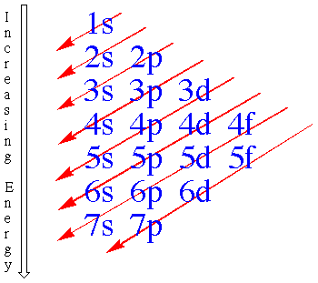
Energy Levels of Orbitals
Get an inverted version of this diagram
Orbitals do not fill according to the quantum number
Orbitals fill according
to the pattern shown here

Slide 77
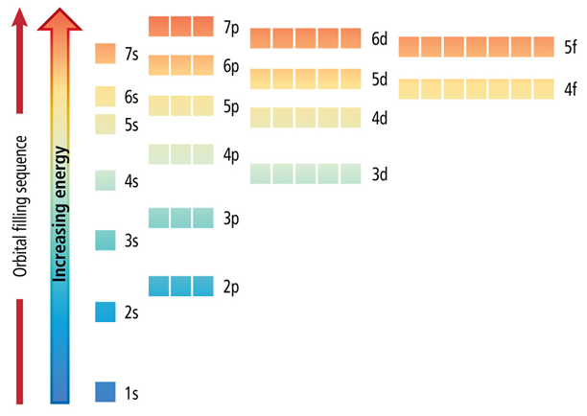
Each box holds two electrons with opposite spins

Slide 78
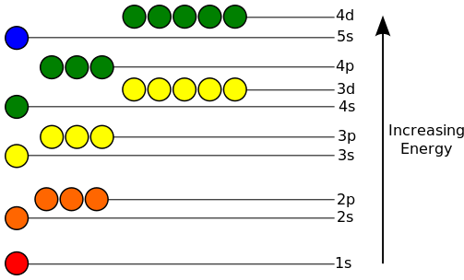

Slide 79
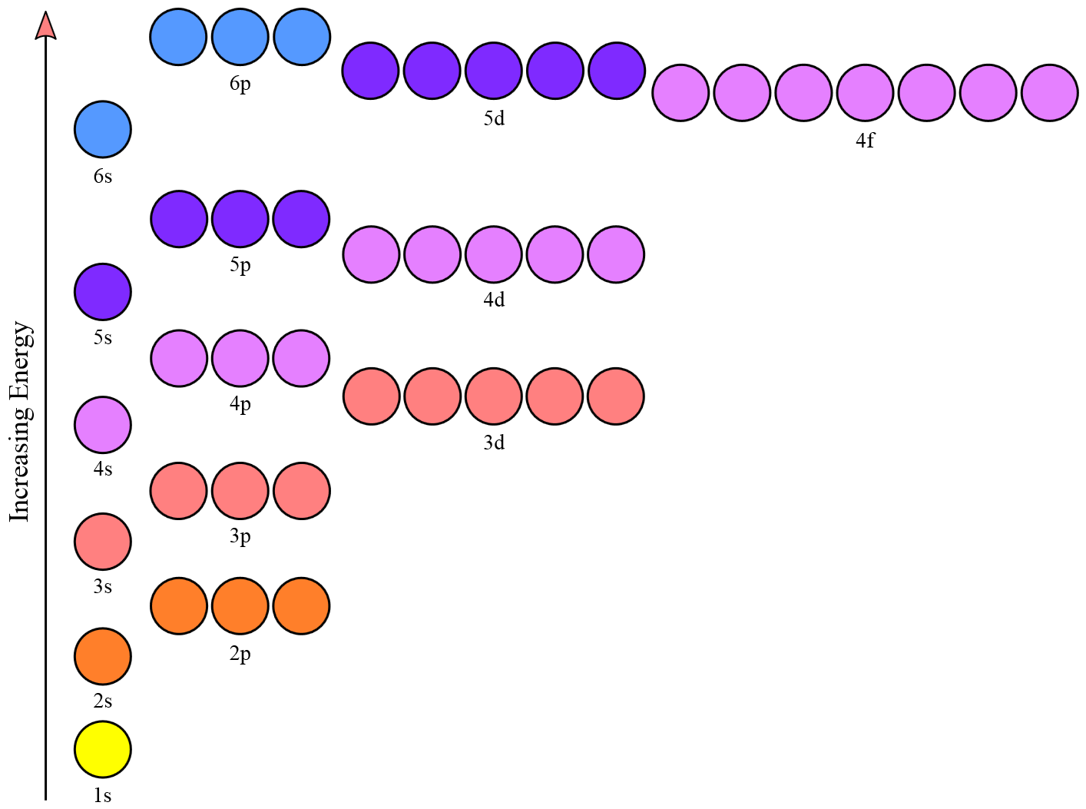

Slide 80
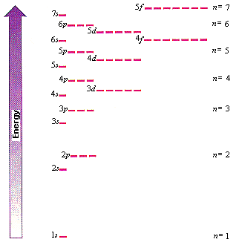

Slide 81
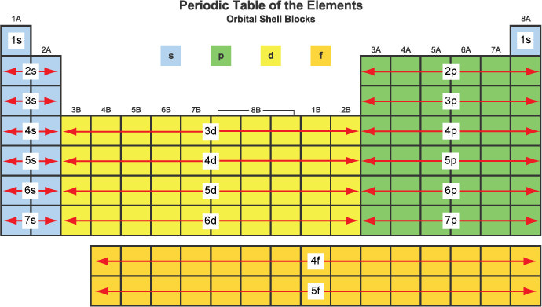

Slide 82
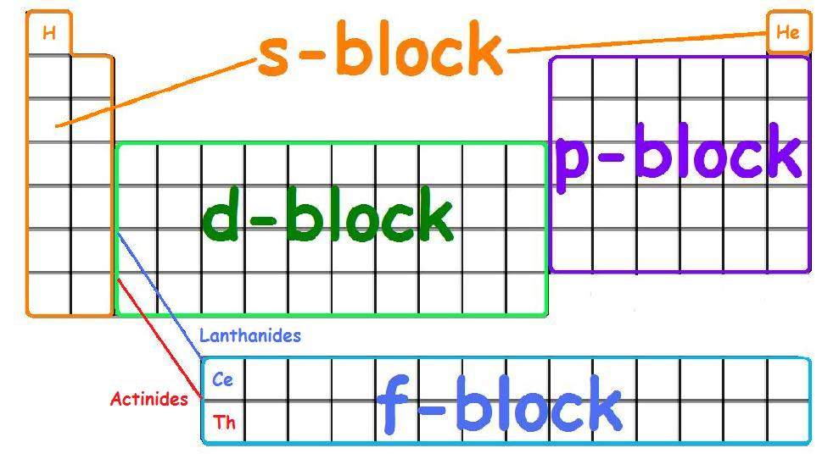

Slide 83
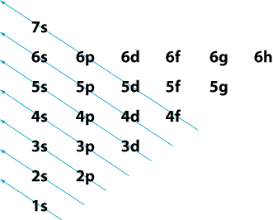

Slide 84
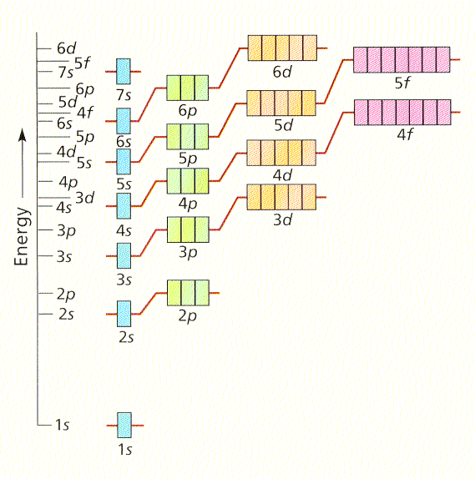

Slide 86
Practice with a Partner
Choose a partner
Write a question for your partner
Answer the question your partner wrote for you
Grade your partner's answer
Compare results

Slide 88
Filling the Orbitals
Hydrogen has an atomic number of 1
That means it has 1 proton
It is neutral, so it has the same number of electrons (e.g. 1)
The electron occupies the lowest energy level
It is represented by an up arrow to indicate its spin
3p
3s
2p
2s
1s

Slide 89
3p
3s
2p
2s
1s

Slide 90
3p
3s
2p
2s
1s

Slide 91
3p
3s
2p
2s
3p
3s
1s
2p
2s
1s

Slide 92
Energy Levels of Orbitals
8s | 8p | 8d | 8f | 8g | 8h | 8i | 8k
7s | 7p | 7d | 7f | 7g | 7h | 7i
6s | 6p | 6d | 6f | 6g | 6h
5s | 5p | 5d | 5f | 5g
4s | 4p | 4d | 4f
3s | 3p | 3d
2s | 2p
1s

Slide 93
4p
3d
4s
3p
3s
2p
2s
1s

Slide 95
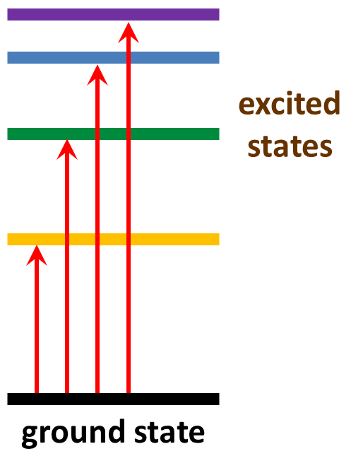
Absorption of Light
What is the ground state of the electrons in a given element?

Slide 96
Where are the Electrons?
When an element absorbs light, an electron moves from its ground state energy level to an excited state energy level.
Hydrogen has just one electron, but all other elements have many electrons.
What is the ground state energy level for each electron in an element?

