Slide 1
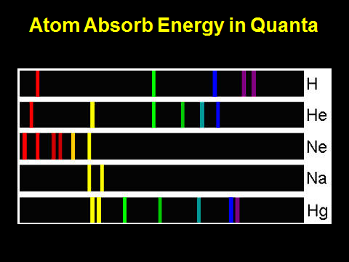
Last Class

Slide 2
Outline
Quantum Energy
Bohr Atom
Wave-Particle Duality
Heisenberg Uncertainty Principle
Schrödinger Equation
You need to be able to explain each of these concepts and how they contributed to the evolution of the electron theory

Slide 3
ANY QUESTIONS??

Slide 4
Open Note Quiz
What is a quantum?
What is the Bohr model of the atom?
What is wave-particle duality?
What impact does the Heisenberg Uncertainty Principle have on electron theory?
What is the Schrödinger Equation?

Slide 5
Concept | Simple Summary
Quantum Energy | In atoms, electrons can only absorb specific amounts of energy (quanta).
Bohr Atom | Early model that says electrons orbit the nucleus like planets orbit the sun
Wave-Particle Duality | Electrons have properties of both particles and waves.
Heisenberg Uncertainty Principle | Exact position and speed of electron can't be known, so we need to talk about "electron clouds".
Schrödinger Equation | Complex mathematical equation that describes electron orbitals.

Slide 6
Do Now
Make a drawing based on these instructions
Draw a horizontal line
Draw four rectangles next to each other
long side vertical
each touches the line
the group is above and centered on the line
Draw 3 circles next to each other
each touches 2 rectangles
the group is above and centered on the rectangles
Draw an upside-down triangle
touching the middle circle
above and centered on the middle circle

Slide 8
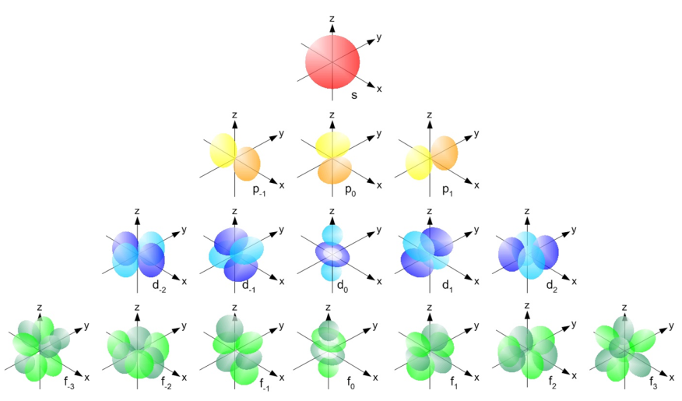
quantum numbers
n, l, m_{l}, m_{s}

Slide 9
Electron Orbitals
SWBAT explain electron quantum numbers and how electron orbitals are derived from them.
Write this in your notes

Slide 10
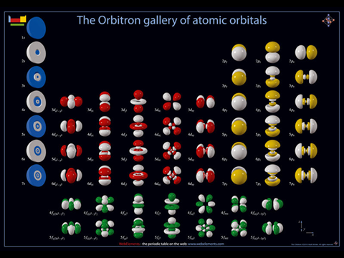
Where do we go from here?
quantum numbers
n, l, m_{l}, m_{s}
From the Schrödinger Equation, we get our most complete description of electron orbitals

Slide 11
Electron Quantum Numbers
Write this in your notes
name | symbol | values | what it describes

Slide 12
Principal Quantum Number
n
describes the orbital size & energy
average distance from the nucleus
can be any positive integer
e.g. 1, 2, 3,...

Slide 13
Electron Quantum Numbers
Write this in your notes
name | symbol | values | what it describes
principal | n | positive integers | orbital size and energy

Slide 14
Angular Momentum Quantum Number
l
describes orbital shape
different numbers for different shapes
can be an integer from 0 to n-1
l | letter designation
0 | s
1 | p
2 | d
3 | f
Write this in your notes

Slide 15
Shape of Electron Orbitals

Slide 16
Electron Quantum Numbers
Write this in your notes
name | symbol | values | what it describes
principal | n | positive integers | orbital size and energy
angular momentum | l | positive integers from 0 to (n-1) | orbital shape

Slide 17
Magnetic Quantum Number
m_{l}
describes orientation of orbitals
each number indicates how the orbital is tilted in space
values are integers from - l to + l
e.g. -1, 0, 1

Slide 18
Orientation of p-Orbitals

Slide 19
Electron Quantum Numbers
Write this in your notes
name | symbol | values | what it describes
principal | n | positive integers | orbital size and energy
angular momentum | l | positive integers from 0 to (n-1) | orbital shape
magnetic | m_{l} | integers from ‒l to +l | orbital orientation

Slide 20
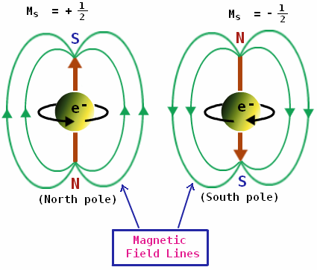
Spin Quantum Number
m_{s}
an electron spins along its axis
this spin induces a magnetic field
clockwise spin induces the opposite magnetic polarity as counter-clockwise spin
m_{s} describes the electron spin
can be - ½ or + ½

Slide 21
Electron Quantum Numbers
Write this in your notes
name | symbol | values | what it describes
principal | n | positive integers | orbital size and energy
angular momentum | l | positive integers from 0 to (n-1) | orbital shape
magnetic | m_{l} | integers from ‒l to +l | orbital orientation
spin | m_{s} | ‒½ or +½ | electron spin

Slide 22
Where do we go from here?
quantum numbers
n, l, m_{l}, m_{s}
From the Schrödinger Equation, we get our most complete description of electron orbitals

Slide 23
Building Electron Orbitals
quantum numbers
n, l, m_{l}, m_{s}
An electron's quantum state is described by n, l, m_{l}, m_{s}
No two electrons can have identical quantum numbers
What are the names of the orbitals and how many electrons can they hold?

Slide 24
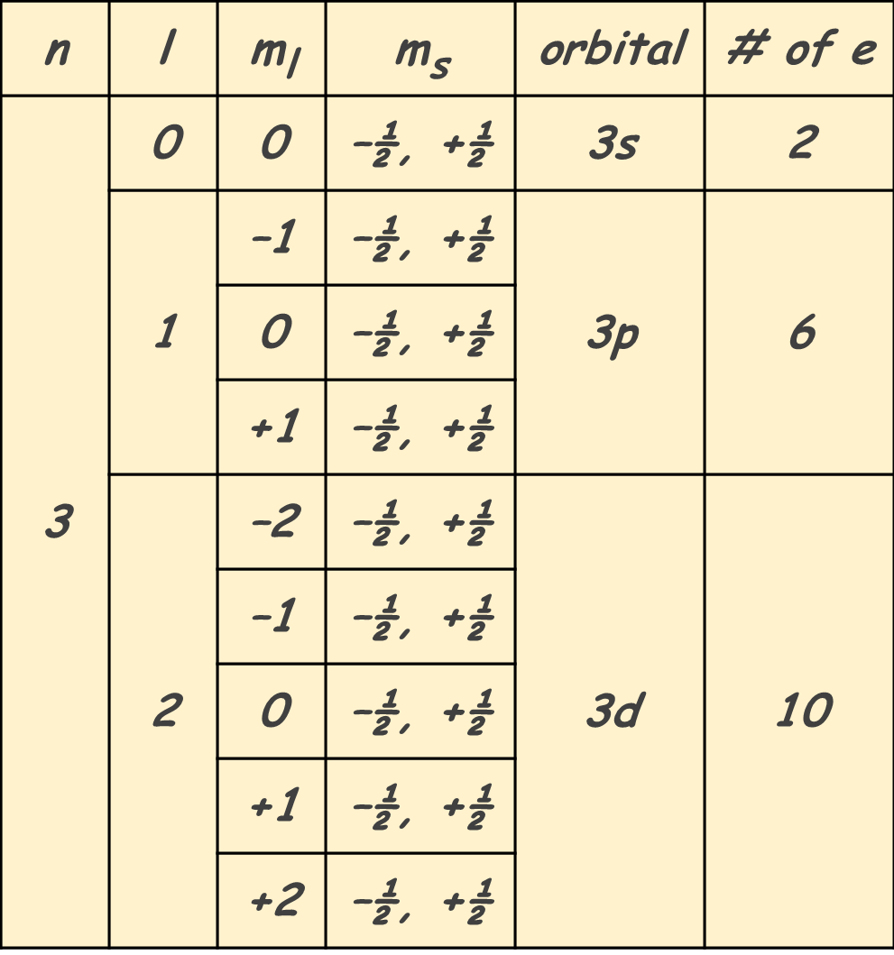
n | l (0 to n-1) | m_{l} (–l to + l) | m_{s} (–½ or +½) | orbital notation | number of electrons
We are going to derive the allowable orbitals and the number of electrons
On an empty sheet of paper, you need to start a table where you can write this in your notes
Write these column headings

Slide 25
n = 1: s orbitals
n | l (0 to n-1) | m_{l} (–l to + l) | m_{s} (–½ or +½) | orbital notation | number of electrons

Slide 26
n = 1: s orbitals
n | l (0 to n-1) | m_{l} (–l to + l) | m_{s} (–½ or +½) | orbital notation | number of electrons
1

Slide 27
n = 1: s orbitals
n | l (0 to n-1) | m_{l} (–l to + l) | m_{s} (–½ or +½) | orbital notation | number of electrons
1 | 0

Slide 28
n = 1: s orbitals
n | l (0 to n-1) | m_{l} (–l to + l) | m_{s} (–½ or +½) | orbital notation | number of electrons
1 | 0 | 0

Slide 29
n = 1: s orbitals
n | l (0 to n-1) | m_{l} (–l to + l) | m_{s} (–½ or +½) | orbital notation | number of electrons
1 | 0 | 0 | –½
 |  |  | +½

Slide 30
Orbital Notation
Write this in your notes
principal
quantum
number
angular
momentum
letter
l | letter designation
0 | s
1 | p
2 | d
3 | f
n = 3
l = 2
3
d

Slide 31
n = 1: s orbitals
n | l (0 to n-1) | m_{l} (–l to + l) | m_{s} (–½ or +½) | orbital notation | number of electrons
1 | 0 | 0 | –½ | 1s
 |  |  | +½

Slide 32
n = 1: s orbitals
n | l (0 to n-1) | m_{l} (–l to + l) | m_{s} (–½ or +½) | orbital notation | number of electrons
1 | 0 | 0 | –½ | 1s | 2
 |  |  | +½
electron #1: quantum numbers = 1, 0, 0, –½
electron #2: quantum numbers = 1, 0, 0, +½

Slide 33
n = 1: s orbitals
n | l (0 to n-1) | m_{l} (–l to + l) | m_{s} (–½ or +½) | orbital notation | number of electrons
1 | 0 | 0 | –½, +½ | 1s | 2
The two spin quantum number values are usually shown on the same line to save space

Slide 34
n = 2: s and p orbitals
n | l (0 to n-1) | m_{l} (–l to + l) | m_{s} (–½ or +½) | orbital notation | number of electrons
2
What are the allowable values of l?

Slide 35
n = 2: s and p orbitals
n | l (0 to n-1) | m_{l} (–l to + l) | m_{s} (–½ or +½) | orbital notation | number of electrons
2 | 0
 | 1
What are the allowable values of m_{l} and m_{s}?

Slide 36
n = 2: s and p orbitals
n | l (0 to n-1) | m_{l} (–l to + l) | m_{s} (–½ or +½) | orbital notation | number of electrons
2 | 0 | 0 | –½, +½
 | 1
What is the orbital notation?
How many electrons can it hold?

Slide 37
n = 2: s and p orbitals
n | l (0 to n-1) | m_{l} (–l to + l) | m_{s} (–½ or +½) | orbital notation | number of electrons
2 | 0 | 0 | –½, +½ | 2s | 2
 | 1
What are the allowable values of m_{l}?

Slide 38
n = 2: s and p orbitals
n | l (0 to n-1) | m_{l} (–l to + l) | m_{s} (–½ or +½) | orbital notation | number of electrons
2 | 0 | 0 | –½, +½ | 2s | 2
 | 1 | –1
 |  | 0
 |  | +1
What are the allowable values of m_{s}?

Slide 39
n = 2: s and p orbitals
n | l (0 to n-1) | m_{l} (–l to + l) | m_{s} (–½ or +½) | orbital notation | number of electrons
2 | 0 | 0 | –½, +½ | 2s | 2
 | 1 | –1 | –½, +½
 |  | 0 | –½, +½
 |  | +1 | –½, +½
What is the orbital notation?

Slide 40
n = 2: s and p orbitals
n | l (0 to n-1) | m_{l} (–l to + l) | m_{s} (–½ or +½) | orbital notation | number of electrons
2 | 0 | 0 | –½, +½ | 2s | 2
 | 1 | –1 | –½, +½ | 2p
 |  | 0 | –½, +½
 |  | +1 | –½, +½
How many electrons can it hold?

Slide 41
n = 2: s and p orbitals
n | l (0 to n-1) | m_{l} (–l to + l) | m_{s} (–½ or +½) | orbital notation | number of electrons
2 | 0 | 0 | –½, +½ | 2s | 2
 | 1 | –1 | –½, +½ | 2p | 6
 |  | 0 | –½, +½
 |  | +1 | –½, +½

Slide 42
Set-Up for Do Now
Student Name | Date | Level | Section | Row | Seat | Energy
A | 1/14/15 | 1 | 3 | P | 104
B | 1/14/15 | 1 | 2 | J | 304 | lowest
C | 1/14/15 | 3 | 10 | R | 202 | highest
D | 1/14/15 | 2 | 6 | D | 107 | 2nd highest
E | 1/15/15 | 1 | 3 | P | 104

Slide 43
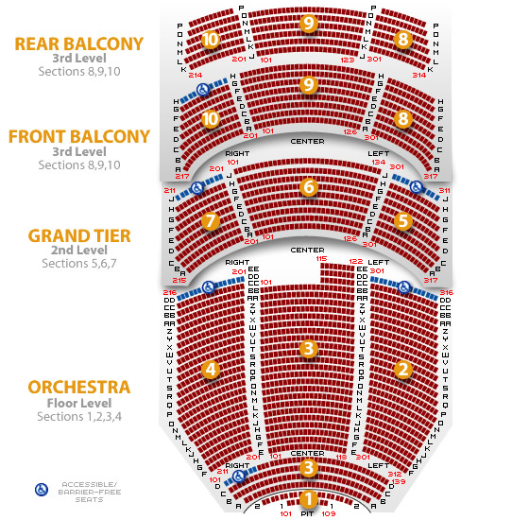
Do Now

Slide 44
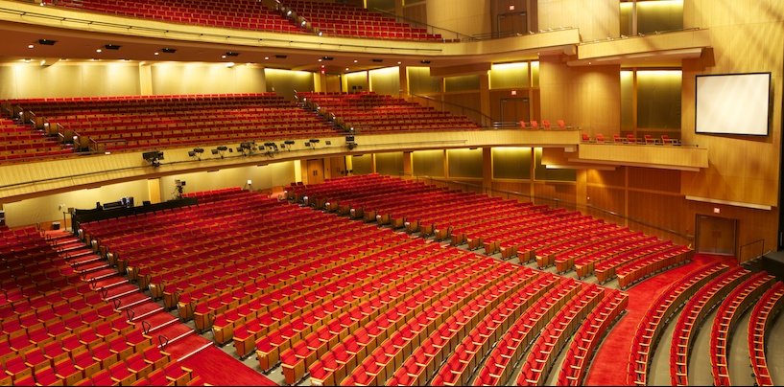
Energy Levels???

Slide 45
Review
Electrons are weird
Solution of Schrödinger Equation generates quantum numbers
These quantum number give us orbitals, the allowed locations and energy levels for electrons around an atom
These orbitals are like parking spots for electrons around an atom
Each electron must have a unique set of quantum numbers (e.g. Do Now)

Slide 46
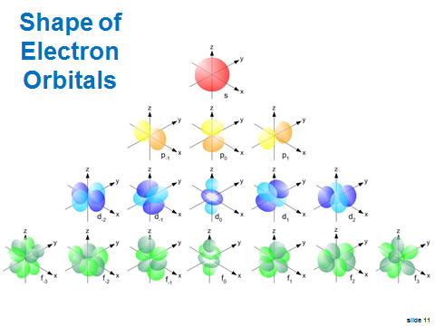
Last Class

Slide 47
n = 3: s, p and d orbitals
n | l (0 to n-1) | m_{l} (–l to + l) | m_{s} (–½ or +½) | orbital notation | number of electrons
3
Write the allowable values of l

Slide 48
n = 3: s, p and d orbitals
n | l (0 to n-1) | m_{l} (–l to + l) | m_{s} (–½ or +½) | orbital notation | number of electrons
3 | 0
 | 1
 | 2
Write the allowable values of m_{l} and m_{s}?

Slide 49
n = 3: s, p and d orbitals
n | l (0 to n-1) | m_{l} (–l to + l) | m_{s} (–½ or +½) | orbital notation | number of electrons
3 | 0 | 0 | –½, +½
 | 1
 | 2
Write the orbital notation & the number of electrons can it hold

Slide 50
n = 3: s, p and d orbitals
n | l (0 to n-1) | m_{l} (–l to + l) | m_{s} (–½ or +½) | orbital notation | number of electrons
3 | 0 | 0 | –½, +½ | 3s | 2
 | 1
 | 2
Complete the orbitals for n = 3, l = 1

Slide 51
n = 3: s, p and d orbitals
n | l (0 to n-1) | m_{l} (–l to + l) | m_{s} (–½ or +½) | orbital notation | number of electrons
3 | 0 | 0 | –½, +½ | 3s | 2
 | 1 | –1
 |  | 0
 |  | +1
 | 2

Slide 52
n = 3: s, p and d orbitals
n | l (0 to n-1) | m_{l} (–l to + l) | m_{s} (–½ or +½) | orbital notation | number of electrons
3 | 0 | 0 | –½, +½ | 3s | 2
 | 1 | –1 | –½, +½
 |  | 0 | –½, +½
 |  | +1 | –½, +½
 | 2

Slide 53
n = 3: s, p and d orbitals
n | l (0 to n-1) | m_{l} (–l to + l) | m_{s} (–½ or +½) | orbital notation | number of electrons
3 | 0 | 0 | –½, +½ | 3s | 2
 | 1 | –1 | –½, +½ | 3p
 |  | 0 | –½, +½
 |  | +1 | –½, +½
 | 2

Slide 54
n = 3: s, p and d orbitals
n | l (0 to n-1) | m_{l} (–l to + l) | m_{s} (–½ or +½) | orbital notation | number of electrons
3 | 0 | 0 | –½, +½ | 3s | 2
 | 1 | –1 | –½, +½ | 3p | 6
 |  | 0 | –½, +½
 |  | +1 | –½, +½
 | 2
Complete the orbitals for n = 3, l = 2

Slide 55
n = 3: s, p and d orbitals
n | l (0 to n-1) | m_{l} (–l to + l) | m_{s} (–½ or +½) | orbital notation | number of electrons
3 | 0 | 0 | –½, +½ | 3s | 2
 | 1 | –1 | –½, +½ | 3p | 6
 |  | 0 | –½, +½
 |  | +1 | –½, +½
 | 2 | –2
 |  | –1
 |  | 0
 |  | +1
 |  | +2

Slide 56
n = 3: s, p and d orbitals
n | l (0 to n-1) | m_{l} (–l to + l) | m_{s} (–½ or +½) | orbital notation | number of electrons
3 | 0 | 0 | –½, +½ | 3s | 2
 | 1 | –1 | –½, +½ | 3p | 6
 |  | 0 | –½, +½
 |  | +1 | –½, +½
 | 2 | –2 | –½, +½
 |  | –1 | –½, +½
 |  | 0 | –½, +½
 |  | +1 | –½, +½
 |  | +2 | –½, +½

Slide 57
n = 3: s, p and d orbitals
n | l (0 to n-1) | m_{l} (–l to + l) | m_{s} (–½ or +½) | orbital notation | number of electrons
3 | 0 | 0 | –½, +½ | 3s | 2
 | 1 | –1 | –½, +½ | 3p | 6
 |  | 0 | –½, +½
 |  | +1 | –½, +½
 | 2 | –2 | –½, +½ | 3d
 |  | –1 | –½, +½
 |  | 0 | –½, +½
 |  | +1 | –½, +½
 |  | +2 | –½, +½

Slide 58
n = 3: s, p and d orbitals
n | l (0 to n-1) | m_{l} (–l to + l) | m_{s} (–½ or +½) | orbital notation | number of electrons
3 | 0 | 0 | –½, +½ | 3s | 2
 | 1 | –1 | –½, +½ | 3p | 6
 |  | 0 | –½, +½
 |  | +1 | –½, +½
 | 2 | –2 | –½, +½ | 3d | 10
 |  | –1 | –½, +½
 |  | 0 | –½, +½
 |  | +1 | –½, +½
 |  | +2 | –½, +½

Slide 59
n = 4: s, p, d and f orbitals
n | l (0 to n-1) | m_{l} (–l to + l) | m_{s} (–½ or +½) | orbital notation | number of electrons
4
Write the allowed values of l

Slide 60
n = 4: s, p, d and f orbitals
n | l (0 to n-1) | m_{l} (–l to + l) | m_{s} (–½ or +½) | orbital notation | number of electrons
4 | 0
 | 1
 | 2
 | 3
Complete these three orbitals

Slide 61
n = 4: s, p, d and f orbitals
n | l (0 to n-1) | m_{l} (–l to + l) | m_{s} (–½ or +½) | orbital notation | number of electrons
4 | 0 | 0 | –½, +½ | 4s | 2

Slide 62
n = 4: s, p, d and f orbitals
n | l (0 to n-1) | m_{l} (–l to + l) | m_{s} (–½ or +½) | orbital notation | number of electrons
4 | 0 | 0 | –½, +½ | 4s | 2
 | 1 | –1 | –½, +½ | 4p | 6
 |  | 0 | –½, +½
 |  | +1 | –½, +½

Slide 63
n = 4: s, p, d and f orbitals
n | l (0 to n-1) | m_{l} (–l to + l) | m_{s} (–½ or +½) | orbital notation | number of electrons
4 | 0 | 0 | –½, +½ | 4s | 2
 | 1 | –1 | –½, +½ | 4p | 6
 |  | 0 | –½, +½
 |  | +1 | –½, +½
 | 2 | –2 | –½, +½ | 4d | 10
 |  | –1 | –½, +½
 |  | 0 | –½, +½
 |  | +1 | –½, +½
 |  | +2 | –½, +½

Slide 64
n = 4: s, p, d and f orbitals
n | l (0 to n-1) | m_{l} (–l to + l) | m_{s} (–½ or +½) | orbital notation | number of electrons
4 | 0 |  |  | 4s | 2
 | 1 |  |  | 4p | 6
 | 2 |  |  | 4d | 10
 | 3
Complete the rest of this chart

Slide 65
n = 4: s, p, d and f orbitals
n | l (0 to n-1) | m_{l} (–l to + l) | m_{s} (–½ or +½) | orbital notation | number of electrons
4 | 0 |  |  | 4s | 2
 | 1 |  |  | 4p | 6
 | 2 |  |  | 4d | 10
 | 3 | –3
 |  | –2
 |  | –1
 |  | 0
 |  | +1
 |  | +2
 |  | +3

Slide 66
n = 4: s, p, d and f orbitals
n | l (0 to n-1) | m_{l} (–l to + l) | m_{s} (–½ or +½) | orbital notation | number of electrons
4 | 0 |  |  | 4s | 2
 | 1 |  |  | 4p | 6
 | 2 |  |  | 4d | 10
 | 3 | –3 | –½, +½
 |  | –2 | –½, +½
 |  | –1 | –½, +½
 |  | 0 | –½, +½
 |  | +1 | –½, +½
 |  | +2 | –½, +½
 |  | +3 | –½, +½

Slide 67
n = 4: s, p, d and f orbitals
n | l (0 to n-1) | m_{l} (–l to + l) | m_{s} (–½ or +½) | orbital notation | number of electrons
4 | 0 |  |  | 4s | 2
 | 1 |  |  | 4p | 6
 | 2 |  |  | 4d | 10
 | 3 | –3 | –½, +½ | 4f
 |  | –2 | –½, +½
 |  | –1 | –½, +½
 |  | 0 | –½, +½
 |  | +1 | –½, +½
 |  | +2 | –½, +½
 |  | +3 | –½, +½

Slide 68
n = 4: s, p, d and f orbitals
n | l (0 to n-1) | m_{l} (–l to + l) | m_{s} (–½ or +½) | orbital notation | number of electrons
4 | 0 |  |  | 4s | 2
 | 1 |  |  | 4p | 6
 | 2 |  |  | 4d | 10
 | 3 | –3 | –½, +½ | 4f | 14
 |  | –2 | –½, +½
 |  | –1 | –½, +½
 |  | 0 | –½, +½
 |  | +1 | –½, +½
 |  | +2 | –½, +½
 |  | +3 | –½, +½

Slide 69
Electron Orbitals (n = 1- 4)
Write this in your notes
n | orbitals present | electrons per orbital | total electrons
1 | 1s | 2 | 2
2 | 2s | 2 | 8
 | 2p | 6
3 | 3s | 2 | 18
 | 3p | 6
 | 3d | 10
4 | 4s | 2 | 32
 | 4p | 6
 | 4d | 10
 | 4f | 14

Slide 70
Create a Table for n=5, l = 4
n | l (0 to n-1) | m_{l} (–l to + l) | m_{s} (–½ or +½) | orbital notation | number of electrons
5 | 4

Slide 71
Create a Table for n=5, l = 4
n | l (0 to n-1) | m_{l} (–l to + l) | m_{s} (–½ or +½) | orbital notation | number of electrons
5 | 4 | –4
 |  | –3
 |  | –2
 |  | –1
 |  | 0
 |  | +1
 |  | +2
 |  | +3
 |  | +4

Slide 72
Create a Table for n=5, l = 4
n | l (0 to n-1) | m_{l} (–l to + l) | m_{s} (–½ or +½) | orbital notation | number of electrons
5 | 4 | –4 | –½, +½
 |  | –3 | –½, +½
 |  | –2 | –½, +½
 |  | –1 | –½, +½
 |  | 0 | –½, +½
 |  | +1 | –½, +½
 |  | +2 | –½, +½
 |  | +3 | –½, +½
 |  | +4 | –½, +½

Slide 73
Create a Table for n=5, l = 4
n | l (0 to n-1) | m_{l} (–l to + l) | m_{s} (–½ or +½) | orbital notation | number of electrons
5 | 4 | –4 | –½, +½ | 5g
 |  | –3 | –½, +½
 |  | –2 | –½, +½
 |  | –1 | –½, +½
 |  | 0 | –½, +½
 |  | +1 | –½, +½
 |  | +2 | –½, +½
 |  | +3 | –½, +½
 |  | +4 | –½, +½

Slide 74
Create a Table for n=5, l = 4
n | l (0 to n-1) | m_{l} (–l to + l) | m_{s} (–½ or +½) | orbital notation | number of electrons
5 | 4 | –4 | –½, +½ | 5g | 18
 |  | –3 | –½, +½
 |  | –2 | –½, +½
 |  | –1 | –½, +½
 |  | 0 | –½, +½
 |  | +1 | –½, +½
 |  | +2 | –½, +½
 |  | +3 | –½, +½
 |  | +4 | –½, +½

Slide 76
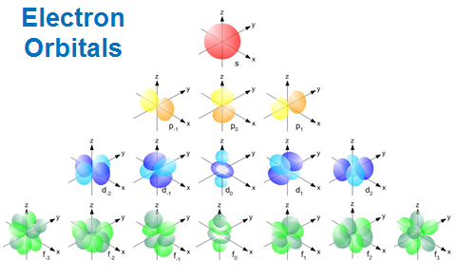
Where do we go from here?
quantum numbers
n, l, m_{l}, m_{s}
From the Schrödinger Equation, we get our most complete description of electron orbitals

Slide 77
Backups

Slide 78
Electron Quantum Numbers
Write this in your notes
name | symbol | values | what it describes
principal | n | positive integers | orbital size and energy
angular momentum | l | positive integers from 0 to (n-1) | orbital shape
magnetic | m_{l} | integers from ‒l to +l | orbital orientation
spin | m_{s} | ‒½ or +½ | electron spin

Slide 79
Shape of Electron Orbitals

Slide 80
Open Note Quiz
On a blank piece of paper, write your name and answer these 5 questions. Do not write the questions. Put your paper in the red basket when done.
What is a quantum?
What is the Bohr model of the atom?
What is wave-particle duality?
What impact does the Heisenberg Uncertainty Principle have on electron theory?
What is the Schrödinger Equation?

Slide 82
Do Now
How many outcomes are possible for the following events:
toss a coin
roll a die
toss a coin 2 times
roll a die 2 times
toss a coin 4 times
toss a coin, roll a die, toss another coin
2
6
4
2 x 2
36
6 x 6

Slide 83
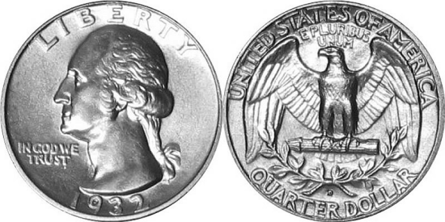
How many possible outcomes?
Trial 1 | Trial 2 | Trial 3 | Trial 4
H | H | H | H
 |  |  | T
 |  | T | H
 |  |  | T
 | T | H | H
 |  |  | T
 |  | T | H
 |  |  | T
T | H | H | H
 |  |  | T
 |  | T | H
 |  |  | T
 | T | H | H
 |  |  | T
 |  | T | H
 |  |  | T
Trial 1 | 2 | 2
Trial 2 | 2 ● 2 | 4
Trial 3 | 2 ● 2 ● 2 | 8
Trial 4 | 2 ● 2 ● 2 ● 2 | 16

Slide 84
Do Now
How many outcomes are possible for the following events:
toss a coin
roll a die
toss a coin 2 times
roll a die 2 times
toss a coin 4 times
toss a coin, roll a die, toss another coin
2
6
4
2 x 2
36
6 x 6
16
2 x 2 x 2 x 2

Slide 85
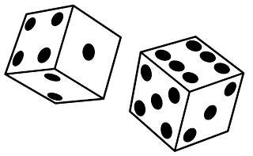
How many possible outcomes?
Trial 1 | Trial 2 | Trial 3
H | 1 | H
 |  | T
 | 2 | H
 |  | T
 | 3 | H
 |  | T
 | 4 | H
 |  | T
 | 5 | H
 |  | T
 | 6 | H
 |  | T
Trial 1 | Trial 2 | Trial 3
T | 1 | H
 |  | T
 | 2 | H
 |  | T
 | 3 | H
 |  | T
 | 4 | H
 |  | T
 | 5 | H
 |  | T
 | 6 | H
 |  | T

Slide 86
Do Now
How many outcomes are possible for the following events:
toss a coin
roll a die
toss a coin 2 times
roll a die 2 times
toss a coin 4 times
toss a coin, roll a die, toss another coin
2
6
4
2 x 2
36
6 x 6
16
2 x 2 x 2 x 2
24
2 x 6 x 2

Slide 87
Electron Quantum Numbers
name | symbol | values | what it describes

Slide 88
Electron Quantum Numbers
name | symbol | values | what it describes
principal | n | positive integers | orbital size and energy
angular momentum | l | positive integers from 0 to (n-1) | orbital shape
magnetic | m_{l} | integers from ‒l to +l | orbital orientation
spin | m_{s} | ‒½ or +½ | electron spin

Slide 89
Angular Momentum Quantum Number
l | letter designation

Slide 90
Angular Momentum Quantum Number
l | letter designation
0 | s
1 | p
2 | d
3 | f

Slide 91
quantum numbers
n, l, m_{l}, m_{s}
From the Schrödinger Equation, we get our most complete description of electron orbitals

