Slide 1
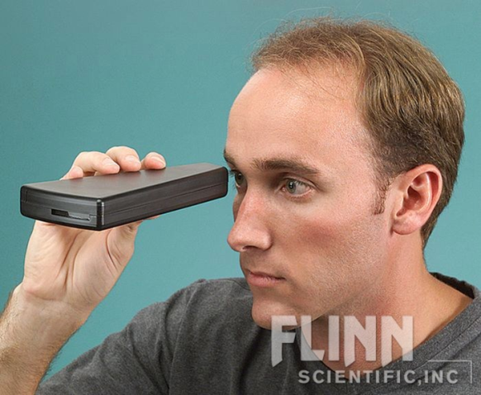
Do Now
Get a spectroscope from the front table
Need to share
Hold it with the pink sticker up
Look through the narrow end
Point the wide end at one of the ceiling lights
You need to see the light through the slit opening
Write down a description of what you see to the right of the slit
DO NOT POINT THE SCOPE AT THE SUN

Slide 3
Slit - Opening thru which light enters spectroscope
Spectra - Diffracted light broken into its component colors

Slide 4
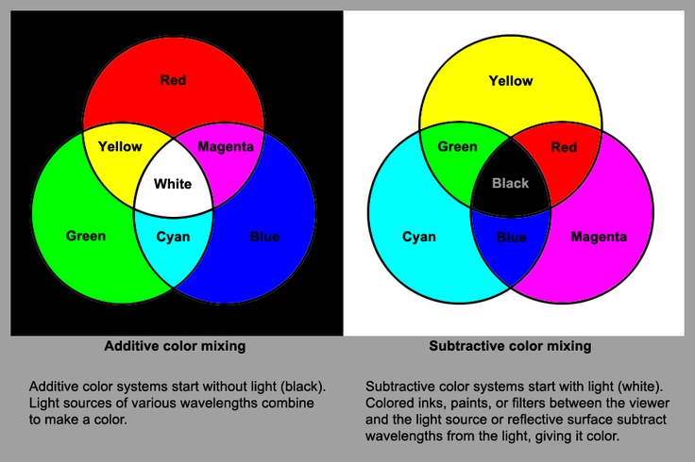
Why the Lights Appear White

Slide 5
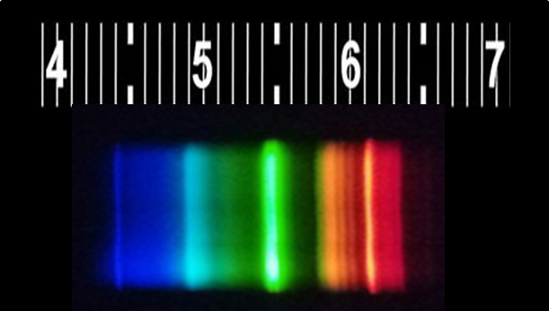
Enhanced Resolution

Slide 6
Each of these bands represents the output of a different phosphor. All of these colors combine to produce the white light we see.

Slide 7
Each of these bands is produced by an electron transitioning from one energy state to another. Observations such as this started scientists on the path to understanding electrons, which we start studying today.

Slide 8
Units
Scientific Method
Atomic Theory
Nuclear Chemistry
The Mole
Electrons
Periodic Properties
Bonding
Nomenclature
Chemical Reactions
Stoichiometry
Mixtures and Solutions
Chemical Equilibrium
Acid-Base Chemistry
Redox & Electrochemistry
Gas Laws
Thermodynamics
Chapter 5 in our book
This unit starts with very complex concepts (quantum mechanics) and ends with simple processes for understanding the electronics of an atom

Slide 9
Evolution of Electron Theory
SWBAT explain the evolution and current understanding of the electron theory
Write this in your notes

Slide 10
Outline
Write this in your notes
Quantum Energy
Bohr Atom
Wave-Particle Duality
Heisenberg Uncertainty Principle
Schrödinger Equation
You need to be able to explain each of these concepts and how they contributed to the evolution of the electron theory

Slide 11
Outline
Quantum Energy
Bohr Atom
Wave-Particle Duality
Heisenberg Uncertainty Principle
Schrödinger Equation

Slide 12
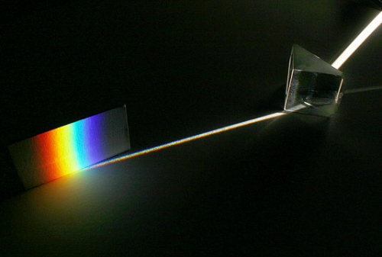
Effect of a Prism on Sunlight

Slide 13
Electromagnetic Spectrum
But our eyes can only see some of the light present in sunlight

Slide 14
Describing Light - Wavelengths

Slide 15
Describing Light - Frequency

Slide 16
Frequency & Wavelength Inversely Related
Write this in your notes
Low frequency means long wavelength
High frequency means short wavelength

Slide 17
Energy increase with Frequency
Write this in your notes
Which has more energy, radio waves or gamma rays?
gamma rays (higher frequency, so higher energy)
Which has more energy, ultraviolet or infrared?
ultraviolet (higher frequency, so higher energy)
Which has more energy, red or violet?
violet (higher frequency, so higher energy)
This allows scientists to relate light frequency to energy

Slide 18
Atomic Emission and Absorption
Scientists used light to study the nature of atoms

Slide 19
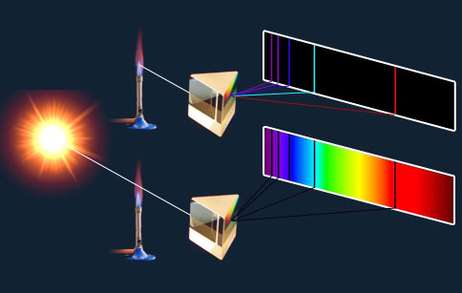
Atomic Emission and Absorption
Atoms are drawn into the flame and absorb energy.
They lose this energy through the release of light .
This process is called atomic emission
Example

Slide 20
Atomic Emission and Absorption
Atoms are drawn into the flame
While there, they absorb light from a source passing through the flame
This process is called atomic absorption

Slide 21
Atomic Emission and Absorption

Slide 22
Atomic Emission and Absorption
Light is emitted and absorbed
at the same wavelengths

Slide 23
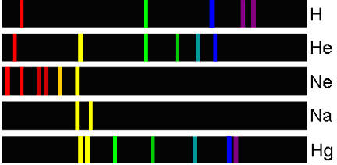
Atomic Emission Spectra

Slide 24
The Concept of Quantum Energy
Sunlight is made up of a continuous spectrum of light
Elements only emit and absorb light of specific wavelengths and energy levels
Why the difference?
Matter can gain or lose energy in small, specific amounts called quanta
A quantum is the minimum amount of energy that can be gained or lost by an atom
Write this in your notes

Slide 25
What do the Quanta do to the Atom?
Atoms can exist in a low-energy state called the ground state or in a number of higher-energy states call excited states
excited
states
ground state
Write this in your notes

Slide 26
What do the Quanta do to the Atom?
Atoms can exist in a low-energy state called the ground state or in a number of higher-energy states call excited states
When absorbing light, a specific quantum raises the atom from its ground state to a specific excited state
excited
states
ground state
Write this in your notes

Slide 27
What do the Quanta do to the Atom?
Atoms can exist in a low-energy state called the ground state or in a number of higher-energy states call excited states
When absorbing light, a specific quantum raises the atom from its ground state to a specific excited state
In an emission spectrum, a specific quantum of energy is released as the atom falls from a specific excited state back to the ground state
excited
states
ground state
Write this in your notes

Slide 29
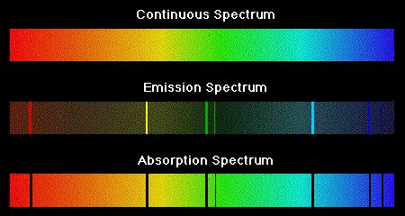
So why these specific energy levels?

Slide 30
Outline
Quantum Energy
Bohr Atom
Wave-Particle Duality
Heisenberg Uncertainty Principle
Schrödinger Equation

Slide 31
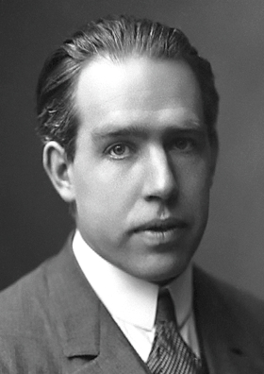
Niels Bohr
A Danish physicist named Niels Bohr thought the excited states were higher-energy electron orbitals
He proposed that electrons transitioning between the ground state and these excited states accounted for the spectra results
Bohr proposed a model of the atom in which the electrons could occupy only discrete energy levels

Slide 32
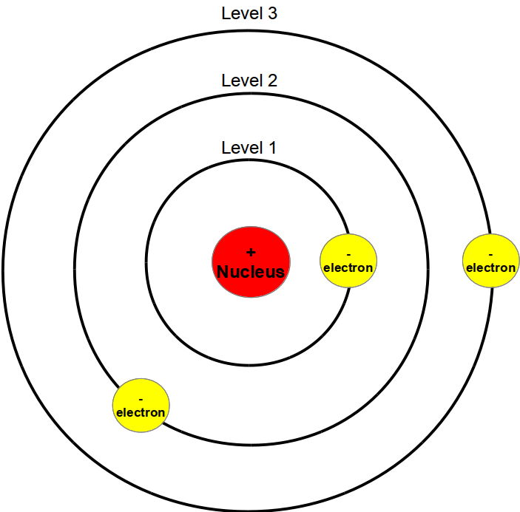
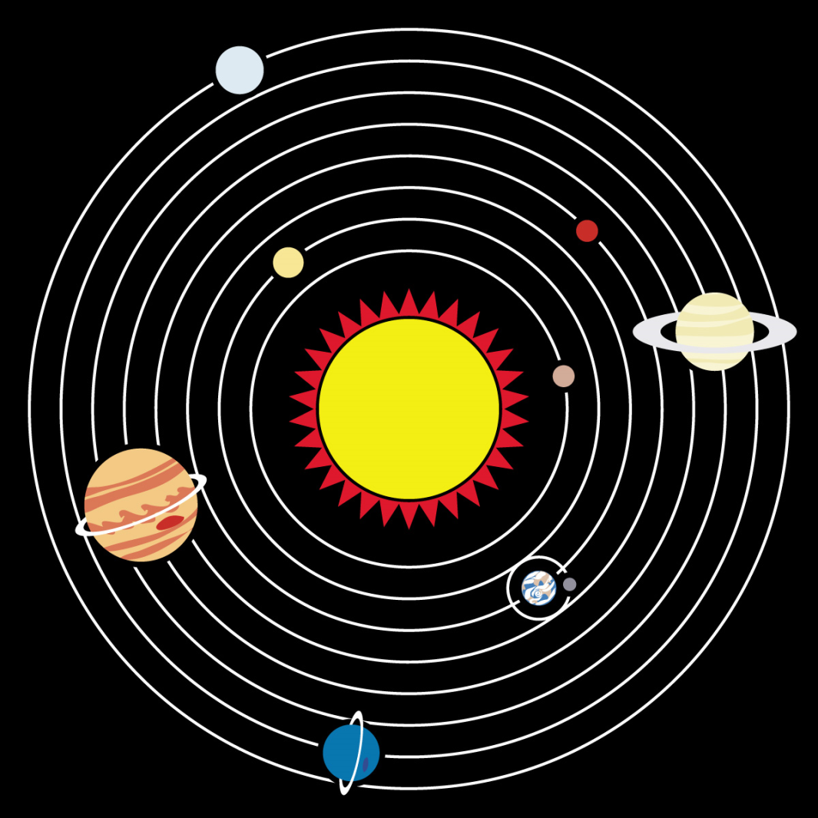
Bohr's model is like our solar system

Slide 33
Bohr Model of the Atom
Write this in your notes
Compact, massive, positively-charged nucleus
Electrons are solid, negatively-charged particles
Electrons circulate in defined paths around the nucleus like planets around the sun
Excited states have electrons further away from the nucleus

Slide 34
Transition from various excited states to the ground state releases specific quanta of energy which can be observed
write this in your notes

Slide 35
Bohr Model
The Bohr model of the atom perfectly explained the emission spectra for hydrogen
It did not explain the emission spectra for any other elements
The model also did not explain all aspects of chemical reactivity
The Bohr model, although incomplete, was a key step in the evolution of the electron theory

Slide 36
Outline
Quantum Energy
Bohr Atom
Wave-Particle Duality
Heisenberg Uncertainty Principle
Schrödinger Equation

Slide 37
The Electron World Masses & Velocities Beyond Normal Human Experience
Masses
Velocities
object | mass (kg)
Titanic | 5 x 10⁷
car | 1 x 10⁴
human | 7 x 10¹
orange | 2 x 10⁻¹
dollar bill | 1 x 10⁻³
mosquito | 2 x 10⁻⁶
electron | 9 x 10⁻³¹
object | velocity (m/s)
snail | 3 x 10⁻³
human walking | 1
human sprinting | 2.4 x 10¹
70 mph car | 3.2 x 10¹
bullet | 4.2 x 10²
electron | 3 x 10⁷

Slide 38
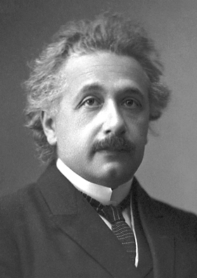
Paradox of Light
In some ways, light behaves like a wave
In some ways, light behaves like a particle
So which is it?
It is both!!!
Light exhibits the properties of not only particles, which have mass, but also waves, which transfer energy.
Albert Einstein, 1905

Slide 39
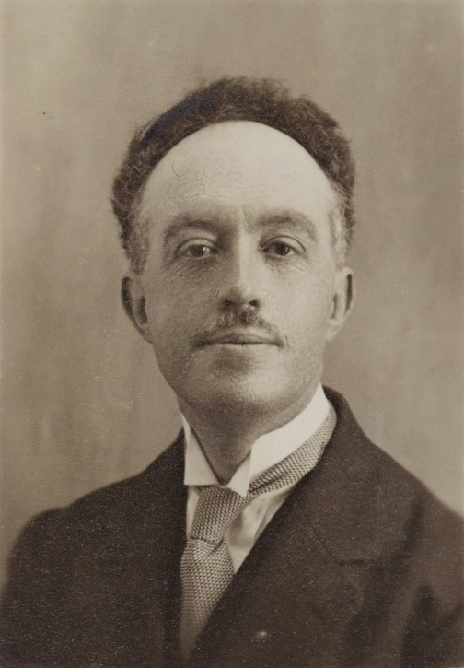
Paradox of Electron
In some ways, electrons behave like a particle
But some behavior of electrons cannot be explain by particle theory alone
How is this resolved?
Electrons are both particles & waves
All matter, not just light, exhibits the properties of not only particles, which have mass, but also waves, which transfer energy.
Louis De Broglie, 1924

Slide 40
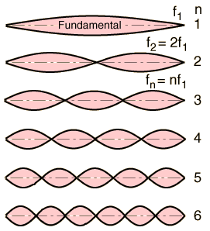
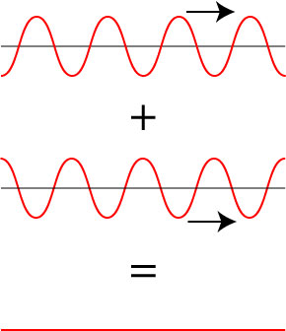
Waves on Guitar String
Standing Waves
Destructive Interference
https://www.youtube.com/watch?v=-gr7KmTOrx0

Slide 41
Waves in an Electron Orbital
De Broglie hypothesized that electrons could only occupy orbitals in which they were able to maintain a standing wave

Slide 42
Real World Impact of Standing Waves
Tacoma Narrows Bridge
Suspension bridge in Washington state
Certain wind speeds match the precise resonance frequency for the bridge to has a standing wave
The bridge ultimately collapsed under the strain of vibrations
https://www.youtube.com/watch?v=j-zczJXSxnw

Slide 43
Wave-Particle Duality
Write this in your notes
In 1924, De Broglie postulates that all matter, including electrons, have the wave-particle duality
Wave-Particle Duality - All matter exhibits the properties of not only particles, which have mass, but also waves, which transfer energy.
Electrons could absorb or emit only quanta that moved them between wave frequencies that allow for standing waves in their orbital
no standing wave
FORBIDDEN
standing wave
ALLOWED
standing wave
ALLOWED

Slide 44
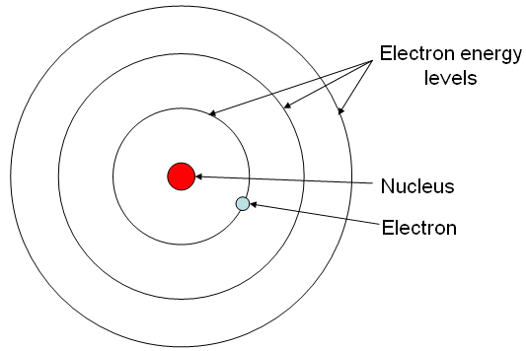
In the Bohr Atom, electrons gained energy by physically moving from one allowed orbit to another.
Some orbitals are allowed.
Some orbitals are forbidden
Wave-particle duality says that energy is gained by increasing the frequency of the electron's wave nature
If a standing wave is possible, then the orbital is allowed
If not, the orbital is forbidden

Slide 45
Outline
Quantum Energy
Bohr Atom
Wave-Particle Duality
Heisenberg Uncertainty Principle
Schrödinger Equation

Slide 46
Another Weird Thing About Electrons
There is a limit to how precisely we can measure both the position and momentum of an object
With a car, the limit is too small to ever notice
With an electron, however, the limit is noticeable.
This limit restricts our precision with very small and very fast objects

Slide 47
Heisenberg Uncertainty Principle
In 1927, Werner Heisenberg defined the limit to this type of simultaneous precision
$$\text{Δ}x∙\text{Δ}\text{p}\text{ = }\frac{\text{ℏ}}{2}$$
x = position, p = momentum, ℏ = Planck's constant/2π
Write this in your notes
The Heisenberg Uncertainty Principle says there is a limit to the precision with which pairs of physical properties such as position & momentum can be known simultaneously
Because of this, an electron's orbital cannot be described as a fixed path
Instead, it is described as the "electron cloud", a volume of space which is the probable location of an electron

Slide 48
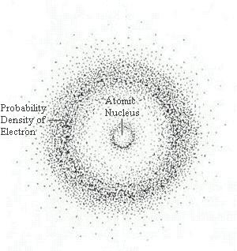
In classical mechanics, scientists know the position and velocity of objects with absolute precision.
At the atomic scale, however, the Heisenberg Uncertainty Principle tells us that there is a fundamental limit to which certain pairs of physical properties are known.
For example, if we know an electron's position with high precision, our knowledge of its momentum will be imprecise.
As a result, an electron orbital can not be defined as a line, but rather a volume of space with a certain probability of electron density.

Slide 49
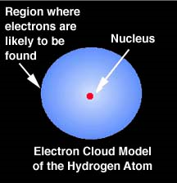
Where is the electron?
REVIEW
Electrons are very small and moving very fast, such that their position cannot describe precisely.
Instead an electron's location is described by the probability of an electron being in a volume of space.
This is called:
"The electron cloud"

Slide 50
Outline
Quantum Energy
Bohr Atom
Wave-Particle Duality
Heisenberg Uncertainty Principle
Schrödinger Equation

Slide 51
Tying It All Together
In 1926, Erwin Schrödinger sought to tie all of these new concepts together into a complete description of the position and energy levels of an electron around an atom.
Schrödinger began with a fundamental equation that Newton developed for classical mechanics
total energy = kinetic energy + potential energy
Schrödinger then modified the equation to account for aspects of the subatomic world such as the wave-particle duality and the Heisenberg Uncertainty Principle

Slide 52
Schrödinger Equation
The resulting equation, known as the Schrödinger Equation, is the cornerstone of quantum mechanics
Write this in your notes
The Schrödinger Equation describes matter in terms of the wavelike properties of particles in a field.
Its solution is related to the probability density of a particle in space and time.
From the Schrödinger Equation, we get our most complete description of electron orbitals

Slide 53
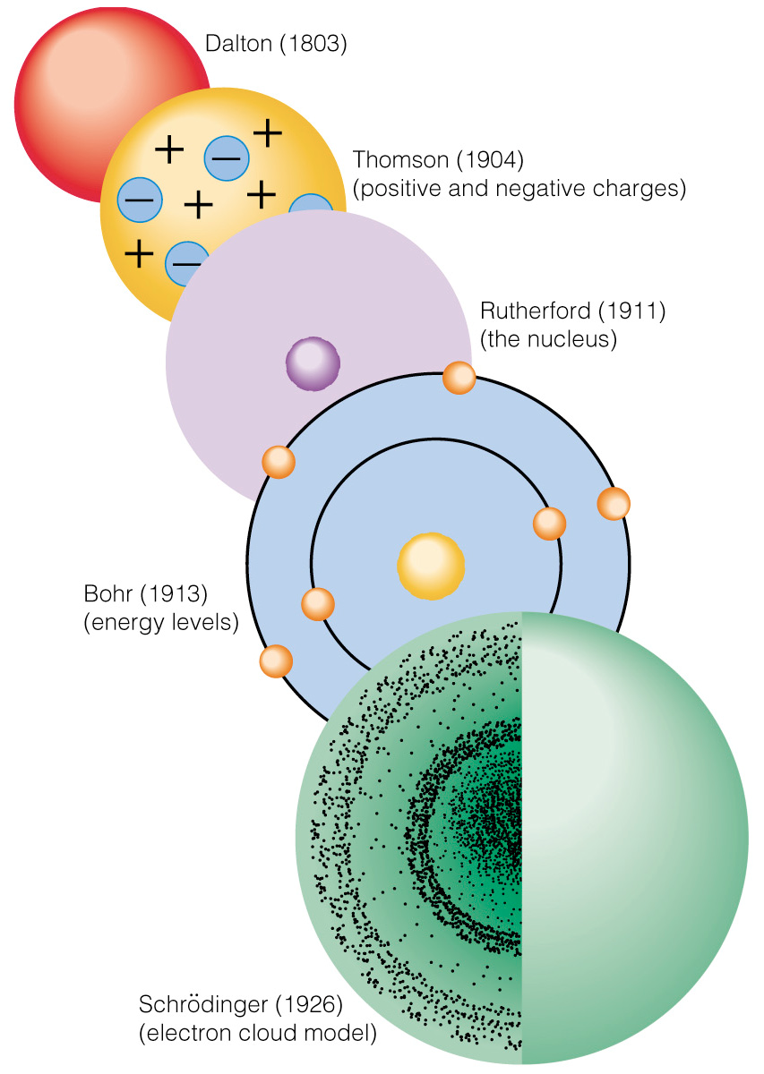
Evolution
of the
Atomic Theory

Slide 54
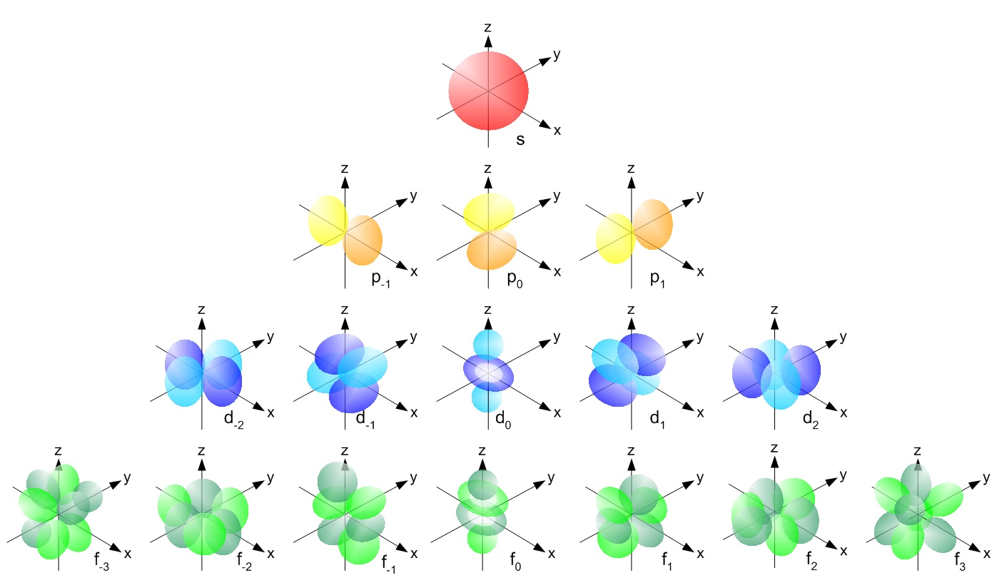
In Our Next Lesson

Slide 55
ANY QUESTIONS?? (need 10 minutes to proceed)

Slide 56
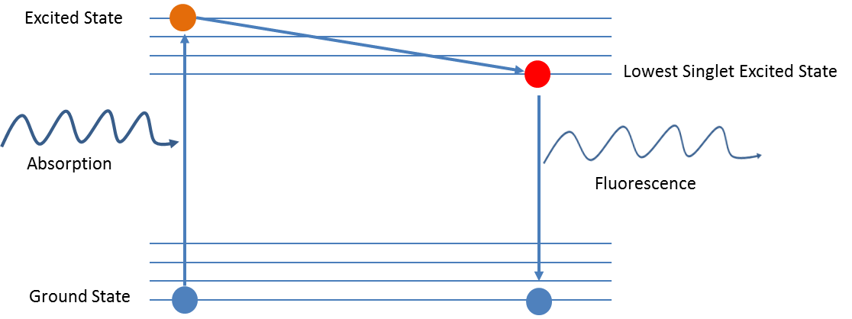

Slide 57
WPD Videos
Destructive Interference
https://www.youtube.com/watch?v=kS3VPlR6Ifg
Waves on a guitar string
https://www.youtube.com/watch?v=QEDKcIzJAnI
Standing wave on a string
https://www.youtube.com/watch?v=-gr7KmTOrx0
https://www.youtube.com/watch?v=VmGWvuqFqxQ
https://www.youtube.com/watch?v=RcDqsf2f7u4
Tacoma Narrows Bridge
https://www.youtube.com/watch?v=j-zczJXSxnw

Slide 58
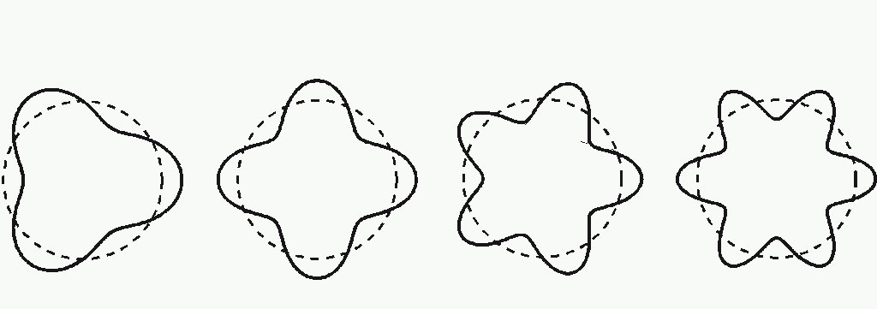

Slide 63
In the Bohr Atom, electrons gained energy by physically moving from one allowed orbit to another.
Some orbitals are allowed.
Some orbitals are forbidden
Wave-particle duality says that energy is gained by increasing the frequency of the electron's wave nature
If a standing wave is possible, then the orbital is allowed
If not, the orbital is forbidden

Slide 64
In classical mechanics, scientists know the position and velocity of objects with absolute precision.
At the atomic scale, however, the Heisenberg Uncertainty Principle tells us that there is a fundamental limit to which certain pairs of physical properties are known.
For example, if we know an electron's position with high precision, our knowledge of its momentum will be imprecise.
As a result, an electron orbital can not be defined as a line, but rather a volume of space with a certain probability of electron density.

Slide 65
Evolution
of the
Atomic Theory

