Slide 1
Do Now
The table below shows one set of spare parts for the Ferrari F1 racing team. What percent of the mass is due to the tires? What percent by mass is due to the nose cones & rear spoilers?
item | number | mass (kg) | total mass (kg) | percent by mass
tires | 8 | 9 | 72
nose cones | 3 | 2 | 6
rear spoiler | 2 | 4 | 8
 |  |  | 86

Slide 2
Percentage by Mass
percent by mass | = | mass of component | x | 100
 |  | total mass of set
Component: Tires
percent by mass | = | 72 kg | x | 100
 |  | 86 kg
 | = | 83.7%

Slide 3
Do Now
The table below shows one set of spare parts for the Ferrari F1 racing team. What percent of the mass is due to the tires? What percent by mass is due to the nose cones & rear spoilers?
item | number | mass (kg) | total mass (kg) | percent by mass
tires | 8 | 9 | 72 | 83.7%
nose cones | 3 | 2 | 6
rear spoiler | 2 | 4 | 8
 |  |  | 86

Slide 4
Do Now
The table below shows one set of spare parts for the Ferrari F1 racing team. What percent of the mass is due to the tires? What percent by mass is due to the nose cones & rear spoilers?
item | number | mass (kg) | total mass (kg) | percent by mass
tires | 8 | 9 | 72 | 83.7%
nose cones | 3 | 2 | 6 | 7.0%
rear spoiler | 2 | 4 | 8 | 9.3%
 |  |  | 86

Slide 5
Do Now
The table below shows one set of spare parts for the Ferrari F1 racing team. What percent of the mass is due to the tires? What percent by mass is due to the nose cones & rear spoilers?
item | number | mass (kg) | total mass (kg) | percent by mass
tires | 8 | 9 | 72 | 83.7%
nose cones | 3 | 2 | 6 | 7.0%
rear spoiler | 2 | 4 | 8 | 9.3%
 |  |  | 86 | 100%

Slide 6
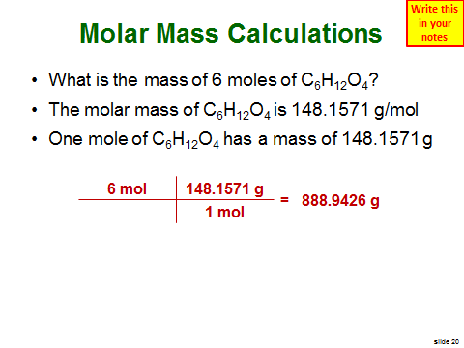
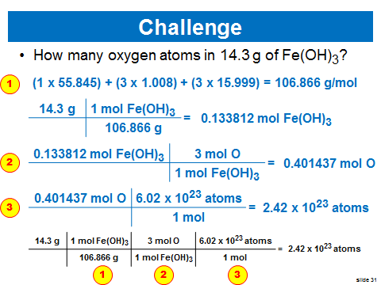
Last Class

Slide 7
Identifying Unknowns 1
SWBAT explain how percent composition can be used to find the formulas of unknown substances
SWBAT explain the difference between an empirical and a molecular formula
Write this in your notes

Slide 8
Determining Percent Composition from 1) Elemental Analysis Data 2) Chemical Formula

Slide 9
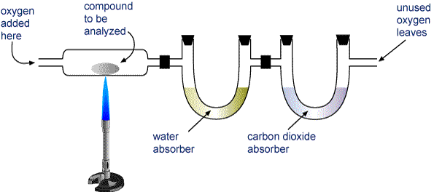
Elemental Analysis
Review
Elemental analysis is a way of finding out how much of each element is in a substance
Many methods exist, but combustion analysis is one of the most common

Slide 10
Typical Elemental Analysis Data
A 160 gram sample of molecule X contains 10 g H, 55 g C and 95 g O.
This information can be used to calculate percent composition by mass

Slide 11
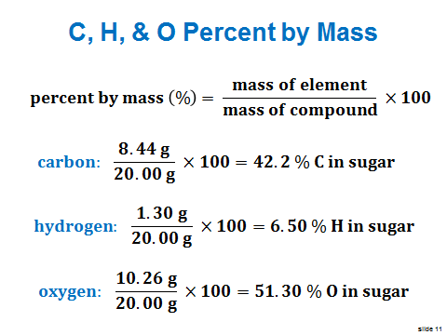
Percent Composition
Review
$$percent by mass \left(\%\right)= \frac{mass of element}{mass of compound} ×100$$
Also called
"percent composition"

Slide 12
Percent Composition from Elemental Analysis Data
A 160 gram sample of molecule X contains 10 g H, 55 g C and 95 g O. What is the percent composition?
$$\% by mass H= \frac{10 g}{160 g} ×100= 6.2\%$$
$$\% by mass C= \frac{55 g}{160 g} ×100=34.4\%$$
$$\% by mass O= \frac{95 g}{160 g} ×100=59.4\%$$

Slide 13
Percent Composition
Write this in your notes
Percent composition of a compound can also be determined from its chemical formula.

Slide 14
Percent Composition from Chemical Formulas
Write this in your notes
What is the percent composition of C₆H₁₂O₄?
symbol | number | atomic mass | mass
C | 6 | 12.011 | 72.066
H | 12 | 1.008 | 12.096
O | 4 | 15.999 | 63.996
 |  |  | 148.158

Slide 15
Percent Composition from Chemical Formulas
Write this in your notes
What is the percent composition of C₆H₁₂O₄?
symbol | number | atomic mass | mass | percent comp
C | 6 | 12.011 | 72.066
H | 12 | 1.008 | 12.096
O | 4 | 15.999 | 63.996
 |  |  | 148.158

Slide 16
Percent Composition from Chemical Formulas
Write this in your notes
What is the percent composition of C₆H₁₂O₄?
symbol | number | atomic mass | mass | percent comp
C | 6 | 12.011 | 72.066 | 48.641%
H | 12 | 1.008 | 12.096
O | 4 | 15.999 | 63.996
 |  |  | 148.158

Slide 17
Percent Composition from Chemical Formulas
Write this in your notes
What is the percent composition of C₆H₁₂O₄?
symbol | number | atomic mass | mass | percent comp
C | 6 | 12.011 | 72.066 | 48.641%
H | 12 | 1.008 | 12.096 | 8.164%
O | 4 | 15.999 | 63.996
 |  |  | 148.158

Slide 18
Percent Composition from Chemical Formulas
Write this in your notes
What is the percent composition of C₆H₁₂O₄?
symbol | number | atomic mass | mass | percent comp
C | 6 | 12.011 | 72.066 | 48.641%
H | 12 | 1.008 | 12.096 | 8.164%
O | 4 | 15.999 | 63.996 | 43.194%
 |  |  | 148.158

Slide 19
Percent Composition from Chemical Formulas
Write this in your notes
What is the percent composition of C₆H₁₂O₄?
symbol | number | atomic mass | mass | percent comp
C | 6 | 12.011 | 72.066 | 48.641%
H | 12 | 1.008 | 12.096 | 8.164%
O | 4 | 15.999 | 63.996 | 43.194%
 |  |  | 148.158 | 99.999%
A good way to check your calculations is to see if all the percentages add up to 100

Slide 20
Check for Understanding
Find the percent composition of Ca₃(PO₄)₂?
symbol | number | atomic mass | mass | percent comp
Ca | 3 | 40.078 | 120.234
P | 2 | 30.974 | 61.948
O | 8 | 15.999 | 127.992
 |  |  | 310.174

Slide 21
Check for Understanding
Find the percent composition of Ca₃(PO₄)₂?
symbol | number | atomic mass | mass | percent comp
Ca | 3 | 40.078 | 120.234 | 38.763%
P | 2 | 30.974 | 61.948
O | 8 | 15.999 | 127.992
 |  |  | 310.174

Slide 22
Check for Understanding
Find the percent composition of Ca₃(PO₄)₂?
symbol | number | atomic mass | mass | percent comp
Ca | 3 | 40.078 | 120.234 | 38.763%
P | 2 | 30.974 | 61.948 | 19.972%
O | 8 | 15.999 | 127.992
 |  |  | 310.174

Slide 23
Check for Understanding
Find the percent composition of Ca₃(PO₄)₂?
symbol | number | atomic mass | mass | percent comp
Ca | 3 | 40.078 | 120.234 | 38.763%
P | 2 | 30.974 | 61.948 | 19.972%
O | 8 | 15.999 | 127.992 | 41.265%
 |  |  | 310.174

Slide 24
Check for Understanding
Find the percent composition of Ca₃(PO₄)₂?
symbol | number | atomic mass | mass | percent comp
Ca | 3 | 40.078 | 120.234 | 38.763%
P | 2 | 30.974 | 61.948 | 19.972%
O | 8 | 15.999 | 127.992 | 41.265%
 |  |  | 310.174 | 100%

Slide 25
Check for Understanding
Find the % composition for NaHCO₃
A 32.0 g sample of molecule X contains 26.1 g of Cl and 5.9 g of Na. Find the % composition
symbol | number | atomic mass | mass | percent comp
Na | 1 | 22.990 | 22.990 | 27.367%
H | 1 | 1.008 | 1.008 | 1.200%
C | 1 | 12.011 | 12.011 | 14.298%
O | 3 | 15.999 | 47.997 | 57.135%
 |  |  | 84.006 | 100%
symbol | number | atomic mass | mass | percent comp
Na |  |  | 5.9 | 18%
Cl |  |  | 26.1 | 81.6%
 |  |  | 32.0 | 99.6%

Slide 26
Check for Understanding
Find the % composition for Pt₃(PO₄)₄
A 153 g sample of BaO contains 16.0 g of oxygen. Find the % composition
symbol | number | atomic mass | mass | percent comp
Pt | 3 | 195.085 | 585.225 | 60.6397%
P | 4 | 30.974 | 123.896 | 12.8372%
O | 16 | 15.999 | 255.984 | 26.5231%
 |  |  | 965.135 | 100%
symbol | number | atomic mass | mass | percent comp
Ba |  |  | 137 | 89.5%
O |  |  | 16.0 | 10.5%
 |  |  | 153 | 100%

Slide 27
Distinguishing Empirical Formulas from Molecular Formulas

Slide 28
What is this good for?
percent composition
from
Elemental Analysis
of
Actual Sample
percent composition
from
Chemical Formula
of
Proposed Structure
=

Slide 29
Chemical Formulas

Slide 30
Two Types of Chemical Formulas
Molecular Formula
Empirical Formula
We will learn other types of formulas later

Slide 31
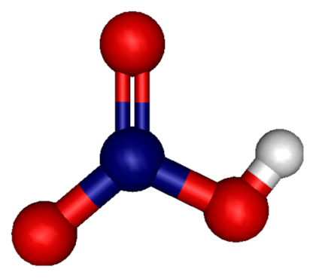
Molecular Formula
Empirical and Molecular Formulas
SECTION10.4
Write this in your notes
The molecular formula specifies the actual number of atoms of each element in one molecule or formula unit of the substance.
Nitric acid has:
one hydrogen
one nitrogen
three oxygens
so its molecular formula is
HNO₃

Slide 32
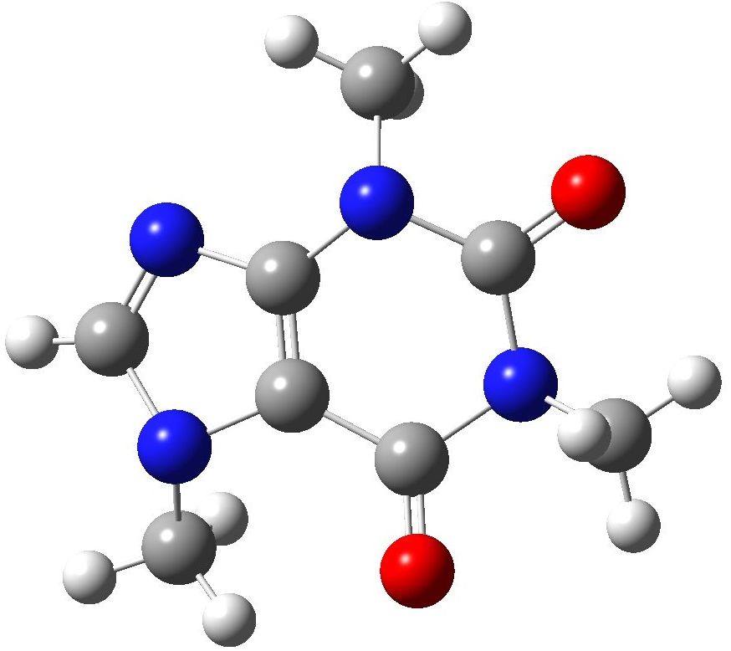
Empirical Formula
Write this in your notes
The empirical formula for a compound is the smallest whole-number mole ratio of the elements.
molecular
formula
empirical
formula
C₈H₁₀N₄O₂
C₄H₅N₂O
8:10:4:2 ratio
GCF = 2
4:5:2:1 ratio
this mole ratio
can be simplified
smallest
whole-number
mole ratio
caffeine
GCF = Greatest common factor - The largest whole number by which a group of numbers can be divided evenly.

Slide 33
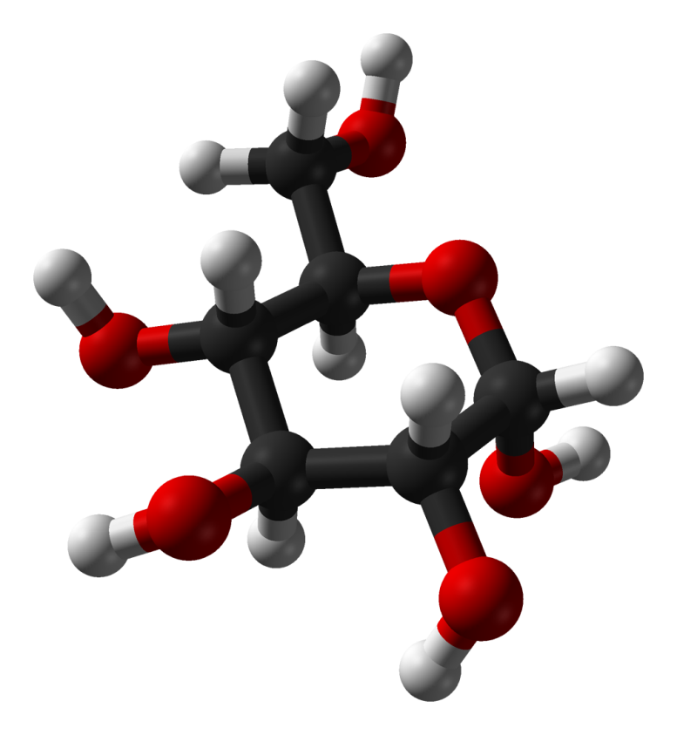
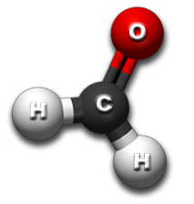
Molecular vs Empirical Formula
Write this in your notes
molecular formula
largest common denominator
empirical formula

Slide 34
Molecular vs Empirical Formula
Write this in your notes
molecular formula | CH₂O
largest common denominator
empirical formula

Slide 35
Molecular vs Empirical Formula
Write this in your notes
molecular formula | CH₂O | C₆H₁₂O₆
largest common denominator
empirical formula

Slide 36
Molecular vs Empirical Formula
Write this in your notes
molecular formula | CH₂O | C₆H₁₂O₆
largest common denominator | 1
empirical formula

Slide 37
Molecular vs Empirical Formula
Write this in your notes
molecular formula | CH₂O | C₆H₁₂O₆
largest common denominator | 1
empirical formula | CH₂O

Slide 38
Molecular vs Empirical Formula
Write this in your notes
molecular formula | CH₂O | C₆H₁₂O₆
largest common denominator | 1 | 6
empirical formula | CH₂O

Slide 39
Molecular vs Empirical Formula
Write this in your notes
molecular formula | CH₂O | C₆H₁₂O₆
GCF | 1 | 6
empirical formula | CH₂O | CH₂O

Slide 40
Relationship
Write this in your notes
Molecular formula is always a whole-number multiple of the empirical formula.
molecular formula = (empirical formula)_{n}
The empirical formula may or may not be the same as the molecular formula.
molecular formula | empirical formula
CH₂O | CH₂O
C₂H₄O₂ | CH₂O
C₃H₆O₃ | CH₂O
C₄H₈O₄ | CH₂O
C₅H₁₀O₅ | CH₂O
C₆H₁₂O₆ | CH₂O

Slide 41
Check for Understanding
What is the empirical formula for the following compounds?
H₂O₂
H₂O
N₂O₄
P₄O₁₀
C₆H₉O₃
C₆H₁₂O₄
C₃H₁₂O₄
HO
H₂O
NO₂
P₂O₅
C₂H₃O
C₃H₆O₂
C₃H₁₂O₄

Slide 42
Classwork
pg 344, # 54, 56 (% composition from molar mass)
pg 360, # 156, 159 (molecular vs empirical formulas)
pg 361, # 167 (molecular vs empirical formulas)
Anything not finished becomes homework!

Slide 43
Identifying Unknowns 1 - Homework
pg 344, # 54, 56 (% composition from molar mass)
pg 360, # 156, 159 (molecular vs empirical formulas)
pg 361, # 167 (molecular vs empirical formulas)

Slide 44
Backup Slides

Slide 45
Not Covered

Slide 46
The periodic table gives us atomic masses and molar masses for each element

Slide 47
Do Now
1) What is a mole?
a) 6.02 × 10²³ atoms, molecules, formula units, or representative particles
b) SI base unit used to measure the amount of a substance.
c) The amount of atoms in 12 g of pure carbon-12
d) All of the above
2) What is the molar mass of (NH₄)₂SO₄?
a) 63.09 g/mol
b) 114.12 g/mol
c) 132.17 g/mol
d) 228.38 g/mol

Slide 48
Do Now
1) What is a mole?
a) 6.02 × 10²³ atoms, molecules, formula units, or representative particles
b) SI base unit used to measure the amount of a substance.
c) The amount of atoms in 12 g of pure carbon-12
d) All of the above
2) What is the molar mass of (NH₄)₂SO₄?
a) 63.09 g/mol
b) 114.12 g/mol
c) 132.17 g/mol
d) 228.38 g/mol

