Slide 1
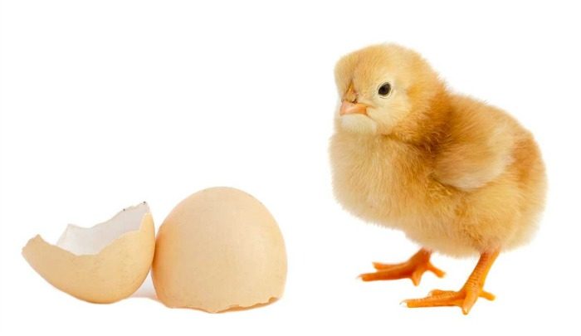
Do Now
Put homework into red basket
If each egg is 27 grams, what is the mass of 3.5 dozen eggs? Use a picket fence to complete this dimensional analysis
3.5 dozen | 12 eggs | 27 g | = | 1134 g
 | 1 dozen | 1 egg
 |  |  |  | ↓ ↓ ↓
 |  |  |  | 1100 g

Slide 2
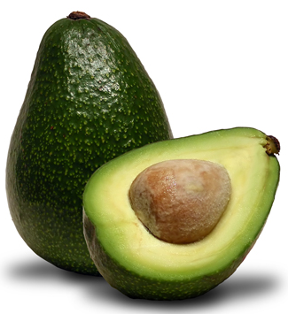
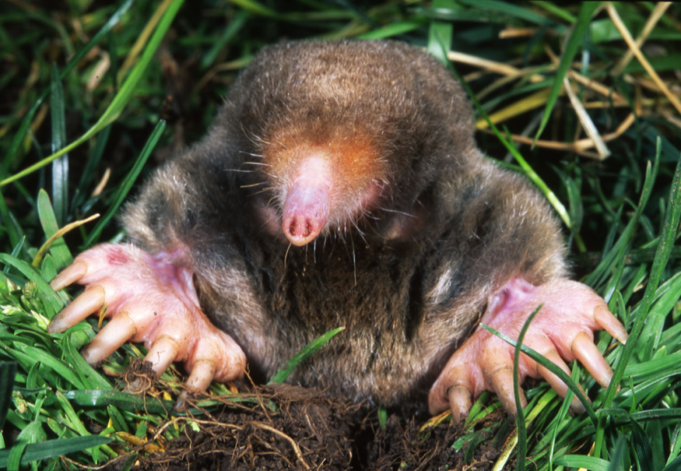
Last Class

Slide 3
Mass and the Mole
SWBAT explain the concepts of atomic mass and molar mass, and use them to complete conversions between mass and atoms or moles
Write this in your notes

Slide 4
Units for Chemistry
Chemistry deals with atoms which are very, very small.
Accordingly, the mass of each atom is very, very small.
The SI unit for mass, the kilogram, is much too large for atoms
The unit created is called the "atomic mass unit"

Slide 5
Unified Atomic Mass Units
Write this in your notes
Unified atomic mass units are used for measuring the mass of individual atoms or molecules
1 u = 1/12th the mass of carbon-12
Symbol is "u"
1 u is nearly the same as the mass of one proton or neutron
Also called a dalton ("Da") or amu (old term)

Slide 6
u per Atom
By definition, each atom of carbon-12 has a mass of 12 u.
This can be represented by 12 $\frac{u}{atom}$
The mass of 2 carbon-12 atoms is 24 u
The mass of 3 carbon-12 atoms is 36 u
The mass of 4 carbon-12 atoms is 48 u
. . . and so on.

Slide 7
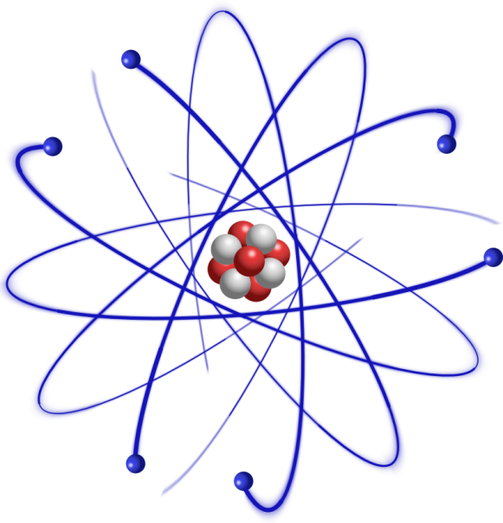
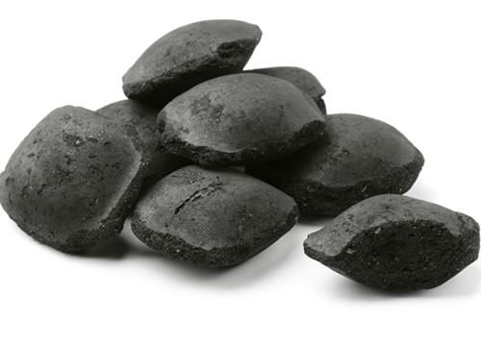
A Cool Thing about Moles
One atom of carbon-12
has a mass of
12 u
One mole of carbon-12
has a mass of
12 grams
12 $\frac{u}{atom}$
12 $\frac{g}{mol}$
The values are
identical in both units

Slide 8
A Cool Thing about Moles
Write this
in your notes
One atom of carbon-12
has a mass of
12 u
One mole of carbon-12
has a mass of
12 grams
12 $\frac{u}{atom}$
12 $\frac{g}{mol}$
The values are
identical in both units

Slide 9
Atomic Mass vs Molar Mass
This tells us the mass of one atom, so it is called the atomic mass
This tells us the mass of one mole, so it is called the molar mass
12 $\frac{u}{atom}$
12 $\frac{g}{mol}$
The values are
identical in both units

Slide 10
We Know Atomic Mass

Slide 11
Atomic Mass
Write this in your notes
Atomic mass is used to measure the mass of individual atoms or molecules.
Atomic Mass | = | The mass of an element weighted according to its natural abundance
The units are $\frac{u}{atom}$ or $\frac{u}{molecule}$

Slide 12
Molar Mass
Write this in your notes
Molar mass is used to measure the mass of a mole of an atom or molecule.
Molar Mass | = | The mass in grams of one mole of any pure substance
The units are $\frac{g}{mol}$

Slide 13
Atomic Mass is a Weighted Average

Slide 14
Carbon's Atomic Mass
Carbon's atomic mass is a weighted average of all carbon isotopes
carbon-12
carbon-13
carbon-14
This is why carbon's atomic mass is 12.0108, not 12
This tells us the mass of one atom, so it is called the atomic mass
12 $\frac{u}{atom}$

Slide 15
Carbon's Molar Mass
So what is the story on the molar mass?
It too is a weighted average of all carbon isotopes.
Thus one mole of carbon has the molar mass of 12.0108 grams, not 12 grams
This tells us the mass of one mole, so it is called the molar mass
12 $\frac{g}{mol}$

Slide 16
The periodic table gives us atomic masses and molar masses for each element

Slide 17
Calculations
Write this in your notes
Atomic and molar masses allow for a very important conversion
The amount
of substance
The mass
of substance
Units are
number of atoms
or moles of atoms
Units are
u
or grams
Mole to gram interconversions
are very important in chemistry and we will practice them a lot
Determines how atoms combine, but can't be measured
Can be measured and indirectly tells us how atoms combine

Slide 18
Conversions from Moles to Mass
A sample of air contains 3.00 mol of argon gas. What is the mass of the argon?
3.00 mol | 39.948 g | = | 119.844 g
 | 1 mol
 |  |  | ↓ ↓ ↓
 |  |  | 120 g

Slide 19
Does this look familiar???
If each egg is 27 grams, what is the mass of 3.5 dozen eggs? Use a picket fence to complete this dimensional analysis
3.5 dozen | 12 eggs | 27 g | = | 1134 g
 | 1 dozen | 1 egg
 |  |  |  | ↓ ↓ ↓
 |  |  |  | 1100 g

Slide 20
Conversions from Moles to Mass
A layer of the earth crusts is found to contain 0.148 mol of iridium. What is the mass of the iridium?
0.148 mol | 192.217 g | = | 28.448116 g
 | 1 mol
 |  |  | ↓ ↓ ↓
 |  |  | 28.4 g

Slide 21
Conversions from Atoms to u
A silicon wafer is 14 atoms thick. What is the mass of these 14 atoms in u?
14 atoms | 28.0855 u | = | 393.197 u
 | 1 atom
 |  |  | ↓ ↓ ↓
 |  |  | 393.197 u
14 is a counting number and thus has an infinite number of significant figures

Slide 22
Conversions from Moles to Mass
A metal rod from a nuclear reactor is radioactive because it contains 3.3 x 10⁻⁸ mol of uranium. What is the mass of the uranium?
3.3 x 10⁻⁸ mol | 238.029 g | = | 7.854957 x 10⁻⁶ g
 | 1 mol
 |  |  | ↓ ↓ ↓
 |  |  | 7.9 x 10⁻⁶ g

Slide 23
Conversions from Mass to Moles
A ring contains 65 g of gold. How many moles of gold does it contain?
65 g | 1 mol | = | 0.3300045185 mol
 | 196.967 g
 |  |  | ↓ ↓ ↓
 |  |  | 0.33 mol

Slide 24
Conversions from Mass to Moles
A balloon is filled with 495 g of helium. How many moles of helium does it contain?
495 g | 1 mol | = | 123.6696148 mol
 | 4.0026 g
 |  |  | ↓ ↓ ↓
 |  |  | 124 mol

Slide 25
Conversions from Mass to Moles
When it was first discovered, only 2.65 mg of ununoctium was created. How many moles does this contain?
2.65 mg | 1 g | 1 mol | = | 9.01 x 10⁻⁶mol
 | 1000 mg | 294 g

Slide 26
Challenge
Nitrogen gas is diatomic, meaning that each molecule of nitrogen gas contains two nitrogen atoms. What is the mass of 6.44 mol of diatomic nitrogen gas?
6.44 mol N₂ | 2 mol N | 14.0067 g N | = | 180 g
 | 1 mol N₂ | 1 mol N

Slide 27
Conversions from Mass to Atoms
How many atoms are there in 0.0383 g of potassium?
0.0383 g | 1 mol | 6.02 x 10²³ atoms | = | 6.00 x 10²⁰ atoms
 | 39.0983 g | 1 mole

Slide 28
Conversions from Mass to Atoms
How many atoms are there in 0.190 g of osmium?
0.189 g | 1 mol | 6.02 x 10²³ atoms | = | 6.00 x 10²⁰ atoms
 | 190.23 g | 1 mole

Slide 29
Observation
0.0383 g | 1 mol | 6.02 x 10²³ atoms | = | 6.00 x 10²⁰ K atoms
 | 39.0983 g | 1 mole
0.189 g | 1 mol | 6.02 x 10²³ atoms | = | 6.00 x 10²⁰ Os atoms
 | 190.23 g | 1 mole
Same number of atoms but different masses!!!
Both of these are 6.00 x 10²⁰ atoms
But the osmium has five times the mass of potassium

Slide 30
Conversions from Atoms to Mass
What is the mass of 1.55 x 10²⁶ atoms of lead?
1.55 x 10²⁶ atoms | 1 mol | 207.2 g | = | 5.33 x 10³ g
 | 6.02 x 10²³ atoms | 1 mole

Slide 31
Conversions from Atoms to Mass
What is the mass of 7.81 x 10²⁰ atoms of zirconium?
7.81 x 10²⁰ atoms | 1 mol | 91.224 g | = | 0.118 g
 | 6.02 x 10²³ atoms | 1 mole

Slide 32
Mass & the Mole - Homework
pg 328, problem 16
pg 329, problem 18
pg 331, problem 20 a & b, 21

Slide 33
Individual Practice
What is the mass of 6.02 x 10²⁴ atoms of Bi?
How many moles in 1.25 x 10³ g of Zn?
What is the mass of 3.54 x 10² mol of Co?
How many atoms in 4.56 x 10³ g of Si?
2.09 x 10³ g Bi
1.91 x 10¹ mol Zn
2.03 x 10⁴ g Co
9.77 x 10²⁵ atoms of Si
pg 331, #20a, pg 329, #18a, pg 328 #16a, pg 331, #21a

Slide 34
Individual Practice
How many atoms in 0.120 kg of Ti?
How many moles in 1.00 kg of Fe?
What is the mass of 2.45 x 10⁻² mol of Zn?
What is the mass of 1.00 x 10²⁴ atoms of Mn?
1.51 x 10²⁴ atoms Ti
1.79 x 10¹ mol Fe
1.60 g Zn
91.3 g Mn
pg 331, #21b, pg 329, #18b, pg 328 #16b, pg 331, #20b

Slide 35
Backup Slides

Slide 36
Not Covered

Slide 37
Pennies and Sand
The value of an atomic mass

Slide 38
Conversions from u to Atoms
Inside the synapse of a nerve cell, a voltage-dependent calcium channel gains 2,484 u in mass when Ca²⁺ are allowed to flow through it. How many Ca²⁺ are in the channel at one time?
2,484 u | 1 atom | = | 61.9791
 | 40.078 u
 |  |  | ↓ ↓ ↓
 |  |  | 62 atoms
We use counting numbers for the number of atoms, so it always is rounded to a whole number

Slide 39
Conversions from g to Pennies
A beaker contains 324 g of pennies. If the average mass of a penny is 2.57 g, how many pennies are in the beaker?
324 g | 1 penny | = | 126.070
 | 2.57 g
 |  |  | ↓ ↓ ↓
 |  |  | 126 pennies
We use counting numbers for the number of pennies so it always is rounded to a whole number

Slide 40
Conversions from g to Sand
A beaker contains 206.33 g of sand. If the average mass of a grain of sand is 0.17 mg, how many grains of sand are in the beaker
206.33 g | 1 grain of sand | = | 1.2137 x 10⁶
 | 1.7 x 10⁻⁴ g
 |  |  | ↓ ↓ ↓
 |  |  | 1.2 x 10⁶ grains
We use counting numbers for grains of sand so it always is rounded to a whole number

Slide 41
Conversions from Mass to Atoms
How many atoms are there in 0.0383 g of potassium?
0.0383 g | 1 mol | 6.02 x 10²³ atoms | = | 6.00 x 10²⁰ atoms
 | 39.0983 g | 1 mole

